Slide 1

KURUKSHETRA 2.0​
TITLE PAGE
HACKFEST 2026
Problem ID : PS09
Problem Statement : - Agentic Guardian for Real-Time Payment Scam Interception
Theme : AIML
Team ID : KH051
Team name : Midnight Ciphers
MIT ACSC • ALANDI, PUNE

Slide 2

Midnight Ciphers
Problem
`
  The Core Issue: Digital payment scams are not technical hacks. They are social engineering traps where victims willingly transfer money.
  The Catch: Because the victim enters their own PIN from their own phone, classic bank security sees a 100% normal payment.
  The Critical Window: Once sent, real-time UPI payments disappear into scam accounts within 30–60 seconds.
  Our Goal: Stop the scam during the 2–4 seconds before PIN entry by giving the user clear facts and timely warnings.
Problem Analysis / Background
Who It Affects
Scale of the Problem
Why Current Solutions Fail
  How Scammers Operate: They call or message victims pretending to be bank officials, police (CBI/RBI), or customer support, using fear and urgency.
  5 Key Attack Types:
  Impersonation: Posing as CBI, RBI, or police to threaten arrest unless money is moved.
  Suspicious Requests: Demanding small fees to release fake lottery wins or package deliveries.
  Unusual Recipients: Directing payments to brand-new accounts created days ago.
  Urgency Pressure: Forcing victims to act within hours while keeping the transfer secret.
  Target Users & Stakeholders: Retail Consumers, Payment Apps, Banks & Regulators (RBI/NPCI)
  $15B Loss:Projected global scam losses to reach $15B by 2028 (Deloitte).
  30–60 Second Drain: Banks have under 1 minute to stop funds before they split across fraud accounts (Fintech Fest 2026).
  Traditional Security Fails: Card security blocked $40B in hacks, but fails on scams because the victim approves the payment (Visa).
  Bank Security & Card AI: Looks for stolen passwords or new devices both look normal in a scam.
  Old Rule Engines: Uses rigid rules (e.g. flag over ₹50,000). Scammers bypass this by asking for ₹9,999.
  Name Check Systems: Only verifies that a bank account exists, not why you are paying.
  Generic Warning Popups: Users get used to popups and click "OK" without reading.
02
MIT ACSC • ALANDI, PUNE

Slide 3
KURUKSHETRA 2.0​
HACKFEST 2026
Midnight Ciphers
TITLE PAGE
Proposed solution
Solution Overview
  GuardianPay - An AI payment security assistant that intercepts scams right before PIN entry during the 2 to 4 second review window.
  How It Directly Solves Problem:
    Smart 2-Tier Triage: Clears 99% of safe routine payments in under 10ms, reserving deep AI checks for suspicious transfers.
    Multi-Agent NLU Checks: Analyzes payment notes, checks account age, and flags urgency or secrecy words.
    MCP Server Integration: Pluggable security tool that allows any UPI app or LLM assistant to run GuardianPay analysis.
    Voice & Live Assistance: Connects users to a 24/7 Voice AI (Vapi) or live human agent (Trug.en) with live context during high-pressure calls.
Innovation & Uniqueness
Existing Solutions
  Cross-App Smurfing Detection: Catches structured payment splitting across multiple UPI apps (GPay, PhonePe) at the central NPCI switch level.
  Core Banking (CBS) Mule Intelligence: Inspects account age and transfer velocity to detect rapid burst-drain money movement in new mule accounts.
  Out-of-Band FastMCP Agentic Interventions: Triggers AI reasoning only on high-risk transfers to build plain-English evidence reports with low latency on safe payments.
  Entity-Purpose KYC Clash Check: Flags mismatches between bank KYC categories and payment
Feature | Legacy Bank Rules | Standard Card AI | GuardianPay (Ours)
Primary Focus | Fixed numeric limits | Stolen card detection | Real-Time Scam Interception
Reads Payment Notes | No | No | Yes (Detects Urgency & Scams)
Purpose vs. Identity Check | No | No | Yes (Catches Account Mismatches)
User Alert Style | Generic popup | Passive risk score | Active Cognitive Challenge
Integration Layers | Bank backend only | Payment switch | App + Extension + MCP Tool
03
MIT ACSC • ALANDI, PUNE

Slide 4
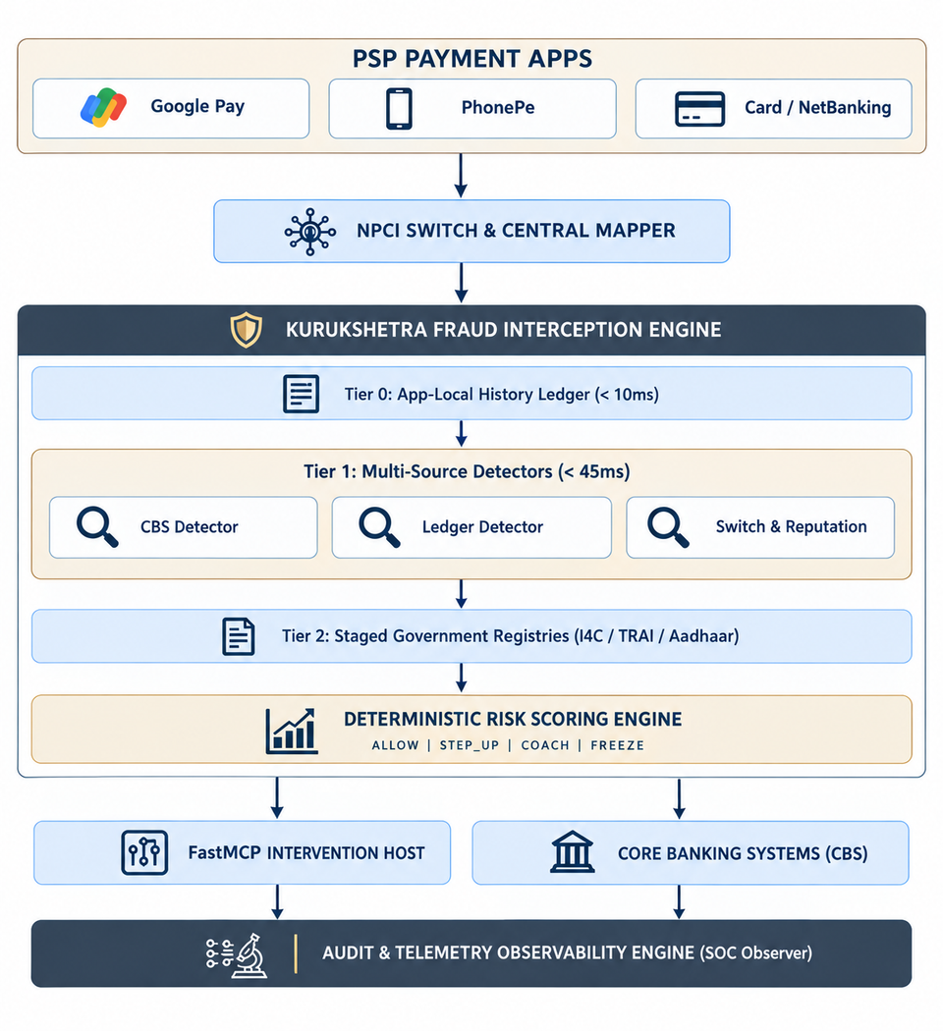
KURUKSHETRA 2.0​
HACKFEST 2026
Midnight Ciphers
Technical Approach
SYSTEM ARCHITECTURE
TITLE PAGE
Technology Stack
  Frontend: Vanilla JavaScript , HTML5, Custom CSS3
  Backend: Python 3.11, FastAPI , Uvicorn (v0.32)
  Protocol & Agent Framework: FastMCP (v1.0 - Model Context Protocol Server & Host)
  Database & Storage: SQLite for Core Banking Ledgers + PostgreSQL Audit Store
  Voice & Live Support: Vapi AI + Trug.en
  AI & ML Models:
    Fast Path: Gradient-Boosted Tree ML model (Sub-10ms risk scoring).
    Deep Path: GPT-4o / Gemini 1.5 Pro (Structured JSON scam analysis).
    Memory (RAG): ChromaDB (Local vector database ).
Implementation Approach
  Draft Capture: Intercepts recipient, amount, and note before payment submission.
  Fast Check (Tier 1): Rule engine and ML model evaluate the transaction in under 10ms.
  Deep AI Analysis (Tier 2): If flagged, 4 specialized AI agents inspect language, account age, and scam patterns concurrently.
  Safety Policy: A fixed code rule engine sets the final action (ALLOW, ADVISE, CHALLENGE, PAUSE, BLOCK).
  Support Handoff: On high-risk pauses, users can talk to a Voice AI or live agent with full transaction context.
  Audit Record: Saves every decision in an immutable, tamper-evident log.
04
MIT ACSC • ALANDI, PUNE

Slide 5
Midnight Ciphers
Feasibility, Viability & Impact
Feasibility & Viability
Impact & Benefits
  Drop-in NPCI Integration: Connects directly to NPCI's native ReqValAdd and ReqPay protocol hooks without altering existing UPI apps or bank backends.
  Zero Checkout Latency: Fast Tier 0/1 checks clear safe payments in <10ms; out-of-band AI runs only on elevated risk to prevent checkout delays.
  Hardened Security & Injection Defense: Isolates note text from prompts; Policy Engine code rules block AI from overriding baseline safety floors.
  Citizen Protection: Intercepts coercion before PIN entry and provides a Public Scam Lookup tool to verify UPI IDs before paying.
  Bank Cost Savings: Eliminates expensive post-facto Ombudsman disputes, chargeback investigations, and legal overhead.
  Zero Checkout Friction: Clears 99%+ of safe payments in under 10ms, preserving app checkout speeds and user experience.
  Chokes Mule Networks: Blocks scam funds on Day 1, stopping money laundering before transfers split across mule accounts.
 | Potential Challenges & Risks | Strategies for Overcoming These Challenges
AI Latency | LLM calls could delay the payment flow. | Auto-fallback to Tier 1 fast rules if AI exceeds 6 seconds.
Data Privacy | Must comply with India's DPDP Act 2023. | Only payment draft metadata is processed temporarily. No calls, messages, or personal content are stored.
Prompt Injection | Scammers could craft note text to trick the AI agent. | Policy Engine blocks any AI attempt to lower safety below fixed rules.
AI/ML Details
  Multi-Source Detector Matrix: Evaluates 33 technical detectors across Tier 0 (local ledger), Tier 1 (CBS, transaction ledger, switch reputation), and Tier 2 (government registries).
  FastMCP Agentic Host: Uses FastMCP (1.0) out-of-band to build plain-English evidence reports and contextual intervention screens for COACH and FREEZE decisions.
  Weighted Risk Scoring Engine: Calculates a 0.0 to 1.0 risk score and dynamic confidence rating (FULL, PARTIAL, DEGRADED) based on available data completeness.
05
MIT ACSC • ALANDI, PUNE

Slide 6
KURUKSHETRA 2.0​
HACKFEST 2026
Midnight Ciphers
Research & References
TITLE PAGE
References / Sources
Research Conducted
  APP Scam Taxonomy: Analyzed Indian and global scam types including CBI/police digital arrest scams, tech support scams, fake utility disconnections, investment fraud, and lottery advance-fee scams. Mapped the social engineering tactics behind each.
  UPI Payment Architecture: Studied NPCI's UPI specification, message payloads, TPAP client flows, and latency budgets. Found that pre-authorization client interception (before PIN entry) is the only viable point to stop a scam.
  Behavioral Economics of Friction: Researched why users ignore generic warning popups (alert fatigue). This drove our 5-level graduated friction design (ALLOW / ADVISE / CHALLENGE / PAUSE / BLOCK) which forces active user engagement instead of passive tap-through.
  Adversarial Robustness & Prompt Injection: Studied how scammers can craft payment notes to trick AI models. Designed structural defenses including strict note text isolation and a code-enforced policy invariant that prevents AI from overriding fixed safety rules.
  NPCI UPI Specifications - https://www.npci.org.in
  RBI: Digital Payment Security Guidelines - https://www.rbi.org.in
  IEEE / ACM: Real-Time Fraud Detection - https://ieeexplore.ieee.org
  I4C: National Cybercrime Advisory (Digital Arrest) -https://www.cybercrime.gov.in
  Explainable Agent Systems (arxiv 2607.11707v2) - https://arxiv.org/abs
  FTC Consumer Sentinel Fraud Reports - https://www.ftc.gov
06
MIT ACSC • ALANDI, PUNE

Slide 7
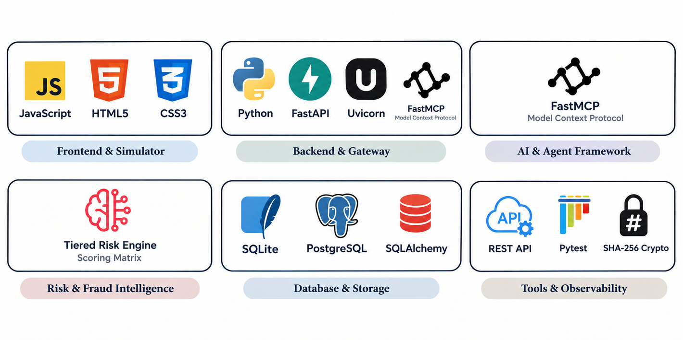
KURUKSHETRA 2.0​
HACKFEST 2026
Midnight Ciphers
TITLE PAGE
Build With
  JavaScript | HTML5 | Custom CSS3 : Powers a fast, zero-dependency Google Pay simulator, interactive payment flows, and live SOC observer dashboard.
  Python 3.11 | FastAPI | Uvicorn : Drives the high-performance security gateway, connecting NPCI payment switch hooks with sub-10ms response times.
  FastMCP | Model Context Protocol : Orchestrates out-of-band agentic interventions, generating contextual evidence reports and user warning screens for suspicious payments.
  SQLite | PostgreSQL | SQLAlchemy : Manages Core Banking System (CBS) ledgers, user reputation scores, and append-only SHA-256 hash-chained audit logs.
  REST APIs | Pytest | SHA-256 Hashing : Exposes public scam lookup tools, runs 28+ automated test suites, and provides tamper-evident regulatory records.
GitHub Repository
GitHub repository URL: click here
07
MIT ACSC • ALANDI, PUNE

Slide 8
KURUKSHETRA 2.0​
HACKFEST 2026
Midnight Ciphers
TITLE PAGE
THANK YOU
07
MIT ACSC • ALANDI, PUNE

