Slide 1
Family Organizer Application

Slide 2
Description
This application was built with an idea of helping families organize their daily activities. This application will help any family plan for events like birthday’s, buying a present, and other important events in our lives. Reminders for these events will be visible on home screen. This application will also help families while grocery shopping and creating a meal plan for the week. This multi-faceted application will help families of all sizes manage their daily and weekly routines.

Slide 3
Features
Custom authentication
Date/Time Features
Current date/time or plan future dates
Organize daily and weekly activities.
Create, edit, and delete To Do List or Events
Create, edit, and delete a grocery list
Create, edit, and delete a menu items

Slide 4
Planning - User Stories
User Authentication – create account, login/logout
Events:- Add, Update and Delete events
To Do List - Add, Update and Delete tasks
Grocery List - Add, Update and Delete items
Menu – Add, Update and Delete meals

Slide 5
Planning - Database
Model Classes/tables:
User – represents a generic user with an account
Event and Event_details tables – details regarding events
To_do_List table – details regarding to do list tasks
GroceryList – details of items
Menu – details of meals

Slide 6
Technology Stack
Java
SpringBoot with Thymeleaf templates
MySQL
Bootstrap
Html/CSS

Slide 7
Demo

Slide 8
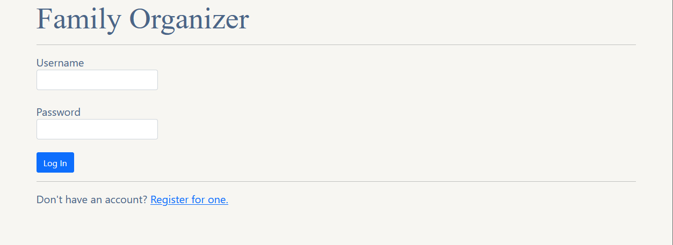
Login

Slide 9
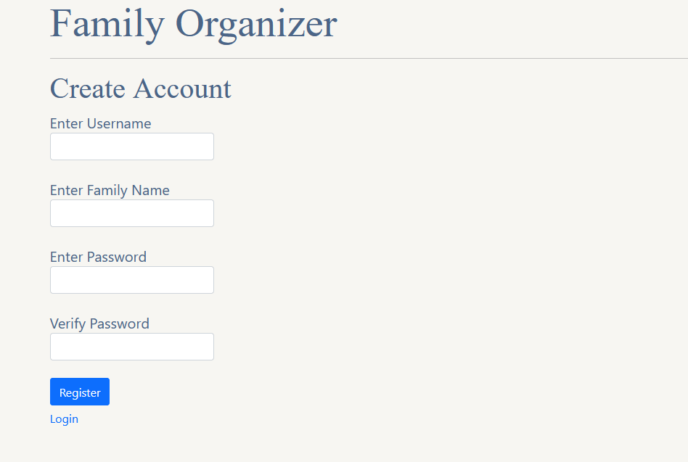
Register

Slide 10
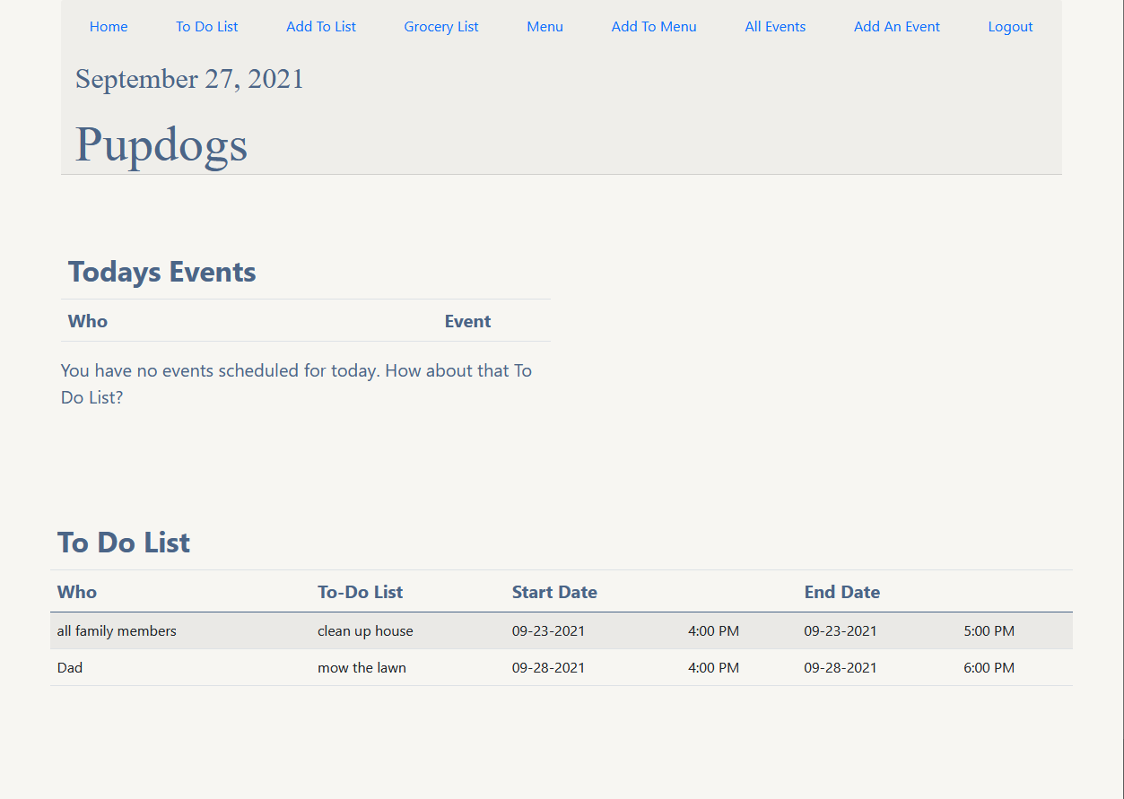
Home

Slide 11
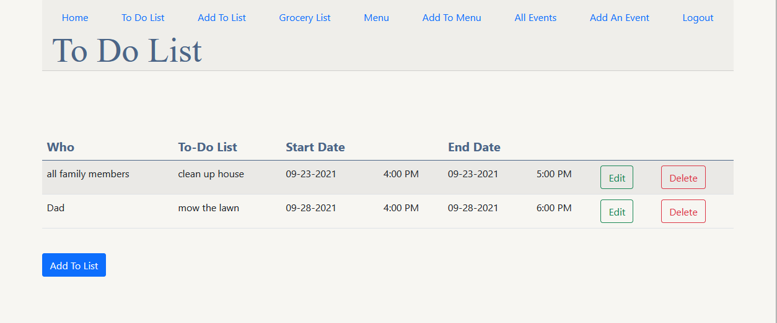
To Do List

Slide 12
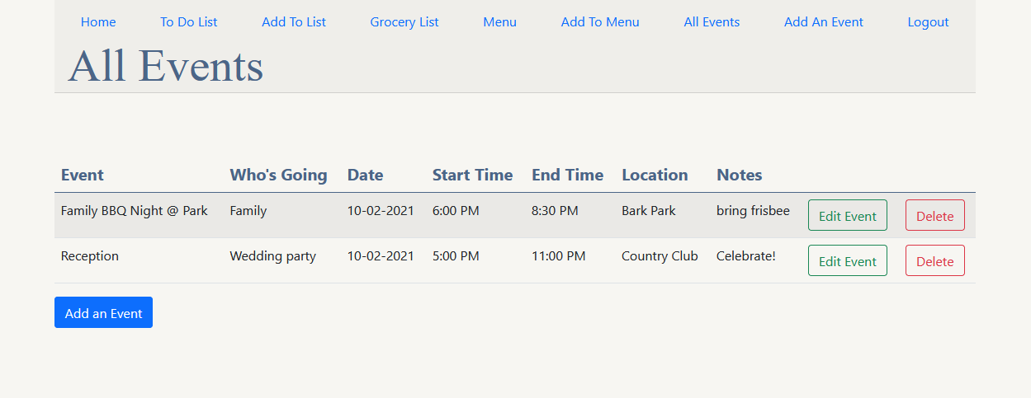
Events

Slide 13
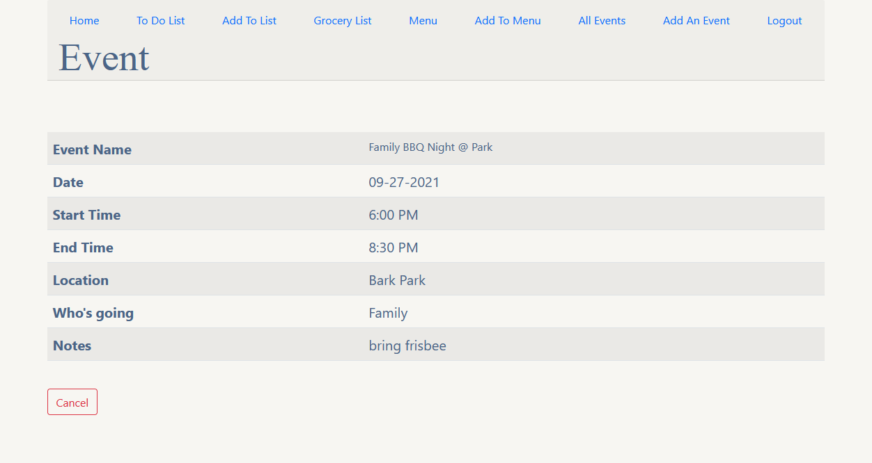
Event Details

Slide 14
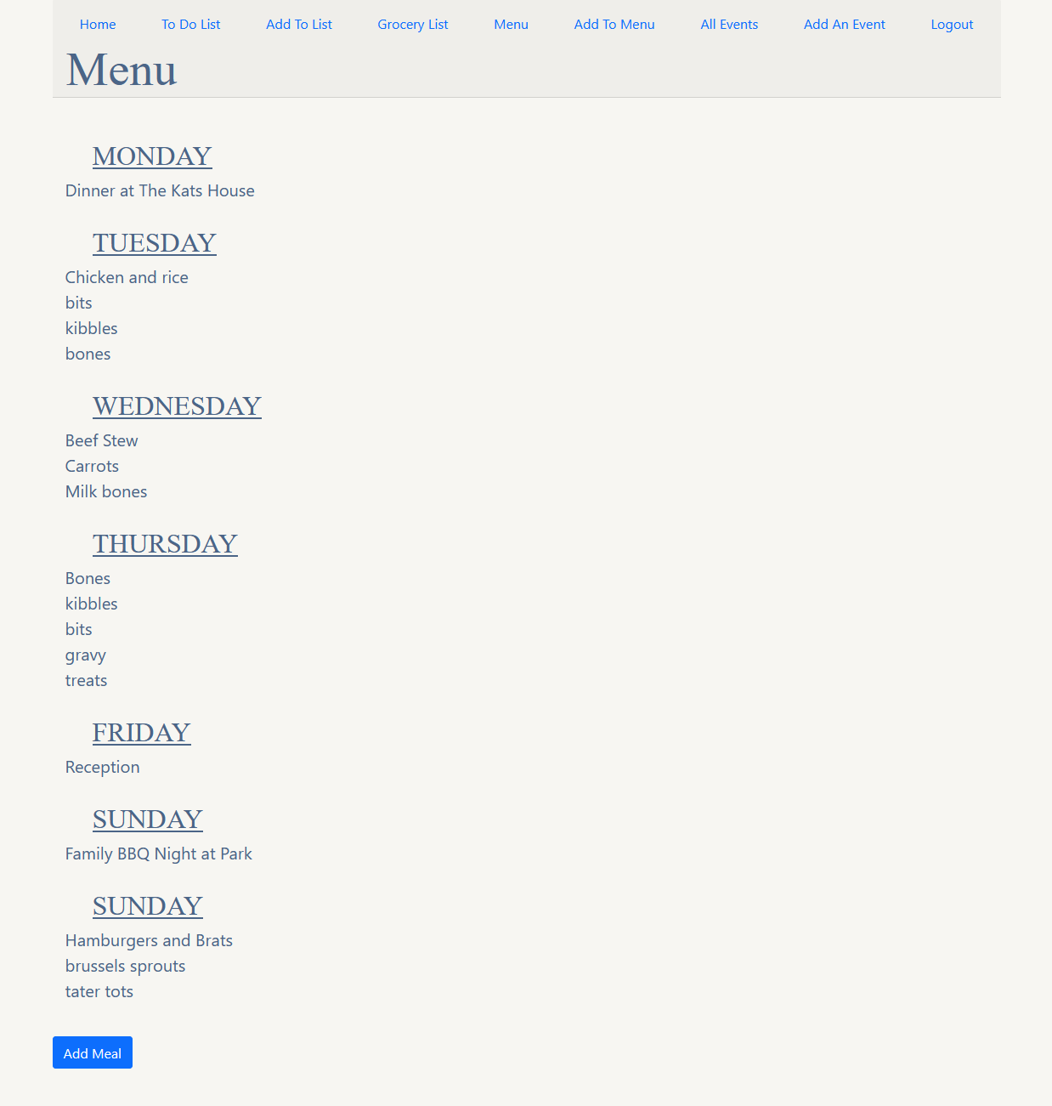
Menu

Slide 15
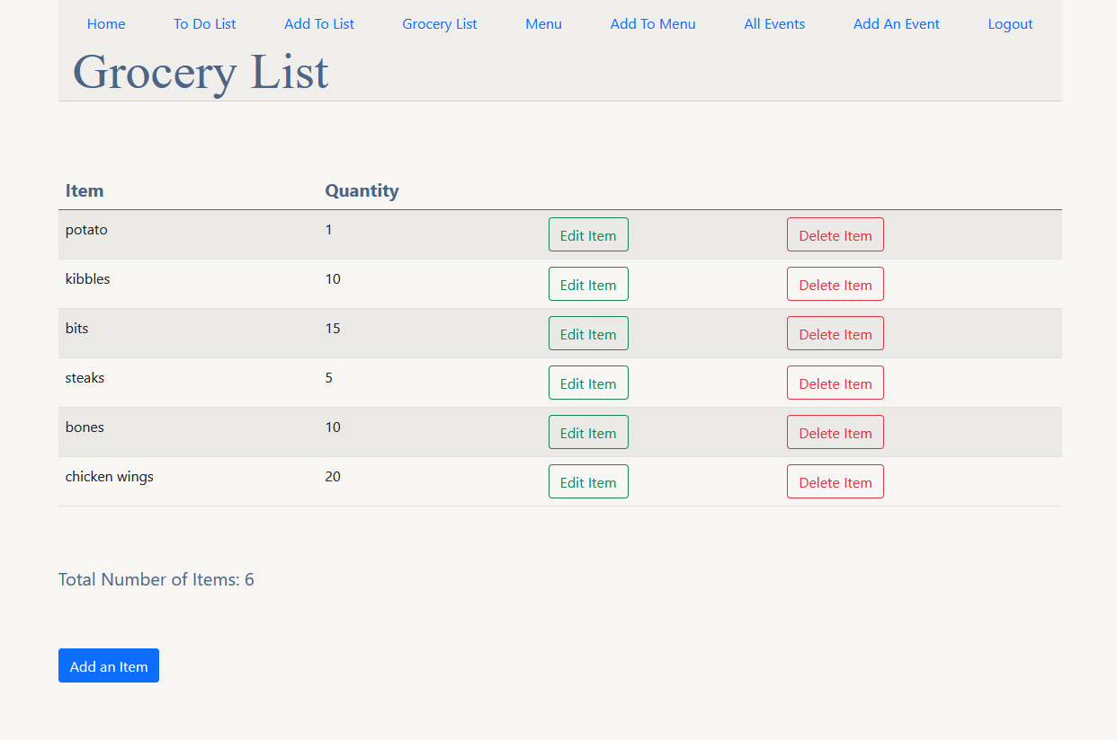
Grocery List

Slide 16
What I Learned
Authentication and Security
Maintenance of user session
Gained experience utilizing MVC Pattern
How to build wireframes to design UI
SDLC and application lifecycle management using Trello

Slide 17
What’s Next
Add a calendar option to home page
Improve UI
Add multiple family members with limited access to features
Expand functionality of the Menu feature
Notes:
Be specific! If you mention another feature describe why that features is necessary, or what problem it solves. If you mention changing the UI mention specific technologies, or libraries you will use to do that. If you mention a technology, or feature you don’t know yet tell them how you plan on learning it.

Slide 18
Contributors:
Arpitha Nagappa @ArpithaNagappa on GitHub
Christopher Rebuck @crebuck2308 on GitHub
Kay Allen @kdallen01 on GitHub
Amy Humrich @AmHum77 on GitHub

