Slide 1
HyreUS: Showing how to bias districting
By: Benjamin Kolarik, Dylan Demchuk, Austin DeLauney, Jamal Savoy, Damian Overton, Brad Harmening

Slide 2
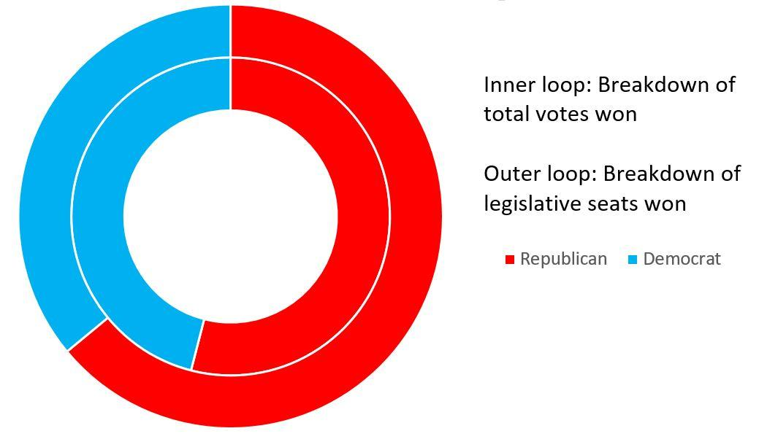
Some Interesting Facts
Majorities can be enhanced via proper districting
If people are in the right places, you can even turn minorities into majorities

Slide 3
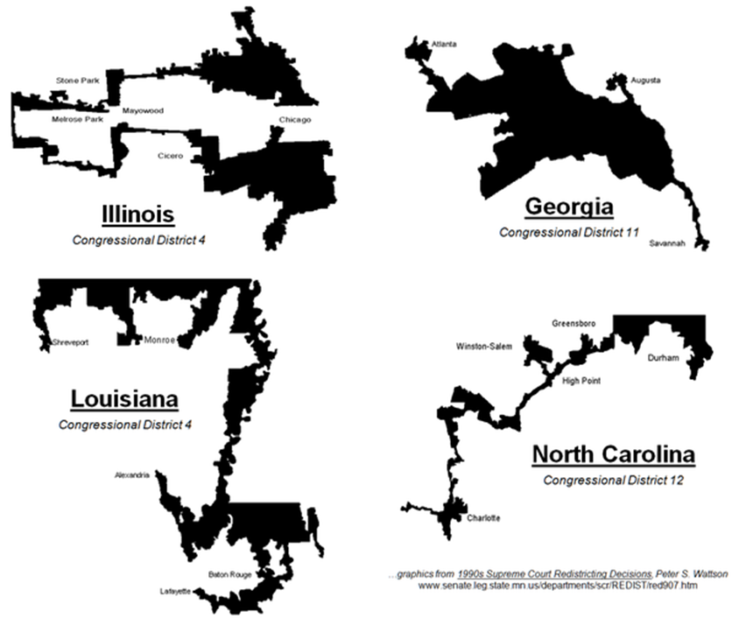
How can this happen
Districts like these don’t happen by chance
They’re this way for a reason
But this takes a lot of work

Slide 4

Process
Attempted to begin with a foundation using previous attempts at this problem
Very difficult to compile other people’s code without very good instructions
Began coding own algorithm

Slide 5
Product Summary
Software is an application, not web based
When run, a slider is available to decide how many districts customer wishes to divide the state into
More states could be added

Slide 6
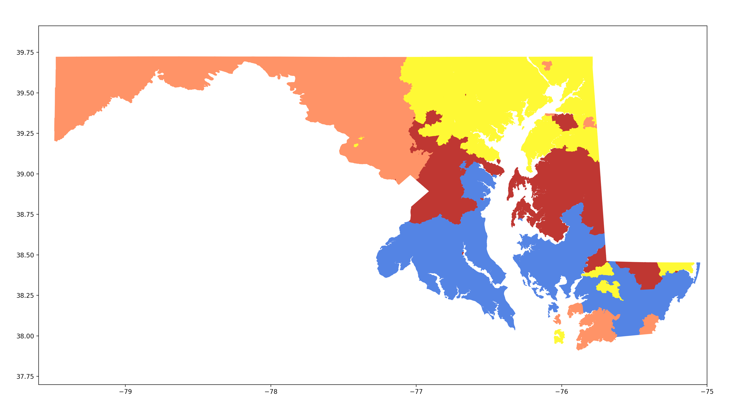
Sample result

Slide 7
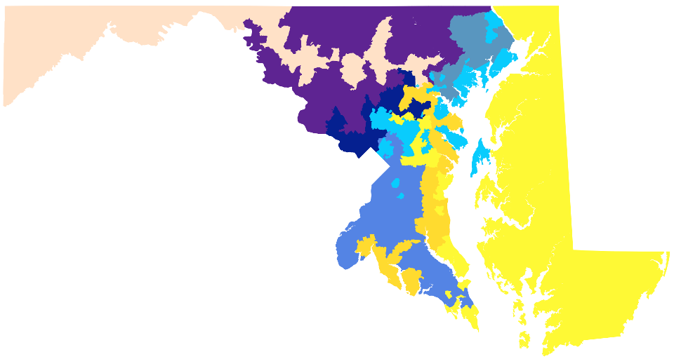
Other results

Slide 8
Lessons learned
Have intermediate deadlines
Establish realistic requirements
Communicate more amongst peers

Slide 9
Summary
Product has issues, but fulfills some requirements
Requires little maintenance due to offline-status
Rapid generation of effective maps

