Slide 1

ALTO New Transport using HTTP/2 draft-schott-alto-new-transport-01
Roland Schott
Y. Richard Yang
Kai Gao
Jensen Zhang
March 23, 2022
IETF 113

Slide 2
Outline
Motivation and requirements
ALTO/H2 design
Discussions and open issues

Slide 3
Motivation
ALTO base protocol [RFC7285] is an HTTP/1.x client-pull protocol
ALTO/SSE [RFC8895] adds incremental server push using Server-Sent-Event, but is based on HTTP/1.x
Need additional control connection
Updates must be serialized
RFC8895 IESG review
Consider HTTP/2
------------------------------------------------------------------
| |
| +-------+ +-------+ 1. init request +------+ |
| | | | | <------------- | | |
| | | | | -------------> | | |
| 3.add/ | | | | 1'. control uri | | |
| remove | | | | | | |
| resource |Stream | |Update | | | |
-------->|Control| private |Stream | 2a. data update |Client| --
|Server |<------->|Server | messages | |
-------- | | | | --------------> | | <-
| response | | | | --------------> | | |
| | | | | 2b.control update| | |
| +-------+ +-------+ messages +------+ |
| |
------------------------------------------------------------------

Slide 4
ALTO/H2 Design Requirements
From ALTO base protocol [RFC 7285]
R0: Client can request any ALTO resource using the connection, just as using ALTO base protocol using HTTP/1.x
From ALTO SSE [RFC 8895]
R1: Client can request the addition (start) of incremental updates to a resource
R2: Client can request the deletion (stop) of incremental updates to a resource
R3: Server can signal to the client the start or stop of incremental updates to a resource
R4: Server can choose the type of each incremental update encoding, as long as the type is indicated to be acceptable by the client
From ALTO base framework [RFC 7285]
R5: Design follows basic HTTP Representational State Transfer architecture if possible
Can use only a limited number of verbs (GET, POST, PUT, DELETE, HEAD)
R6: Design takes advantage of HTTP/2 design features such as parallel transfer and respects HTTP/2 semantics [PUSH_PROMISE]
Allow flexible deployment
R7: Capability negotiation

Slide 5
Outline
Motivation and requirements
ALTO/H2 design
Overview

Slide 6
ALTO/H2 Transport Information Structure
_{ALTO} _{Server}
Static resource such as CostMap
Filterable resource such as FilteredCostMap
ir1
Information resource
Existing
Transport queue
tq1
tq2
tq3
New
tq1/uq
Incremental updates queue
tq1/rs
Receiver set
A single HTTP/2 connection between each client and the server
Clients
C1
C2
C3

Slide 7
ALTO/H2 Transport Information Structure
Client opens a connection to the server
Client opens/identifies a transport queue tq
Client requests transport queue status
Client requests an element in the message queue
Client becomes a receiver
Client receives push updates
Client closes the transport queue
Client closes connection

Slide 8
Outline
Motivation and requirements
ALTO/H2 design
Overview
Transport queue

Slide 9
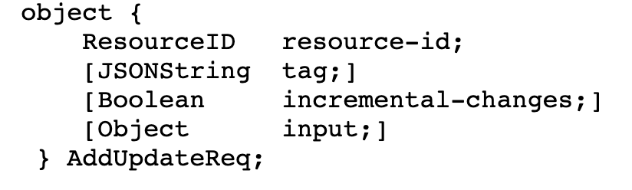
Transport Queue
Basic operations (CRUD): create, read (get status), delete
Client creates transport queue
POST to transport queues path
Request reuses ALTO/SSE input
HTTP :method=post with AddUpdateReq [RFC8895]
Response
<transport-queue>
Client reads transport queue: GET <transport-queue>
Client closes transport queue:
Explicit: DELETE <transport-queue>
Delete from local view (server may still maintain the transport queue for other client connections)
Implicit: Transport queue for a client is ephemeral: close of connection or stream deletes the transport queue from the client’s view --- when the client reconnects, the client MUST NOT assume that the queue is still valid
Notes:
The HTTP stream that created a transport queue is kept open until the stream is deleted or a non-recoverable error associated with the transport queue happens
The stream should be closed

Slide 10
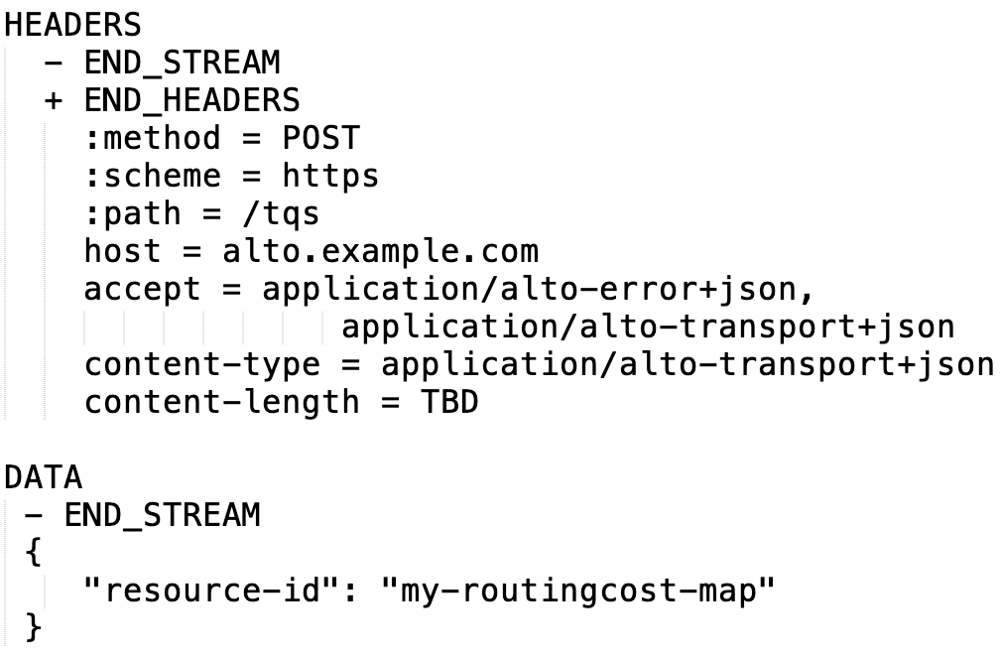
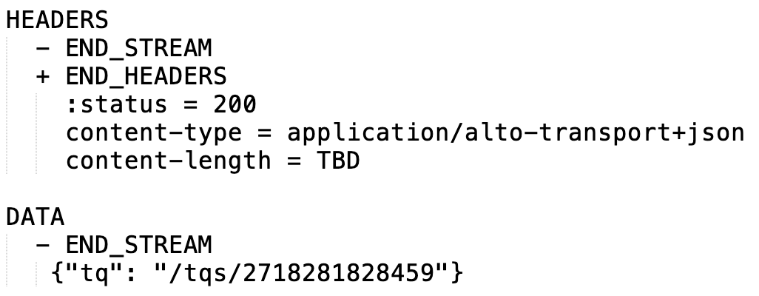
Transport Queue Example (Create)
Client -> Server request
Server -> Client response

Slide 11
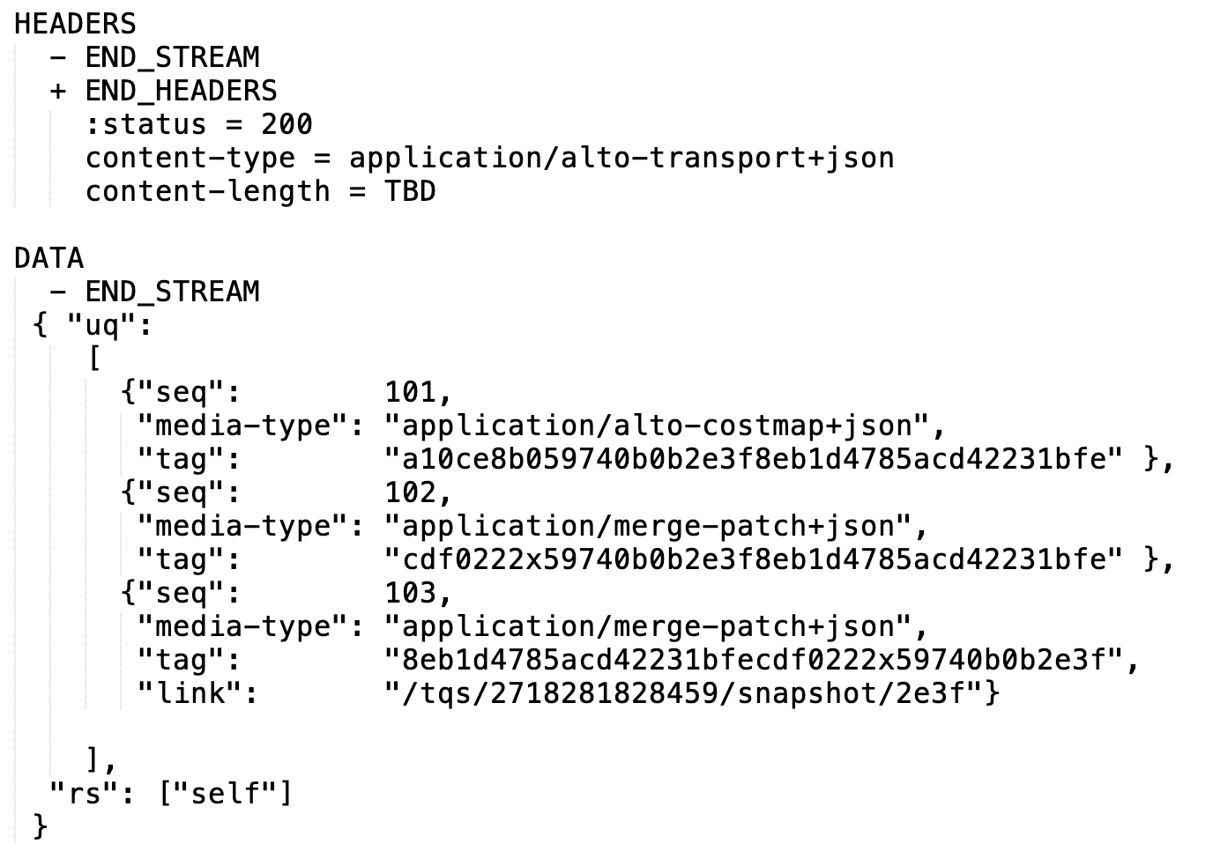
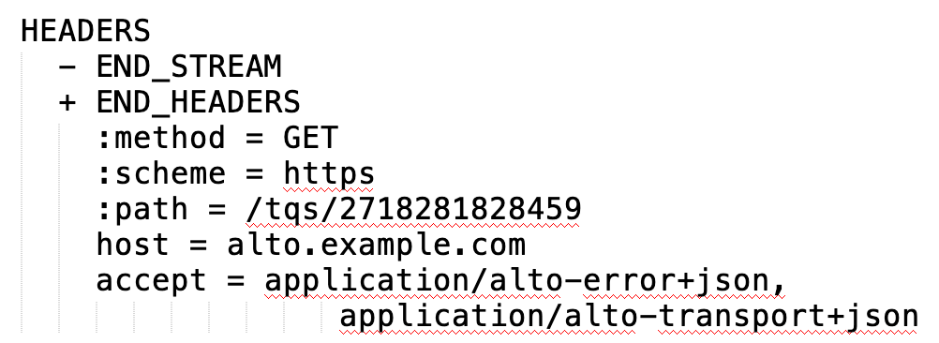
Transport Queue Example (Read)
Client -> Server request
Server -> Client response

Slide 12
Outline
Motivation and requirements
ALTO/H2 design
Overview
Transport queue
Incremental updates queue

Slide 13
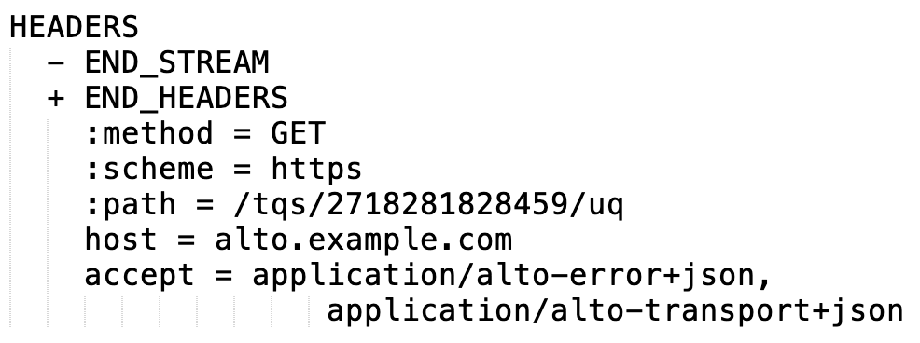
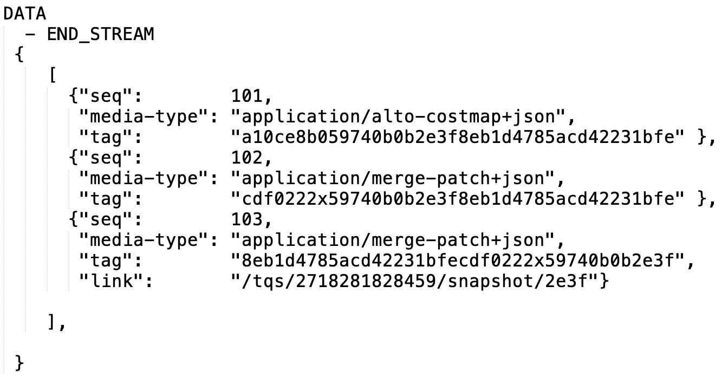
Incremental Updates Queue
Incremental updates queue basic operations (CRUD): read (get status)
Client cannot create, update, or delete incremental updates queue directly---it is read only, and associated with transport queue automatically
Read:
Input: <tq>/uq
Response: updates queue state
Note
Server determines the state (window of history and type of each update) in the update queue [R4]
Read of updates queue status allows client to know
backlog status
workload to catch up (HEAD)
potential direct link
Request
Response data

Slide 14
Outline
Motivation and requirements
ALTO/H2 design
Overview
Transport queue
Incremental updates queue
Individual updates

Slide 15
Individual Incremental Updates
Individual incremental updates operations (CRUD): pull read or push read
Client pull
GET <update-uri>
Server push
Initialization:
the first update pushed from the server to the client MUST be the later of the following two
the last independent update in the incremental updates queue
the following entry of the entry that matches the tag when the client creates the transport queue
The client MUST set SETTINGS_ENABLE_PUSH to be consistent
State: the server maintains the last entry pushed to the client and schedules next update push
Per client, connection state
Client MUST NOT cancel (RST_STREAM) a PUSH_PROMISE
To avoid complex server state management

Slide 16
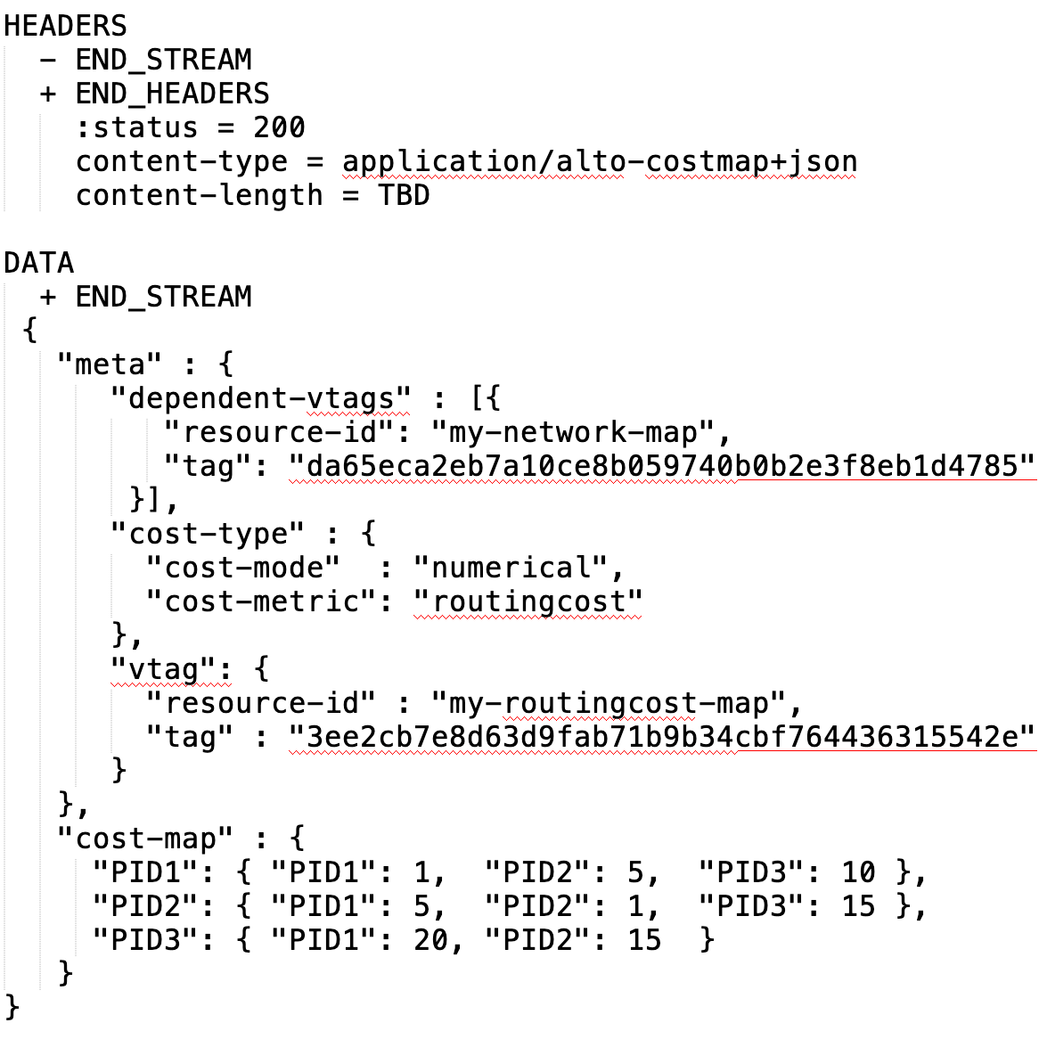
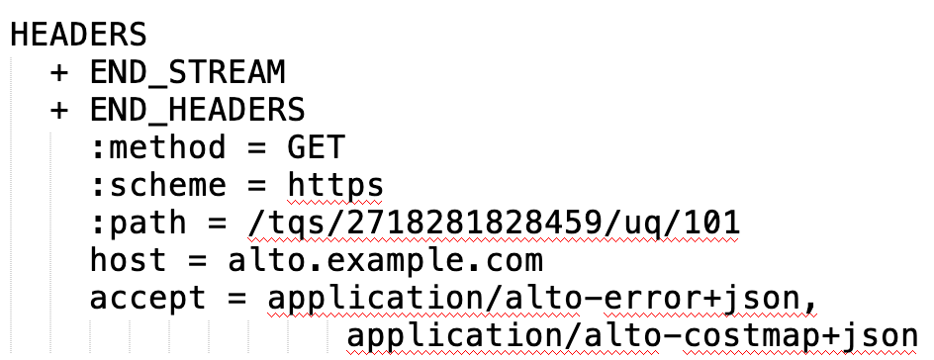
Client Pull Example

Slide 17

Server Push Initialization Example
First push, if client has no matching tag
First push, if client has tag matching previous entry

Slide 18
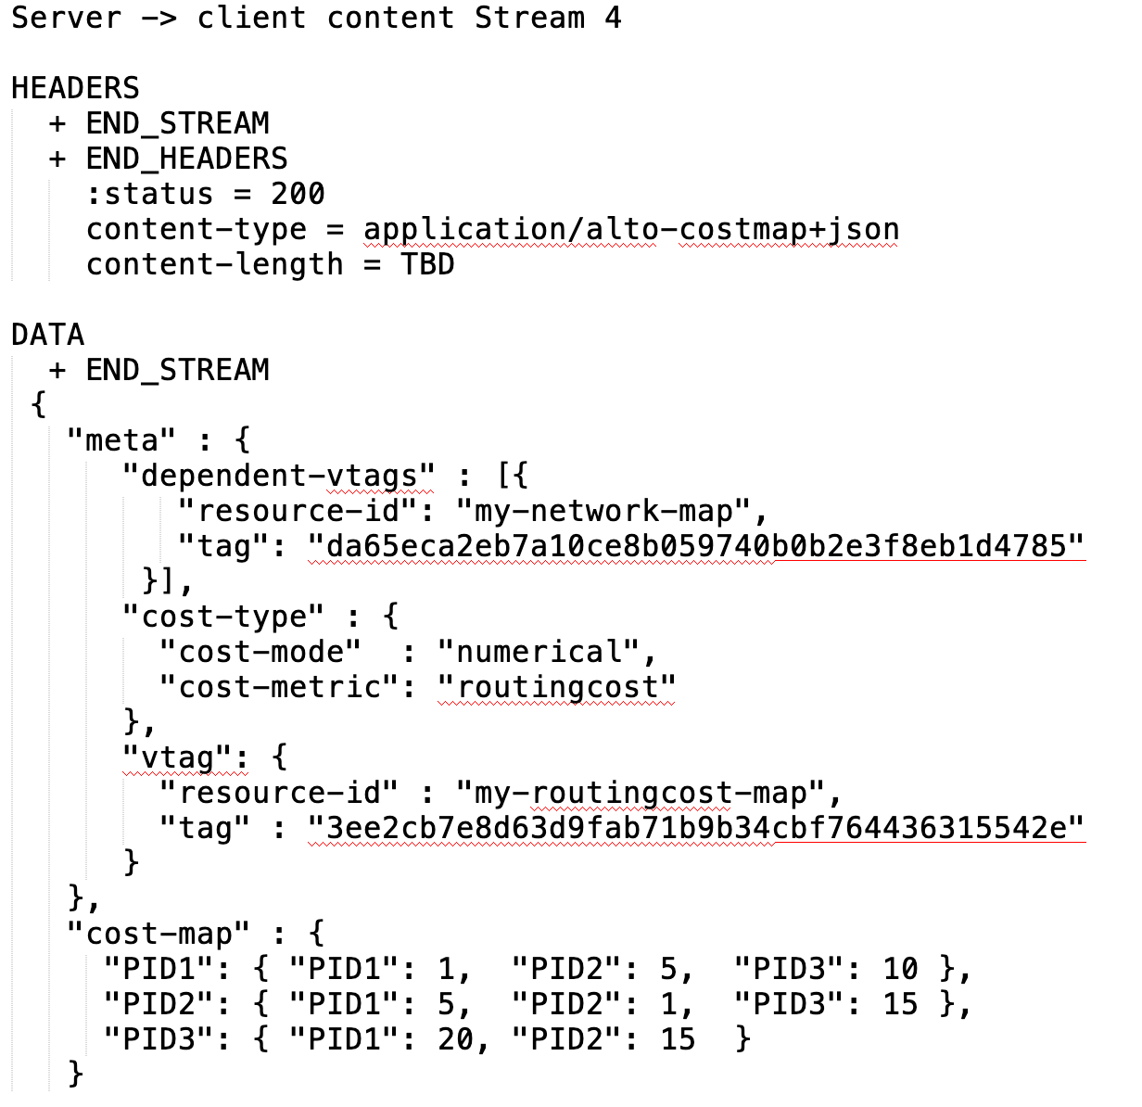
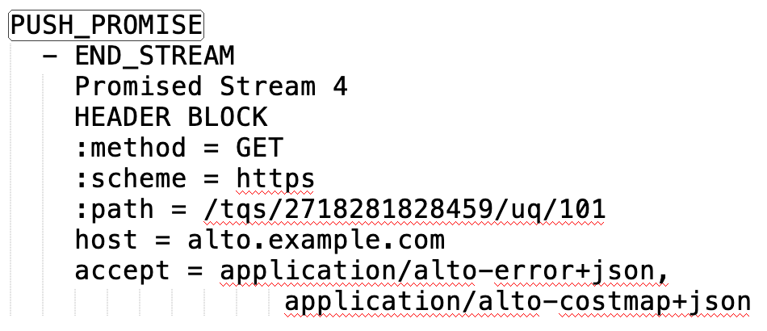
Server Push Transport Example
Each pushed update is indicated first in a PUSH_PROMISE

Slide 19
Outline
Motivation and requirements
ALTO/H2 design
Overview
Transport queue
Incremental updates queue
Individual updates
Receiver set

Slide 20
Receiver Set
Receiver set operations (CRUD): read (get status), delete (self only)
By default a client can see only itself in the receiver set
Appearance of self in the receiver set (read does not return not exists) is an indication that push starts
A client can delete itself (stops receiving push):
Explicit: DELETE <transport-queue>/rs/self
Implicit: Transport queue is connection ephemeral: close of connection or stream for the transport queue deletes the transport queue (from the view) for the client

Slide 21
Outline
Motivation and requirements
ALTO/H2 design
Overview
Transport queue
Incremental updates queue
Individual updates
Receiver set
Stream management

Slide 22
ALTO/H2 Stream Management: Objectives
Objectives
Allow stream concurrency to reduce latency
Minimize the number of streams created
Enforce dependency among streams (so that if A depends on B, then A should be sent before B)
Encode dependency to enforce semantics (correctness)

Slide 23
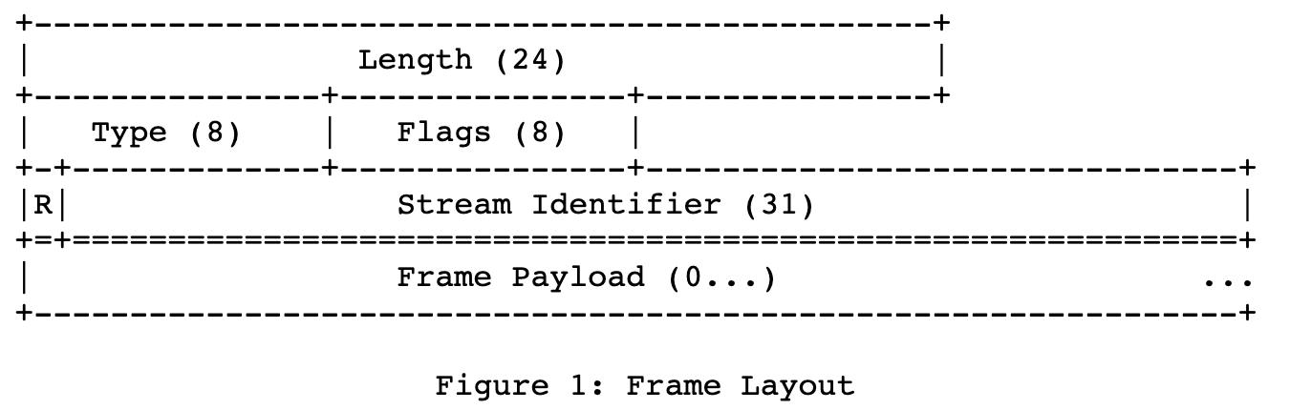
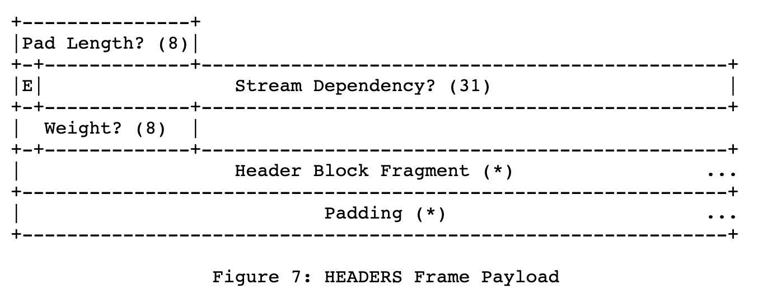
ALTO/H2 Stream Management: Specification
Client -> Server [Create transport queue]
Each request to create a transport queue (POST) MUST choose a new client selected stream ID (SID_tq)
Stream Identifier of the frame is a new client-selected stream ID; Stream Dependency in HEADERS is 0 (connection) for an independent resource, the other transport queue if the dependency is known
Invariant: Stream keeps open until close or error

Slide 24
ALTO/H2 Stream Management: Specification
Client -> Server [Close transport queue]
DELETE to close a transport queue (SID_tq) MUST be sent in SID_tq
Stream Identifier of the frame is SID_tq; Stream Dependency in HEADER is 0 (connection)
So that a client cannot close a different stream
HEADERS indicates END_STREAM; server response also close stream

Slide 25
ALTO/H2 Stream Management: Specification
Client -> Server [Request on data of a transport queue SID_tq, e.g., read message]
Stream Identifier of the frame is a new client-selected stream ID, Stream Dependency in HEADERs MUST be SID_tq
So that a client cannot issue request on a closed transport queue
Request indicates END_STREAM; response also indicates end of stream

Slide 26
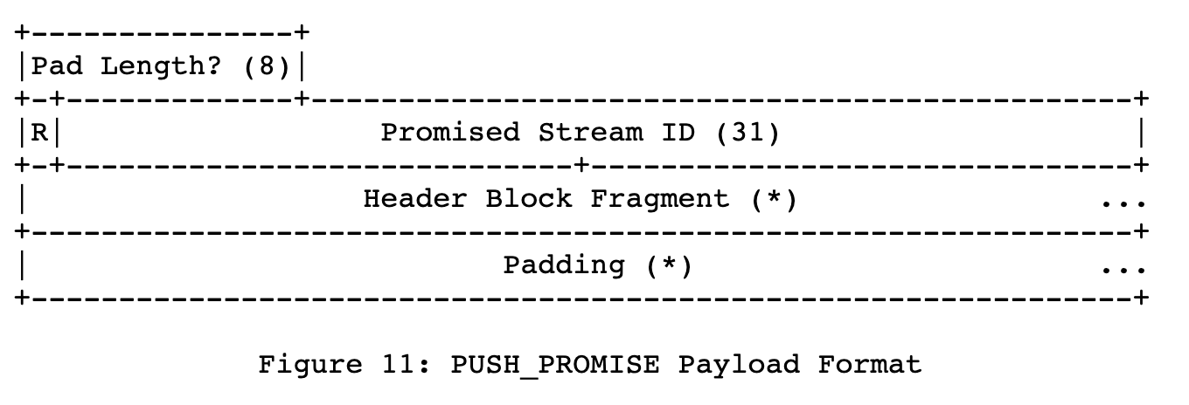
ALTO/H2 Stream Management: Specification
Server -> Client PUSH_PROMISE for transport queue SID_tq
PUSH_PROMISE sent in stream SID_tq to serialize to allow the client to know the push order
Each PUSH_PROMISE chooses a new server-selected stream ID
Stream is closed after push

Slide 27
Concurrent Streams Management
Controlled by SETTINGS_MAX_CONCURRENT_STREAMS
Client -> Server
There is one stream for each open transport queue
A client can always close a transport queue (it uses the open stream) and hence can open -> can close, without issue of deadlock
Server -> Client push
Each push needs to open a new stream

Slide 28
Outline
Motivation and requirements
ALTO/H2 design
Overview
Transport queue
Incremental updates queue
Individual updates
Receiver set
Stream management
Discussions and open issues

Slide 29
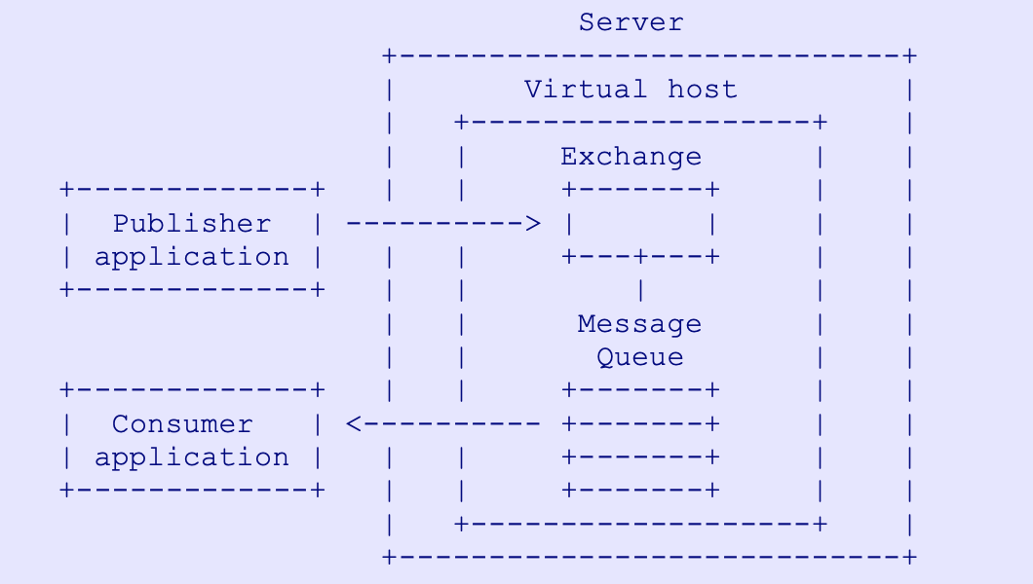
Transport and Pub/sub
What is missing
The design does not allow creation of generic message queues
Only the server can be the publisher
Clients publish info to be shared with other client
The design does not have the capability of Exchange (message router)
Way forward: Keep simple
Broker for further discussion
https://www.rabbitmq.com/resources/specs/amqp0-9-1.pdf

Slide 30
Additional Information about Transport Queue
Calendar semantics
Tell the client ALTO information (e.g., cost) for a future time point
Tell the client when the next information will be released, it is the time that the info is released is distributed, not the value [support]

Slide 31
Backup Slides

Slide 32
Service | Type (Out if not labeled) | Core Information Structures | Main Size Var | Stability Expectation | Incremental Changes
Information Resource Directory [RFC7285] | application/alto-directory+json | Key-value store; Delegation | #resources | Stable | Add/delete resources
Network Map [RFC7285] | application/alto-networkmap+json | Key-value store: pid -> addrType -> array | #CIDRs | Stable | Add/delete CIDR from pid
Cost Map [RFC7285] | application/alto-costmap+json | Key-value store: srcPID -> dstPID -> value Depend on network map | #SRCPID * #DSTPID | More dynamic than network map | Update cost map entries
Filtered Map Services [RFC7285] | In: application/alto-networkmapfilter+json Out: application/alto-costmapfilter+json | In: selected srcPID, dstPID Key-value store: srcPID -> dstPID -> value Depend on network map | Filtered #SRCPID * #DSTPID | More dynamic than network map | Update cost map entries
Endpoint Property Service [RFC7285] | In: application/alto-endpointpropparams+json Out: application/alto-endpointprop+json | In: addr + prop Key-value store: addr -> prop -> value | #addr * #prop | Depend on property, can be dynamic or stable | Update property value
Endpoint Cost Service [RFC7285] | In: application/alto-endpointcostparams+json Out: application/alto-endpointcost+json | In: srcAddr x dstAddr Key-value store: srcAddr -> dstAddr -> value | #src * #dst | Can be more dynamic than cost map | Update cost value
Cost Calendar [RFC8896] | Extension to CostType | Calendar array | Previous * #num_intervals | Can be dynamic | Calendar window moves
Unified Property | In: application/alto-propmapparams+json; Out: application/alto-propmap+json | In: addr, prop Key-value store: addr -> prop -> value | #addr * #prop | Depend on property, can be dynamic or stable | Update property value
Path Vector | In: see costmap; Out: multipart/related;type=application/alto-costmap+json, | Cost map + unified property map | #src * #dst * #vec size | Depend on metric, can be dynamic or stable | Update path vector
CDNi Cap & Footprint | application/alto-cdni+json | Array; {capability-type: capability-value} | #footprint * #capability | Can be dynamic, bursty | Update capabilities

Slide 33
Performance and Effectiveness of Current Transport
Infrastructures | Basic Workload (ALTO SPEC) | Transport | Collecting metrics
Benocs is fully open to use its infrastructure as an evaluation environment Greater Bay Network is also fully open to use its infrastructure as an evaluation environment | (Filtered) Cost map: distribute inter-site performance metrics and calendar; routing changes + link dynamics => updated metrics Endpoint/unified property service: endpoint access status query/updates/bwe CDN node footprint & capability Flow direction (pointing to CDN nodes) using ECS Path vector providing available reservable bandwidth | HTTP/1.x per request full retrieval keep alive pipelining HTTP/2, HTTP/3 per request, full retrieval ALTO/SSE RFC8895 (on HTTP/1.x) | ALTO Server processing load ALTO client processing load Transport load (bytes) Transport latency Throughput Scalability

Slide 34
General Space of Network->App Information Transport
Protocol/Base Reference | What information | How transported | Frequency
ALTO/RFC7285, RFC8895 | Network map, cost map, unified property, … | HTTP/1.x client/server | Request/response; ALTO/SSE incremental push
ECN/RFC3168 | Congestion notification | 2 bits in IP Traffic Class header; ECN-Echo/CWR flags in TCP header | Per packet marking
NEF, SCEF<->AS/3GPP, … | Network capabilities/events -> AF | HTTP | Request/response
…

Slide 35
Working Items
JSON-LINK as data model [TBD]
Benchmarking deployment and initial reports [Richard, Danny]
openalto.org
Open platforms, all are welcome to join
Initial draft surveying of Net->App information and transport in major SDOs [Roland, Chunshan, Richard]

Slide 36
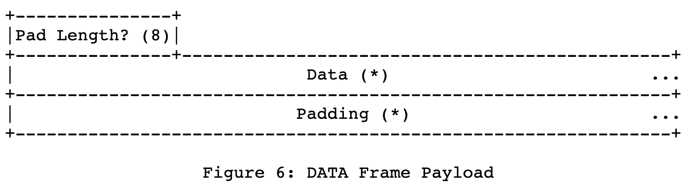
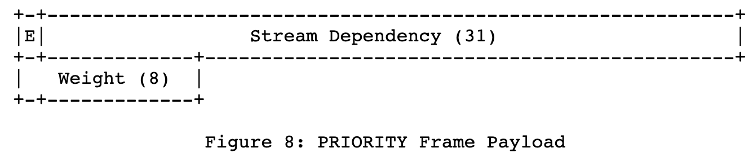
The value 0x0 is reserved for frames that are associated with the connection as a whole as opposed to an individual stream.

