Slide 1
Application-Layer Traffic Optimization (ALTO) for Data Intensive Sciences
WCLG DOMA 4/27/2022 Meeting
Jordi Ros Giralt, Y. Richard Yang
on behalf of IETF ALTO WG (Jacob, Jensen, Kai, Alex, …)

Slide 2
Outline
ALTO background
Basic ALTO protocol
ALTO in a bigger picture
ALTO implementation and applications
openalto
next steps

Slide 3
IETF ALTO High-Level Goals and Basic Information
ALTO is an effort of the ALTO working group in the Transport Area of Internet Engineering Task Force (IETF)
ALTO high-level goal: provide a standard for applications and networks to work together to optimize both network and application performance
Initial data distribution, replication for peer-to-peer applications (e.g., BitTorrent)
Evolve to include CDNi, …

Slide 4
IETF ALTO RFCs/Ongoing/Drafts
Problem Statement
(RFC5693)
Base Protocol (RFC7285)
Path Vector (RFC editor)
MEC drafts (service edge, FDN, unified resources)
Comcast Deployment
(RFC5632)
SSE/Incr Update (RFC8895)
Unified Properties (RFC editor)
Cellular/mobile networks drafts (MOWIE, cellular addresses, mobility network models)
Requirements (RFC6708)
Multicost (RFC8189)
CDNi (RFC editor)
Aggregation, proxy, multi-domain drafts
Deployment (RFC7971)
Cost Calendar (RFC8896)
Xdom Service Discovery (RFC8686)
Cost Metrics (RFC editor)
Update ALTO drafts (FCS, cost context, BGP, multipart, )
Server Discovery (RFC7286)
List see google doc: https://docs.google.com/document/d/1qP9jf-CMXvNiEE3YAnApTczAE4QkBW23Q1Eg99uOaEQ/edit?usp=sharing

Slide 5
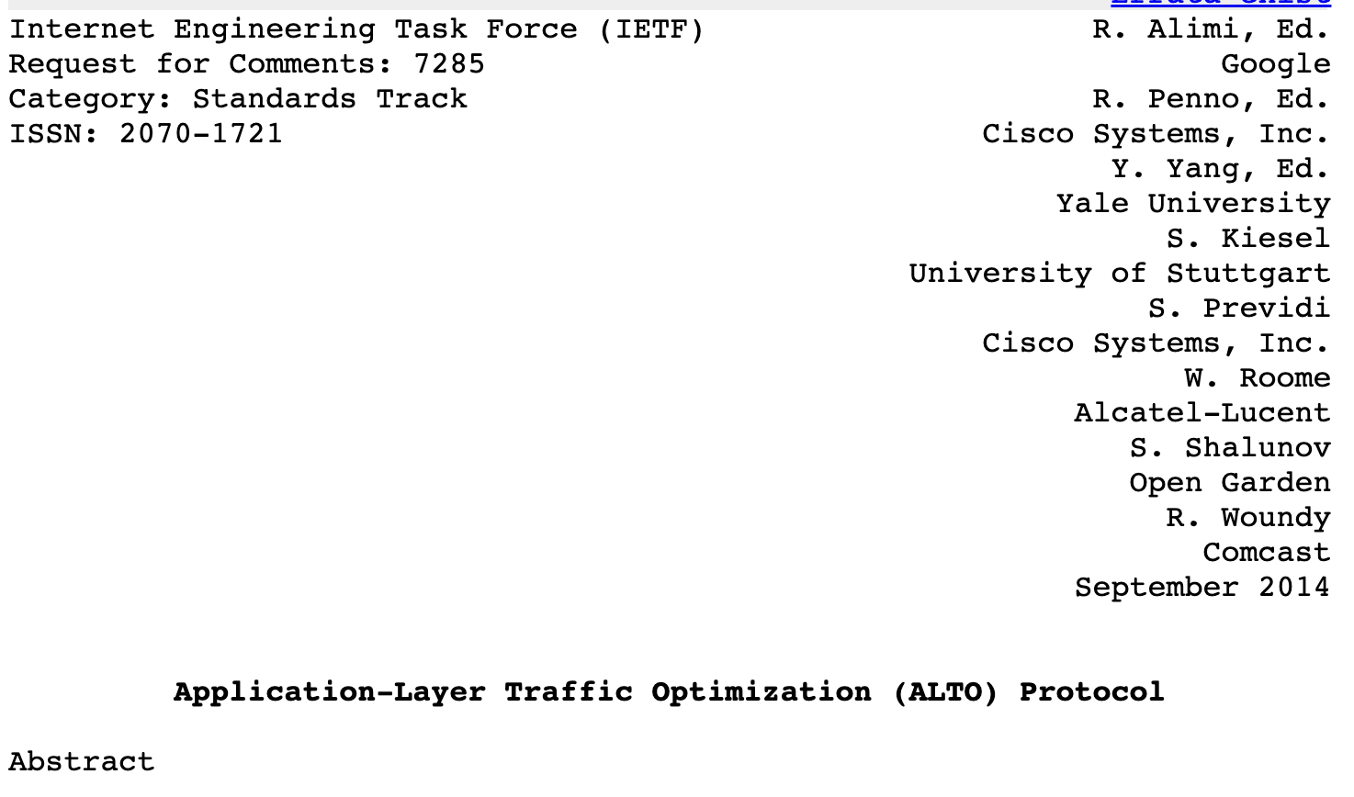
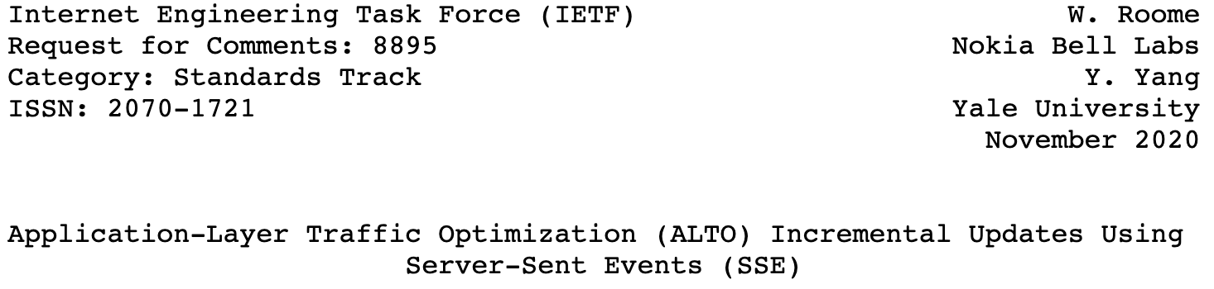
Basic ALTO Protocol Framework
Network information divided into (network) information resources
List of available information resources provided by Information Resource Directory (IRD)
Bootstrap server provided by server discovery
Server discovery, xdom discovery
Each individual information resource is provided as a RESTful service
A generic, SSE-based framework to stream-control, push, incrementally update information resources

Slide 6
General Protocol Structure
alto client
Abstractions, services
Transport
East-west (server-to-server)
alto server
alto server
Backend/infrastructure
network substrate (NMS, routing protocols)
Notes:
Northbound abstractions and services
Cellular network information
MEC network information
Huge data network information
Transport
HTTP/2/3, multipart, inband+outband
Backend (southbound) and operations
Automatic measurements/derivation
East-west (server-to-server)

Slide 7
Basic Network Abstractions
Entity: A network consists of a set of entities
Endpoints, aggregation of endpoints, abstract network elements
Each entity can have a set of properties
A generic framework supporting entity properties, inheritance
Path: a network-traversal path from a src entity to a dst entity
Path has properties called cost metrics [PerfMetrics, MultiCost, CostCalendar]
Originally cost was called distance
The path properties from a set of src to a set of dst can be queried as a cost map
Ongoing work to introduce more flexible path properties
Path vector
Path bottleneck structure (G2)

Slide 8
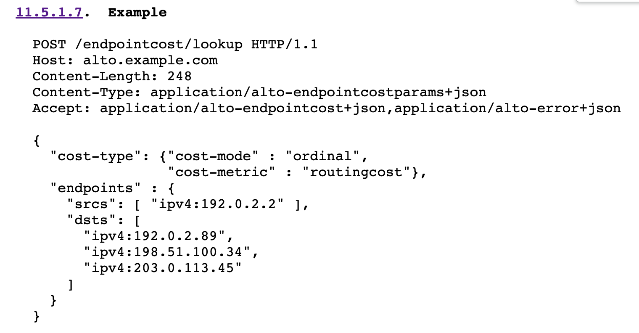
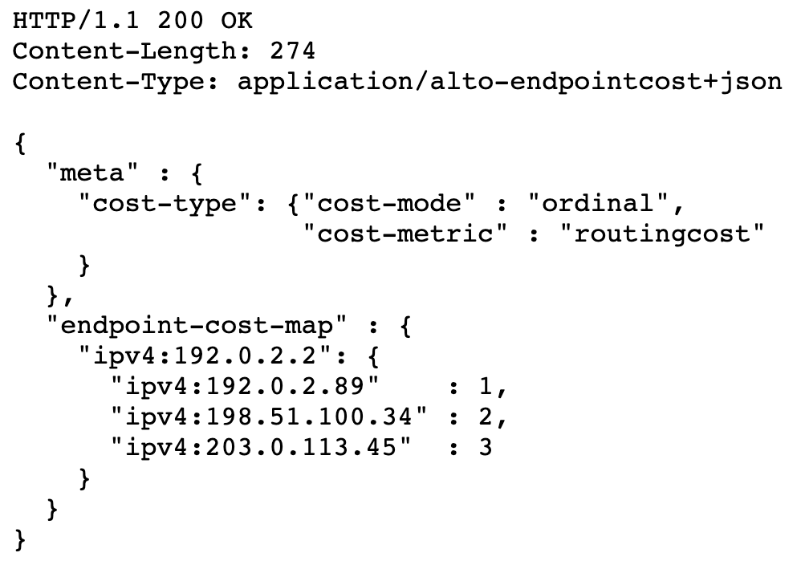
Simple ALTO Example: Endpoint Cost
More details see RFC7285

Slide 9
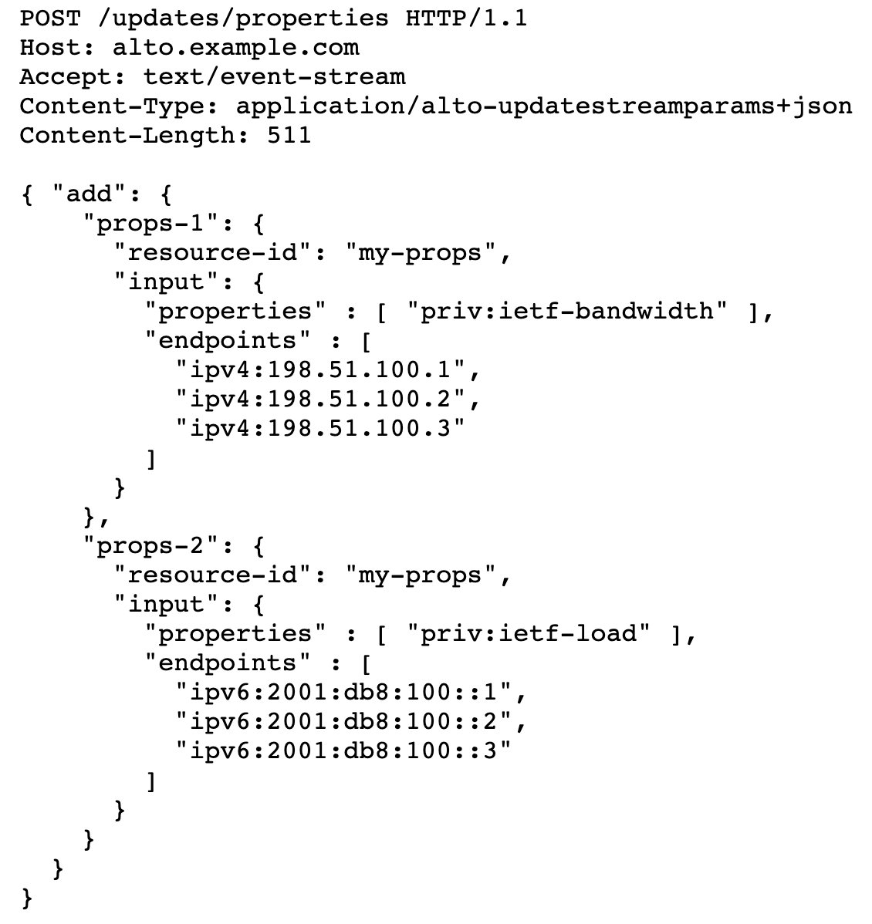
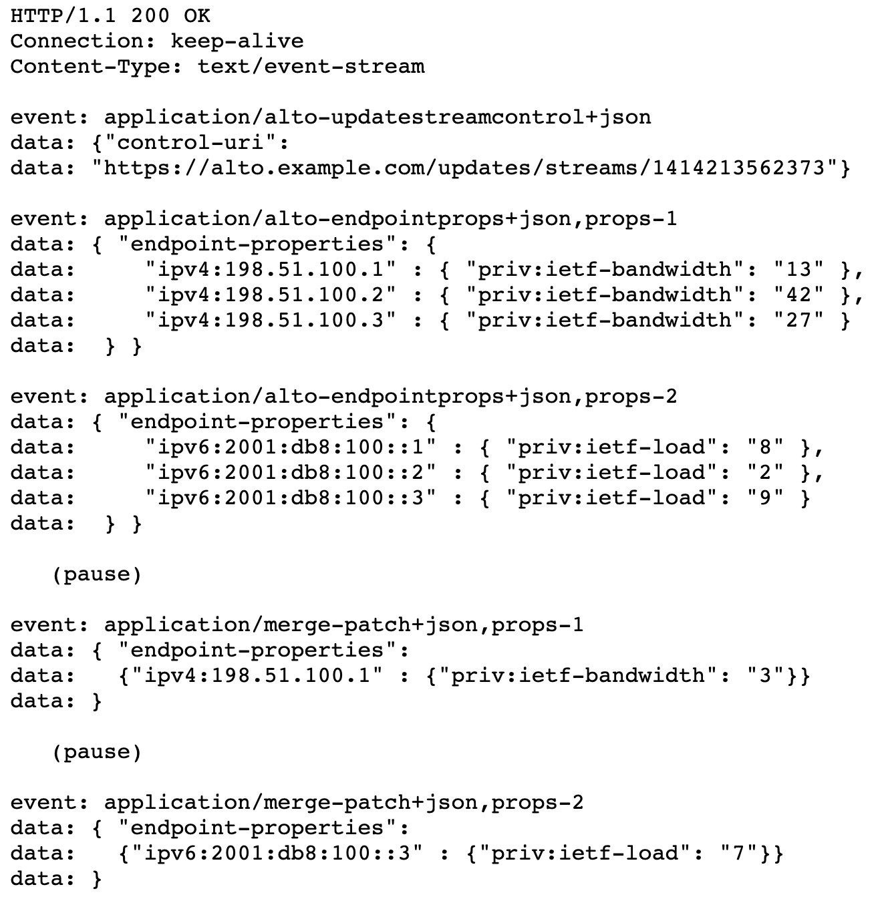
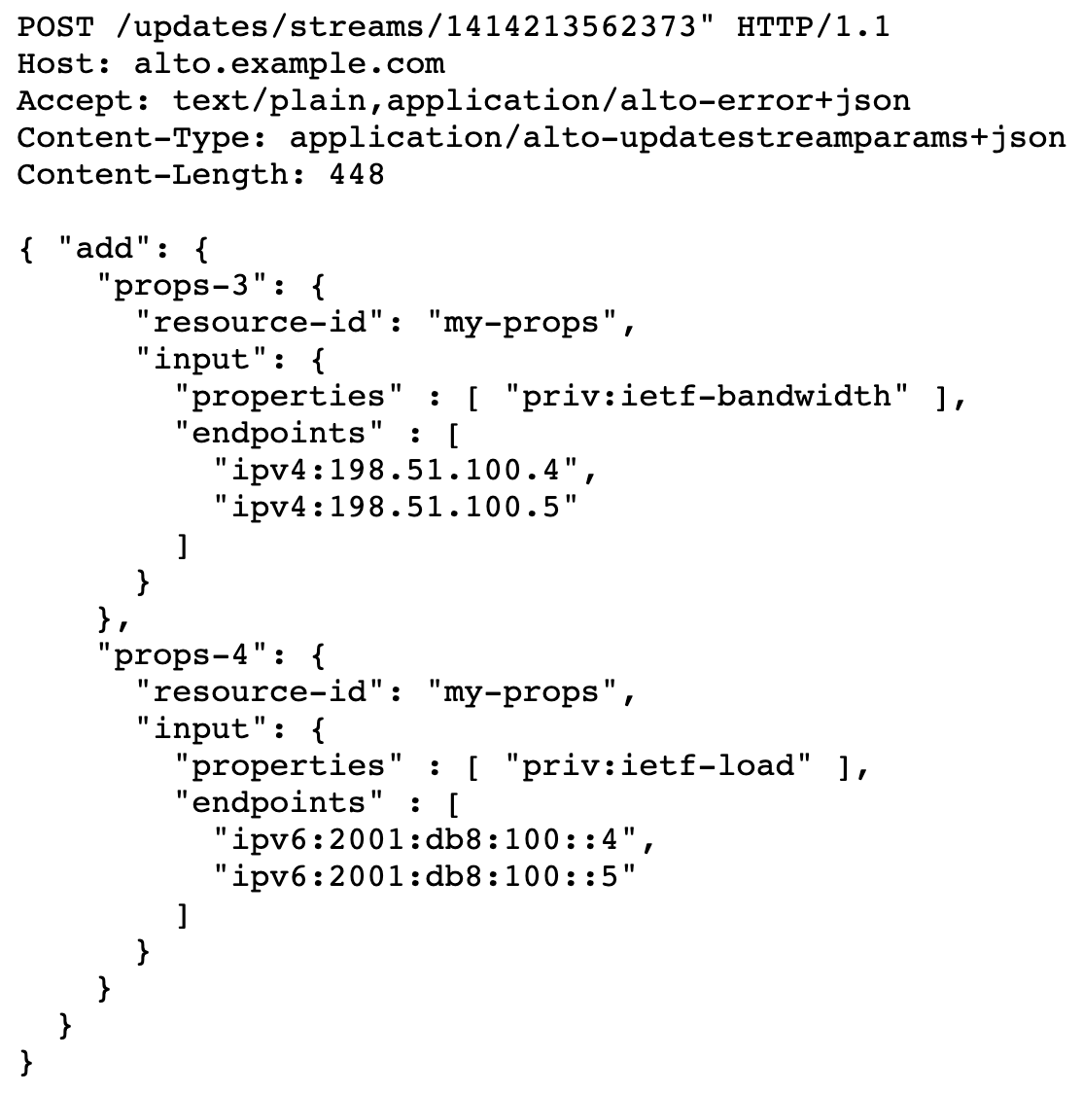
Simple ALTO Example: Incremental Push Update
More details see RFC8895

Slide 10
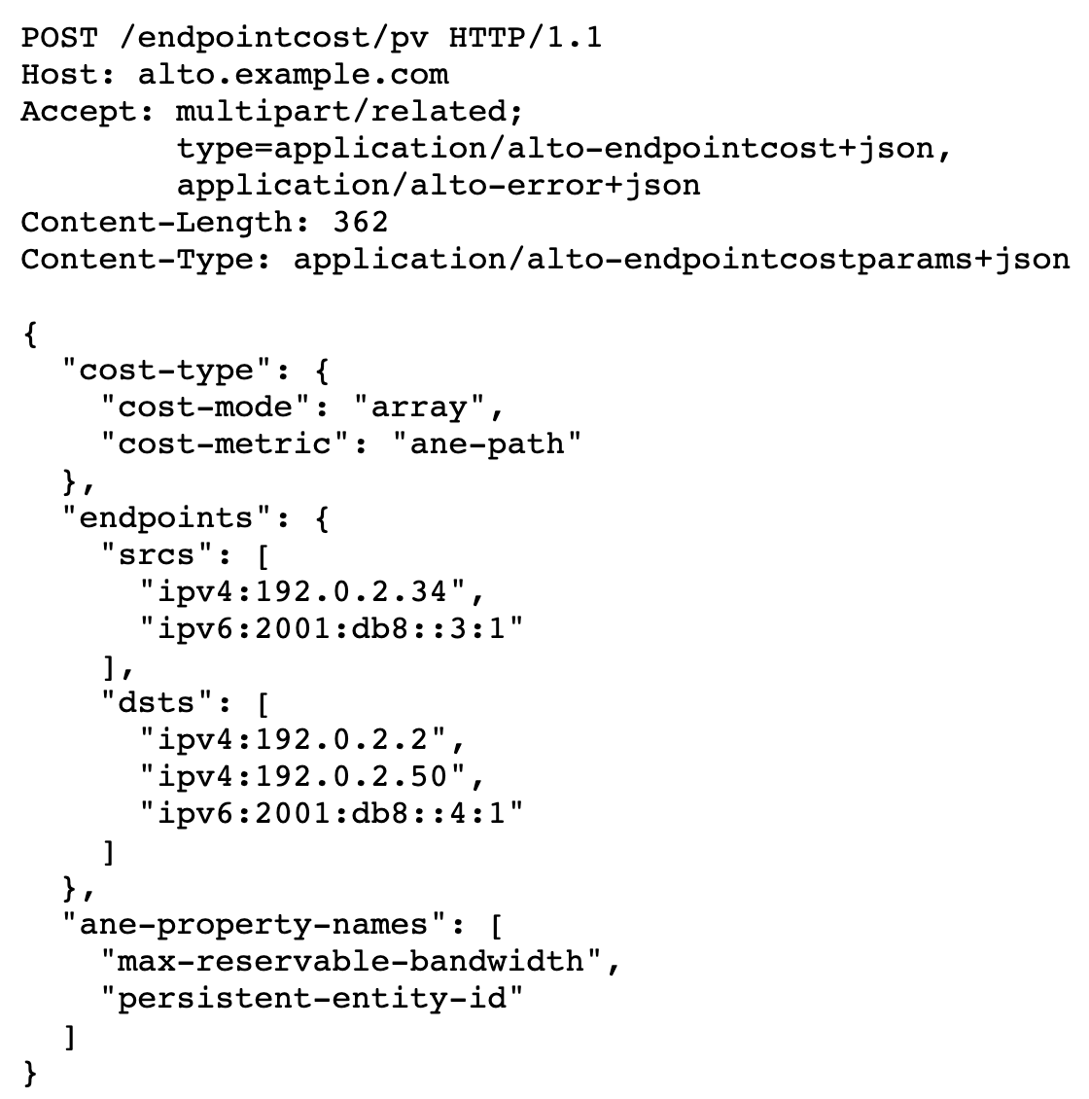
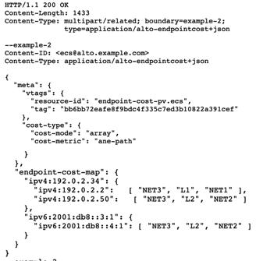
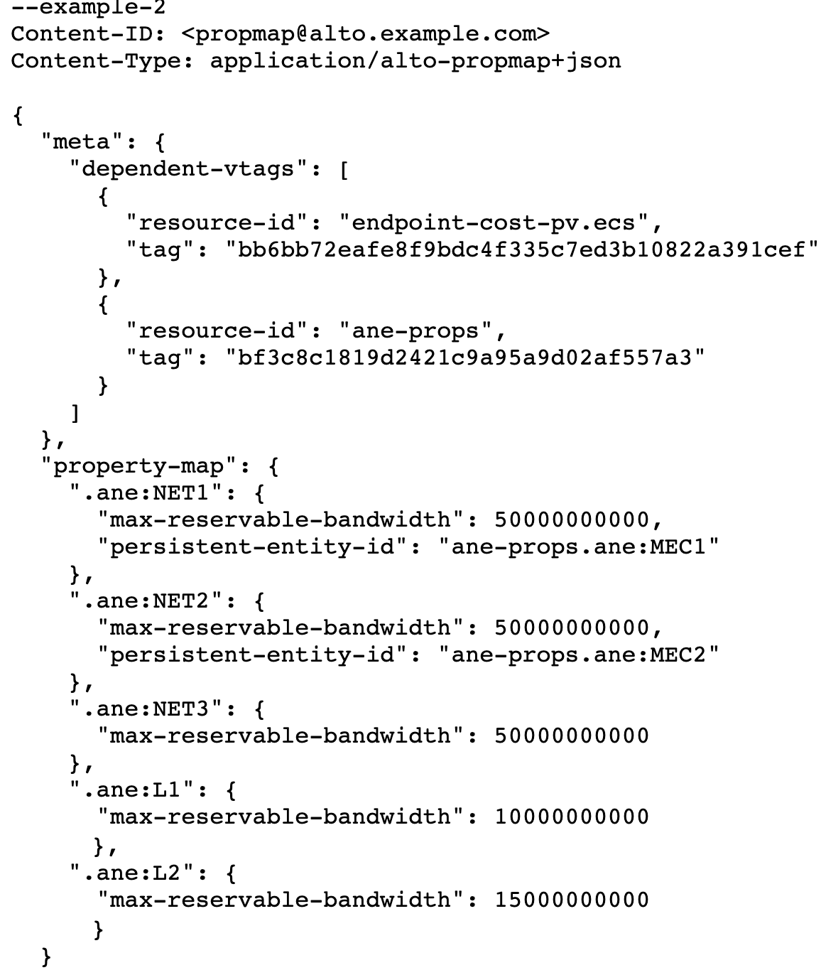
Simple ALTO Example: Path Vector
More details see https://datatracker.ietf.org/doc/html/draft-ietf-alto-path-vector-21#section-8.1

Slide 11
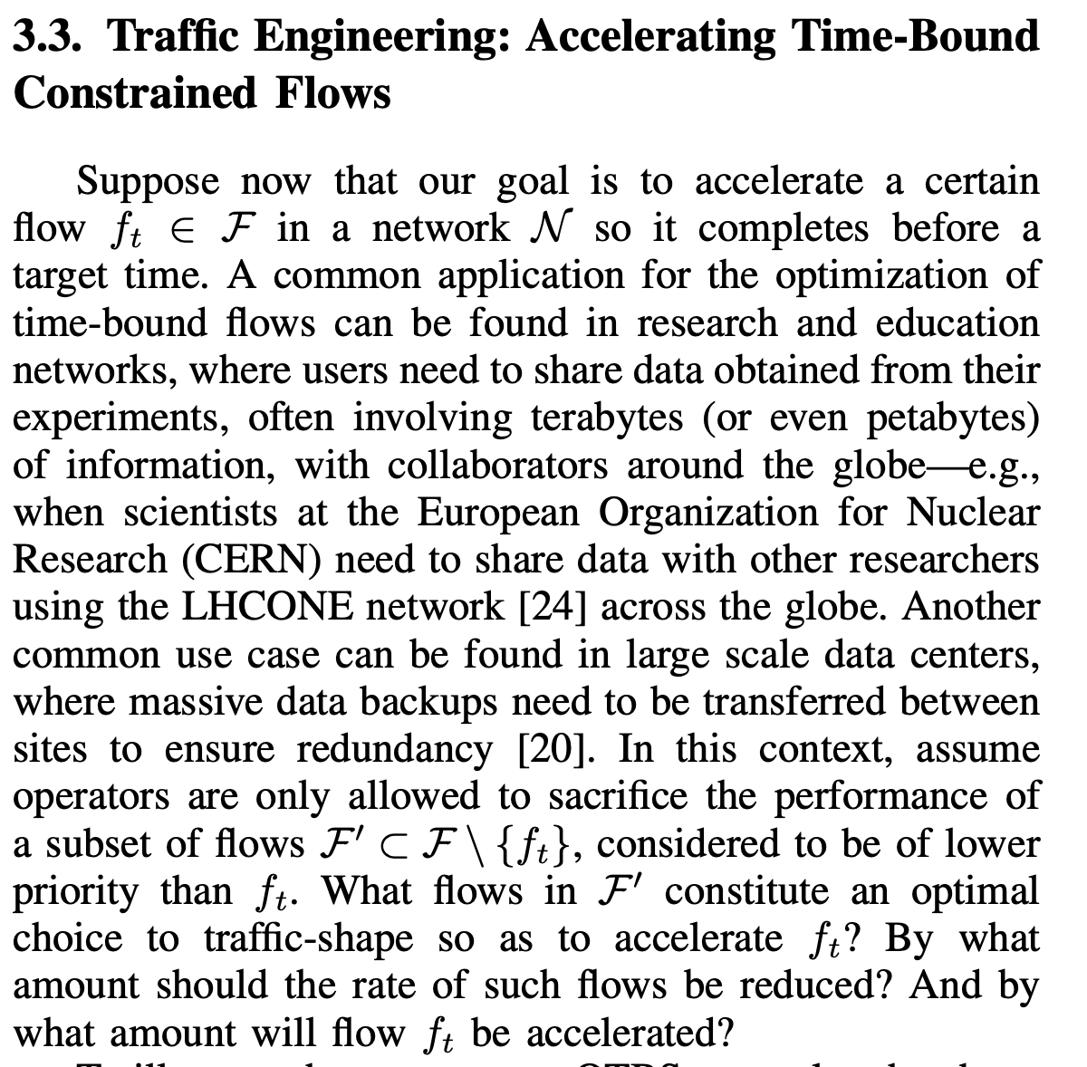
ALTO Abstraction for Bottleneck Structure (Ongoing)
More details see
https://www.reservoir.com/wp-content/uploads/2021/08/G2_QTBS_TR_2021.pdf

Slide 12
The Visibility, Intelligence, Control Framework
For large-scale data management

Slide 13
Outline
ALTO background
ALTO protocol basic
ALTO in a bigger picture, on going extensions
ALTO implementation and extensions
openalto
next steps

Slide 14
openalto

Slide 15
Potential ALTO WG + DOMA
Bidirectional collaboration
ALTO => Rucio: provide information and abstraction that Rucio can use
Rucio => ALTO: provide use cases and abstractions to define as Internet standards
Consider both short term and long term collaborations

Slide 16
Starting Point
Direction: ALTO team works with Rucio team advising: introduces ALTO path costs as a source of Rucio RSE distances
Step 1: IETF 113 Hackathon [March 2022]
Simple emulated network setting
Focus: build initial development framework, initial code development/integration, initial contribution to address Rucio #5012 (https://github.com/rucio/rucio/issues/5012)
Step 2: After Hackathon
Abstraction of real LHC networks
Integration of path vector/bottleneck structure

Slide 17
Long-term Goals
The declarative data management system for large-scale scientific data management
Built on top of Rucio declarative (replication-rule) design
Extension with flexible, declarative network-application goals
Rucio user specifies m(x), where x is rate vector of {xij}, for each RSE i->j
System jointly computes feasible region

Slide 18
How openalto may fit into DOMA
Integration w/ Rucio (automatic workflow)
Manual workflow (client download)
Demo 1/2/3
Southbound: Provide automatic, network-aware, dynamic distance []
Northbound: Automatic replication QoS aware scheduling
QoS and scheduling to implementation
Bi-level

Slide 19
Roadmap: Replication Workflow
User specifies replication rules
We allow to add QoS requirement (e.g., the repli util)
Visibility
Cross-layer integration
Intelligence
Predict
Control
When: Transfer dispatching control (FTS, stripping)
Reasonable pred (BS, util), solve scheduling (bi-level)
At what rate: Transfer rate control (tc)
Routing control (SRv6, PCE)

Slide 20
Feedback
What are your high-level problems, guidance?

Slide 21
Backup: More Details

Slide 22
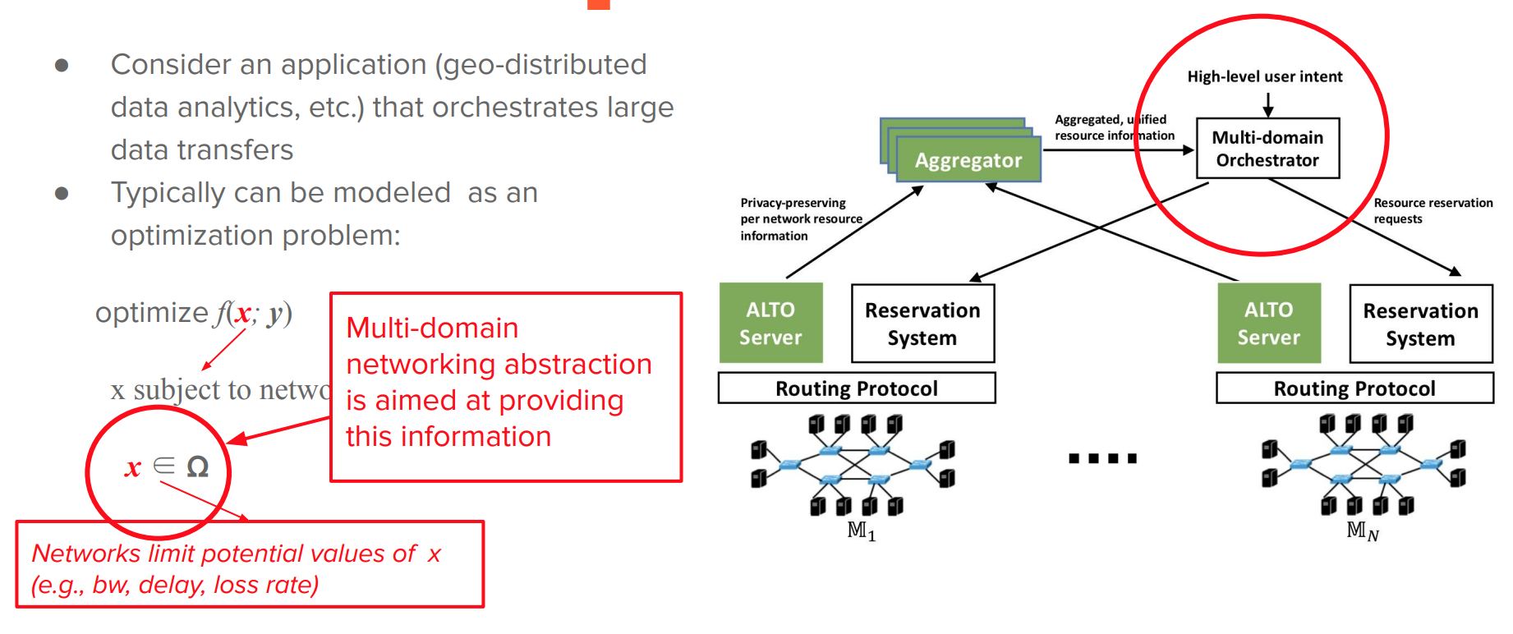
Multi-Domain Data Management Optimization
https://irtf.org/anrw/2019/slides-anrw19-final28.pdf

Slide 23
ALTO Network Abstractions
A network consists of nodes and paths
A nodes can be an
endpoint
aggregations of endpoints (PID)
abstract network element
A path has path properties:
cost metrics, multicost, calendars
vector of abstract network elements
Endpoints, aggregations of endpoints, abstract network elements are called entities
Entities have properties that can be inherited
Entities can have capabilities
A set of paths can form a co-flow, with:
shared abstract network elements cross the co-flows

Slide 24

ALTO Network Abstractions and Services
UP/ EPS/CDNi
Net Map
Cost Map
ECS
PV

Slide 25
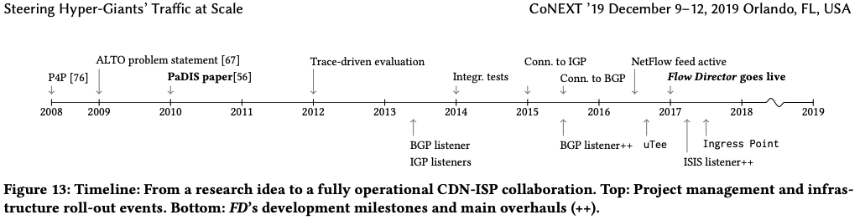
Example ALTO Deployment Setting: Flow Director
source: http://people.csail.mit.edu/gsmaragd/publications/CoNEXT2019/CoNEXT2019.pdf CoNEXT 2019 Best Paper Award; IETF/IRTF 2020 Applied Networking Research Prize

Slide 26
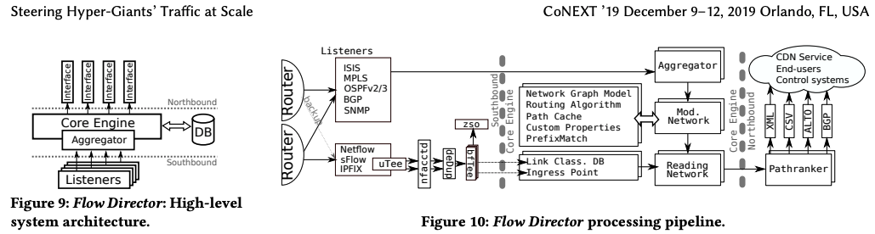
Example ALTO Deployment Setting: Flow Director
source: http://people.csail.mit.edu/gsmaragd/publications/CoNEXT2019/CoNEXT2019.pdf CoNEXT 2019 Best Paper Award; IETF/IRTF 2020 Applied Networking Research Prize

Slide 27
Operations Workflow
Expose the information resource directory (IRD)
Decide what information resources I can/should provide [e.g., what metrics, how they are divided into multiple entries]
Populate (may be proactive, reactive) the content of the services i.e., pull the backend if knows already exists, or trigger just-in-time measurements
Aggregation/processing the collected information and give to clients

Slide 28
Basic Challenge of ALTO Design
Applications and networks can be designed with different objectives
Application: optimizes application’s utility
Network: optimizes network’s utility, enforces fairness, …
Apps and networks have privacy/scalability concerns to share complete info
NA-Application
Cap & Info
Cap & Info
Network

Slide 29
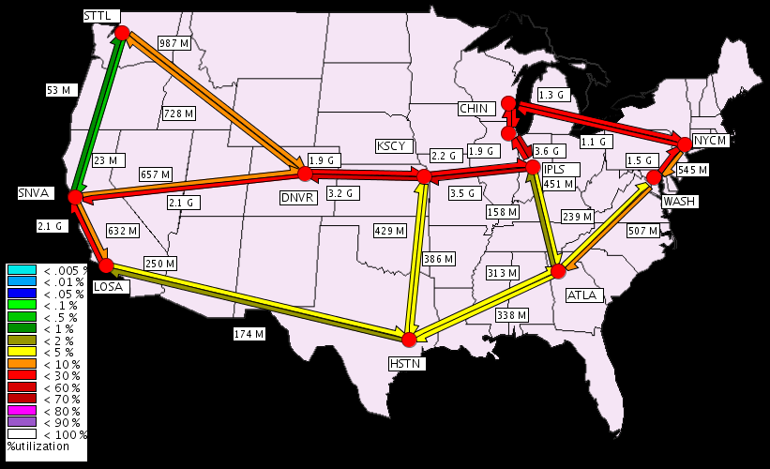
A Simple, Illustration Example
Application objective: optimize total throughput
Using a fluid model*, we can derive that: optimizing throughput ⇒ maximizing up/down link capacity usage
Network objective: load balancing minimizing maximum link utilization (MLU)
be: background traffic volume on link e
ce: capacity of link e
Ie(i,j) = 1 if link e is on the route from i to j
t^{k} : a traffic matrix {t^{k}ij} for each pair of nodes (i,j) for app k

Slide 30
Global Traffic Engineering System Formulation
Combine the objectives of network and applications
s.t., for any k,
T¹
t^{k}
T^{k}

Slide 31
Global Traffic Engineering System Formulation
Combine the objectives of network and applications
s.t., for any k,
T¹
t^{k}
T^{k}

Slide 32
Why Hard: Constraints Couple Net/App
Constraints couple network/applications together!

Slide 33
A Two-Slide Summary of Constrained Convex Optimization (Primal-Dual) Theory
f(x) concave
g(x) linear
S is a convex set
slope q
f(x)
Map each x in S, to [g(x), f(x)]
S
slope q
Top contour of map is concave
Easy to read solution from contour (how?)
For each slope q (>=0), computes f(x) – q g(x) of all mapped [f(x), g(x)]
g(x)
Notes:
Concave meaning: consider two points (g(x1), f(x1)) and (g(x1), f(x1))
consider a g(x1) + (1-a)g(x2)
since g() is linear, a g(x1) + (1-a)g(x2) = g(ax1 + (1-a)x2)
f(ax1 + (1-a)x2) >= af(x1) + (1-a)f(x2) since f() is concave
The intersection w/ y-axis is f(x)-qg(x)
Important to draw the two cases of g(x)

Slide 34
A Two-Slide Summary of Constrained Convex Optimization (Primal-Dual) Theory
f(x) concave
g(x) linear
S is a convex set
f(x)
q1
q2
S
q3
D(q) is called the dual; q (>= 0) are called prices in economics
D(q) provides an upper bound on obj.
- According to optimization theory: when D(q) achieves minimum over all q (>= 0), then the optimization objective is achieved.
g(x)

Slide 35
Exercise
S
f(x)
g(x)

Slide 36
ALTO Solution Architecture: Decouple Network and Application
t^{k}
Introduce pe to decouple the constraints
T^{k}
pe
Look at dual function, with dual variable pe (≥ 0) for the inequality of each link e, and apply dual finite condition
pij is the sum of pe along the path from node i to node j

Slide 37
Solution Architecture:
The interface between applications and network is the dual variables {p_{ij}}
There are more straightforward settings to understand p_{ij}, e.g., financial cost of the path from i to j
High-level goal: provide provider-distance between network points
pe1(t)
pe2(t)
t^{k}(t)
t^{k}
T^{k}

