Slide 1
June 21, 2022

Slide 2
Scope
IETF application-layer traffic optimization (ALTO) application and development
Analysis (science) and design (engineering) of data transport for data-intensive sciences (DIS)
More traditional networking -> DIS
DIS -> networking

Slide 3
IETF ALTO High-Level Goals and Basic Information
ALTO is an effort of the ALTO working group in the Transport Area of Internet Engineering Task Force (IETF)
ALTO high-level goal: provide a standard for applications and networks to work together to optimize both network and application performance
Initial data distribution, replication for peer-to-peer applications (e.g., BitTorrent)
Evolve to include CDNi, …

Slide 4
IETF ALTO RFCs/Ongoing/Drafts
Problem Statement
(RFC5693)
Base Protocol (RFC7285)
Path Vector (RFC editor)
MEC drafts (service edge, FDN, unified resources)
Comcast Deployment
(RFC5632)
SSE/Incr Update (RFC8895)
Unified Properties (RFC editor)
Cellular/mobile networks drafts (MOWIE, cellular addresses, mobility network models)
Requirements (RFC6708)
Multicost (RFC8189)
CDNi (RFC editor)
Aggregation, proxy, multi-domain drafts
Deployment (RFC7971)
Cost Calendar (RFC8896)
Xdom Service Discovery (RFC8686)
Cost Metrics (RFC editor)
Update ALTO drafts (FCS, cost context, BGP, multipart, )
Server Discovery (RFC7286)
List see google doc: https://docs.google.com/document/d/1qP9jf-CMXvNiEE3YAnApTczAE4QkBW23Q1Eg99uOaEQ/edit?usp=sharing

Slide 5
General ALTO Structure
Two core components: (1) abstractions of network state/services and (2) transport and discovery of abstractions
alto client
Abstractions, services
Transport
East-west (server-to-server)
alto server
alto server
Backend/infrastructure
network substrate (NMS, routing protocols)
Notes:
Northbound abstractions and services
Cellular network information
MEC network information
Huge data network information
Transport
HTTP/2/3, multipart, inband+outband
Backend (southbound) and operations
Automatic measurements/derivation
East-west (server-to-server)

Slide 6
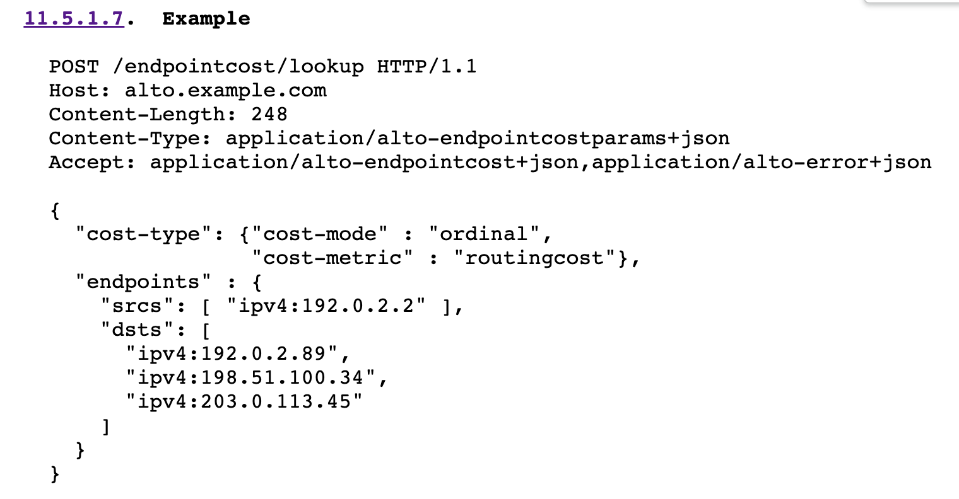
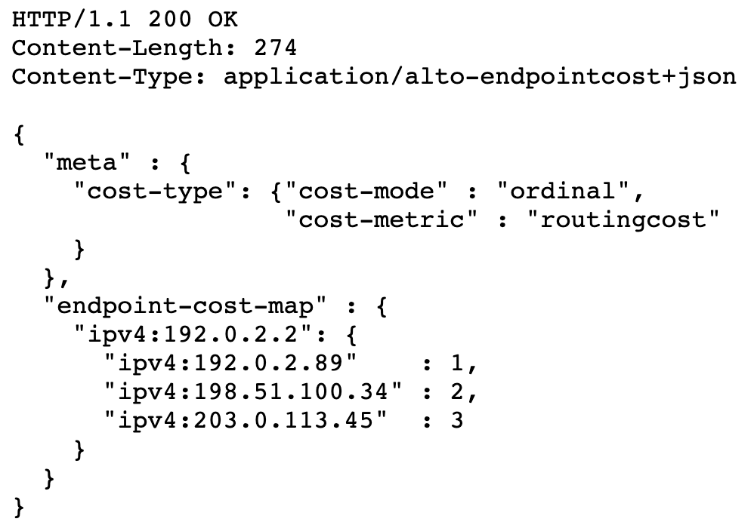
ALTO Abstraction Example: Endpoint Cost
More details see RFC7285

Slide 7
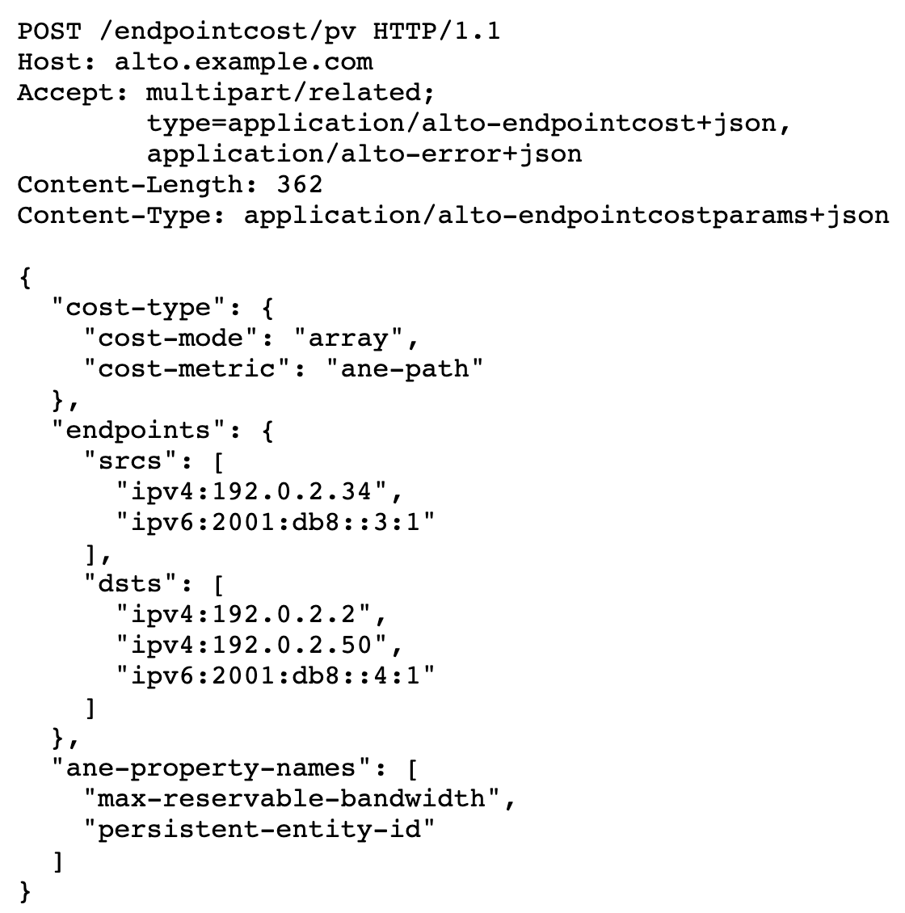
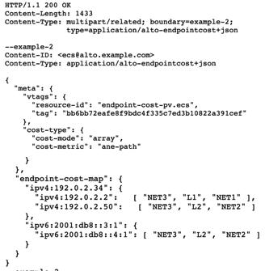
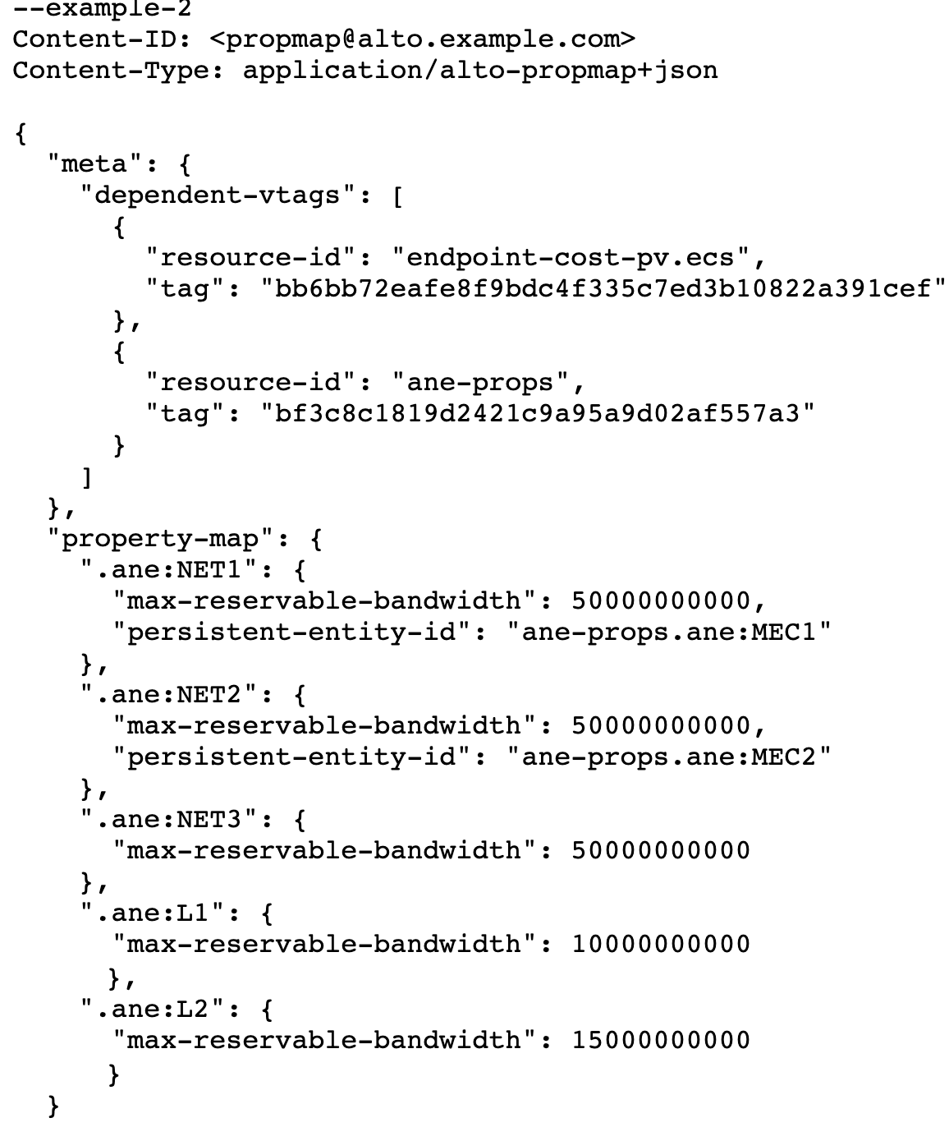
ALTO Abstraction Example: Path Vector
More details see https://datatracker.ietf.org/doc/html/draft-ietf-alto-path-vector-21#section-8.1

Slide 8
Analysis and Design of Efficient, Controllable DIS Data Transport
Initial focus
Prototyping integration of ALTO w/ Rucio
Analysis of FTS
Integrated design of Rucio/FTS

Slide 9
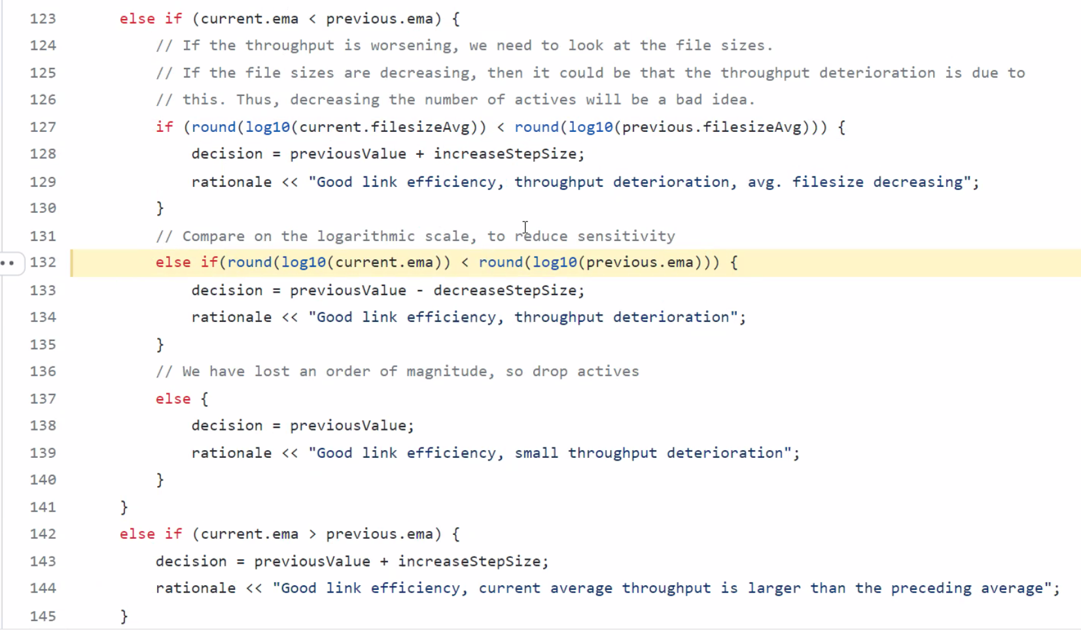
FTS as a Dynamic System Process

Slide 10
FTS Analysis
Distinguish FTS-Model I, FTS-Model II, and FTS
Some findings
Complex dynamic behaviors of FTS-Models, e.g.,
Converged state depends on floating point precision
Introduce exponential moving average complexity
Model as a variant of gradient algorithm, but
Can be considered as multiple objective functions Ti
Non-Pareto optimal
Cannot control resource allocation

Slide 11
Next Steps
Understanding relationship w/ other projects such as NOTED
Joint design and deployment
Network wide resource allocation
Single gradient design
Global infrastructure state exposure in the DIS community
Deadlines
SIGCOMM NAI’22
IETF 114 hackathon
SC’22

