Slide 1
July 14, 2022
Meeting: FTS (Mihia, Steve), ALTO Team (Richard, Ryan, Jordi, Mahdi)

Slide 2
Scope
Internet Engineering Task Force (IETF) application-layer traffic optimization (ALTO) working group development and applications
Data-intensive sciences as a core domain driving ALTO development and applications
Integrated analysis (science) and design (engineering), focusing on data transport control of data intensive sciences
Exploration of data data intensive sciences design back to the networking community

Slide 3
IETF ALTO High-Level Goals and Basic Information
ALTO is an effort of the ALTO working group in the Transport Area of Internet Engineering Task Force (IETF)
ALTO high-level goal: provide a standard for applications and networks to work together to optimize both network and application performance
Initial data distribution, replication for peer-to-peer applications (e.g., BitTorrent)
Evolve to include CDNi, …

Slide 4
IETF ALTO RFCs/Ongoing/Drafts
Problem Statement
(RFC5693)
Base Protocol (RFC7285)
Path Vector (RFC9242)
MEC drafts (service edge, FDN, unified resources)
Comcast Deployment
(RFC5632)
SSE/Incr Update (RFC8895)
Unified Properties (RFC9241)
Cellular/mobile networks drafts (MOWIE, cellular addresses, mobility network models)
Requirements (RFC6708)
Multicost (RFC8189)
CDNi (RFC9240)
Aggregation, proxy, multi-domain drafts
Deployment (RFC7971)
Cost Calendar (RFC8896)
Xdom Service Discovery (RFC8686)
Cost Metrics (RFC editor)
Update ALTO drafts (FCS, cost context, BGP, multipart, )
Server Discovery (RFC7286)
List see google doc: https://docs.google.com/document/d/1qP9jf-CMXvNiEE3YAnApTczAE4QkBW23Q1Eg99uOaEQ/edit?usp=sharing

Slide 5
General ALTO Structure
Two core components: (1) abstractions of network state/services and (2) transport and discovery of abstractions
alto client
Abstractions, services
Transport
East-west (server-to-server)
alto server
alto server
Backend/infrastructure
network substrate (NMS, routing protocols)
Notes:
Northbound abstractions and services
Cellular network information
MEC network information
Huge data network information
Transport
HTTP/2/3, multipart, inband+outband
Backend (southbound) and operations
Automatic measurements/derivation
East-west (server-to-server)

Slide 6
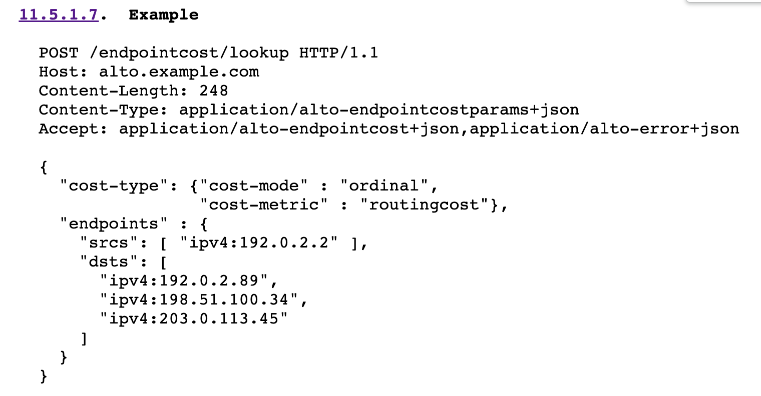
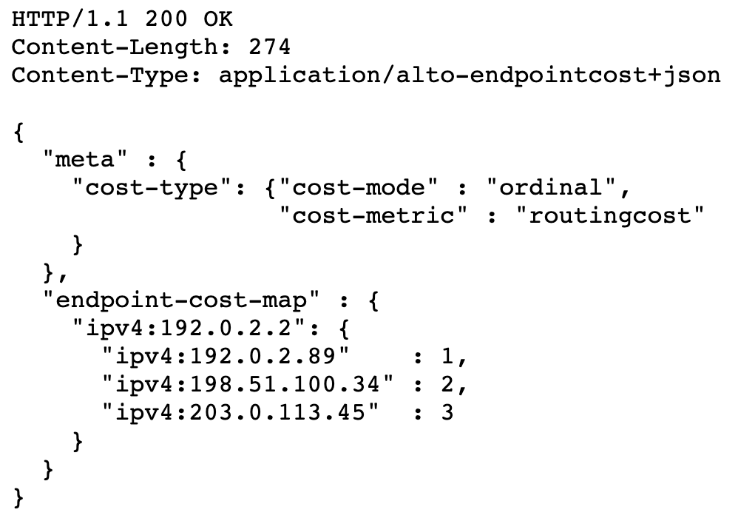
ALTO Abstraction Example: Endpoint Cost
More details see RFC7285

Slide 7
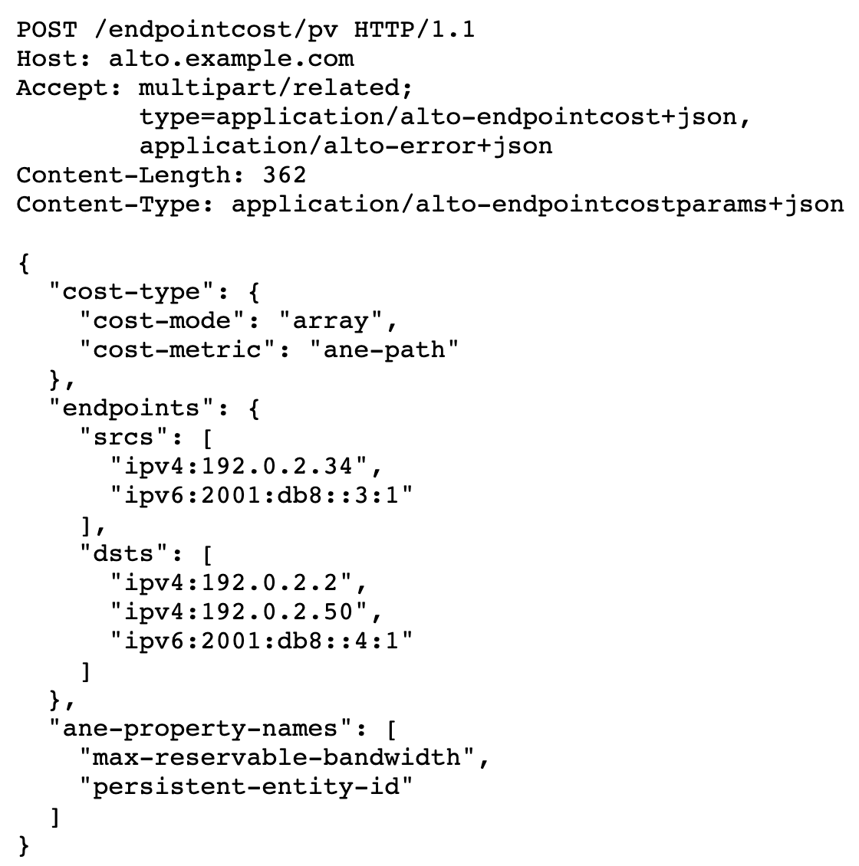
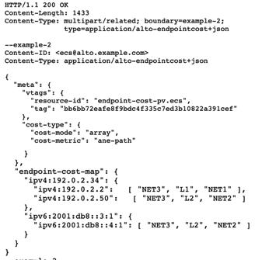
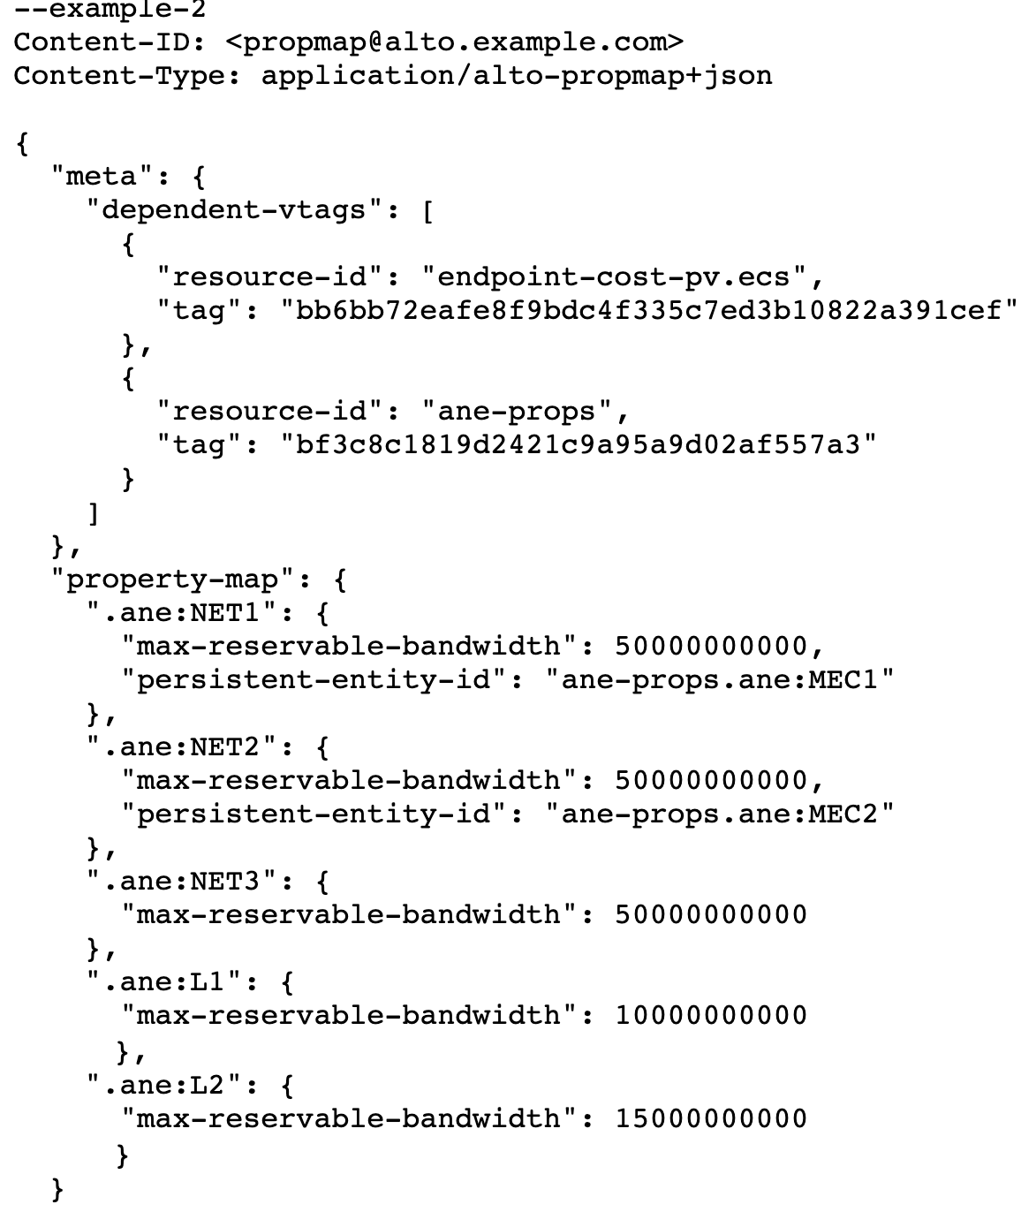
ALTO Abstraction Example: Path Vector
More details see https://datatracker.ietf.org/doc/html/draft-ietf-alto-path-vector-21#section-8.1

Slide 8
(Data Sciences Big Data) Transport Control Framework
O, A, M
Transport Select (who sends to whom; e.g., Rucio)
Transport Control Scheduling (when, at what rate; FTS)
Transport Data Plane (e.g., xRootd, HTTP)
Transport Networking (e.g., SENSE)

Slide 9
FTS in Transport Control Plane Architecture
Software architecture
Transport control using widely available, end-to-end control knob (i.e., #tcp connections)
Transport control using light-weight control knob (i.e., #tcp connections, not packets)
FTS providing a single point in control flow graph
Performance properties
Efficiency (optimal usage of resources)
Resource control

Slide 10
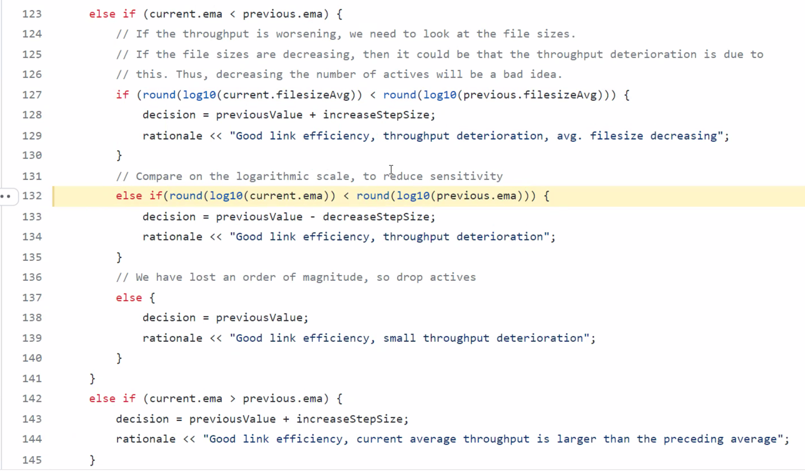
FTS as Transport Control Plane Architecture Core: Dynamic System Process
Model FTS behavior as a dynamic system
x(t+1) = f( x(t) )
Focus on convergence, controllability and optimality
Results are based on modeling, to provide foundation
Results are for FTS-M, not FTS
Systems eval are important next step

Slide 11
FTS-M Assumptions and Math Model
Throughput as a dynamic system
Define
RL_{B}(x) = round( log_{B}(x ) )
E_{i}(t+1) = (1-a) E_{i}(t) + a T_{i}(t+1)
n_{i}(t+1) =
ni(t) + 1 Ei(t+1) > Ei(t) ) // new > old
n_{i}(t) - 1 RL_{B} ( E_{i}(t+1) ) < RL_{B} ( E_{i}(t) ) // new < old by round log
ni(t) otherwise
Idealized model: Ti(t) is a simple function of n(t), where n(t) is the vector of control states
More accurate when always backlog at each queue (link)
More accurate when no transfer boundary effects

Slide 12
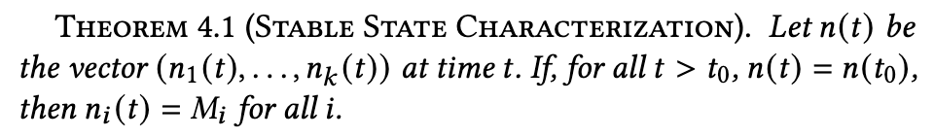
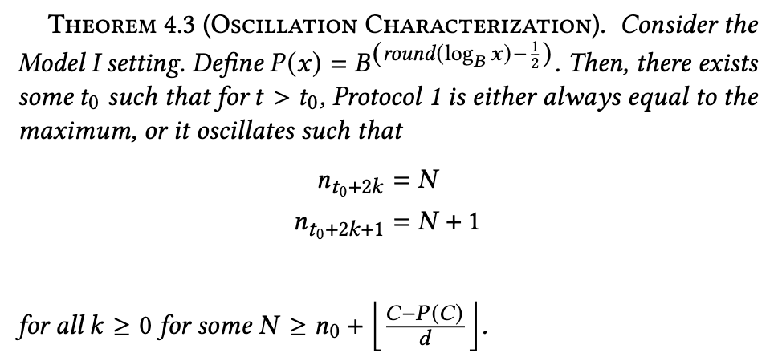

FTS-M Behaviors
FTS-M can have complex dynamic system behaviors, e.g.,
Fixed point, oscillations
Fixed point example:
Oscillation example:
Assume

Slide 13
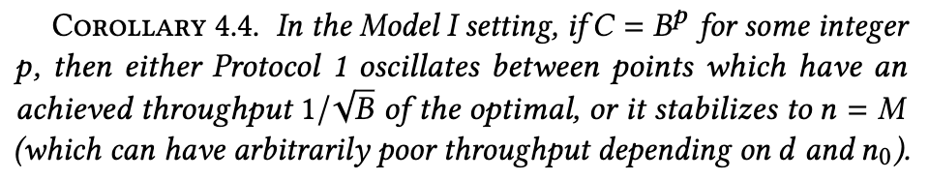
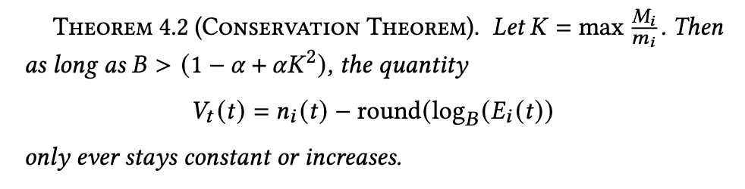
FTS-M Behaviors: Optimality and Control
Optimality: FTS-M may converge to non-Pareto state
Example (the oscillation example)
Controllability: converge to configuration

Slide 14
FTS-M Structure Analysis
Base structure, with the following potential extensions
Powerful zero-order gradient based, but semi-gradient (not converge to opt) => full zero order gradient, first-order gradient if there is an explicit model
Multi-objective functions design (non-pareto opt) => introduce objective function integration, to explore the Pareto boundary
Only per link configuration (not control bw on physical links) => introduce alto to map app-level to network level, as optimization control
Focus on individual transfers (may not handle sets of transfers, co-flow) => introduce transfer dependency to integrate co-flow scheduling

Slide 15
FTS’ (Transport Control Networking) Design

Slide 16
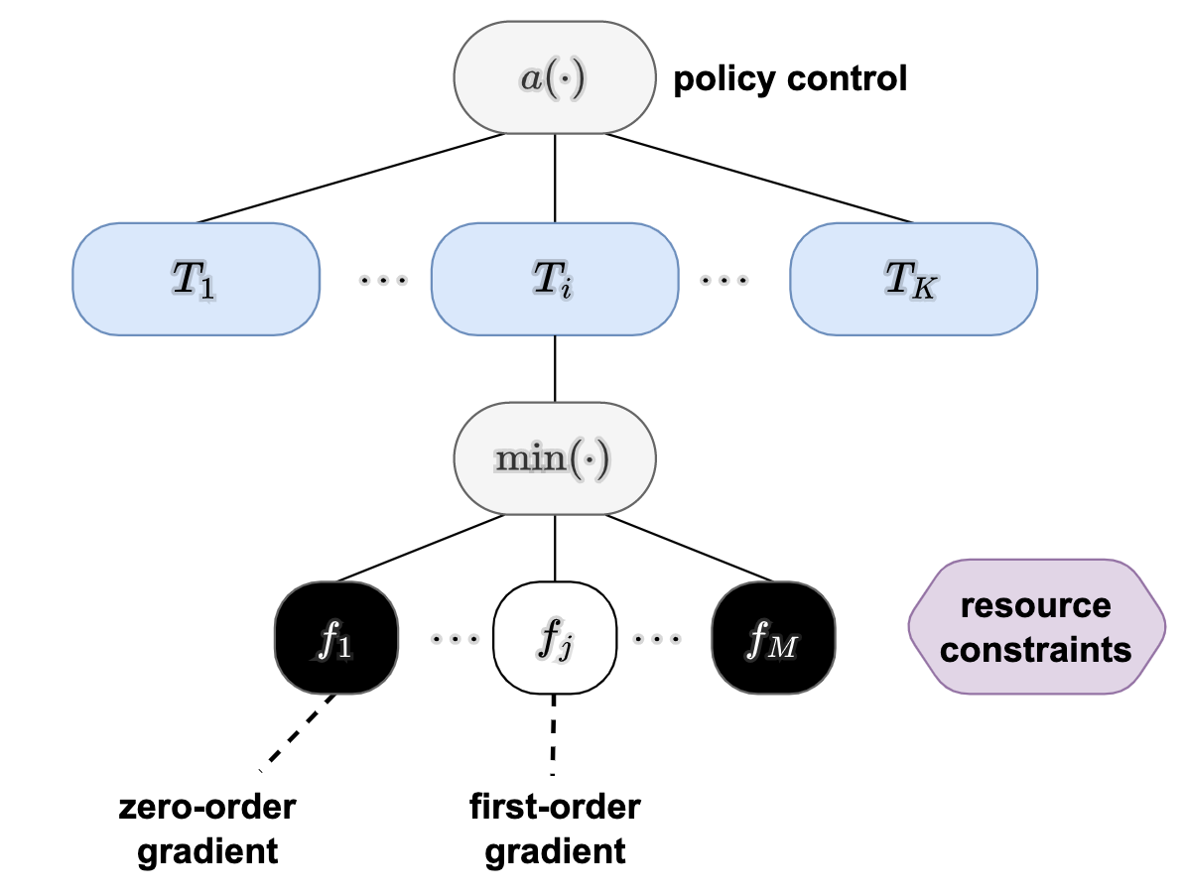
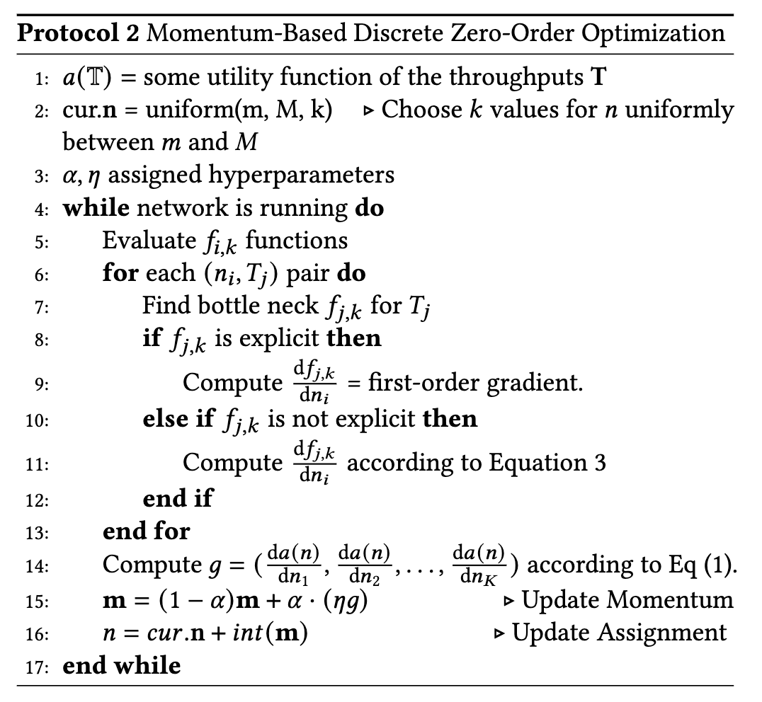
FTS’ Scheduling Framework

Slide 17
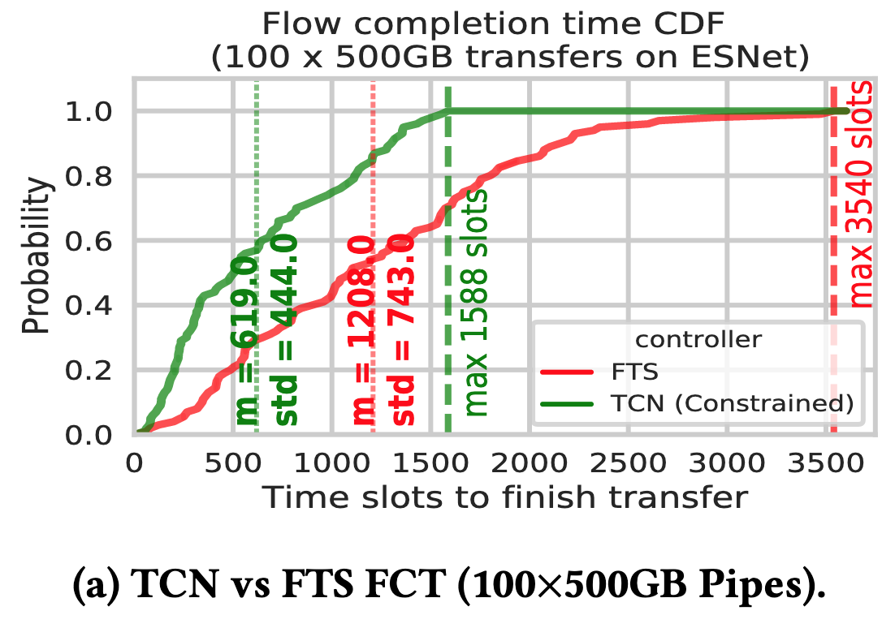
Preliminary Simulation Evals

Slide 18
Next Steps
Conduct systematic evaluation
Potential collaboration => work together
Deadlines
SIGCOMM NAI’22 invited paper (asap)
IETF 114 hackathon (July 24, ongoing)
SC’22 (Nov)
SIGCOMM’23 full paper

Slide 19
Backup Slides

Slide 20
Controllability of Only #TCP Connections
Single physical link
Assume background m links
The controllable space
{n/(n+m) C}_{n=1, …}
m = 0 => {C, C, C, …}
m = 1 => {1/2 C, 2/3 C, …}
m = 2 => {1/3 C, 2/4 C, …}
Pick a relatively large m to provide background traffic to generate a more controllable control space
The larger the value of m, the more fine-grained you can control

Slide 21
Stitching Multi-Domain ALTO Query
pipe -> srcIP, dstIP
ingress_src = srcIP
while (not reach dstIP)
path = Query ALTO server (ingress_src, dst/packet.attr)
ingress_src = path.last

Slide 22
Some Control APIs
Pipe
create-pipe(src, dst, user) // delete, modify as well
Resource control
<user, resource-set> -> bound | rel-weight
Transfer select -> transfer scheduling
push: add-transfer(data-info, pipe, before-after-sets-of-transfers; assignment to pipe---binding; early binding)
pull: upcall to higher layer (delay for the maximum flexibility; lazy binding)

