Slide 2

ALTO New Transport using HTTP/2 draft-schott-alto-new-transport-01
Roland Schott
Y. Richard Yang
Kai Gao
Jensen Zhang
March 23, 2022
IETF 113

Slide 3
Outline
Motivation and requirements
ALTO/H2 design
Discussions and open issues

Slide 4
Motivation
ALTO base protocol [RFC7285] is an HTTP/1.x client-pull protocol
ALTO/SSE [RFC8895] adds incremental server push using Server-Sent-Event, but is based on HTTP/1.x
Need additional control connection
Updates must be serialized
RFC8895 IESG review
Consider HTTP/2
------------------------------------------------------------------
| |
| +-------+ +-------+ 1. init request +------+ |
| | | | | <------------- | | |
| | | | | -------------> | | |
| 3.add/ | | | | 1'. control uri | | |
| remove | | | | | | |
| resource |Stream | |Update | | | |
-------->|Control| private |Stream | 2a. data update |Client| --
|Server |<------->|Server | messages | |
-------- | | | | --------------> | | <-
| response | | | | --------------> | | |
| | | | | 2b.control update| | |
| +-------+ +-------+ messages +------+ |
| |
------------------------------------------------------------------

Slide 5
ALTO/H2 Design Requirements
From ALTO base protocol [RFC 7285]
R0: Client can request any ALTO resource using the connection, just as using ALTO base protocol using HTTP/1.x
From ALTO SSE [RFC 8895]
R1: Client can request the addition (start) of incremental updates to a resource
R2: Client can request the deletion (stop) of incremental updates to a resource
R3: Server can signal to the client the start or stop of incremental updates to a resource
R4: Server can choose the type of each incremental update encoding, as long as the type is indicated to be acceptable by the client
From ALTO base framework [RFC 7285]
R5: Design follows basic HTTP Representational State Transfer architecture if possible
Can use only a limited number of verbs (GET, POST, PUT, DELETE, HEAD)
R6: Design takes advantage of HTTP/2 design features such as parallel transfer and respects HTTP/2 semantics [PUSH_PROMISE]
Allow flexible deployment
R7: Capability negotiation

Slide 6
Outline
Motivation and requirements
ALTO/H2 design
Overview

Slide 7
ALTO/H2 Transport Information Structure
_{ALTO} _{Server}
Static resource such as CostMap
Filterable resource such as FilteredCostMap
ir1
Information resource
INT/
Existing
Transport queue
tq1
tq2
tq3
tq4
New
tq1/uq
Incremental updates queue
tq1/rs
Receiver set
A single HTTP/2 connection between each client and the server
HTTP/2
HTTP/2
IPv4 headers
Clients
C1
C2
C3
C3

Slide 8
Futuristic SIGCOMM Challenge: Channel Spec
Multiple cases
L3/4: Information bits that already exist in the datapath, indicate the information
IPv4 header fields, DSCP, IPv4/6 options, tunneling protocol headers
Cross: Information bits that can be defined in a programmable network
P4 INT bits
L1/2: In particular in wireless, which Freq, Time Multiplexing, sends the network information
A way to define a universal (cross-layer) schema to specify the network information channel (https://; …)
Hierarchy, dependency
Security properties
Dummy design
Datapath packets:
can be lost (dummy: add redundancy); packet pattern may not be regular (dummy: send dummy packets)
Intermediates: HTTP based streaming server -> client => HTTP based streaming server -> revers proxy nginx -> client

Slide 9
A Framework to Transport Network Info to App

Slide 10
Main Todo
Specify the mapping of incr to physical bits (streams, e.g., HTTP/2, HTTP/3, IPv4/6 bits, …)
Need to do in a separate document
Write a SIGCOMM’22 NAI
Call for adoption of HTTP/2
Forward to request art review [http/2 feedback, but also http/3 feedback]

Slide 11
ALTO/H2 Transport Information Structure
Client opens a connection to the server
Client opens/identifies a transport queue tq
Client requests transport queue status
Client requests an element in the message queue
Client becomes a receiver
Client receives push updates
Client closes the transport queue
Client closes connection

Slide 12
Outline
Motivation and requirements
ALTO/H2 design
Overview
Transport queue

Slide 13
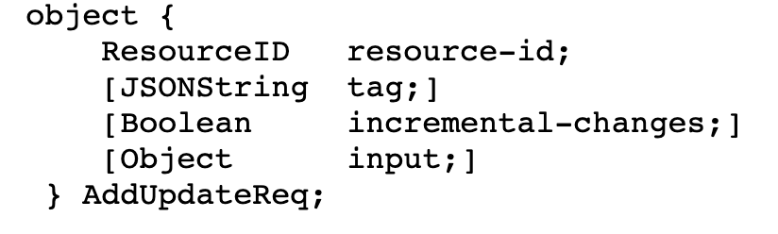
Transport Queue
Basic operations (CRUD): create, read (get status), delete
Client creates transport queue
POST to transport queues path
Request reuses ALTO/SSE input
HTTP :method=post with AddUpdateReq [RFC8895]
Response
<transport-queue> // add error codes, …, txt add error handling spec; give a pointer that stream management will be given in later section
Client reads transport queue: GET <transport-queue>
Client closes transport queue:
Explicit: DELETE <transport-queue>
Delete from local view (server may still maintain the transport queue for other client connections)
Implicit: Transport queue for a client is ephemeral: close of connection or stream deletes the transport queue from the client’s view --- when the client reconnects, the client MUST NOT assume that the queue is still valid
Notes:
The HTTP stream that created a transport queue is kept open until the stream is deleted or a non-recoverable error associated with the transport queue happens
The stream should be closed

Slide 14
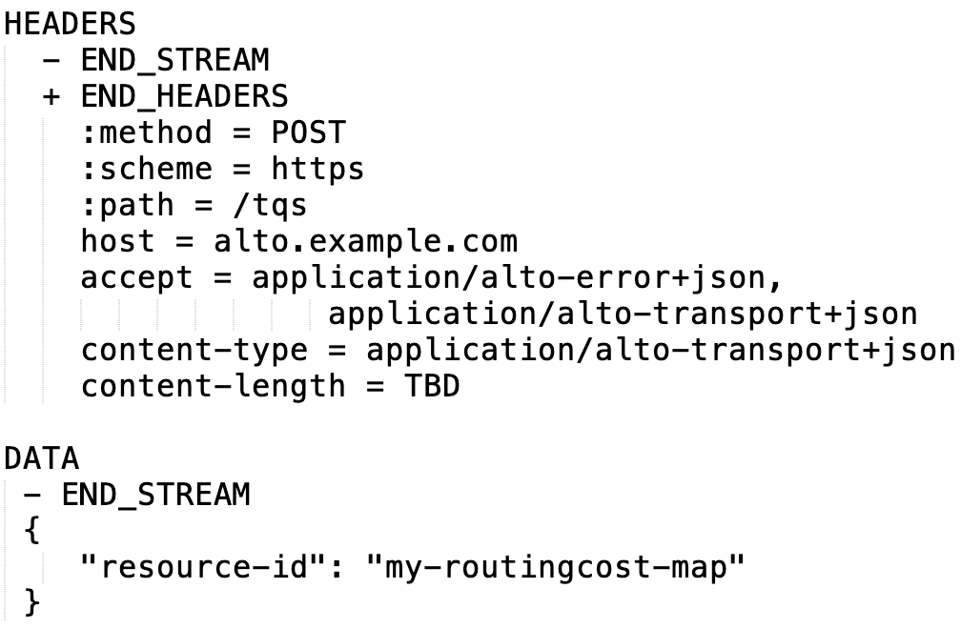
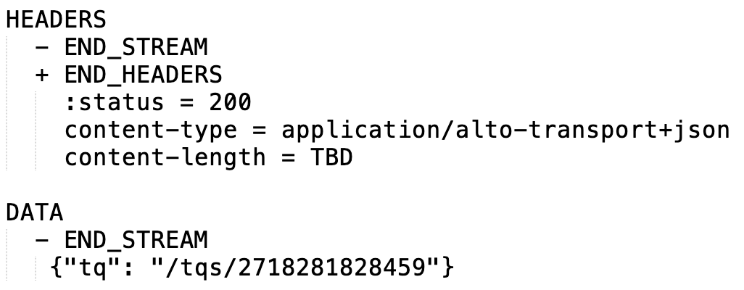
Transport Queue Example (Create)
Client -> Server request
Server -> Client response

Slide 16
Slightly Extreme Design
First use flow service to specify a flow
Endpoint flow cost service [L3, L4, 5Gtunnel]
Identifier: [srcIP, dstIP, sPort, dPort, protocol] => ECN
srcIP, dstIP => IPoption
Cost metric: ECN
Create a transport queue
Map incr update queue to the data path spec
incremental update queue (virtual queue embedded into the IPv4 stream)
IPv4/6:ECN bits, TCP transport options
Receiver set

Slide 17
SEND header transport-mapping-directive
SEND header-fields !end-stream
Specify mapping to HTTP/2

Slide 18
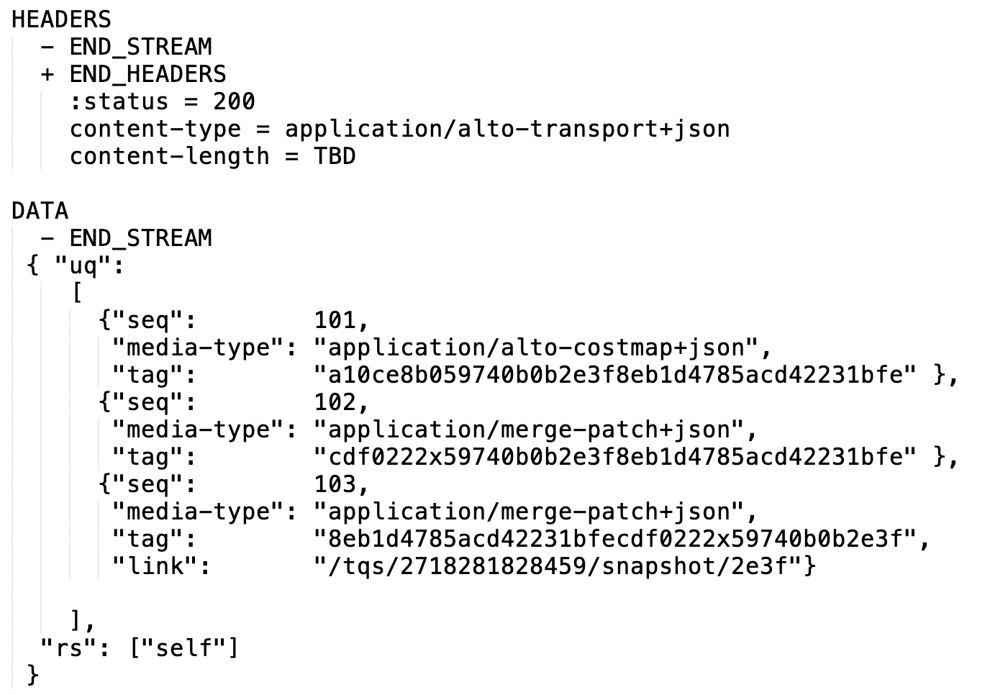
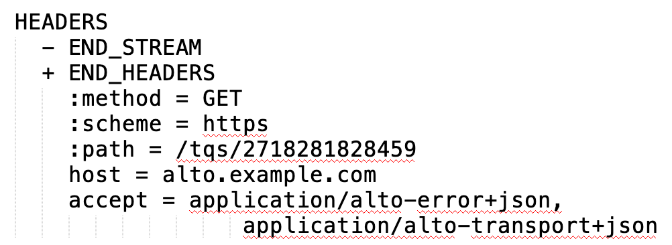
Transport Queue Example (Read)
Client -> Server request
Server -> Client response

Slide 19
Outline
Motivation and requirements
ALTO/H2 design
Overview
Transport queue
Incremental updates queue

Slide 20
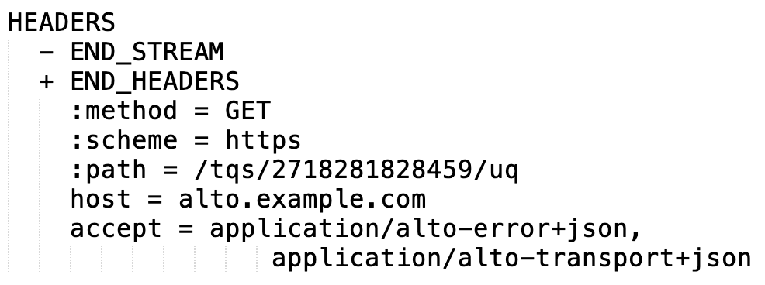
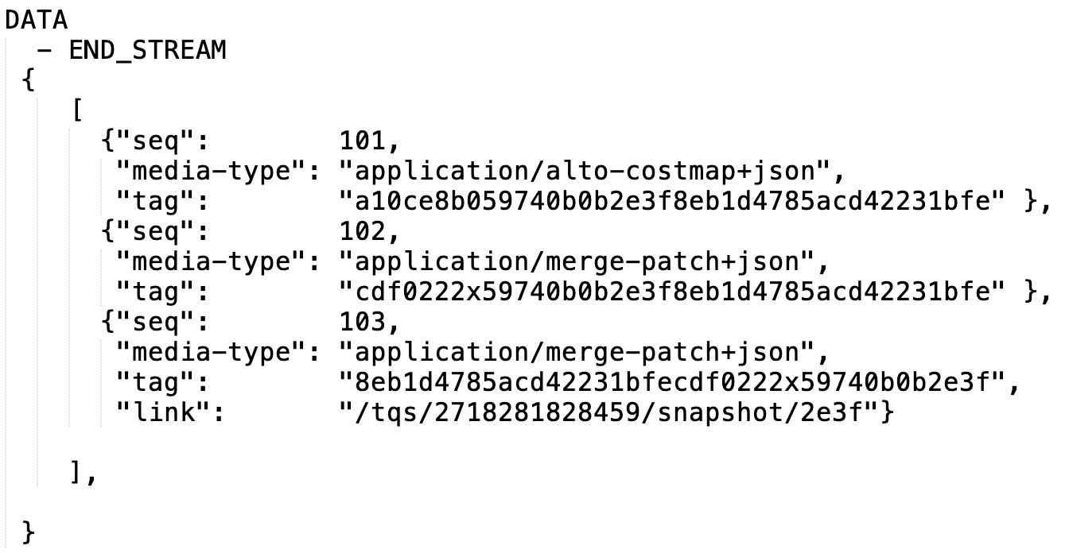
Incremental Updates Queue
Incremental updates queue basic operations (CRUD): read (get status)
Client cannot create, update, or delete incremental updates queue directly---it is read only, and associated with transport queue automatically
Read:
Input: <tq>/uq
Response: updates queue state // TODO: error
Add schema; responses have tags;
What if the seq number runs out
Seq# is integer,
Note
Server determines the state (window of history and type of each update) in the update queue [R4]
Read of updates queue status allows client to know
backlog status
workload to catch up (HEAD)
potential direct link
Request
Response data

Slide 21
Outline
Motivation and requirements
ALTO/H2 design
Overview
Transport queue
Incremental updates queue
Individual updates

Slide 22
Individual Incremental Updates
Individual incremental updates operations (CRUD): pull read or push read
Client pull
GET <update-uri>
Server push
Initialization:
the first update pushed from the server to the client MUST be the later of the following two
the last independent update in the incremental updates queue
the following entry of the entry that matches the tag when the client creates the transport queue
The client MUST set SETTINGS_ENABLE_PUSH to be consistent
State: the server maintains the last entry pushed to the client and schedules next update push
Per client, connection state
Client MUST NOT cancel (RST_STREAM) a PUSH_PROMISE
To avoid complex server state management

Slide 23
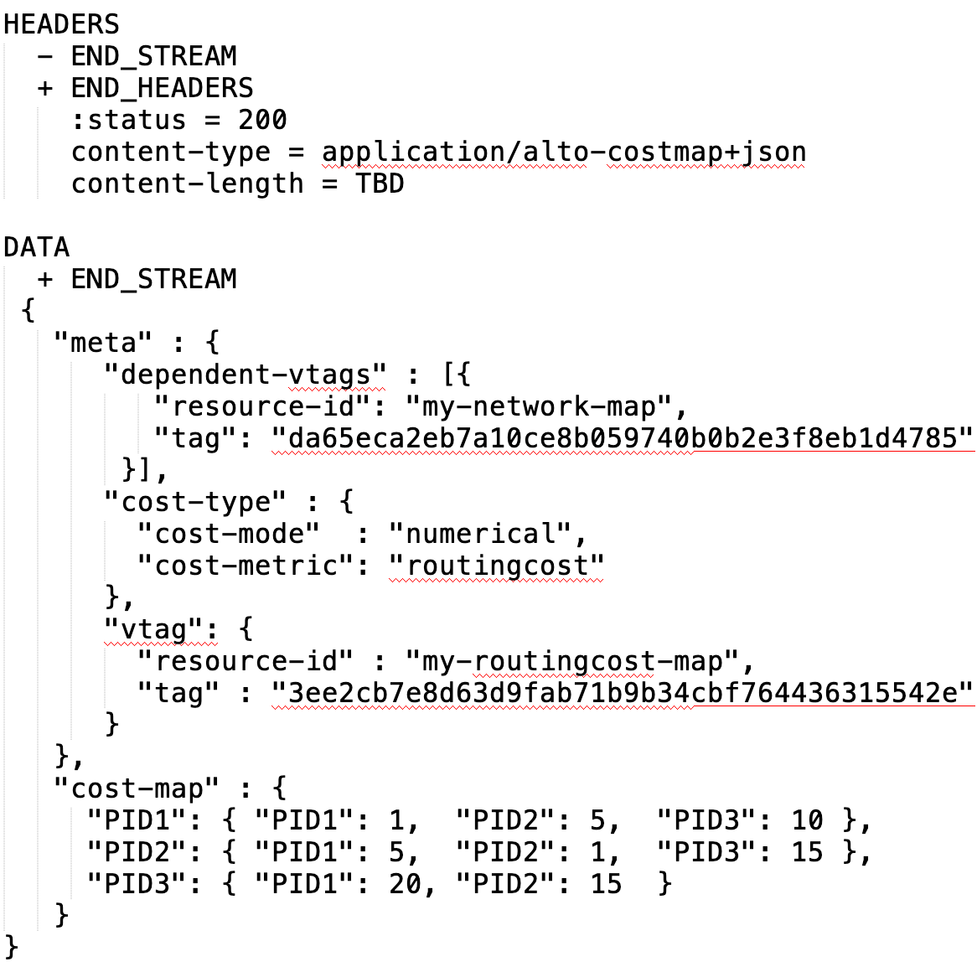
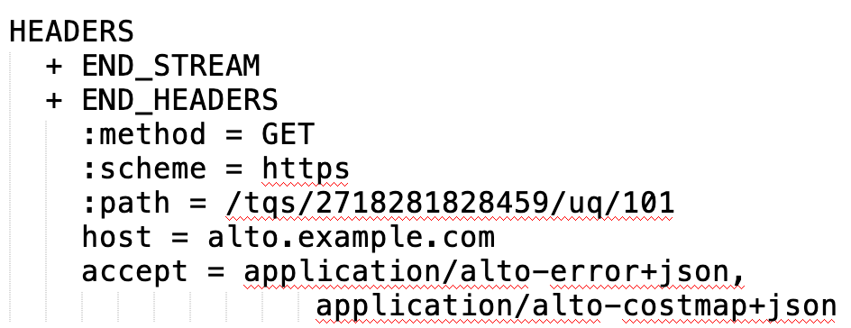
Client Pull Example

Slide 24

Server Push Initialization Example
First push, if client has no matching tag
First push, if client has tag matching previous entry

Slide 25
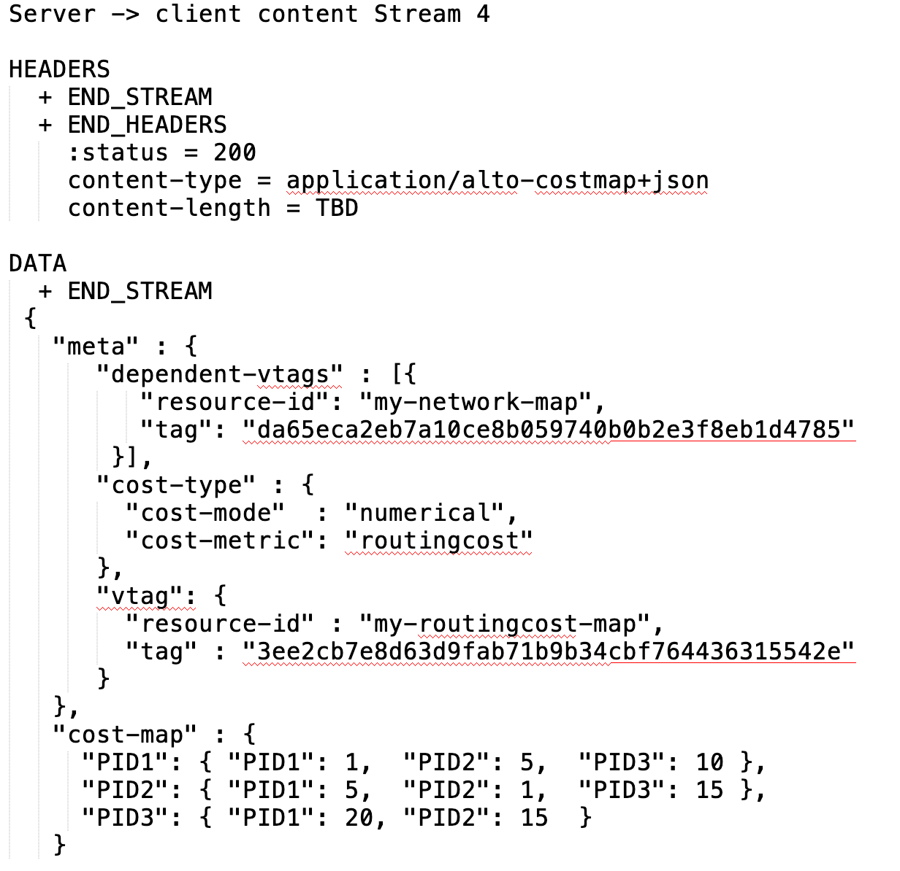
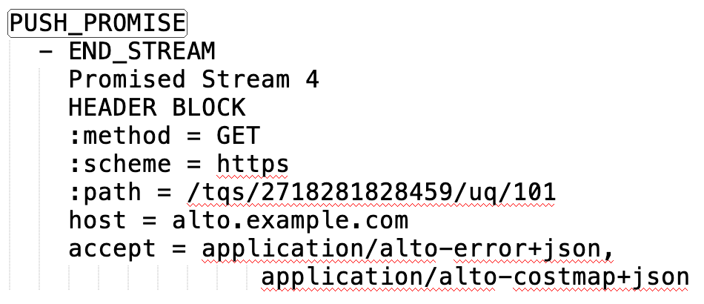
Server Push Transport Example
Each pushed update is indicated first in a PUSH_PROMISE

Slide 26
ALTO server (app controller)
Cong bit client -> server
ALTO client (app controller)
Network controller
src
dst

Slide 27
ALTO server (app controller)
Cong bit client -> server; cschannel = HTTP/2
ALTO client (app controller)
Network controller
client
server

Slide 28
ALTO server
Cong bit client -> server; cschannel = IPV4:ecn
ALTO client
sender
receiver

Slide 29
Instantiation
IPv4/v6
5G tunnel
P4
Socket API
..
Compression
Authentication
ALTO server (app controller)
Cong bit client -> server; cschannel = IPV4:ecn
ALTO client (app controller)
Info CP
sketch
Info DP
client
server
Raw info

Slide 30
Key Design Points – Dummy Design
Network node
FlowSpec Which packets (e.g., L3: IPv4, IPv6; L4: TCP flow, QUIC)
Dummy one is OpenFlow to specify flow match condition, or some IETF spec
LHS = RHS (e.g., x = a * 5; x = x + 5) { flow.<var> = <expr> //}
InfoSpec What info is put into (e.g., queue length) Yang model
RHS A set of attributes which is well specified, e.g., queue length, ECN, … (IANA numbers)
Instruction set: read, write, add, incr, count, sketch, … (very small crud)
FormatSpec In what format (existing or new)
LHS (address of the packet header space) IPv4 ECN bit, IPv4 optional header, IPv6 header (wireshark packet field spec)
WhenSpec When (e.g., every packet, sampling function, …)
When vocabulary: every packet|sample function (1/n, random…, )

Slide 31
Unified, App-Driven Network Monitoring [ALTO]
<match> <lhs> := <rhs>
Simple mapping to ipv4/ipv6
Compile to p4 headers
{ p4 header spec; p4 language } INT
Apps
ecn
HPCC (style; Alibaba/Harvard)
Demonstrate the benefit of joint coding between off-path and on-path
Off-path sends the long term info, and on-path sends the updates

Slide 32
Application-Driven Data-Intensive Data Sciences [Position]
Introduction
Architecture
Modeling
Jacob: make a model on the transport prediction [formulation]
Control
Scheduling system
QoE aware scheduling (bi-level) [Alex, Jensen]
Initial performance eval – mininet based eval
Science Workflows (Panda, HTCondor)
_{Access Layer}
_{Replication (Rucio)}
App Transport System (FTS): scheduling
xrootd, gridftp: basic 3rd transport
_{TCP/network transport}

Slide 33
Spec to use datapath for network info exposure consists of the following:
FlowSpec InfoSpec FormatSpec WhenSpec
Datapath-control: { flowspec:
infospec:
formatspec:
whenspec: }

Slide 34
<send-condition> <flow-selector> <LHS-pkt> := <RHS>
<update-local-state-cond> <flow-selector> <LHS-state> := <RHS>
_{send}
_{Update condi}
Update the local state
pkt

Slide 35
Match | Action
FlowSpec | Mark the info to be sent to the app Already typed system, e.g., IPv4 header format-><var> = <value> <- info Generic container // C struct, ie.., union data type <var>.attr = value

Slide 36
TODOs
Benefit analysis (settings)
Gap analysis (appendix to specify)
Challenges
Leverage existing packet formats

Slide 37
Fast information (mostly INT)

Slide 38
Outline
Motivation and requirements
ALTO/H2 design
Overview
Transport queue
Incremental updates queue
Individual updates
Receiver set

Slide 39
Receiver Set
Receiver set operations (CRUD): read (get status), delete (self only)
By default a client can see only itself in the receiver set
Appearance of self in the receiver set (read does not return not exists) is an indication that push starts
A client can delete itself (stops receiving push):
Explicit: DELETE <transport-queue>/rs/self
Implicit: Transport queue is connection ephemeral: close of connection or stream for the transport queue deletes the transport queue (from the view) for the client

Slide 40
Outline
Motivation and requirements
ALTO/H2 design
Overview
Transport queue
Incremental updates queue
Individual updates
Receiver set
Stream management

Slide 41
ALTO/2 Stream Management: Objectives
Objectives
Allow stream concurrency to reduce latency
Minimize the number of streams created
Enforce dependency among streams (so that if A depends on B, then A should be sent before B)
Encode dependency to enforce semantics (correctness)
TODO/Appendix: how to handle/map to HTTP/3 QUIC

Slide 42
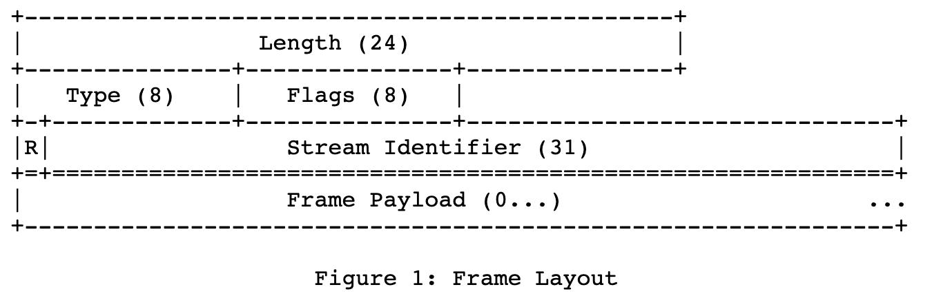
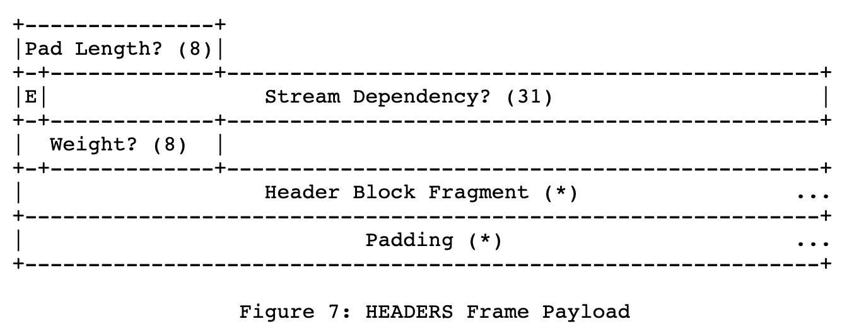
ALTO/H2 Stream Management: Specification
Client -> Server [Create transport queue]
Each request to create a transport queue (POST) MUST choose a new client selected stream ID (SID_tq)
Stream Identifier of the frame is a new client-selected stream ID; Stream Dependency in HEADERS is 0 (connection) for an independent resource, the other transport queue if the dependency is known
Invariant: Stream keeps open until close or error

Slide 43
ALTO/H2 Stream Management: Specification
Client -> Server [Close transport queue]
DELETE to close a transport queue (SID_tq) MUST be sent in SID_tq
Stream Identifier of the frame is SID_tq; Stream Dependency in HEADER is 0 (connection)
So that a client cannot close a different stream
HEADERS indicates END_STREAM; server response also close stream

Slide 44
ALTO/H2 Stream Management: Specification
Client -> Server [Request on data of a transport queue SID_tq, e.g., read message]
Stream Identifier of the frame is a new client-selected stream ID, Stream Dependency in HEADERs MUST be SID_tq
So that a client cannot issue request on a closed transport queue
Request indicates END_STREAM; response also indicates end of stream

Slide 45
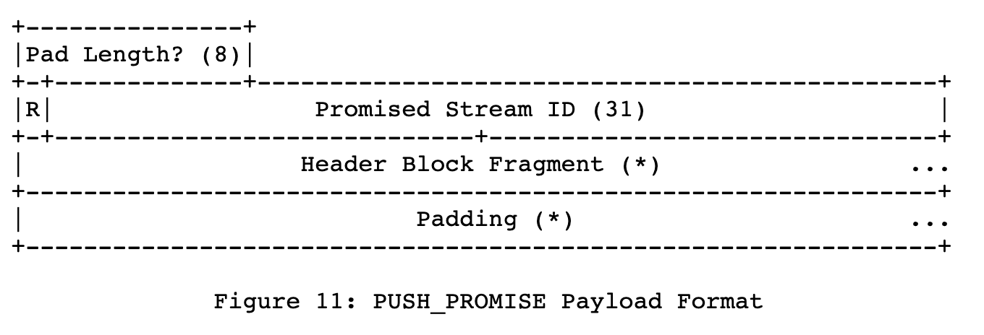
ALTO/H2 Stream Management: Specification
Server -> Client PUSH_PROMISE for transport queue SID_tq
PUSH_PROMISE sent in stream SID_tq to serialize to allow the client to know the push order
Each PUSH_PROMISE chooses a new server-selected stream ID
Stream is closed after push

Slide 46
Concurrent Streams Management
Controlled by SETTINGS_MAX_CONCURRENT_STREAMS
Client -> Server
There is one stream for each open transport queue
A client can always close a transport queue (it uses the open stream) and hence can open -> can close, without issue of deadlock
Server -> Client push
Each push needs to open a new stream

Slide 47
Outline
Motivation and requirements
ALTO/H2 design
Overview
Transport queue
Incremental updates queue
Individual updates
Receiver set
Stream management
Discussions and open issues

Slide 48
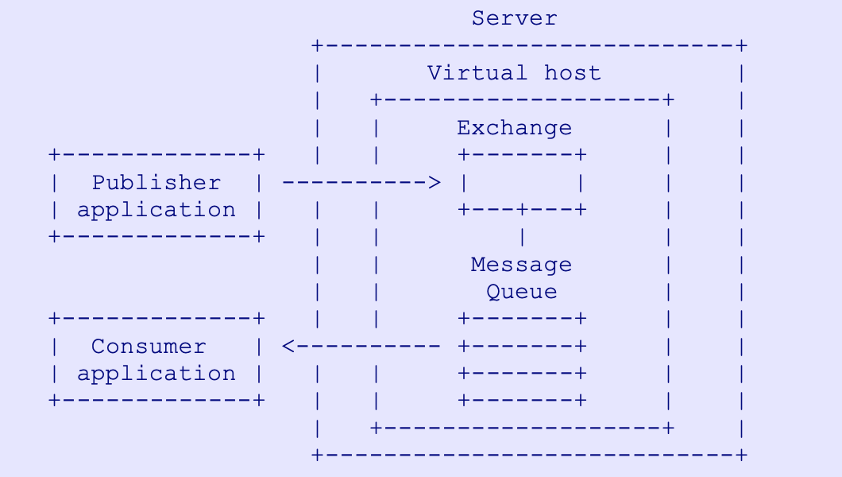
Transport and Pub/sub
What is missing
The design does not allow creation of generic message queues
Only the server can be the publisher
Clients publish info to be shared with other client
The design does not have the capability of Exchange (message router)
Way forward: Keep simple
Broker for further discussion
https://www.rabbitmq.com/resources/specs/amqp0-9-1.pdf

Slide 49
Additional Information about Transport Queue
Calendar semantics
Tell the client ALTO information (e.g., cost) for a future time point
Tell the client when the next information will be released, it is the time that the info is released is distributed, not the value [support]

Slide 50
Open Issues
Make a two-layered design [Need update]
Base layer
Instantiation into HTTP/2 and HTTP/3 separately
_{Base Design (tq, uq, rs, …)}
_{HTTP/2}
_{HTTP/3}

Slide 51
Decision
Separate base layer
First get a complete first version for HTTP/2
Next or earlier look into HTTP/3
Two sides of issues
Neg: HTTP/3 flexibility may cause issues for our design
Pos: HTTP/3 allows more flexibility which we can benefit from
Current design
PUSH_PROMISE are sent in the open stream and they all follow the same order
HTTP/3 allows all to be concurrent

Slide 52
HTTP2 -> HTTP/3 Issues
HTTP/2 frames are serialized into a single FIFO, reliable TCP connection
http2-send(stream-id, msg1) followed by http2-send(stream-id, msg2);
We know that msg1 will arrive before msg2
HTTP/3 frames use independent UDP data connections

Slide 53
Negotiation
Task: to fully specify the complete set of negotiation parameters
Use HTTP/2 (default), HTTP/3
Incremental updates queue encoding
Chosen by server, but must be specified as HTTP Accept header of client
Initial connection setup: client sends list of incr update mime types, and server returns the subset which it can use (Vary header in response)
Concurrency level (e.g., Rucio controller need to monitor info for a large number of clients) stream control

Slide 54
Backup Slides

Slide 55
Service | Type (Out if not labeled) | Core Information Structures | Main Size Var | Stability Expectation | Incremental Changes
Information Resource Directory [RFC7285] | application/alto-directory+json | Key-value store; Delegation | #resources | Stable | Add/delete resources
Network Map [RFC7285] | application/alto-networkmap+json | Key-value store: pid -> addrType -> array | #CIDRs | Stable | Add/delete CIDR from pid
Cost Map [RFC7285] | application/alto-costmap+json | Key-value store: srcPID -> dstPID -> value Depend on network map | #SRCPID * #DSTPID | More dynamic than network map | Update cost map entries
Filtered Map Services [RFC7285] | In: application/alto-networkmapfilter+json Out: application/alto-costmapfilter+json | In: selected srcPID, dstPID Key-value store: srcPID -> dstPID -> value Depend on network map | Filtered #SRCPID * #DSTPID | More dynamic than network map | Update cost map entries
Endpoint Property Service [RFC7285] | In: application/alto-endpointpropparams+json Out: application/alto-endpointprop+json | In: addr + prop Key-value store: addr -> prop -> value | #addr * #prop | Depend on property, can be dynamic or stable | Update property value
Endpoint Cost Service [RFC7285] | In: application/alto-endpointcostparams+json Out: application/alto-endpointcost+json | In: srcAddr x dstAddr Key-value store: srcAddr -> dstAddr -> value | #src * #dst | Can be more dynamic than cost map | Update cost value
Cost Calendar [RFC8896] | Extension to CostType | Calendar array | Previous * #num_intervals | Can be dynamic | Calendar window moves
Unified Property | In: application/alto-propmapparams+json; Out: application/alto-propmap+json | In: addr, prop Key-value store: addr -> prop -> value | #addr * #prop | Depend on property, can be dynamic or stable | Update property value
Path Vector | In: see costmap; Out: multipart/related;type=application/alto-costmap+json, | Cost map + unified property map | #src * #dst * #vec size | Depend on metric, can be dynamic or stable | Update path vector
CDNi Cap & Footprint | application/alto-cdni+json | Array; {capability-type: capability-value} | #footprint * #capability | Can be dynamic, bursty | Update capabilities

Slide 56
Performance and Effectiveness of Current Transport
Infrastructures | Basic Workload (ALTO SPEC) | Transport | Collecting metrics
Benocs is fully open to use its infrastructure as an evaluation environment Greater Bay Network is also fully open to use its infrastructure as an evaluation environment | (Filtered) Cost map: distribute inter-site performance metrics and calendar; routing changes + link dynamics => updated metrics Endpoint/unified property service: endpoint access status query/updates/bwe CDN node footprint & capability Flow direction (pointing to CDN nodes) using ECS Path vector providing available reservable bandwidth | HTTP/1.x per request full retrieval keep alive pipelining HTTP/2, HTTP/3 per request, full retrieval ALTO/SSE RFC8895 (on HTTP/1.x) | ALTO Server processing load ALTO client processing load Transport load (bytes) Transport latency Throughput Scalability

Slide 57
General Space of Network->App Information Transport
Protocol/Base Reference | What information | How transported | Frequency
ALTO/RFC7285, RFC8895 | Network map, cost map, unified property, … | HTTP/1.x client/server | Request/response; ALTO/SSE incremental push
ECN/RFC3168 | Congestion notification | 2 bits in IP Traffic Class header; ECN-Echo/CWR flags in TCP header | Per packet marking
NEF, SCEF<->AS/3GPP, … | Network capabilities/events -> AF | HTTP | Request/response
…

Slide 58
Working Items
JSON-LINK as data model [TBD]
Benchmarking deployment and initial reports [Richard, Danny]
openalto.org
Open platforms, all are welcome to join
Initial draft surveying of Net->App information and transport in major SDOs [Roland, Chunshan, Richard]

Slide 59
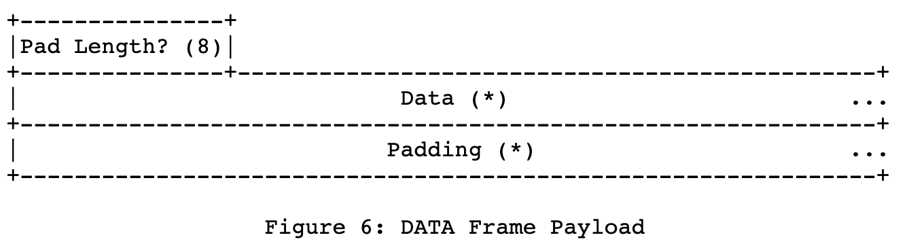
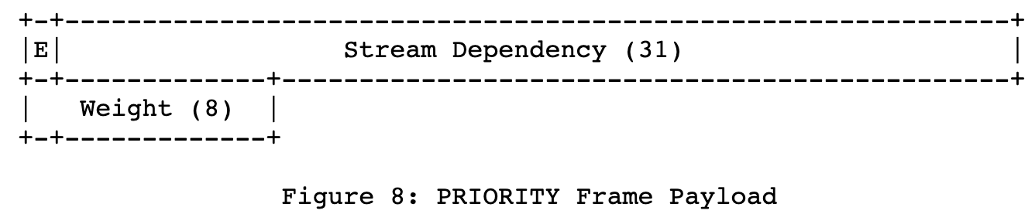
The value 0x0 is reserved for frames that are associated with the connection as a whole as opposed to an individual stream.

Slide 60
Outline
High-level goal: openalto development, deep involvement of CERN team
Tool: NAI submission(s)

Slide 61
Direction 1: Systematic Optimization
_{BW Allocation Formulation}
Bi-Level Opt: Lower level is the real network BW alloc
_{BW Allocation Formulation}
_{DNN Modeling (GNN Model)}
+ Adjust if the model is not accurate, introduce DNN to adjust
_{BW Allocation Formulation}
_{DNN Modeling}
_{Blackbox Closed-Loop Control}
+ Adjust if the model is not accurate, introduce DNN to adjust
z,ztz = 1
O(1/k) -> O(d/k)

Slide 62
What’s new, what is substantial (hard)? What is the benefit?
Automatic workflow 3.3 use case (opt, QoE function, minimize the control overhead/leverage underlying fairness as much as possible)
Intro
Problem definition (flows are fixed and long term)
Overview and framework
Eval
Conclusion and future

Slide 63
Direction 2
Focus on batch setting first
Formulation
A set of rules {Ri}
Ri: a set of current sources Si, a super set of candidates Ci, and need to pick Di \subset Ci s.t. |Di| = ni
E.g., 2 nodes (Si) have data item i already, Ci nodes (4 nodes) can potentially host the data, and the target is have to 4 copies
Pick 2 from Ci
Note: it can be more complex, for example, pick one copy from EU, one from NA, …
Each Rule Ri has a rule completion time RCTi
Compute the optimal selection and scheduling of transfer rates
F{RCTi} // assume a simple min_SelxSch {max RCTi} // average might be in that it can extended to incremental case // later consider download; goal is robustness; later add download
Technical content
NP hard (proof is a nugget; bin packing)
How to come up w/ a reasonable algorithm

Slide 64
Complexity
Selection problem Select Di out of Ci
Millions of rules, Ci can be on the order of tens of nodes, Di might be only 2 or 3
Bandwidth estimation problem
BW allocation (cubic, max-min) //
Future
Rules can be dynamic (users add new data and their rules)

Slide 65
TODO: Lower Bound
Dummy lower bound: the finishing time [bear 1]
Assume each node is rate limited only at the edge; no bottleneck in the internal network
Total supply of upload bw of all sources
Mi is the file size for data item I
Sum_i(Mi * ni) / Sum(BWUij) // this bound can be loose

Slide 66
TODO: Initial Alg (Strawman I)
Step 1: assume the Di’s are chosen // main criticism: per rule auto
Scheduling problem: each dst in Di will maintain a connection with each src and other members of Di
Chop the file into fixed chunks (64M, 16M)
Assume the list at download j is Lj (potential sourcers), each member in Lj has a state rj (moving average of downloading rate)
Each interval T (10 sec)
Swarm will exchange bit map about chunk availability
Each will request from those chunks that it needs
Each will unchoke the top 4 sourcers
If (it is the 3rd interval) one of the 4 is a random to be unchoked

Slide 67
TODO: Initial Alg (Strawman IIa)
Step 1: assume the Di’s are chosen and routes are given
Millions of rules, but only 10s or at around lower 100 nodes
Formulation
Virtual nodes to link each rule Ri’s sources
Add a destination for each rule and dst
System state at any instance
Set of flows are VS_i -> VS_ij … -> Tdik if Tdik has not finished downloading
When a dst finishes downloading, the flows for the dst are deleted
_{TDij}
_{VS_i}

Slide 68
TODO: Initial Alg (Strawman IIb)
Step 1: assume the Di’s are chosen and routes are given
Millions of rules, but only 10s or at around lower 100 nodes
Formulation
Virtual nodes to link each rule Ri’s sources
Add a destination for each rule and dst
System state at any instance [finished dst can become a src]
Set of flows are VS_i -> {VS_ij} … -> Tdik if Tdik has not finished downloading
When a dst finishes downloading, the flows for the dst are deleted
_{TDij}
_{VS_i}
Notes:
10^6 rules, 2 srcs each rule and 3 dst each rule: 10^6 * 2 * 2 flows in a graph of 10s-100s of nodes;

Slide 69
Aggregation and Compact
Virtual-node flows a few millions
Representation:
(src_phy, dst_phy, #n)

Slide 70
Technical Content
Assumption
Case 1: Can rate limit each flow as needed [upper bound of potential]
Assignment 1: come up the best alg you can
Case 2: running a congestion control protocol + tc for a small number K of flows [real deployment]
Assignment 2: give an initial alg for this setting
BitTorrent alg [BEAT this; swarming, 70%]
Case 2: max min fairness [conceptual]
Content:
Design a control plane for the scheduling framework (replicated, consistency, multi-domain, fault tolerance)
Simple greedy alg:
Kai’s greedy alg which picks the maximum flow
Eval: the performance of the alg compared to simple alg

Slide 71
Basic Formulation
di in Di, pick the lowest cost si in Si using ALTO cost map

Slide 72
Design 1
Order: 10s-100s of sites; can be millions of rules i
Fixed set Di from Ci is already given; sij -> dik (sizes) is given
Step 1: Compute the bw allocation to each flow using max-min fairness (the state will change as a flow finishes)
Aggregation // as quickly as possible
Initial solution:
Aggregate the flows according to src-dst RSE pairs (100x100 10K)
Input becomes <src-dst-rse-pair, #flows>
For each link, compute the fair share (L_C / sum(#flows, src-dst-rse-pair uses link L)
…

Slide 73
Naïve Design 1
Naïve data structure
Each flow is identified by an flow id
Each flow’s route is stored in an array indexed by flow id, route[1][0], … index links
Each flow’s size is stored in an array indexed by flow id size[flow_id]
Water-filling using naïve data structure will be very bad
Loop // Major places for improvements: (1) incremental max-min, lower the #flows
compute_fair_share of each
compute the finishing_time of each flow // compute w/ the min (size_f / r_f)
remove the flow from the flow list
Compute share
Foreach link l // total #link times #links * (2 #flows + # links)
Scan the route array
flow_counts[L] ++ if route[i][j] == L // compute the
Compute fair share
Lset = argmin(L: C[L]/flow_counts[L] ) // more like heap priority queue // optimization
Scan the route array
route[i][k] == DELETED if route[i][j] == L

Slide 74
Naïve Design 2-3
Based on 1
Aggregate the flows by src-dst-rse-pairs // Q: how to store the sizes
// likely depends on the special structure of max-min fairness
Incremental bottleneck structures
Even “parallel-structure” of computation

Slide 75
Design 4
Compute the rate when it is not max-min fair share
NUM design // go back to optimization, but we want to explore the algorithmic side first
TCP Cubic/Reno
Assign each link a loss rate p_l
Each flow’s rate: alpha MSS / RTT / \sqrt(q_i)
q_f ~ sum p_l
If the bottlenecks are at the edges, then it may not be too bad

Slide 77
Alg.
Initialization
Each link has a loss of fully utilize total capacity for shortest RTT

Slide 78
Remaining Issues to be Done
Selection of Ci
…

Slide 79
Stability Condition
Finite system: S1, … SN, and the system must drain all flows by T
Stability condition for any j: \sum Si_{i=j, N} <= C (T – Tj)
Sj
SN
Sj+1
Sj+2
Define backlog upon flow I arrival
Service curve definition
A(t) – S(t) will not go to infinity

Slide 80
Arrival curve

