Slide 1

ALTO New Transport using HTTP/2 draft-ietf-alto-new-transport-01
Roland Schott
Y. Richard Yang
Kai Gao
Jensen Zhang
July 26, 2022
IETF 114

Slide 2
Outline
Document activities
High-level recap
Major changes from IETF 113
Discussions and remaining issues to finalize

Slide 3
Document Activities
Adopted as working group (WG) document
draft-ietf-alto-new-transport-00 submitted on June 22, 2022
Updates to fix review feedbacks
Many helpful feedback from WG chairs (Med and Qin) and members (Luis, Sabine, Jordi)
draft-ietf-alto-new-transport-01 submitted on July 10, 2022
Three excellent, early HTTP expert reviews
[MT] Martin Thompson (July 11)
https://mailarchive.ietf.org/arch/msg/alto/sa1Pv7jmTfBF3TbGuJr_PffIjXg/
[SD] Spencer Dawkins (July 15)
https://datatracker.ietf.org/doc/review-ietf-alto-new-transport-01-artart-early-dawkins-2022-07-15/
[MN] Mark Nottingham (July 17)
https://mailarchive.ietf.org/arch/msg/alto/D84S0qLbgtpL0-jf93gNPS3NUJE/
More discussion details see WG mailing list archive

Slide 4
Recap: ALTO New Transport Design Requirements
From ALTO base protocol [RFC 7285]
R0: Client can request any ALTO resource using the connection, just as using ALTO base protocol using HTTP/1.x
From ALTO SSE [RFC 8895]
R1: Client can request the addition (start) of incremental updates to a resource
R2: Client can request the deletion (stop) of incremental updates to a resource
R3: Server can signal to the client the start or stop of incremental updates to a resource
R4: Server can choose the type of each incremental update encoding, as long as the type is indicated to be acceptable by the client
From ALTO base framework [RFC 7285]
R5: Design follows basic HTTP Representational State Transfer architecture if possible
Can use only a limited number of verbs (GET, POST, PUT, DELETE, HEAD)
R6: Design takes advantage of HTTP/2 design features such as parallel transfer and respects HTTP/2 semantics [PUSH_PROMISE]
Allow flexible deployment
R7: Capability negotiation

Slide 5
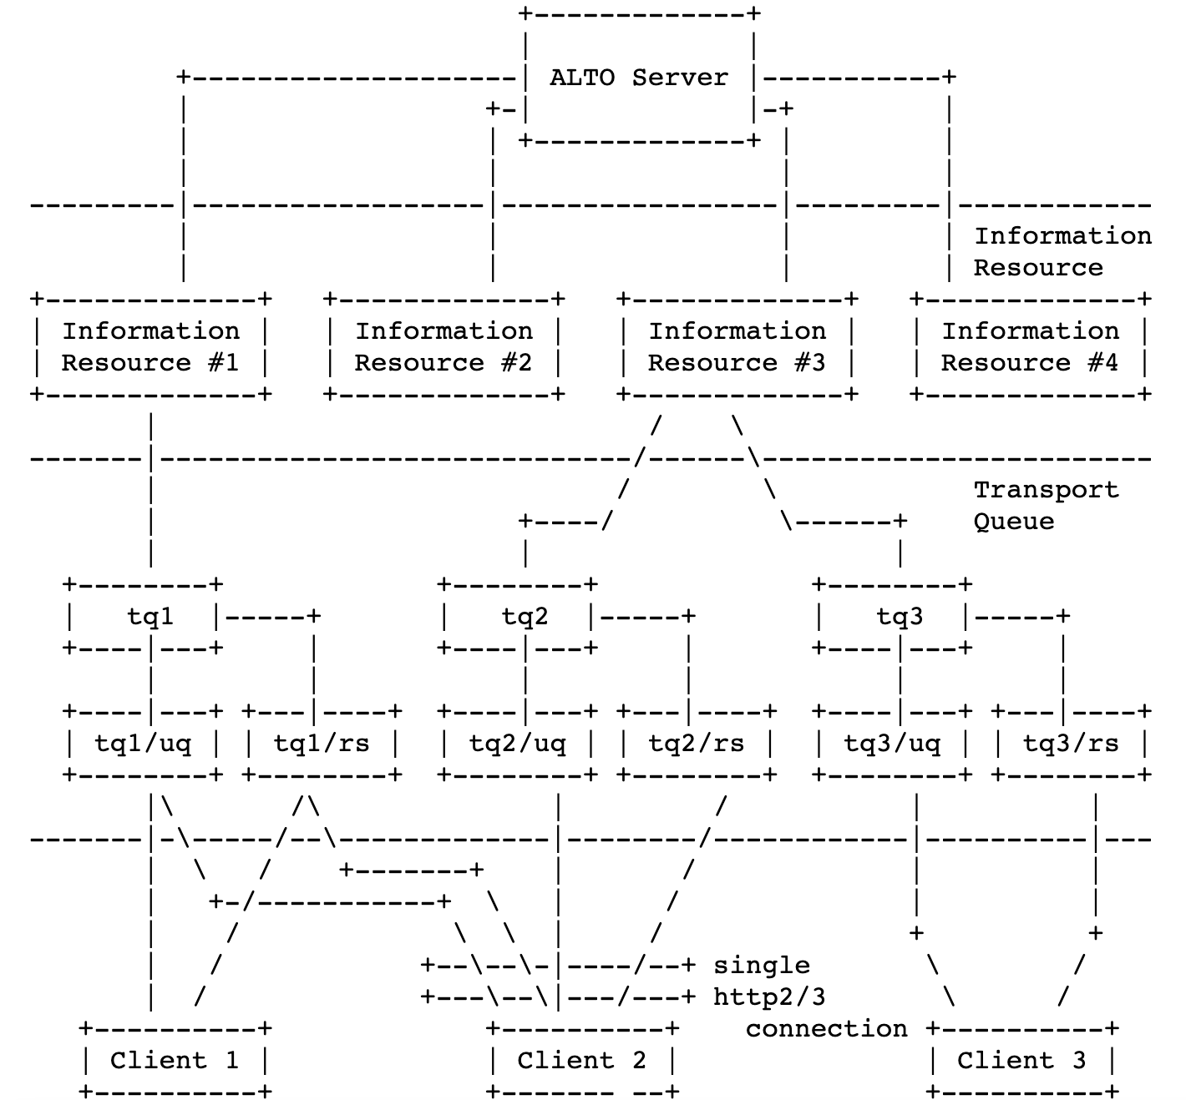
Recap: New Transport Architecture
An ALTO server provides multiple info resources {R[i]}
URIs announced in Information Resource Directory (IRD)
An ALTO client uses a single HTTP/[2-3] connection to receive the content of multiple resources
Content of a resource with updates stored in an update queue (URI)
Client can pull items in the update queue from server or server can push items in the update queue to client

Slide 6
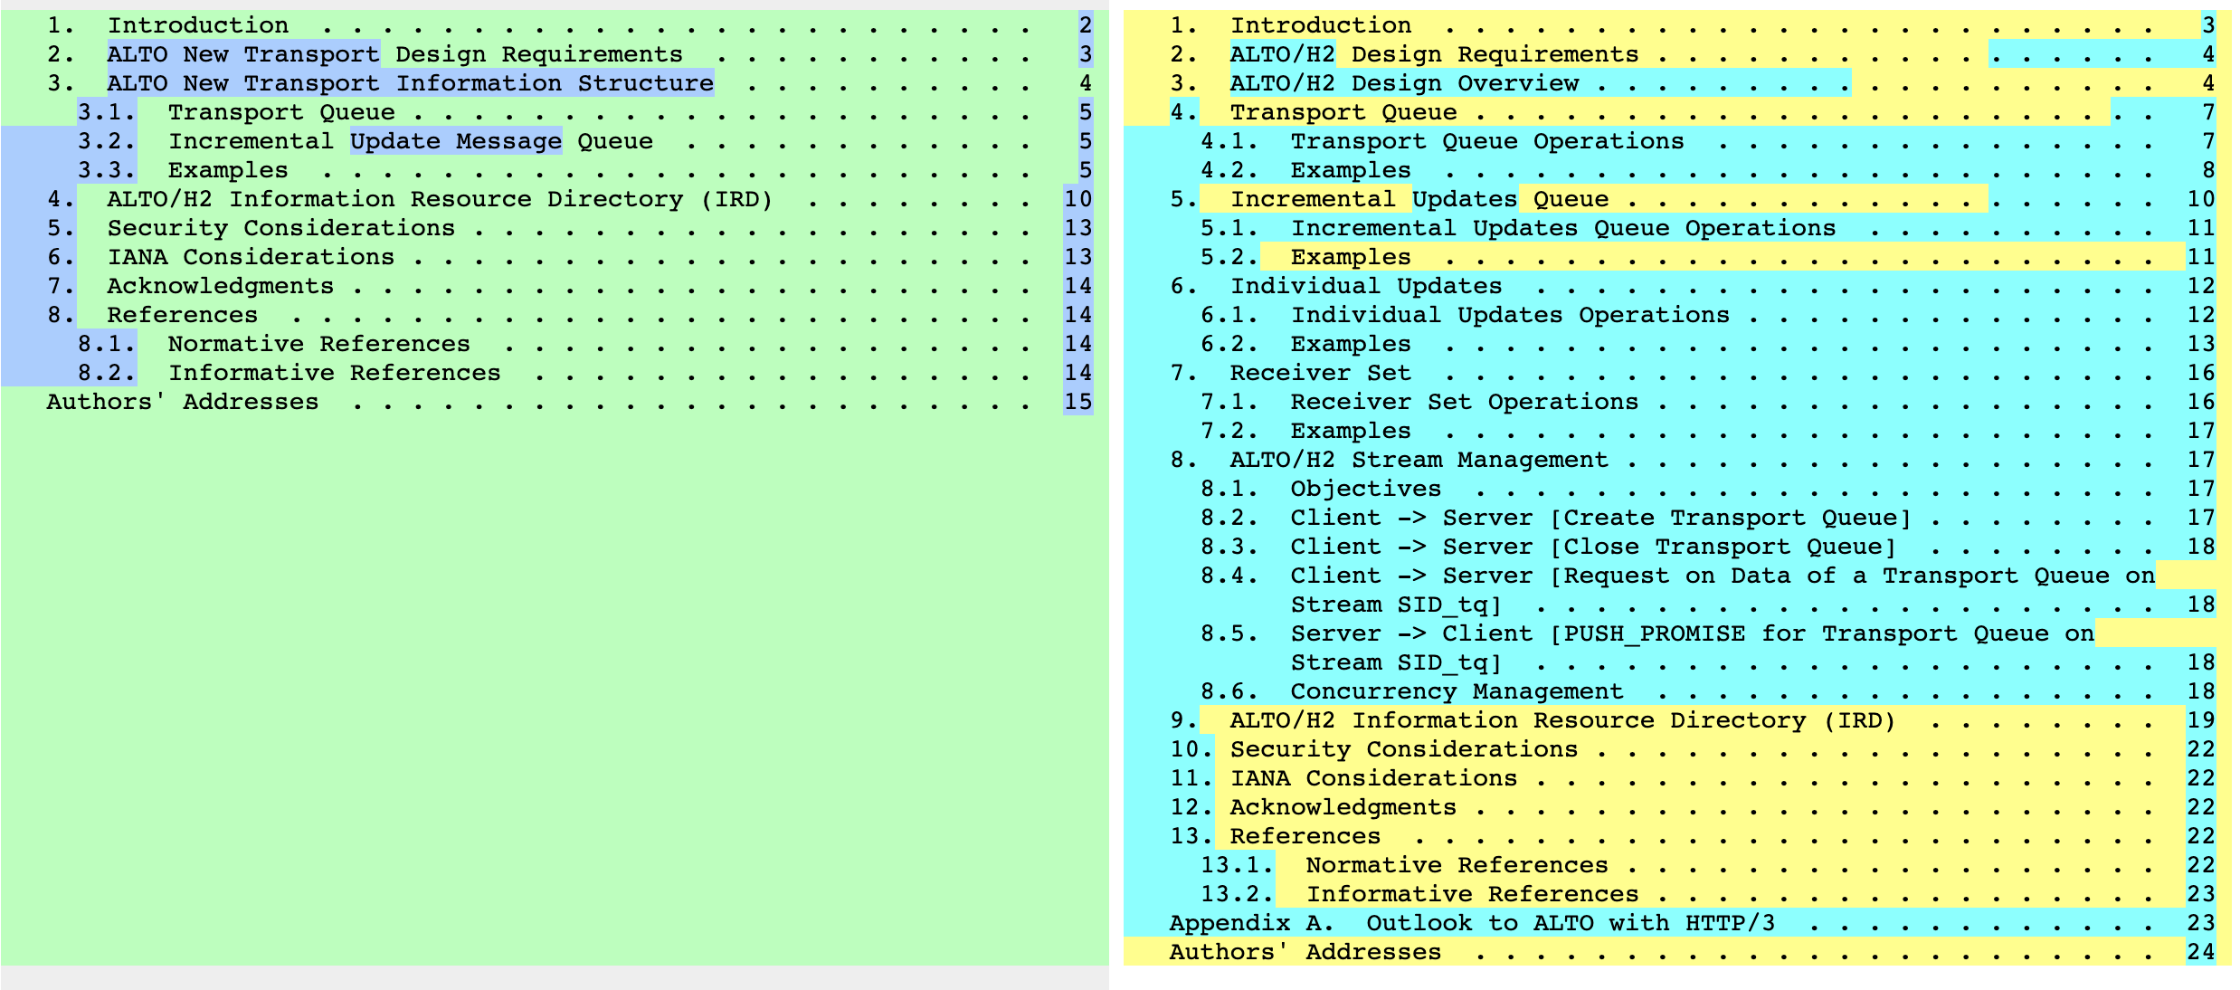
Major Changes from IETF 113
Substantial updates to specify protocol details
Notes:
https://www.ietf.org/archive/id/draft-schott-alto-new-transport-00.txt
https://www.ietf.org/archive/id/draft-ietf-alto-new-transport-01.txt

Slide 7
Discussions and Remaining Issues
Excellent comments and discussions from HTTP experts
Main remaining issues for the WG are to finalize the concurrency control and semantics of the transport of the information items
They may represent generic problem for HTTP/[2-3] design
The finalization of the remaining issues does not look like to need substantial texts, but need careful WG decision and specification

Slide 8
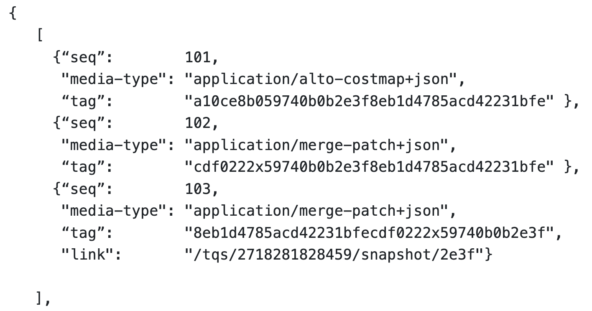
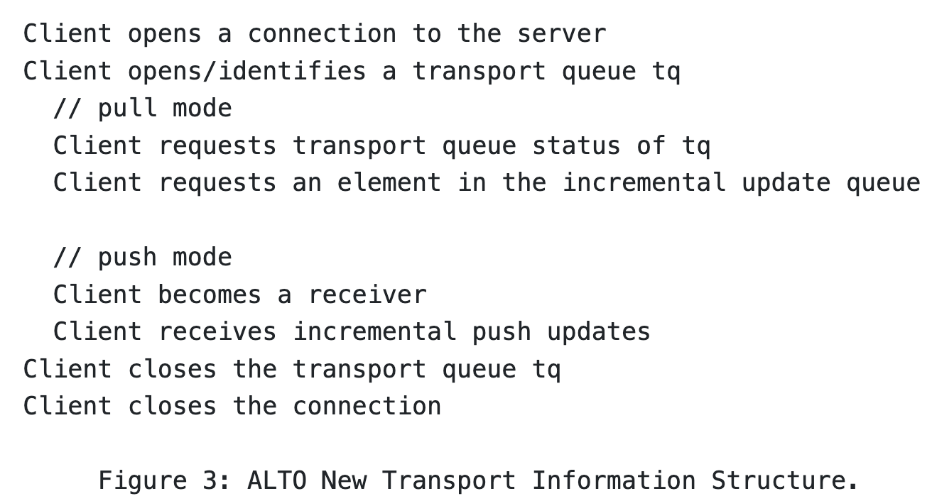
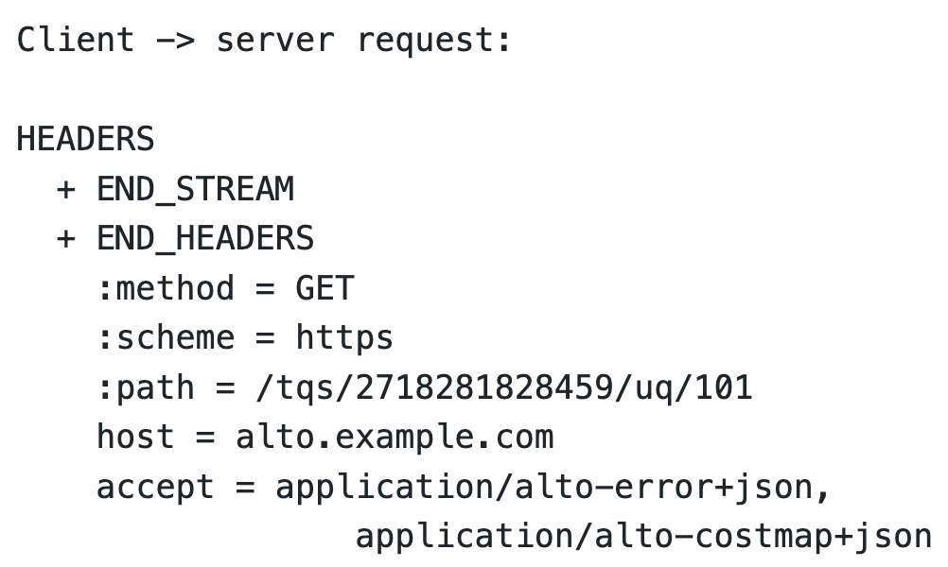
Discuss 1: Finalizing Op Mode: Client Pull/Server Push/ Client Long Pull/Server Put
Current mechanisms
Client pull

Slide 9
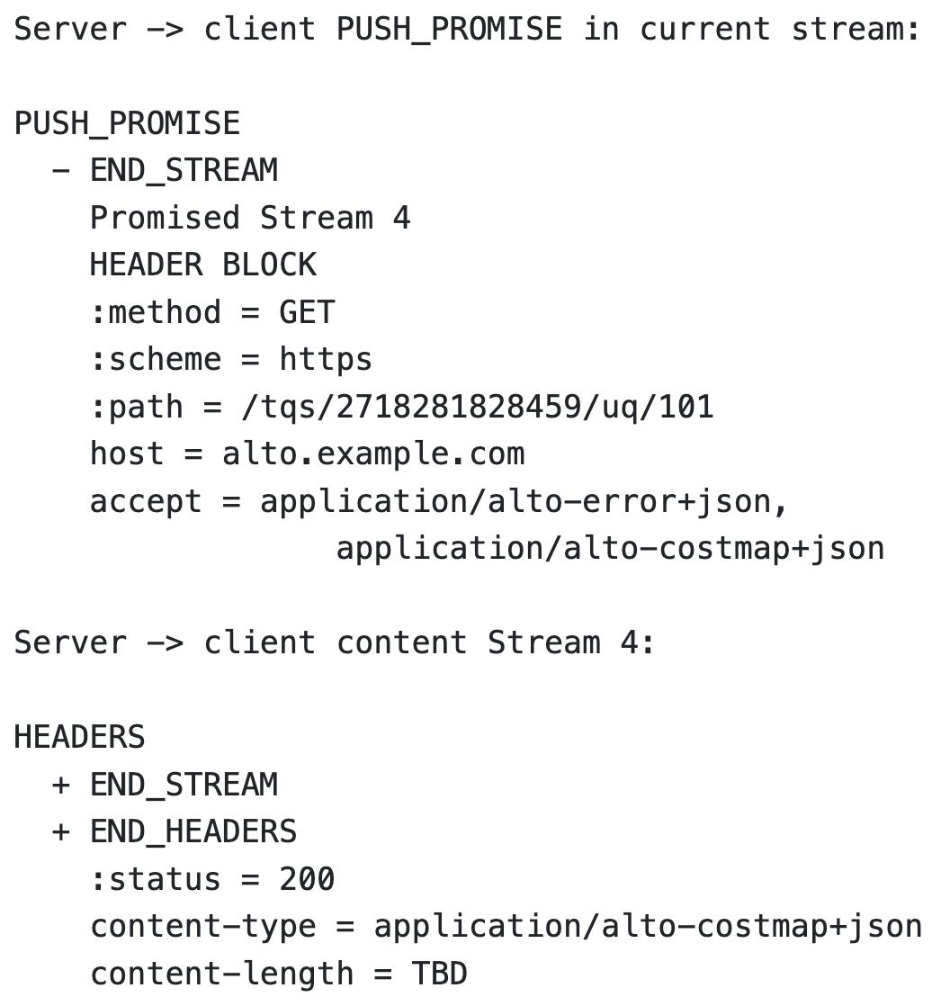
Discuss 1: Finalizing Op Mode: Client Pull/Server Push/ Client Long Pull/Server Put
Current mechanisms
Client pull
Server push (push_promise)

Slide 10
Discuss 1: Finalizing Op Mode: Client Pull/Server Push/ Client Long Pull/Server Put
Incremental push alternatives [MN review]
Client long pull
Allow request on next seq number
104

Slide 11
Discuss 1: Finalizing Op Mode: Client Pull/Server Push/ Client Long Pull/Server Put
Incremental push alternatives
Client long pull
Server put [MN review]
Benefit:
Avoid “awkward” promise (current spec: MUST NOT cancel push promise)
Issue: semantics
Client conceptually is only a cache, not a persistent state replica
PUT

Slide 12
Discuss 2: How Much to Specify Ordering Control: Transport-Aware of App Semantics [MN, MT, SD reviews]
App/ALTO
network map 1
network map 1 patch 1
R1
R2
Design 1:
ALTO specifies only: mapping each Ri to an independent HTTP/2-3 stream; HTTP does scheduling.
Issue: HTTP could schedule R4, then R3, then R2 and then R1 in transmitting order
R3
R4
cost map 1
cost map 1 patch 1
Design 2:
ALTO specifies that server submits to the HTTP transport in DAG order: submit Ri only when what Ri depends on are finished: R1; R2/R3, R4
Issue: Sliding window is large and transport can fit R1/R2/R/R4 into a single window
HTTP/2-3 server
R1
R2
Design 3:
ALTO indicates the dependencies to HTTP
Issue: HTTP client can indicate a parent in req header, but this is signaling from client to server; what we need are (1) app signaling to HTTP server, (2) multiple dependencies
R3
R4

Slide 13
Discuss 3: How/Whether to Specify Settings
Current draft allows client to specify two (HTTP/2) control knobs on server behaviors
0x02 SETTINGS_ENABLE_PUSH (a BCP14 “MUST”)
0x03 SETTINGS_MAX_CONCURRENT_STREAMS (a BCP14 “must”)
HTTP/3 changed these settings (RFC9114) [SD review]
SETTINGS_ENABLE_PUSH (0x02):This is removed in favor of the MAX_PUSH_ID frame, which provides a more granular control over server push. Specifying a setting with the identifier 0x02 is HTTP/3 error.
SETTINGS_MAX_CONCURRENT_STREAMS (0x03):QUIC controls the largest open stream ID as part of its flow-control logic. Specifying it is HTTP/3 error
Discussion: (1) remove them in the spec and discuss them in operations; (2) specify generic requirements statement

Slide 14
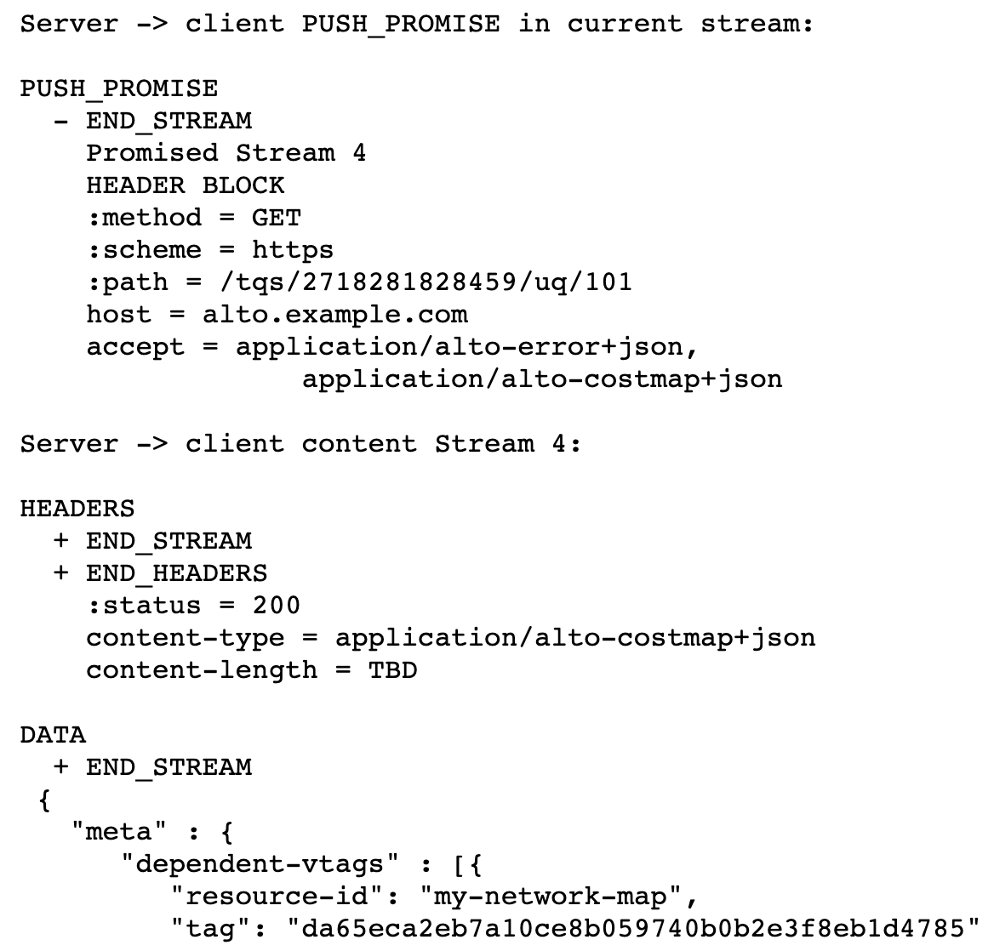
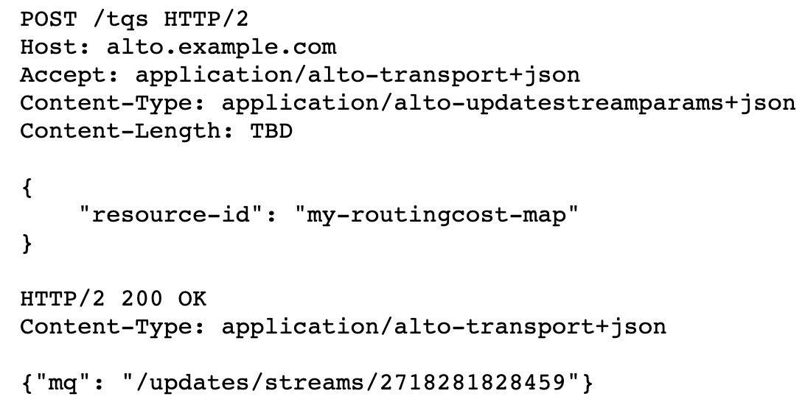
Discuss 4: Examples using HTTP/1.1 or Later
Initial draft used HTTP/1.1; then switched to 1.1+2; current draft is only HTTP/2
Style guide recommends using HTTP/1.1 but if we want to specify more control, we need a way to specify them

Slide 15
Discuss 5: Media Type
Finalize media type: a single media type (application/alto-transport+json) to encode all new data items

Slide 16
Next Step
The authors will submit a new version as soon as the WG makes the decisions on Discuss 1-5 (in two weeks if possible)
Discuss 1.1 Allow client long pull
Discuss 1.2 Server push promise -> server put | + server put
Discuss 2: How much to specify ordering control: how much transport-awareness of app semantics
Discuss 3: How/whether to specify settings
Discuss 4: Examples using HTTP/1.1 or HTTP/2
Discuss 5: Media type comments

Slide 17
Backup Slides

Slide 18
Service | Type (Out if not labeled) | Core Information Structures | Main Size Var | Stability Expectation | Incremental Changes
Information Resource Directory [RFC7285] | application/alto-directory+json | Key-value store; Delegation | #resources | Stable | Add/delete resources
Network Map [RFC7285] | application/alto-networkmap+json | Key-value store: pid -> addrType -> array | #CIDRs | Stable | Add/delete CIDR from pid
Cost Map [RFC7285] | application/alto-costmap+json | Key-value store: srcPID -> dstPID -> value Depend on network map | #SRCPID * #DSTPID | More dynamic than network map | Update cost map entries
Filtered Map Services [RFC7285] | In: application/alto-networkmapfilter+json Out: application/alto-costmapfilter+json | In: selected srcPID, dstPID Key-value store: srcPID -> dstPID -> value Depend on network map | Filtered #SRCPID * #DSTPID | More dynamic than network map | Update cost map entries
Endpoint Property Service [RFC7285] | In: application/alto-endpointpropparams+json Out: application/alto-endpointprop+json | In: addr + prop Key-value store: addr -> prop -> value | #addr * #prop | Depend on property, can be dynamic or stable | Update property value
Endpoint Cost Service [RFC7285] | In: application/alto-endpointcostparams+json Out: application/alto-endpointcost+json | In: srcAddr x dstAddr Key-value store: srcAddr -> dstAddr -> value | #src * #dst | Can be more dynamic than cost map | Update cost value
Cost Calendar [RFC8896] | Extension to CostType | Calendar array | Previous * #num_intervals | Can be dynamic | Calendar window moves
Unified Property | In: application/alto-propmapparams+json; Out: application/alto-propmap+json | In: addr, prop Key-value store: addr -> prop -> value | #addr * #prop | Depend on property, can be dynamic or stable | Update property value
Path Vector | In: see costmap; Out: multipart/related;type=application/alto-costmap+json, | Cost map + unified property map | #src * #dst * #vec size | Depend on metric, can be dynamic or stable | Update path vector
CDNi Cap & Footprint | application/alto-cdni+json | Array; {capability-type: capability-value} | #footprint * #capability | Can be dynamic, bursty | Update capabilities

Slide 19
Performance and Effectiveness of Current Transport
Infrastructures | Basic Workload (ALTO SPEC) | Transport | Collecting metrics
Benocs is fully open to use its infrastructure as an evaluation environment Greater Bay Network is also fully open to use its infrastructure as an evaluation environment | (Filtered) Cost map: distribute inter-site performance metrics and calendar; routing changes + link dynamics => updated metrics Endpoint/unified property service: endpoint access status query/updates/bwe CDN node footprint & capability Flow direction (pointing to CDN nodes) using ECS Path vector providing available reservable bandwidth | HTTP/1.x per request full retrieval keep alive pipelining HTTP/2, HTTP/3 per request, full retrieval ALTO/SSE RFC8895 (on HTTP/1.x) | ALTO Server processing load ALTO client processing load Transport load (bytes) Transport latency Throughput Scalability

Slide 20
General Space of Network->App Information Transport
Protocol/Base Reference | What information | How transported | Frequency
ALTO/RFC7285, RFC8895 | Network map, cost map, unified property, … | HTTP/1.x client/server | Request/response; ALTO/SSE incremental push
ECN/RFC3168 | Congestion notification | 2 bits in IP Traffic Class header; ECN-Echo/CWR flags in TCP header | Per packet marking
NEF, SCEF<->AS/3GPP, … | Network capabilities/events -> AF | HTTP | Request/response
…

Slide 21
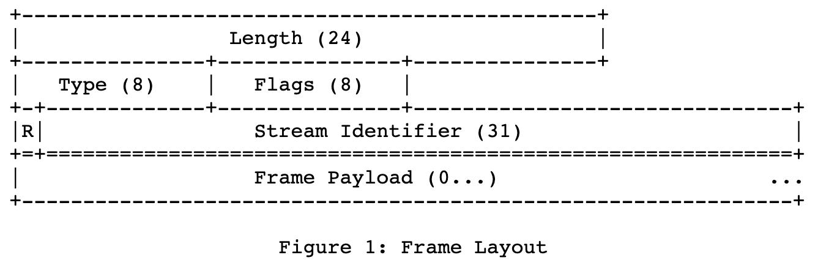
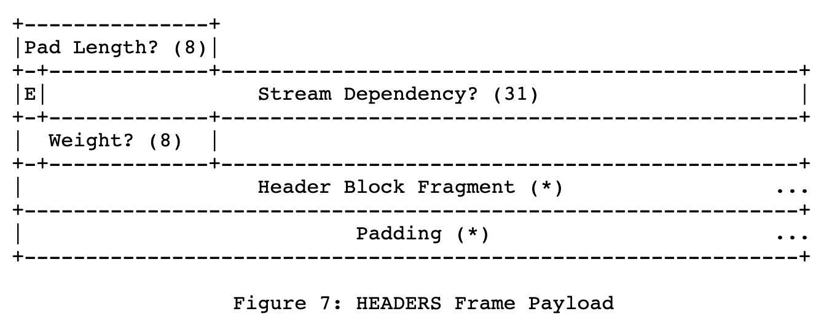
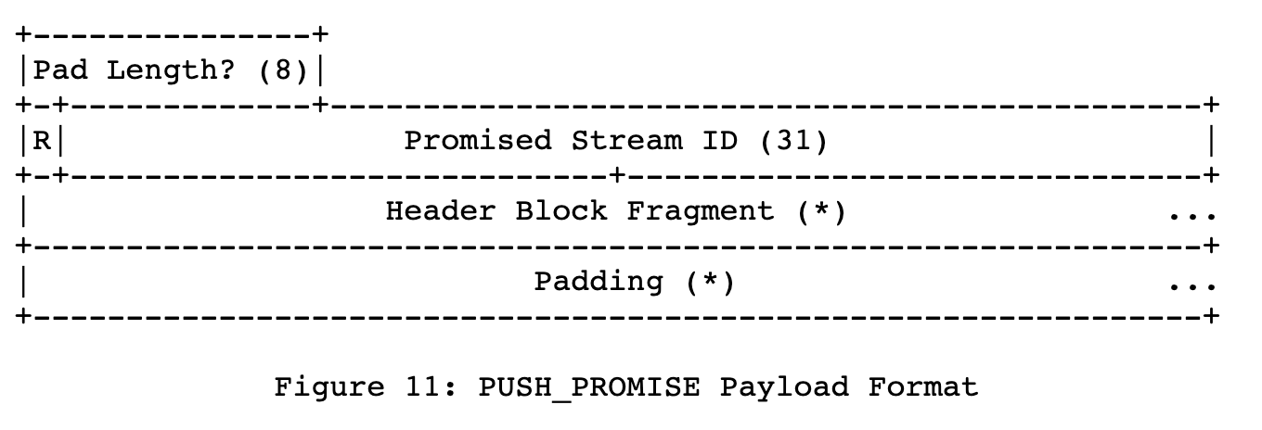
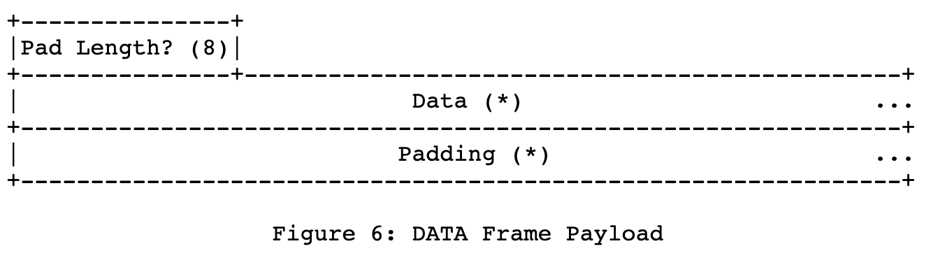
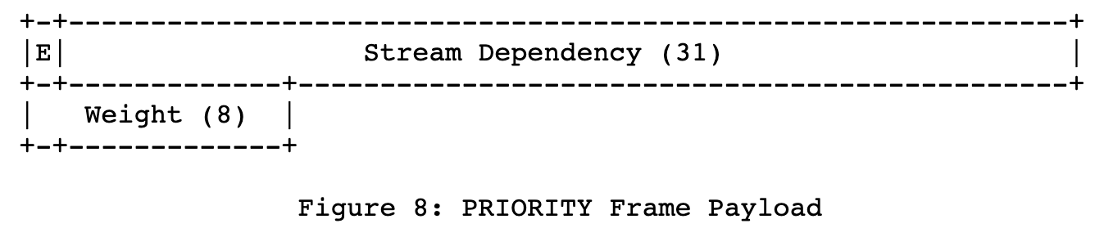
The value 0x0 is reserved for frames that are associated with the connection as a whole as opposed to an individual stream.

Slide 22
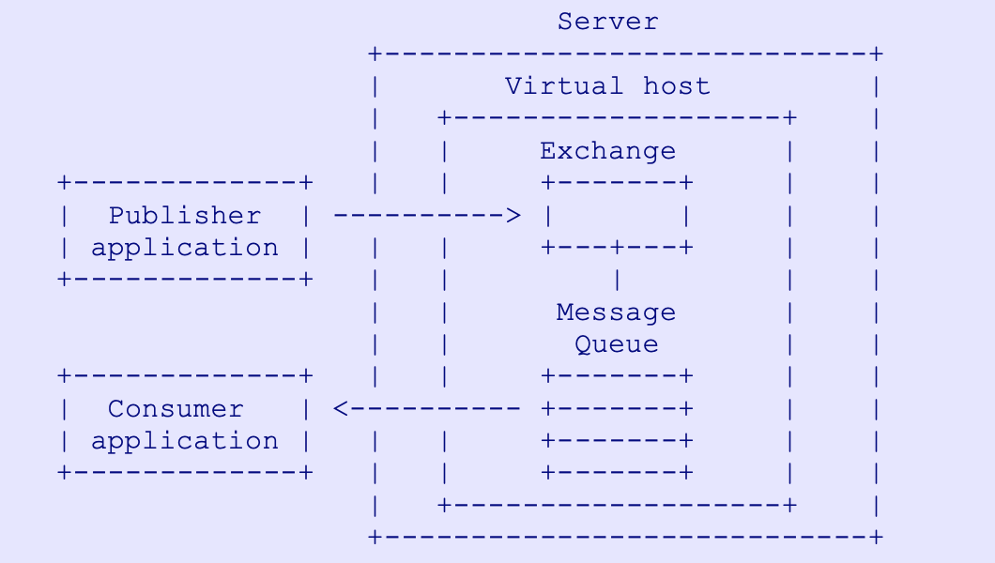
Transport and Pub/sub
What is missing
The design does not allow creation of generic message queues
Only the server can be the publisher
Clients publish info to be shared with other client
The design does not have the capability of Exchange (message router)
Way forward: Keep simple
Broker for further discussion
https://www.rabbitmq.com/resources/specs/amqp0-9-1.pdf

Slide 23
Additional Information about Transport Queue
Calendar semantics
Tell the client ALTO information (e.g., cost) for a future time point
Tell the client when the next information will be released, it is the time that the info is released is distributed, not the value [support]

Slide 24
Negotiation
Task: to fully specify the complete set of negotiation parameters
Use HTTP/2 (default), HTTP/3
Incremental updates queue encoding
Chosen by server, but must be specified as HTTP Accept header of client
Initial connection setup: client sends list of incr update mime types, and server returns the subset which it can use (Vary header in response)
Concurrency level (e.g., Rucio controller need to monitor info for a large number of clients) stream control

