Slide 1
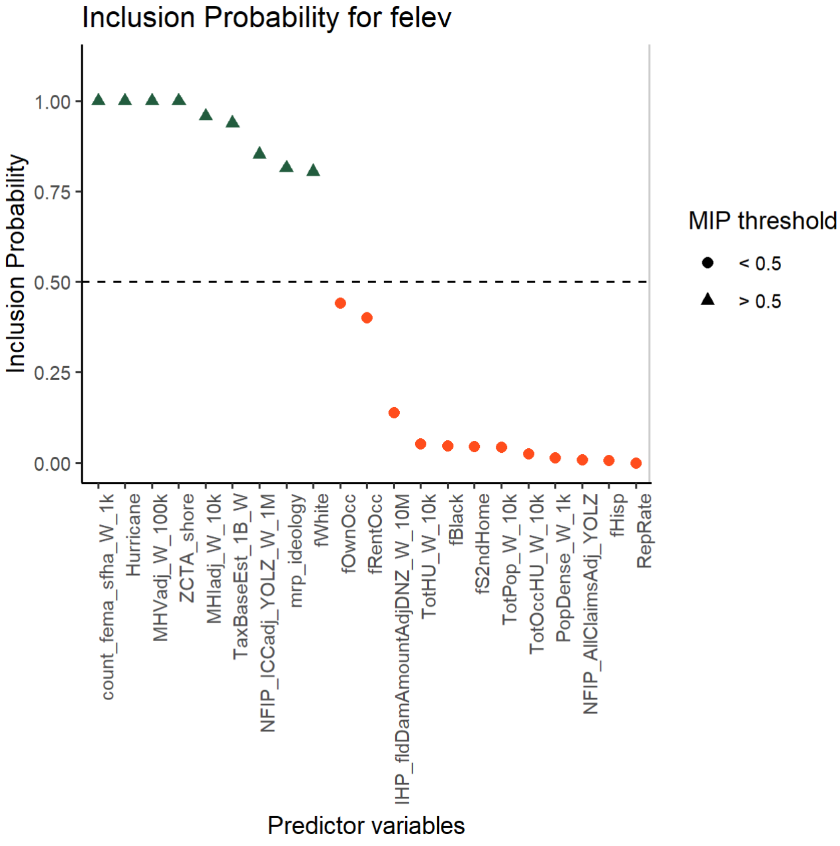
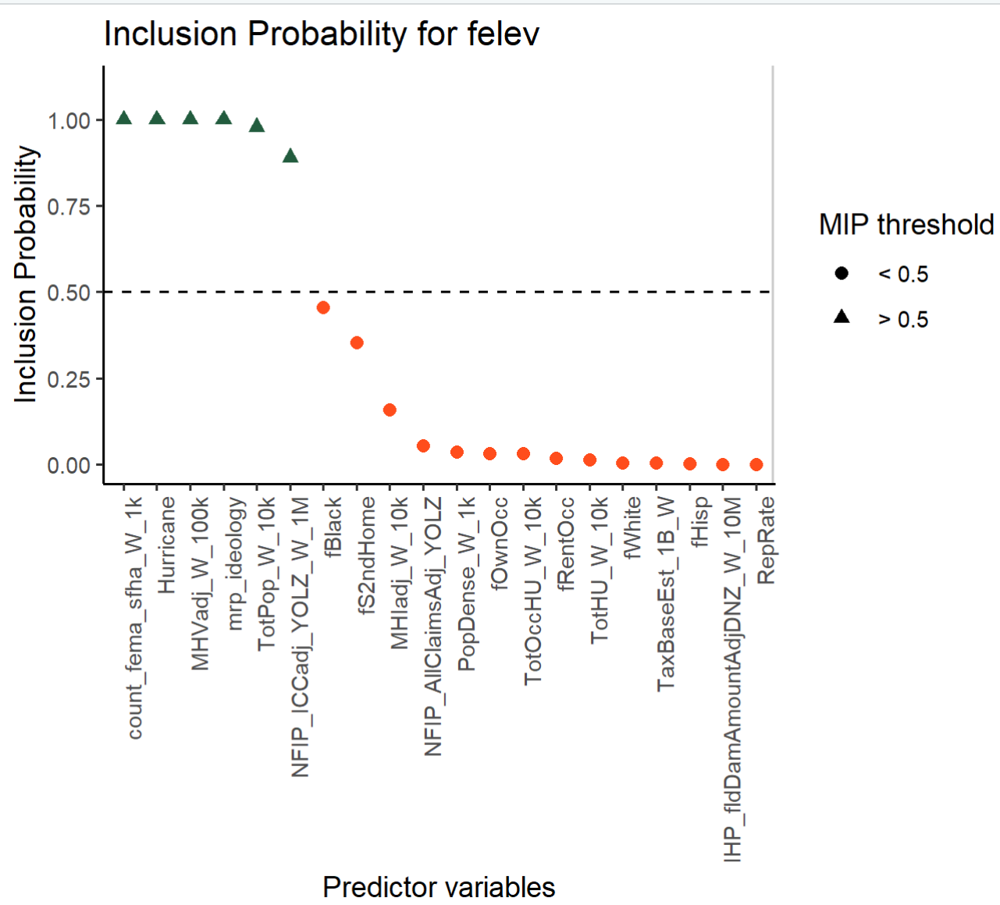
Full Sample
Shoreline Sample

Slide 2
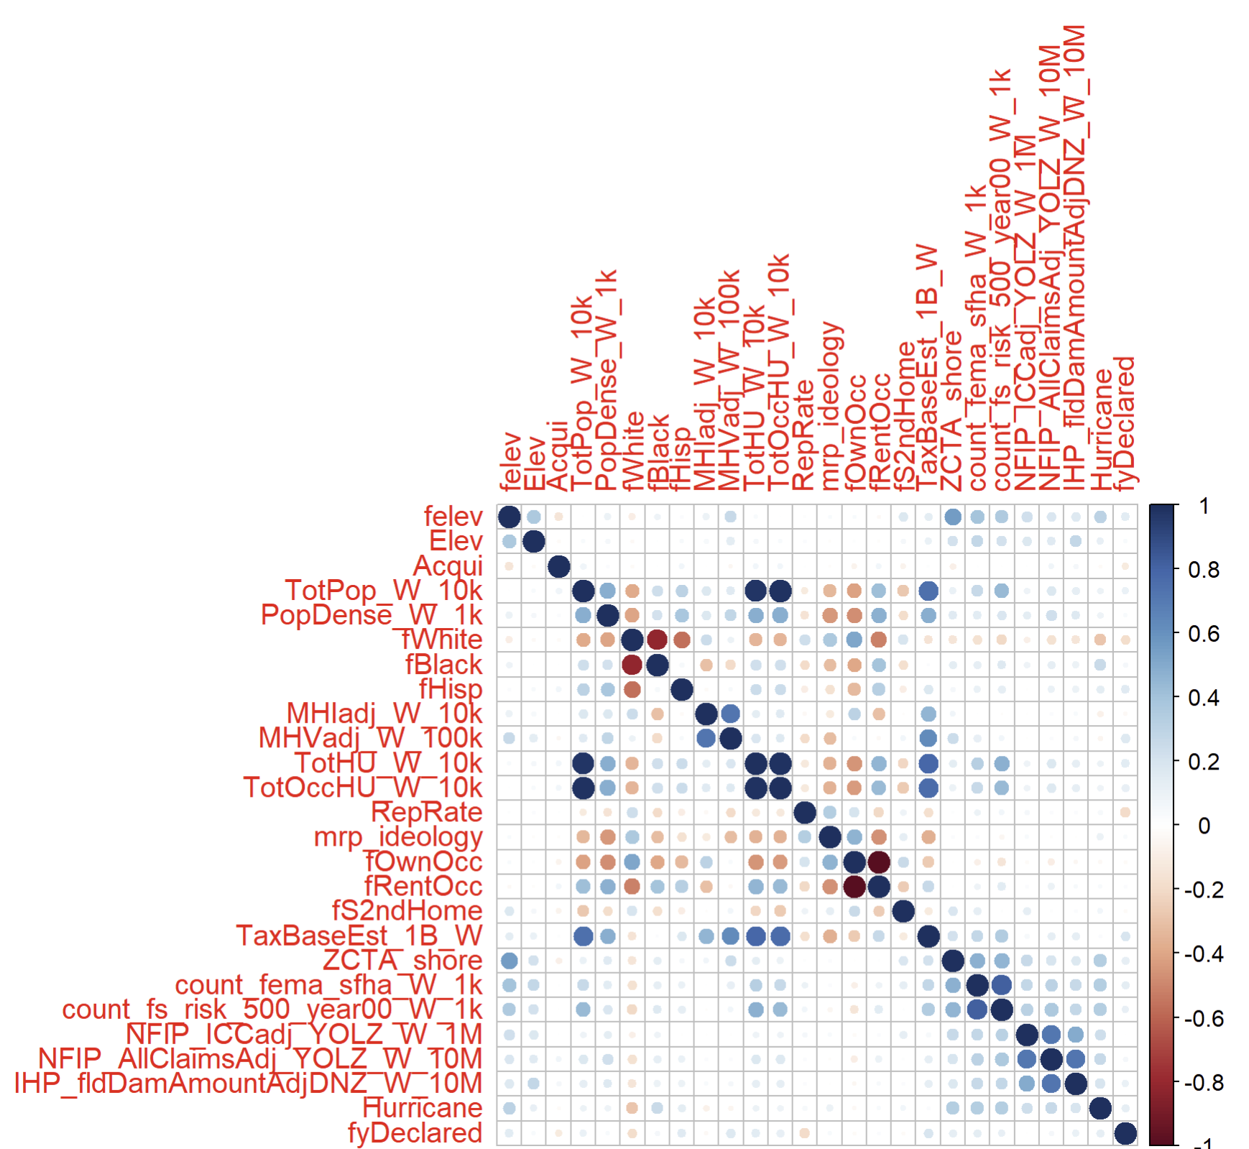
Corr Matrix – All vars: Full Sample

Slide 3
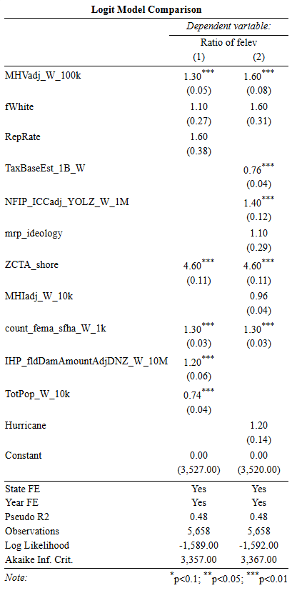
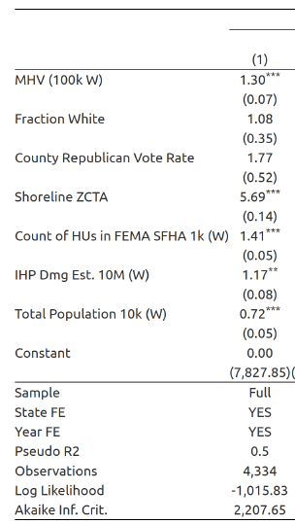
Full Set with new sample: Dissertation Model versus SVSS model
Old Full Set: Dis Model
Dis.
SVSS

Slide 4
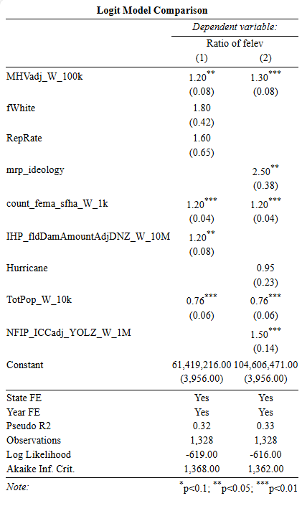
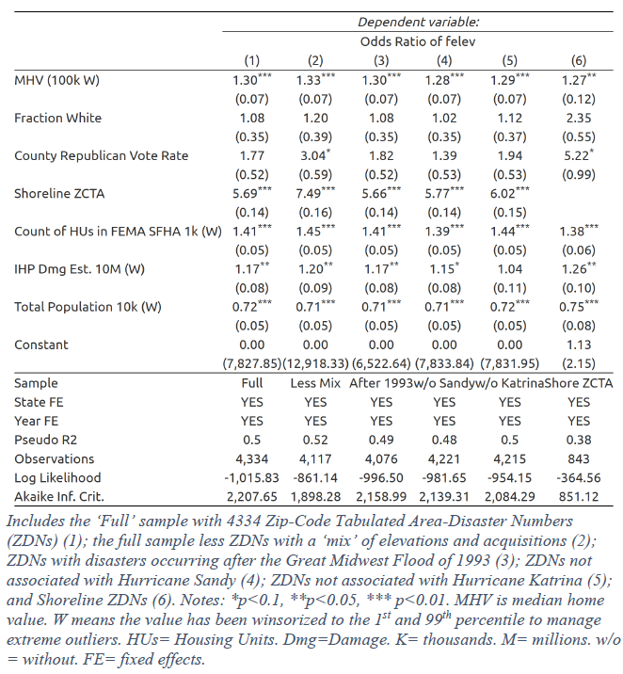
Old Shore Sample:
Dis Model
Dis.
SVSS
Shore Set with new sample:
Dissertation Model versus SVSS model

Slide 5
