Slide 1
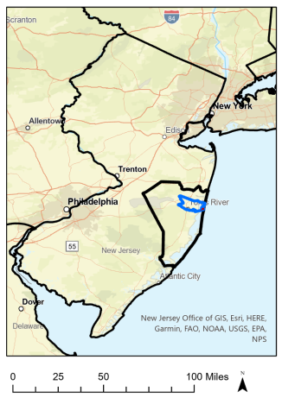
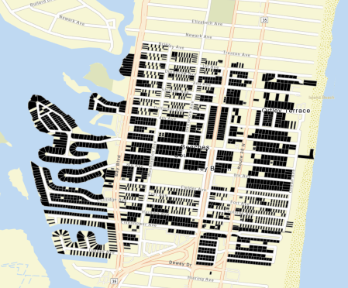
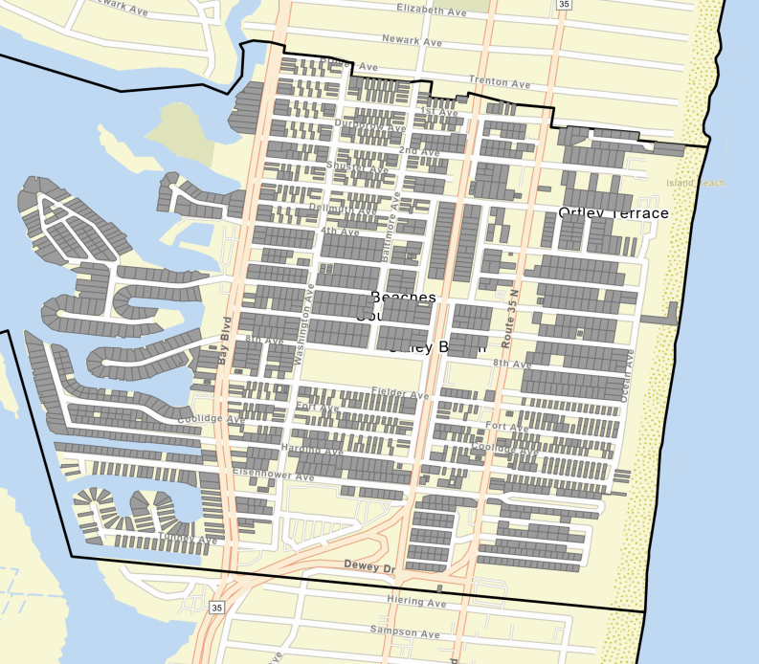
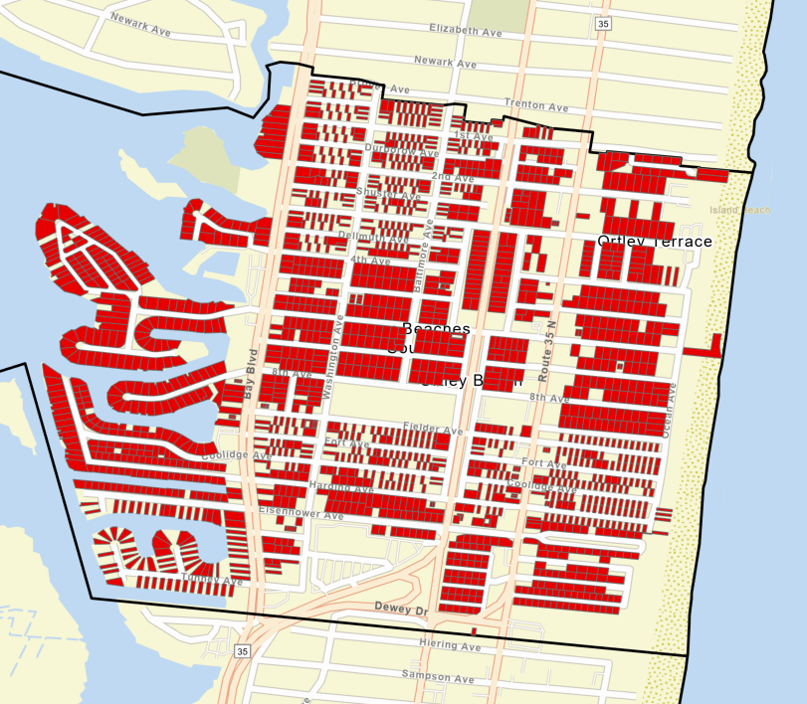
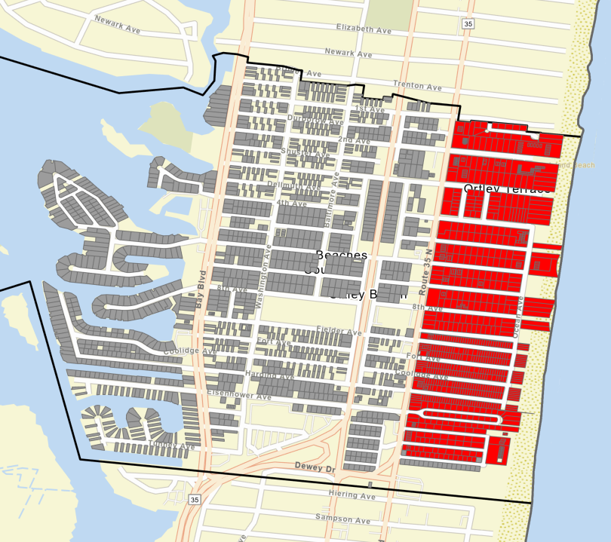
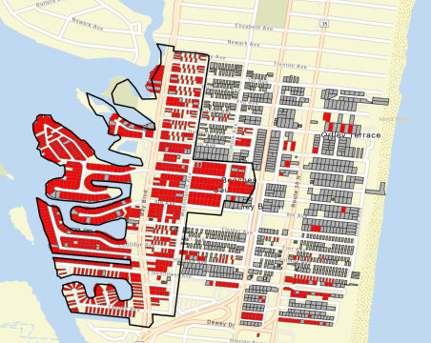
Figure 1: Visualization of the baseline and three alternative scenarios for response pathways for Ortley Beach post-Sandy.
(S0) No Sandy / Do Nothing
(S1) Rebuild & Elevate (1855 homes)
(S2) Full Buyout & Relocation (1855 homes)
(S3) Clustered Buyout East of Route 35 (421 homes).
Elevate other homes (1434).
S4) Buyout homes with greater than median Average Annual Losses (AAL) (921 homes).
Elevate other homes (934).
Do Nothing
Elevations
Buyouts

Slide 2
Figure 2: Distinction between retrospective financial analysis and societal economic analysis
Policy implementation costs (I)
Residual risk to buildings (R) and protection costs (P)
2012
2022
2062
Retrospective Distributional Financial Analysis
Societal Economic Analysis
Society-wide perspective
Federal
Household
Municipal

Slide 3
Table 1: Discount Rate Sensitivities
Discount Rates Applied to Municipal Flows for FA:
DR 2%: Outer-bound case where the mean municipal annual bond interest rate is 2%.
DR 6%: Outer-bound case where the mean annual bond interest rate is 6%.
Discount Rates Applied to All Flows for EA and Federal Flows for FA:
DR 2%: Outer-bound case reflecting guidance from OMB Circular No. A-4, 2023.
DR 3%: Reflecting OMB Circular A-94 guidance from 2003.
DR 7%: Outer-bound case reflecting OMB Circular A-94 guidance from 1992.
Discount Rates Applied to Household Flows for FA:
DR 4%: Reflects the average 30-year fixed mortgage rate of return between 2010 and 2020.

Slide 4
Figure 3: Toms River Revenues 2012-2022
Sandy (Oct. 2012)
Open Records
Request
NJDCA Municipal Budget
User Friendly Database

Slide 5
Figure 4: (S1) Rebuild Ortley Beach and Elevate Homes: Diagram illustrating discounted estimates of financial flows between three stakeholder types based on the historical record. All values are CPI adjusted to USD2020. Ranges represent the effect of applying different discount rates (2-7 percent).
Federal Government
$64.9.0M to 77.8M
Federal cost share:
Repairs to Routes 35 & 37.
$14.5M-$17.5M: Federal response programs direct to households.
$4.3M to $5.2M
Federal cost share:
Municipal response & recovery.
$71.7M: NFIP Claims
$0.9M to $1.3M
Federal cost share:
Ortley Beach Nourishment
$13.0M to $16.2M:
NFIP Premiums
Municipality / School District
$10.3M to $13.5M Municipal. Property Tax Revenue
Households
$18.2M to $23.8M School District Property Tax Revenue
$6.7M to $8.5M: Services (Public Works & Public Safety)
$0.4M to $0.5M:
Municipal cost share:
Response & Recovery
$2.4M to $3.1M:
Municipal cost share:
Ortley Beach Nourishment
$8.3M to $10.2M: School Services
Notes:
Notes: line widths are proportional to millions / 5

Slide 6
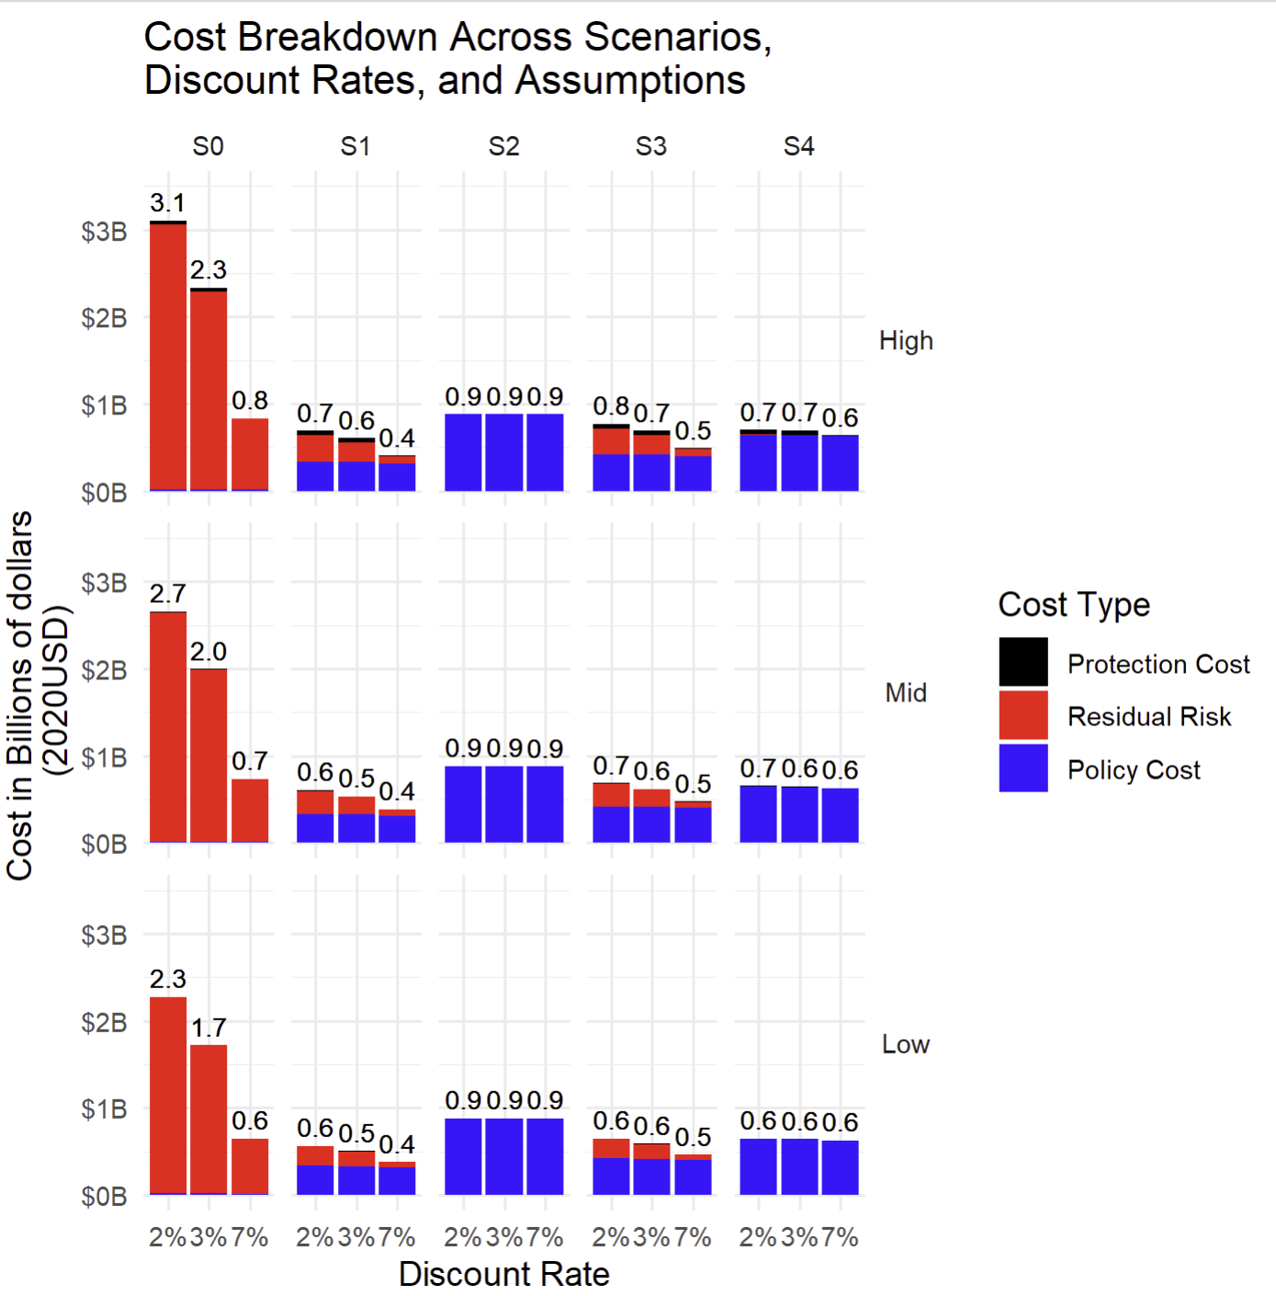
Figure 5: Societal perspective: Total costs by scenarios (S0, S1, S3, S3, S4), assumptions (high, mid, low), and discount rate (2%, 3%, 7%).

