Slide 1
Revisiting the Bit-Serial Computer Architecture
A Practical Guide to Bit Serial Computing Ken Boak OSHCamp, 24th August 2024

Slide 2
Introduction
In the late 1980s, the late, great author and futurologist, Richard Adams made a series of radio documentaries, and a book “Last Chance to See” documenting his travels around the world to seek out and document various animal species that were on the brink of extinction, including the Komodo Dragon, the Kakapo of New Zealand and the Aye-Aye lemur of Madagascar. In a lesser capacity, I have spent the last 5 years exploring simple computer architectures, based on what are often colloquially known as “TTL” chips, but more correctly 74HC series of logic devices.
With successive generations of logic, these devices have 60+ years or heritage, and are based on high-speed CMOS logic, FETs and transmission gates, and no longer bipolar, multi-emitter transistors, but have retained their pin compatibility with the older series. However, these devices are slowly being obsoleted, resulting in a smaller range, fewer packaging options and decreased availability. Basically the slow erosion and ultimate extinction of the species. I realised that the window of opportunity to build a working “TTL Computer” was rapidly diminishing, and so after 4 years of procrastination, I began my journey, for proper, earlier this year.
To add a little novelty to my design, I chose to use the little known technique of Bit Serial Arithmetic.

Slide 3
Until 1960, almost all computers used bit-serial arithmetic
Uses considerably fewer vacuum tubes or transistors than parallel
It only had to process a pair of bits at a time
It simplified hardware making it practical and mostly affordable
Easily extended to longer word sizes with no linear scaling in hardware
The trade off, was it was relatively slow. EDSAC (1949) managed 600 operations per second, on 17-bit words.
With 74HCxx logic we can achieve 50,000 8-bit additions per second.

Slide 4
In this presentation I will discuss the techniques and practical hardware required for bit-serial computation.
Commencing with the basic full adder circuit, I show how it is applied to bit serial addition and subtraction and then extend it to provide the common logic functions AND, OR, XOR and ZERO. It may also provide one’s complement invertion, and two’s complement negation. Increment and Decrement are also possible with simple extensions to the control of the ALU.
As well as the ALU, shift registers are the fundamental storage device for bit-serial computer architectures. I summarise the basic types, their function and use and give examples available cheaply in 74HCxx High Speed series logic.
Shift registers can also perform operations such as shift, rotate and nybble or byte swap.
The discussion concludes with an illustration of how a small, experimental 8-bit, bit-serial computer can be built up from common 74HC series parts.
This is the theme of tomorrow’s Workshop Build session: your own bit-serial machine.

Slide 5
1 plus 1 is 10……. 1 and 1 is 1 ……..
The principle is very simple – it’s just like basic addition that we all learned in primary school, except that it is in binary.
We start with the units on the right, and if there is a carry, we make a mental note and bring it to the next column to the left.
For binary, the process is almost identical. Starting with the least significant bits, A0 and B0, we add them together. If a carry is generated, we store it in a flipflop so that it can be added into the next addition, A1 plus B1.
We repeat this bit operation until we have completed the whole word.
To do this in logic we need a pair of shift registers to feed the serialised data into a full adder. The full adder produces the SUM term from A XOR B and carry from the A AND B function. This produces a half add, which is then repeated to include any carry input from the previous stage.
In total we require just two XOR gates and 3 NAND gates, plus a flipflop to hold the inter-stage carry.

Slide 6
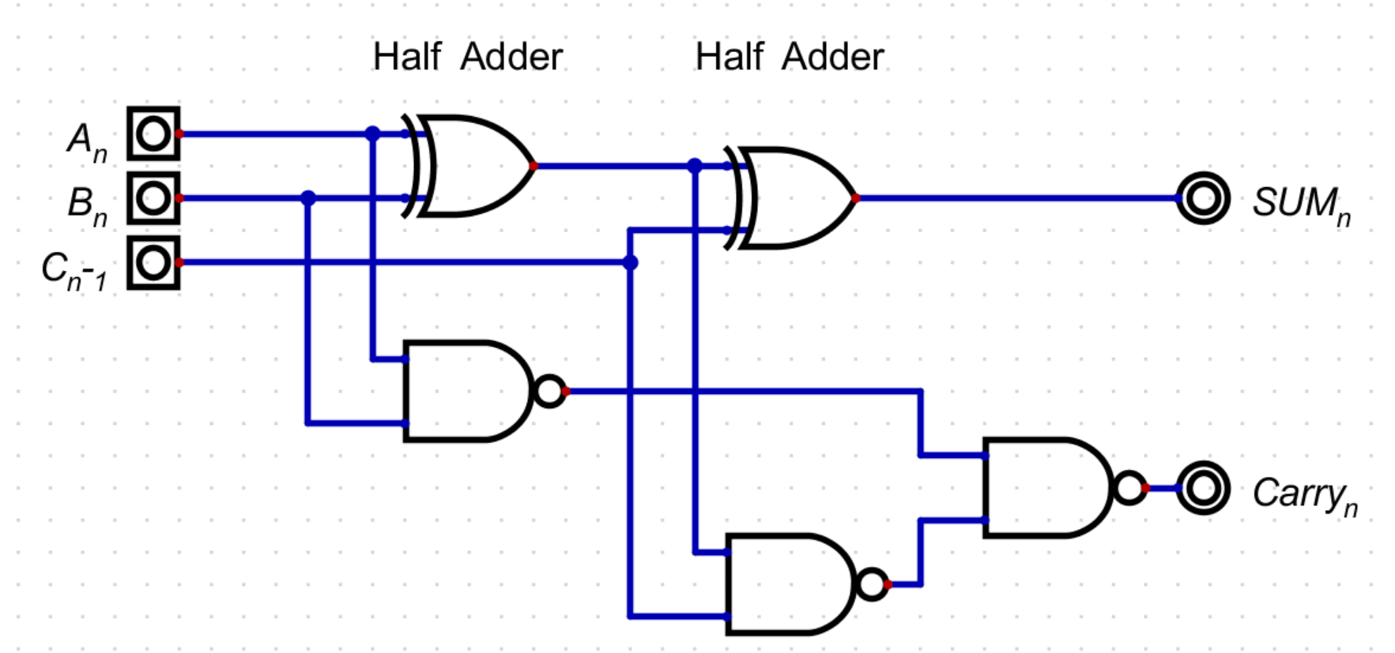
A Full Adder made from basic gates.

Slide 7
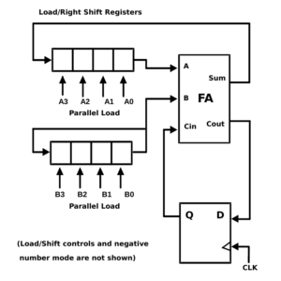
A typical serial adder. It uses two shift registers A3:A0 and B3:B0. Shift register A is normally called the Accumulator. It can be parallel loaded from a bus, or serially loaded via register B. Note how the least significant bits A0 and B0 are processed first!
The full adder FA, generates the Sum and Carry terms of the applied bits. The sum is recirculated back to the A shift register.
Any carry generated is stored in a D-type flipflop and fed to the Carry Input Cin, so that it can be included in the next cycle.
The cycle repeats until all n-bits have been processed, and all bits are stored in the Accumulator – in the position of their correct binary weighting. This basic design is easily modified for subtraction and other logical functions.

Slide 8
The Arithmetic and Logic Unit ALU
The ALU provides addition, subtraction and 3 logic functions AND, OR and XOR. It also can generate zero, which is good for clearing the accumulator.
It operates on A and B inputs, one bit at a time – plus any carry that was generated from the previous bit operation.
Carry is suppressed when we perform logical operations.
It is based around a full adder which generates Sum and Carry outputs.
As the sum is the XOR of the inputs and the Carry is AND, we get these logic functions almost for free. We use a multiplexer to select either the XOR or the AND function.
Using 74HCxx basic gates the ALU is just 5 ICs – regardless of the length of the word to be processed.
Because of its compactness, the ALU could be programmed into a small ROM (256 bytes) to replace the combinational logic of XOR and NAND gates

Slide 9
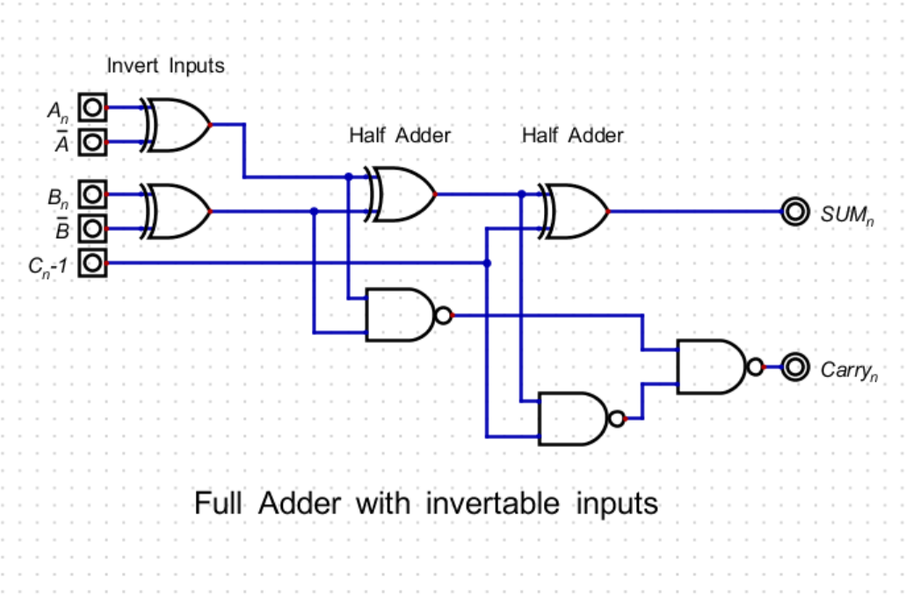
The ALU design commences with a full adder, (made from 2 half adders) with its inputs invertible, using a pair of XOR gates. It produces the two terms, Sum and Carry, which are the XOR and the AND functions of its inputs.

Slide 10
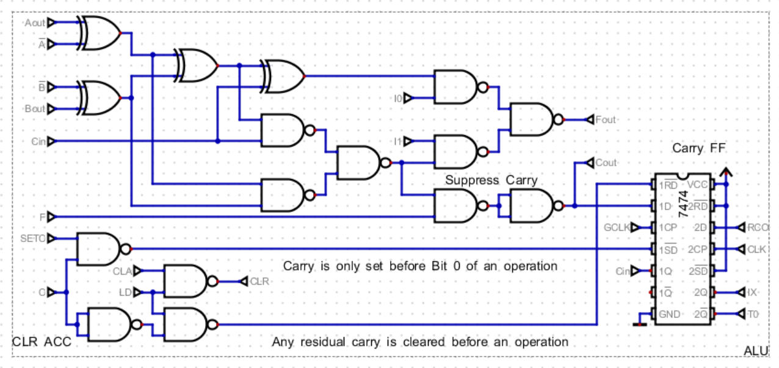
The Full Adder is extended with multiplexer output (I0 and I1) to select between the SUM function (XOR) and the Carry function (AND). This mux will also produce the ZERO and OR functions.
Note carry suppress logic controlled by input F for Boolean opeartions, and carry D-type flipflop.
7 control signals define which instruction is selected and control the Carry logic.

Slide 11
Shift Registers - Demystified
Shift registers are a fundamental building block of serial arithmetic.
Essentially just a chain of D-type flipflops, with some surrounding support logic.
Widely forgotten or misunderstood by current generation of engineers and hobbyists.
5 or 6 types available in 74HCxx logic. Available in 4, 8, 64(dual) bits in length.
Serial In – Parallel Out (SIPO) 74HC164 (8-bit)
Parallel In – Serial Out (PISO) 74HC165 (8-bit)
Serial In – Latched Parallel Out (Tristate) 74HC595 (8-bit)
Universal, Bidirectional, Parallel In/Out (tristate), 8-bit Serial In/Out 74HC299
Serial In – Serial Out CD4517 (Dual 64-bit with taps every 16-bits)
Up to 64 or 128 stages in length. CD4517 is dual 64-bit, CD4557 is 1 to 64 bit
They provide the interface between the parallel and serial domains and allow communication of data via a 4 wire interface at clock speeds of about 20MHz.

Slide 12
Program Counter – Using Shift Registers
Frequently a Program Counter would be made from a binary counter, often using 4-bit presettable counters like the 74HC161.
In a bit serial design the program counter runs at the machine cycle rate – updating every 20 clock pulses.
In the proposed design the program counter is made from a pair of 74HC595 shift registers and a half- adder to add 1 on each machine cycle.
When a jump is performed, a multiplexer allows the PC to be loaded with a jump address from the B-register or other serial data source.

Slide 13
Timing and Control
We have to co-ordinate the action of the shift registers with a series of Timing, State and clock pulses.
Timing pulses, T0 to Tn are used to initiate the loading and reading of the shift registers.
A gated clock GCLK, of n pulses, ensures that n-bits are correctly transferred between registers.
The machine has certain states: instruction fetch, decode, operand fetch, execute, write-back results to memory and increment the Program Counter.
Certain operations can be completed in parallel with one another.

Slide 14
Instruction Decoding
The instruction is held in ROM as a 16-bit word.
It consists of a 4-bit instruction field and a 12-bit address/data field.
There are 8 instruction groups: LOAD, AND, XOR, OR, ADD, SUB, STORE and JUMP.
The instruction group is decoded using a 74HC138, a 3 to 8 line decoder.
Futher combinational logic combines (gates) the instruction group, with certain timing pulses to generate the various control signals for the machine.
Each instruction takes 20 clock cycles to perform. This 20 clock machine cycle consists of 16 clock cycles needed to increment the serial Program Counter, plus a pair of “top and tail” pulses at each end of the PC clock burst.
Instructions operate on the current contents of the Accumulator and a byte from a 12-bit memory address or an 8-bit literal or constant from ROM that is fed to the ALU via the B-Register.

Slide 15
Shift Registers are Key to SPI Serial Communication
The intention is to make a simple bit serial computer which can communicate with memory and other peripherals, such as sensors, I/O expanders over SPI (Serial Peripheral Interface – Motorola c.1983)
The machine has a 6-pin socket that conveys the necessary serial data streams, clocking and power and ground. This equires a minimum of 4 wires between Master and Slave: frequently called MOSI, MISO, SCLK and /CE (/SS).
A word is transferred from Master to Slave, whilst simultaneously the Slave transfers a word back to the Master.
This can be easily done using a pair of 74HC299 universal shift registers
Easy to implement and economical in pcb traces
Additionally, a parallel 8-bit bus which essentially replicates the SRAM data and address buses on a female pcb connector may be used for further parallel expansion.

Slide 16
Serial Memory
Serial memory was originally implemented as serial delay lines (e.g. mercury acoustic delay lines used in EDSAC 1949), electrostatic storage of charge in the phosphor of a CRT tube or a rotating magnetic drum with multiple heads.
Disks and magnetic drums are fundamentally serial devices
Serial EEPROM, Flash FRAM and SRAM appeared in the mid-1990s
Low cost, 8-pin packages and relatively easy to use, with SPI and an industry standard package and instruction set.

Slide 17
“TICK” – A Bit Serial SBC for Experimentation
Combines a versatile ALU with examples of some of the common shift register types. 74HC165, 74HC595, 74HC299
8-bit, bit serial arithmetic, ADD, SUB, AND, XOR, OR
32K bytes of SRAM
Direct interface to SPI with MOSI, MISO and GCLK
Entirely through hole components for simplified construction
Raspberry Pi Pico clone provides user interface, ROM emulation, GPIO and debugging
Link selectable clock frequency from 1kHz to 1MHz
Single stepping and debug to laptop
8 LEDs to show Accumulator contents
Affordable – about £20 on 110x110 mm pcb from JLC PCB

Slide 18
Part 1- A Brief Introduction to Shift Registers
Here I present four common types of shift register. They will be used together to build the first stage of the processor – a bit serial adder. This adder will ;ater be augmented with more ICs, to extend it to a fully capable ALU.
The first shift register is a 74HC164, an 8-bit serial input, parallel output device, in a compact 14-pin package. It can be clocked at approaching 80MHz.
The complementary part is the 74HC165 which is an 8-bit parallel input, serial output part. It has a greater than 50MHz maximum clock frequency at 5V
The third device is the 74HC595, which is similar to the 74HC164, but incorporates an 8-bit tristate output, parallel register. This makes it compatible with parallel-bus oriented systems. Some manufacturer’s 74HC595s will clock at 90 to 110MHz.

Slide 19
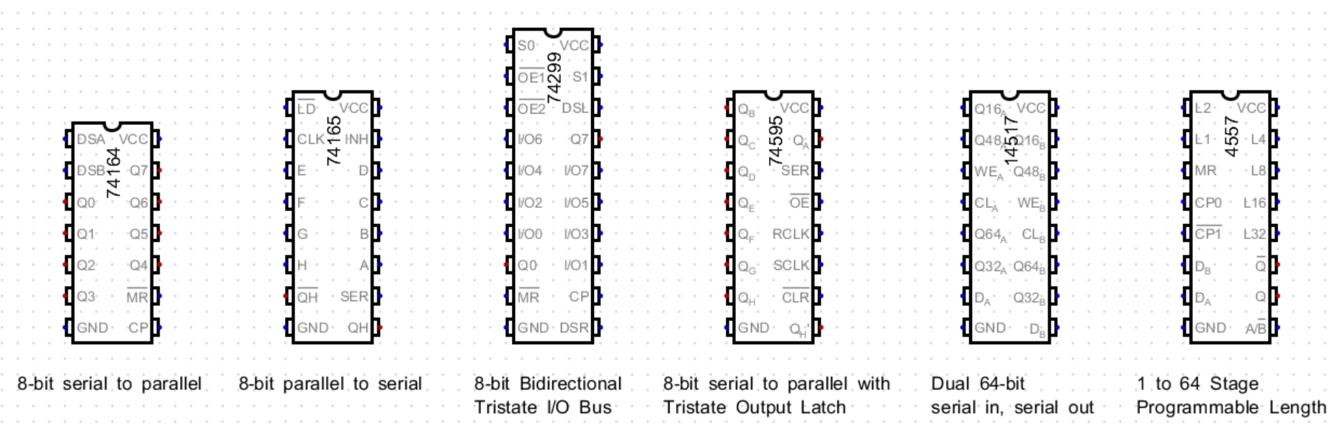
Common types of shift register in 74HCxx and 4xxx series CMOS Logic

Slide 20
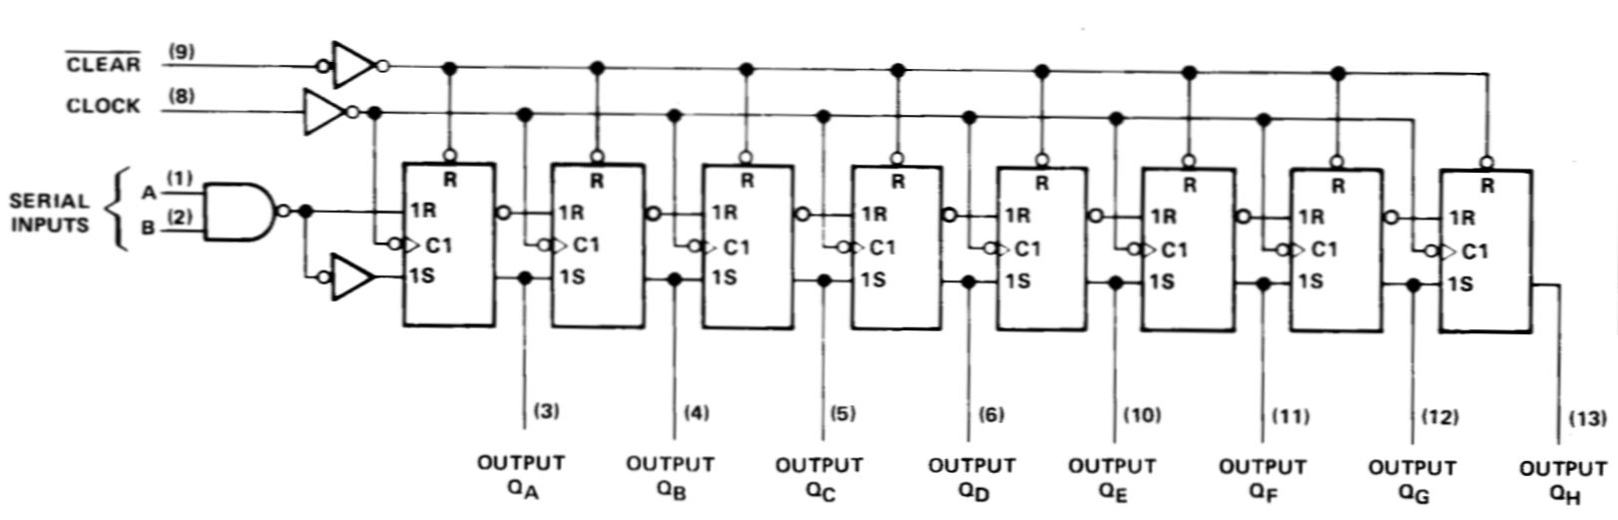
74HC164 8-bit SIPO shift register
Simplest of all shift register devices
Used to convert serial data into parallel
Note – outputs will change with every clock pulse – so only read at end of clock sequence
Compact 14-pin DIL package

Slide 21
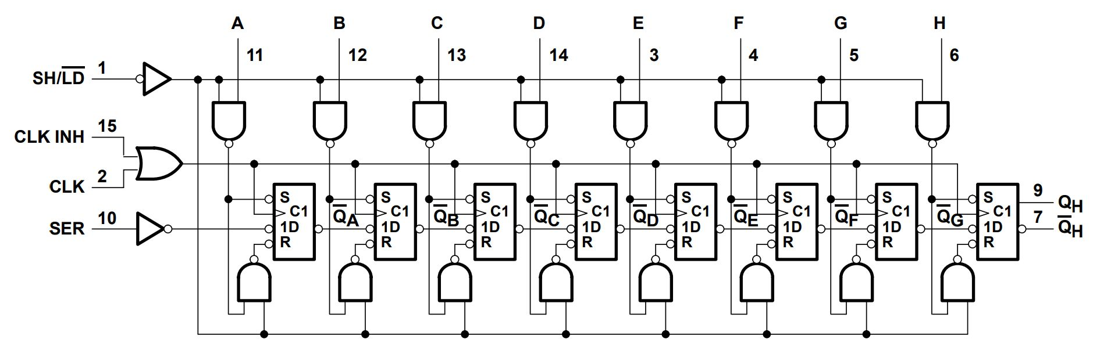
74HC165 8-bit PISO shift register
Used for inputing data from parallel bus and converting to series bit stream
Often used to read switch matrices or extending number of input ports
16 pin DIL package

Slide 22
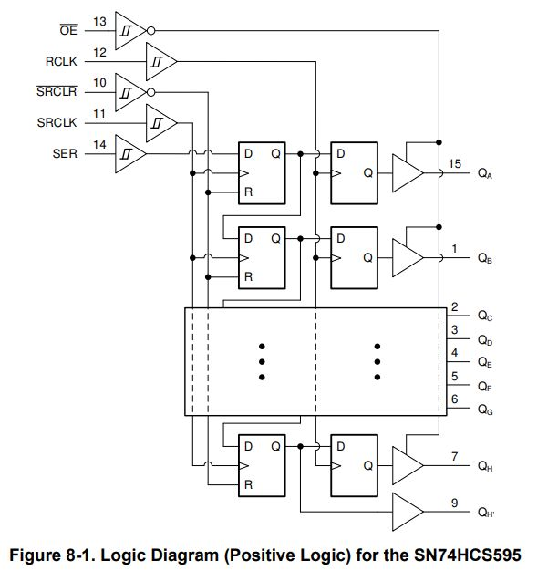
74HC595 8-bit SIPO shift register with parallel, tristate D-type output latch.
Often used for GPIO extension and bus based systems
Separate clocks for serial shift register and parallel latch
16 pin DIL package

Slide 23
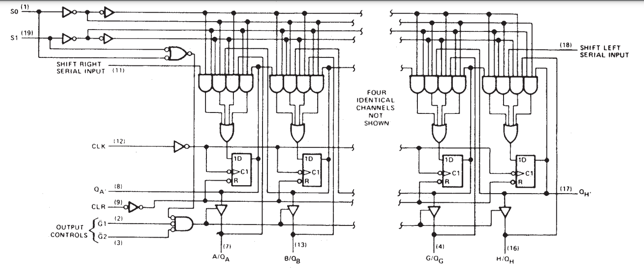
74HC299 Universal, bidirectional 8-bit shift register with with tristate parallel I/0 bus
Ideal to interface to parallel bus systems
Note extensive use of “steering” logic.
20 DIL pin package

Slide 24
The Clock Sequencer
Timing is very important in any digital circuit. The clock sequencer and timing pulse generator (TPG) co-ordinates all of the control signals.
The timing pulses trigger an SR flip-flop and generate a clock gating pulse, which is used to generate a sequence of 16 clock pulses, plus two “top and tail” pulses.

Slide 25
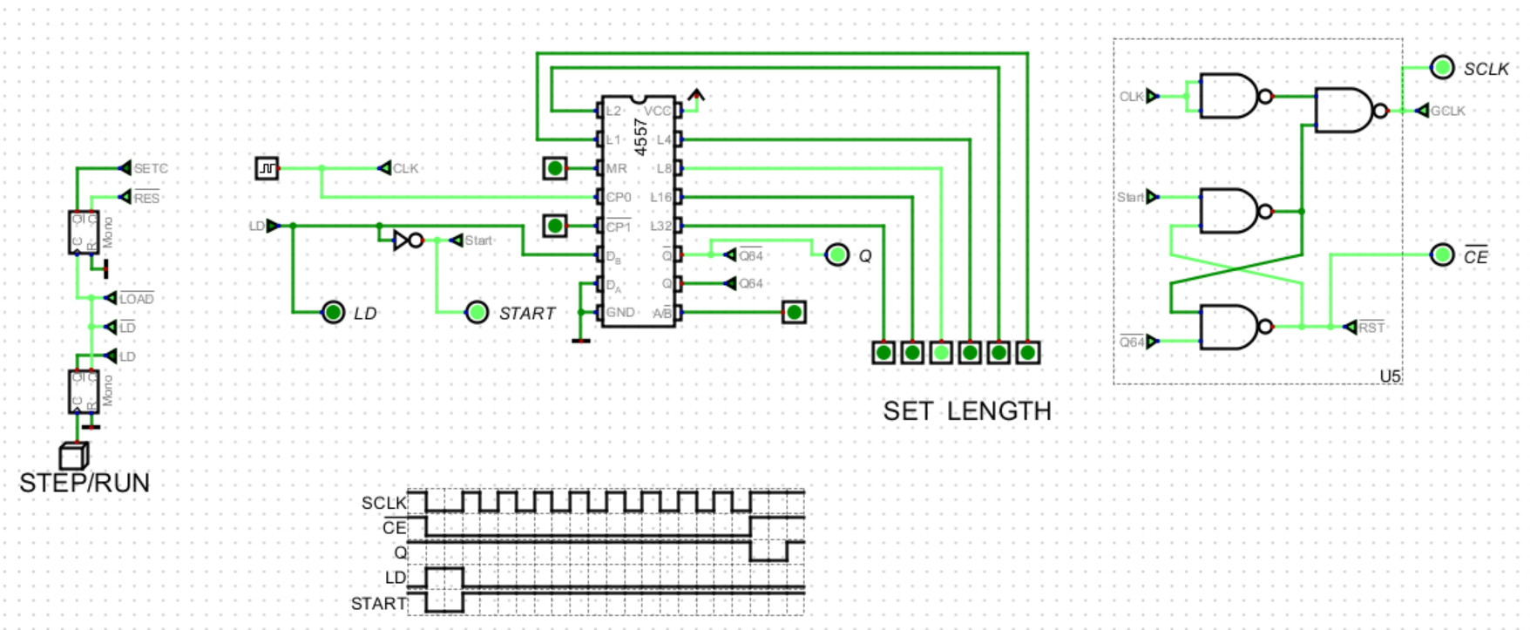
The SR Latch generates the !CE signal and gates the system clock to produce a train of 8-clock pulses, in this example.

Slide 26
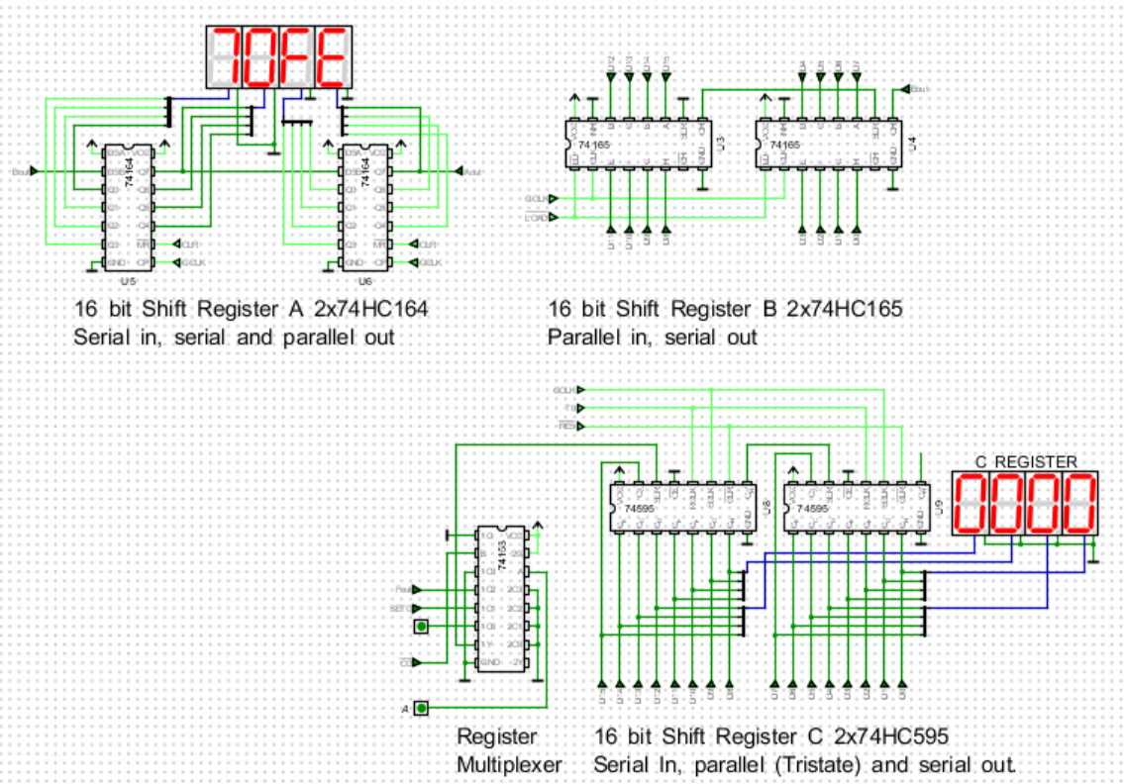

Slide 27
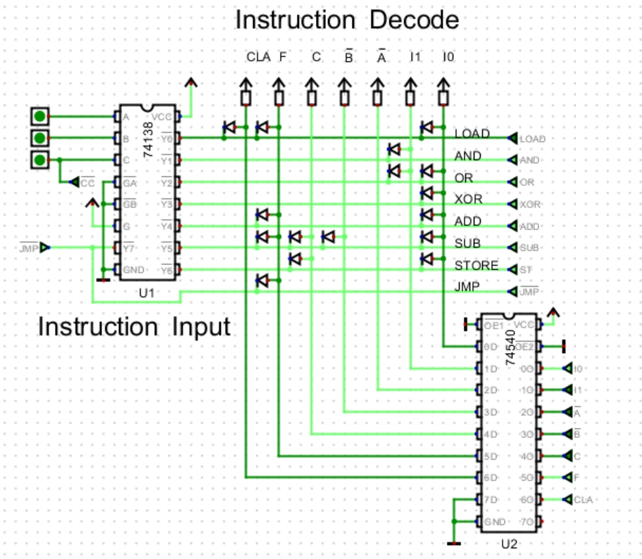
A 3 bit instruction is applied to the 74HC138, 3 to 8-line decoder on the left. One of its outputs goes low and this is decoded into 8-control signals by the diode array. A 74HC540 inverter/driver buffers the output signal

Slide 28
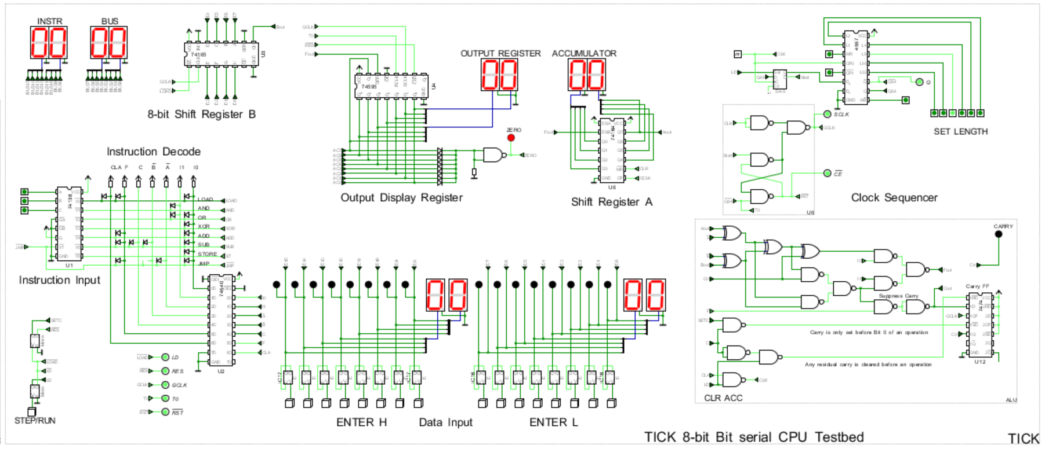
The various system elements are combined to make a simple 8-bit processor. For workshop purposes, The instruction decoder and data entry inputs, and display of results will be handled using an Arduino NANO. This reduces the total package count to about 12 parts, whilst experimenting, flexibly with longer shift registers.

