Slide 1
Value Proposition
Value Proposition: Diversify and increase the news people receive.
Problem/Solution: People tend to get their news from one or few sources, and often the news they get is biased, causing polarization. Our app seeks to close this divide by ensuring users understand their biases and read many articles from multiple news sources, through self-motivation and friendly competition with other users.
Notes:
Consistent questioning across individuals
Pros: aren’t scattered about with our questions and thus able to discern some kind of pattern
Cons: Maybe asking the same questions also reduces new insights (but that is why we asked follow-up questions)
How was the voting experience for you?
How do you decide how to vote on an issue?
How often do you see media that supports/contradicts your own opinion?
Have you ever voted on a referendum? How was that experience different?
What would you want to know about referendums beforehand?
Have you ever taken a quiz about politics that tells you which politicians/ideologies you align with most? Was it accurate/surprising/…?
How do you feel while reading something (political) that you disagree with?

Slide 2
Three Tasks
Our simple task: The user should set goals for the number and variety of articles per day (e.g. two articles written by conservative viewpoints, and one article written from a liberal viewpoint.)
Our moderate task: The user should become aware of the biases of their news sources, e.g. “80% of the articles you read are written from a liberal perspective.”
Our complex task: The user can compare and compete with other users on the number of articles read and the variety of their sources over a given length of time.
Notes:
Consistent questioning across individuals
Pros: aren’t scattered about with our questions and thus able to discern some kind of pattern
Cons: Maybe asking the same questions also reduces new insights (but that is why we asked follow-up questions)
How was the voting experience for you?
How do you decide how to vote on an issue?
How often do you see media that supports/contradicts your own opinion?
Have you ever voted on a referendum? How was that experience different?
What would you want to know about referendums beforehand?
Have you ever taken a quiz about politics that tells you which politicians/ideologies you align with most? Was it accurate/surprising/…?
How do you feel while reading something (political) that you disagree with?

Slide 3
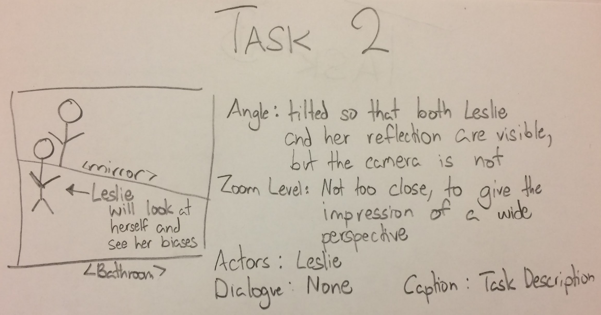
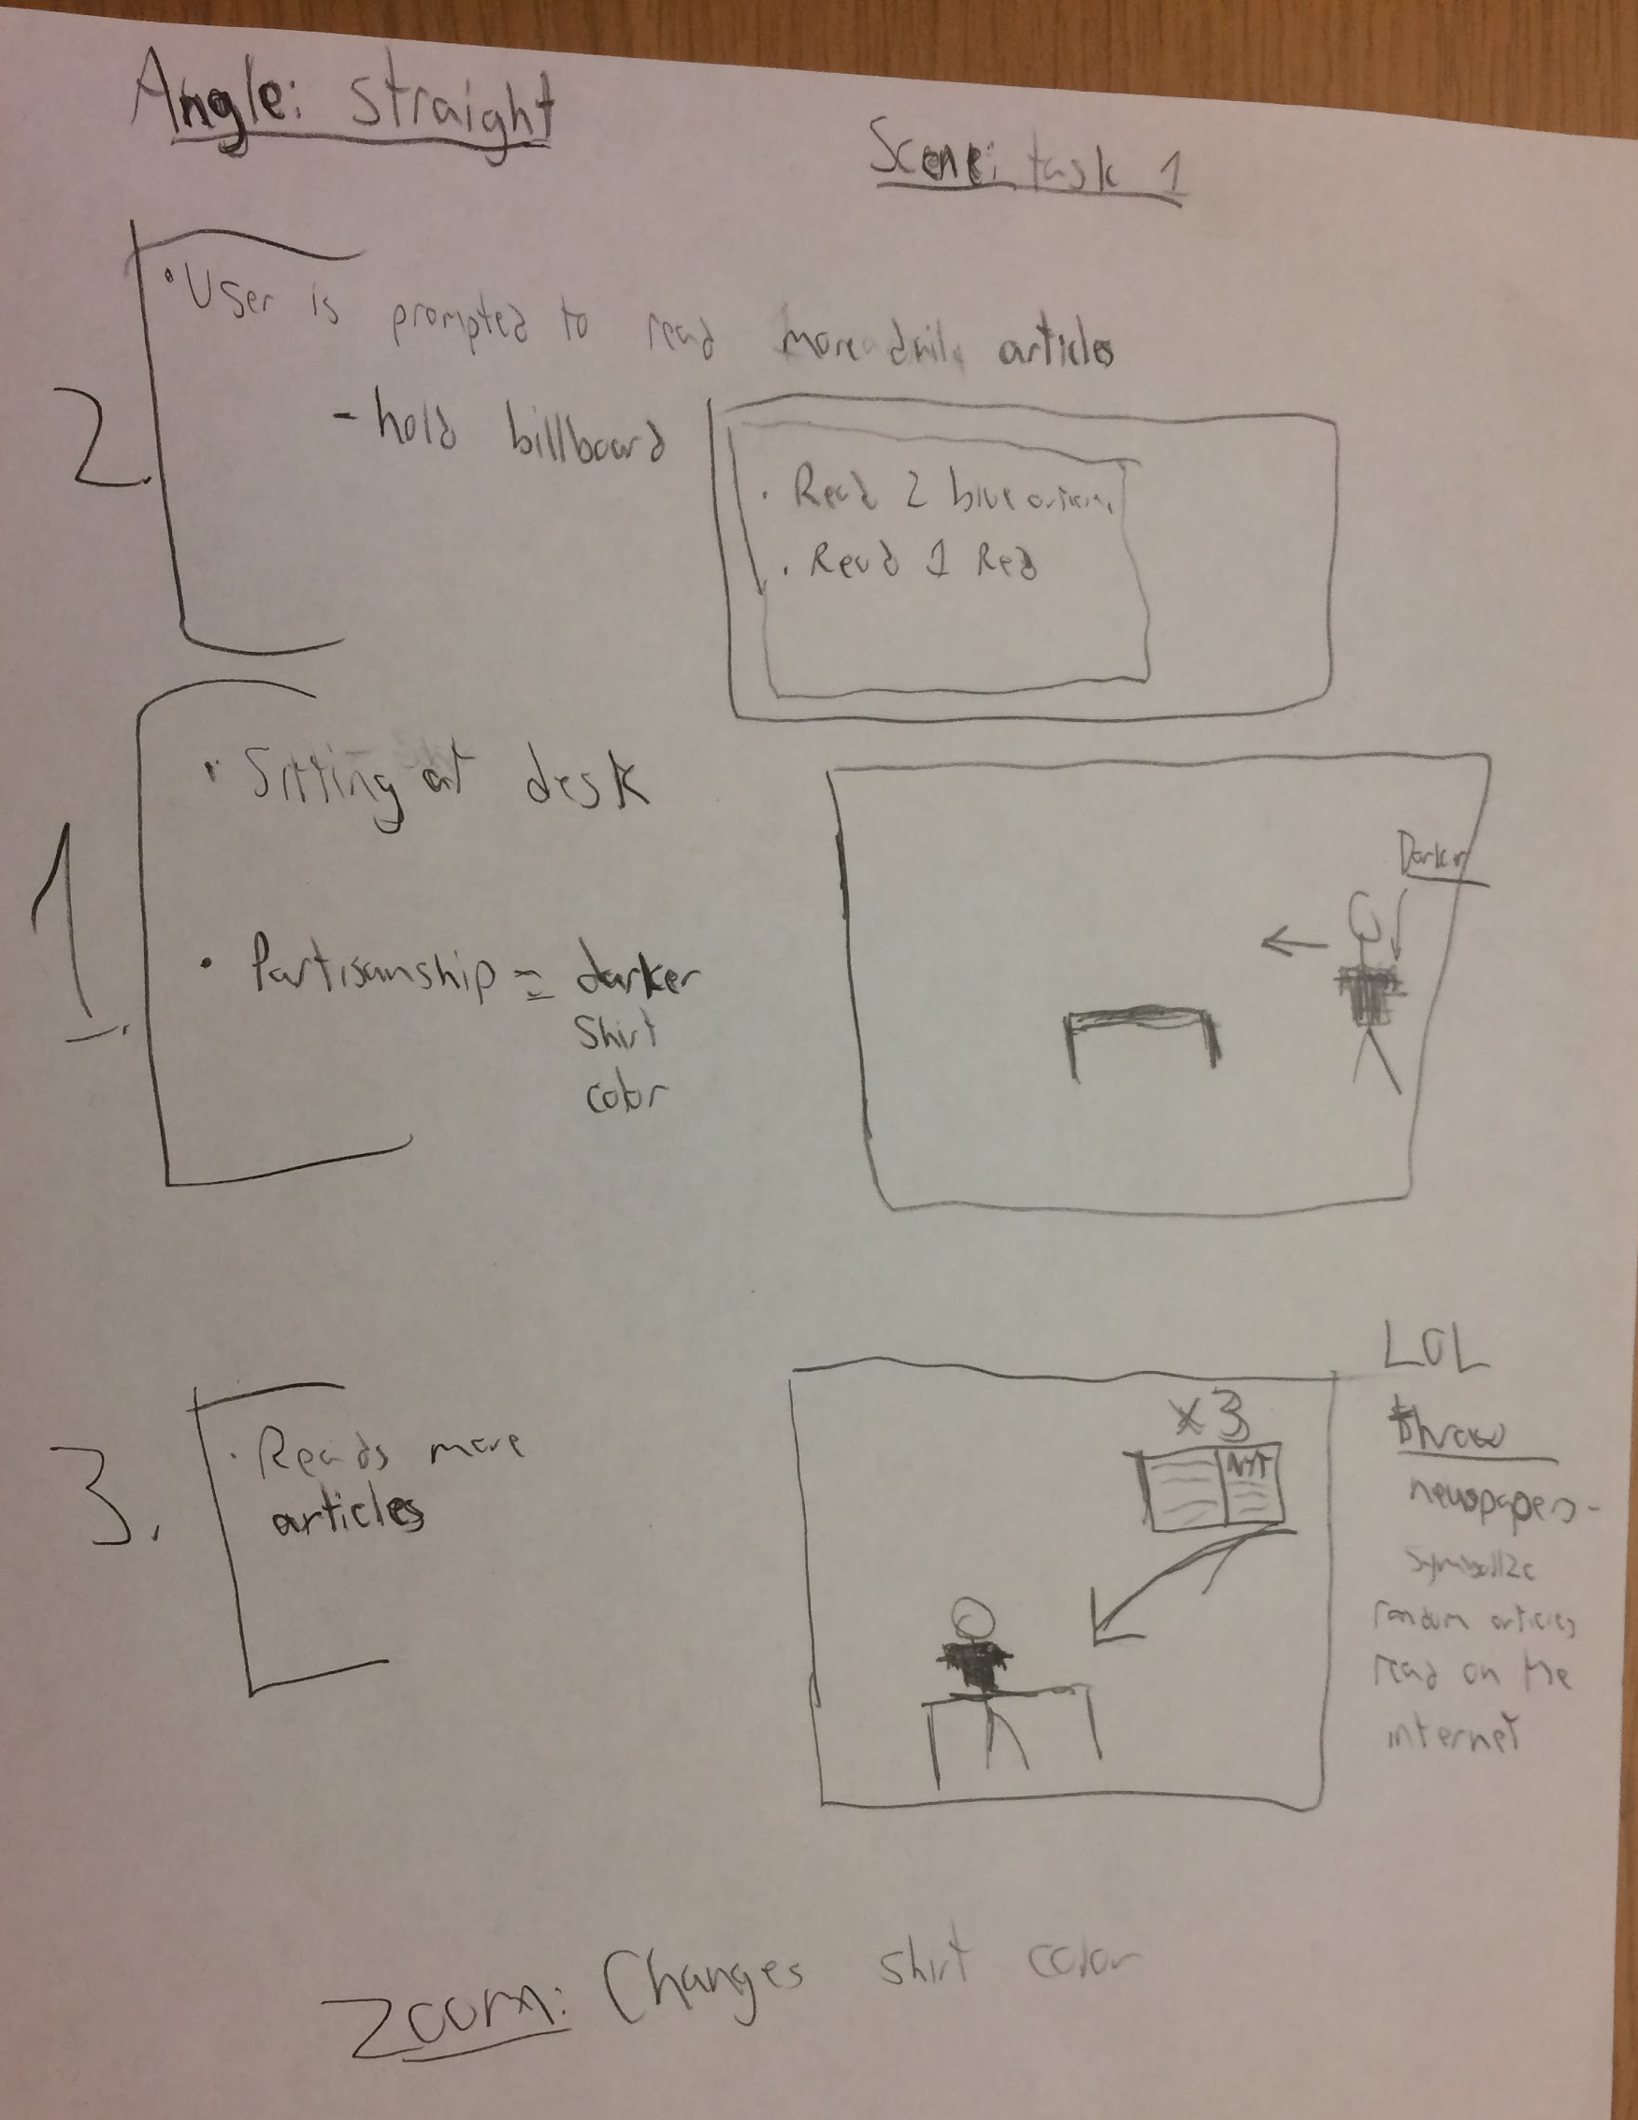
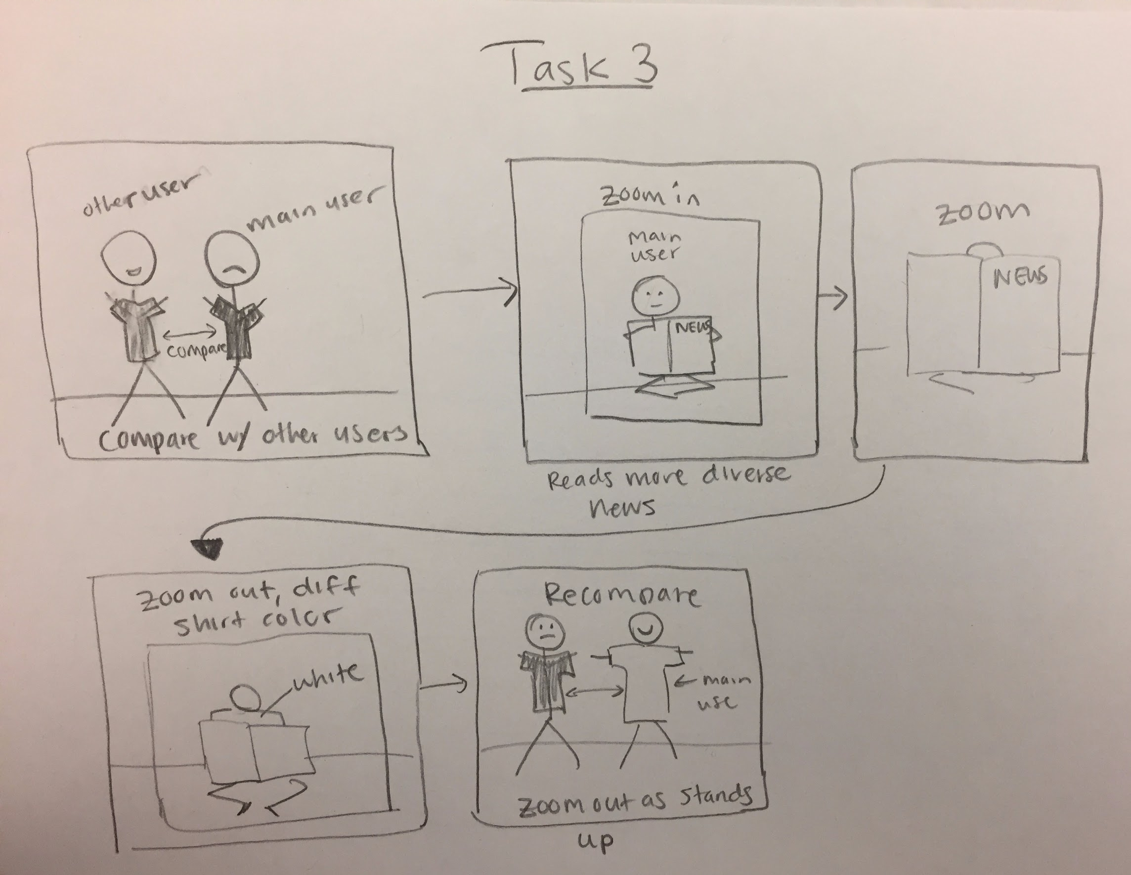
Video Storyboard

Slide 4
Concept Video
https://www.youtube.com/watch?v=dpGcQ4OCjfg&feature=youtu.be
Notes:
Consistent questioning across individuals
Pros: aren’t scattered about with our questions and thus able to discern some kind of pattern
Cons: Maybe asking the same questions also reduces new insights (but that is why we asked follow-up questions)
How was the voting experience for you?
How do you decide how to vote on an issue?
How often do you see media that supports/contradicts your own opinion?
Have you ever voted on a referendum? How was that experience different?
What would you want to know about referendums beforehand?
Have you ever taken a quiz about politics that tells you which politicians/ideologies you align with most? Was it accurate/surprising/…?
How do you feel while reading something (political) that you disagree with?

