Slide 1
Exploratory Data Analysis with Python

Slide 2
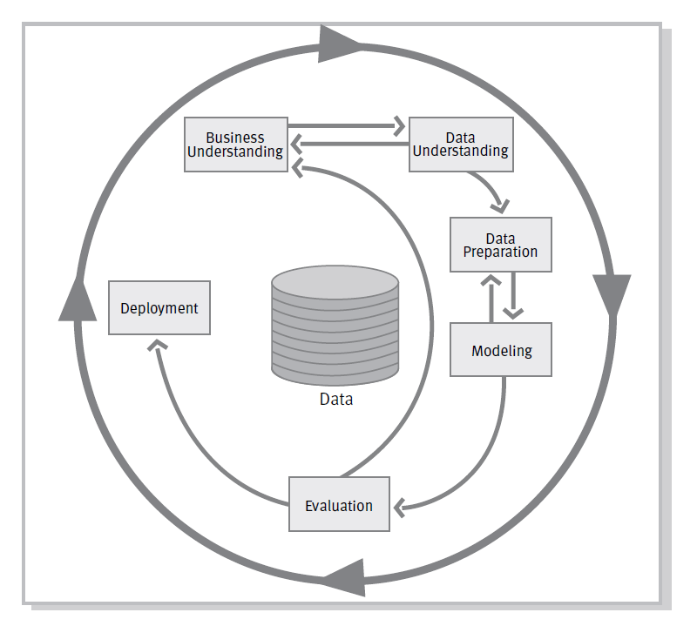
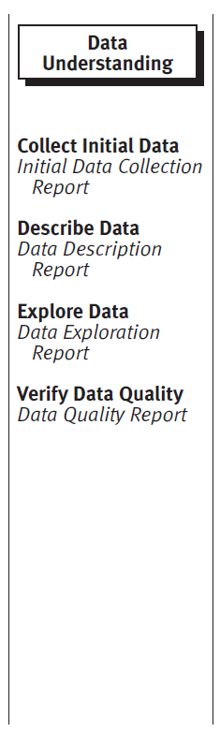
The CRISP-DM Model

Slide 3
Previous IWDS workshop
Dataset: https://data.gov.uk/dataset/road-safety
Tasks for today:
Collect initial data
Data Description Report
Data Exploration Report
Data Quality Report

Slide 4
IWDS workshop today: Exploratory data analysis with Python overview
The Data
Examining missing values and data imputation
Examining and dealing with outliers
Correlation matrices
Other plots

Slide 5
Data Understanding
To prepare your data, you would need to use:
The file called stats20-2005.pdf as it explains how the data was collected.
The script called “dataUnderstanding.py” that prepares the data for you

Slide 6
Examining missing values and imputation
Use describe from Pandas to basic statistics of your dataframe
Visualise missing values using the package called missingno
10% rule: it is appropriate to impute missing values when 10% is missing. If we impute data with more than 10% of that column missing then artificial relationships can be introduced leading to errors.

Slide 7
Resources for Missing values
Missing values using Pandas
http://pandas.pydata.org/pandas-docs/stable/missing_data.html
Imputation of missing values with Scikit-learn
http://scikit-learn.org/stable/modules/preprocessing.html#imputation-of-missing-values

Slide 8
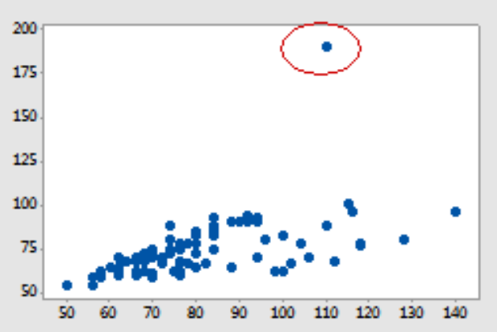
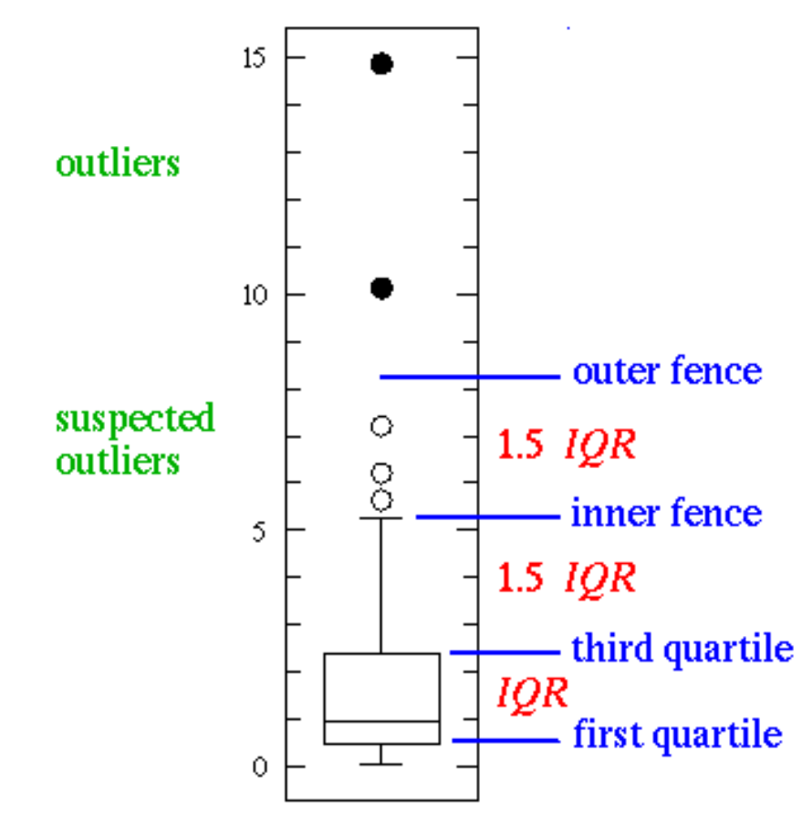
Examining and dealing with outliers
Summary
Useful link

Slide 9
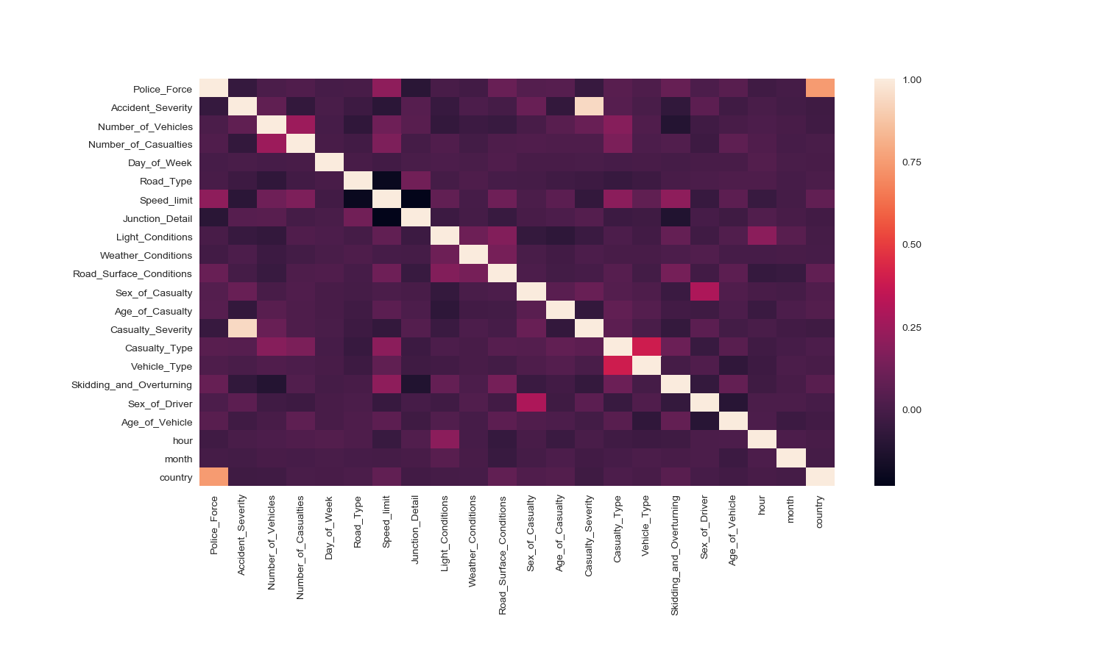
Correlation matrices

Slide 10
Go through the Python script

Slide 11
Tasks
Try to explore and answer the following questions:
1) When are the accidents happening?
2) What people are involved in the accidents?
3) What type of vehicles are likely to have accidents?
4) What are the weather conditions when the accidents happened?
5) Where are the accidents happening?

Slide 12
Resources for Data manipulation
Library dfply
https://towardsdatascience.com/dplyr-style-data-manipulation-with-pipes-in-python-380dcb137000
Pandas
https://www.shanelynn.ie/summarising-aggregation-and-grouping-data-in-python-pandas/

Slide 13
Resources for Missing values
Missing values using Pandas
http://pandas.pydata.org/pandas-docs/stable/missing_data.html
Imputation of missing values with Scikit-learn
http://scikit-learn.org/stable/modules/preprocessing.html#imputation-of-missing-values

Slide 14
Resources for Visualization
Visualization of missing values
http://www.ultravioletanalytics.com/blog/investigating-missing-data-with-missingno
Visualization of Correlation matrices
https://seaborn.pydata.org/generated/seaborn.heatmap.html

Slide 15
Univariate and Bivariate Visualization
Pandas
https://machinelearningmastery.com/visualize-machine-learning-data-python-pandas/
https://pandas.pydata.org/pandas-docs/stable/visualization.html
Matplotlib
https://matplotlib.org/tutorials/introductory/sample_plots.html#sphx-glr-tutorials-introductory-sample-plots-py
https://matplotlib.org/gallery/statistics/boxplot_demo.html
Plotly
https://plot.ly/python/getting-started/#more-examples

