Slide 1
BCCA figures
Feb 18 2025

Slide 2
At least 5 entries – top

Slide 3
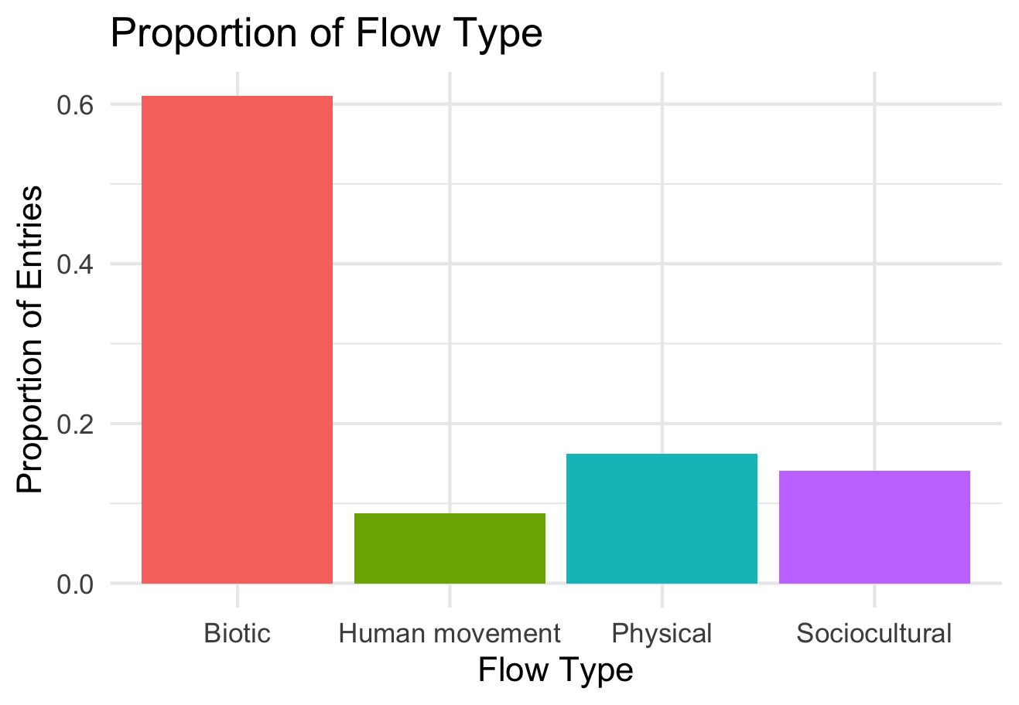

Slide 4
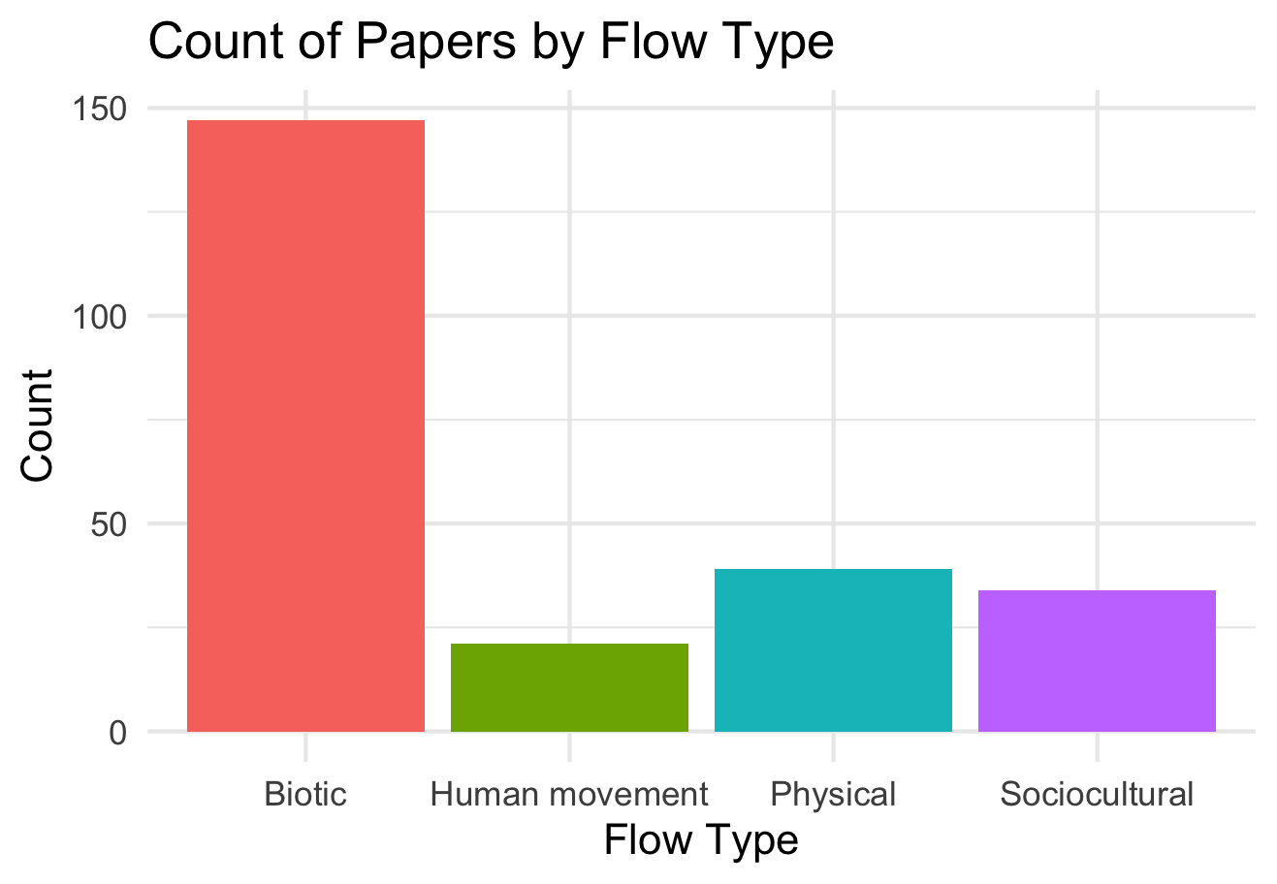

Slide 5
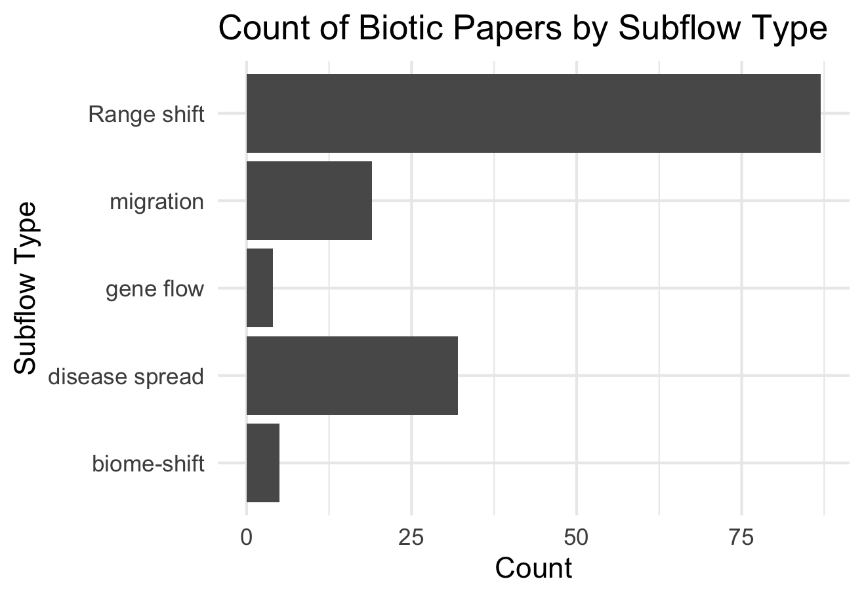

Slide 6
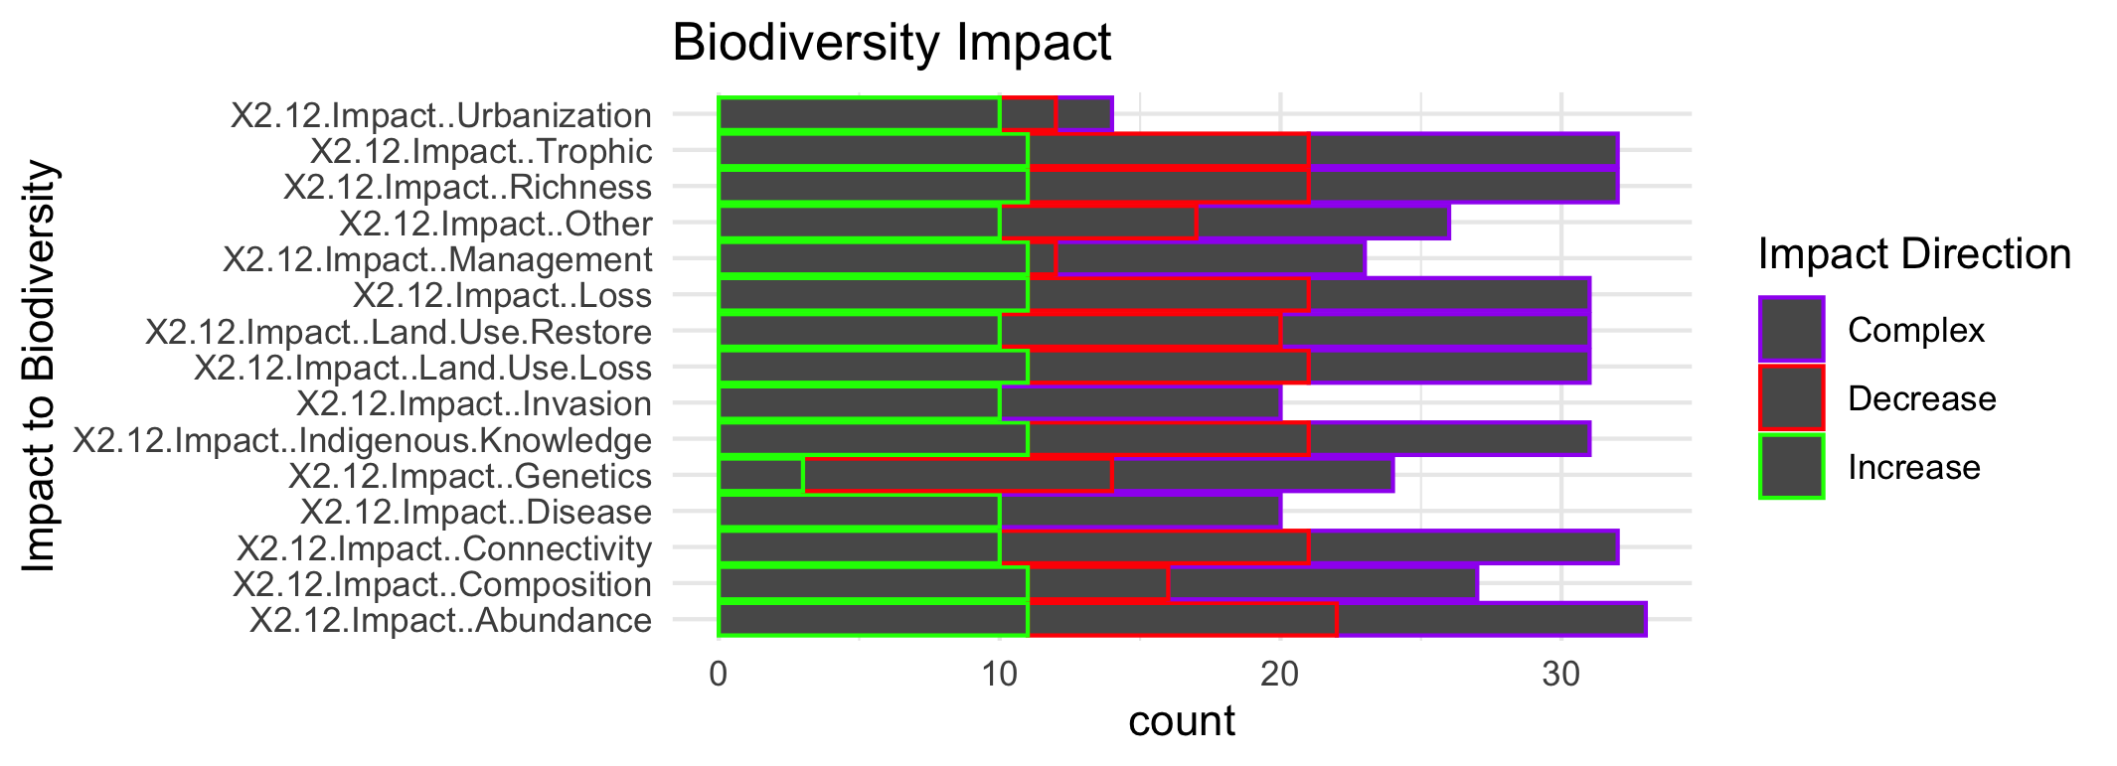
Increase is “good” –

