Slide 1

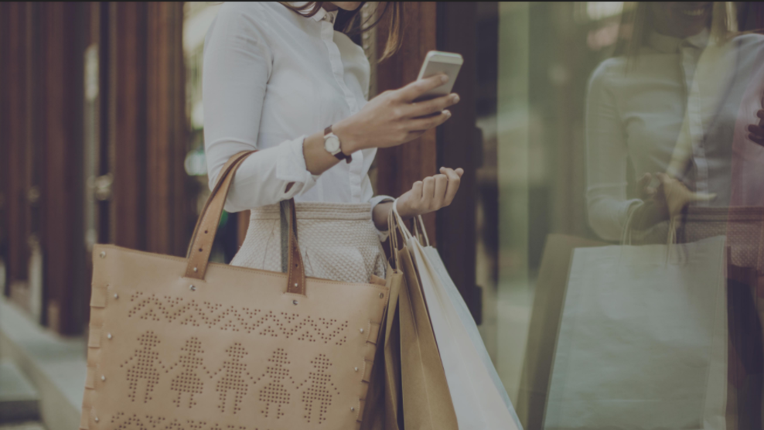
Landing page
Séminaire Pig Hive
2018

Slide 2

ABOUT ME
2009 – 2011 : Prépa MP
2011 - 2014 : Ensai – Filière SID
2014 – Aujourd’hui : Data Scientist – Advalo
«Réinventer la relation entre la marque et ses consommateurs»
cbremard@advalo.com

Slide 3
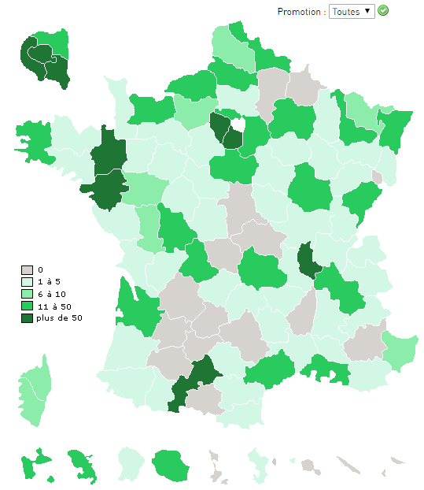
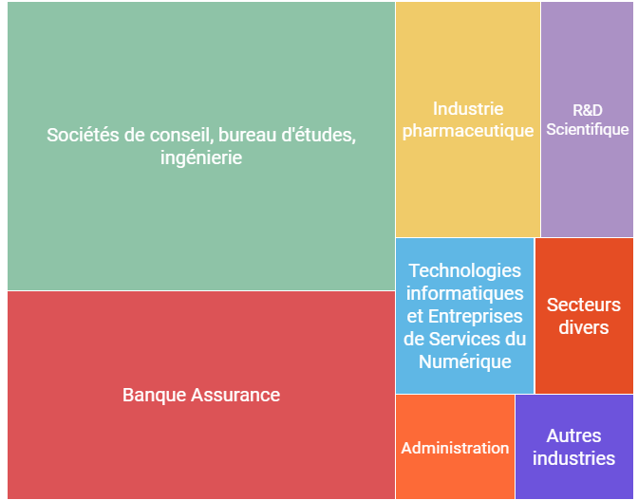
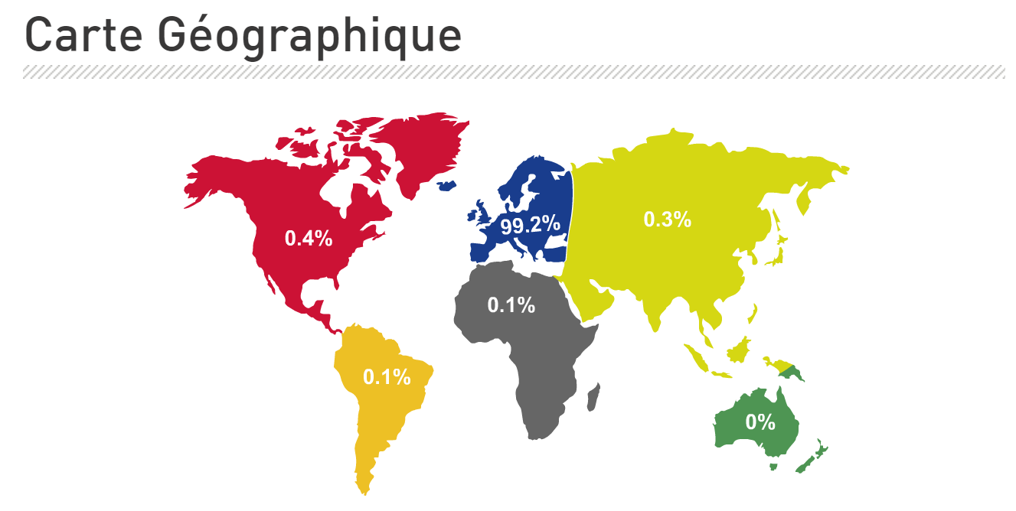

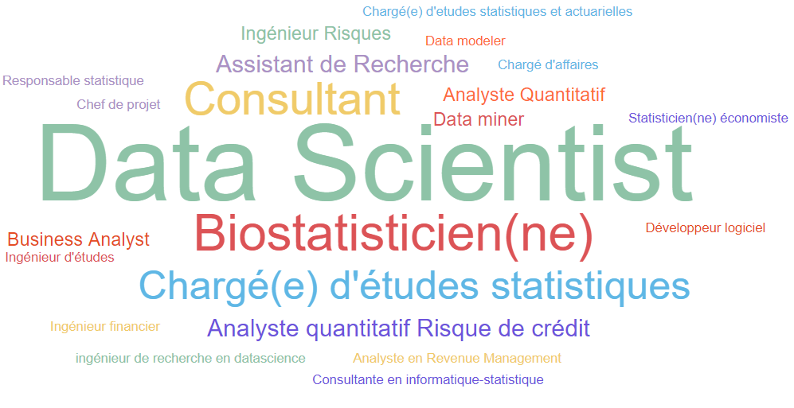
ABOUT YOU

Slide 4
Around you
lundi 15 janvier 2018 : New feature representations for image retrieval and semantic matching (Rennes)
mercredi 24 janvier 2018 : R, vous avez dit R ? (Rennes)
lundi 5 février 2018 : GuessWhat?! A Visually grounded goal-oriented dialogue tasks for Deep Reinforcem (Nantes)
lundi 12 février 2018 : Mise en production de code R : retour d'expRience (Nantes)
http://www.datatau.com/
https://www.lebigdata.fr/
https://www.decideo.fr/
Etc.

Slide 5








VARIETE

Slide 6





VELOCITE

Slide 7

















VOLUME
https://db-engines.com/en/ranking
Notes:
Rank DBMS Database Model Score
1. Oracle Relational DBMS 1341.94
2. MySQL Relational DBMS 1299.71
3. Microsoft SQL Server Relational DBMS 1148.07
4. PostgreSQL Relational DBMS 386.18
5. MongoDB Document store 330.95
6. DB2 Relational DBMS 190.28
7. Microsoft Access Relational DBMS 126.70
8. Cassandra Wide column store 123.88
9. Redis Key-value store 123.14
10. Elasticsearch Search engine 122.55
11. SQLite Relational DBMS 114.25
12. Teradata Relational DBMS 72.63
13. SAP Adaptive Server Relational DBMS 65.46
14. Solr Search engine 64.37
15. Splunk Search engine 64.00
16. HBase Wide column store 61.64
17. MariaDB Relational DBMS 58.30
18. Hive Relational DBMS 55.49
19. FileMaker Relational DBMS 55.20
20. SAP HANA Relational DBMS 46.16

Slide 8


BIG DATA
VARIETE
VELOCITE
VOLUME

Slide 9

query.wikidata.org

Slide 10
ftp://ftp.fu-berlin.de/pub/misc/movies/database/frozendata/ratings.list.gz
https://www.prix-carburants.gouv.fr/rubrique/opendata/

Slide 11

END
advalo.com

