Slide 1

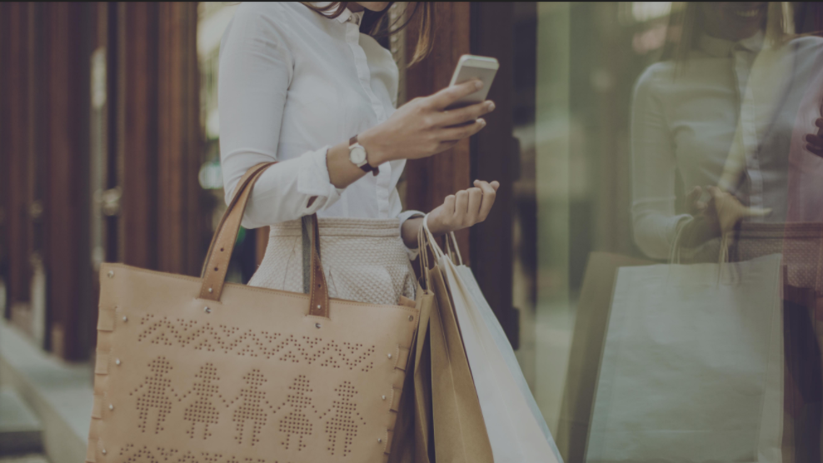
Landing page
Séminaire Pig Hive
Mercredi 17 janvier 2018

Slide 2

ABOUT ME
2009 – 2011 : Prépa MP
2011 - 2014 : Ensai – Filière SID
2014 – Aujourd’hui : Data Scientist – Advalo
«Réinventer la relation entre la marque et ses consommateurs»
cbremard@advalo.com

Slide 3
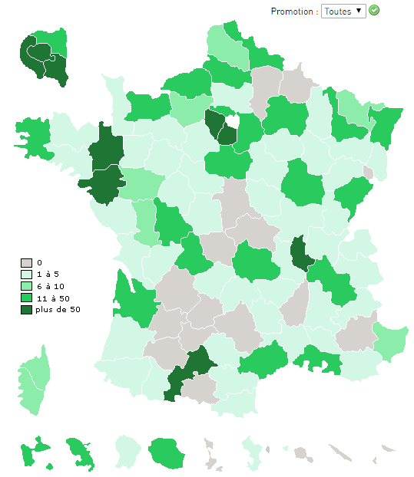
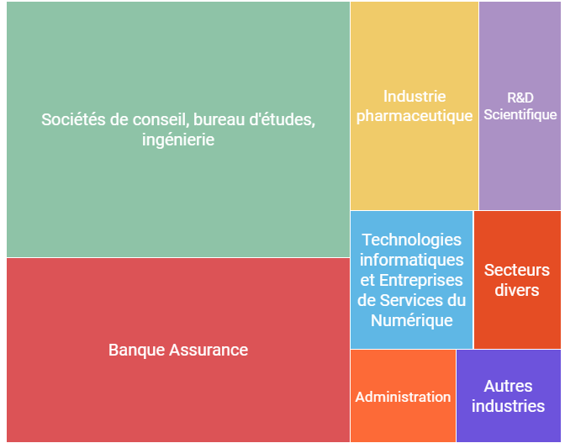
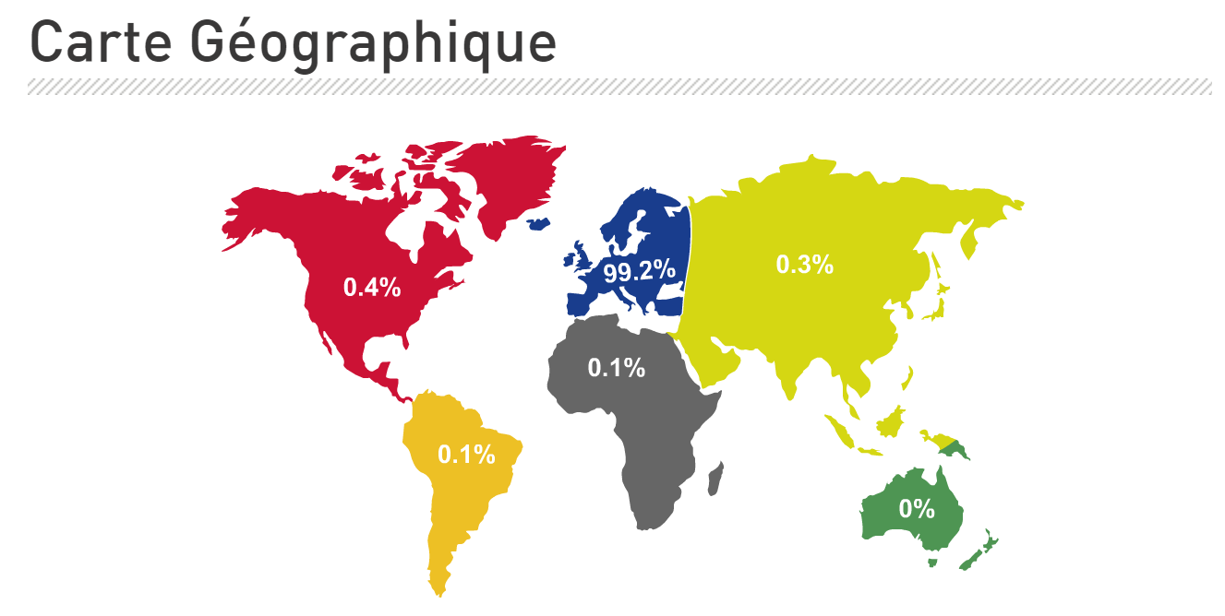

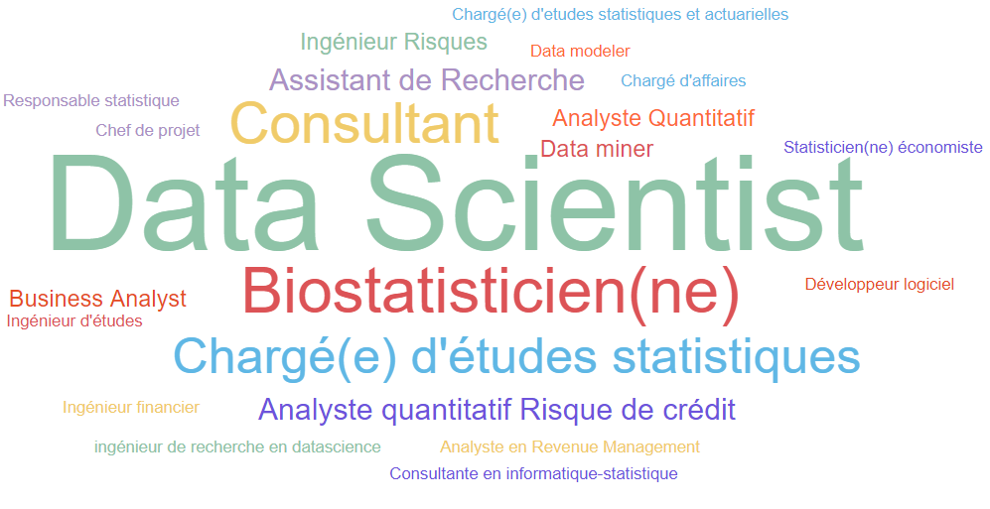
ABOUT YOU

Slide 4
Around you
jeudi 17 janvier 2018 : Data Thursday, vous faites parler vos données, venez en parler !(Rennes)
mercredi 24 janvier 2018 : R, vous avez dit R ? (Rennes)
lundi 5 février 2018 : GuessWhat?! A Visually grounded goal-oriented dialogue tasks for Deep Reinforcem (Nantes)
lundi 12 février 2018 : Mise en production de code R : retour d'expRience (Nantes)
http://www.datatau.com/
https://www.lebigdata.fr/
https://www.decideo.fr/
Etc.

Slide 5

































BIG DATA
VARIETE
VELOCITE
VOLUME
https://db-engines.com/en/ranking
Notes:
Rank DBMS Database Model Score
1. Oracle Relational DBMS 1341.94
2. MySQL Relational DBMS 1299.71
3. Microsoft SQL Server Relational DBMS 1148.07
4. PostgreSQL Relational DBMS 386.18
5. MongoDB Document store 330.95
6. DB2 Relational DBMS 190.28
7. Microsoft Access Relational DBMS 126.70
8. Cassandra Wide column store 123.88
9. Redis Key-value store 123.14
10. Elasticsearch Search engine 122.55
11. SQLite Relational DBMS 114.25
12. Teradata Relational DBMS 72.63
13. SAP Adaptive Server Relational DBMS 65.46
14. Solr Search engine 64.37
15. Splunk Search engine 64.00
16. HBase Wide column store 61.64
17. MariaDB Relational DBMS 58.30
18. Hive Relational DBMS 55.49
19. FileMaker Relational DBMS 55.20
20. SAP HANA Relational DBMS 46.16

Slide 6
HIVE
CREATE [TEMPORARY] [EXTERNAL] TABLE [IF NOT EXISTS] [db_name.]table_name ( col_name1 data_type1 [COMMENT col_comment1],
col_name2 data_type2 [COMMENT col_comment2], etc. );
Date Functions :
unix_timestamp() String
unix_timestamp(String date) BigInt
unix_timestamp(String date, String pattern) BigInt
date_format(Date/Timestamp/String ts, String fmt) String
year, quarter, month, weekofyear, day, dayofmonth, hour, minute, second Int
datediff(String enddate, String startdate) Int
date_add(String startdate, Int days) (date_sub) String
add_months(String start_date, Int num_months) String
months_between(enddate, startdate) Int
String Functions :
concat(str1, str2, …) String
concat_ws(SEP, str1, str2, …) String
concat_ws(SEP, Array<String>) String
instr(String text, String str) Int
length(string A) Int
locate(String str, String text [, Int pos]) Int
lower(String A), lcase(String A) String
get_json_object(String json_string, String path) String
json_tuple(jsonStr, k1, k2, ...) Tuple
Etc.
Built-in Aggregate Functions (UDAF) :
count(*), count(expr), count(DISTINCT expr[, expr...])
sum(col), sum(DISTINCT col)
avg(col), avg(DISTINCT col)
min(col), max(col)
variance(col), var_pop(col)
stddev_pop(col)
corr(col1, col2)
Collection Functions :
map_keys(Map<K,V>) Array<K>
map_values(Map<K,V>) Array<V>
sort_array(Array<T>) Array<T>
array_contains(Array<T>,value) Boolean
explode(ARRAY<T>) T
size(Map<K,V>) Int
size(Array<T>) Int
CREATE TABLE
SELECT [ALL | DISTINCT] select_expr, select_expr, ...
FROM table_reference
[WHERE where_condition]
[GROUP BY col_list]
[LIMIT number] ;
Datatypes :
INT
BIGINT
STRING
DATE
TIMESTAMP
BOOLEAN
BINARY
ARRAY < data_type >
MAP < primitive_type, data_type >
STRUCT <
col_name : data_type,
col_name : data_type,
etc. >
UNIONTYPE < data_type, data_type, ... >
SELECT QUERY
FUNCTIONS
https://cwiki.apache.org/confluence/display/Hive/LanguageManual+DDL

Slide 7
Exercice 1 : Créer une table Hive
https://www.prix-carburants.gouv.fr/rubrique/opendata/
<pdv id="35200003" latitude="4808940" longitude="-166422" cp="35200" pop="R"> <adresse>Boulevard Paul Hutin Desgrées</adresse> <ville>RENNES</ville> <ouverture debut="01:00" fin="01:00" saufjour=""/> <services> <service>Vente de gaz domestique</service> </services> <prix nom="Gazole" id="1" maj="2018-01-06 08:58:27" valeur="1.368"/> <prix nom="SP95" id="2" maj="2018-01-06 08:58:27" valeur="1.445"/> <prix nom="E10" id="5" maj="2018-01-06 08:58:28" valeur="1.404"/> </pdv>

Slide 8
Correction exo 1

Slide 9

HIVE
Math Functions:
ABS
ACOS
ASIN
ATAN
CBRT
CEIL
COS
COSH
EXP
FLOOR
LOG
LOG10
RANDOM
ROUND
ROUND_TO
SIN
SINH
SQRT
TAN
TANH
alias = LOAD 'data' [USING function] [AS schema];
Datetime Functions:
AddDuration
CurrentTime
DaysBetween
GetDay
GetHour
GetMilliSecond
GetMinute
GetMonth
GetSecond
GetWeek
GetWeekYear
GetYear
HoursBetween
MilliSecondsBetween
MinutesBetween
MonthsBetween
SecondsBetwee
SubtractDuration
ToDate
ToMilliSeconds
ToString
ToUnixTime
WeeksBetween
YearsBetween
alias = GROUP alias { ALL | BY expression} [USING 'collected' | 'merge'] [PARALLEL n];
alias = COGROUP alias BY field_alias , alias BY field_alias ;
ALL Use ALL if you want all tuples to go to a single group.
BY Use this clause to group the relation by field, tuple or expression.
expression A tuple expression.
USING Keyword
'collected‘ With the GROUP operation (works with one relation).
'merge‘ With the COGROUP operation (works with two or more relations).
PARALLEL n Increase the parallelism of a job by n.
String Functions :
ENDSWITH
EqualsIgnoreCase
INDEXOF
LAST_INDEX_OF
LCFIRST
LOWER
LTRIM
REGEX_EXTRACT
REGEX_EXTRACT_ALL
REPLACE
RTRIM
SPRINTF
STARTSWITH
STRSPLIT
STRSPLITTOBAG
SUBSTRING
TRIM
UCFIRST
UPPER
UniqueID
Eval Functions :
AVG
BagToString
CONCAT
COUNT
COUNT_STAR
DIFF
IsEmpty
MAX
MIN
PluckTuple
SIZE
SUBTRACT
SUM
TOKENIZE
Tuple, Bag, Map Functions :
TOTUPLE
TOBAG
TOMAP
LOAD DATA
'data' The name of the file or directory, in single quotes.
USING Keyword.
function The load function.
schema A schema using the AS keyword, enclosed in parentheses.
alias = JOIN left-alias BY left-alias-column [LEFT|RIGHT|FULL][OUTER], right-alias BY right-alias-column [USING 'replicated' | 'skewed' | 'merge'] [PARALLEL n];
BY Keyword
LEFT Left outer join.
RIGHT Right outer join.
FULL Full outer join.
OUTER (Optional) Keyword
alias = LIMIT alias n;
alias The name of a relation.
n The number of output tuples
alias = FILTER alias BY expression;
alias The name of the relation.
BY Required keyword.
expression A boolean expression.
alias = FOREACH alias GENERATE (col AS col_name);
Function :
BinStorage
JsonLoader, JsonStorage
PigDump
PigStorage
TextLoader
HBaseStorage
HCatLoder/HCatStorer
DATA OPERATION
FUNCTIONS
http://pig.apache.org/docs/r0.15.0/func.html

Slide 10
Exercice 2 : Importer les données dans Hive avec Pig
<pdv id="35200003" latitude="4808940" longitude="-166422" cp="35200" pop="R"> <adresse>Boulevard Paul Hutin Desgrées</adresse> <ville>RENNES</ville> <ouverture debut="01:00" fin="01:00" saufjour=""/> <services> <service>Vente de gaz domestique</service> </services> <prix nom="Gazole" id="1" maj="2018-01-06 08:58:27" valeur="1.368"/> <prix nom="SP95" id="2" maj="2018-01-06 08:58:27" valeur="1.445"/> <prix nom="E10" id="5" maj="2018-01-06 08:58:28" valeur="1.404"/> </pdv>

Slide 11
Correction exo 2

Slide 12
Exercice 3 : Recommender system
ratings.csv -> userId,movieId,rating,timestamp
tags.csv -> userId,movieId,tag,timestamp
movies.csv -> movieId,title,genres
links.csv -> movieId,imdbId,tmdbId

Slide 13

END
advalo.com

