Slide 1
Comfortable Chaos
Managing an Open Project

Slide 2

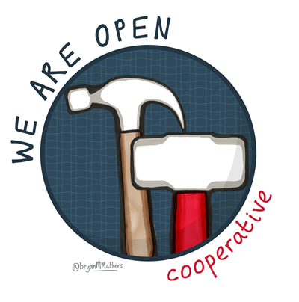
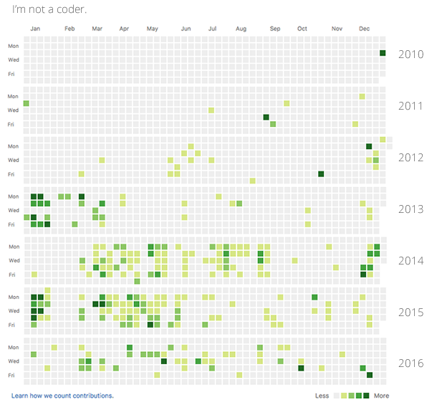




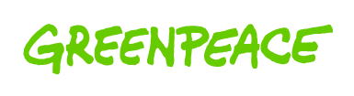
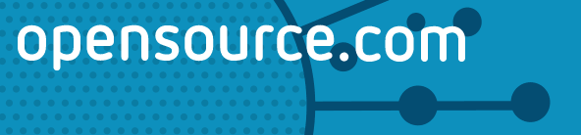
 | Laura Hilliger Open Strategist laurahilliger.com @epilepticrabbit linkedin.com/in/laurahilliger
Notes:
Hi, my name is Laura Hilliger. I am a founding member of the We Are Open Cooperative and I’ve been working with Greenpeace since 2015. Both my coop and my gig at Greenpeace is about spreading the beliefs, processes and culture of open. I spent over five years working at Mozilla, the makers of Firefox, where I helped spread web literacy – the social and technical skills and competencies that make working openly possible. I’ve contributed to loads of different open projects, all over the web.
And while I truly believe in the core of open practices – decentralizing power, 100% transparency, allowing for remixabilty – I also believe that this way of working and being is highly nuanced and utterly dependent on the collective consciousness, rather than individual understandings of “open”.
So today, I’m going to talk a little about the nuances I’ve seen in bringing open practices and then I’m going to invite you to openly reflect or ask questions.

Slide 3
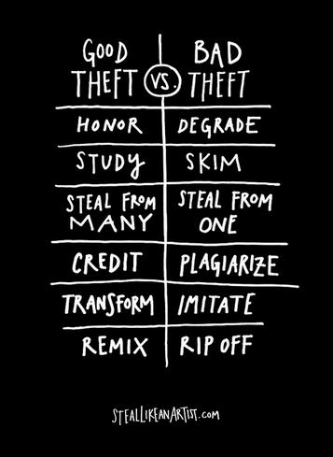
What does “open”
really mean?
Transparency
Decentralization
Hackability / Innovation
Notes:
“Open source”, open data, open education, open government, open food...“Open” isn’t just a fun buzzword, it started as a technological revolution and has evolved into a cultural movement. There are three main tenets of open.
Transparency: the culture of Open is one that is transparent about processes, creations and authors. We make media and write posts about our work. We ask questions and allow anyone to feedback on them through commenting and social media. We change things based on what our peers say, and we explain our decisions openly, so that everyone can see not only what we've done, but how and why.
Decentralization: The Open Web is made up of thousands of independent servers and webpages. The networked computers that make up the Internet are not owned by any single entity. Additionally, webpages are created and maintained by millions of people. Decentralization in the social and cultural space is inherent in anything “open”. Nothing is under a single authority. The themes, topics and materials a project addresses and creates aren’t created in a vacuum. They are created collaboratively. Peer to peer feedback and collective work runs the show.
Hackability and Innovation: Transparency and decentralization allow for hackability and innovation – Good ideas can come from anywhere. Open is a structure that makes remix and redistribution easy, the culture that lives by these tenets takes pride in extending, changing and reforming each other's work. Because we can see how things are built, we can change them and apply new meaning and context atop someone else's ideas. We start to have a conversation through production, and that is something that is supported by and encouraged through “open”

Slide 4
Distributed Leadership
Notes:
Let’s talk a little about the benefits of working openly, from a meta - philosophical level. Or in GP terms, from the mindset level.

Slide 5
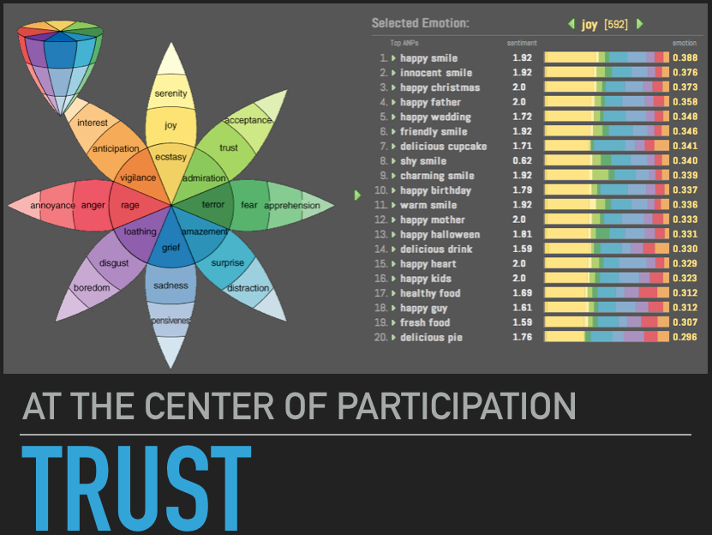
Culture is a shared space and…
"the prevailing beliefs, values, and customs of a group"
The Culture Group, 2013
Notes:
At Greenpeace, we’ve determined that we need to think differently than the status quo to make impact. We need to be innovative, fail forward, take more risks, and all that other stuff the Framework says. Part of transitioning to this new mode of being, mode of working is about overcoming aspects of our identities and emotions that we’ve had instilled upon us. We have to reflect on and give tribute to the social and cultural norms that define us.
Our emotional legacy is influenced by surroundings and norms, so what keeps us from truly participating 100% of the time is fear and the social and cultural norms we’ve been taught are rules in civil discourse and social behavior. We’ve been taught that that the speaker is notable, that the CEO has vision, that the teacher is the expert, that the police maintain control, that respect means being quiet and letting others have the floor. We’ve been taught what “right” in social situations is.
But all of that is a collective perception that has roots.
With the invention of the web, we’re much quicker to learn histories and contexts, relationships and influences that we didn’t know about before. Our ability to connect, allows us to talk about social norms and push back at common public perceptions.
This is beginning to bleed into the real world in fascinating ways. We’ve been taught a certain degree of distrust, but much of the open community is adopting views around the way we interact with each other. There are communities who are putting trust at the center of how they operate.
Views like “Everyone’s voice matters” or “There are no stupid questions”. Simple, humanistic points of view that are directly related to how we as human beings participate in the world and govern our lives.
In business, this is changing entire power structures and dynamics.

Slide 6
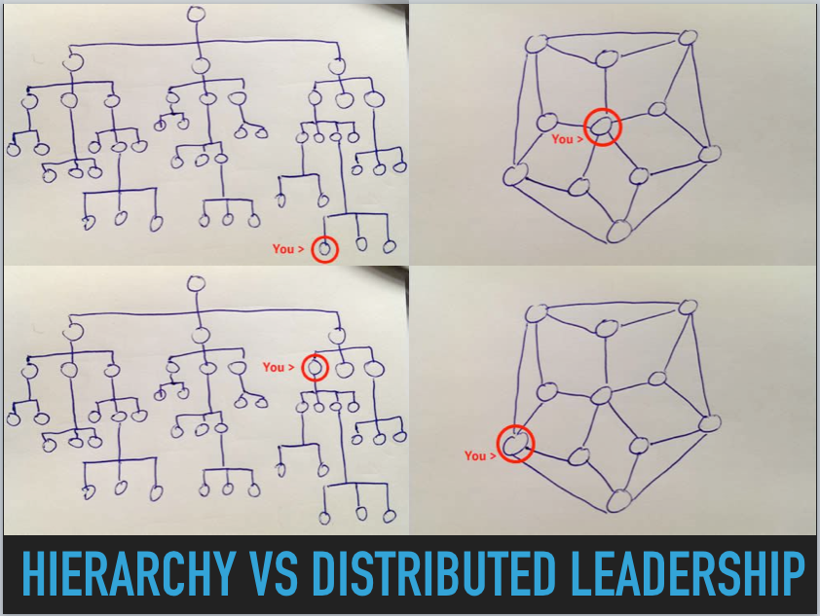
How distributed leadership looks like
Notes:
Ok, now that we have the behaviors bit out of the way, let’s talk about it more practically. Putting everyone on the same level and giving everyone agency and promoting open collaboration is a terrifying prospect, especially in business. It’s a pretty unnatural feeling. And it’s a pretty impossible feeling to feel, all the time, that we are worthy of having voice.
We are groomed to understand hierarchies, authorities and seniorities. An agile management structure allows the person most capable of a particular job to manage that bit of the project in a way that makes sense to them. This is critical because we don’t all think the same way.
Let’s look at Planet 4 through this lens, yeah?

Slide 7
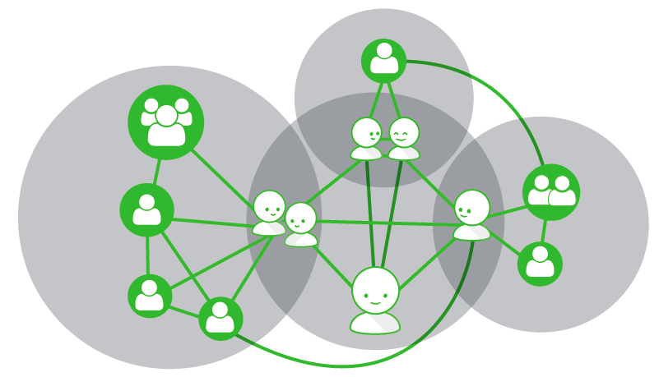
Decentralized Planet 4 Team
Notes:
Left is the tech team, up top is Support and Comms, to the right Design and in the middle the PM team. The 6 people in the PM team coordinate their pieces and parts. We work together to coordinate each other.
This structure might look confusing, but it’s what makes innovation possible. We are all responsible. We are all accountable.

Slide 8
Designing for Participation
Notes:
I explain "participatory" as the difference between a lecture and a conversation. It's the difference between passive and active. Centering on people’s interests and facilitating connections helps people produce something is valuable for their community. Their personal and professional development hangs on the feeling of connection. Humans live for connection, we physically need it.

Slide 9

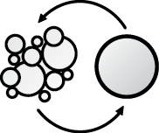




What is an open decision?
TRANSPARENT
INCLUSIVE
COMMUNITY-CENTRIC
Explain what problems you're trying to solve, the requirements and constraints involved, the process you will follow, how people can contribute and document your decision making.
Engage others for feedback and collaborate throughout the decision-making process.
Seek out diverse perspectives, including potential detractors.
Think of people as with competing needs and priorities. Some people have opinions on UX while others want to talk about testing. This framework helps involve the right people at the right time.
When a decision will help some community members, but disappoint others, manage relationships and expectations while getting stuff done.
Notes:
This framework shows how individuals (or groups) have contributed to a project thereby creating a more equitable structure, but does not change the RACI/RASCI.
1 - We have a project team, and they are responsible for the project outcome and the audience management (there won't be any trolling involved)
2 - We need to keep in mind that we can't please everyone, and since we are responsible we will take decisions
3 - Project RACI/RASCI remains the same - the difference is that the responsible party will be more informed in their decision making because they'll have the documented input of people more equipped to make certain decisions (e.g. A project manager might be responsible for a decision around UX, but it's the designers and their peers who have the authority to advise.)
Publish early and often

Slide 10
Hackability & Innovation by Inviting participation
Community Calls. Here’s a guide, this is long term trust building. http://bit.ly/OS-calls
Individual outreach. It’s so easy to say please and thank you, ask how people are.
Listening. Amazing what you hear if you learn to listen well.
Notes:
So people who believe in open strive to design projects to be participatory and collaborative by creating structures where roles are shifted.
There are many simple techniques that help people have agency. My top 3 are super simple:
Community Calls. Here’s a guide, this is long term trust building.
Individual outreach. It’s so easy to say please and thank you.
Listening. Amazing what you hear if you learn to listen well.

Slide 11
Managing an Open Project
Notes:
How does this work? Practically?
Every project team is different, so you need to work together to define which structures work for your team. This is a negotiation because our brains function differently. In an open project it’s massively important to think about how transparency, decentralization and hackability are represented in your management structures.
The Planet 4 team negotiated over months. Not days. We made decisions as we went, changed our minds, and went through the process of getting to know how each individual works. We made compromises to each other.
I urge colleagues to publish links to every document, image, bug and product to get them thinking about open practices through practice. Giving people agency is the reason I serve as a model regardless of perceived power dynamics. This has gotten me into loads of trouble, but modeling the behaviors you want to see in the world is the only way you can adequately affect change.
I organize my own work around the idea that other people can participate. I set up systems that they can use. I adjust to their technical and social skill level.
I believe that together we are smarter. Participation is key for any organization looking to change the world, so getting people to trust in best intentions again is part of making the world a better place.
Shifting the behaviors and mindsets of “everyone”, which, by the way is every non-profits target audience, means that we need the input and understanding of “everyone”. We have to stop pretending like we can save the planet without the “masses”.
I’ve learned that you have to help people understand why their participation is necessary and create systems that make participation easy. You have to help people understand what you’re working on, and you have to respect peoples contributions. Most importantly, you have to model the behaviors you want to see in the world.

Slide 12
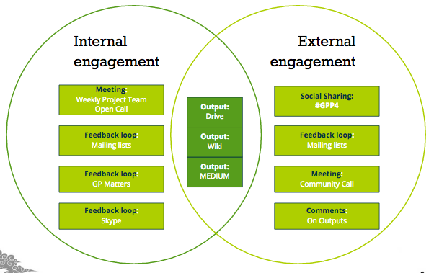
Transparency: Having a corner of the web
Notes:
Having a corner of the web you control so you can publish your outputs.

Slide 13
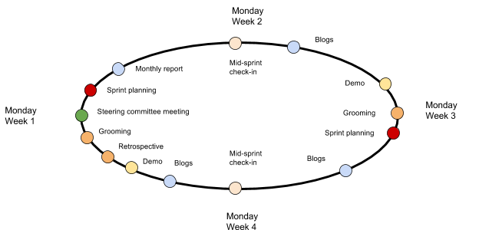
Coordination: Agile Methodology
Notes:
Since open is inherently about making sure that people have agency, the project management needs to be designed in a way that coordinates people but gives them freedom.
Every two weeks, the Planet 4 team comes together to define high level, achievable goals for the sprint. Subteams then refine those goals into specific tasks based on their areas of focus. Once agreed, tasks are logged and assigned in Jira, and everyone gets to work. After a week, we check in with one another to see if there are blockers or to onboard new fellows and catch them up. We then write about the work or create demos, so that the greater community can actively contribute or generally stay up to date with the project. This document includes more detailed documentation on each individual step of this process.

Slide 14
Leading by Example: Behaviors that spur cultural shifts
Standing up for others
Listening
Giving credit
Sharing openly
Being polite, kind and human
Admitting mistakes
Acting with integrity
all those behaviors you learned when you were little and then forgot because the world got “complicated”.
Notes:
PMs need to enable. You’re in a position to lead by example, which is why it’s critical that you learn how to support open, emergent leadership. This is mostly about opening the door for people. Help people see what it means to have agency. We're successful if we take initiative. It doesn't matter if we fail, it's about believing that we have agency.

