Slide 1
Open + Co-op
A force to be reckoned with?

Slide 2
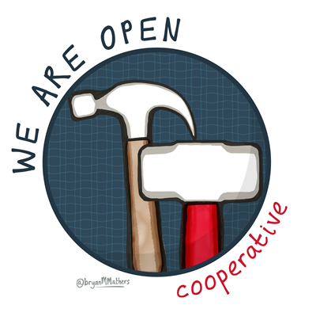
Laura Hilliger | @epilepticrabbit
Josef Davies-Coates | @jdaviescoates
http://weareopen.coop |

Slide 3
open source used to be…
A little background
kind of crappy, alternative software for poor people
a hobby for nerds
a crazy dream
Co-ops were
kind of radical business form for people who wore sandals
grocery stores that sold a lot of whole grain products
a crazy dream

Slide 4
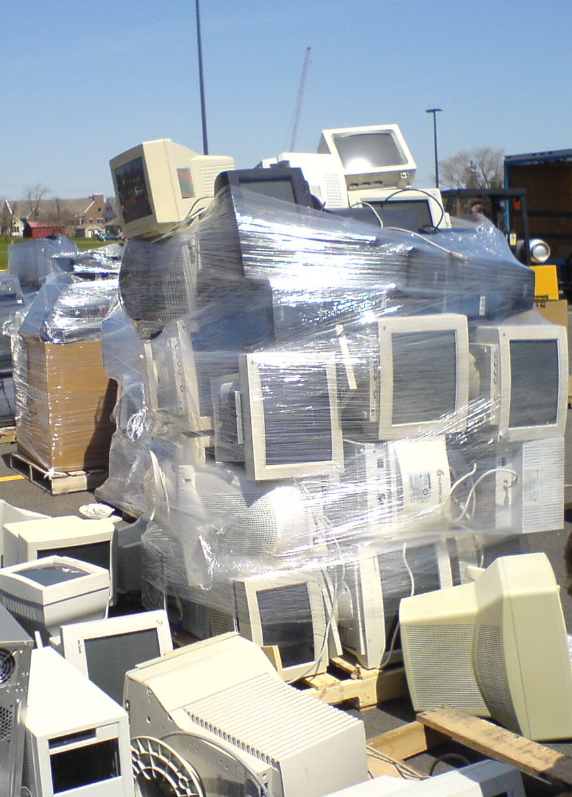
300 billion
the software industry is worth

Slide 5
78% of Companies run on #FOSS Technologies
The Future of Open Source Survey received over 1300 responses and revealed that corporate open source use
Only 3% of companies don’t use #FOSS at all

Slide 6

250 million
Co-ops worldwide employ

Slide 7

2.2 trillion turnover
2014 The World Co-operative Monitor
the largest 300 co-operatives had a

