Slide 1
Mechatronics
Week 8 Day 1

Slide 2
Previously
We learned that delays may modify the stability properties of a system
We studied the Nyquist’s criterion as an alternative to check the stability of a system without computing its poles
We learned to compute phase and gain margin of a system, and how to obtain them from their Nyquist plot
We learned the phase margin of a system is helpful to determine how much the system is robust or not in the presence of delays

Slide 3
Today’s lecture:
Absolute stability.
Stability of nonlinear system as per
Circle criterion and Popov’s criterion

Slide 4
Learning objectives
After today’s lecture, you will be able to
Check closed-loop stability of linear systems with sector nonlinearities

Slide 5
Linear Systems with Sector Nonlinearities

Slide 6
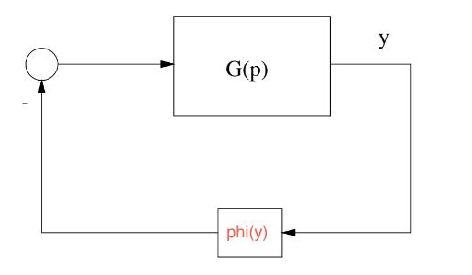



Linear systems with sector nonlinearities
A class of non-linear systems include linear time-invariant systems, with transfer function $G(s)$ and a feedback part with static nonlinearity.
$\dot{x}=Ax−bϕ\left(y\right)$
$y=c^{T}x$
$$G(s)$$
$$ϕ\left(y\right)$$

Slide 7
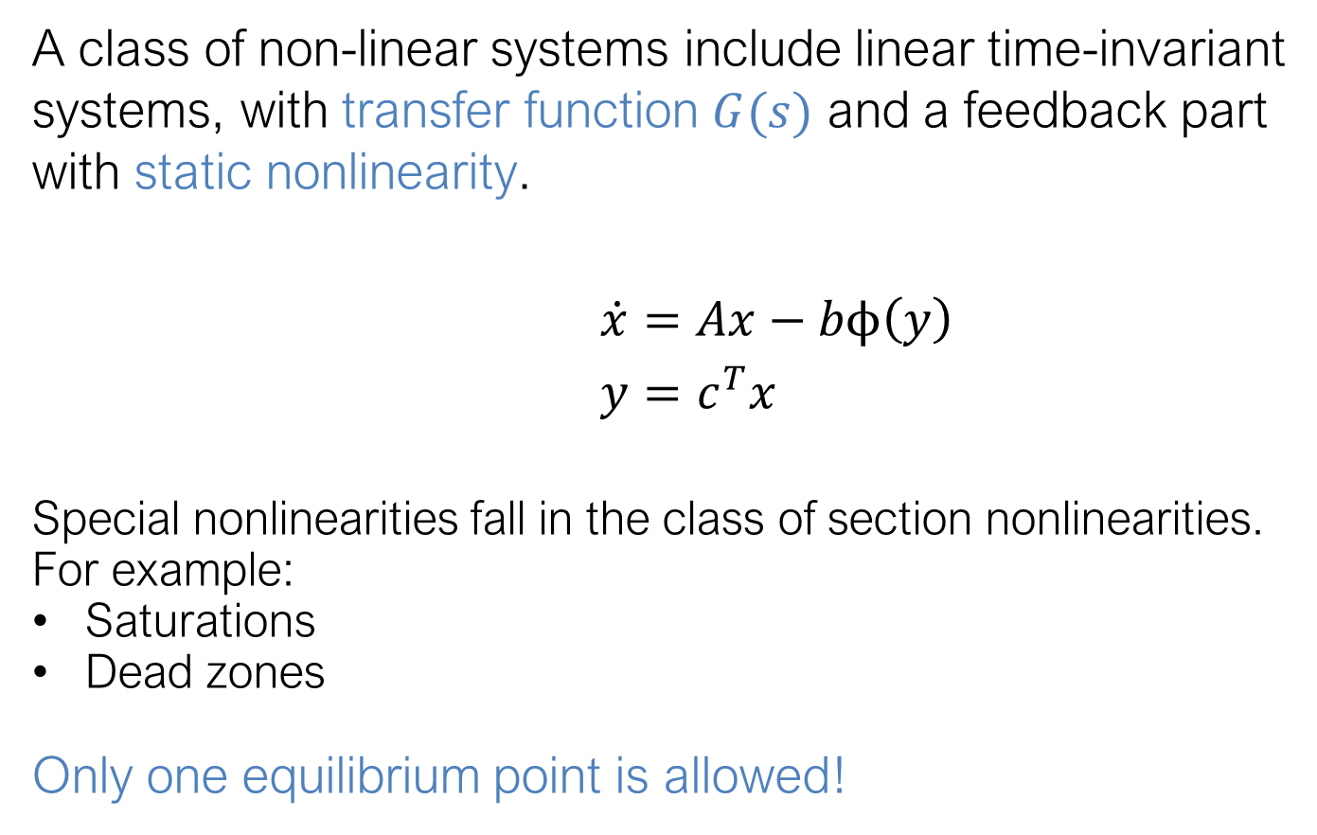
Linear systems with sector nonlinearities
A class of non-linear systems include linear time-invariant systems, with transfer function $G(s)$ and a feedback part with static nonlinearity.
$\dot{x}=Ax−bϕ\left(y\right)$
$y=c^{T}x$
Special nonlinearities fall in the class of section nonlinearities. For example:
Saturations
Dead zones
Only one equilibrium point is allowed!
$$G(s)$$
$$ϕ\left(y\right)$$
Hysteresis
Relais

Slide 8
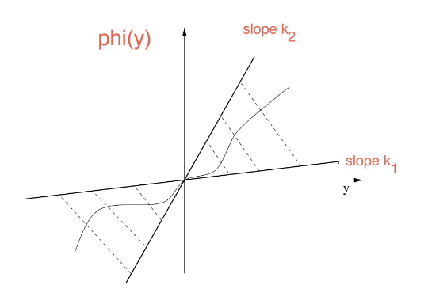




Sector nonlinearities
Sector nonlinearities $ϕ$ are continuous and belong to a sector $\left[k_{1}, k_{2}\right]$ if $k_{1}$ and $k_{2}$ exist such that
$y≠0⇒k_{1}≤\frac{φ\left(y\right)}{y}≤k_{2}$
with $ϕ\left(0\right)=0,ϕ\left(y\right)y≥0$
$$φ\left(y\right)$$
Slope $k_{2}$
Slope $k_{1}$

Slide 9

Sector nonlinearities
Sector nonlinearities $ϕ$ are continuous and belong to a sector $\left[k_{1}, k_{2}\right]$ if $k_{1}$ and $k_{2}$ exist such that
$y≠0⇒k_{1}≤\frac{φ\left(y\right)}{y}≤k_{2}$
with $ϕ\left(0\right)=0,ϕ\left(y\right)y≥0$
*A special class is defined when $0≤ϕ\left(y\right)≤ky$
*If $k_{1},k_{2}≥0$, then $ϕ$ lies only in the first and third quadrant
$$φ\left(y\right)$$
Slope $k_{2}$
Slope $k_{1}$

Slide 10
Popov’s Criterion

Slide 11

Popov’s criterion
Only useful for nonlinearities in sector $[0,k]$
Generalisation of Nyquist criterion with $\left(−1, 0\right)$replaced with a line

Slide 12

Popov’s criterion
Only useful for nonlinearities in sector $[0,k]$
Generalisation of Nyquist criterion with $\left(−1, 0\right)$replaced with a line
What line?
Consider $G\left(jω\right)=G_{1}\left(ω\right)+jG_{2}(ω)$ and correspondingly:
$$W\left(jω\right)=G_{1}\left(ω\right)+jωG_{2}\left(ω\right)$$
Then $ℜ\left\{W(jω)\right\}=ℜ\left\{G(jω)\right\}$and $ℑ\left\{W(jω)\right\}=ωℑ\left\{G(jω)\right\}$.

Slide 13
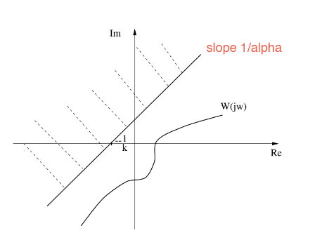


Popov’s criterion
Only useful for nonlinearities in sector $[0,k]$
Generalisation of Nyquist criterion with $\left(−1, 0\right)$replaced with a line
What line?
Consider $G\left(jω\right)=G_{1}\left(ω\right)+jG_{2}(ω)$ and correspondingly:
$$W\left(jω\right)=G_{1}\left(ω\right)+jωG_{2}\left(ω\right)$$
Then $ℜ\left\{W(jω)\right\}=ℜ\left\{G(jω)\right\}$and $ℑ\left\{W(jω)\right\}=ωℑ\left\{G(jω)\right\}$.
Consider the polar plot of $W$,
called Popov plot, and take
the line
$x−αy+\frac{1}{k}=0$
Slope $\frac{1}{α }$

Slide 14

Popov’s criterion
Proposition
If a linear system combines with a static nonlinearity in the feedback and fulfills
$A$ is asympt. stable (Hurwitz) i.e $λ_{i}\left(A\right)<0$ for all $i$ and $\left(A,b\right)$ is controllable, i.e., $\left[b Ab …A^{n−1}b\right]$ full rank
$Φ$ belongs to sector $\left[0, k\right]$
There exists an $α>0$ such that for all $ω≥0$
$$ℜ\left(\left(1+jαω\right)G\left(jω\right)\right)+\frac{1}{k}≥ε$$
for an arbitrarily small $ε>0$
then $0$is globally asymptotically stable

Slide 15
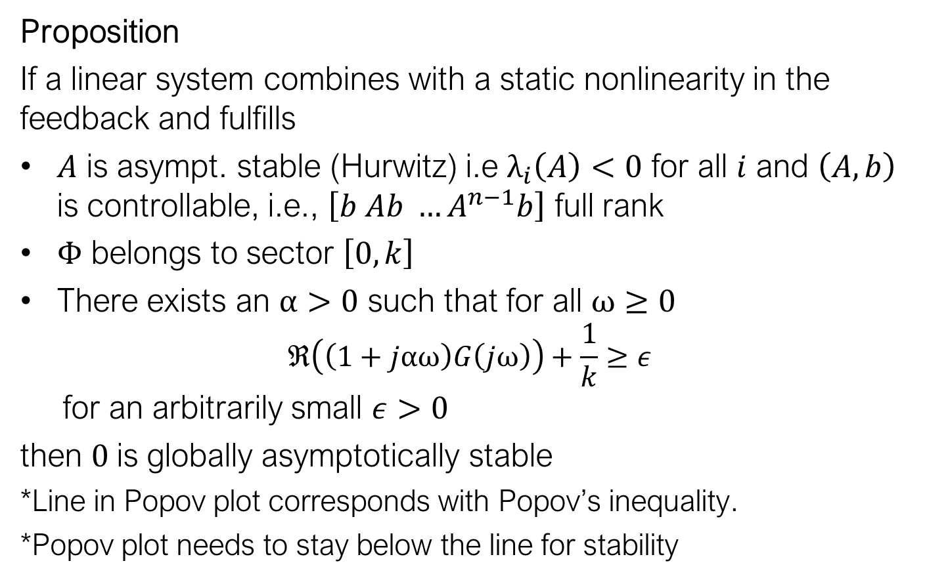
Popov’s criterion
Proposition
If a linear system combines with a static nonlinearity in the feedback and fulfills
$A$ is asympt. stable (Hurwitz) i.e $λ_{i}\left(A\right)<0$ for all $i$ and $\left(A,b\right)$ is controllable, i.e., $\left[b Ab …A^{n−1}b\right]$ full rank
$Φ$ belongs to sector $\left[0, k\right]$
There exists an $α>0$ such that for all $ω≥0$
$$ℜ\left(\left(1+jαω\right)G\left(jω\right)\right)+\frac{1}{k}≥ε$$
for an arbitrarily small $ε>0$
then $0$is globally asymptotically stable
*Line in Popov plot corresponds with Popov’s inequality.
*Popov plot needs to stay below the line for stability

Slide 16
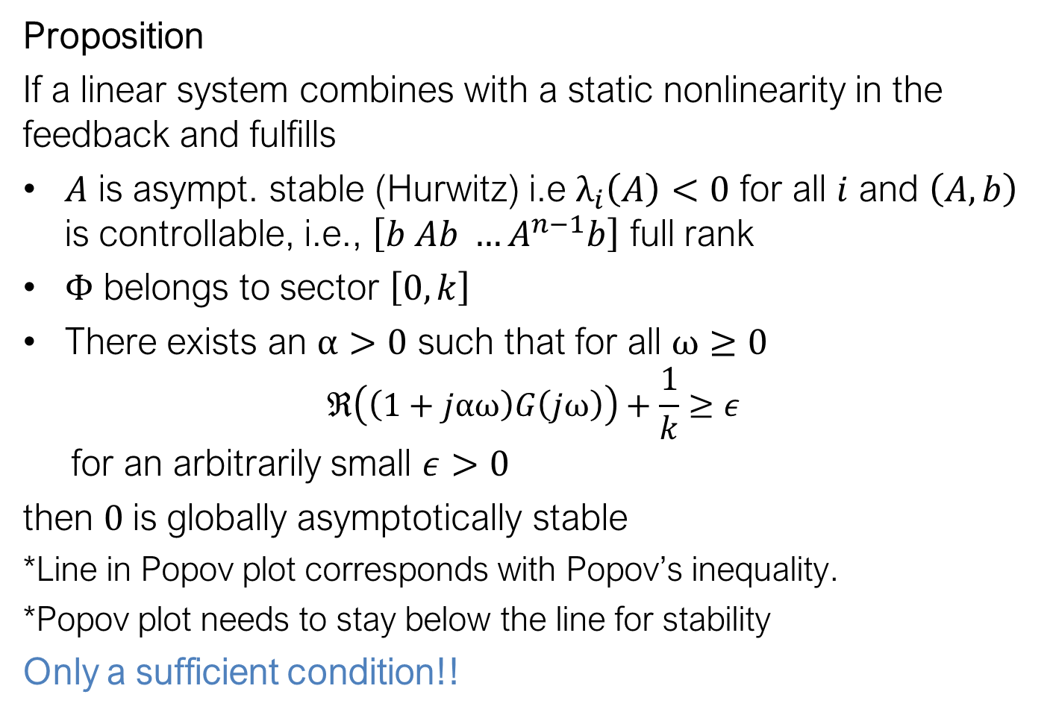
Popov’s criterion
Proposition
If a linear system combines with a static nonlinearity in the feedback and fulfills
$A$ is asympt. stable (Hurwitz) i.e $λ_{i}\left(A\right)<0$ for all $i$ and $\left(A,b\right)$ is controllable, i.e., $\left[b Ab …A^{n−1}b\right]$ full rank
$Φ$ belongs to sector $\left[0, k\right]$
There exists an $α>0$ such that for all $ω≥0$
$$ℜ\left(\left(1+jαω\right)G\left(jω\right)\right)+\frac{1}{k}≥ε$$
for an arbitrarily small $ε>0$
then $0$is globally asymptotically stable
*Line in Popov plot corresponds with Popov’s inequality.
*Popov plot needs to stay below the line for stability
Only a sufficient condition!!

Slide 17
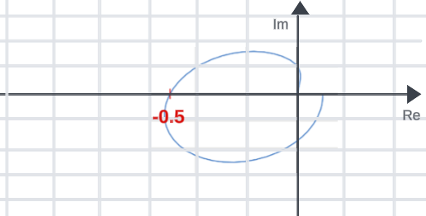




Example: Stability by Popov’s criterion
$$G(s)$$
Consider the nonlinear system on the right
where nonlinearity $ϕ(s)$ belongs to sector $[0,1]$
The Popov plot looks as follows:
$$ϕ\left(y\right)$$
$$−1$$

Slide 18

Example: Stability by Popov’s criterion
$$G(s)$$
Consider the nonlinear system on the right
where nonlinearity $ϕ(s)$ belongs to sector $[0,1]$
The Popov plot looks as follows:
We have a nonlinearity in sector $[0,1]$
$$ϕ\left(y\right)$$
$$−1$$

Slide 19


Example: Stability by Popov’s criterion
$$G(s)$$
Consider the nonlinear system on the right
where nonlinearity $ϕ(s)$ belongs to sector $[0,1]$
The Popov plot looks as follows:
We have a nonlinearity in sector $[0,1]$
We can draw a line cutting the real line at $−1$with slope $\frac{1}{α}$ with $α\text{>}\text{0 }$
$$ϕ\left(y\right)$$
$$−1$$

Slide 20
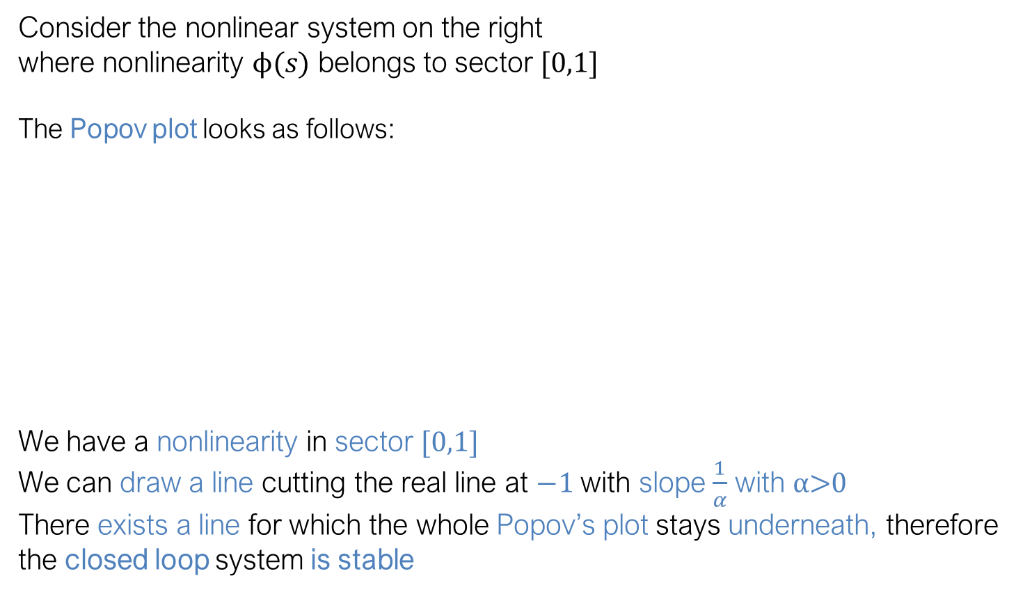
Example: Stability by Popov’s criterion
$$G(s)$$
Consider the nonlinear system on the right
where nonlinearity $ϕ(s)$ belongs to sector $[0,1]$
The Popov plot looks as follows:
We have a nonlinearity in sector $[0,1]$
We can draw a line cutting the real line at $−1$with slope $\frac{1}{α}$ with $α\text{>0 }$
There exists a line for which the whole Popov’s plot stays underneath, therefore the closed loop system is stable
$$ϕ\left(y\right)$$
$$−1$$

Slide 21
Circle criterion

Slide 22

Circle criterion
Useful for sector nonlinearities $Φ$ in sector $\left[k_{1}, k_{2}\right]$
Generalisation of Nyquist criterion with $(−1,0)$ replaced by a circle.

Slide 23
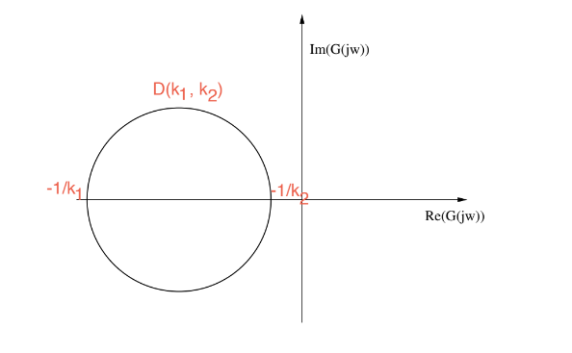




Circle criterion
Useful for sector nonlinearities $Φ$ in sector $\left[k_{1}, k_{2}\right]$
Generalisation of Nyquist criterion with $(−1,0)$ replaced by a circle.
What circle?
$$D\left(k_{1},k_{2}\right)$$
$$−\frac{1}{k_{1}}$$
$$−\frac{1}{k_{2}}$$

Slide 24

Circle criterion
Useful for sector nonlinearities $Φ$ in sector $\left[k_{1}, k_{2}\right]$
Generalisation of Nyquist criterion with $(−1,0)$ replaced by a circle.
What circle?
*Note that if $k_{2}→k_{1}:$
-sector becomes thinner -nonlinearity $→$ linear
-circle $→$ point
Then circle criterion becomes Nyquist criterion
$$D\left(k_{1},k_{2}\right)$$
$$−\frac{1}{k_{1}}$$
$$−\frac{1}{k_{2}}$$

Slide 25

Circle criterion
Theorem
If a linear system combines with a static nonlinearity in the feedback and fulfills
$A$ no eigenvalues on $jω−$axis and $ρ$ eigenvalues in RHP
$Φ$ belongs to sector $\left[k_{1}, k_{2}\right]$
One of the following holds
$0<k_{1}≤k_{2}$, Nyquist plot of $G\left(jω\right)$ does not enter $𝒟(k_{1}, k_{2}$) and
encircles it $ρ$ times anti-clockwise
$0=k_{1}<k_{2}$, Nyquist plot of $G\left(jω\right)$ stays to the right of $ℜ\left(s\right)>$ $−\frac{1}{k_{2}}$
$k_{1}<0<k_{2}$, Nyquist plot of $G\left(jω\right)$ stays in $𝒟(k_{1}, k_{2}$)
$k_{1}<k_{2}<0$, Nyquist plot of $−G\left(jω\right)$ does not enter $𝒟({−k}_{1}, {−k}_{2}$)
and encircles it $ρ$ times anti-clockwise
then $0$is globally asymptotically stable

Slide 26
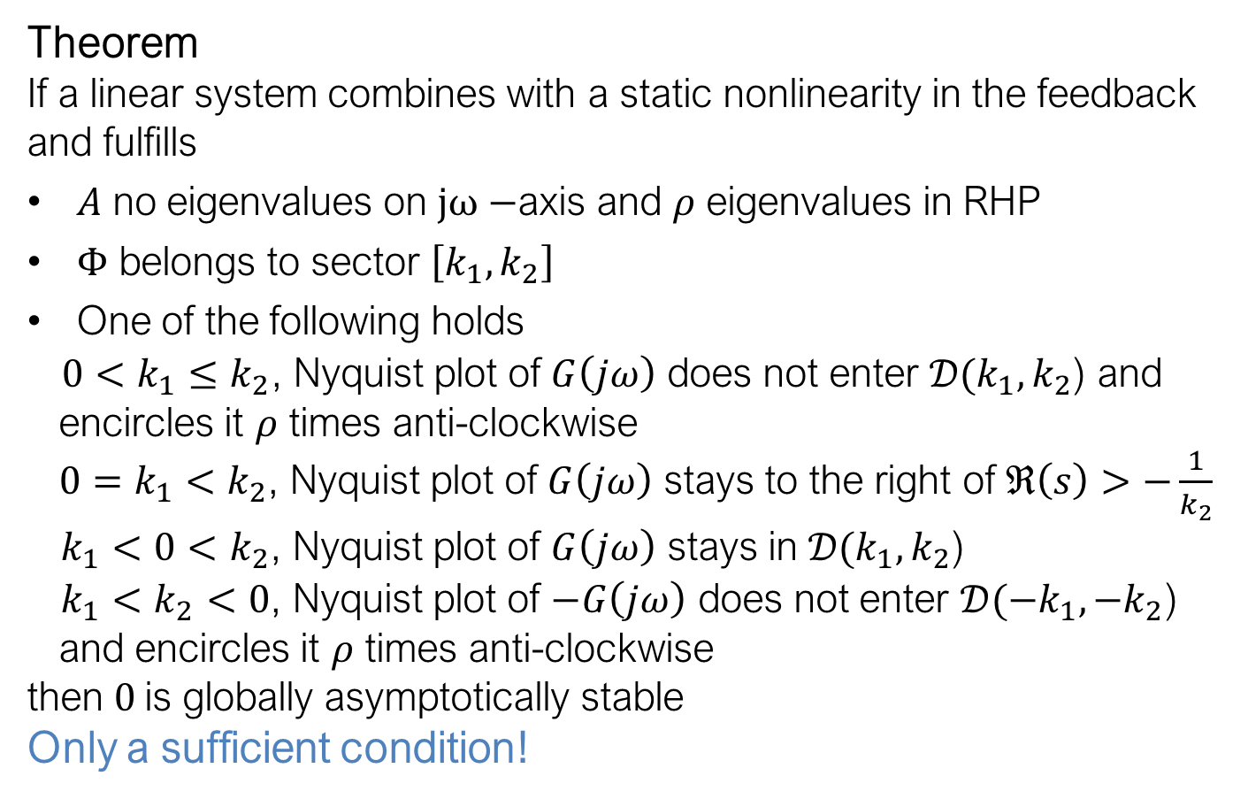
Circle criterion
Theorem
If a linear system combines with a static nonlinearity in the feedback and fulfills
$A$ no eigenvalues on $jω−$axis and $ρ$ eigenvalues in RHP
$Φ$ belongs to sector $\left[k_{1}, k_{2}\right]$
One of the following holds
$0<k_{1}≤k_{2}$, Nyquist plot of $G\left(jω\right)$ does not enter $𝒟(k_{1}, k_{2}$) and
encircles it $ρ$ times anti-clockwise
$0=k_{1}<k_{2}$, Nyquist plot of $G\left(jω\right)$ stays to the right of $ℜ\left(s\right)>$ $−\frac{1}{k_{2}}$
$k_{1}<0<k_{2}$, Nyquist plot of $G\left(jω\right)$ stays in $𝒟(k_{1}, k_{2}$)
$k_{1}<k_{2}<0$, Nyquist plot of $−G\left(jω\right)$ does not enter $𝒟({−k}_{1}, {−k}_{2}$)
and encircles it $ρ$ times anti-clockwise
then $0$is globally asymptotically stable
Only a sufficient condition!

Slide 27
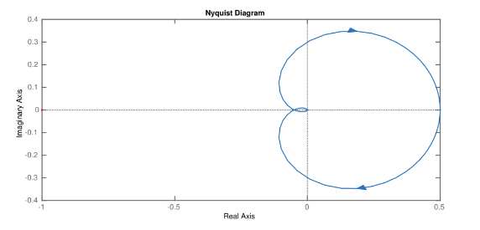


Example: Stability by Circle criterion
$$G(s)$$
Consider the nonlinear system on the right
where nonlinearity $ϕ(s)$ belongs to sector $[0,2]$
The Nyquist plot looks as follows:
$$ϕ\left(y\right)$$

Slide 28

Example: Stability by Circle criterion
$$G(s)$$
Consider the nonlinear system on the right
where nonlinearity $ϕ(s)$ belongs to sector $[0,2]$
The Nyquist plot looks as follows:
We have a nonlinearity in sector $[0,2]$
The nonlinearity corresponds to case $0=k_{1}<k_{2}$
$$ϕ\left(y\right)$$

Slide 29


Example: Stability by Circle criterion
$$G(s)$$
Consider the nonlinear system on the right
where nonlinearity $ϕ(s)$ belongs to sector $[0,2]$
The Nyquist plot looks as follows:
We have a nonlinearity in sector $[0,2]$
The nonlinearity corresponds to case $0=k_{1}<k_{2}$
We need to look at $ℜ\left(s\right)>$ $−\frac{1}{k_{2}}$ and check that the Nyquist plot stays to the right
$$ϕ\left(y\right)$$
$$−0.5$$

Slide 30
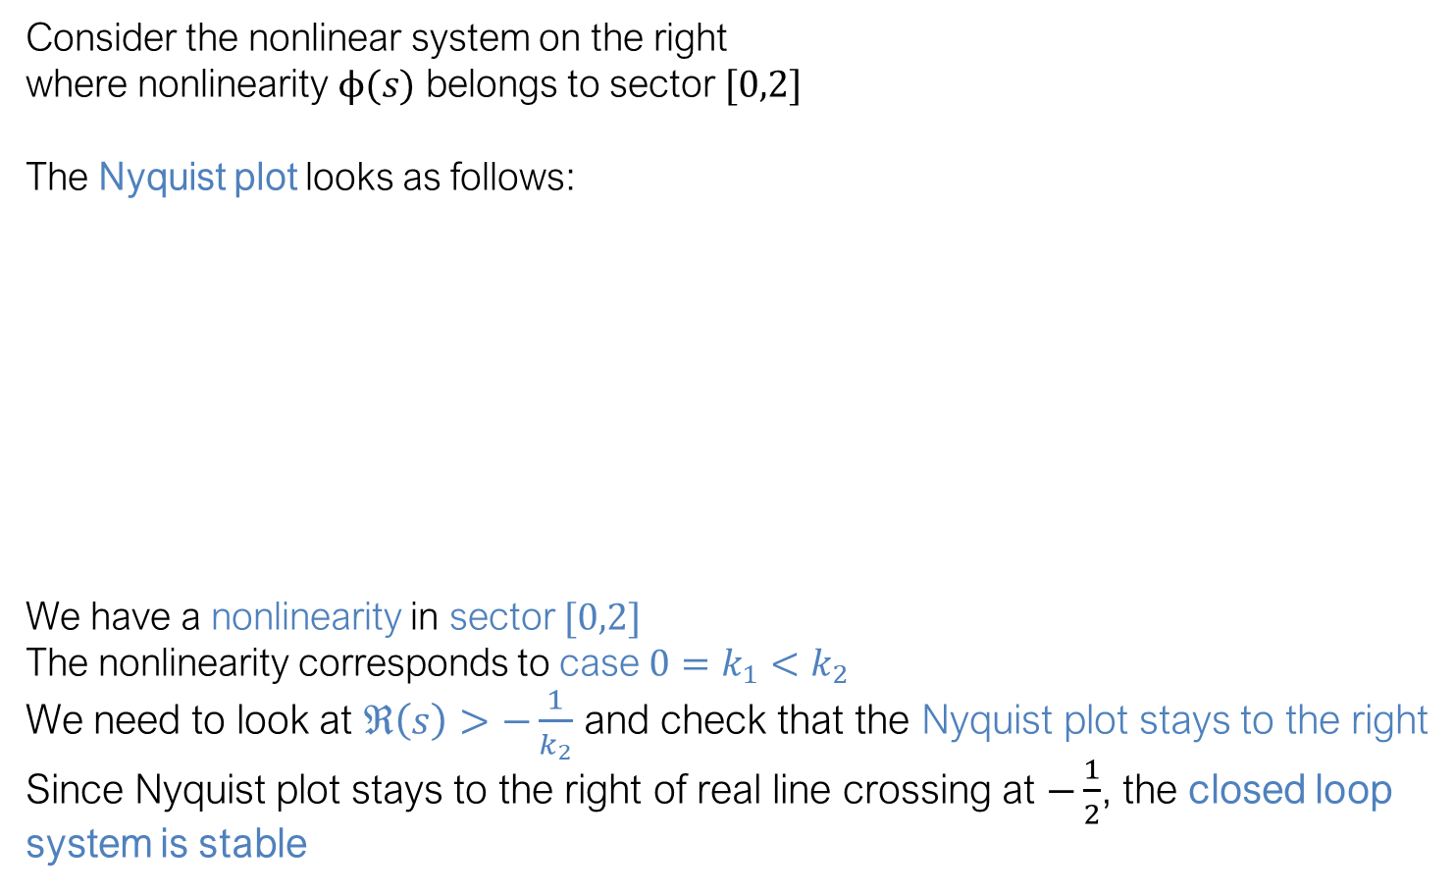
Example: Stability by Circle criterion
$$G(s)$$
Consider the nonlinear system on the right
where nonlinearity $ϕ(s)$ belongs to sector $[0,2]$
The Nyquist plot looks as follows:
We have a nonlinearity in sector $[0,2]$
The nonlinearity corresponds to case $0=k_{1}<k_{2}$
We need to look at $ℜ\left(s\right)>$ $−\frac{1}{k_{2}}$ and check that the Nyquist plot stays to the right
Since Nyquist plot stays to the right of real line crossing at $−\frac{1}{2}$, the closed loop system is stable
$$ϕ\left(y\right)$$
$$−0.5$$

Slide 31

Example: Stability by Circle criterion
$$G(s)$$
Consider the nonlinear system on the right
where nonlinearity $ϕ(s)$ belongs to sector $[−1,2]$
The Nyquist plot looks as follows:
$$ϕ\left(y\right)$$

Slide 32

Example: Stability by Circle criterion
$$G(s)$$
Consider the nonlinear system on the right
where nonlinearity $ϕ(s)$ belongs to sector $[−1,2]$
The Nyquist plot looks as follows:
We have a nonlinearity in sector $[−1,2]$
The nonlinearity corresponds to the case $k_{1}<0<k_{2}$
$$ϕ\left(y\right)$$

Slide 33



Example: Stability by Circle criterion
$$G(s)$$
Consider the nonlinear system on the right
where nonlinearity $ϕ(s)$ belongs to sector $[−1,2]$
The Nyquist plot looks as follows:
We have a nonlinearity in sector $[−1,2]$
The nonlinearity corresponds to the case $k_{1}<0<k_{2}$
We need to take circle $D(−1, 2)$ and check that Nyquist plot stays inside
$$ϕ\left(y\right)$$
$$−\frac{1}{k_{2}}=−0.5$$
$$−\frac{1}{k_{1}}=1$$

Slide 34
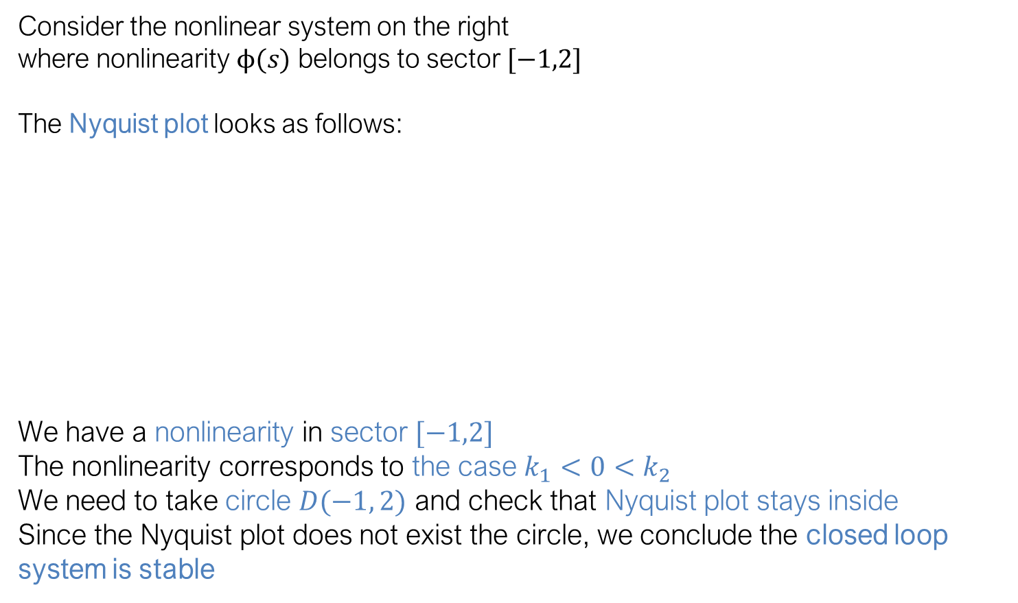
Example: Stability by Circle criterion
$$G(s)$$
Consider the nonlinear system on the right
where nonlinearity $ϕ(s)$ belongs to sector $[−1,2]$
The Nyquist plot looks as follows:
We have a nonlinearity in sector $[−1,2]$
The nonlinearity corresponds to the case $k_{1}<0<k_{2}$
We need to take circle $D(−1, 2)$ and check that Nyquist plot stays inside
Since the Nyquist plot does not exist the circle, we conclude the closed loop system is stable
$$ϕ\left(y\right)$$
$$−\frac{1}{k_{2}}=−0.5$$
$$−\frac{1}{k_{1}}=1$$

Slide 35
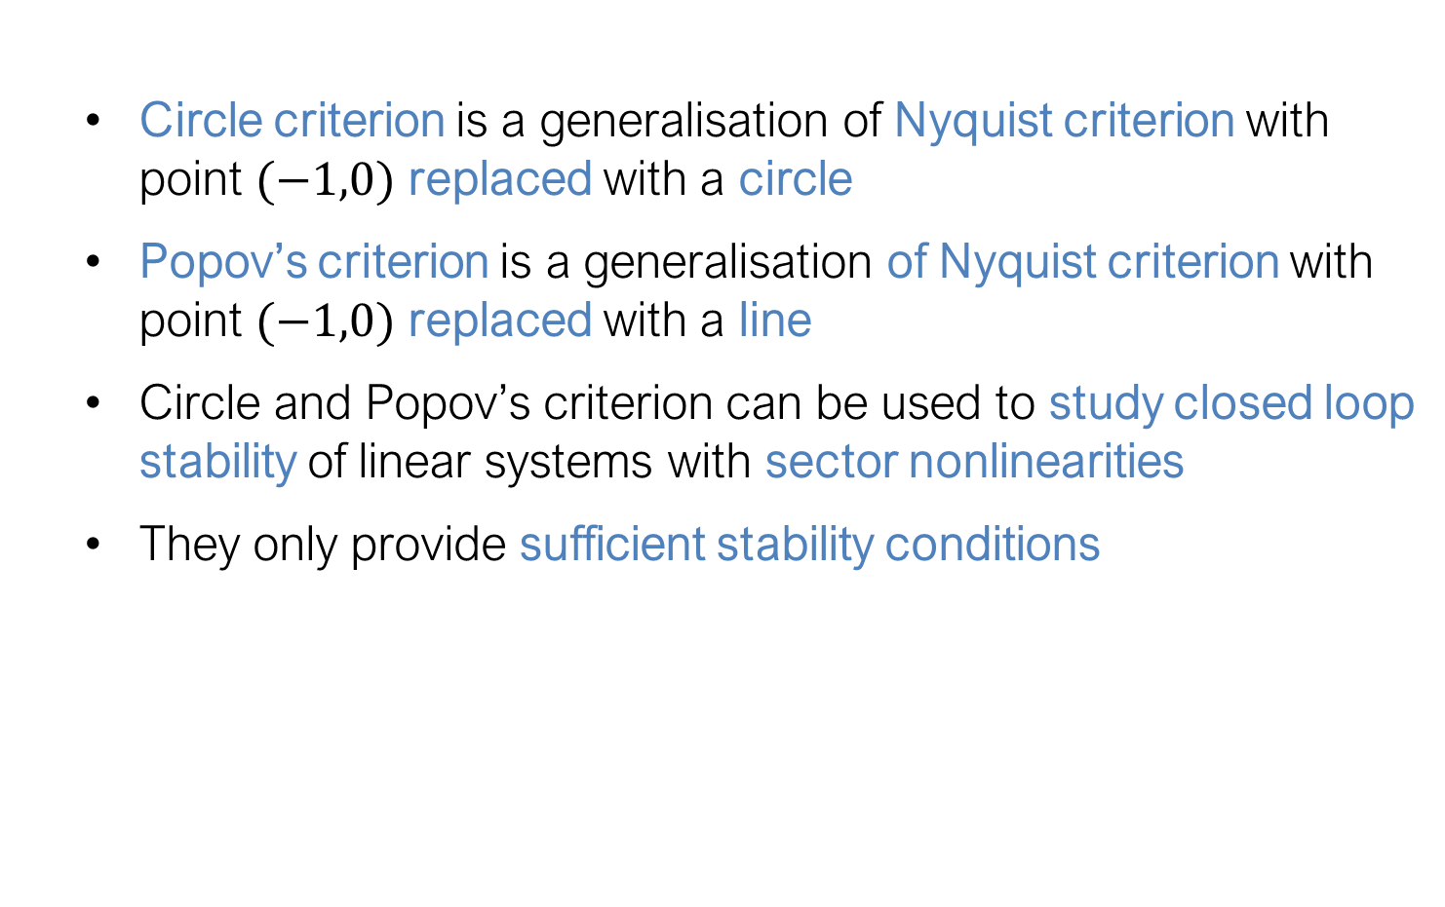
Summary
Circle criterion is a generalisation of Nyquist criterion with point $(−1,0)$ replaced with a circle
Popov’s criterion is a generalisation of Nyquist criterion with point $(−1,0)$ replaced with a line
Circle and Popov’s criterion can be used to study closed loop stability of linear systems with sector nonlinearities
They only provide sufficient stability conditions

Slide 36
The End

