Slide 1


Intel Advanced Power Converter
PowerBit
With growing electric vehicle market and limited number of chargers, our group provide a faster and economical design of charger.
Matthew Cooper, Shenghua Duan, Joshua Liu, Laura Marks

Slide 2
Comparison of Solutions:
Our specification was to make an electric vehicle charger that is: Efficient, 100kW power output, FPGA controlled and ideally bi-directional.
AC-DC converter | Vienna | Six-switch Boost PFC
Bi-directional? | NO | YES
Efficiency | 98.5% | 89.5%
Maximum Overshoot | 12% | 0%
Output Voltage ripple | 3v | 0.75V
Settling time | 12 ms | 320ms
DC-DC converter | Dual-active Bridge | LLC Resonant Converter
Bi-directional? | YES | YES
Efficiency | 85% | >98%
Maximum Overshoot | <1% | 9.8%
Output Voltage ripple | 0.01V | 0.00V
Settling time | 300ms | 1.6ms
Our final choice of AC-DC converter is Six-switch Boost PFC.
Our final choice of DC-DC converter is LLC Resonant Converter.
Notes:
SD; LM – Will have accurate numbers by eod

Slide 3
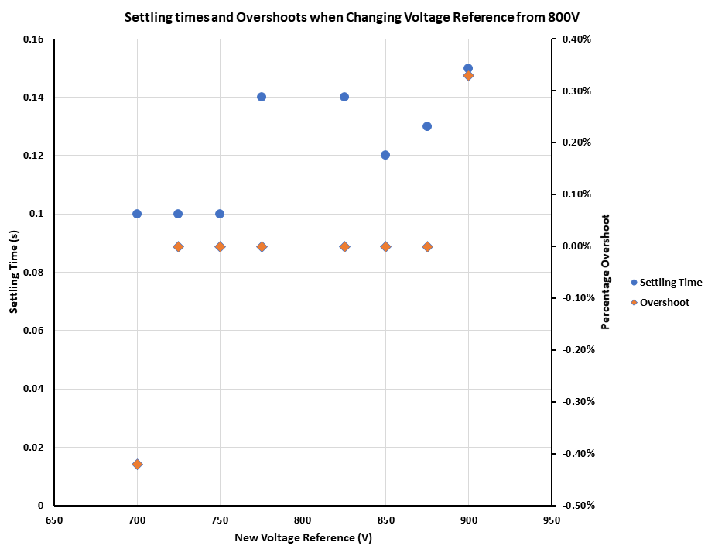
AC/DC Solution
Six-switch three-phase boost topology
Works at a consistent efficiency across load percentages - above 85% efficiency from load percentages of 50% up to 200%
Capable of bidirectional power flow for V2G charging
Uses an LCL filter to reduce harmonics in grid current – current has THD of 0.58%
Controls both output voltage and input active/reactive current
Tolerant of load changes and reference value changes
Notes:
MC

Slide 4
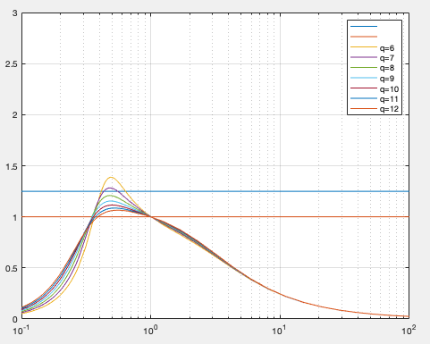
DC/DC solution
Resonant LLC circuit
Half bridge input to provide square wave and diode rectifier on output
Transfer function dependent on switching frequency, not duty cycle
Makes it particularly suited to FPGA control
Transformer provides an additional layer of isolation
Improved harmonic response (no need for extra harmonic filters on output)
Improved efficiency with zero current and voltage switching
Resonant converter transfer function of tank gain vs switching frequency ratio for design
Notes:
LM

Slide 5
Overall Features and Final Thoughts
Smart solution for Vehicle to Grid (V2G) applications
  Bi-directional
  Implementation of FPGA - highly customizable
Low emission footprint and waste
Lower product lifetime costs
Notes:
JL

