Slide 1
DIPARTIMENTO DI INGEGNERIA ELETTRICA E TECNOLOGIE DELL’INFORMAZIONE
SCUOLA POLITECNICA E DELLE SCIENZE DI BASE
LAUREA IN INGEGNERIA DELL’AUTOMAZIONE E ROBOTICA
Final Project FSR
Eyes in the Sky: Advanced Control of Quadrotors for Real-Time Monitoring
Professor Fabio Ruggiero
Students Laura Milone P38000254 Sabrina Sarnataro P38000255

Slide 2
SUMMARY
Introduction
Planner
Coplanar UAV
Hierarchical Control
Adaptive Sliding Mode Control
Results with nominal condition
Results with an external disturbance
Tilting UAV
Holocopter approach
Non Linear Model Predictive Control
Results with nominal condition
Results with an external disturbance
Conclusion

Slide 3
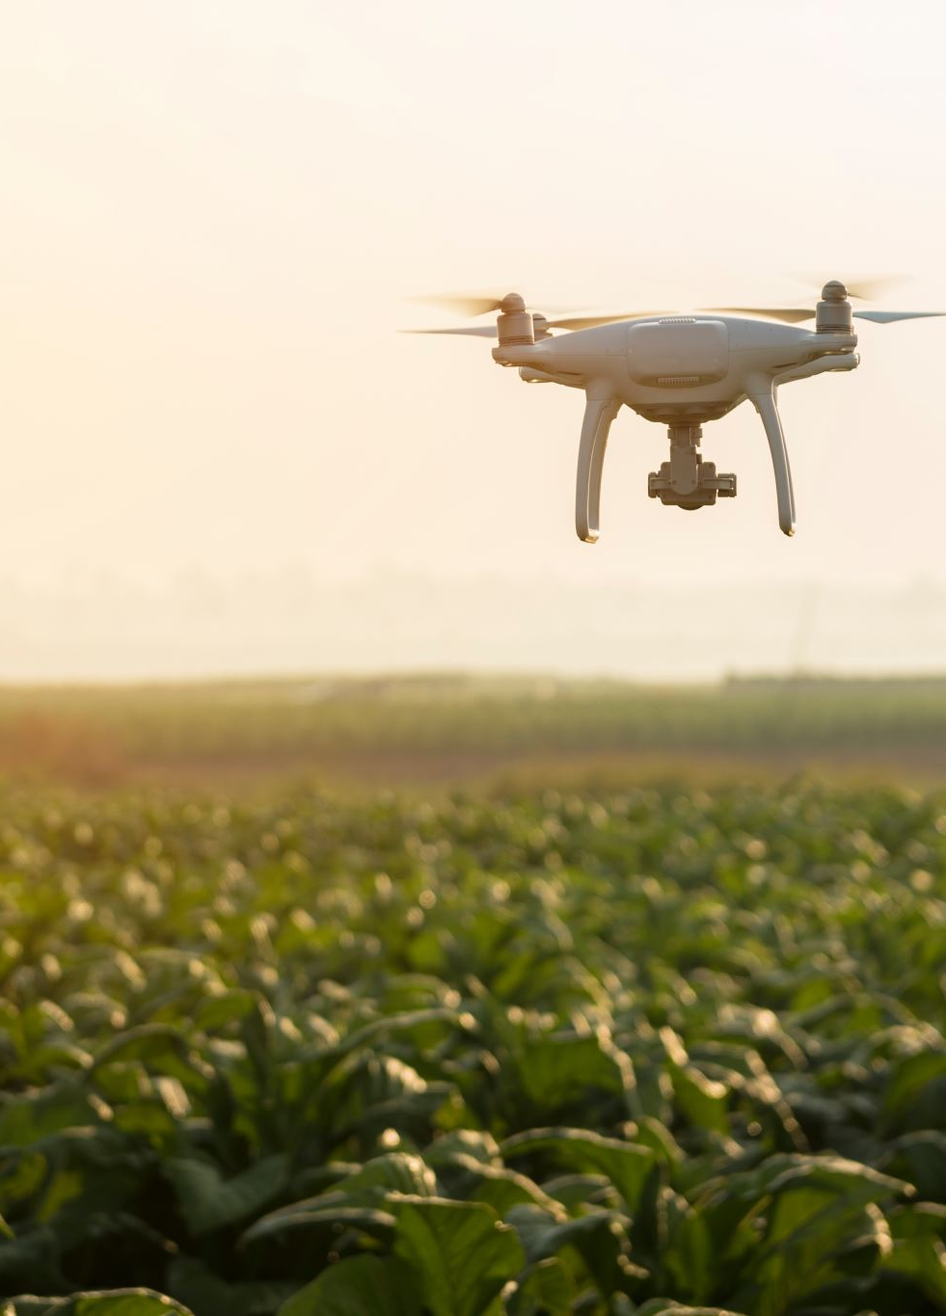
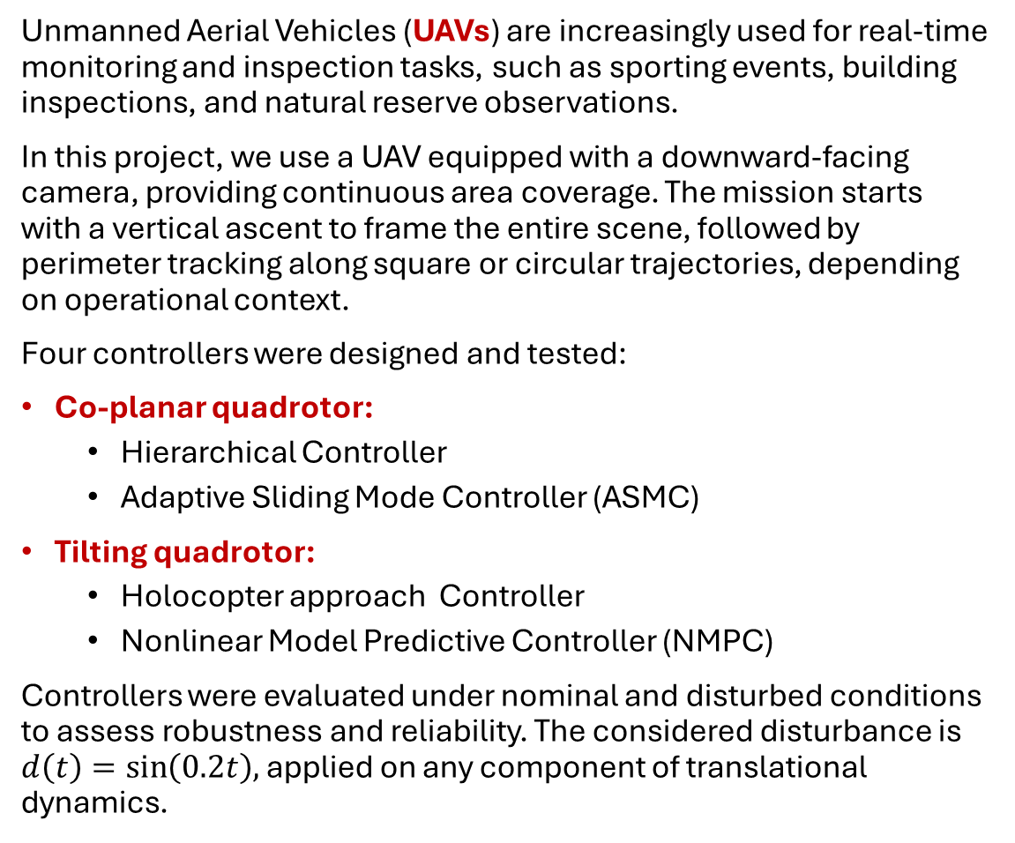
INTRODUCTION
Unmanned Aerial Vehicles (UAVs) are increasingly used for real-time monitoring and inspection tasks, such as sporting events, building inspections, and natural reserve observations.
In this project, we use a UAV equipped with a downward-facing camera, providing continuous area coverage. The mission starts with a vertical ascent to frame the entire scene, followed by perimeter tracking along square or circular trajectories, depending on operational context.
Four controllers were designed and tested:
Co-planar quadrotor:
Hierarchical Controller
Adaptive Sliding Mode Controller (ASMC)
Tilting quadrotor:
Holocopter approach Controller
Nonlinear Model Predictive Controller (NMPC)
Controllers were evaluated under nominal and disturbed conditions to assess robustness and reliability. The considered disturbance is $d\left(t\right)=\sin\left(0.2t\right),$ applied on any component of translational dynamics.

Slide 4
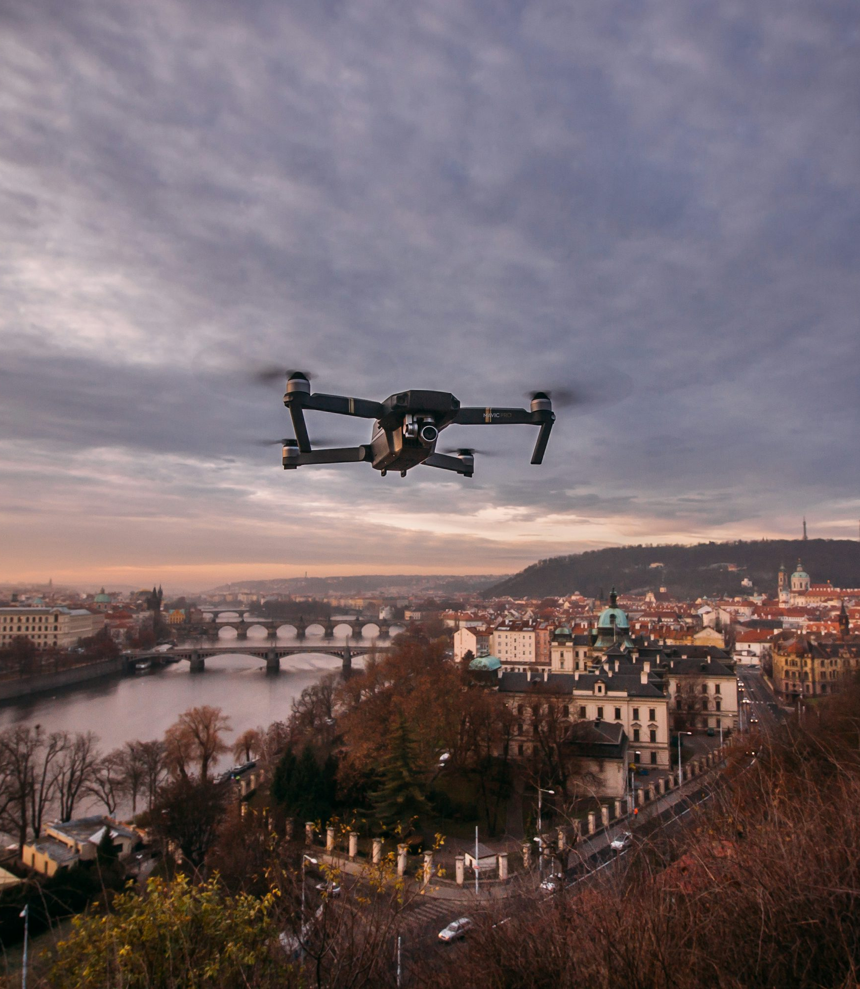
PLANNER
In this work, smooth reference trajectories were designed for two UAV configurations Co-planar quadrotor and Tilting quadrotor.
Two trajectory profiles were tested for both configurations:
Vertical ascent + square path (sharp transitions at corners).
Vertical ascent + circular path (smooth, continuous motion).
This approach highlights controller performance under varying motion conditions.

Slide 5
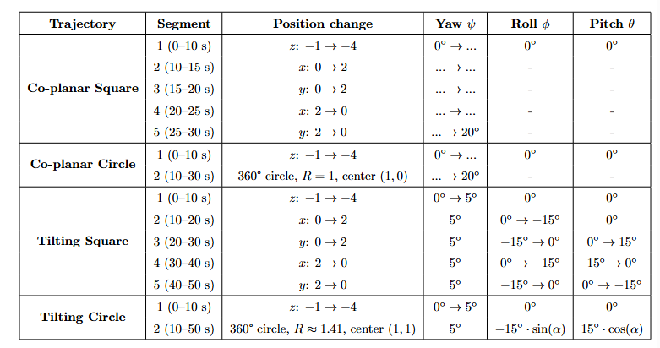
PLANNER: trajectory segment details
Co-planar Quadrotor (Underactuated):
Direct control of position (x, y, z) and yaw angle.
Roll and pitch angles are indirectly determined by the required horizontal accelerations.
Yaw angle smoothly evolves across the entire trajectory.
Tilting Quadrotor (Fully Actuated):
Complete control over both position and orientation due to variable propellers’ inclination.
Explicit assignment of roll and pitch angles, optimizing the camera’s field of view and improving observational capabilities.

Slide 6
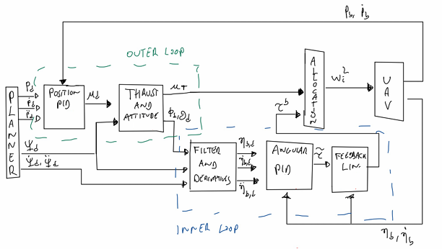
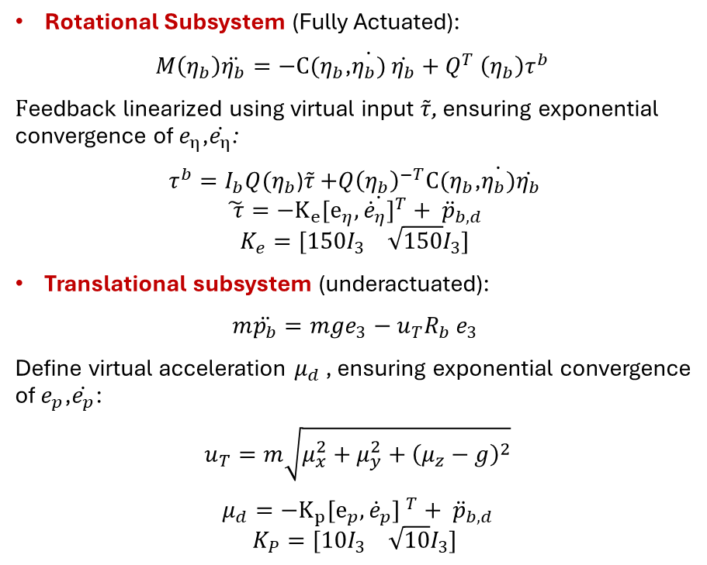
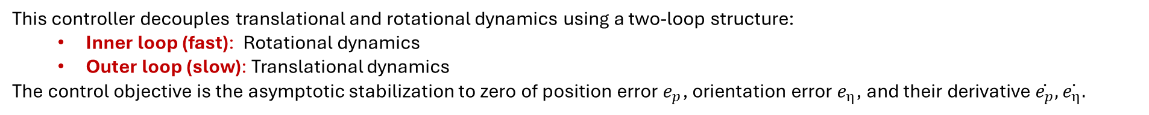
Co-planar UAV: Hierarchical control
This controller decouples translational and rotational dynamics using a two-loop structure:
Inner loop (fast): Rotational dynamics
Outer loop (slow): Translational dynamics
The control objective is the asymptotic stabilization to zero of position error $e_{p}$, orientation error $e_{η}$, and their derivative $\dot{e_{p}}, \dot{e_{η}.}$
Rotational Subsystem (Fully Actuated):
$M\left(η_{b}\right)\ddot{η_{b}}=−C(η_{b}$,$\dot{η_{b})}$ $\dot{η_{b}}+Q^{T} \left(η_{b}\right)τ^{b}$
$F$eedback linearized using virtual input $\tilde{τ}$, ensuring exponential convergence of $e_{η}$,$\dot{e_{η}}$:
$τ^{b}=I_{b}Q(η_{b}$)$\tilde{τ}$ $+{Q\left(η_{b}\right)}^{−T}C(η_{b}$,$\dot{η_{b})}\dot{η_{b}}$
$$\tilde{ τ}={−K_{e}[e_{η},\dot{{\dot{e}}_{η}]}}^{T}+ {\ddot{p}}_{b,d}$$
$$K_{e}=[150I_{3} \sqrt{150}I_{3}]$$
Translational subsystem (underactuated):
$m\ddot{p_{b}}=mge_{3}−u_{T}R_{b}$ $e_{3}$
Define virtual acceleration $μ_{d}$ , ensuring exponential convergence of $e_{p}$,$\dot{e_{p}}$:
$u_{T}=m\sqrt{μ_{x}^{2}+μ_{y}^{2}+{\left(μ_{z}−g\right)}^{2}}$
$μ_{d}={−K_{p}[e_{p},{\dot{e}}_{p}] }^{T}+ {\ddot{p}}_{b,d}$
$$K_{P}=[10I_{3} \sqrt{10}I_{3}]$$

Slide 7
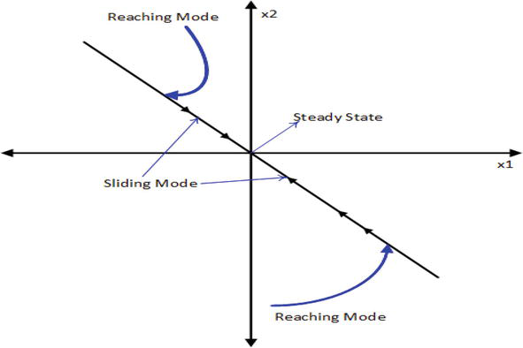
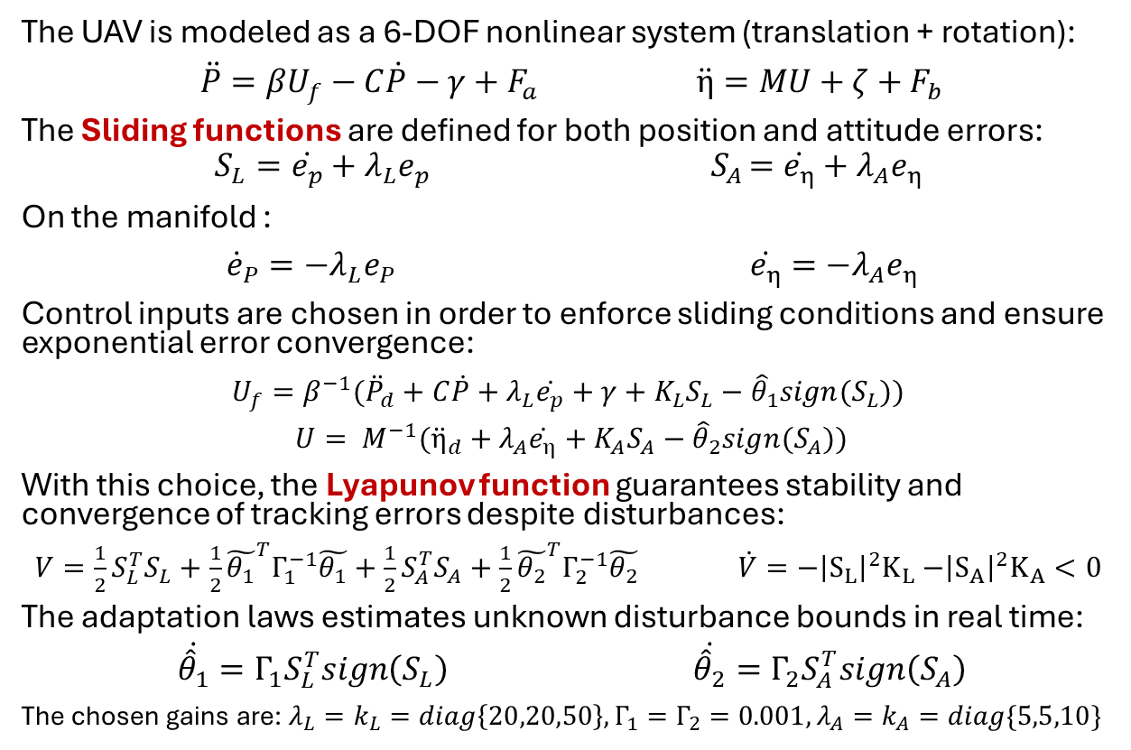
Co-planar UAV: Adaptive Sliding Mode control
This controller combines the robustness of Sliding-Mode Control with adaptive parameter estimation, allowing the controller to reject unknown disturbances without prior knowledge of their bounds.
The UAV is modeled as a 6-DOF nonlinear system (translation + rotation):
$\ddot{P}=βU_{f}−C\dot{P}−γ+F_{a} \ddot{η}=MU+ζ+F_{b}$
The Sliding functions are defined for both position and attitude errors:
$$S_{L}=\dot{e_{p}}+λ_{L}e_{p }{ S}_{A}=\dot{e_{η}}+λ_{A}e_{η}$$
On the manifold :
${\dot{e}}_{P}=−λ_{L}e_{P} \dot{e_{η}}=−λ_{A}e_{η}$
Control inputs are chosen in order to enforce sliding conditions and ensure exponential error convergence:
$U_{f}=β^{−1}({\ddot{P}}_{d}+C\dot{P}+λ_{L}\dot{e_{p}}+γ+K_{L}S_{L}−{\hat{θ}}_{1}sign(S_{L}))$
${U= M}^{−1}({\ddot{η}}_{d}+λ_{A}\dot{e_{η}}+K_{A}S_{A}−{\hat{θ}}_{2}sign(S_{A}))$
With this choice, the Lyapunov function guarantees stability and convergence of tracking errors despite disturbances:
$V=\frac{1}{2}S_{L}^{T}S_{L}+\frac{1}{2}{\tilde{θ_{1}}}^{T}Γ_{1}^{−1}\tilde{θ_{1}}+\frac{1}{2}S_{A}^{T}S_{A}+\frac{1}{2}{\tilde{θ_{2}}}^{T}Γ_{2}^{−1}\tilde{θ_{2}} \dot{V}=−{\left|S_{L}\right|}^{2}K_{L}$ $−{\left|S_{A}\right|}^{2}K_{A}<0$
The adaptation laws estimates unknown disturbance bounds in real time:
$\dot{{\hat{θ}}_{1}}=Γ_{1}S_{L}^{T}sign\left(S_{L}\right)$ $\dot{{\hat{θ}}_{2}}=Γ_{2}S_{A}^{T}sign\left(S_{A}\right)$
The chosen gains are: $λ_{L}=k_{L}=diag\left\{20,20,50\right\}, Γ_{1}=Γ_{2}=0.001, λ_{A}=k_{A}=diag\{5,5,10\}$

Slide 8
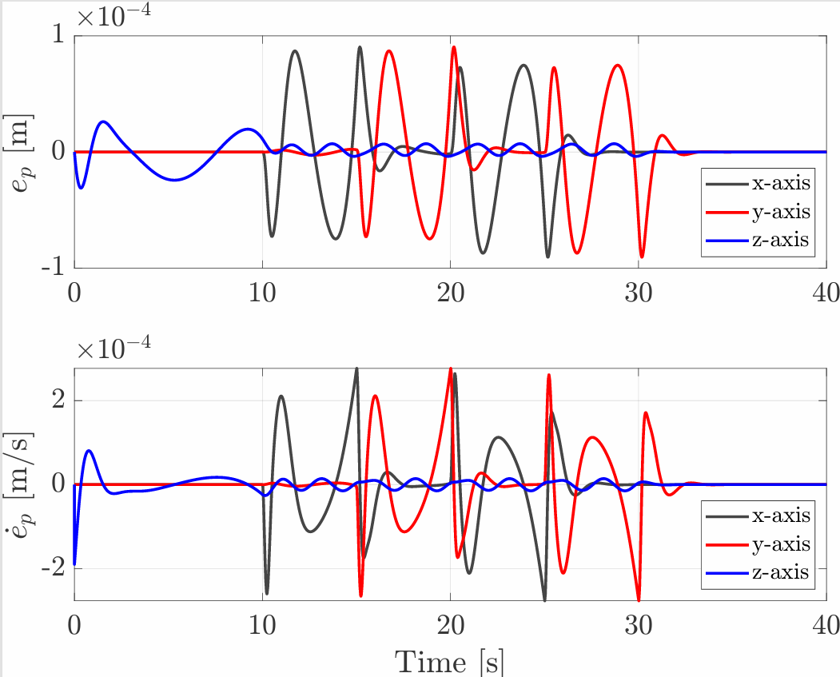
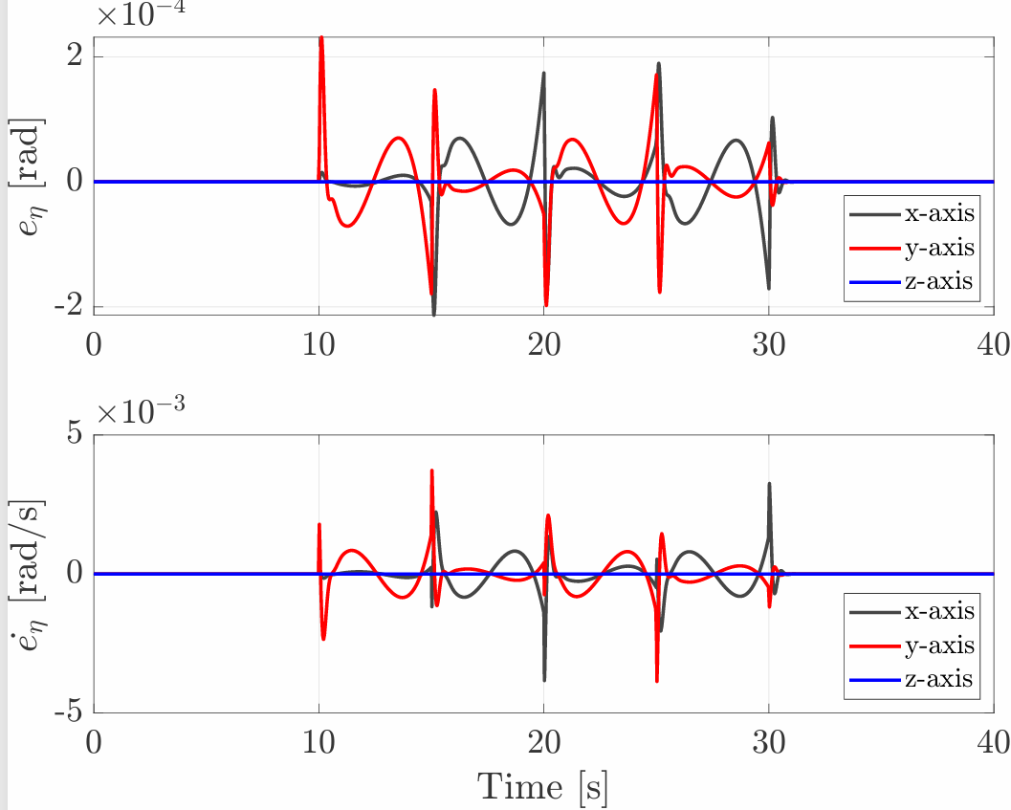
Hierarchical Control: Square trajectory results
Peaks in the errors appear at 10, 15, 20, and 25 s, corresponding to the transition from one side to another.
During the x-axis segments (10–15 s and 20–25 s), position/velocity errors dominate on x, while orientation errors are mainly on y (pitch).
During the y-axis segments (15–20 s and 25–30 s), the opposite occurs: position/velocity errors dominate on y, and orientation errors on x (roll).
Along the z-axis, an initial peak is observed during ascent, followed by damped oscillations, while orientation errors remain nearly zero due to the smooth yaw profile.

Slide 9
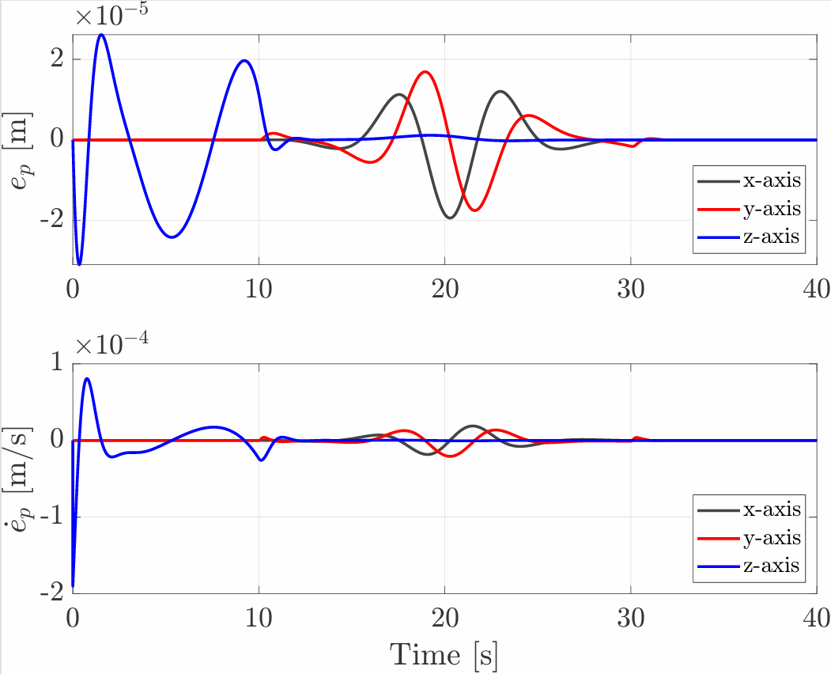
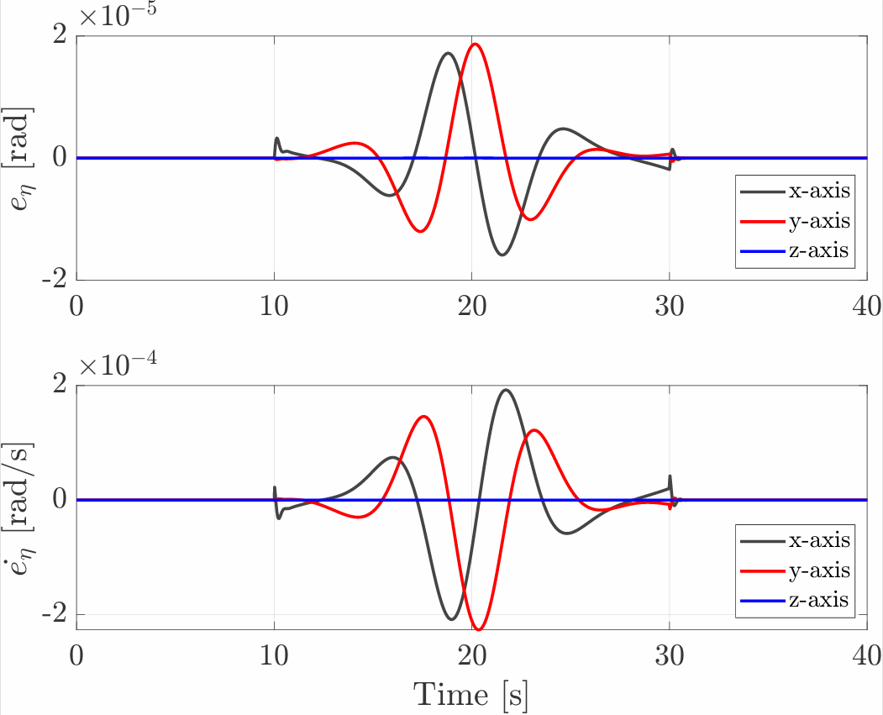
Hierarchical Control: Circular trajectory results
The error profiles are smoother than in the square trajectory, reflecting the continuous nature of the circular path.
Slightly larger errors appear on the x and y axes during 10–30 s, when the UAV performs the circular motion.
A peak in z-axis position and velocity errors occurs during the initial ascent, which rapidly decays as circular flight begins.
Orientation and angular velocity errors on z remain negligible due to the smoothly planned yaw profile.

Slide 10
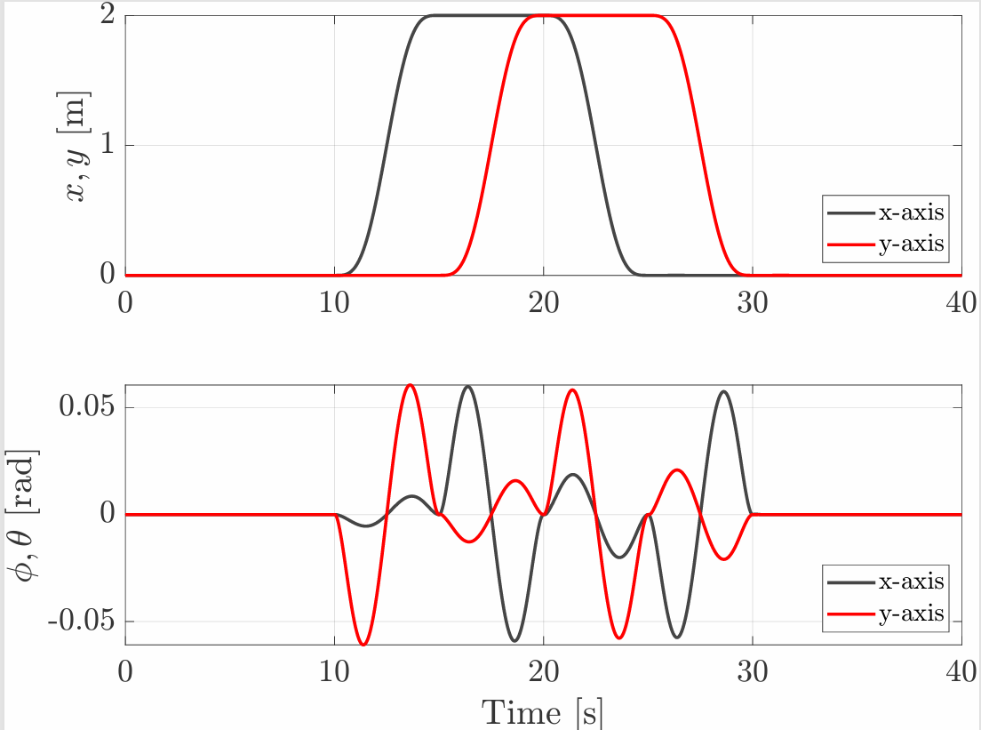
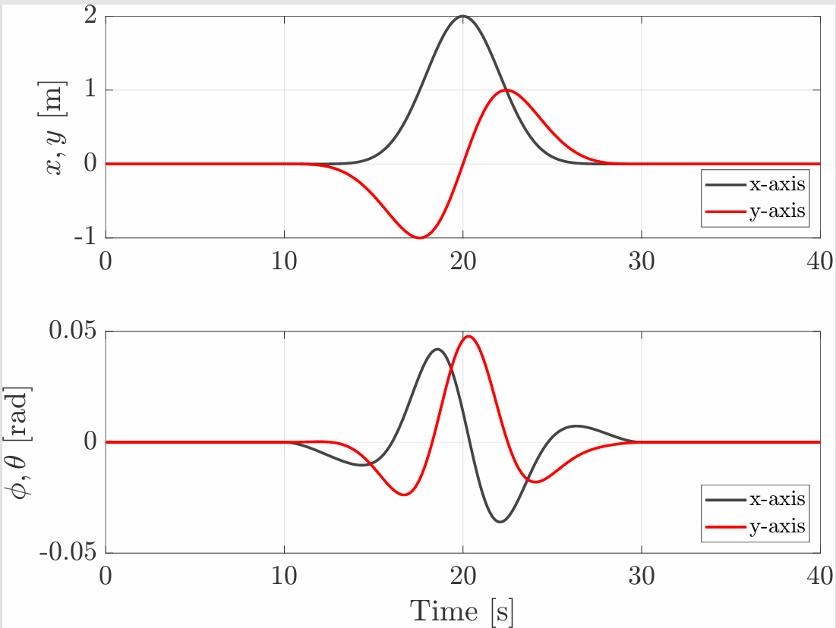
Hierarchical Control: results analysis
A translation motion in the horizontal plane requires tilting of the body.
In the square trajectory pitch is the dominant component for translations along x, whereas roll is the dominant component for translations along y
In the circular trajectory, as soon as the UAV begins following the circular path, both roll and pitch become non-zero.
SQUARE TRAJECTORY
CIRCULAR TRAJECTORY

Slide 11
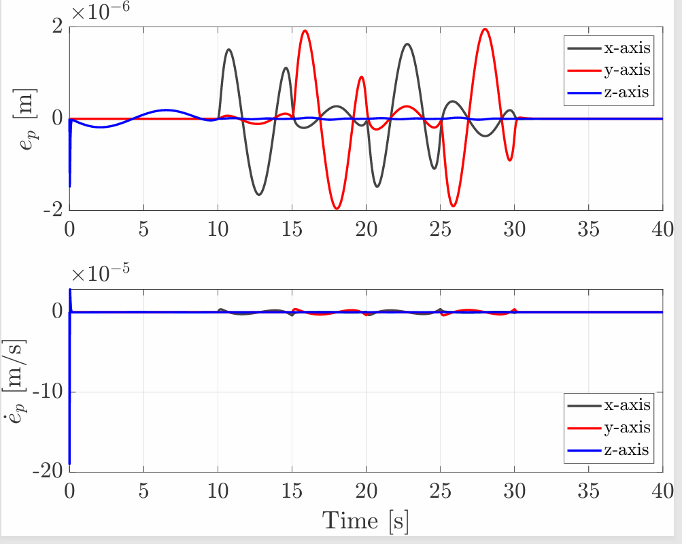
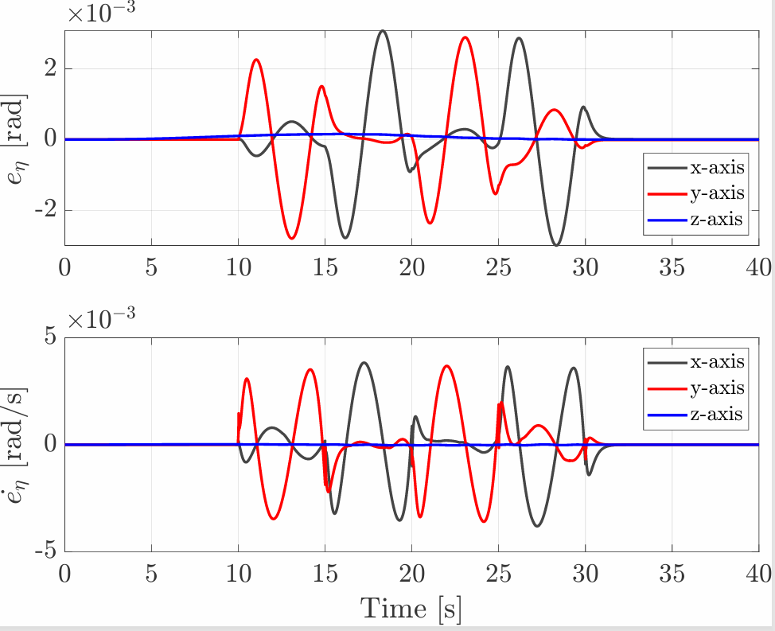
Adaptive Sliding Mode Control: Square trajectory results
The behavior of the ASMC on the square trajectory is similar to that of the hierarchical controller.
A noticeable peak in position and linear velocity errors along the z-axis occurs at the start of the motion.
Compared to the hierarchical controller, the ASMC achieves significantly smaller position and linear velocity errors (about 1 to 2 orders of magnitude lower) and the peaks observed at direction-change instants are also less pronounced for both linear and angular errors.

Slide 12
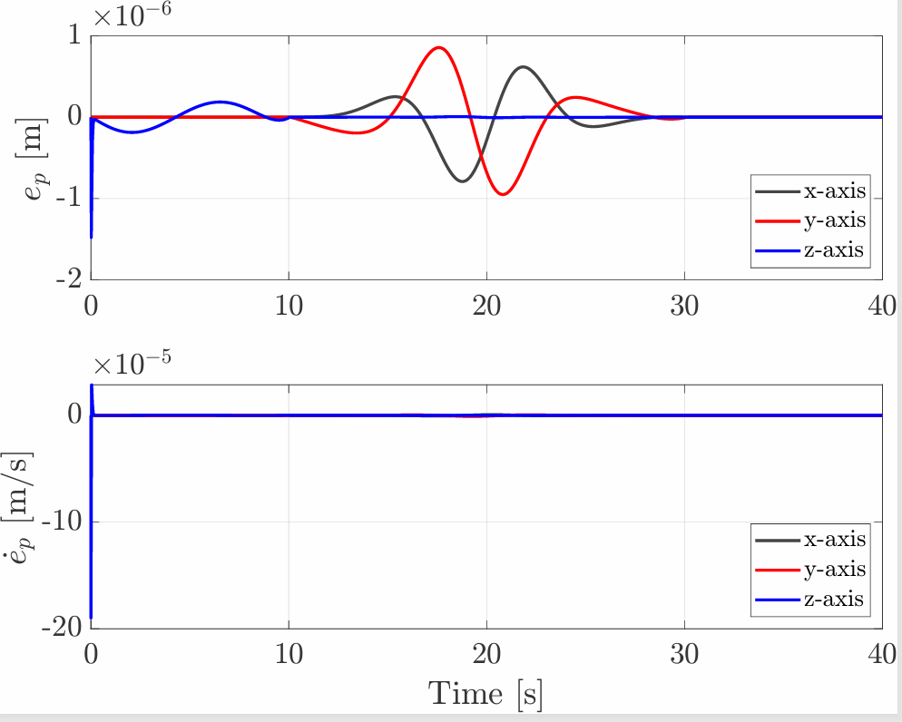
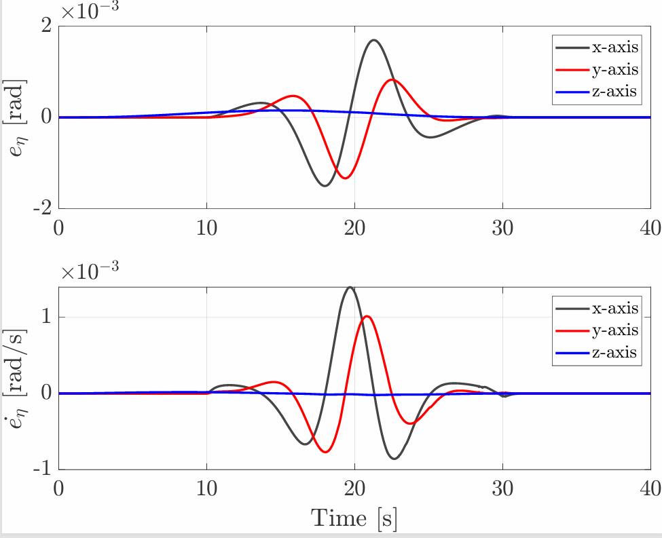
Adaptive Sliding Mode Control: Circular trajectory results
The behavior remains similar to that of the hierarchical controller.
The error profiles are smoother than in the squared trajectory, reflecting the continuous nature of the circular path.
As in the squared case, z-axis position and velocity errors peak during the initial ascent but rapidly decay, while orientation errors about z remain negligible due to the smoothly planned yaw profile.
The key difference lies in gain tuning: the hierarchical controller achieves naturally low z-axis errors with uniform gains, whereas the ASMC requires higher weights along z to ensure comparable altitude stability.

Slide 13
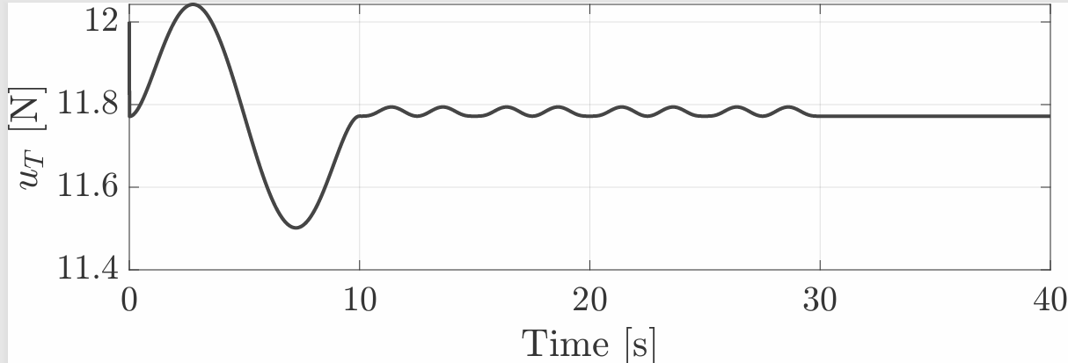
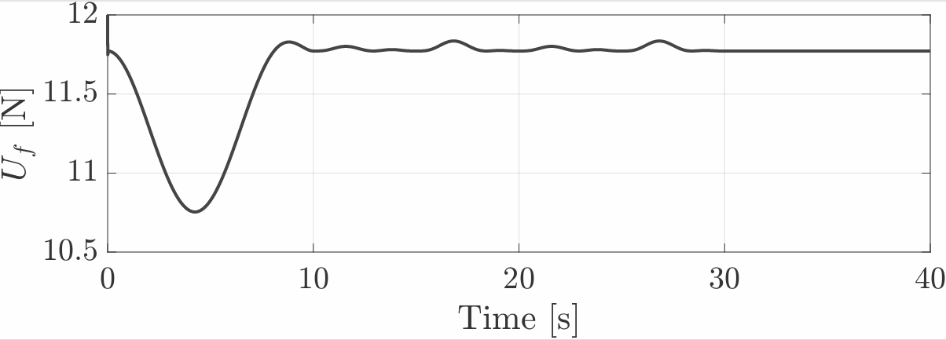
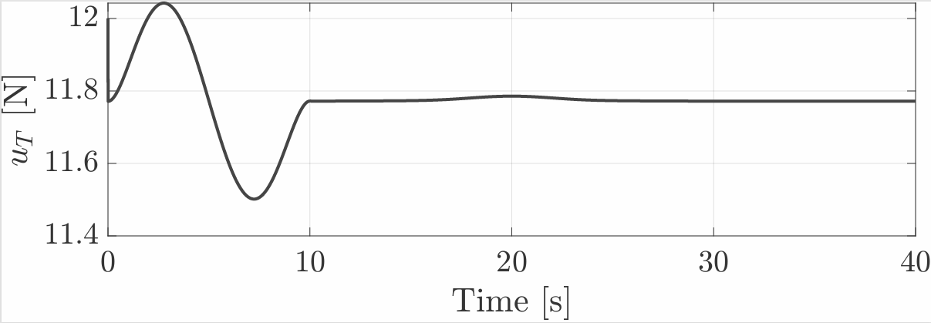
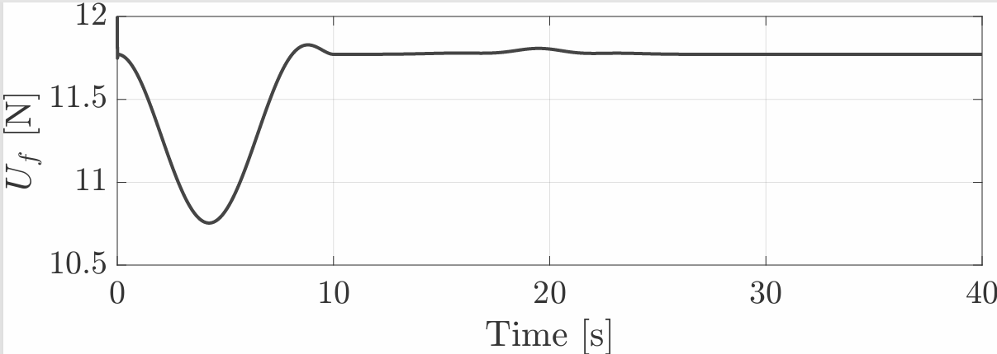
Commanded total thrust analysis in Co-planar UAV controllers
HIERARCHICAL CONROLLER: For both trajectories it exhibits a certain dynamic evolution during the vertical ascent, after which it settles to the value mg. This occurs because the UAV is hovering and must only compensate for gravity. Moreover, in the square trajectory the thrust shows oscillations before settling, phenomenon that does not affect the circular trajectory.
ASMC: The difference is that the oscillations corresponding to the square trajectory are more damped, which is consistent with the fact that the position error exhibits less abrupt peaks, reduced by two orders of magnitude.
SQUARE TRAJECTORY : HIERARCHICAL
SQUARE TRAJECTORY : ASMC
CIRCULAR TRAJECTORY : HIERARCHICAL
CIRCULAR TRAJECTORY : ASMC

Slide 14
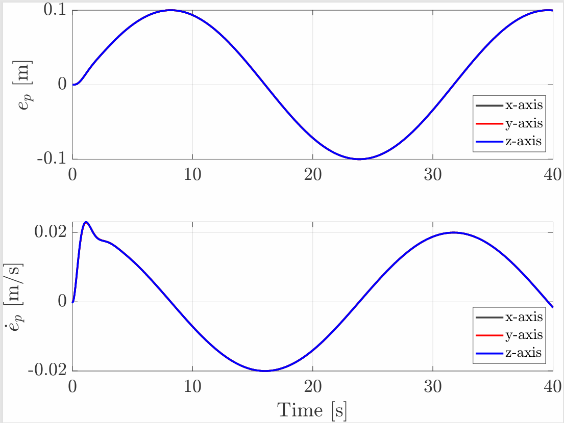
Hierarchical Control in presence of disturbance: Circular trajectory results
It handles the disturbance moderately well, although it does not incorporate a specific mechanism for disturbance rejection.
Compared to the nominal case, the position error has increased by four orders of magnitude, and the velocity error by two.
The system exhibits an equal response in the x, y, and z axes.
WITHOUT DISTURBANCE
WITH DISTURBANCE

Slide 15
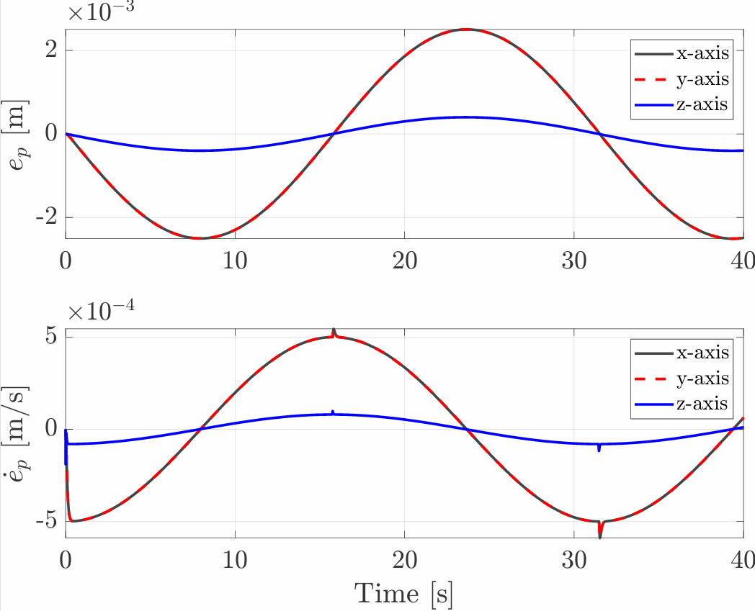
ASMC in presence of disturbance: Circular trajectory results
The controller demonstrates superior robustness to the same disturbance compared to the hierarchical controller. Its adaptive structure estimates the bounds of unknown disturbances in real time and adjusts the control input accordingly.
Compared to the nominal case there is an increase of three orders of magnitude in the position error, one order less than that observed with the hierarchical controller.
Additionally, the smallest errors are observed along the z-axis, which is consistent with the higher gain weight assigned to that direction.
WITHOUT DISTURBANCE
WITH DISTURBANCE

Slide 16
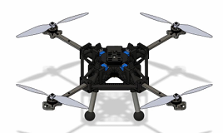
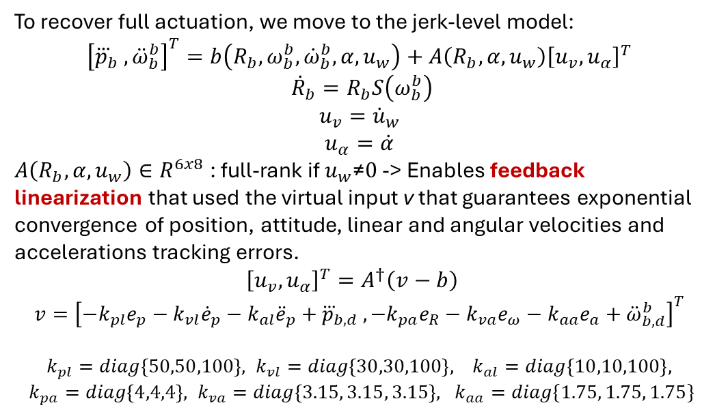
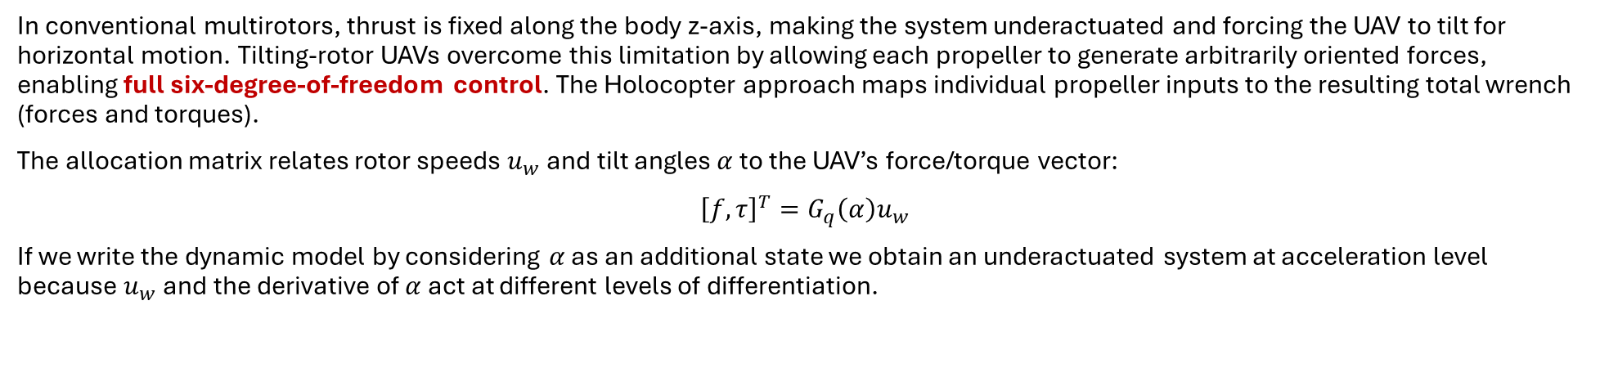
Tilting UAV: Holocopter approach
In conventional multirotors, thrust is fixed along the body z‑axis, making the system underactuated and forcing the UAV to tilt for horizontal motion. Tilting‑rotor UAVs overcome this limitation by allowing each propeller to generate arbitrarily oriented forces, enabling full six‑degree‑of‑freedom control. The Holocopter approach maps individual propeller inputs to the resulting total wrench (forces and torques).
The allocation matrix relates rotor speeds $u_{w}$and tilt angles $α$to the UAV’s force/torque vector:
${\left[f, τ\right]}^{T}=G_{q}\left(α\right)u_{w}$
If we write the dynamic model by considering $α$ as an additional state we obtain an underactuated system at acceleration level because $u_{w}$ and the derivative of $α$ act at different levels of differentiation.
To recover full actuation, we move to the jerk-level model:
$${\left[{\overset{⃛}{p}}_{b} , {\ddot{ω}}_{b}^{b}\right]}^{T}=b\left(R_{b}, ω_{b}^{b},{\dot{ω}}_{b}^{b}, α, u_{w}\right)+A\left(R_{b}, α, u_{w}\right){\left[u_{v}, u_{α}\right]}^{T}$$
$${\dot{R}}_{b}=R_{b}S\left(ω_{b}^{b}\right)$$
$$u_{v}={\dot{u}}_{w}$$
$$u_{α}=\dot{α}$$
$A\left(R_{b}, α, u_{w}\right)∈R^{6x8}$ : full-rank if $u_{w}\text{≠}0$ -> Enables feedback linearization that used the virtual input v that guarantees exponential convergence of position, attitude, linear and angular velocities and accelerations tracking errors.
$${\left[u_{v}, u_{α}\right]}^{T}=A^{†}\left(v−b\right)$$
$$v={\left[−k_{pl}e_{p}−k_{vl}{\dot{e}}_{p}−k_{al}{\ddot{e}}_{p}+{\overset{⃛}{p}}_{b,d} ,−k_{pa}e_{R}−k_{va}e_{ω}−k_{aa}e_{a}+{\ddot{ω}}_{b,d}^{b}\right]}^{T}$$
$k_{pl}=diag\left\{50,50,100\right\}, k_{vl}=diag\left\{30,30,100\right\}, k_{al}=diag\left\{10,10,100\right\}, k_{pa}=diag\left\{4,4,4\right\}, k_{va}=diag\left\{3.15, 3.15, 3.15\right\}, k_{aa}=diag\{1.75, 1.75, 1.75\}$

Slide 17
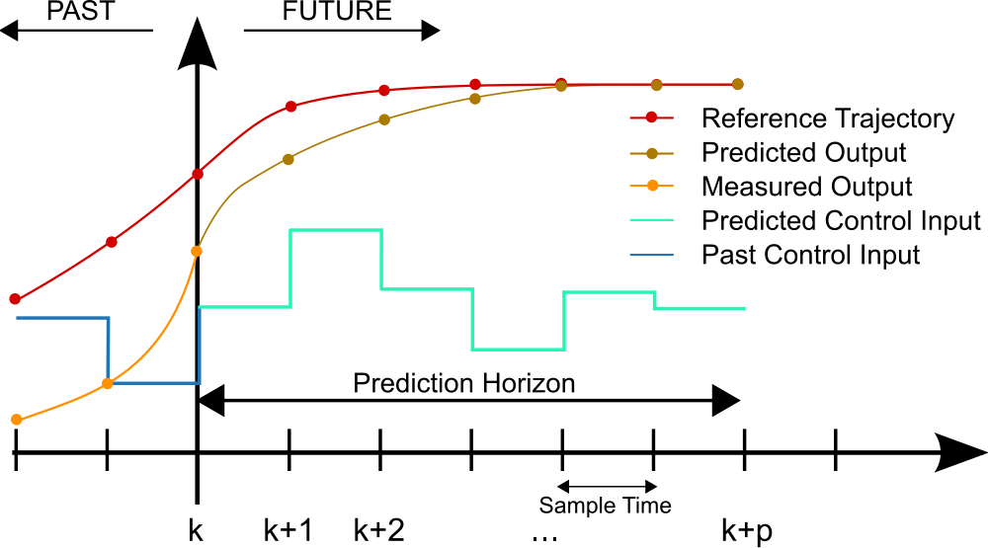
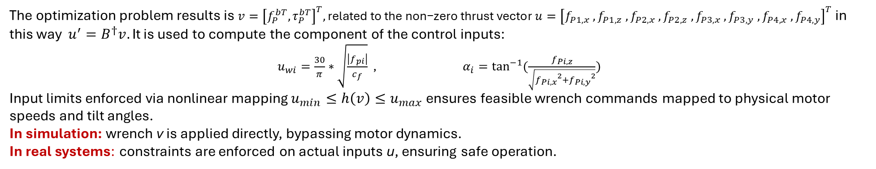

Tilting UAV: NL Model Predictive control
This control computes the optimal control inputs by solving a finite-horizon optimization problem subject to system dynamics and actuator constraints.
6-DOF UAV dynamics with translational motion and rotational motion: $$\ddot{p_{b}}=g+\frac{1}{m}\left(R_{b}\left(f_{P}^{b}−A_{T}v_{b}^{b}\right)+f_{D}\right) \\ {\dot{ω}}_{b}^{b}=J^{−1}\left(−ω × Jω+τ_{P}^{b}−A_{R}ω+τ_{D}\right)$$
NMPC Optimization Problem :
$$\min_{v}{\sum_{i=k}^{k+N−1}{{\left(x−x_{d}\right)}^{T}Q_{x}\left(x−x_{d}\right)+v^{T}Q_{v}v s.t }}$$
$$x\left(i+1\right)=f\left(x\left(i\right),v\left(i\right)\right)$$
$$x\left(i\right)∈X$$
$$v\left(i\right)∈V$$
$$x\left(0\right)=x_{0}$$
Where: $Q_{x}=[diag\left\{{10}^{5}, {10}^{5},{10}^{6}\right\}, diag\left\{{10}^{−4},{10}^{−4},{10}^{2}\right\}, diag\left\{{10}^{−2},{10}^{−2},{10}^{−2}\right\}, diag \{{10}^{−2},{10}^{−2},{10}^{−2}$}]
$$Q_{v}=0.01I_{6}$$
The optimization problem results is $v={\left[f_{P}^{bT},τ_{P}^{bT}\right]}^{T}, \text{related} \text{to} \text{the} \text{non}\text{−}\text{zero} \text{thrust} \text{vector} u={\left[f_{P1,x}{ , f}_{P1,z}{ , f}_{P2,x}{ , f}_{P2,z}{ , f}_{P3,x}{ , f}_{P3,y}{ , f}_{P4,x}{ , f}_{P4,y}\right]}^{T}$ $\text{in} \text{this} \text{way} u^{′}=B^{†}v. \text{I}$t is used to compute the component of the control inputs:
$u_{wi}=\frac{30}{π}∗$ $\sqrt{\frac{\left|f_{pi}\right|}{c_{f}}}$ , $α_{i}=\tan^{−1}{(\frac{f_{Pi,z}}{\sqrt{{f_{Pi,x}}^{2}+{f_{Pi,y}}^{2}}})}$
Input limits enforced via nonlinear mapping $u_{min}≤h\left(v\right)≤u_{max}$ ensures feasible wrench commands mapped to physical motor speeds and tilt angles.
In simulation: wrench v is applied directly, bypassing motor dynamics.
In real systems: constraints are enforced on actual inputs u, ensuring safe operation.

Slide 18
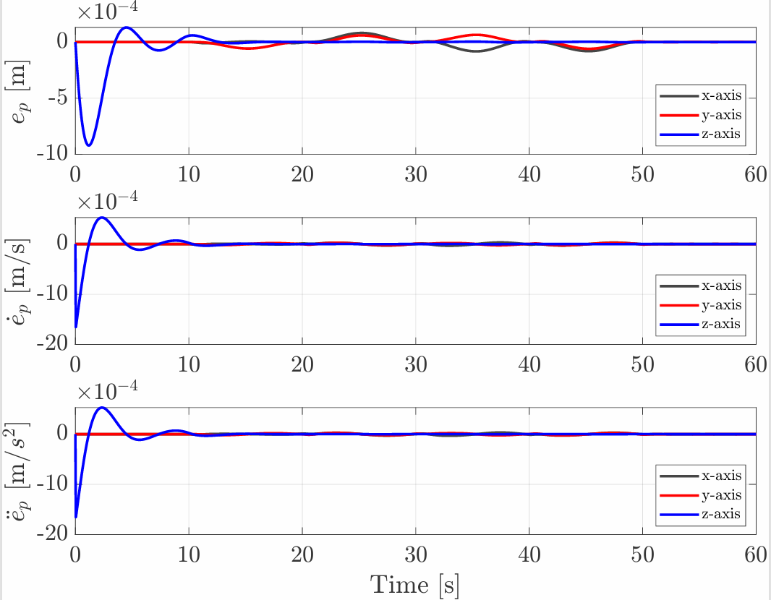
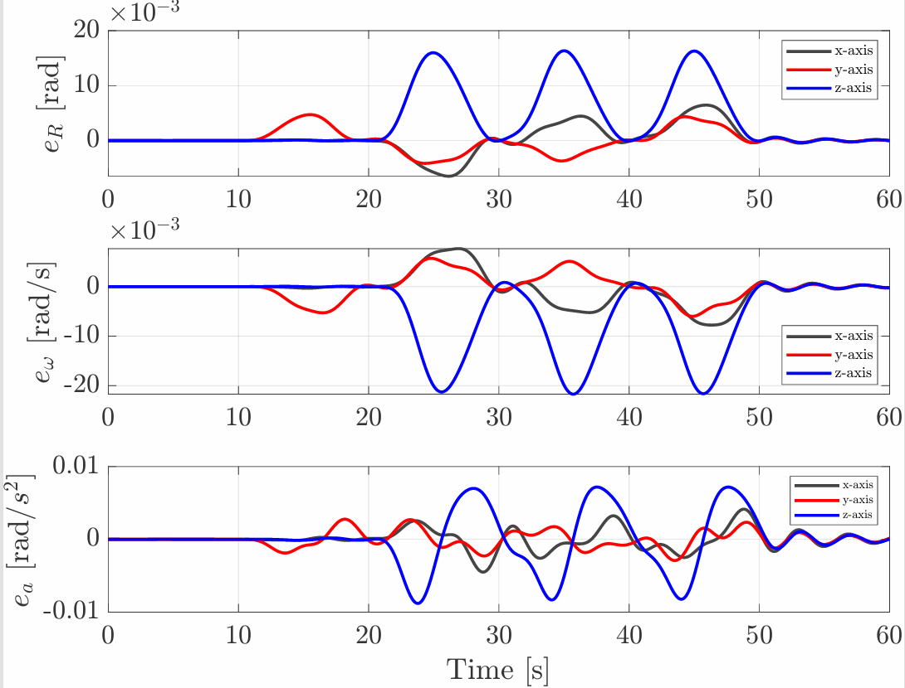
Tiliting control with Holocopter approach: Square trajectory results
In the vertical ascent phase, the position, linear velocity, and linear acceleration errors are larger along the z-axis. Along the x and y axes, these errors exhibit more oscillatory behavior during the square segments.
As for orientation, angular velocity, and angular acceleration errors, they increase significantly once the UAV enters the square trajectory. In the first side of the square (10–20 s), only a roll motion is commanded, so there is only a small pitch error . In the subsequent sides, where both roll and pitch are actively commanded, angular errors appear along both x and y as expected. The simultaneous variation of roll and pitch produces coupling effects that also result in angular errors around the z-axis.

Slide 19
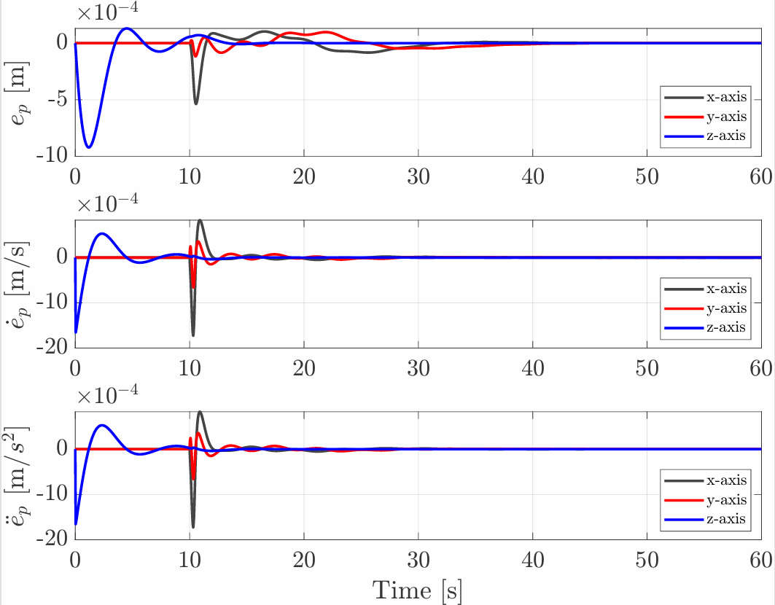
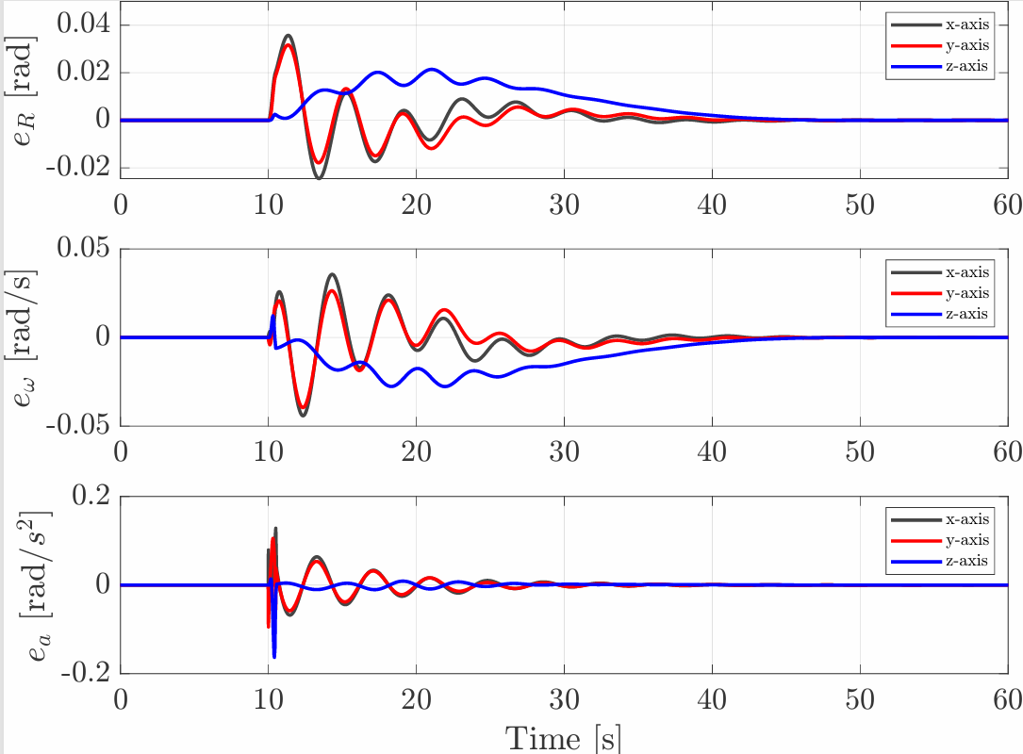
Tiliting control with Holocopter approach: Circular trajectory results
The linear error profiles are overall similar to those in the square trajectory. However, at the transition between the vertical ascent and the beginning of the circular path, we observe significant peaks in the linear errors along x and y.
Regarding angular errors, they remain negligible during the vertical segment, similar to the square case. They begin increasing at the start of the circular motion (10 s). The angular errors exhibit a transient increase, followed by damped oscillations.

Slide 20
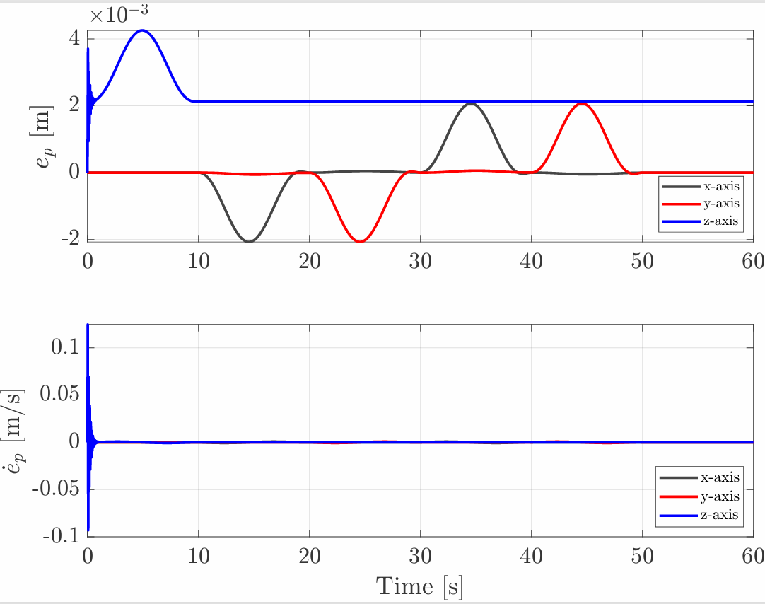
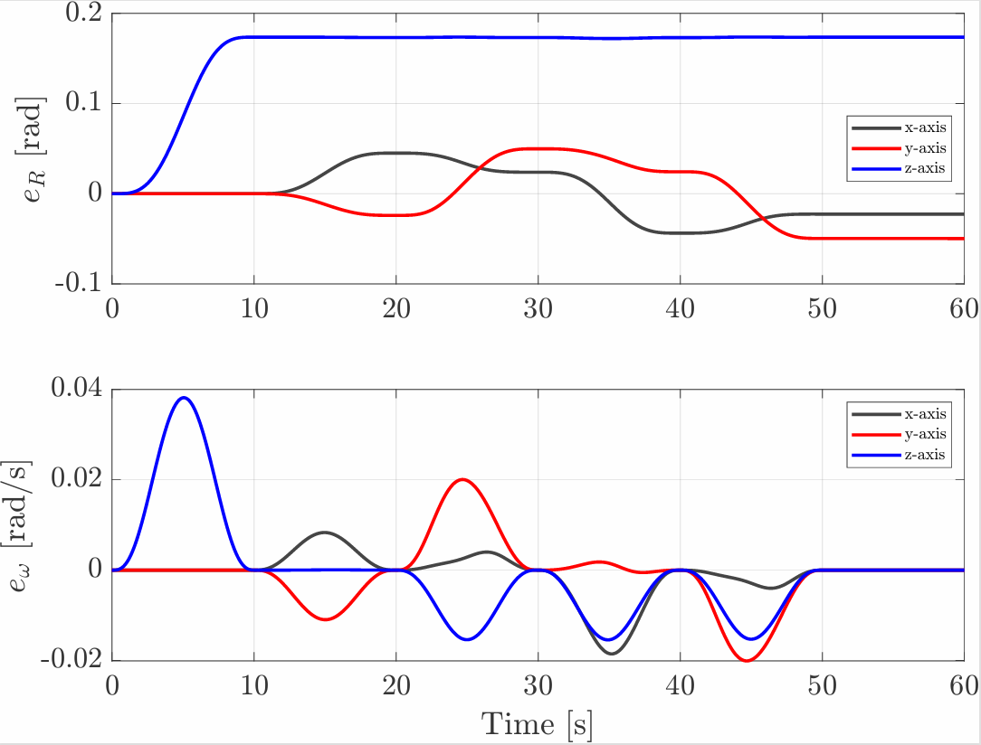
NL Model Predictive Control: Square trajectory results
The orientation error around the z-axis stabilizes around approximately 0.17 rad, while the x and y components settle to small values close to zero.
For the position error, the x and y components converge to zero, but the z component stabilizes around approximately 0.004 m. Furthermore, each axis is affected by error only during the corresponding motion segment.
For the linear velocity errors, we observe high-frequency oscillations at the beginning of the simulation. This behavior is primarily due to the weight configuration within the NMPC cost function.

Slide 21
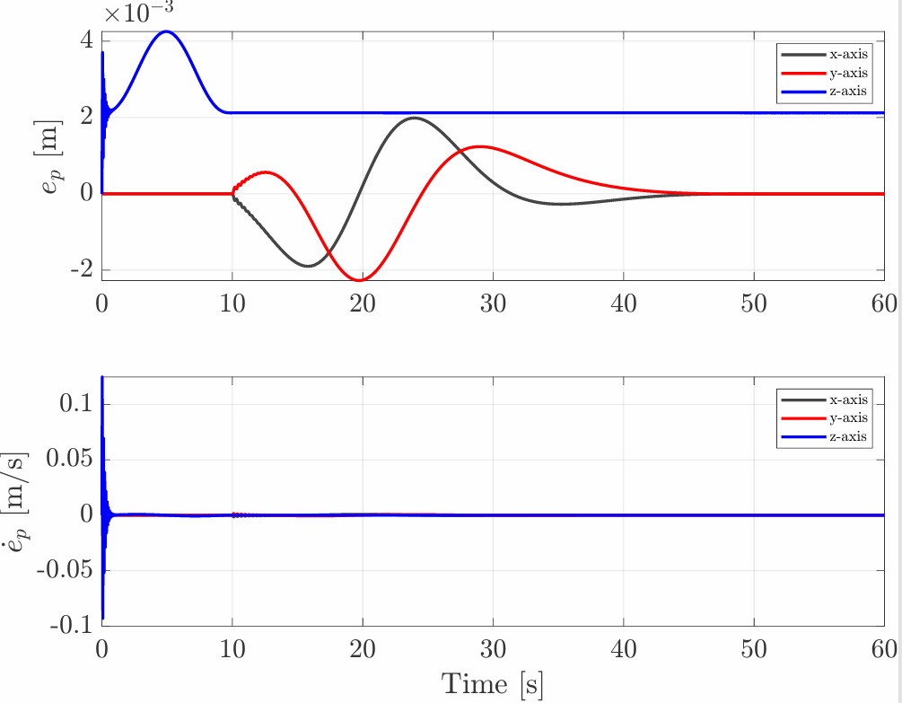
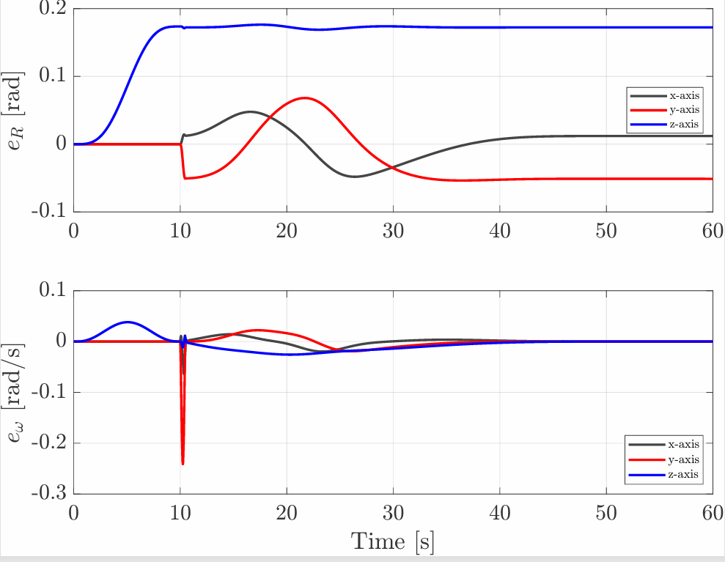
NL Model Predictive Control: Circular trajectory results
The z-axis behavior is similar to the square one, but the x and y components of the position error are different to zero throughout the entire circular motion.
For orientation errors, the z component shows a similar trend to the square one, instead for the x and y components, that starts to increase after 10 s, converge more faster and show higher amplitude.

Slide 22
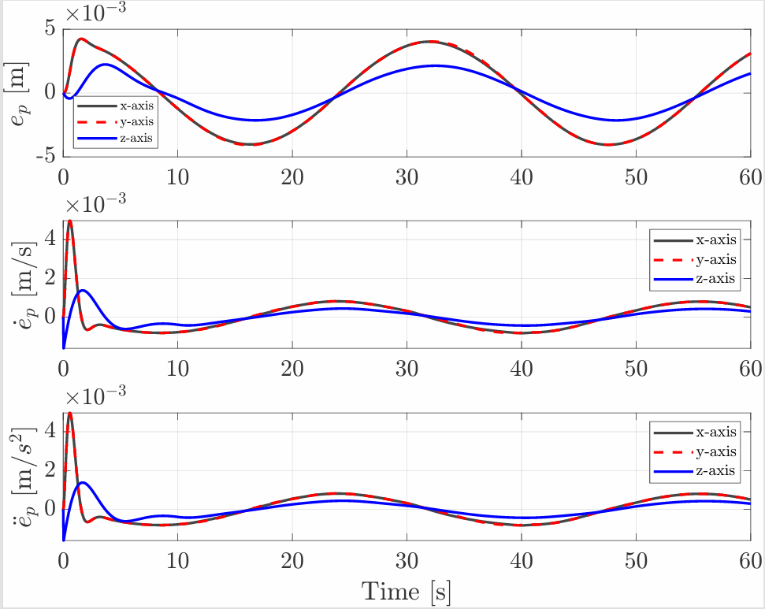
Holocopter approach in presence of disturbance: square trajectory results
This control strategy handles the disturbance reasonably well, although it does not include a dedicated mechanism for disturbance rejection
Compared to the nominal case , this represents an increase of approximately one order of magnitude in all linear error components.
Due to the higher gain weights assigned to the z-direction, we observe better disturbance rejection along this axis, particularly in the position error.
WITHOUT DISTURBANCE
WITH DISTURBANCE

Slide 23
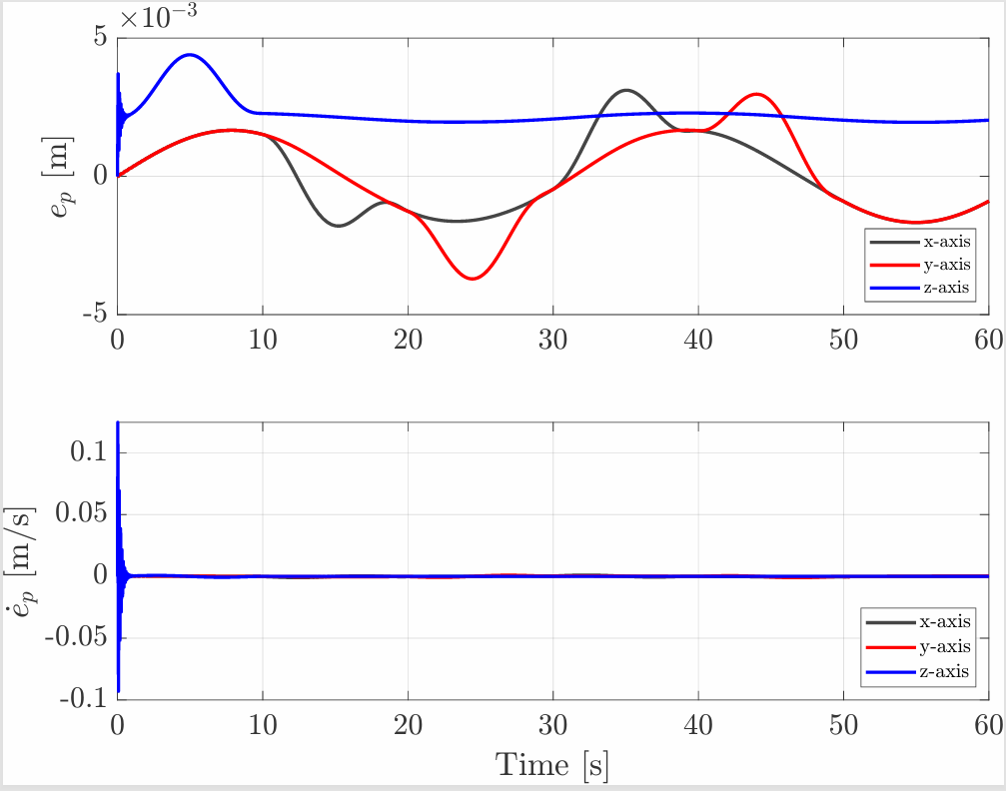
NMPC in presence of disturbance: square trajectory results
It demonstrates greater robustness to the same disturbance compared to the Holocopter approach, consistent with the nature of the NMPC
In this case, both position and linear velocity errors remain on the same order of magnitude as in the nominal.
The main visible difference lies in the position error behavior. Specifically, the x and y components exhibit slightly larger amplitudes compared to the nominal case and no longer stay at zero during phases of no corresponding motion.
WITHOUT DISTURBANCE
WITH DISTURBANCE

Slide 24
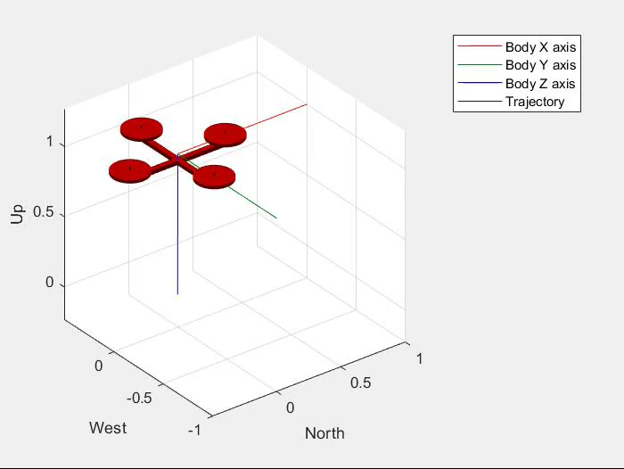
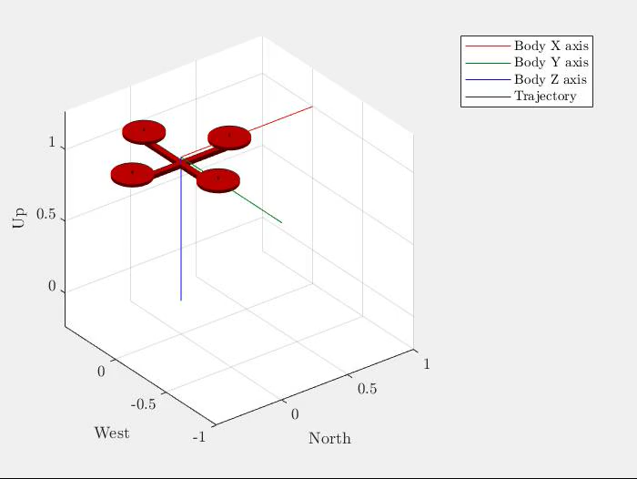


Conclusion: Co-planar UAV
ASMC : CIRCULAR TRAJECTORY + DISTURBANCE
Both perform better on circular trajectory (smoother motion).
Hierarchical Controller
Best for orientation accuracy (e.g., visual inspection).
ASMC
Best for position accuracy (e.g., precise payload delivery).
More robust to external disturbances (sinusoidal).
HIERARCHICAL : SQUARE TRAJECTORY
HIERARCHICAL : CIRCULAR TRAJECTORY
HIERARCHICAL : CIRCULAR TRAJECTORY + DISTURBANCE

Slide 25




Conclusion: Tilting UAV
NMPC : SQUARE TRAJECTORY + DISTURBANCE
Square trajectory: errors oscillate and settle slower than in circular trajectory.
Circular trajectory: smoother overall, but sharp orientation change in transition (vertical ↔ circular). It is handled better by the NMPC → linear errors remain unaffected.
Holocopter approach: drives errors (and derivatives) to zero
NMPC: minimizes cost function (doesn’t ensure zero error) but robust to disturbances
HOLOCOPTER : CIRCULAR TRAJECTORY
HOLOCOPTER : SQUARE TRAJECTORY
HOLOCOPTER : SQUARE TRAJECTORY + DISTURBANCE

Slide 26
