Slide 1
Welcome to A Night For Vision
Notes:
HOW TO USE THIS TEMPLATE: Home > New Slide (arrow) and pick a layout. Fill the placeholders; the styling is built in. Photo and rendering placeholders crop to fill (Picture Format > Crop to adjust the framing). Logo and QR placeholders fit the image without cropping. Every layout has a hidden title placeholder off the slide edge (Home > Select > Selection Pane) so screen reader users can navigate by slide title; give each slide a unique one. Montserrat must be installed on the presenting laptop, or embed fonts when you save (File > Options > Save > Embed fonts). This loop auto-advances every 8 seconds and repeats until Esc (Transitions tab to change timing; Slide Show > Set Up Slide Show to change looping).

Slide 2
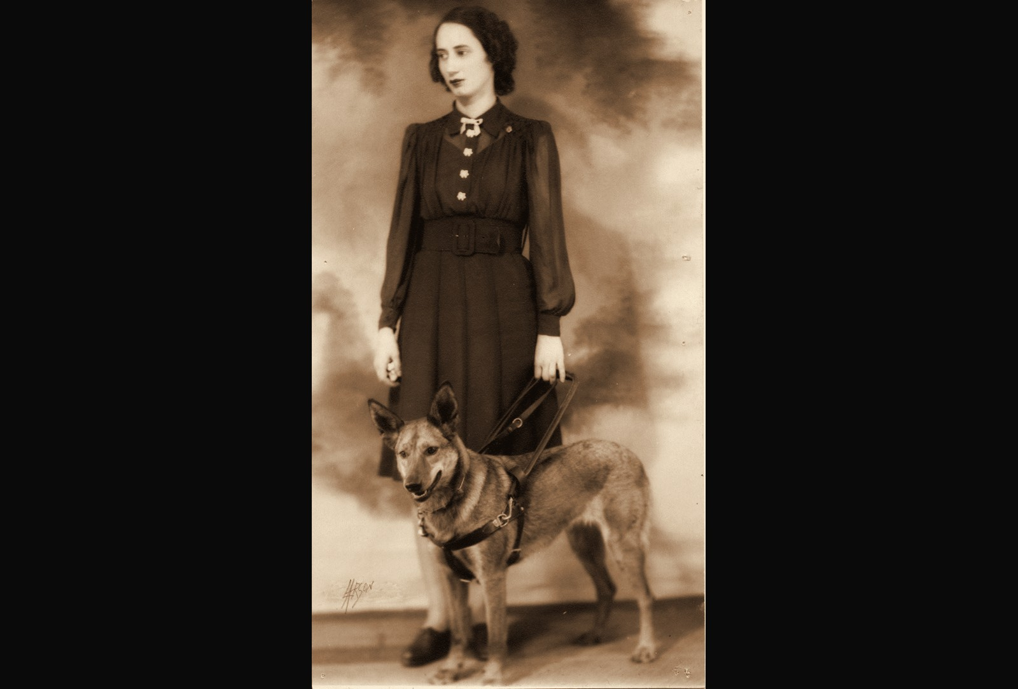
Throwback 1: 1930s, FIRST PROGRAM PARTICIPANT
1930s
FIRST PROGRAM PARTICIPANT
ENVISION THE FUTURE · HONOR THE LEGACY
Notes:
Year basis: Facebook post caption: 1933, one of Envision’s first patrons; label from Laura. Source photo: patron_1933.png. Photos already carry the sepia treatment; to swap one, right-click it > Change Picture.

Slide 3
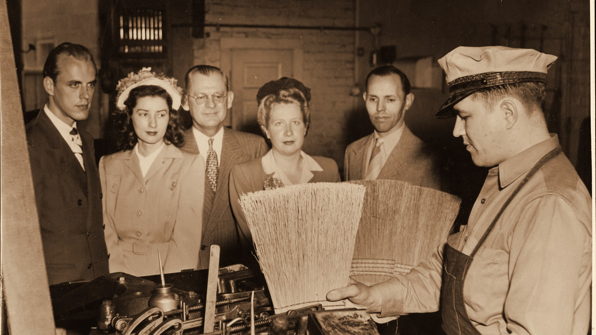


Throwback 2: 1940s, EMPLOYMENT PROGRAM PARTICIPANT
1940s
EMPLOYMENT PROGRAM PARTICIPANT
ENVISION THE FUTURE · HONOR THE LEGACY
Notes:
Year basis: Facebook post caption: broom-making workshop in the 1940s; label from Laura. Source photo: 514729028_24370021999262725_6241323963255478700_n.jpg. Photos already carry the sepia treatment; to swap one, right-click it > Change Picture. The dark scrim over the bottom of the photo is a separate object on this slide; duplicate this slide rather than inserting a fresh one so it comes along.

Slide 4

Presenting sponsor HighTouch Technologies
PRESENTING SPONSOR
ENVISION THE FUTURE · HONOR THE LEGACY
Notes:
Presenting sponsor slide. The HighTouch logo is placed; replace with the official file if a newer version arrives.

Slide 5
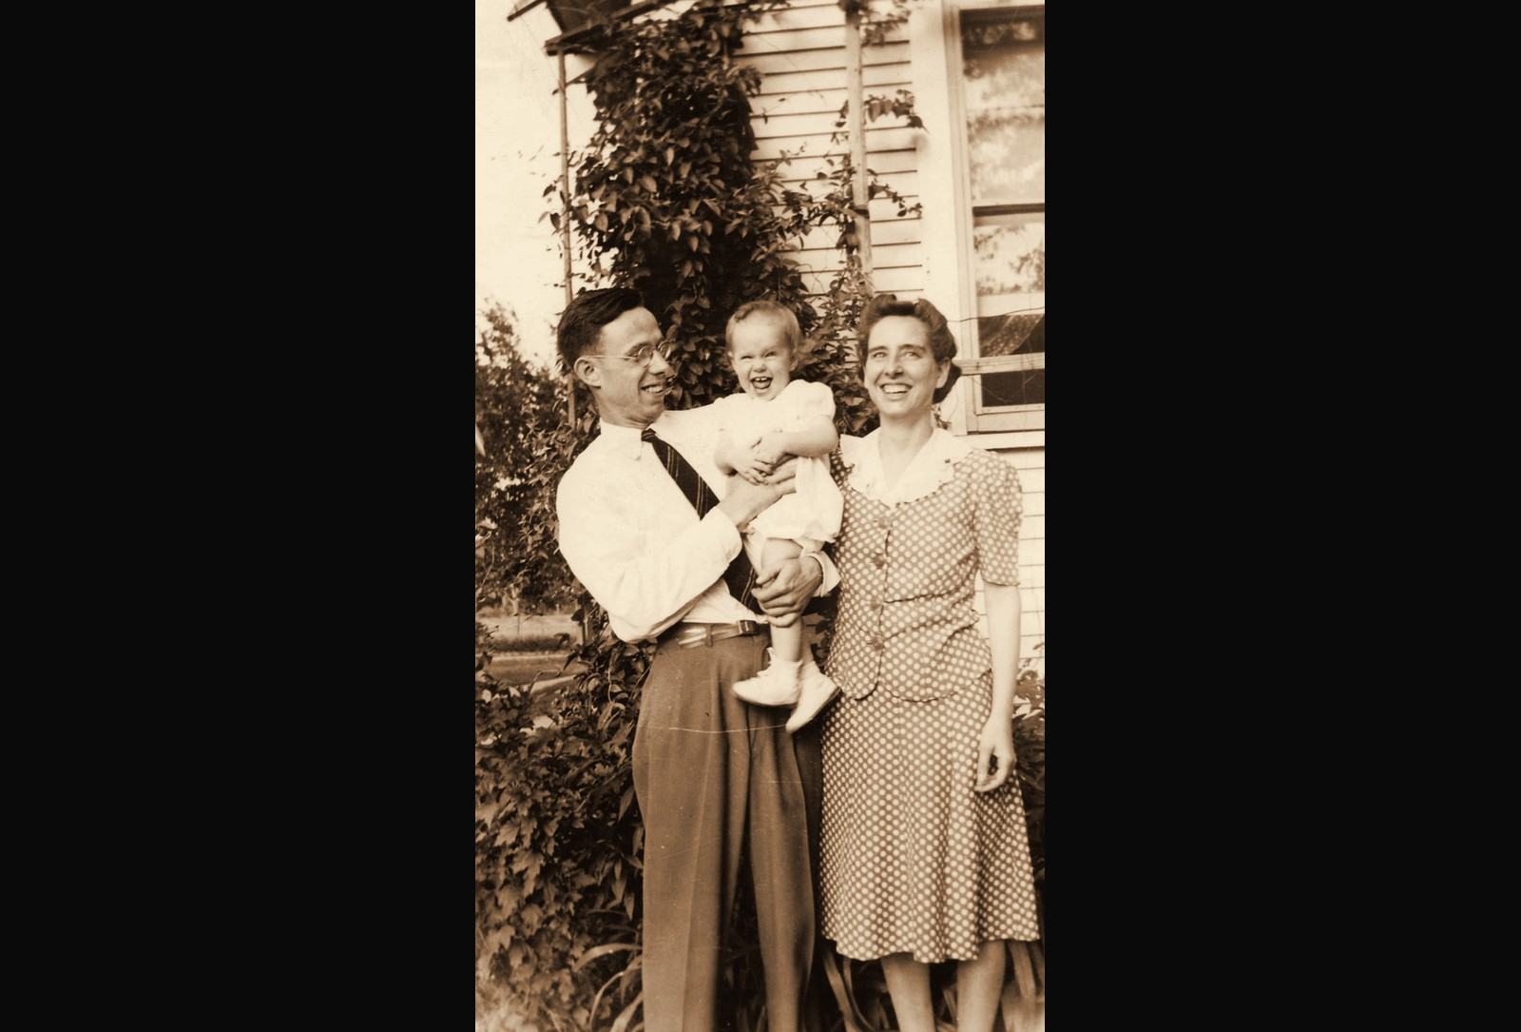
Throwback 3: 1940s, PROGRAM PARTICIPANT AND FAMILY
1940s
PROGRAM PARTICIPANT AND FAMILY
ENVISION THE FUTURE · HONOR THE LEGACY
Notes:
Year basis: Facebook post caption: a program participant and her family in the 1940s. Source photo: family_1940s.png. Photos already carry the sepia treatment; to swap one, right-click it > Change Picture.

Slide 6
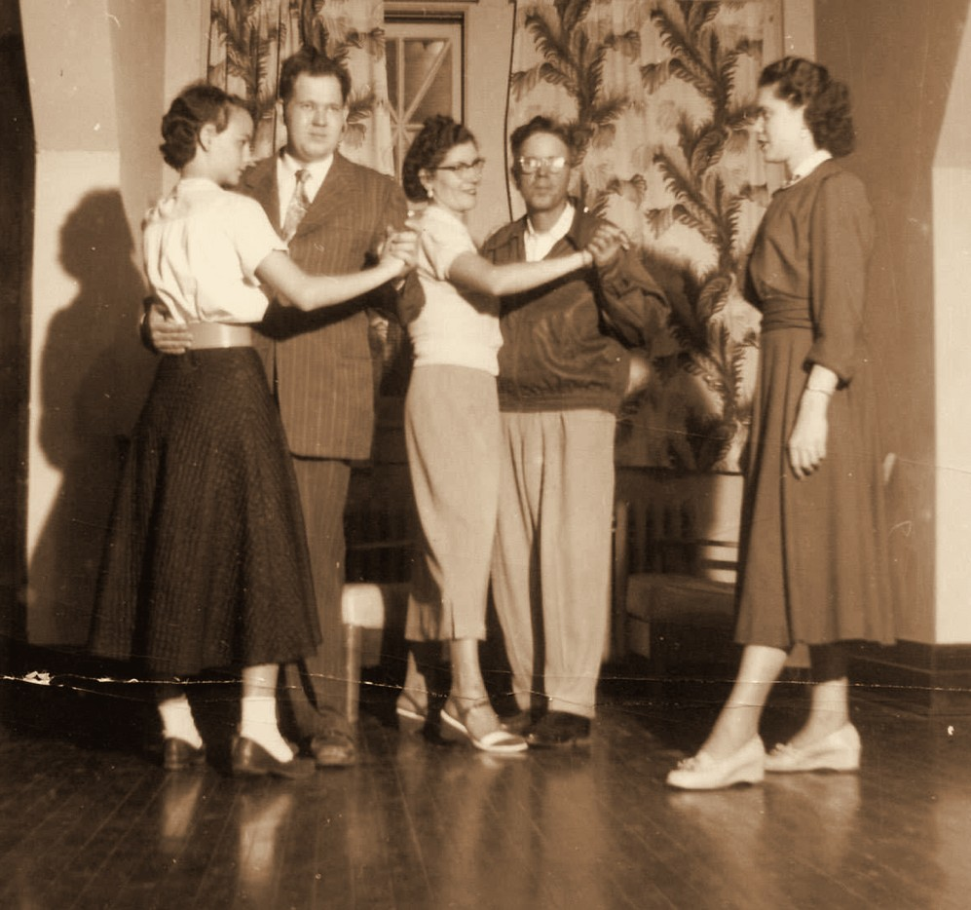
Throwback 4: 1950s, ENVISION PROGRAMS DANCE CLASS
1950s
ENVISION PROGRAMS DANCE CLASS
ENVISION THE FUTURE · HONOR THE LEGACY
Notes:
Year basis: Facebook post caption: a dance put on by Envision in the 1950s; label from Laura. Source photo: dance_1950s.png. Photos already carry the sepia treatment; to swap one, right-click it > Change Picture.

Slide 7
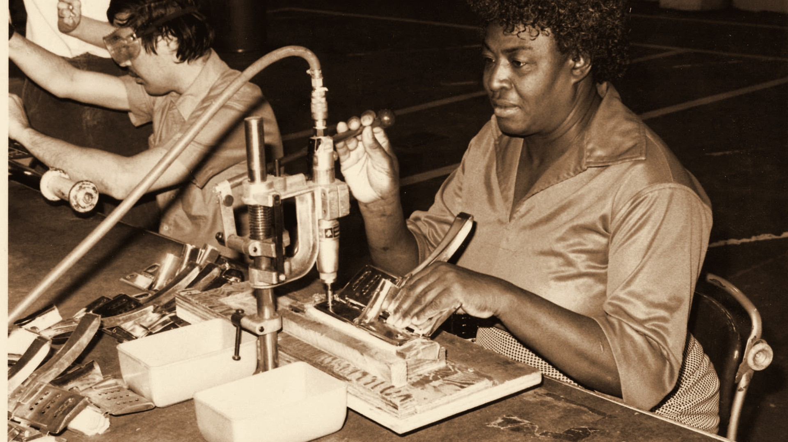
Throwback 5: 1970s, EMPLOYMENT IN WICHITA
1970s
EMPLOYMENT IN WICHITA
ENVISION THE FUTURE · HONOR THE LEGACY
Notes:
Year basis: decade is an estimate; program name not confirmed. Source photo: 514526513_24360271056904486_8424275321534355461_n.jpg. Photos already carry the sepia treatment; to swap one, right-click it > Change Picture. The dark scrim over the bottom of the photo is a separate object on this slide; duplicate this slide rather than inserting a fresh one so it comes along.

Slide 8
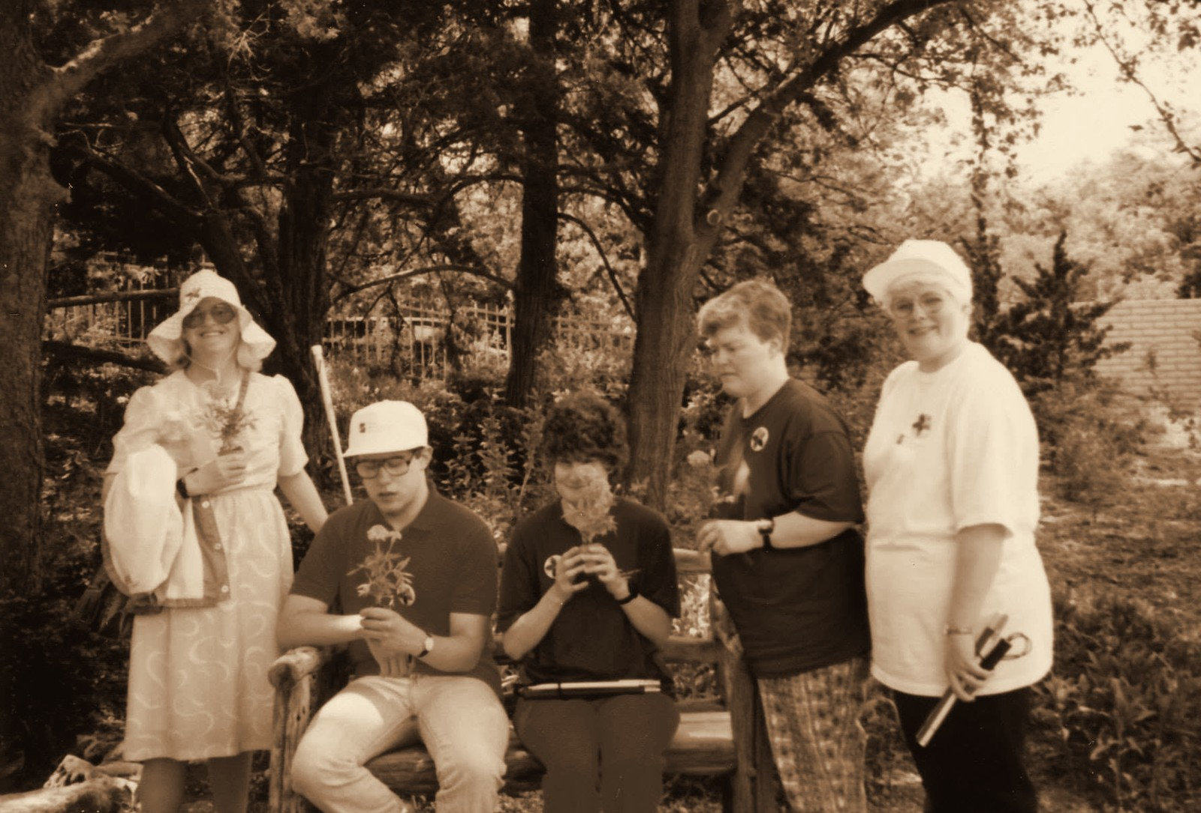
Throwback 6: 1990s, PRIDE PROGRAM AT BOTANICA
1990s
PRIDE PROGRAM AT BOTANICA
ENVISION THE FUTURE · HONOR THE LEGACY
Notes:
Year basis: Facebook post caption: PRIDE program at Botanica in 1992. Source photo: 514399319_24370451429219782_5553540867382418124_n.jpg. Photos already carry the sepia treatment; to swap one, right-click it > Change Picture.

Slide 9


Corporate sponsors
CORPORATE SPONSORS
SPR
ENVISION THE FUTURE · HONOR THE LEGACY
Notes:
Logos here are low-resolution cutouts from the sponsor thank-you graphic, placed so the loop runs complete. Replace each with the official logo file: right-click the logo > Change Picture (the white card fits it without cropping). Set the tier label to the sponsor level.

Slide 10
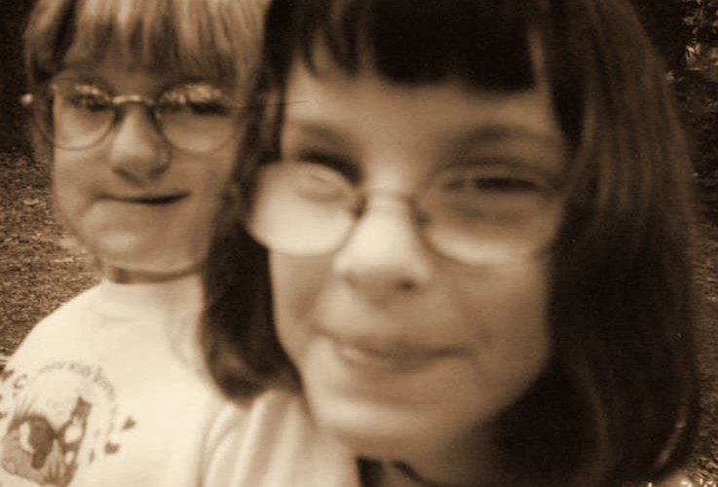
Throwback 7: 1990s, PROGRAM PARTICIPANTS
1990s
PROGRAM PARTICIPANTS
ENVISION THE FUTURE · HONOR THE LEGACY
Notes:
Year basis: Heather’s Camp photos from the PDF Laura sent; the PDF export carried no notes, year read from the print’s date stamp where one exists, otherwise a decade estimate; confirm (stamp reads 199x). Source photo: img-007.png. Photos already carry the sepia treatment; to swap one, right-click it > Change Picture.

Slide 11
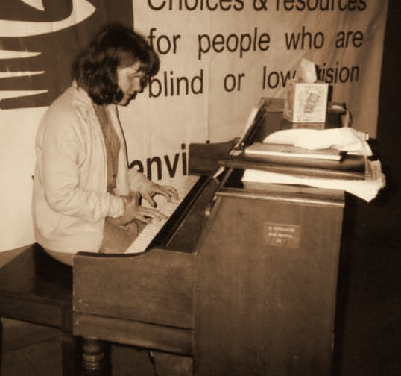
Throwback 8: 1990s, ENVISION PROGRAM PARTICIPANT
1990s
ENVISION PROGRAM PARTICIPANT
ENVISION THE FUTURE · HONOR THE LEGACY
Notes:
Year basis: photo from the PDF Laura sent; the PDF export carried no notes, year read from the print’s date stamp where one exists, otherwise a decade estimate; confirm; piano beneath the older Envision banner. Source photo: img-016.png. Photos already carry the sepia treatment; to swap one, right-click it > Change Picture.

Slide 12
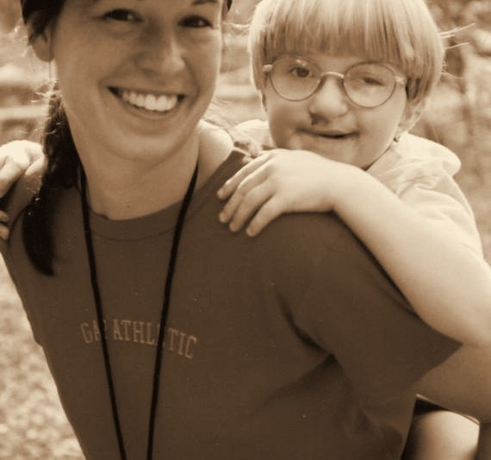
Throwback 12: 2000s, CAMPER & DELTA GAMMA VOLUNTEER
2000s
CAMPER & DELTA GAMMA VOLUNTEER
ENVISION THE FUTURE · HONOR THE LEGACY
Notes:
Year basis: spread across 2000 to 2005 at Laura’s direction; not from a dated record. Source photo: img-003.png. Photos already carry the sepia treatment; to swap one, right-click it > Change Picture.

Slide 13
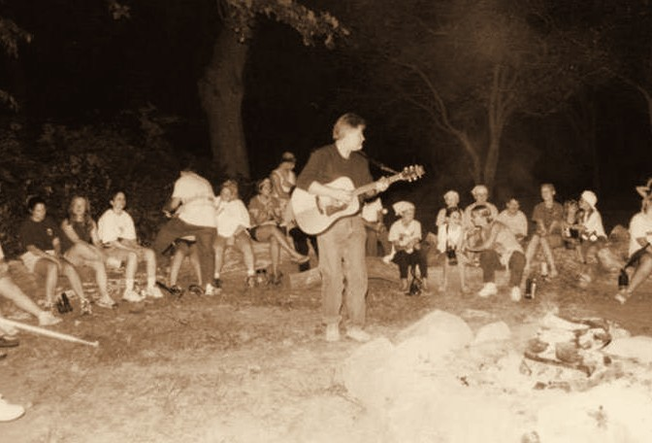
Throwback 17: 2000s, HEATHER’S CAMP PROGRAM PARTICIPANTS
2000s
HEATHER’S CAMP PROGRAM PARTICIPANTS
ENVISION THE FUTURE · HONOR THE LEGACY
Notes:
Year basis: spread across 2000 to 2005 at Laura’s direction; not from a dated record. Source photo: img-011.png. Photos already carry the sepia treatment; to swap one, right-click it > Change Picture.

Slide 14

Platinum level sponsor Forvis Mazars
PLATINUM LEVEL SPONSOR
ENVISION THE FUTURE · HONOR THE LEGACY
Notes:
Logos here are low-resolution cutouts from the sponsor thank-you graphic, placed so the loop runs complete. Replace each with the official logo file: right-click the logo > Change Picture (the white card fits it without cropping). Set the tier label to the sponsor level.

Slide 15
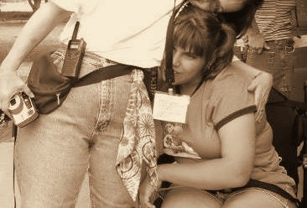
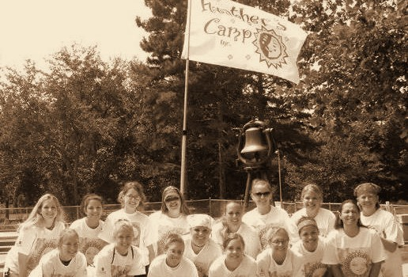
Throwback 23: 2000s, HEATHER’S CAMP, CAMPER & DELTA GAMMA VOLUNTEERS
2000s
HEATHER’S CAMP, CAMPER & DELTA GAMMA VOLUNTEERS
ENVISION THE FUTURE · HONOR THE LEGACY
Notes:
Year basis: Heather’s Camp photos from the PDF Laura sent; the PDF export carried no notes, year read from the print’s date stamp where one exists, otherwise a decade estimate; confirm (both stamped AUG 8 2004). Source photos: img-004.png, img-020.png. Photos already carry the sepia treatment; to swap one, right-click it > Change Picture.

Slide 16
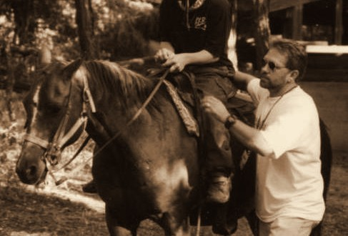
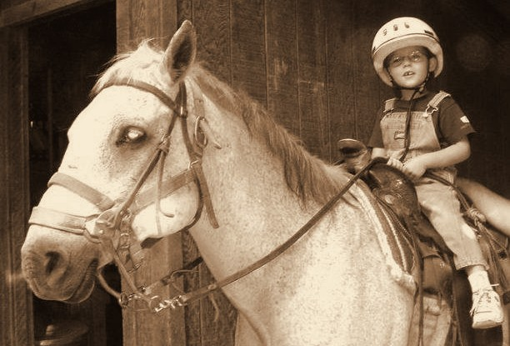
Throwback 21: 2000s, HEATHER’S CAMP
2000s
HEATHER’S CAMP
ENVISION THE FUTURE · HONOR THE LEGACY
Notes:
Year basis: spread across 2000 to 2005 at Laura’s direction; not from a dated record. Source photos: img-015.png, img-019.png. Photos already carry the sepia treatment; to swap one, right-click it > Change Picture.

Slide 17
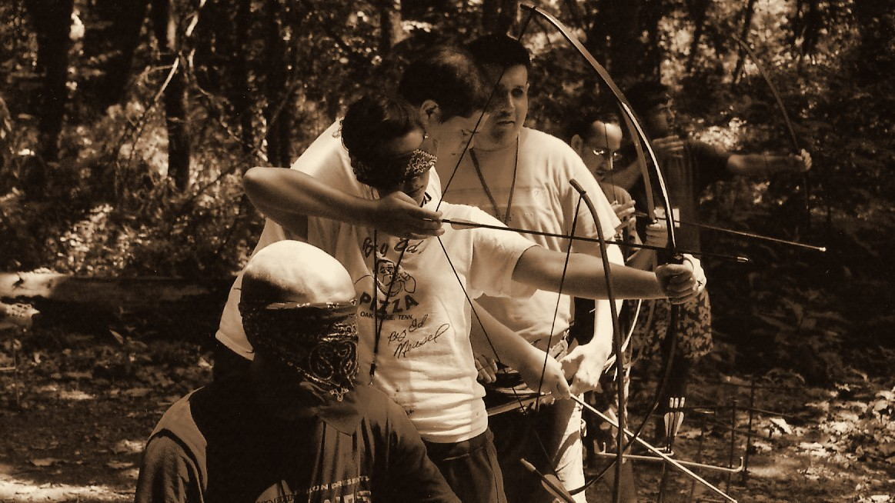
Throwback 25: 2000s, ENVISION PROGRAMS
2000s
ENVISION PROGRAMS
ENVISION THE FUTURE · HONOR THE LEGACY
Notes:
Year basis: Heather’s Camp 2007, confirmed by Laura. Source photo: scan0014_00b.jpg. Photos already carry the sepia treatment; to swap one, right-click it > Change Picture. The dark scrim over the bottom of the photo is a separate object on this slide; duplicate this slide rather than inserting a fresh one so it comes along.

Slide 18

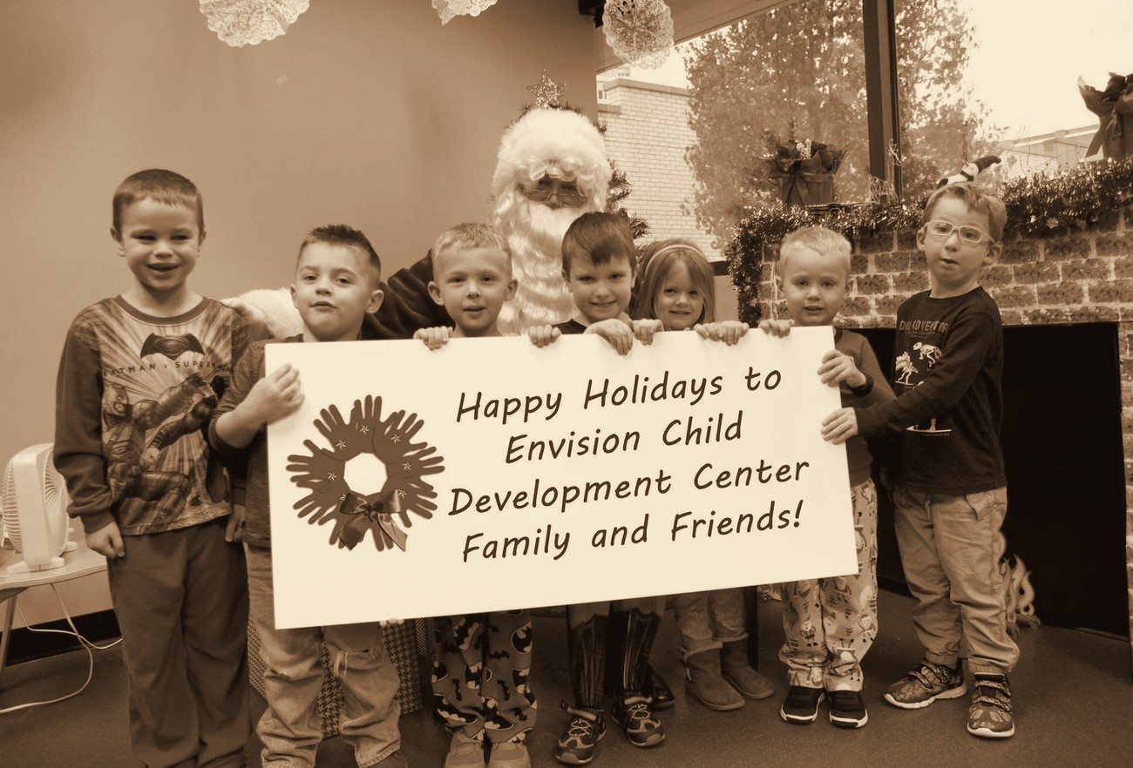
Throwback 41: 2010s, ENVISION CHILD DEVELOPMENT CENTER
2010s
ENVISION CHILD DEVELOPMENT CENTER
ENVISION THE FUTURE · HONOR THE LEGACY
Notes:
Year basis: decade is an estimate; confirm. Source photos: 516307629_24404475582484033_4077145122123939934_n.jpg, 514398054_24407351508863107_4640940189281080079_n.jpg. Photos already carry the sepia treatment; to swap one, right-click it > Change Picture.

Slide 19



Diamond level sponsors
DIAMOND LEVEL SPONSORS
Summit Films
ENVISION THE FUTURE · HONOR THE LEGACY
Notes:
Logos here are low-resolution cutouts from the sponsor thank-you graphic, placed so the loop runs complete. Replace each with the official logo file: right-click the logo > Change Picture (the white card fits it without cropping). Set the tier label to the sponsor level.

Slide 20
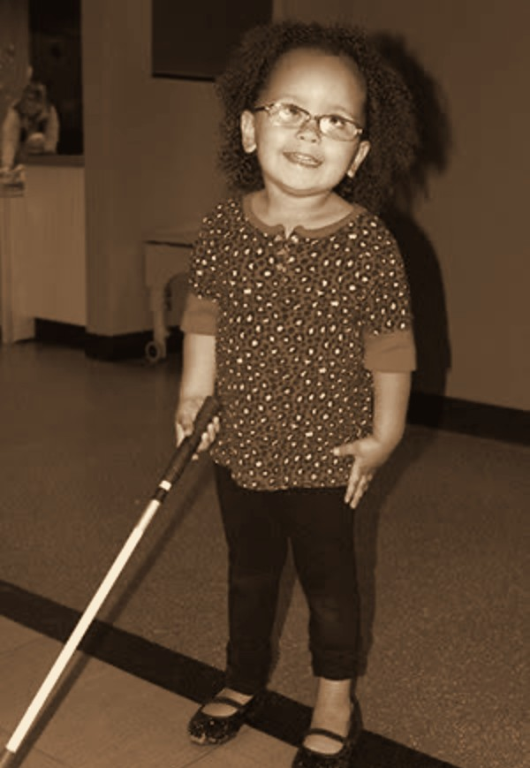
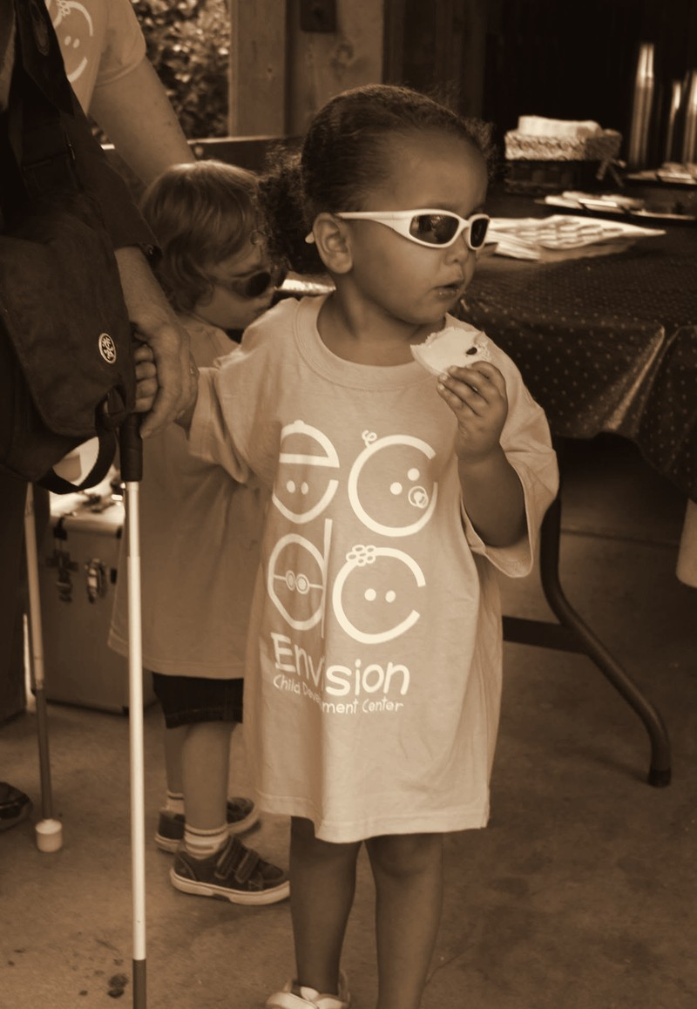
Throwback 34: 2010s, ENVISION CHILD DEVELOPMENT CENTER
2010s
ENVISION CHILD DEVELOPMENT CENTER
ENVISION THE FUTURE · HONOR THE LEGACY
Notes:
Year basis: Facebook posts dated May 16 and August 18, 2014; Adah per Laura. Source photos: girl_cane_2014.png, 514102732_24347428004855458_8712718144461110952_n.jpg. Photos already carry the sepia treatment; to swap one, right-click it > Change Picture.

Slide 21
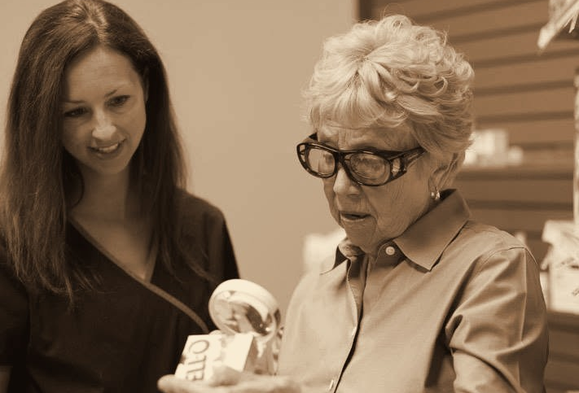
Throwback 36: 2010s, ENVISION LOW VISION CLINIC REHABILITATION PROGRAM PARTICIPANT
2010s
ENVISION LOW VISION CLINIC REHABILITATION PROGRAM PARTICIPANT
ENVISION THE FUTURE · HONOR THE LEGACY
Notes:
Year basis: decade is an estimate; program name not confirmed. Source photo: 514356143_24365277619737163_4572300578063408220_n.jpg. Photos already carry the sepia treatment; to swap one, right-click it > Change Picture.

Slide 22
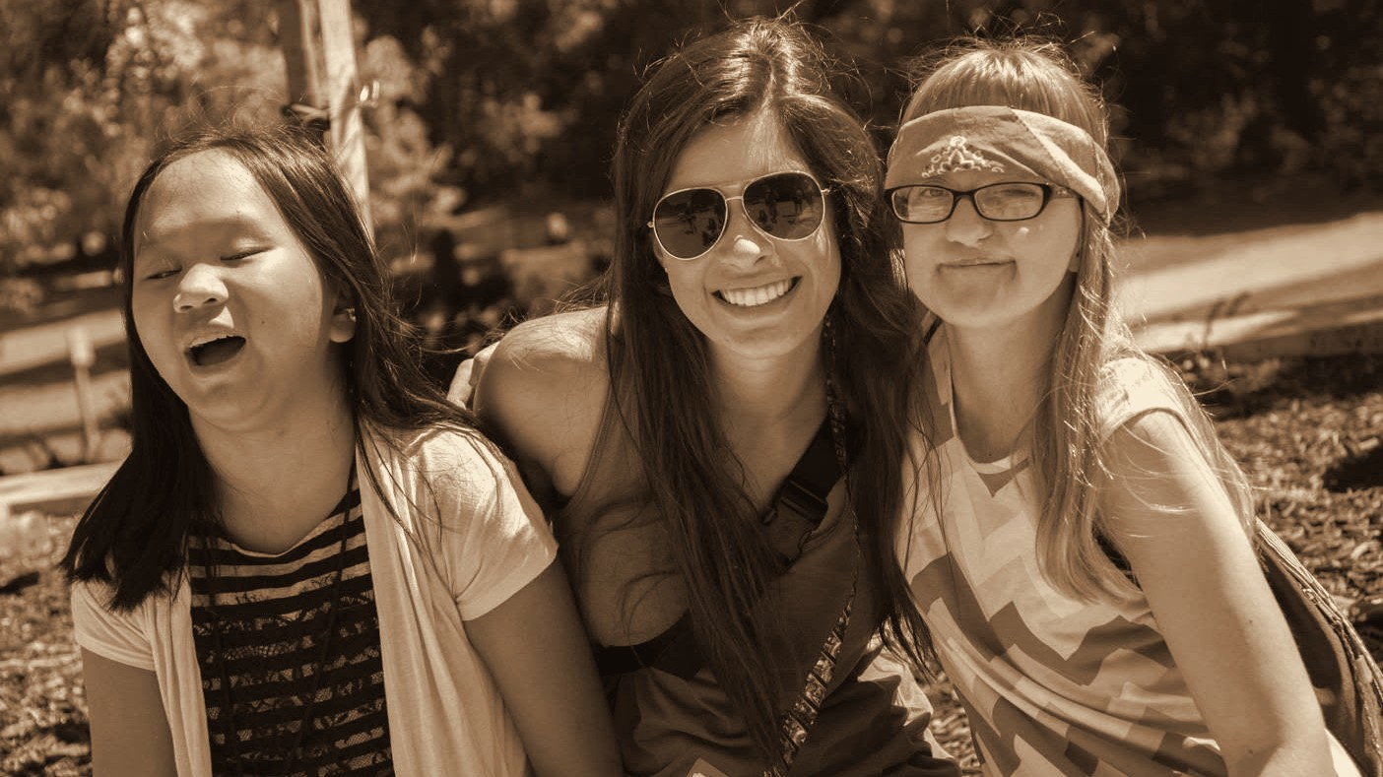
Throwback 37: 2010s, HEATHER’S CAMP, CAMPERS & DELTA GAMMA VOLUNTEER
2010s
HEATHER’S CAMP, CAMPERS & DELTA GAMMA VOLUNTEER
ENVISION THE FUTURE · HONOR THE LEGACY
Notes:
Year basis: Facebook post dated July 31, 2015; camp name not confirmed. Source photo: 515508522_24372597575671834_6507375247130789716_n.jpg. Photos already carry the sepia treatment; to swap one, right-click it > Change Picture. The dark scrim over the bottom of the photo is a separate object on this slide; duplicate this slide rather than inserting a fresh one so it comes along.

Slide 23
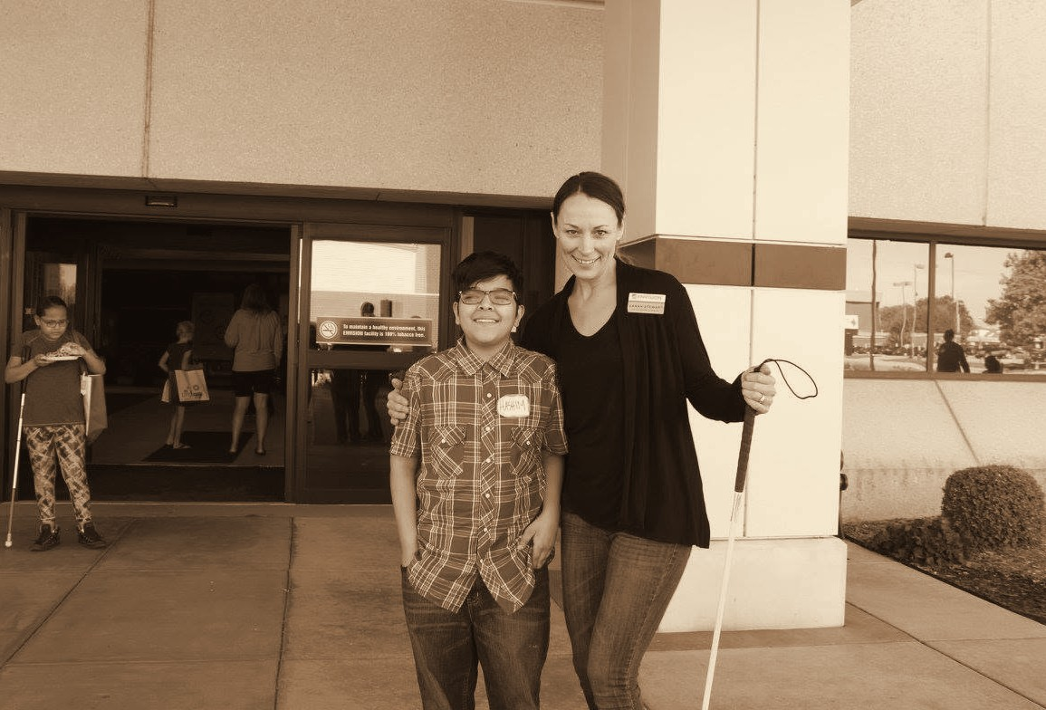
Throwback 38: 2010s, ENVISION ARTS YOUTH PROGRAM PARTICIPANT
2010s
ENVISION ARTS YOUTH PROGRAM PARTICIPANT
ENVISION THE FUTURE · HONOR THE LEGACY
Notes:
Year basis: Facebook post dated October 13, 2016; Laura confirms the photos are from 2015; program name not confirmed. Source photo: 515264128_24392120943719497_1144878044891021107_n.jpg. Photos already carry the sepia treatment; to swap one, right-click it > Change Picture.

Slide 24
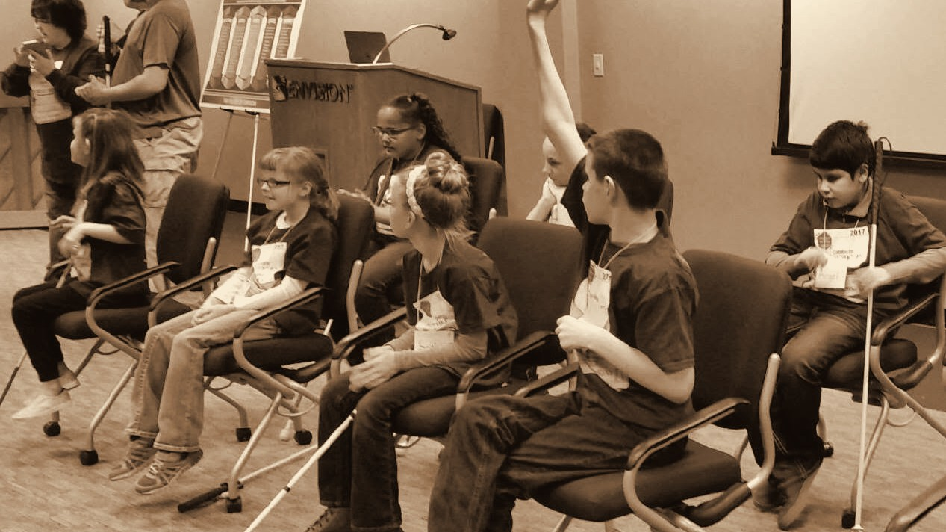
Throwback 42: 2017, BRAILLE CHALLENGE, WICHITA
2017
BRAILLE CHALLENGE, WICHITA
ENVISION THE FUTURE · HONOR THE LEGACY
Notes:
Year basis: Facebook post dated February 27, 2017. Source photo: 515666041_24396518596613065_9163789206916333567_n.jpg. Photos already carry the sepia treatment; to swap one, right-click it > Change Picture. The dark scrim over the bottom of the photo is a separate object on this slide; duplicate this slide rather than inserting a fresh one so it comes along.

Slide 25
Gold level sponsor INTRUST Bank
GOLD LEVEL SPONSOR
INTRUST Bank
ENVISION THE FUTURE · HONOR THE LEGACY
Notes:
Logos here are low-resolution cutouts from the sponsor thank-you graphic, placed so the loop runs complete. Replace each with the official logo file: right-click the logo > Change Picture (the white card fits it without cropping). Set the tier label to the sponsor level.

Slide 26
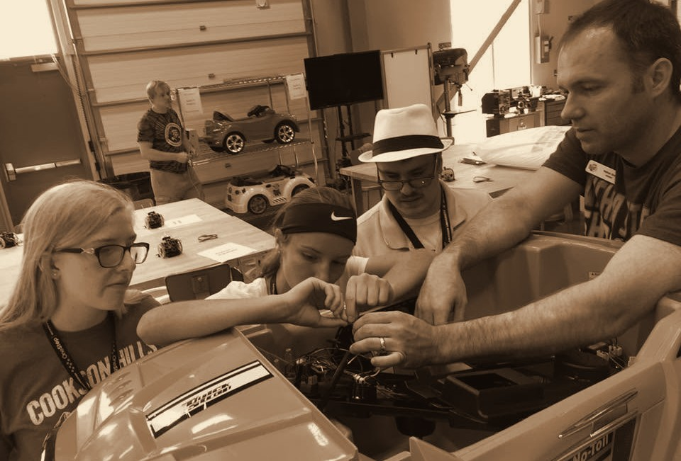
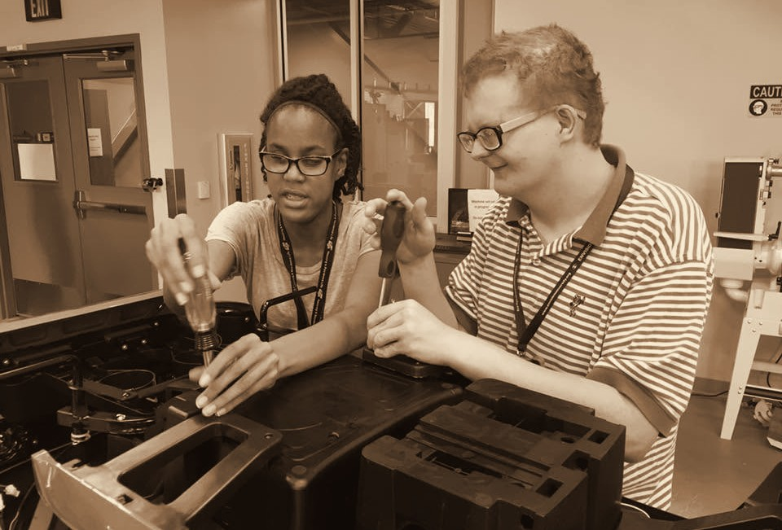
Throwback 43: 2018, ENVISION’S LEVEL UP, PROGRAM PARTICIPANTS
2018
ENVISION’S LEVEL UP, PROGRAM PARTICIPANTS
ENVISION THE FUTURE · HONOR THE LEGACY
Notes:
Year basis: year from Facebook upload timing; program name not confirmed. Source photos: 36679840_1977772592247652_8857339367518109696_n.jpg, 36720032_1977770692247842_8607756704823640064_n.jpg. Photos already carry the sepia treatment; to swap one, right-click it > Change Picture.

Slide 27
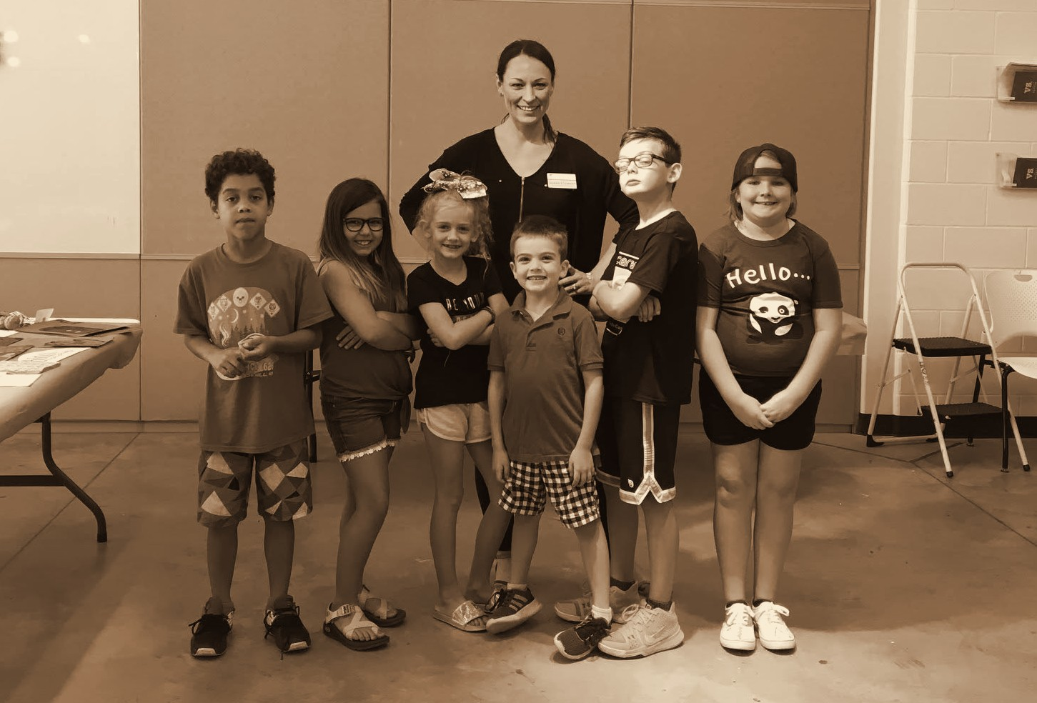
Throwback 44: 2018, ENVISION ARTS YOUTH PROGRAM PARTICIPANTS
2018
ENVISION ARTS YOUTH PROGRAM PARTICIPANTS
ENVISION THE FUTURE · HONOR THE LEGACY
Notes:
Year basis: year from Facebook upload timing; program name not confirmed. Source photo: 39468117_2048172925207618_3198537865604628480_n.jpg. Photos already carry the sepia treatment; to swap one, right-click it > Change Picture.

Slide 28
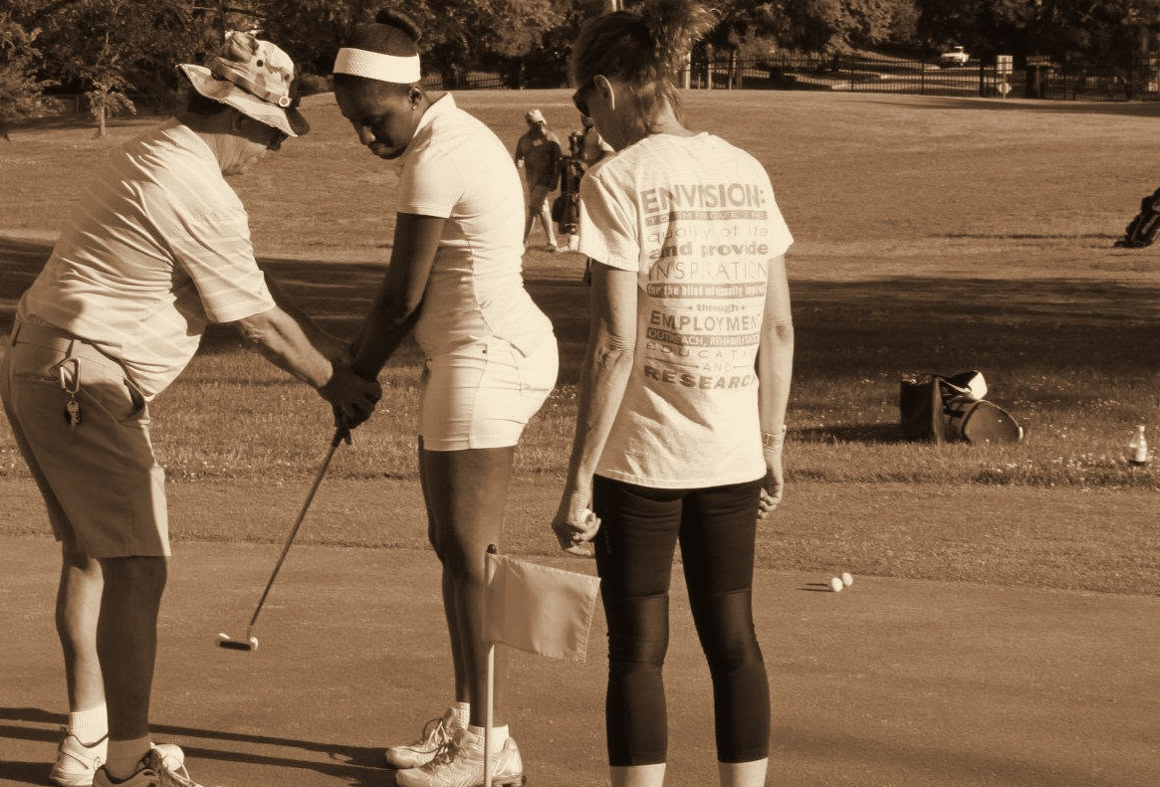
Throwback 45: 2019, ENVISION GOLF CLINIC, PROGRAM PARTICIPANT
2019
ENVISION GOLF CLINIC, PROGRAM PARTICIPANT
ENVISION THE FUTURE · HONOR THE LEGACY
Notes:
Year basis: year from Facebook upload timing; event name not confirmed. Source photo: 56781124_2401507159874191_4435377701120901120_n.jpg. Photos already carry the sepia treatment; to swap one, right-click it > Change Picture.

Slide 29
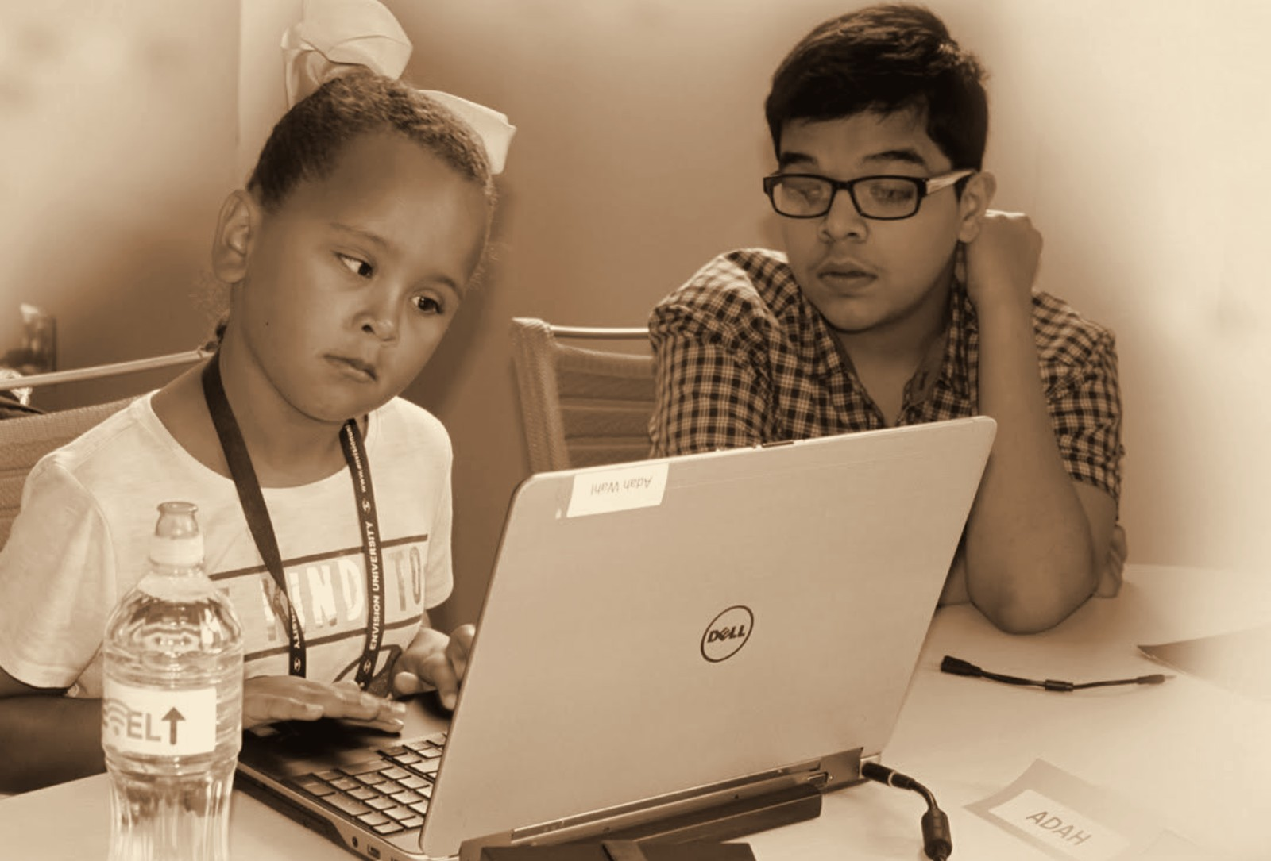
Throwback 47: 2020, ENVISION’S LEVEL UP, PROGRAM PARTICIPANTS
2020
ENVISION’S LEVEL UP, PROGRAM PARTICIPANTS
ENVISION THE FUTURE · HONOR THE LEGACY
Notes:
Year basis: Facebook post dated December 4, 2020; names per Laura. Source photo: weseeclearly.png. Photos already carry the sepia treatment; to swap one, right-click it > Change Picture.

Slide 30
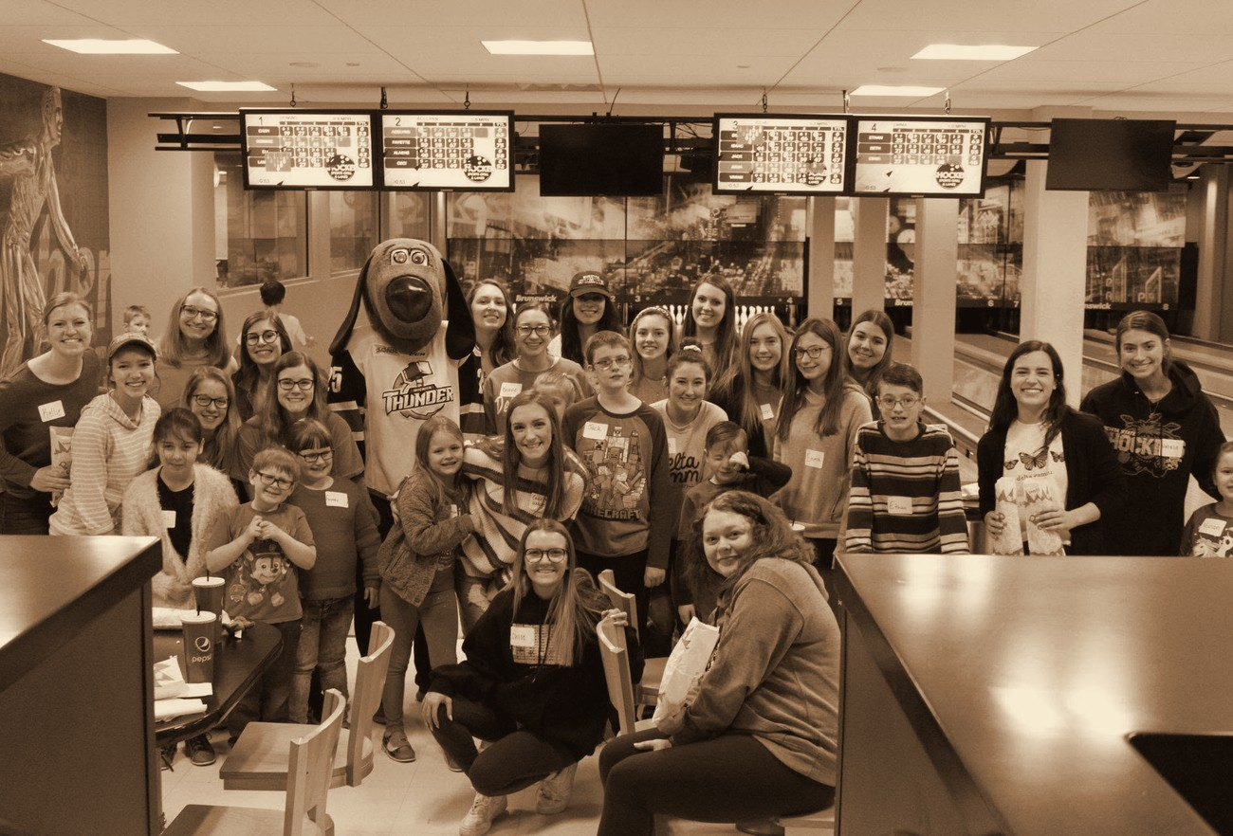
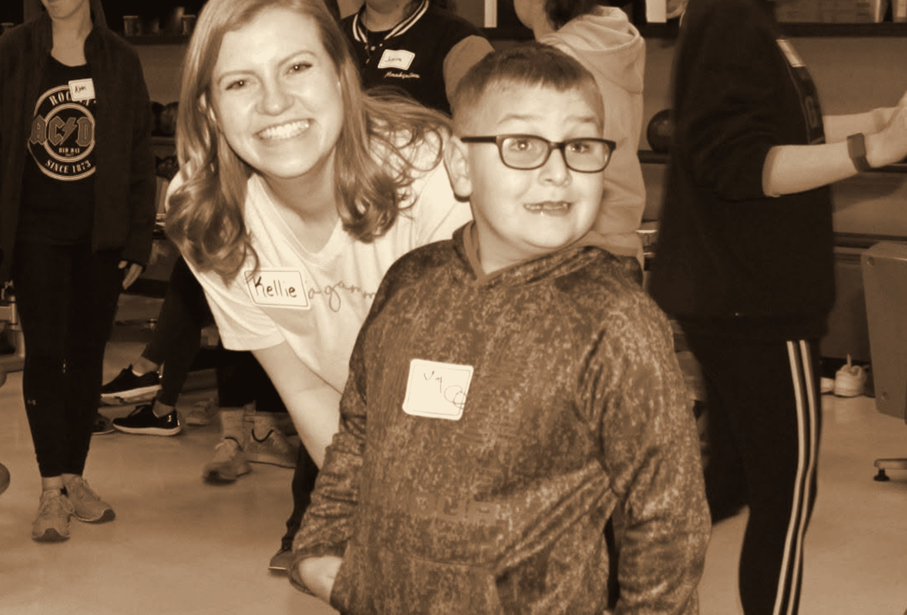
Throwback 48: 2020, ENVISION MONTHLY PROGRAMS
2020
ENVISION MONTHLY PROGRAMS
ENVISION THE FUTURE · HONOR THE LEGACY
Notes:
Year basis: group photo uploaded February 2020; the close-up was reposted March 30, 2021; confirm. Source photos: 87270349_3040969335927967_4814775488343965696_n.jpg, bowling_kid.png. Photos already carry the sepia treatment; to swap one, right-click it > Change Picture.

Slide 31







Silver level sponsors
SILVER LEVEL SPONSORS
Vornado
Novolex
ENVISION THE FUTURE · HONOR THE LEGACY
Notes:
Logos here are low-resolution cutouts from the sponsor thank-you graphic, placed so the loop runs complete. Replace each with the official logo file: right-click the logo > Change Picture (the white card fits it without cropping). Set the tier label to the sponsor level.

Slide 32
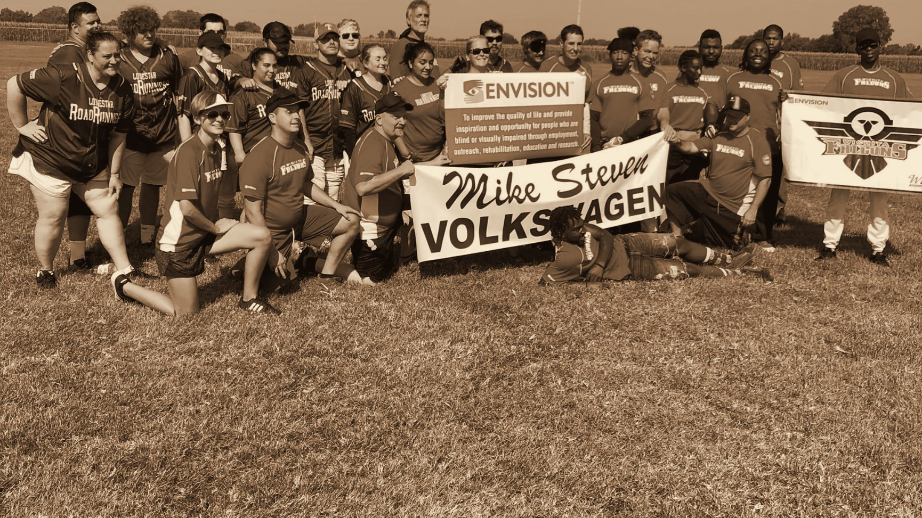
Throwback 49: 2021, ENVISION BEEP BASEBALL
2021
ENVISION BEEP BASEBALL
ENVISION THE FUTURE · HONOR THE LEGACY
Notes:
Year basis: Facebook post dated July 30, 2021. Source photo: falcons2021.png. Photos already carry the sepia treatment; to swap one, right-click it > Change Picture. The dark scrim over the bottom of the photo is a separate object on this slide; duplicate this slide rather than inserting a fresh one so it comes along.

Slide 33
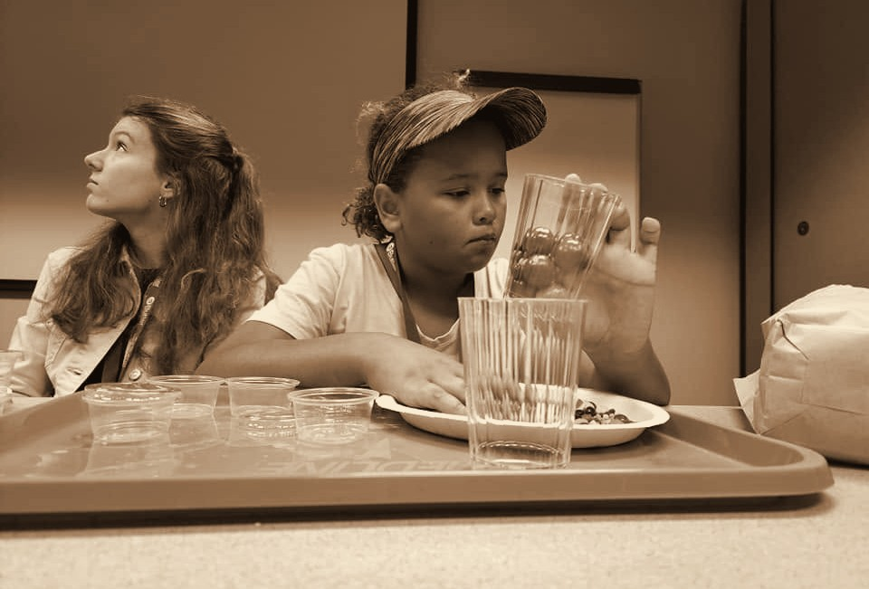
Throwback 51: 2022, ENVISION’S LEVEL UP, PROGRAM PARTICIPANT
2022
ENVISION’S LEVEL UP, PROGRAM PARTICIPANT
ENVISION THE FUTURE · HONOR THE LEGACY
Notes:
Year basis: Facebook post dated July 21, 2022; Adah per Laura. Source photo: adah_2022.png. Photos already carry the sepia treatment; to swap one, right-click it > Change Picture.

Slide 34
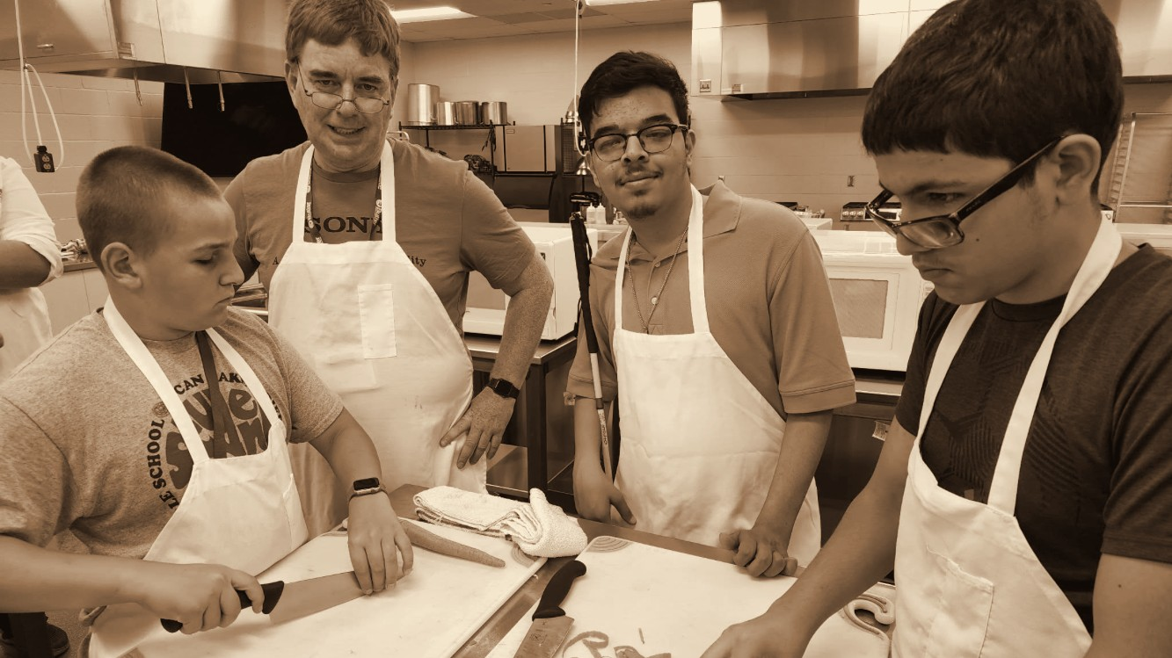
Throwback 52: 2022, ENVISION’S LEVEL UP, PROGRAM PARTICIPANT
2022
ENVISION’S LEVEL UP, PROGRAM PARTICIPANT
ENVISION THE FUTURE · HONOR THE LEGACY
Notes:
Year basis: Facebook post dated July 19, 2022; Hashim per Laura. Source photo: hashim_2022.png. Photos already carry the sepia treatment; to swap one, right-click it > Change Picture. The dark scrim over the bottom of the photo is a separate object on this slide; duplicate this slide rather than inserting a fresh one so it comes along.

Slide 35
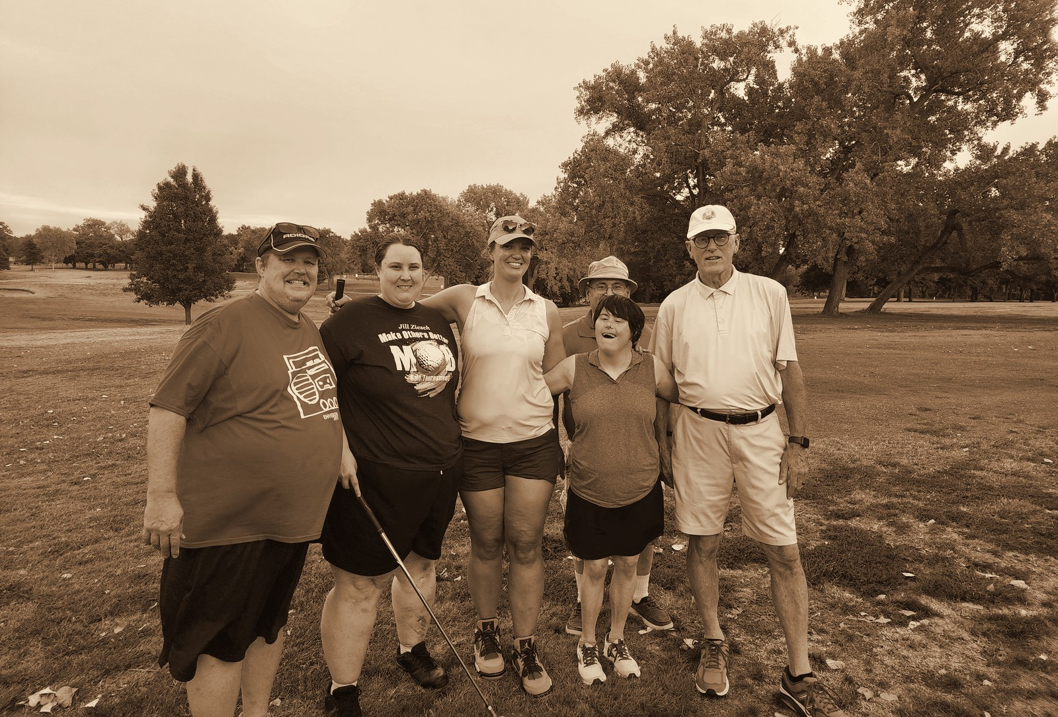
Throwback 53: 2022, ENVISION FORE VISION GOLF TOURNAMENT
2022
ENVISION FORE VISION GOLF TOURNAMENT
ENVISION THE FUTURE · HONOR THE LEGACY
Notes:
Year basis: phone camera timestamp; event name not confirmed. Source photo: 20220829_195341.jpg. Photos already carry the sepia treatment; to swap one, right-click it > Change Picture.

Slide 36
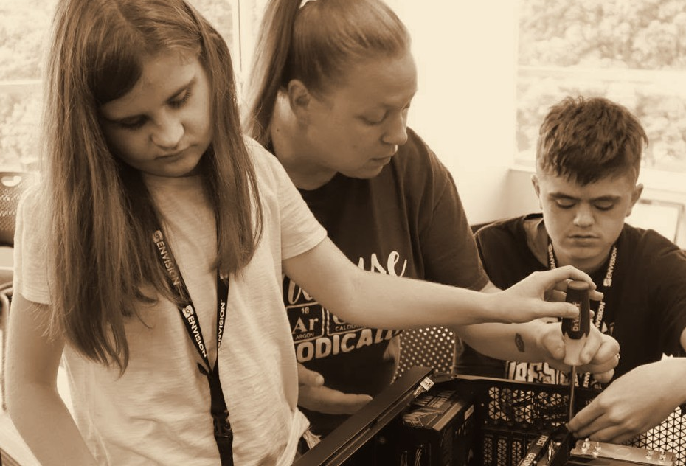
Throwback 54: 2024, ENVISION’S LEVEL UP, PROGRAM PARTICIPANT
2024
ENVISION’S LEVEL UP, PROGRAM PARTICIPANT
ENVISION THE FUTURE · HONOR THE LEGACY
Notes:
Year basis: Facebook post dated June 27, 2024; Kennick per Laura. Source photo: kennick_2024.png. Photos already carry the sepia treatment; to swap one, right-click it > Change Picture.

Slide 37
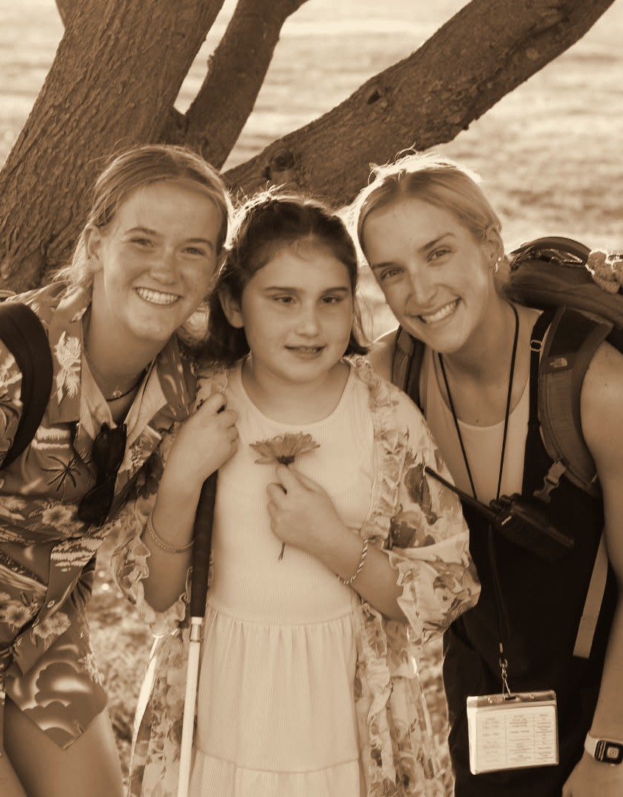
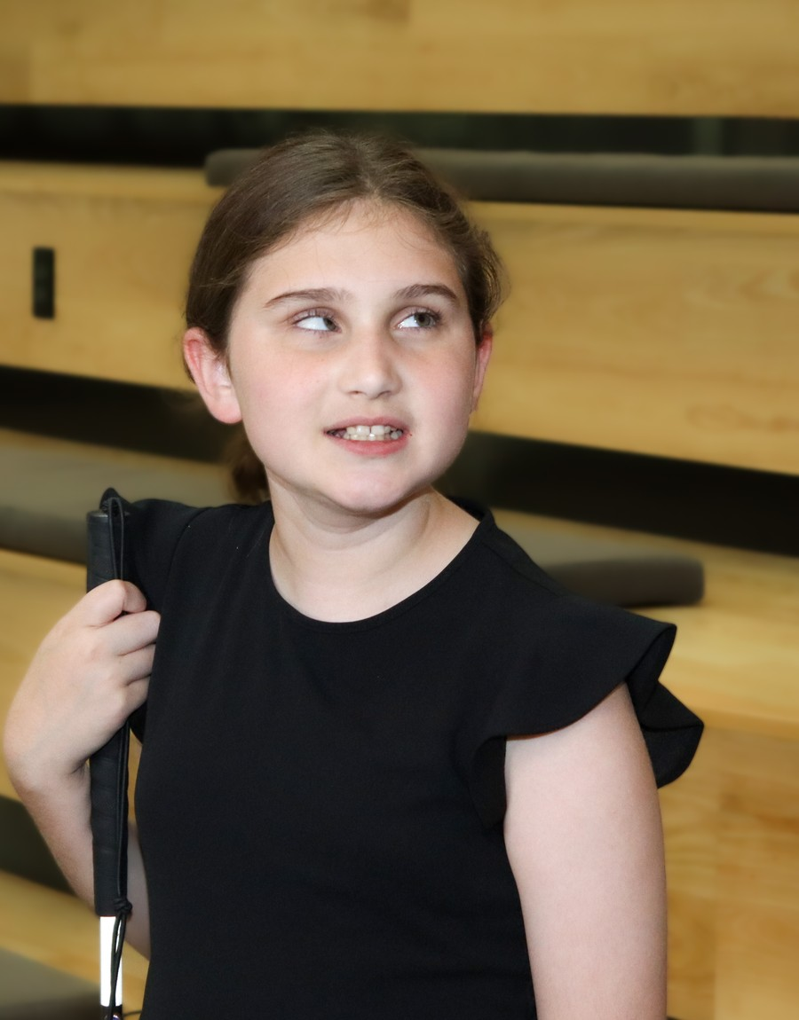
Throwback 55: 2024, HEATHER’S CAMP
AUBREE · FEATURED GUEST
2024
2026
HEATHER’S CAMP
LEVEL UP
ENVISION THE FUTURE · HONOR THE LEGACY
Notes:
Year basis: then: Facebook post dated August 1, 2024 (Heather’s Camp); now: Level Up 2026 photo from Laura. Source photos: 482091992_1036613011835564_1782698059698200373_n.jpg, Aubree_Calvert.jpg. Photos already carry the sepia treatment; to swap one, right-click it > Change Picture.

Slide 38
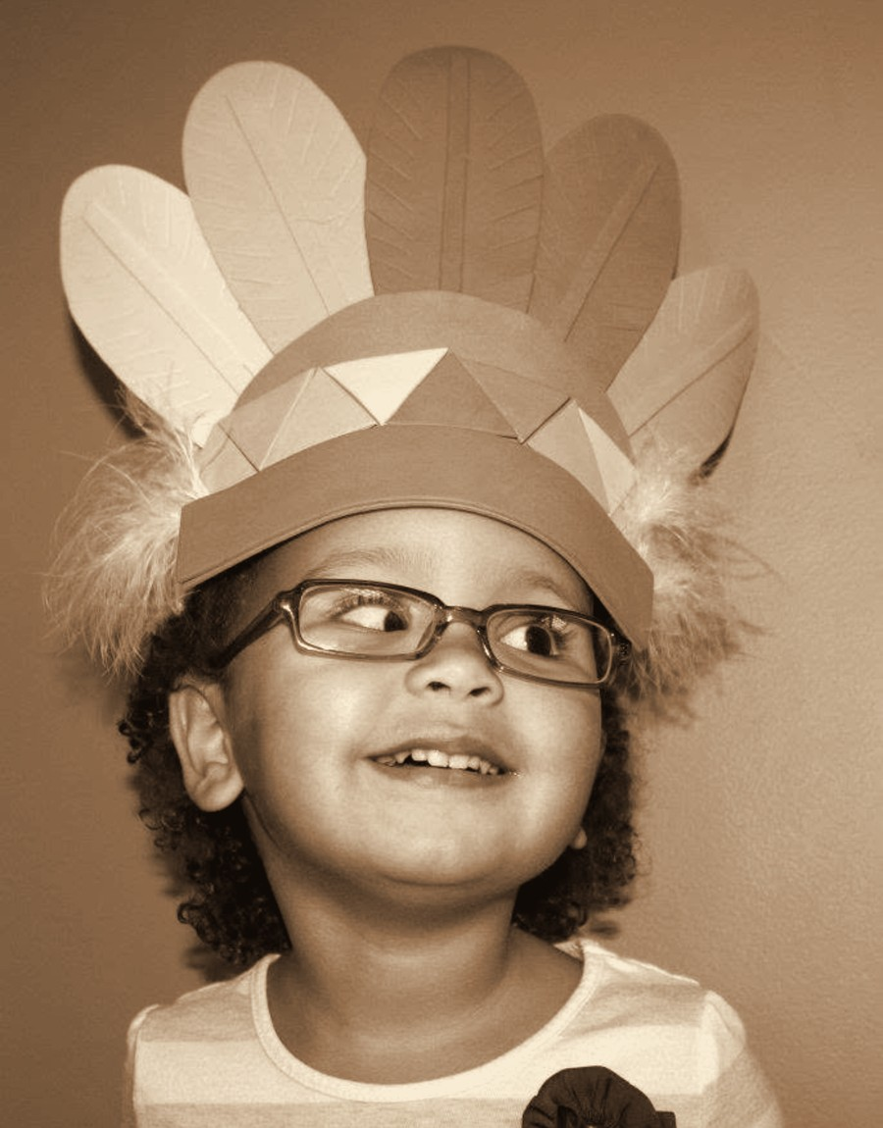

Throwback 56: 2011, ENVISION CHILD DEVELOPMENT CENTER
ADAH · FEATURED GUEST
2011
2026
ENVISION CHILD DEVELOPMENT CENTER
HIGH SCHOOL GRADUATE
ENVISION THE FUTURE · HONOR THE LEGACY
Notes:
Year basis: then: Facebook post dated December 29, 2011; now: high school graduation 2026 per Laura. Source photos: adah_2011.png, 705968911_122313865370027018_2361427042434269514_n.jpg. Photos already carry the sepia treatment; to swap one, right-click it > Change Picture.

Slide 39
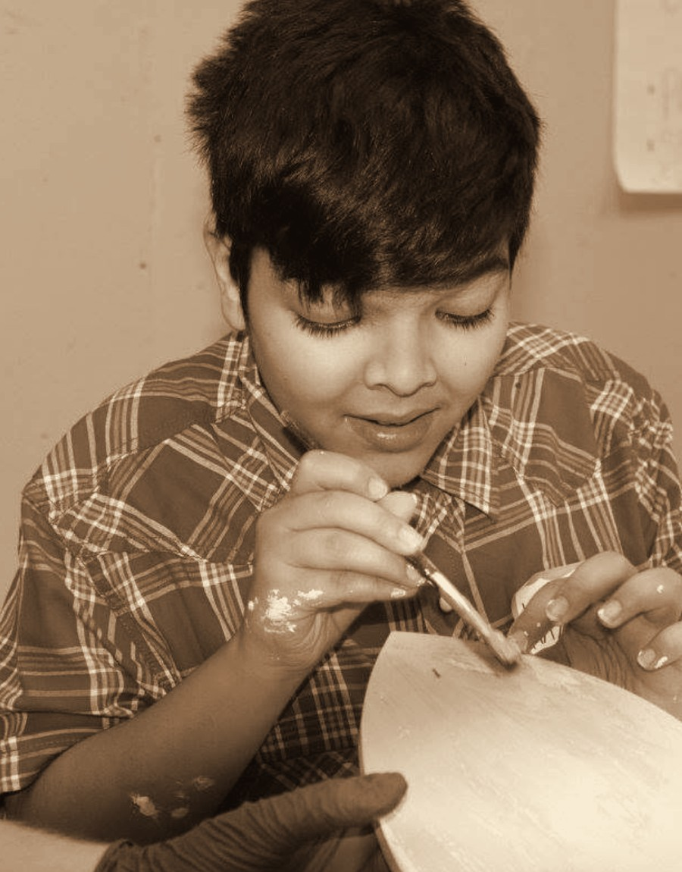

Throwback 57: 2015, ENVISION ARTS YOUTH PROGRAM
HASHIM · FEATURED GUEST
2015
2026
ENVISION ARTS YOUTH PROGRAM
WICHITA STATE GRADUATE
ENVISION THE FUTURE · HONOR THE LEGACY
Notes:
Year basis: then: Facebook post dated October 13, 2016; Laura confirms the photos are from 2015; now: Wichita State graduation 2026. Source photos: boy_painting.png, hashim_grad_2026.jpg. Photos already carry the sepia treatment; to swap one, right-click it > Change Picture.

Slide 40
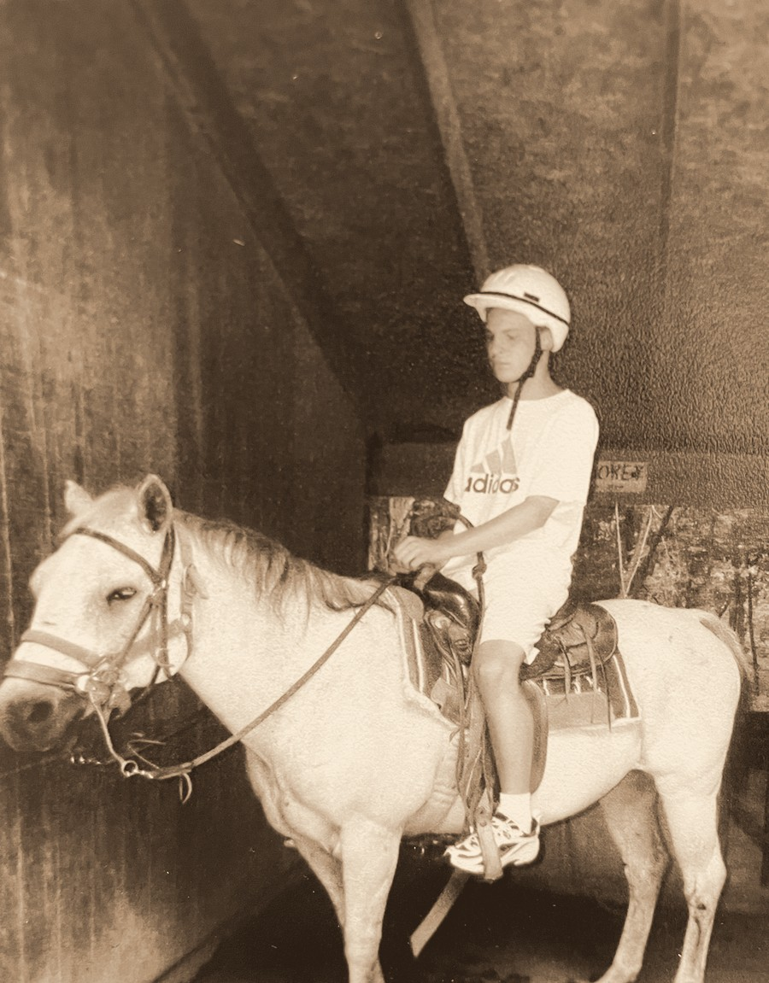
Throwback: 1990s, Envision Programs; 2026, Heather’s Camp; Steven, featured guest
STEVEN · FEATURED GUEST
1990s
2026
ENVISION PROGRAMS
HEATHER’S CAMP
ENVISION THE FUTURE · HONOR THE LEGACY

Slide 41
Thank you to our sponsors
THANK YOU TO OUR SPONSORS
PRESENTING SPONSOR
CORPORATE SPONSORS
PLATINUM LEVEL
SPR
DIAMOND LEVEL
GOLD LEVEL
Summit Films
INTRUST Bank
SILVER LEVEL
Vornado
Novolex
ENVISION THE FUTURE · HONOR THE LEGACY

