Slide 1
Welcome to A Night For Vision
Notes:
HOW TO USE THIS TEMPLATE: Home > New Slide (arrow) and pick a layout. Fill the placeholders; the styling is built in. Photo and rendering placeholders crop to fill (Picture Format > Crop to adjust the framing). Logo and QR placeholders fit the image without cropping. Every layout has a hidden title placeholder off the slide edge (Home > Select > Selection Pane) so screen reader users can navigate by slide title; give each slide a unique one. Montserrat must be installed on the presenting laptop, or embed fonts when you save (File > Options > Save > Embed fonts). This loop auto-advances every 8 seconds and repeats until Esc (Transitions tab to change timing; Slide Show > Set Up Slide Show to change looping).

Slide 2
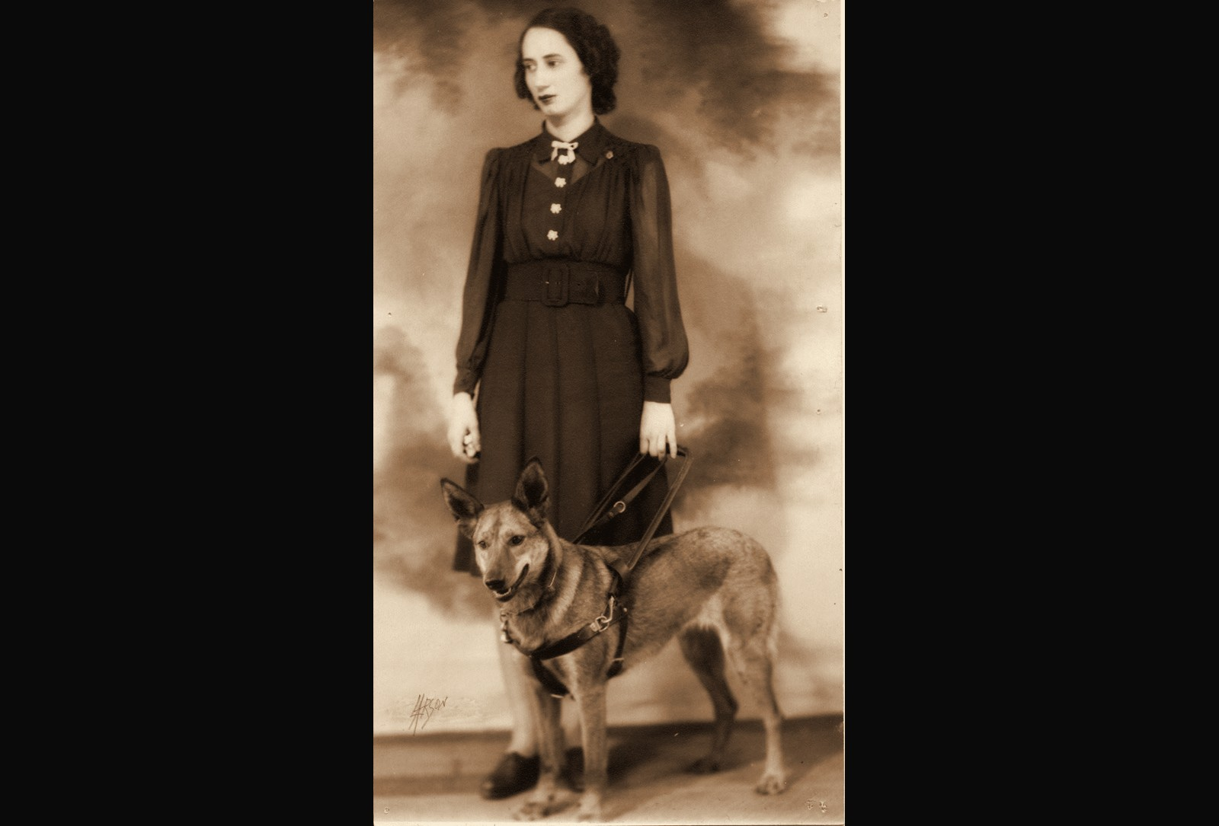
Throwback 1: 1933, FIRST PROGRAM PARTICIPANT
1933
FIRST PROGRAM PARTICIPANT
ENVISION THE FUTURE · HONOR THE LEGACY
Notes:
Year basis: Facebook post caption: 1933, one of Envision’s first patrons; label from Laura. Source photo: patron_1933.png. Photos already carry the sepia treatment; to swap one, right-click it > Change Picture.

Slide 3
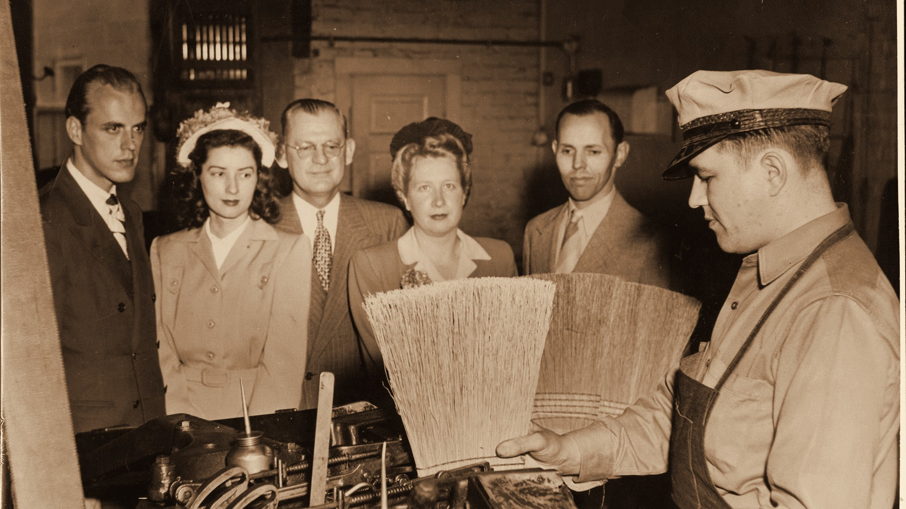


Throwback 2: 1940s, EMPLOYMENT PROGRAM PARTICIPANT
1940s
EMPLOYMENT PROGRAM PARTICIPANT
ENVISION THE FUTURE · HONOR THE LEGACY
Notes:
Year basis: Facebook post caption: broom-making workshop in the 1940s; label from Laura. Source photo: 514729028_24370021999262725_6241323963255478700_n.jpg. Photos already carry the sepia treatment; to swap one, right-click it > Change Picture. The dark scrim over the bottom of the photo is a separate object on this slide; duplicate this slide rather than inserting a fresh one so it comes along.

Slide 4

Presenting sponsor HighTouch Technologies
PRESENTING SPONSOR
ENVISION THE FUTURE · HONOR THE LEGACY
Notes:
Presenting sponsor slide. The HighTouch logo is placed; replace with the official file if a newer version arrives.

Slide 5
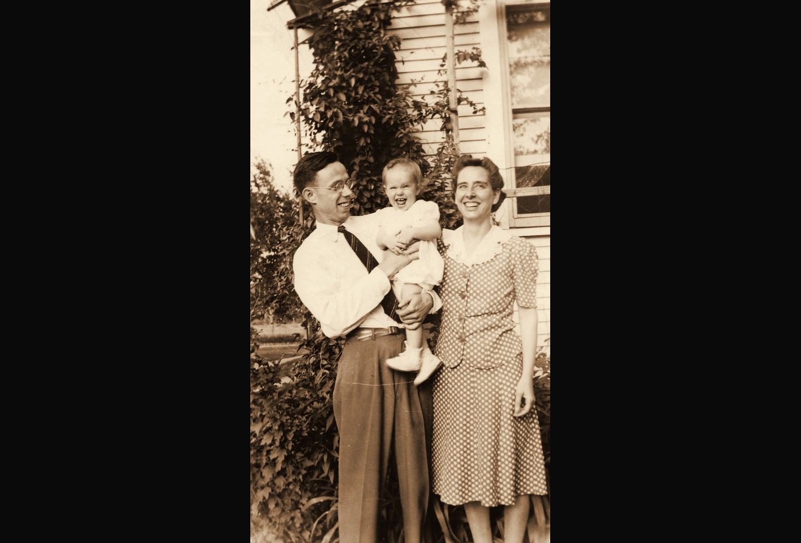
Throwback 3: 1940s, PROGRAM PARTICIPANT AND FAMILY
1940s
PROGRAM PARTICIPANT AND FAMILY
ENVISION THE FUTURE · HONOR THE LEGACY
Notes:
Year basis: Facebook post caption: a program participant and her family in the 1940s. Source photo: family_1940s.png. Photos already carry the sepia treatment; to swap one, right-click it > Change Picture.

Slide 6
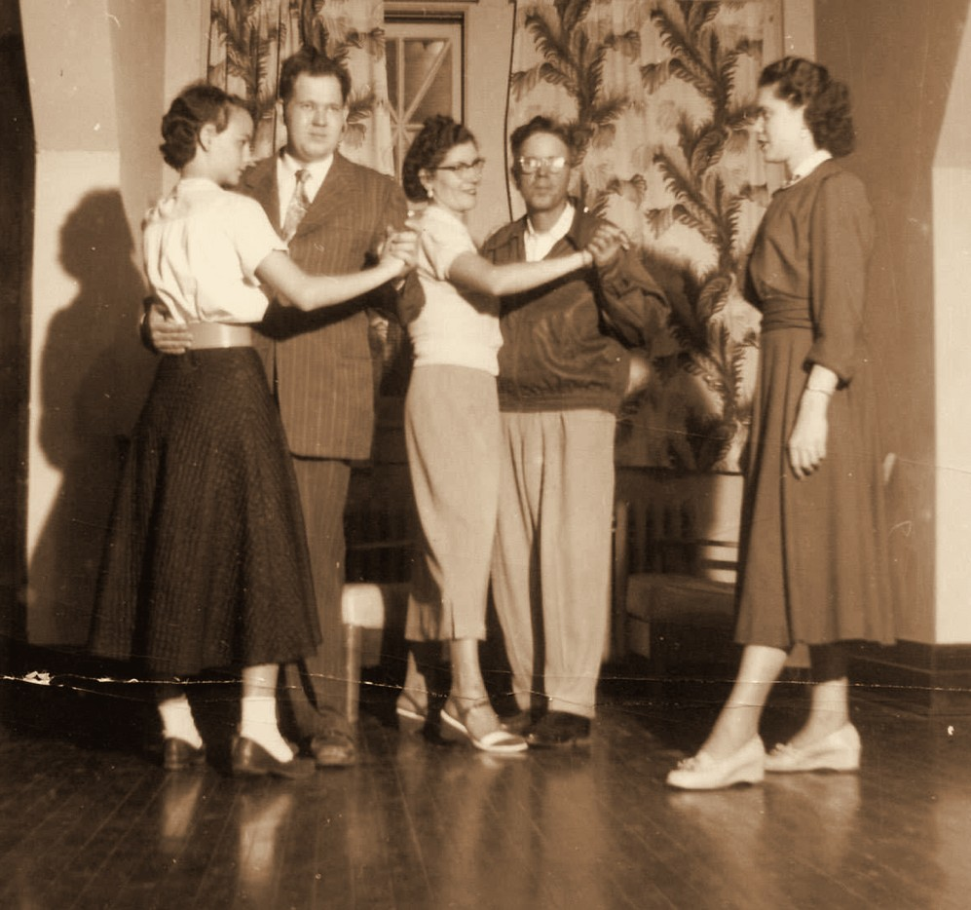
Throwback 4: 1950s, PRIDE ENVISION PROGRAMS DANCE CLASS
1950s
PRIDE ENVISION PROGRAMS DANCE CLASS
ENVISION THE FUTURE · HONOR THE LEGACY
Notes:
Year basis: Facebook post caption: a dance put on by Envision in the 1950s; label from Laura. Source photo: dance_1950s.png. Photos already carry the sepia treatment; to swap one, right-click it > Change Picture.

Slide 7
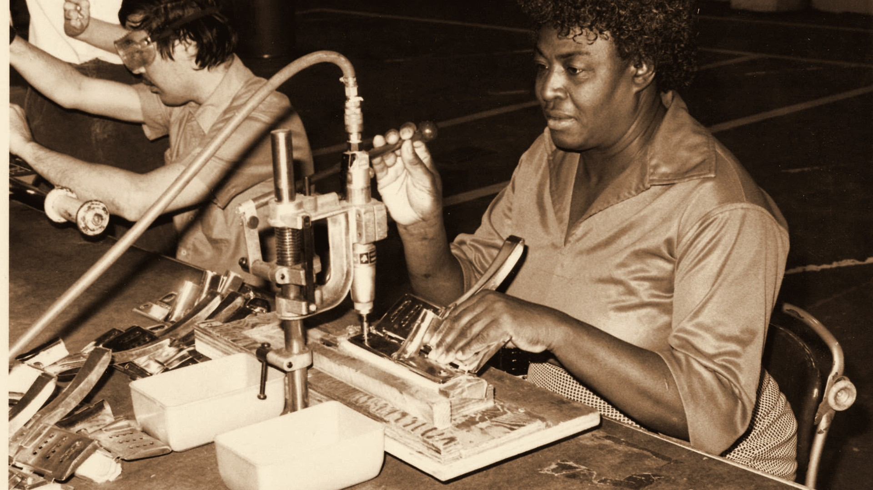
Throwback 5: 1970s, EMPLOYMENT IN WICHITA
1970s
EMPLOYMENT IN WICHITA
ENVISION THE FUTURE · HONOR THE LEGACY
Notes:
Year basis: decade is an estimate; program name not confirmed. Source photo: 514526513_24360271056904486_8424275321534355461_n.jpg. Photos already carry the sepia treatment; to swap one, right-click it > Change Picture. The dark scrim over the bottom of the photo is a separate object on this slide; duplicate this slide rather than inserting a fresh one so it comes along.

Slide 8
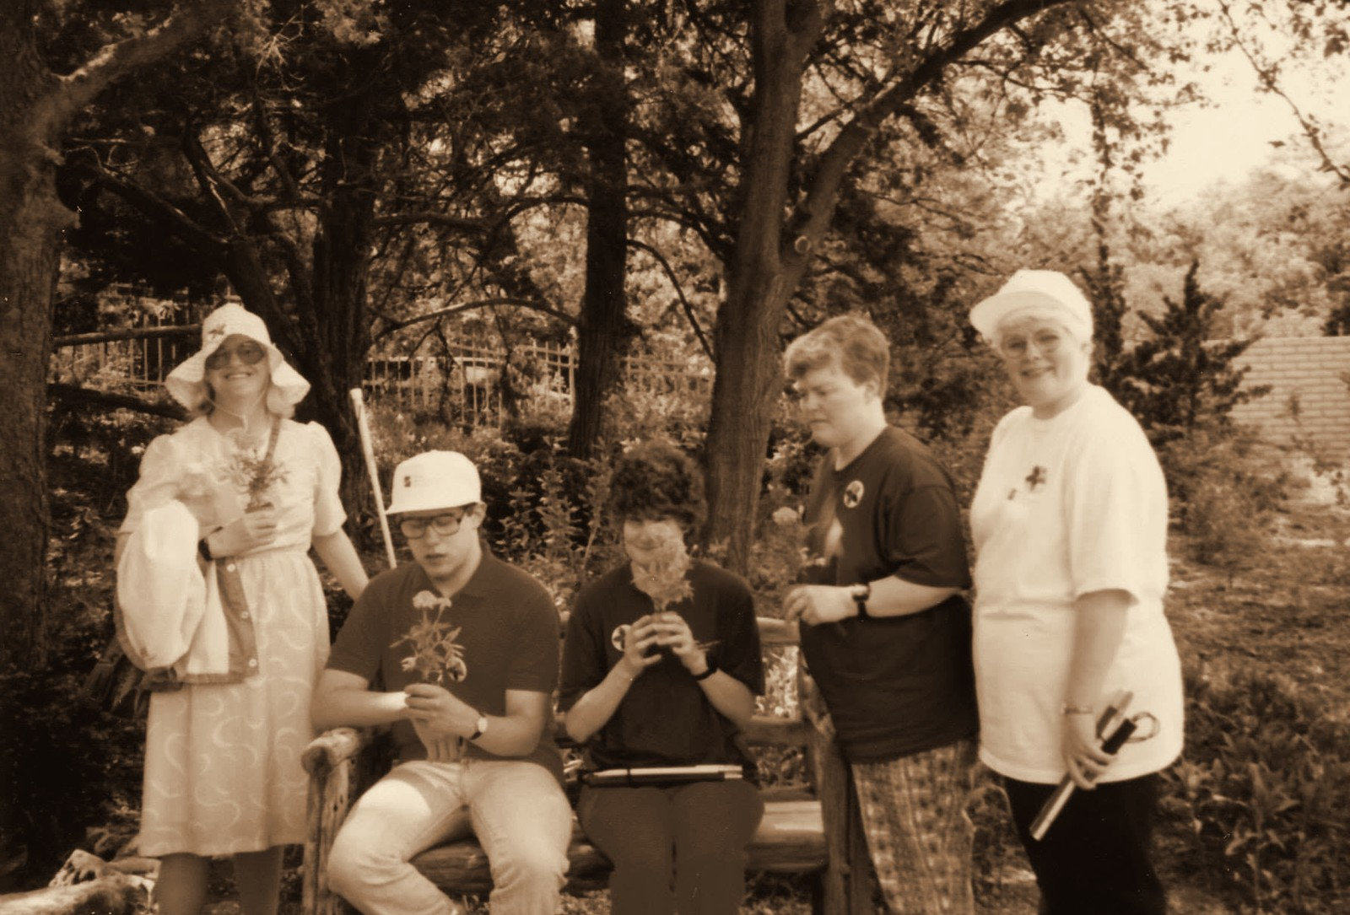
Throwback 6: 1992, PRIDE PROGRAM AT BOTANICA
1992
PRIDE PROGRAM AT BOTANICA
ENVISION THE FUTURE · HONOR THE LEGACY
Notes:
Year basis: Facebook post caption: PRIDE program at Botanica in 1992. Source photo: 514399319_24370451429219782_5553540867382418124_n.jpg. Photos already carry the sepia treatment; to swap one, right-click it > Change Picture.

Slide 9


Corporate sponsors
CORPORATE SPONSORS
SPR
ENVISION THE FUTURE · HONOR THE LEGACY
Notes:
Logos here are low-resolution cutouts from the sponsor thank-you graphic, placed so the loop runs complete. Replace each with the official logo file: right-click the logo > Change Picture (the white card fits it without cropping). Set the tier label to the sponsor level.

Slide 10
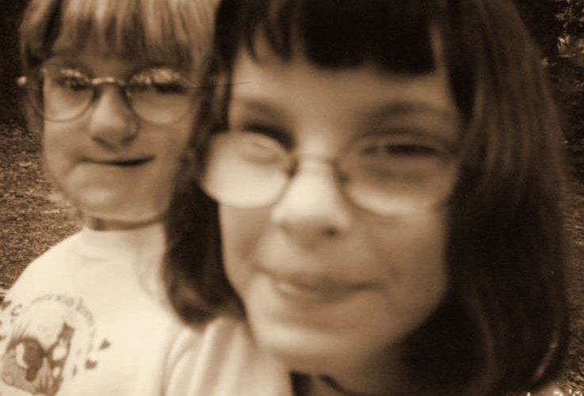
Throwback 7: 1990s, PROGRAM PARTICIPANTS
1990s
PROGRAM PARTICIPANTS
ENVISION THE FUTURE · HONOR THE LEGACY
Notes:
Year basis: Heather’s Camp photos from the PDF Laura sent; the PDF export carried no notes, year read from the print’s date stamp where one exists, otherwise a decade estimate; confirm (stamp reads 199x). Source photo: img-007.png. Photos already carry the sepia treatment; to swap one, right-click it > Change Picture.

Slide 11
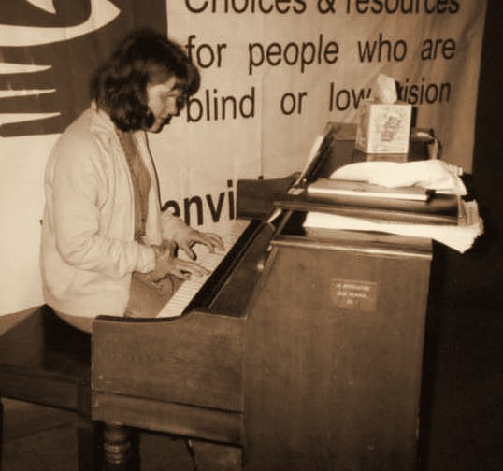
Throwback 8: 1990s, ENVISION PROGRAM PARTICIPANT
1990s
ENVISION PROGRAM PARTICIPANT
ENVISION THE FUTURE · HONOR THE LEGACY
Notes:
Year basis: photo from the PDF Laura sent; the PDF export carried no notes, year read from the print’s date stamp where one exists, otherwise a decade estimate; confirm; piano beneath the older Envision banner. Source photo: img-016.png. Photos already carry the sepia treatment; to swap one, right-click it > Change Picture.

Slide 12
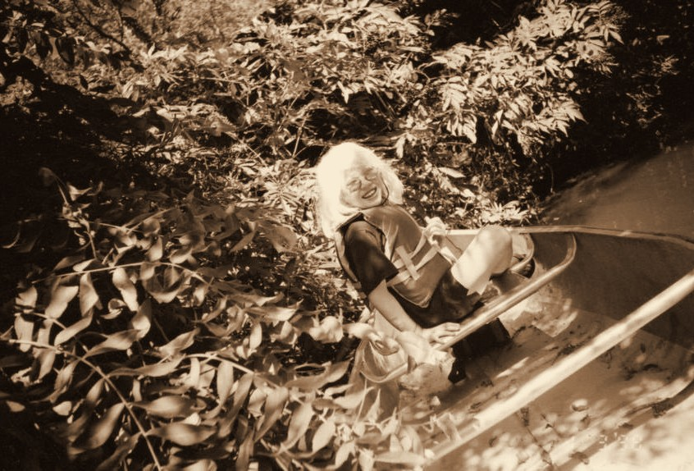
Throwback 9: 1999, PROGRAM PARTICIPANTS
1999
PROGRAM PARTICIPANTS
ENVISION THE FUTURE · HONOR THE LEGACY
Notes:
Year basis: Heather’s Camp photos from the PDF Laura sent; the PDF export carried no notes, year read from the print’s date stamp where one exists, otherwise a decade estimate; confirm (stamp reads 1999). Source photo: img-005.png. Photos already carry the sepia treatment; to swap one, right-click it > Change Picture.

Slide 13
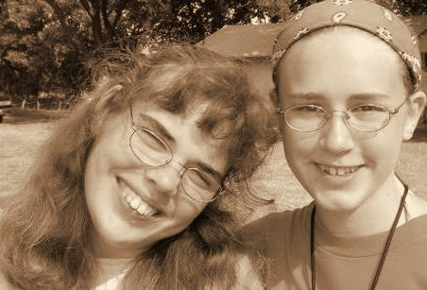
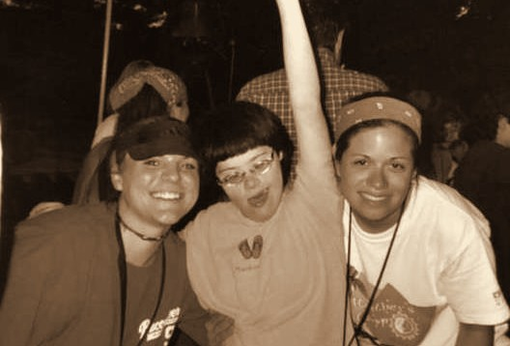
Throwback 10: 2000, HEATHER’S CAMP, DELTA GAMMA VOLUNTEERS
2000
HEATHER’S CAMP, DELTA GAMMA VOLUNTEERS
ENVISION THE FUTURE · HONOR THE LEGACY
Notes:
Year basis: spread across 2000 to 2005 at Laura’s direction; not from a dated record. Source photos: img-000.png, img-017.png. Photos already carry the sepia treatment; to swap one, right-click it > Change Picture.

Slide 14

Platinum level sponsor Forvis Mazars
PLATINUM LEVEL SPONSOR
ENVISION THE FUTURE · HONOR THE LEGACY
Notes:
Logos here are low-resolution cutouts from the sponsor thank-you graphic, placed so the loop runs complete. Replace each with the official logo file: right-click the logo > Change Picture (the white card fits it without cropping). Set the tier label to the sponsor level.

Slide 15
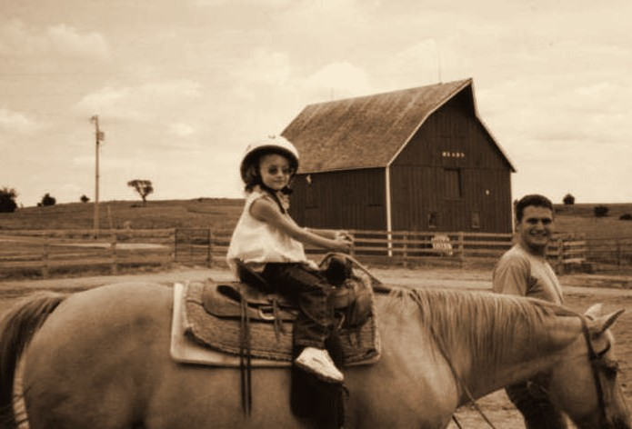
Throwback 11: 2000, ENVISION PROGRAMS
2000
ENVISION PROGRAMS
ENVISION THE FUTURE · HONOR THE LEGACY
Notes:
Year basis: spread across 2000 to 2005 at Laura’s direction; not from a dated record. Source photo: img-001.png. Photos already carry the sepia treatment; to swap one, right-click it > Change Picture.

Slide 16
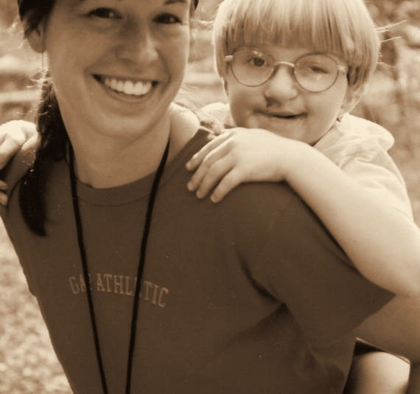
Throwback 12: 2001, CAMPER & DELTA GAMMA VOLUNTEER
2001
CAMPER & DELTA GAMMA VOLUNTEER
ENVISION THE FUTURE · HONOR THE LEGACY
Notes:
Year basis: spread across 2000 to 2005 at Laura’s direction; not from a dated record. Source photo: img-003.png. Photos already carry the sepia treatment; to swap one, right-click it > Change Picture.

Slide 17
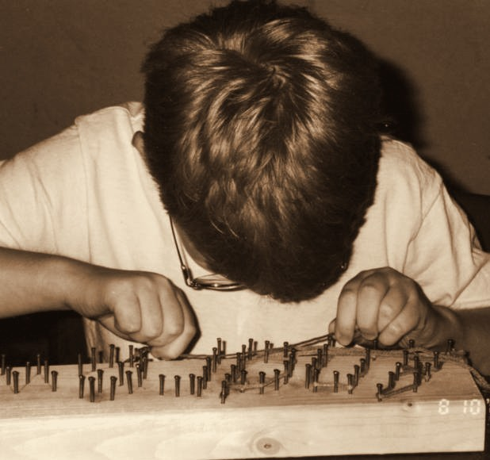
Throwback 18: 2001, HEATHER’S CAMP
2001
HEATHER’S CAMP
ENVISION THE FUTURE · HONOR THE LEGACY
Notes:
Year basis: Heather’s Camp photos from the PDF Laura sent; the PDF export carried no notes, year read from the print’s date stamp where one exists, otherwise a decade estimate; confirm (stamp reads 8 10 01). Source photo: img-013.png. Photos already carry the sepia treatment; to swap one, right-click it > Change Picture.

Slide 18
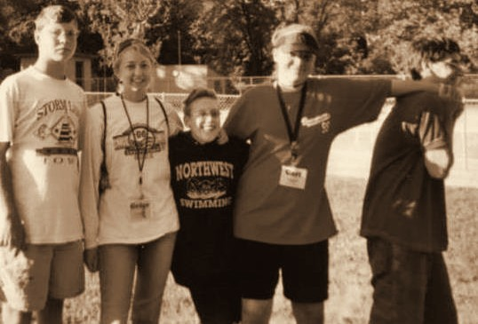
Throwback 13: 2002, HEATHER’S CAMP, CAMPERS & DELTA GAMMA VOLUNTEERS
2002
HEATHER’S CAMP, CAMPERS & DELTA GAMMA VOLUNTEERS
ENVISION THE FUTURE · HONOR THE LEGACY
Notes:
Year basis: spread across 2000 to 2005 at Laura’s direction; not from a dated record. Source photo: img-002.png. Photos already carry the sepia treatment; to swap one, right-click it > Change Picture.

Slide 19



Diamond level sponsors
DIAMOND LEVEL SPONSORS
Summit Films
ENVISION THE FUTURE · HONOR THE LEGACY
Notes:
Logos here are low-resolution cutouts from the sponsor thank-you graphic, placed so the loop runs complete. Replace each with the official logo file: right-click the logo > Change Picture (the white card fits it without cropping). Set the tier label to the sponsor level.

Slide 20
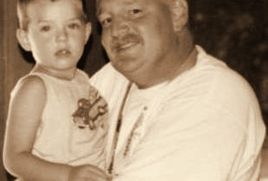
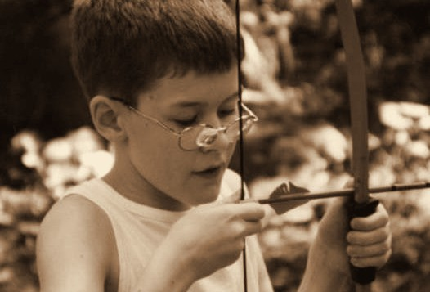
Throwback 14: 2002, ENVISION PROGRAMS
2002
ENVISION PROGRAMS
ENVISION THE FUTURE · HONOR THE LEGACY
Notes:
Year basis: spread across 2000 to 2005 at Laura’s direction; not from a dated record. Source photos: img-008.png, img-009.png. Photos already carry the sepia treatment; to swap one, right-click it > Change Picture.

Slide 21
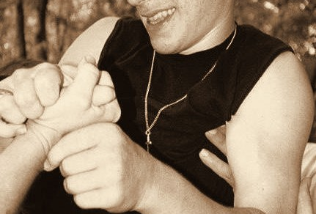
Throwback 15: 2003, HEATHER’S CAMP PROGRAM PARTICIPANT
2003
HEATHER’S CAMP PROGRAM PARTICIPANT
ENVISION THE FUTURE · HONOR THE LEGACY
Notes:
Year basis: spread across 2000 to 2005 at Laura’s direction; not from a dated record. Source photo: img-006.png. Photos already carry the sepia treatment; to swap one, right-click it > Change Picture.

Slide 22
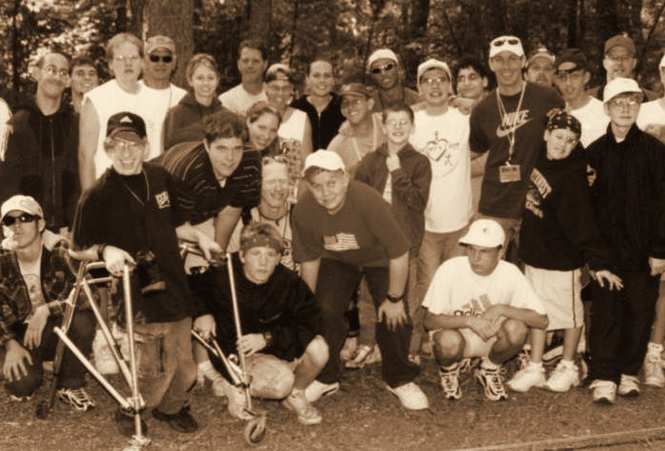
Throwback 16: 2003, HEATHER’S CAMP PROGRAM PARTICIPANTS
2003
HEATHER’S CAMP PROGRAM PARTICIPANTS
ENVISION THE FUTURE · HONOR THE LEGACY
Notes:
Year basis: spread across 2000 to 2005 at Laura’s direction; not from a dated record. Source photo: img-010.png. Photos already carry the sepia treatment; to swap one, right-click it > Change Picture.

Slide 23
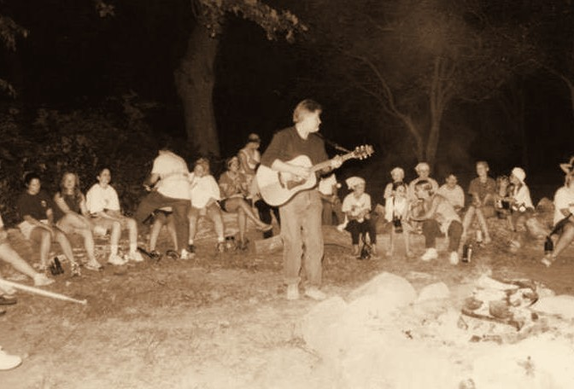
Throwback 17: 2003, HEATHER’S CAMP PROGRAM PARTICIPANTS
2003
HEATHER’S CAMP PROGRAM PARTICIPANTS
ENVISION THE FUTURE · HONOR THE LEGACY
Notes:
Year basis: spread across 2000 to 2005 at Laura’s direction; not from a dated record. Source photo: img-011.png. Photos already carry the sepia treatment; to swap one, right-click it > Change Picture.

Slide 24
Gold level sponsor INTRUST Bank
GOLD LEVEL SPONSOR
INTRUST Bank
ENVISION THE FUTURE · HONOR THE LEGACY
Notes:
Logos here are low-resolution cutouts from the sponsor thank-you graphic, placed so the loop runs complete. Replace each with the official logo file: right-click the logo > Change Picture (the white card fits it without cropping). Set the tier label to the sponsor level.

Slide 25
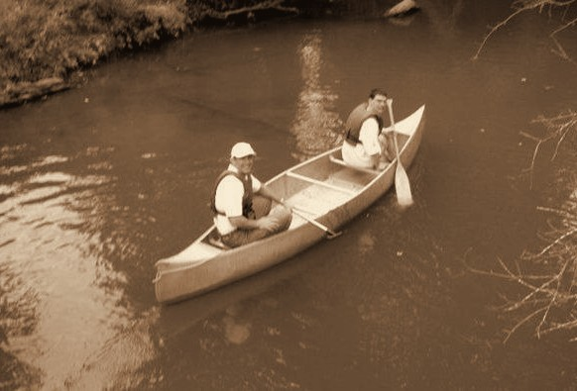
Throwback 19: 2004, HEATHER’S CAMP
2004
HEATHER’S CAMP
ENVISION THE FUTURE · HONOR THE LEGACY
Notes:
Year basis: spread across 2000 to 2005 at Laura’s direction; not from a dated record. Source photo: img-012.png. Photos already carry the sepia treatment; to swap one, right-click it > Change Picture.

Slide 26
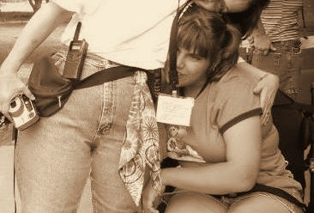
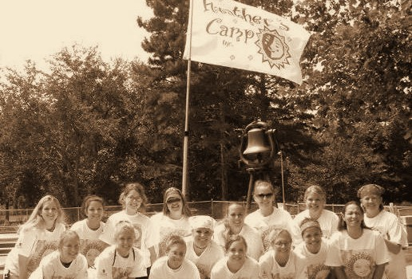
Throwback 23: 2004, HEATHER’S CAMP, CAMPER & DELTA GAMMA VOLUNTEERS
2004
HEATHER’S CAMP, CAMPER & DELTA GAMMA VOLUNTEERS
ENVISION THE FUTURE · HONOR THE LEGACY
Notes:
Year basis: Heather’s Camp photos from the PDF Laura sent; the PDF export carried no notes, year read from the print’s date stamp where one exists, otherwise a decade estimate; confirm (both stamped AUG 8 2004). Source photos: img-004.png, img-020.png. Photos already carry the sepia treatment; to swap one, right-click it > Change Picture.

Slide 27
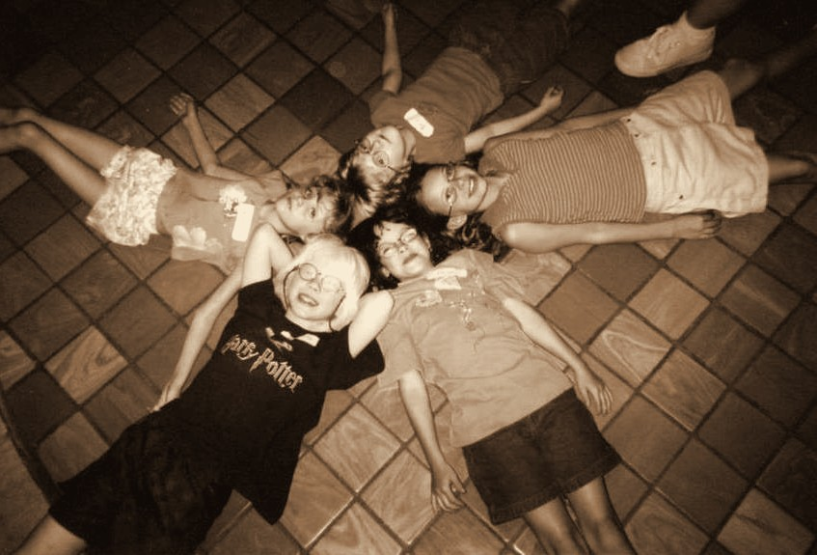
Throwback 20: 2005, ENVISION PROGRAMS
2005
ENVISION PROGRAMS
ENVISION THE FUTURE · HONOR THE LEGACY
Notes:
Year basis: spread across 2000 to 2005 at Laura’s direction; not from a dated record. Source photo: img-014.png. Photos already carry the sepia treatment; to swap one, right-click it > Change Picture.

Slide 28
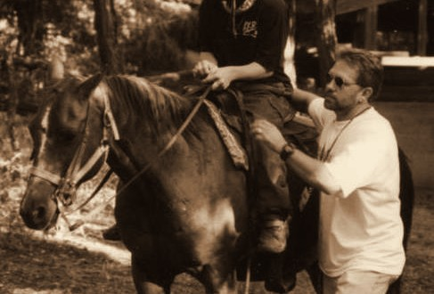
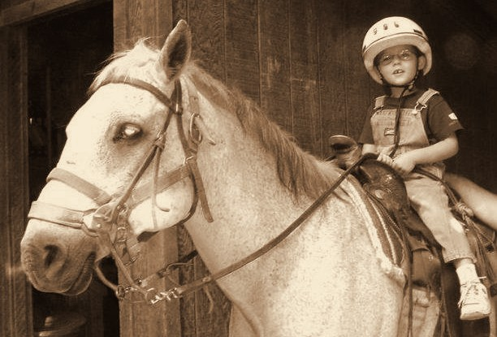
Throwback 21: 2005, HEATHER’S CAMP
2005
HEATHER’S CAMP
ENVISION THE FUTURE · HONOR THE LEGACY
Notes:
Year basis: spread across 2000 to 2005 at Laura’s direction; not from a dated record. Source photos: img-015.png, img-019.png. Photos already carry the sepia treatment; to swap one, right-click it > Change Picture.

Slide 29







Silver level sponsors
SILVER LEVEL SPONSORS
Vornado
Novolex
ENVISION THE FUTURE · HONOR THE LEGACY
Notes:
Logos here are low-resolution cutouts from the sponsor thank-you graphic, placed so the loop runs complete. Replace each with the official logo file: right-click the logo > Change Picture (the white card fits it without cropping). Set the tier label to the sponsor level.

Slide 30
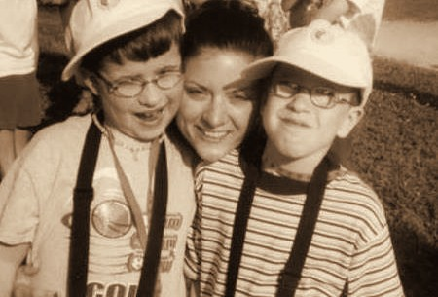
Throwback 22: 2005, HEATHER’S CAMP, CAMPER & DELTA GAMMA VOLUNTEERS
2005
HEATHER’S CAMP, CAMPER & DELTA GAMMA VOLUNTEERS
ENVISION THE FUTURE · HONOR THE LEGACY
Notes:
Year basis: spread across 2000 to 2005 at Laura’s direction; not from a dated record. Source photo: img-018.png. Photos already carry the sepia treatment; to swap one, right-click it > Change Picture.

Slide 31
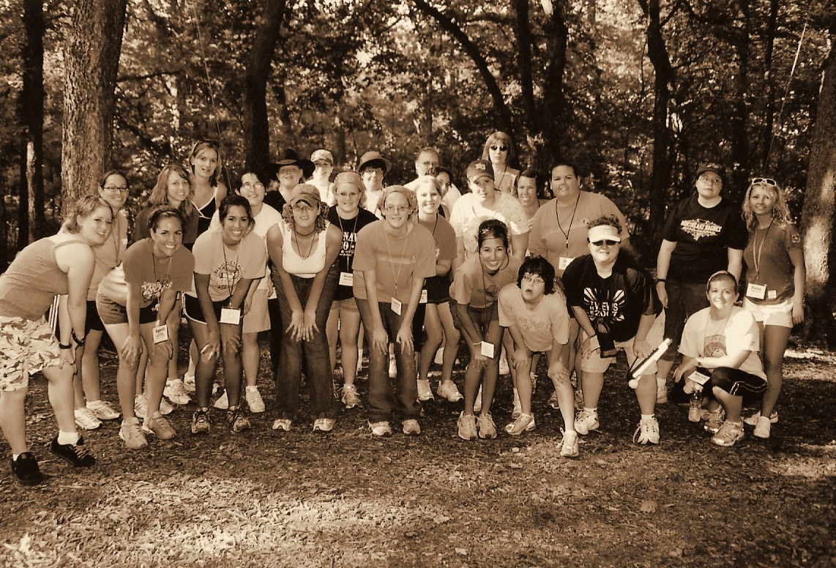
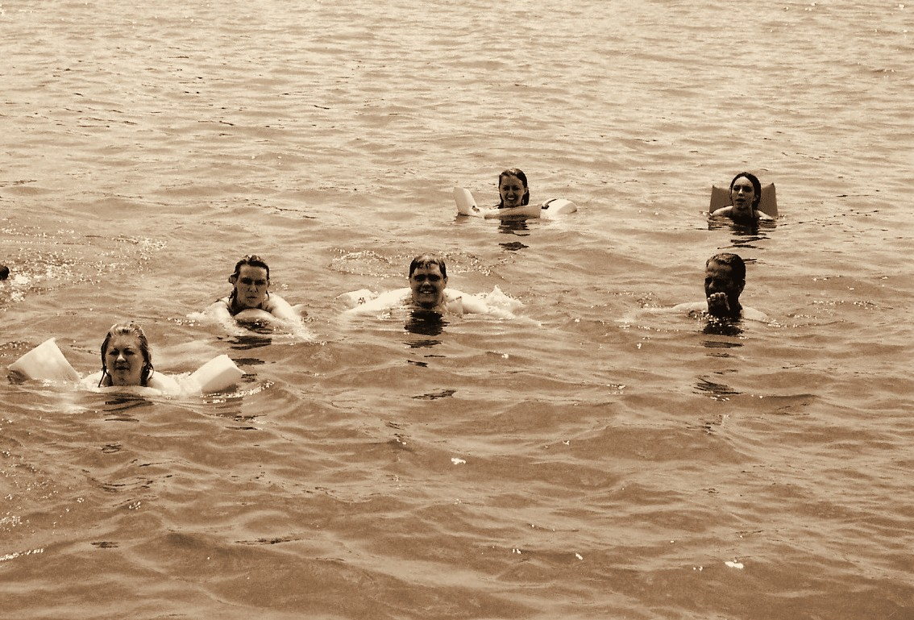
Throwback 24: 2007, HEATHER’S CAMP
2007
HEATHER’S CAMP
ENVISION THE FUTURE · HONOR THE LEGACY
Notes:
Year basis: Heather’s Camp 2007, confirmed by Laura. Source photos: scan0004_01a.jpg, scan0004_00b.jpg. Photos already carry the sepia treatment; to swap one, right-click it > Change Picture.

Slide 32
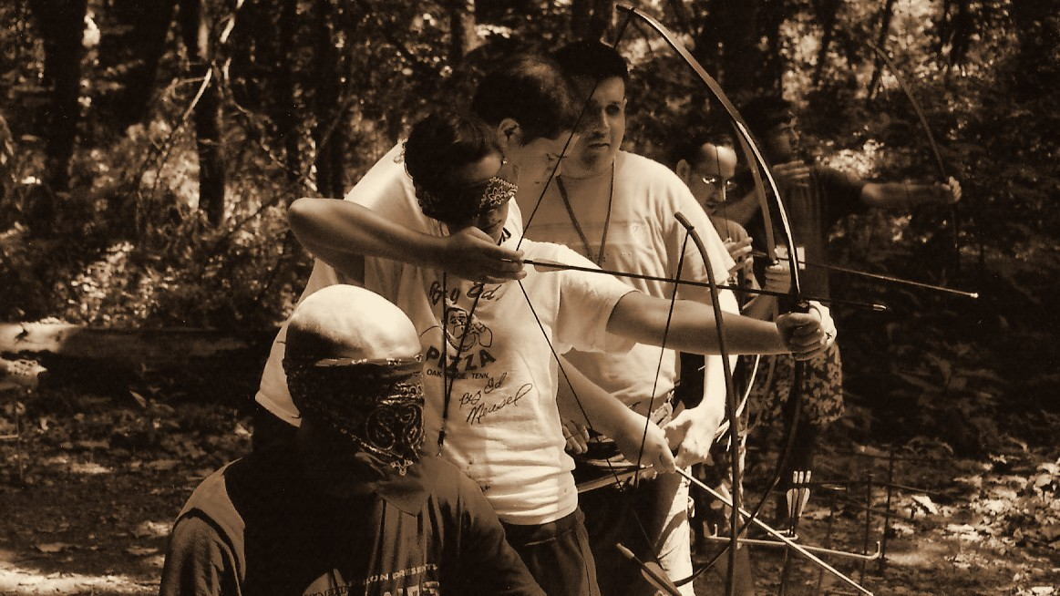
Throwback 25: 2007, ENVISION PROGRAMS
2007
ENVISION PROGRAMS
ENVISION THE FUTURE · HONOR THE LEGACY
Notes:
Year basis: Heather’s Camp 2007, confirmed by Laura. Source photo: scan0014_00b.jpg. Photos already carry the sepia treatment; to swap one, right-click it > Change Picture. The dark scrim over the bottom of the photo is a separate object on this slide; duplicate this slide rather than inserting a fresh one so it comes along.

Slide 33
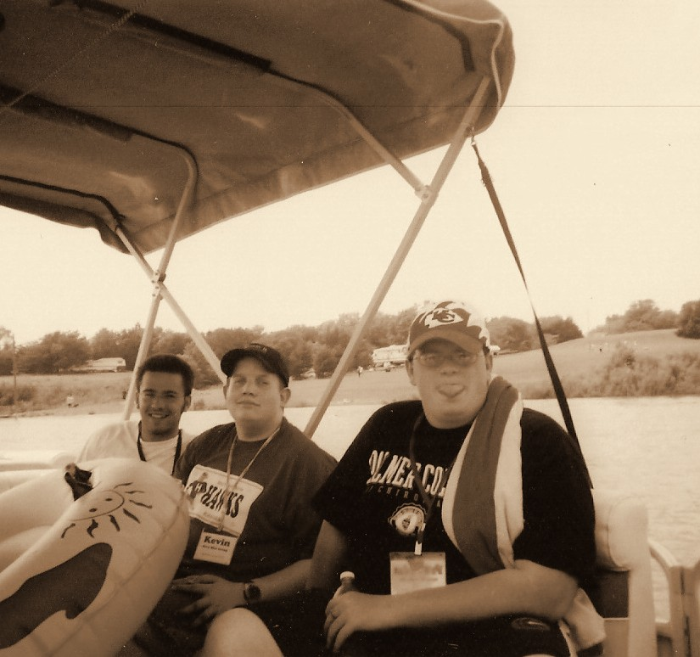
Throwback 26: 2007, HEATHER’S CAMP
2007
HEATHER’S CAMP
ENVISION THE FUTURE · HONOR THE LEGACY
Notes:
Year basis: Heather’s Camp 2007, confirmed by Laura. Source photo: scan0014_01a.jpg. Photos already carry the sepia treatment; to swap one, right-click it > Change Picture.

Slide 34
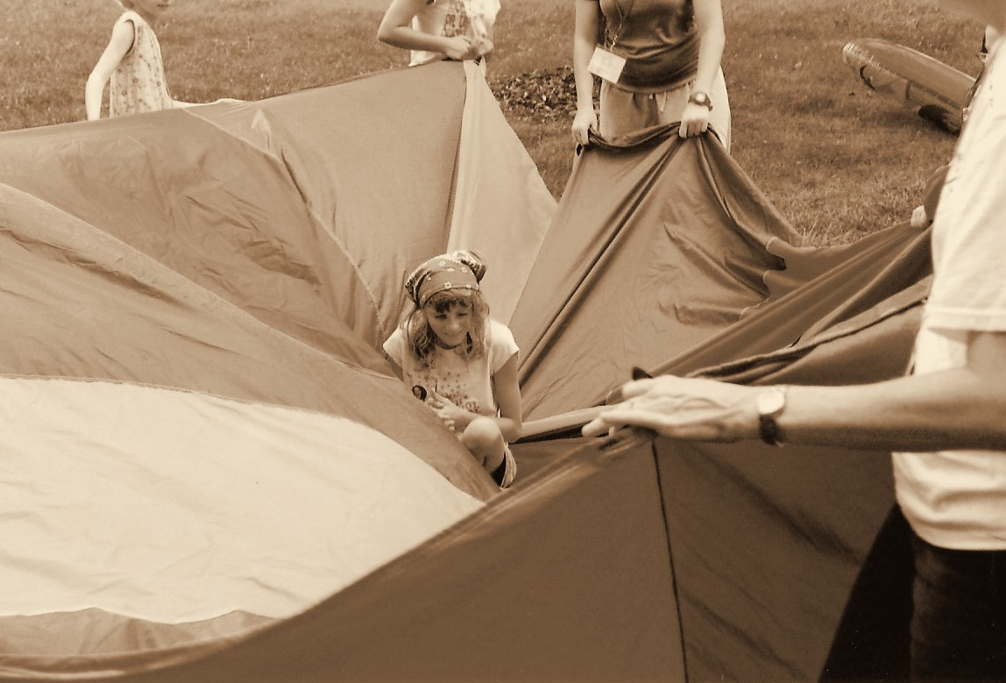
Throwback 27: 2007, ENVISION PROGRAMS
2007
ENVISION PROGRAMS
ENVISION THE FUTURE · HONOR THE LEGACY
Notes:
Year basis: Heather’s Camp 2007, confirmed by Laura. Source photo: scan0015_00b.jpg. Photos already carry the sepia treatment; to swap one, right-click it > Change Picture.

Slide 35
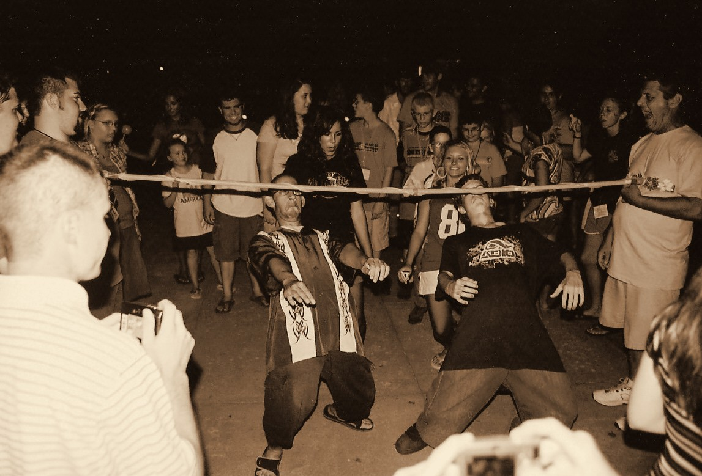
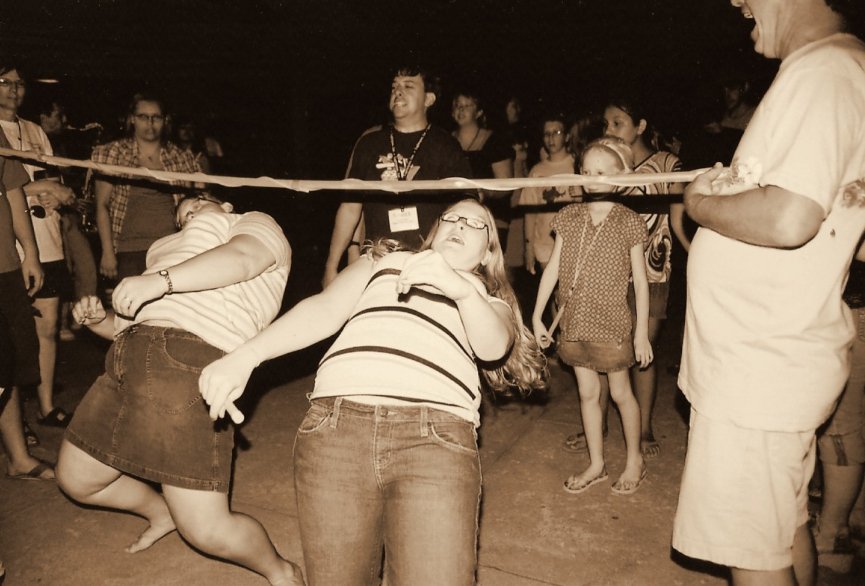
Throwback 28: 2007, HEATHER’S CAMP
2007
HEATHER’S CAMP
ENVISION THE FUTURE · HONOR THE LEGACY
Notes:
Year basis: Heather’s Camp 2007, confirmed by Laura. Source photos: scan0004_00a.jpg, scan0015_00a.jpg. Photos already carry the sepia treatment; to swap one, right-click it > Change Picture.

Slide 36
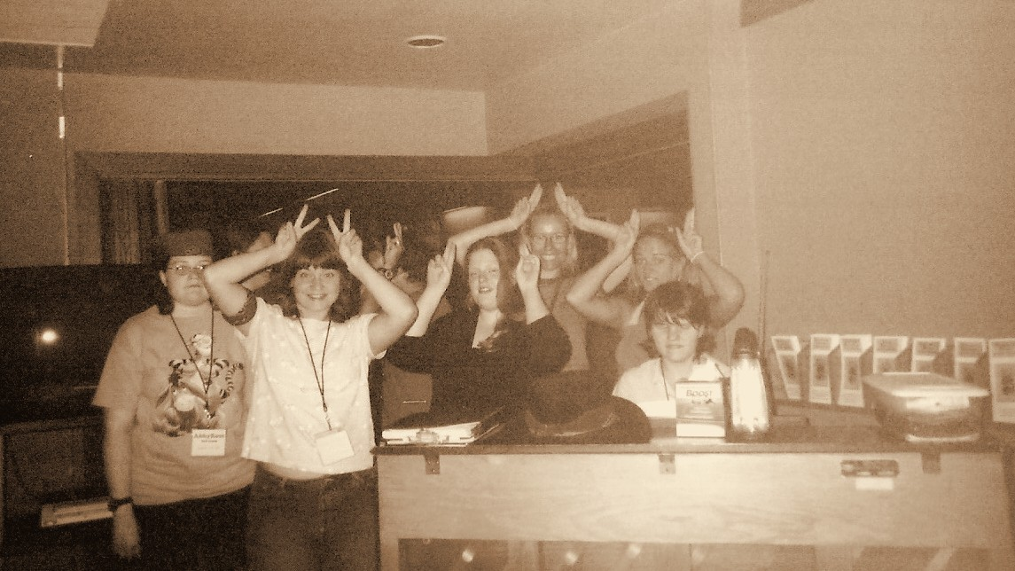
Throwback 29: 2007, ENVISION PROGRAMS
2007
ENVISION PROGRAMS
ENVISION THE FUTURE · HONOR THE LEGACY
Notes:
Year basis: Heather’s Camp 2007, confirmed by Laura. Source photo: scan0014_00a.jpg. Photos already carry the sepia treatment; to swap one, right-click it > Change Picture. The dark scrim over the bottom of the photo is a separate object on this slide; duplicate this slide rather than inserting a fresh one so it comes along.

Slide 37
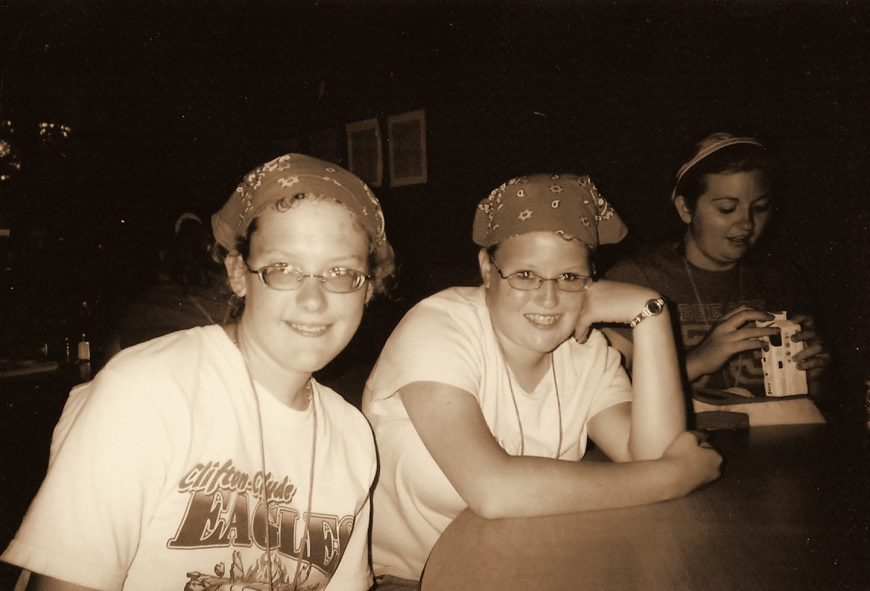
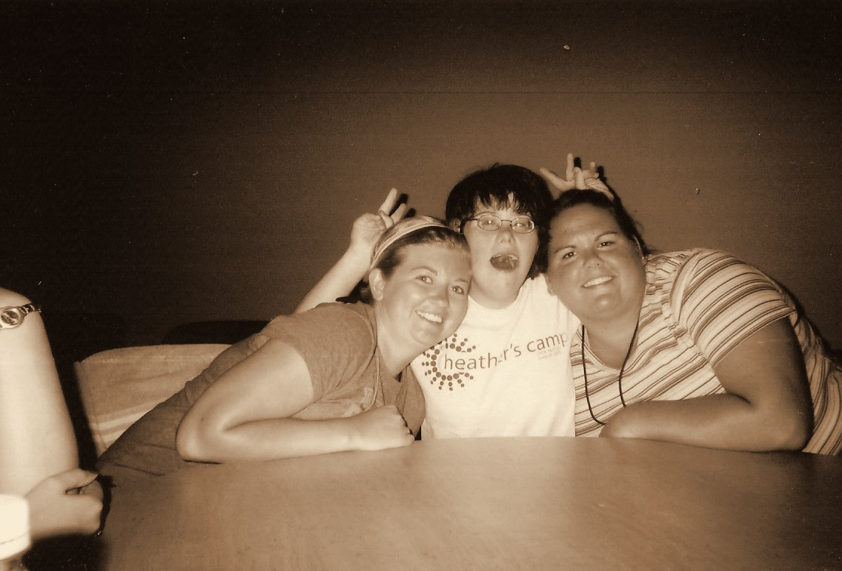
Throwback 30: 2007, HEATHER’S CAMP
2007
HEATHER’S CAMP
ENVISION THE FUTURE · HONOR THE LEGACY
Notes:
Year basis: Heather’s Camp 2007, confirmed by Laura. Source photos: scan0015_01a.jpg, scan0015_01b.jpg. Photos already carry the sepia treatment; to swap one, right-click it > Change Picture.

Slide 38
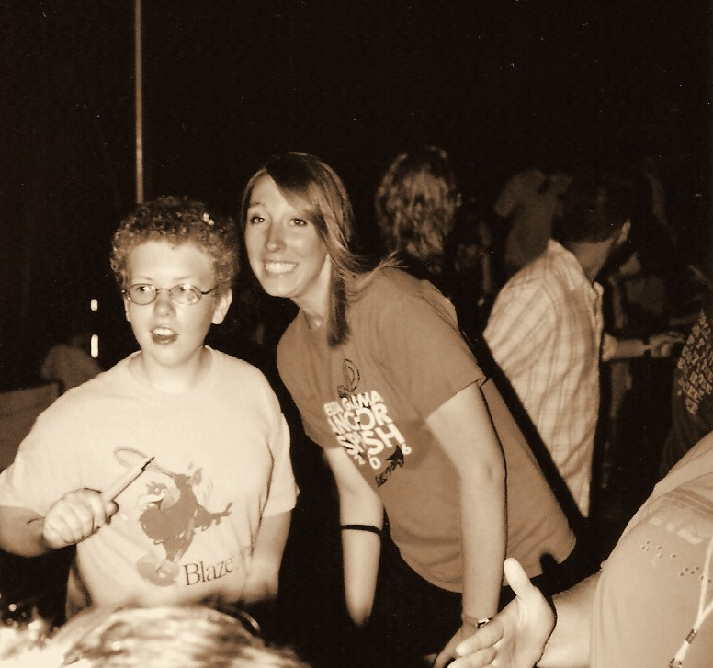
Throwback 31: 2007, ENVISION PROGRAMS
2007
ENVISION PROGRAMS
ENVISION THE FUTURE · HONOR THE LEGACY
Notes:
Year basis: Heather’s Camp 2007, confirmed by Laura. Source photo: scan0004_01b.jpg. Photos already carry the sepia treatment; to swap one, right-click it > Change Picture.

Slide 39
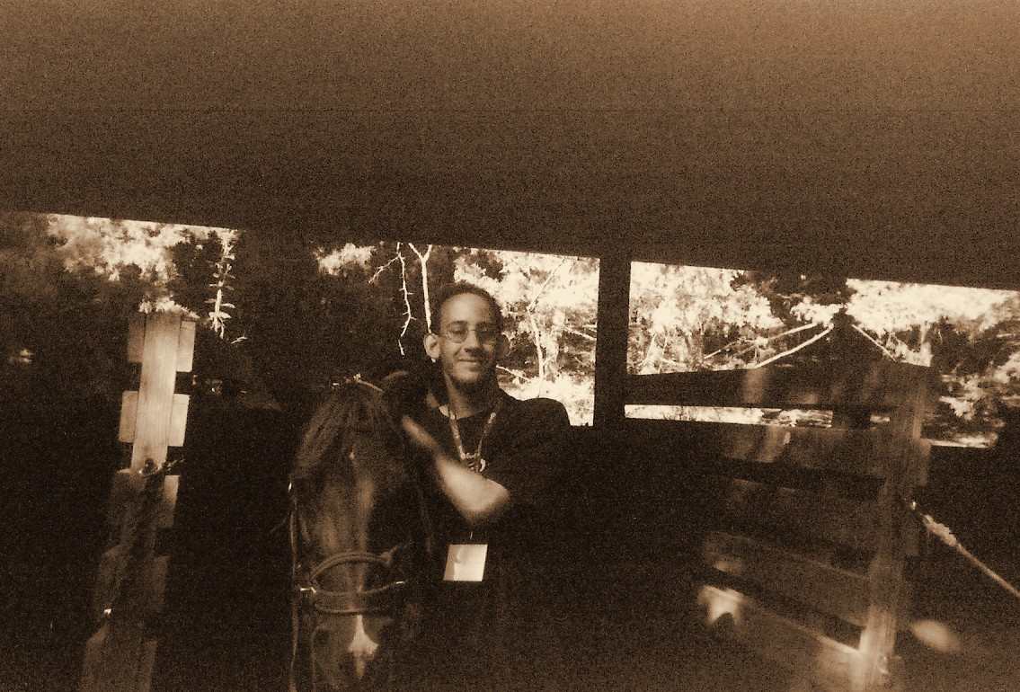
Throwback 32: 2007, HEATHER’S CAMP
2007
HEATHER’S CAMP
ENVISION THE FUTURE · HONOR THE LEGACY
Notes:
Year basis: Heather’s Camp 2007, confirmed by Laura. Source photo: scan0014_01b.jpg. Photos already carry the sepia treatment; to swap one, right-click it > Change Picture.

Slide 40
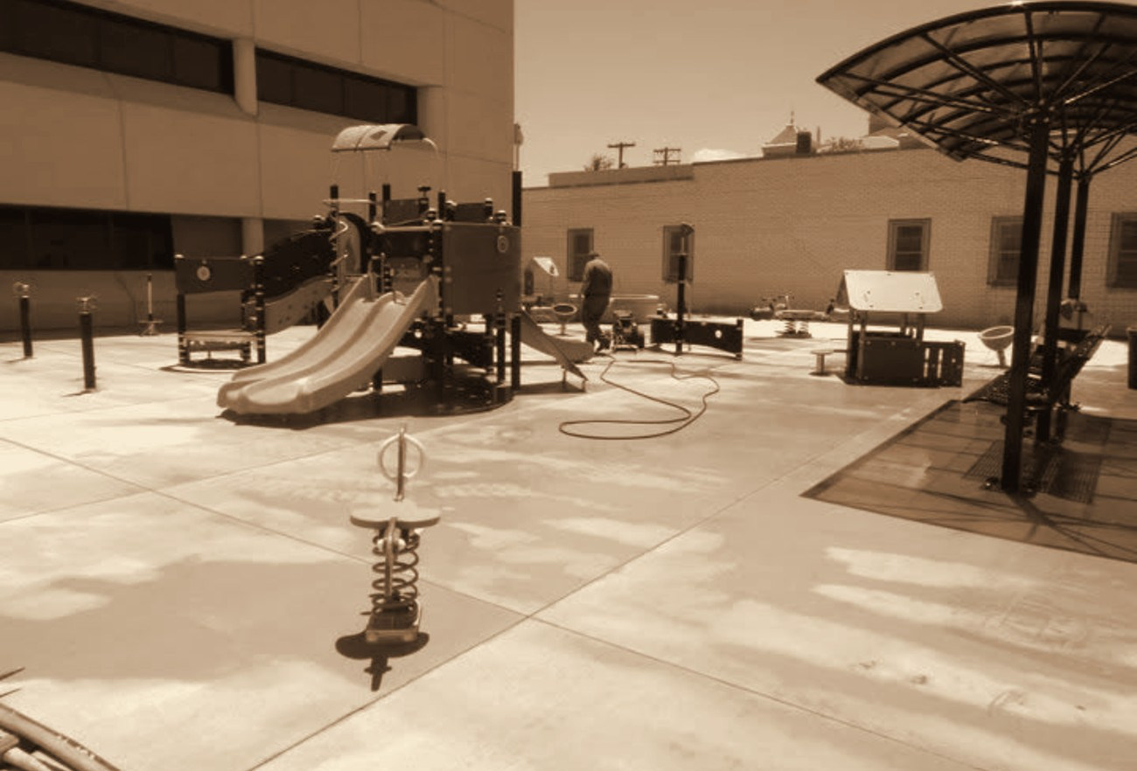
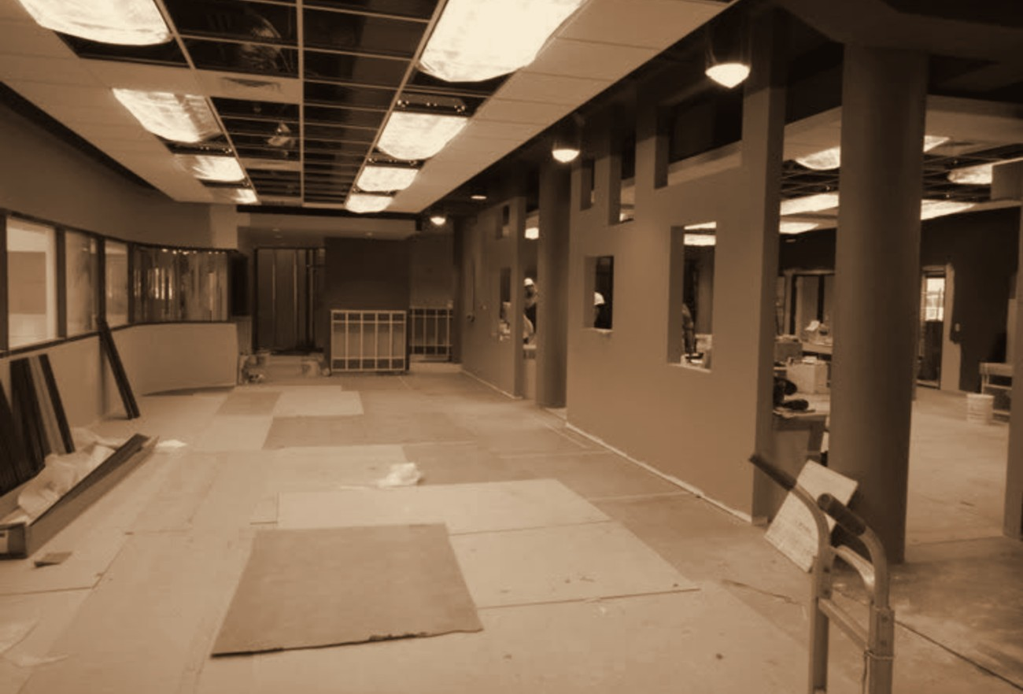
Throwback 33: 2010, ENVISION CHILD DEVELOPMENT CENTER
2010
ENVISION CHILD DEVELOPMENT CENTER
ENVISION THE FUTURE · HONOR THE LEGACY
Notes:
Year basis: Facebook posts dated July 9, 2010. Source photos: playground_2010.png, indoor_play_2010.png. Photos already carry the sepia treatment; to swap one, right-click it > Change Picture.

Slide 41
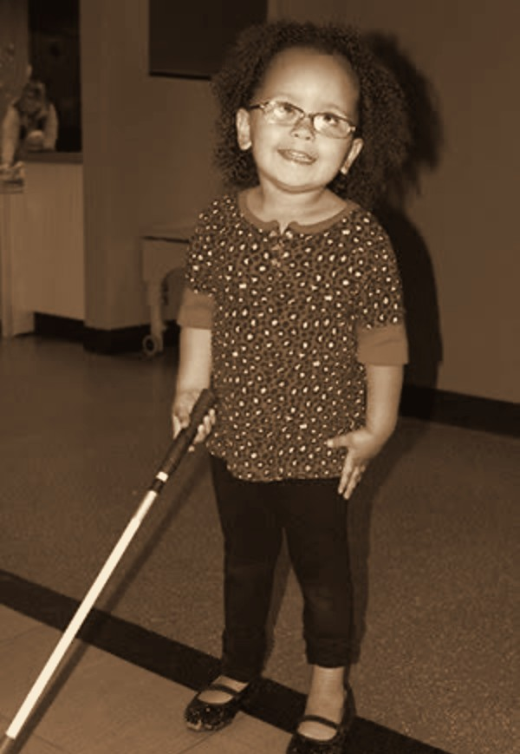
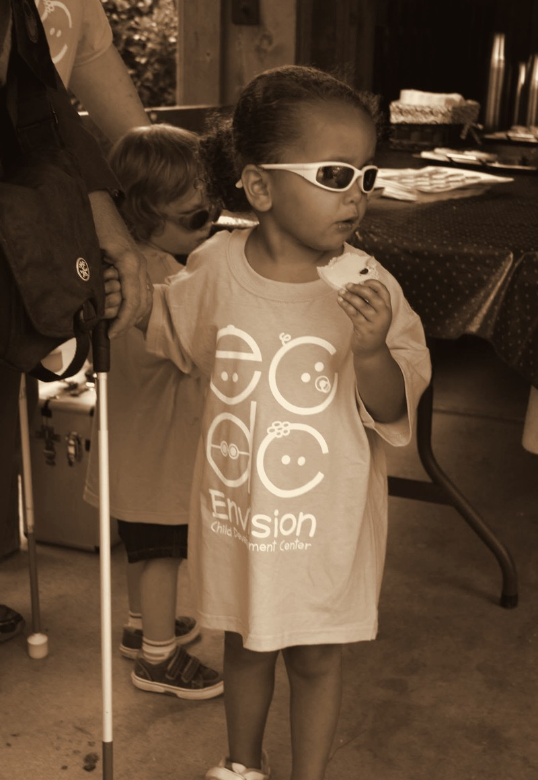
Throwback 34: 2014, ADAH, ECDC WICHITA
2014
ADAH, ECDC WICHITA
ENVISION THE FUTURE · HONOR THE LEGACY
Notes:
Year basis: Facebook posts dated May 16 and August 18, 2014; Adah per Laura. Source photos: girl_cane_2014.png, 514102732_24347428004855458_8712718144461110952_n.jpg. Photos already carry the sepia treatment; to swap one, right-click it > Change Picture.

Slide 42
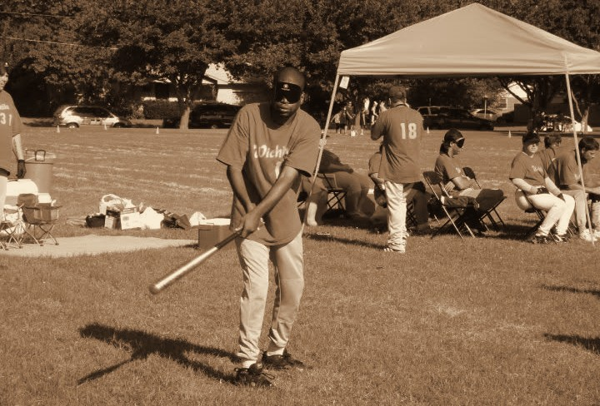
Throwback 35: 2010s, ENVISION BEEP BASEBALL
2010s
ENVISION BEEP BASEBALL
ENVISION THE FUTURE · HONOR THE LEGACY
Notes:
Year basis: decade is an estimate; confirm. Source photo: 505086650_24180749884856605_1969040299231642078_n.jpg. Photos already carry the sepia treatment; to swap one, right-click it > Change Picture.

Slide 43
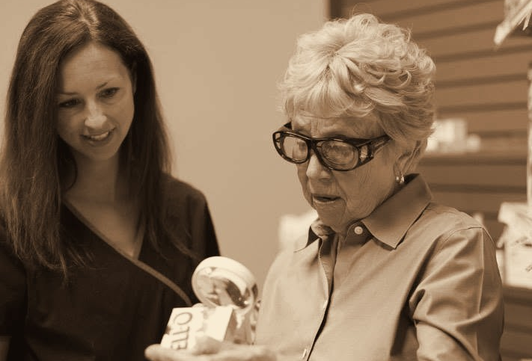
Throwback 36: 2010s, ENVISION LOW VISION CLINIC REHABILITATION PROGRAM PARTICIPANT
2010s
ENVISION LOW VISION CLINIC REHABILITATION PROGRAM PARTICIPANT
ENVISION THE FUTURE · HONOR THE LEGACY
Notes:
Year basis: decade is an estimate; program name not confirmed. Source photo: 514356143_24365277619737163_4572300578063408220_n.jpg. Photos already carry the sepia treatment; to swap one, right-click it > Change Picture.

Slide 44
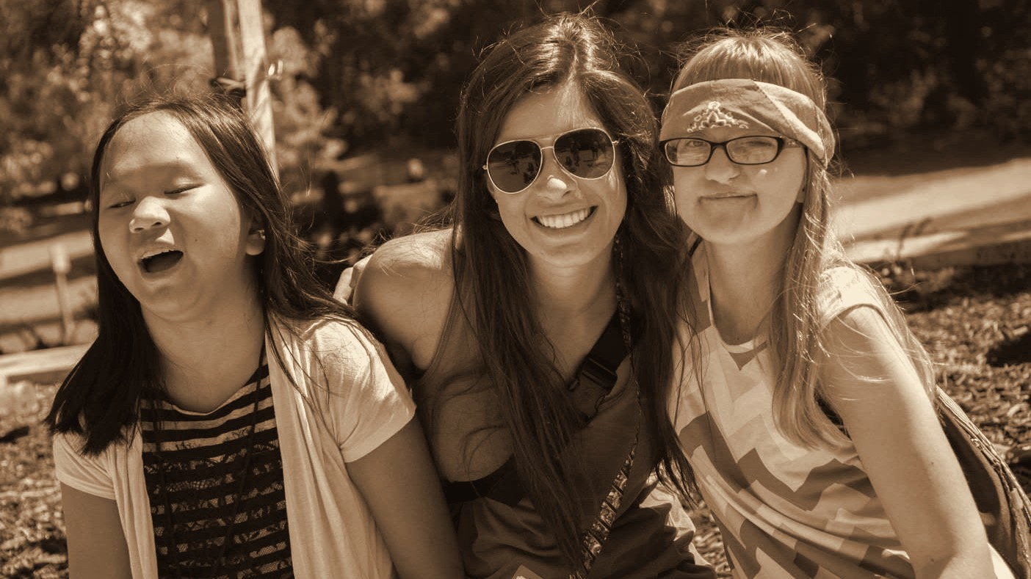
Throwback 37: 2015, HEATHER’S CAMP, CAMPERS & DELTA GAMMA VOLUNTEER
2015
HEATHER’S CAMP, CAMPERS & DELTA GAMMA VOLUNTEER
ENVISION THE FUTURE · HONOR THE LEGACY
Notes:
Year basis: Facebook post dated July 31, 2015; camp name not confirmed. Source photo: 515508522_24372597575671834_6507375247130789716_n.jpg. Photos already carry the sepia treatment; to swap one, right-click it > Change Picture. The dark scrim over the bottom of the photo is a separate object on this slide; duplicate this slide rather than inserting a fresh one so it comes along.

Slide 45
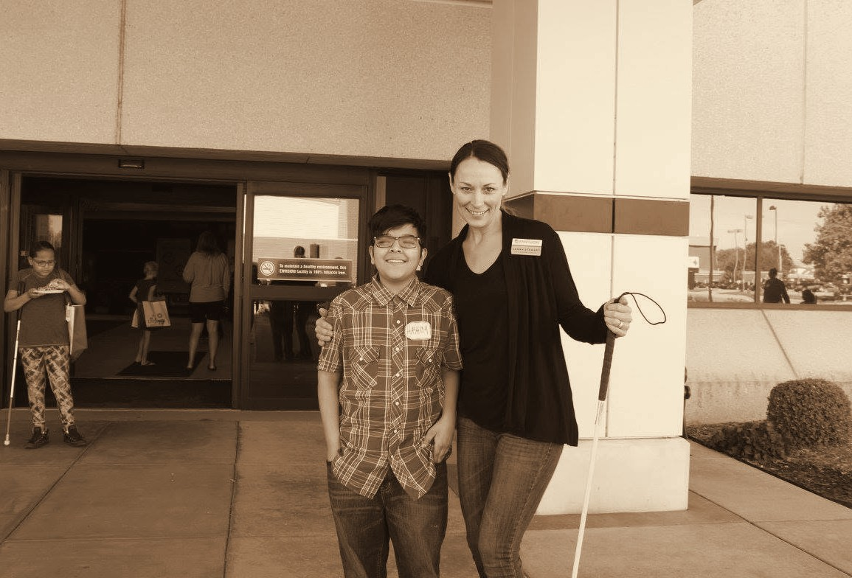
Throwback 38: 2015, HASHIM, ENVISION ARTS YOUTH PROGRAM PARTICIPANT
2015
HASHIM, ENVISION ARTS YOUTH PROGRAM PARTICIPANT
ENVISION THE FUTURE · HONOR THE LEGACY
Notes:
Year basis: Facebook post dated October 13, 2016; Laura confirms the photos are from 2015; program name not confirmed. Source photo: 515264128_24392120943719497_1144878044891021107_n.jpg. Photos already carry the sepia treatment; to swap one, right-click it > Change Picture.

Slide 46
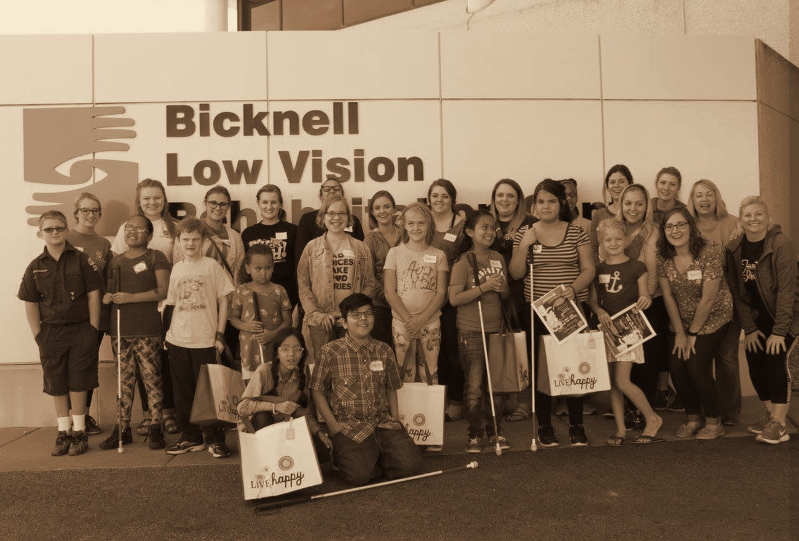
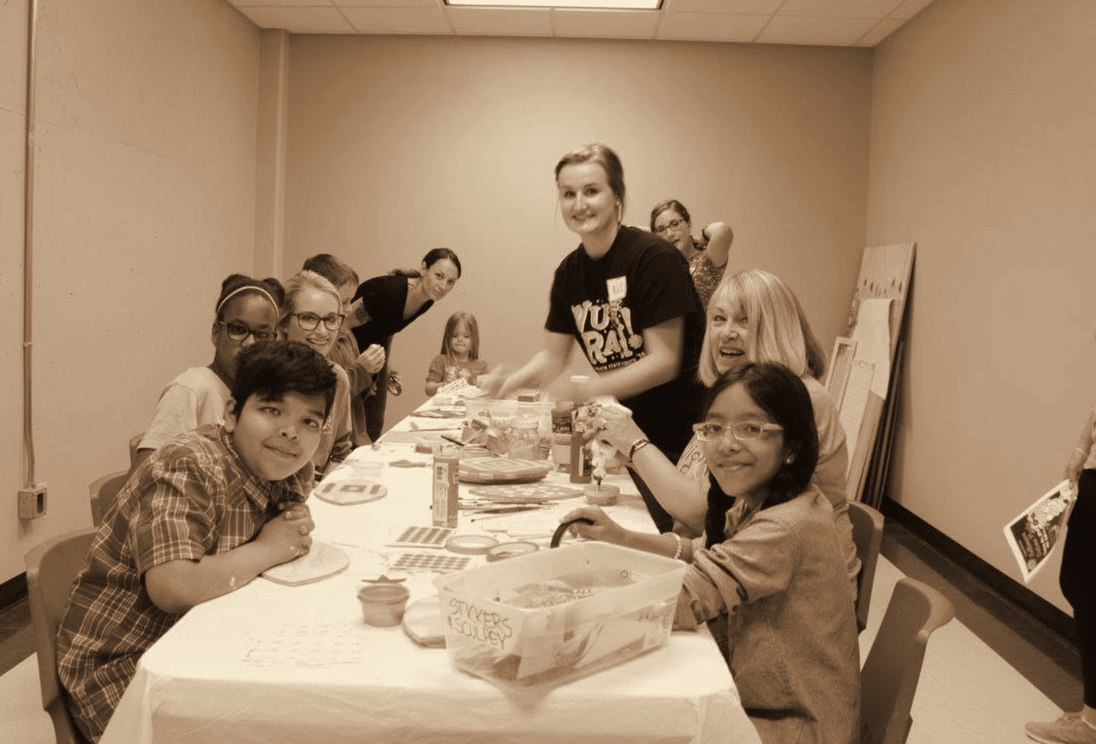
Throwback 39: 2015, ENVISION ARTS YOUTH PROGRAM PARTICIPANTS
2015
ENVISION ARTS YOUTH PROGRAM PARTICIPANTS
ENVISION THE FUTURE · HONOR THE LEGACY
Notes:
Year basis: Facebook post dated October 13, 2016; Laura confirms the photos are from 2015; program name not confirmed. Source photos: bicknell_group.png, art_table.png. Photos already carry the sepia treatment; to swap one, right-click it > Change Picture.

Slide 47
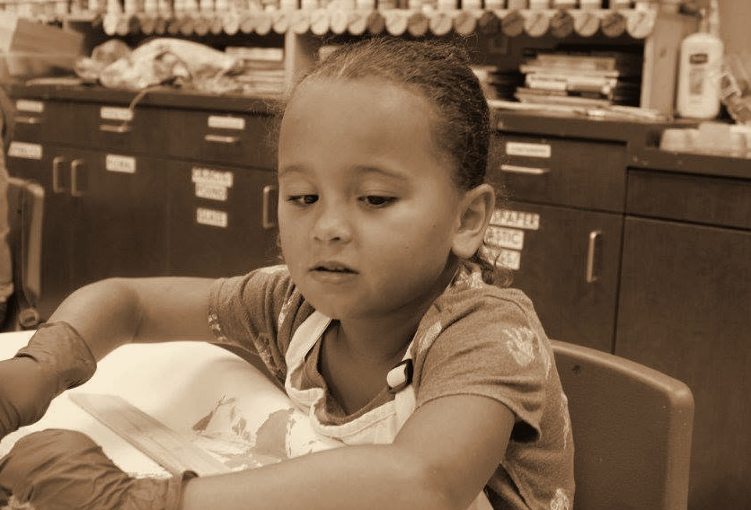
Throwback 40: 2015, ADAH, ENVISION ARTS YOUTH PROGRAM PARTICIPANT
2015
ADAH, ENVISION ARTS YOUTH PROGRAM PARTICIPANT
ENVISION THE FUTURE · HONOR THE LEGACY
Notes:
Year basis: Facebook post dated October 13, 2016; Laura confirms the photos are from 2015; Adah per Laura, program name not confirmed. Source photo: 515496848_24392121030386155_4959498615936162370_n.jpg. Photos already carry the sepia treatment; to swap one, right-click it > Change Picture.

Slide 48


Throwback 41: 2010s, ENVISION CHILD DEVELOPMENT CENTER
2010s
ENVISION CHILD DEVELOPMENT CENTER
ENVISION THE FUTURE · HONOR THE LEGACY
Notes:
Year basis: decade is an estimate; confirm. Source photos: 516307629_24404475582484033_4077145122123939934_n.jpg, 514398054_24407351508863107_4640940189281080079_n.jpg. Photos already carry the sepia treatment; to swap one, right-click it > Change Picture.

Slide 49

Throwback 42: 2017, BRAILLE CHALLENGE, WICHITA
2017
BRAILLE CHALLENGE, WICHITA
ENVISION THE FUTURE · HONOR THE LEGACY
Notes:
Year basis: Facebook post dated February 27, 2017. Source photo: 515666041_24396518596613065_9163789206916333567_n.jpg. Photos already carry the sepia treatment; to swap one, right-click it > Change Picture. The dark scrim over the bottom of the photo is a separate object on this slide; duplicate this slide rather than inserting a fresh one so it comes along.

Slide 50


Throwback 43: 2018, ENVISION’S LEVEL UP, PROGRAM PARTICIPANTS
2018
ENVISION’S LEVEL UP, PROGRAM PARTICIPANTS
ENVISION THE FUTURE · HONOR THE LEGACY
Notes:
Year basis: year from Facebook upload timing; program name not confirmed. Source photos: 36679840_1977772592247652_8857339367518109696_n.jpg, 36720032_1977770692247842_8607756704823640064_n.jpg. Photos already carry the sepia treatment; to swap one, right-click it > Change Picture.

Slide 51

Throwback 44: 2018, ENVISION ARTS YOUTH PROGRAM PARTICIPANTS
2018
ENVISION ARTS YOUTH PROGRAM PARTICIPANTS
ENVISION THE FUTURE · HONOR THE LEGACY
Notes:
Year basis: year from Facebook upload timing; program name not confirmed. Source photo: 39468117_2048172925207618_3198537865604628480_n.jpg. Photos already carry the sepia treatment; to swap one, right-click it > Change Picture.

Slide 52

Throwback 45: 2019, ENVISION GOLF CLINIC, PROGRAM PARTICIPANT
2019
ENVISION GOLF CLINIC, PROGRAM PARTICIPANT
ENVISION THE FUTURE · HONOR THE LEGACY
Notes:
Year basis: year from Facebook upload timing; event name not confirmed. Source photo: 56781124_2401507159874191_4435377701120901120_n.jpg. Photos already carry the sepia treatment; to swap one, right-click it > Change Picture.

Slide 53

Throwback 47: 2020, ADAH AND HASHIM, ENVISION’S LEVEL UP, PROGRAM PARTICIPANTS
2020
ADAH AND HASHIM, ENVISION’S LEVEL UP, PROGRAM PARTICIPANTS
ENVISION THE FUTURE · HONOR THE LEGACY
Notes:
Year basis: Facebook post dated December 4, 2020; names per Laura. Source photo: weseeclearly.png. Photos already carry the sepia treatment; to swap one, right-click it > Change Picture.

Slide 54


Throwback 48: 2020, ENVISION MONTHLY PROGRAMS
2020
ENVISION MONTHLY PROGRAMS
ENVISION THE FUTURE · HONOR THE LEGACY
Notes:
Year basis: group photo uploaded February 2020; the close-up was reposted March 30, 2021; confirm. Source photos: 87270349_3040969335927967_4814775488343965696_n.jpg, bowling_kid.png. Photos already carry the sepia treatment; to swap one, right-click it > Change Picture.

Slide 55

Throwback 49: 2021, ENVISION BEEP BASEBALL
2021
ENVISION BEEP BASEBALL
ENVISION THE FUTURE · HONOR THE LEGACY
Notes:
Year basis: Facebook post dated July 30, 2021. Source photo: falcons2021.png. Photos already carry the sepia treatment; to swap one, right-click it > Change Picture. The dark scrim over the bottom of the photo is a separate object on this slide; duplicate this slide rather than inserting a fresh one so it comes along.

Slide 56

Throwback 51: 2022, ENVISION’S LEVEL UP, PROGRAM PARTICIPANT
2022
ENVISION’S LEVEL UP, PROGRAM PARTICIPANT
ENVISION THE FUTURE · HONOR THE LEGACY
Notes:
Year basis: Facebook post dated July 21, 2022; Adah per Laura. Source photo: adah_2022.png. Photos already carry the sepia treatment; to swap one, right-click it > Change Picture.

Slide 57

Throwback 52: 2022, ENVISION’S LEVEL UP, PROGRAM PARTICIPANT
2022
ENVISION’S LEVEL UP, PROGRAM PARTICIPANT
ENVISION THE FUTURE · HONOR THE LEGACY
Notes:
Year basis: Facebook post dated July 19, 2022; Hashim per Laura. Source photo: hashim_2022.png. Photos already carry the sepia treatment; to swap one, right-click it > Change Picture. The dark scrim over the bottom of the photo is a separate object on this slide; duplicate this slide rather than inserting a fresh one so it comes along.

Slide 58

Throwback 53: 2022, ENVISION FOREVISION GOLF TOURNAMENT
2022
ENVISION FOREVISION GOLF TOURNAMENT
ENVISION THE FUTURE · HONOR THE LEGACY
Notes:
Year basis: phone camera timestamp; event name not confirmed. Source photo: 20220829_195341.jpg. Photos already carry the sepia treatment; to swap one, right-click it > Change Picture.

Slide 59

Throwback 54: 2024, ENVISION’S LEVEL UP, PROGRAM PARTICIPANT
2024
ENVISION’S LEVEL UP, PROGRAM PARTICIPANT
ENVISION THE FUTURE · HONOR THE LEGACY
Notes:
Year basis: Facebook post dated June 27, 2024; Kennick per Laura. Source photo: kennick_2024.png. Photos already carry the sepia treatment; to swap one, right-click it > Change Picture.

Slide 60


Throwback 55: 2024, HEATHER’S CAMP
AUBREE · FEATURED GUEST
2024
2026
HEATHER’S CAMP
LEVEL UP
ENVISION THE FUTURE · HONOR THE LEGACY
Notes:
Year basis: then: Facebook post dated August 1, 2024 (Heather’s Camp); now: Level Up 2026 photo from Laura. Source photos: 482091992_1036613011835564_1782698059698200373_n.jpg, Aubree_Calvert.jpg. Photos already carry the sepia treatment; to swap one, right-click it > Change Picture.

Slide 61


Throwback 56: 2011, ECDC WICHITA
ADAH · FEATURED GUEST
2011
2026
ECDC WICHITA
HIGH SCHOOL GRADUATE
ENVISION THE FUTURE · HONOR THE LEGACY
Notes:
Year basis: then: Facebook post dated December 29, 2011; now: high school graduation 2026 per Laura. Source photos: adah_2011.png, 705968911_122313865370027018_2361427042434269514_n.jpg. Photos already carry the sepia treatment; to swap one, right-click it > Change Picture.

Slide 62


Throwback 57: 2015, ENVISION ARTS YOUTH PROGRAM
HASHIM · FEATURED GUEST
2015
2026
ENVISION ARTS YOUTH PROGRAM
WICHITA STATE GRADUATE
ENVISION THE FUTURE · HONOR THE LEGACY
Notes:
Year basis: then: Facebook post dated October 13, 2016; Laura confirms the photos are from 2015; now: Wichita State graduation 2026. Source photos: boy_painting.png, hashim_grad_2026.jpg. Photos already carry the sepia treatment; to swap one, right-click it > Change Picture.

Slide 63
Thank you to our sponsors
THANK YOU TO OUR SPONSORS
PRESENTING SPONSOR
CORPORATE SPONSORS
PLATINUM LEVEL
SPR
DIAMOND LEVEL
GOLD LEVEL
Summit Films
INTRUST Bank
SILVER LEVEL
Vornado
Novolex
ENVISION THE FUTURE · HONOR THE LEGACY

