Slide 1
Welcome to A Night For Vision
Notes:
HOW TO USE THIS TEMPLATE: Home > New Slide (arrow) and pick a layout. Fill the placeholders; the styling is built in. Photo and rendering placeholders crop to fill (Picture Format > Crop to adjust the framing). Logo and QR placeholders fit the image without cropping. Every layout has a hidden title placeholder off the slide edge (Home > Select > Selection Pane) so screen reader users can navigate by slide title; give each slide a unique one. Montserrat must be installed on the presenting laptop, or embed fonts when you save (File > Options > Save > Embed fonts). This loop auto-advances every 8 seconds and repeats until Esc (Transitions tab to change timing; Slide Show > Set Up Slide Show to change looping).

Slide 2
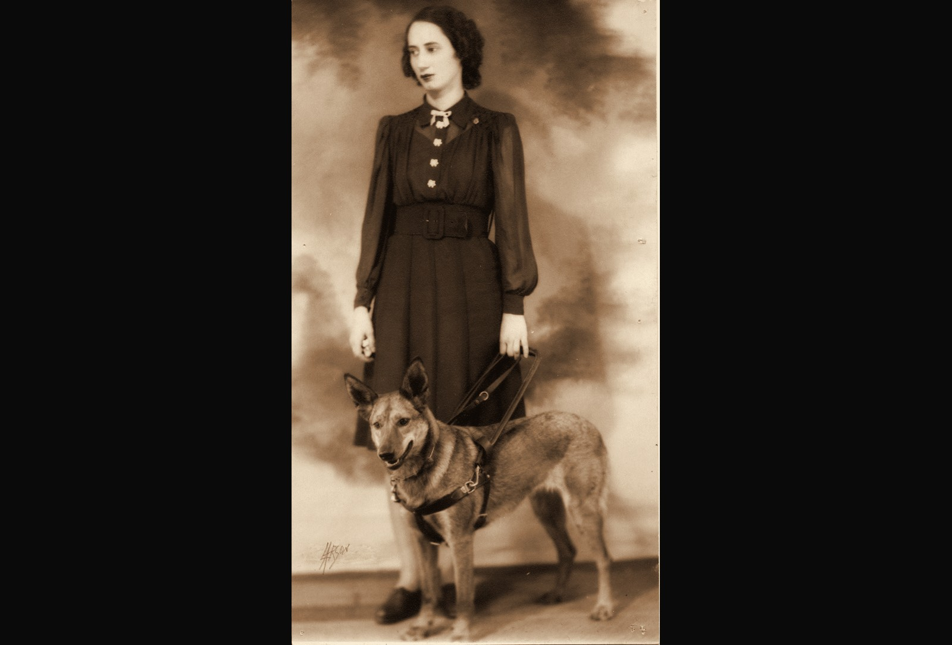

Throwback 1: 1933, FIRST PROGRAM PARTICIPANT
1933
FIRST PROGRAM PARTICIPANT
ENVISION THE FUTURE · HONOR THE LEGACY
Notes:
Year basis: Facebook post caption: 1933, one of Envision’s first patrons; label from Laura. Source photo: patron_1933.png. Photos already carry the sepia treatment; to swap one, right-click it > Change Picture.

Slide 3
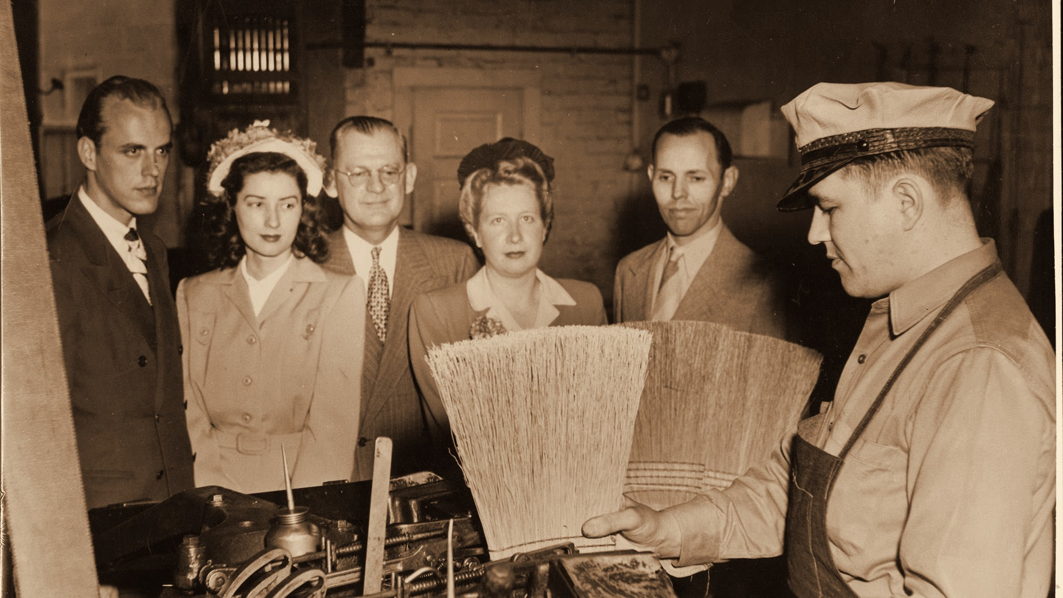

Throwback 2: 1940s, EMPLOYMENT PROGRAM PARTICIPANT
1940s
EMPLOYMENT PROGRAM PARTICIPANT
ENVISION THE FUTURE · HONOR THE LEGACY
Notes:
Year basis: Facebook post caption: broom-making workshop in the 1940s; label from Laura. Source photo: 514729028_24370021999262725_6241323963255478700_n.jpg. Photos already carry the sepia treatment; to swap one, right-click it > Change Picture. The dark scrim over the bottom of the photo is a separate object on this slide; duplicate this slide rather than inserting a fresh one so it comes along.

Slide 4

Presenting sponsor HighTouch Technologies
PRESENTING SPONSOR
Notes:
Presenting sponsor slide. The HighTouch logo is placed; replace with the official file if a newer version arrives.

Slide 5
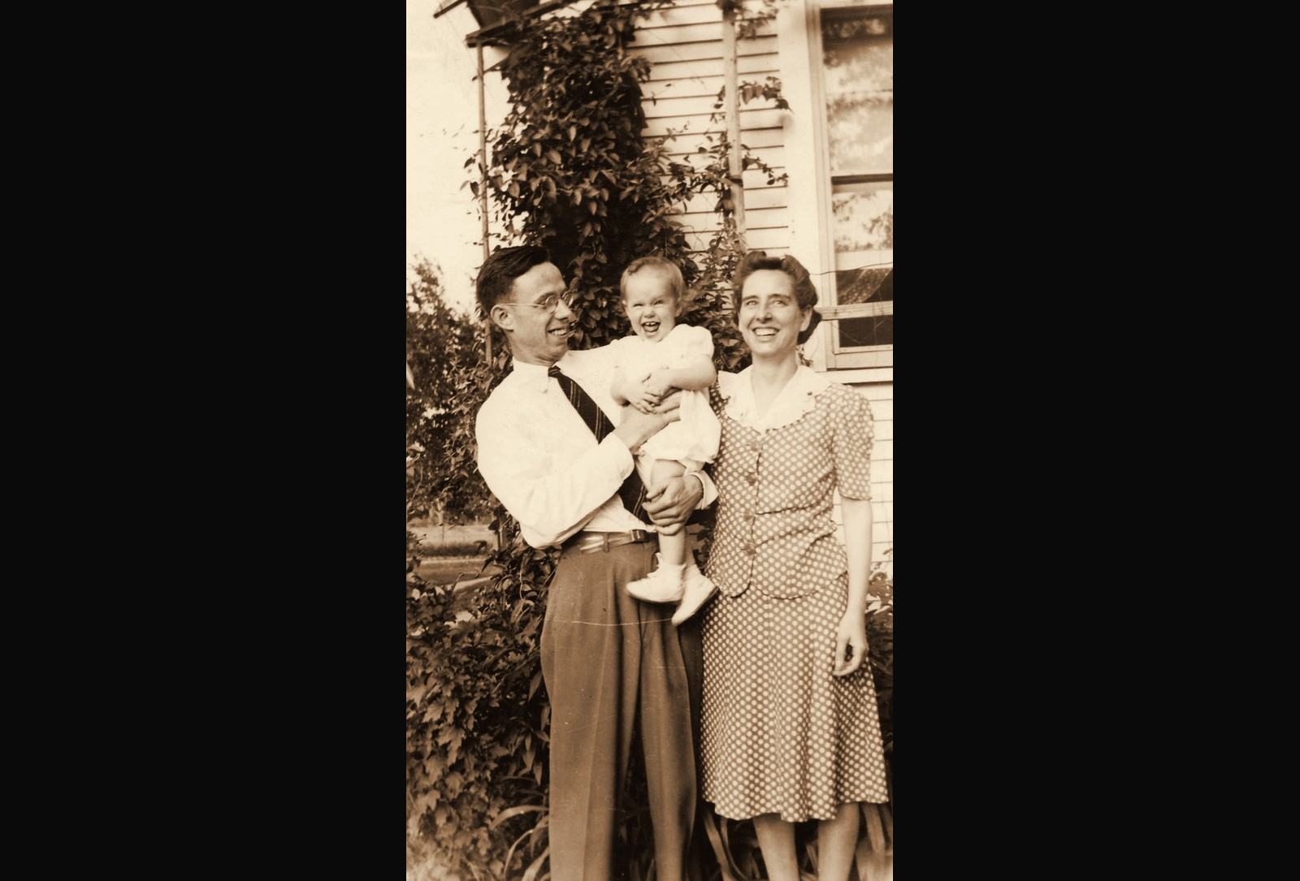
Throwback 3: 1940s, PROGRAM PARTICIPANT AND FAMILY
1940s
PROGRAM PARTICIPANT AND FAMILY
ENVISION THE FUTURE · HONOR THE LEGACY
Notes:
Year basis: Facebook post caption: a program participant and her family in the 1940s. Source photo: family_1940s.png. Photos already carry the sepia treatment; to swap one, right-click it > Change Picture.

Slide 6
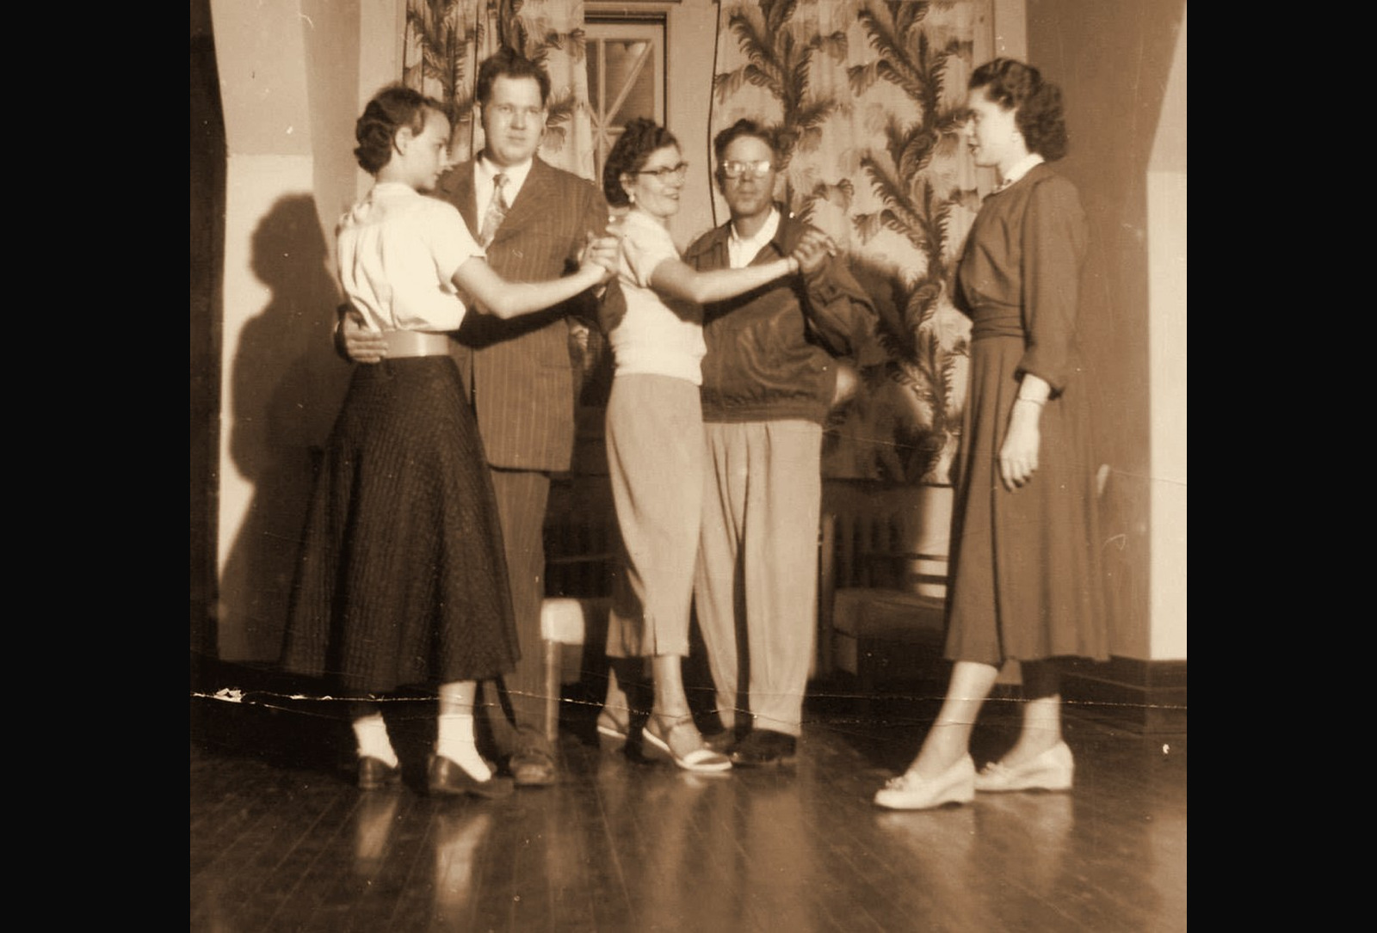
Throwback 4: 1950s, ENVISION PROGRAMS DANCE CLASS
1950s
ENVISION PROGRAMS DANCE CLASS
ENVISION THE FUTURE · HONOR THE LEGACY
Notes:
Year basis: Facebook post caption: a dance put on by Envision in the 1950s; label from Laura. Source photo: dance_1950s.png. Photos already carry the sepia treatment; to swap one, right-click it > Change Picture.

Slide 7
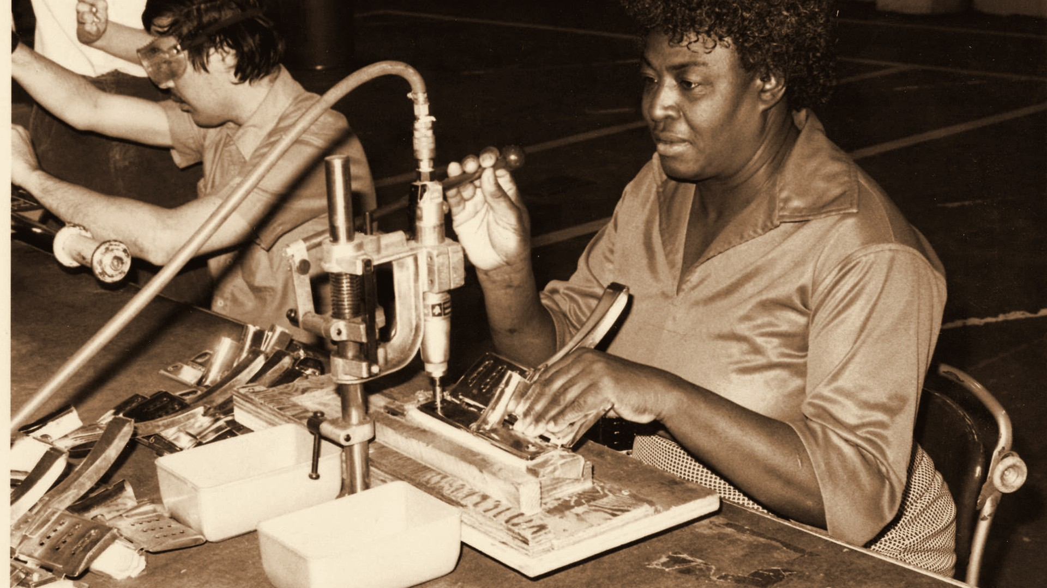
Throwback 5: 1970s, EMPLOYMENT IN WICHITA
1970s
EMPLOYMENT IN WICHITA
ENVISION THE FUTURE · HONOR THE LEGACY
Notes:
Year basis: decade is an estimate; program name not confirmed. Source photo: 514526513_24360271056904486_8424275321534355461_n.jpg. Photos already carry the sepia treatment; to swap one, right-click it > Change Picture. The dark scrim over the bottom of the photo is a separate object on this slide; duplicate this slide rather than inserting a fresh one so it comes along.

Slide 8
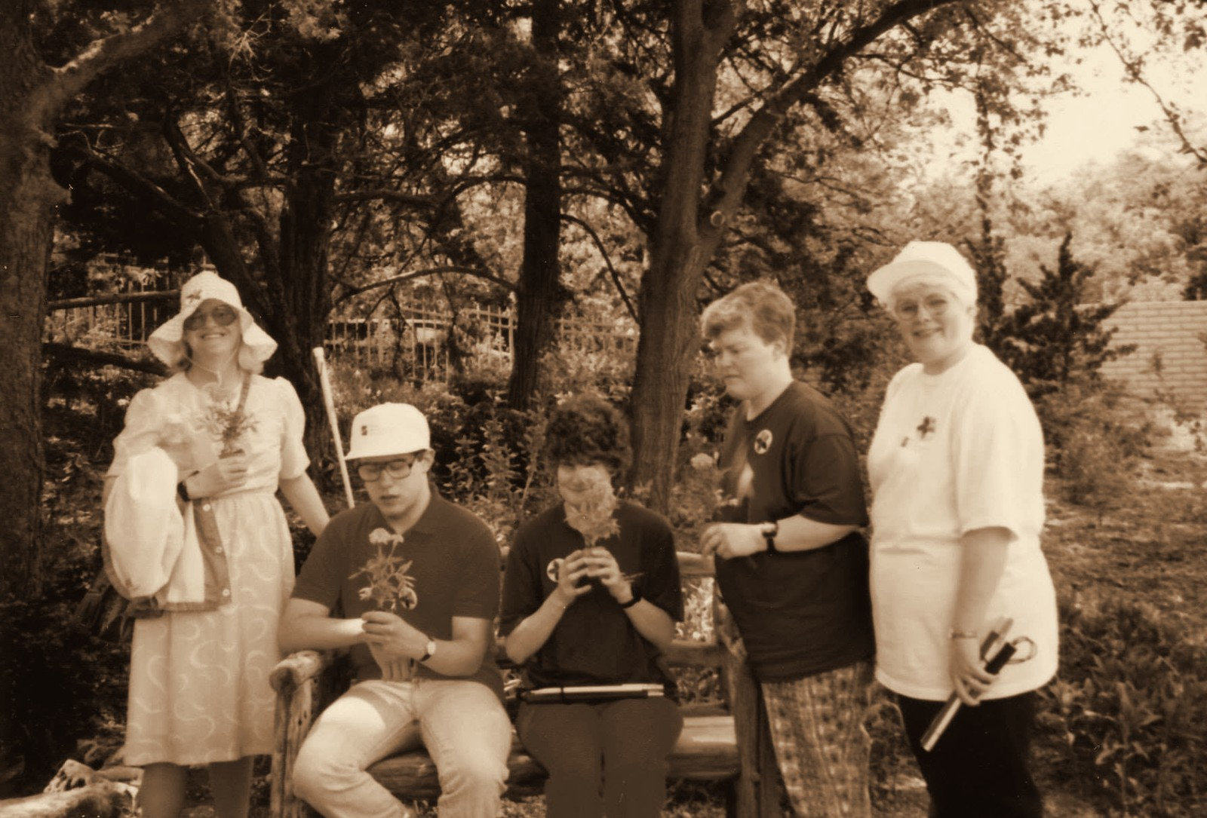
Throwback 6: 1992, ENVISION PRIDE PROGRAM AT BOTANICA
1992
ENVISION PRIDE PROGRAM AT BOTANICA
ENVISION THE FUTURE · HONOR THE LEGACY
Notes:
Year basis: Facebook post caption: PRIDE program at Botanica in 1992. Source photo: 514399319_24370451429219782_5553540867382418124_n.jpg. Photos already carry the sepia treatment; to swap one, right-click it > Change Picture.

Slide 9



Corporate sponsors
CORPORATE SPONSORS
Notes:
Logos here are low-resolution cutouts from the sponsor thank-you graphic, placed so the loop runs complete. Replace each with the official logo file: right-click the logo > Change Picture (the white card fits it without cropping). Set the tier label to the sponsor level.

Slide 10
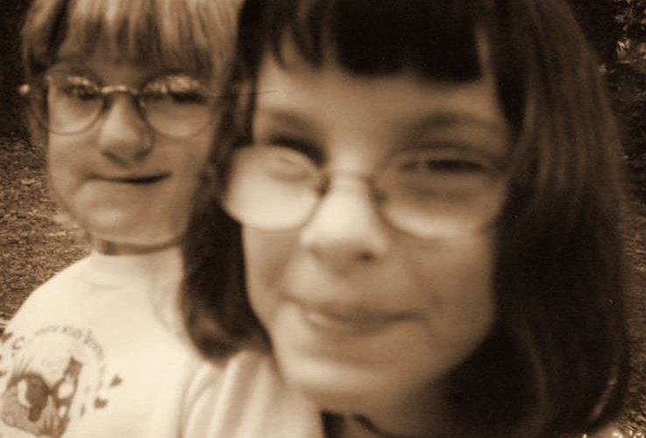
Throwback 7: 1990s, HEATHER’S CAMP PROGRAM PARTICIPANTS
1990s
HEATHER’S CAMP PROGRAM PARTICIPANTS
ENVISION THE FUTURE · HONOR THE LEGACY
Notes:
Year basis: Heather’s Camp photos from the PDF Laura sent; the PDF export carried no notes, year read from the print’s date stamp where one exists, otherwise a decade estimate; confirm (stamp reads 199x). Source photo: img-007.png. Photos already carry the sepia treatment; to swap one, right-click it > Change Picture.

Slide 11
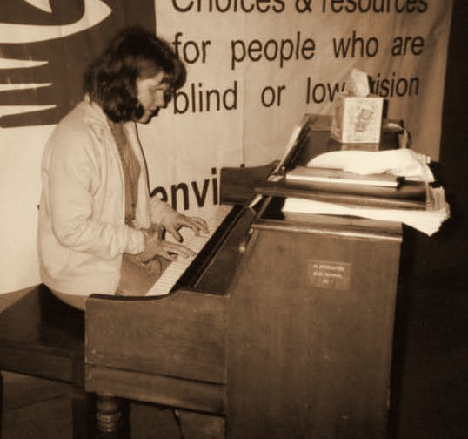
Throwback 8: 1990s, ENVISION PROGRAMS
1990s
ENVISION PROGRAMS
ENVISION THE FUTURE · HONOR THE LEGACY
Notes:
Year basis: photo from the PDF Laura sent; the PDF export carried no notes, year read from the print’s date stamp where one exists, otherwise a decade estimate; confirm; piano beneath the older Envision banner. Source photo: img-016.png. Photos already carry the sepia treatment; to swap one, right-click it > Change Picture.

Slide 12
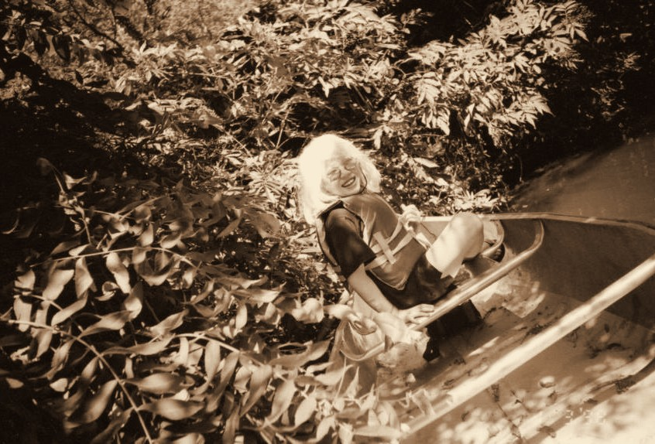
Throwback 9: 1999, HEATHER’S CAMP
1999
HEATHER’S CAMP
ENVISION THE FUTURE · HONOR THE LEGACY
Notes:
Year basis: Heather’s Camp photos from the PDF Laura sent; the PDF export carried no notes, year read from the print’s date stamp where one exists, otherwise a decade estimate; confirm (stamp reads 1999). Source photo: img-005.png. Photos already carry the sepia treatment; to swap one, right-click it > Change Picture.

Slide 13
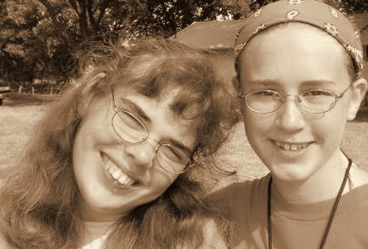
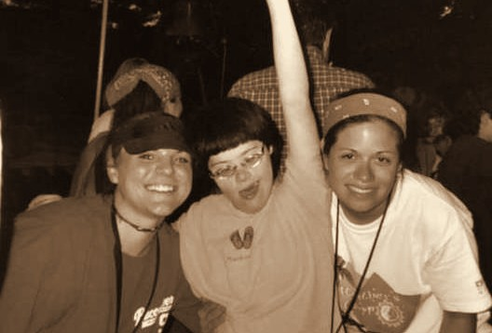
Throwback 10: 2000, HEATHER’S CAMP, DELTA GAMMA VOLUNTEERS
2000
HEATHER’S CAMP, DELTA GAMMA VOLUNTEERS
ENVISION THE FUTURE · HONOR THE LEGACY
Notes:
Year basis: spread across 2000 to 2005 at Laura’s direction; not from a dated record. Source photos: img-000.png, img-017.png. Photos already carry the sepia treatment; to swap one, right-click it > Change Picture.

Slide 14

Platinum level sponsor Forvis Mazars
PLATINUM LEVEL SPONSOR
Notes:
Logos here are low-resolution cutouts from the sponsor thank-you graphic, placed so the loop runs complete. Replace each with the official logo file: right-click the logo > Change Picture (the white card fits it without cropping). Set the tier label to the sponsor level.

Slide 15
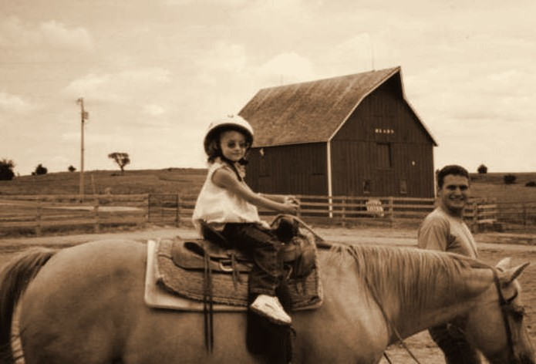
Throwback 11: 2000, ENVISION PROGRAMS
2000
ENVISION PROGRAMS
ENVISION THE FUTURE · HONOR THE LEGACY
Notes:
Year basis: spread across 2000 to 2005 at Laura’s direction; not from a dated record. Source photo: img-001.png. Photos already carry the sepia treatment; to swap one, right-click it > Change Picture.

Slide 16
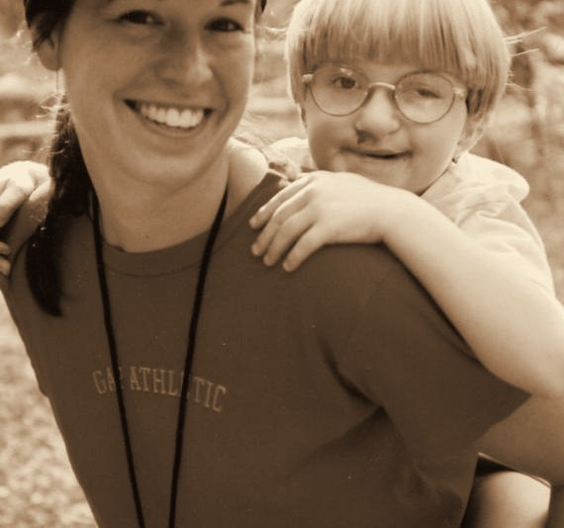
Throwback 12: 2001, HEATHER’S CAMP
2001
HEATHER’S CAMP
ENVISION THE FUTURE · HONOR THE LEGACY
Notes:
Year basis: spread across 2000 to 2005 at Laura’s direction; not from a dated record. Source photo: img-003.png. Photos already carry the sepia treatment; to swap one, right-click it > Change Picture.

Slide 17
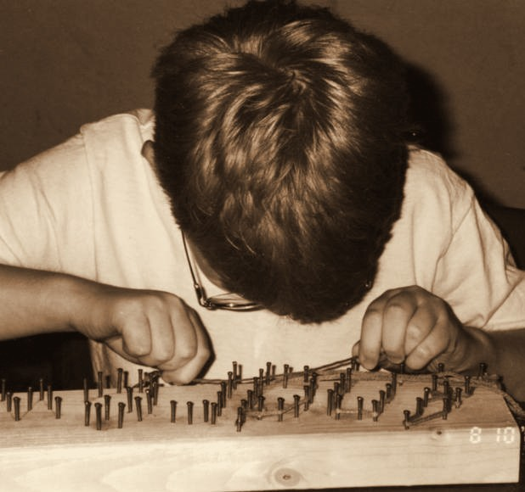
Throwback 18: 2001, ENVISION PROGRAMS
2001
ENVISION PROGRAMS
ENVISION THE FUTURE · HONOR THE LEGACY
Notes:
Year basis: Heather’s Camp photos from the PDF Laura sent; the PDF export carried no notes, year read from the print’s date stamp where one exists, otherwise a decade estimate; confirm (stamp reads 8 10 01). Source photo: img-013.png. Photos already carry the sepia treatment; to swap one, right-click it > Change Picture.

Slide 18
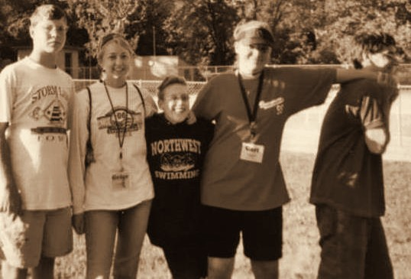
Throwback 13: 2002, DELTA GAMMA VOLUNTEERS WITH CAMPERS
2002
DELTA GAMMA VOLUNTEERS WITH CAMPERS
ENVISION THE FUTURE · HONOR THE LEGACY
Notes:
Year basis: spread across 2000 to 2005 at Laura’s direction; not from a dated record. Source photo: img-002.png. Photos already carry the sepia treatment; to swap one, right-click it > Change Picture.

Slide 19




Diamond level sponsors
DIAMOND LEVEL SPONSORS
Notes:
Logos here are low-resolution cutouts from the sponsor thank-you graphic, placed so the loop runs complete. Replace each with the official logo file: right-click the logo > Change Picture (the white card fits it without cropping). Set the tier label to the sponsor level.

Slide 20
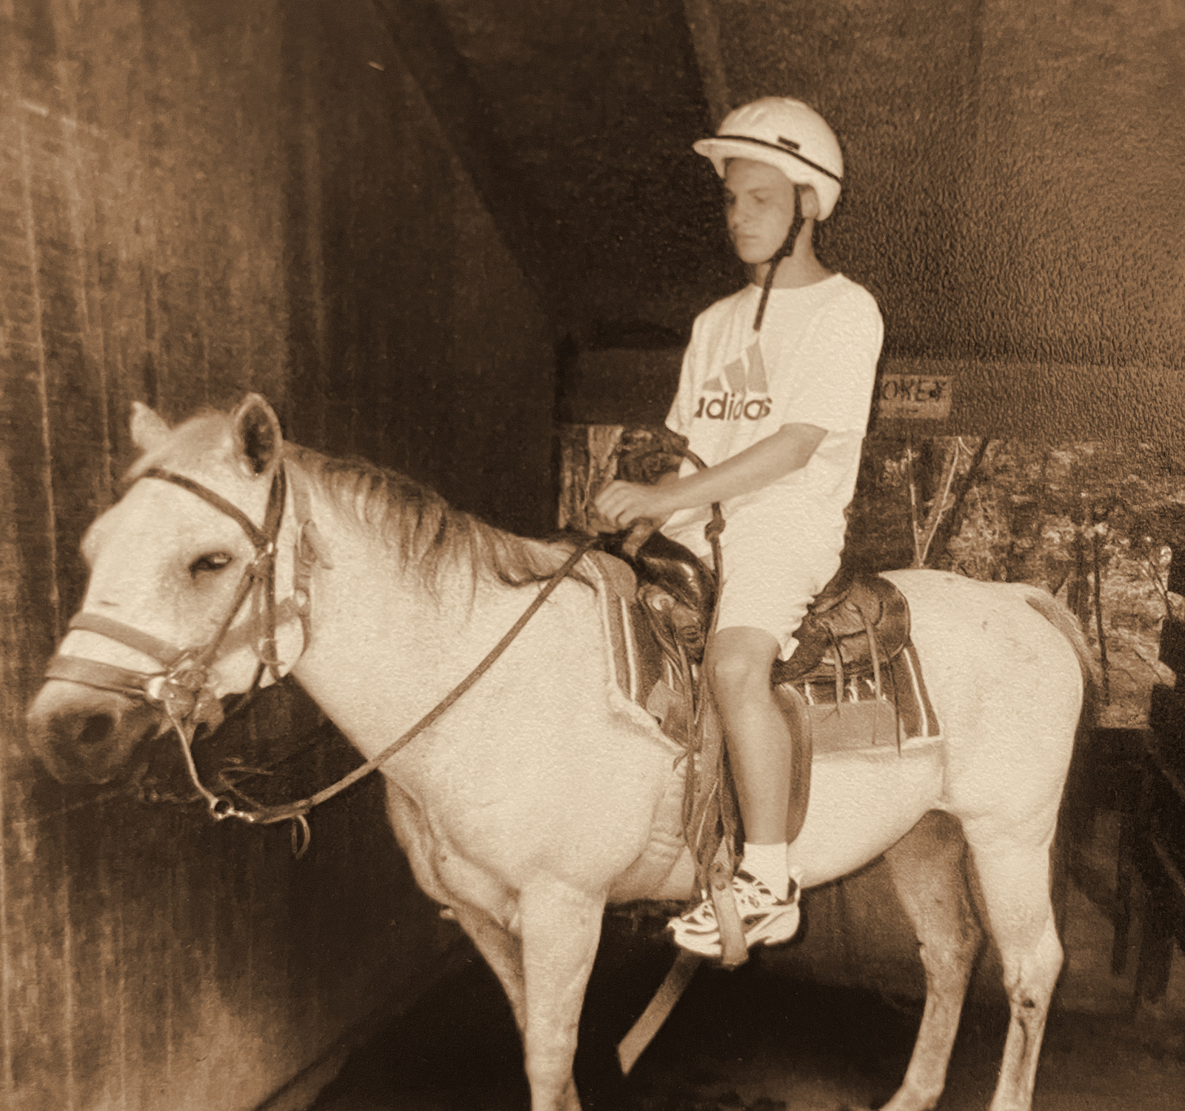
Throwback 60: 2000s, HEATHER’S CAMP
2000s
HEATHER’S CAMP
ENVISION THE FUTURE · HONOR THE LEGACY
Notes:
Year basis: early 2000s per Laura, Sept 21, 2026 (an estimate, not from a dated record). Steven at Heather’s Camp, per Laura. Source photo: 20240102_175857465_iOS.jpg, a phone photo of a print; cropped to the print, dust specks cleaned, sepia treatment. The same photo is the then side of Steven’s hidden featured guest slide.

Slide 21
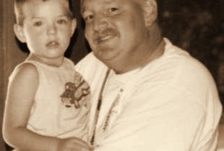
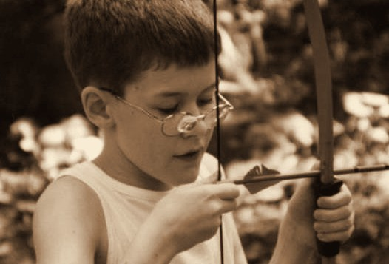
Throwback 14: 2002, ENVISION PROGRAMS
2002
ENVISION PROGRAMS
ENVISION THE FUTURE · HONOR THE LEGACY
Notes:
Year basis: spread across 2000 to 2005 at Laura’s direction; not from a dated record. Source photos: img-008.png, img-009.png. Photos already carry the sepia treatment; to swap one, right-click it > Change Picture.

Slide 22
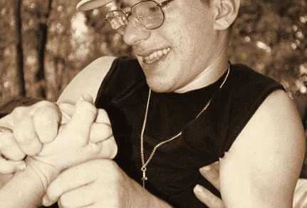
Throwback 15: 2003, HEATHER’S CAMP PROGRAM PARTICIPANT
2003
HEATHER’S CAMP PROGRAM PARTICIPANT
ENVISION THE FUTURE · HONOR THE LEGACY
Notes:
Year basis: spread across 2000 to 2005 at Laura’s direction; not from a dated record. Source photo: img-006.png. Photos already carry the sepia treatment; to swap one, right-click it > Change Picture.

Slide 23
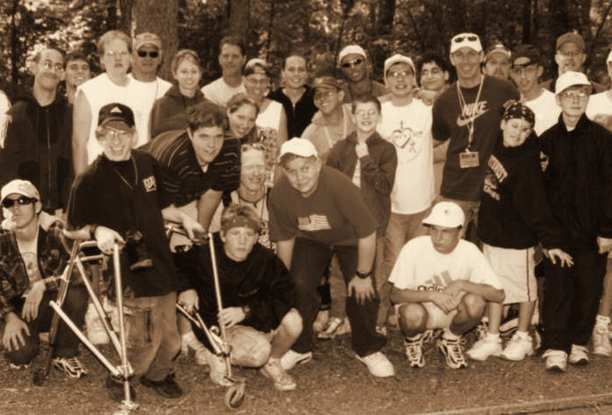
Throwback 16: 2003, ENVISION ANNUAL PROGRAMS
2003
ENVISION ANNUAL PROGRAMS
ENVISION THE FUTURE · HONOR THE LEGACY
Notes:
Year basis: spread across 2000 to 2005 at Laura’s direction; not from a dated record. Source photo: img-010.png. Photos already carry the sepia treatment; to swap one, right-click it > Change Picture.

Slide 24
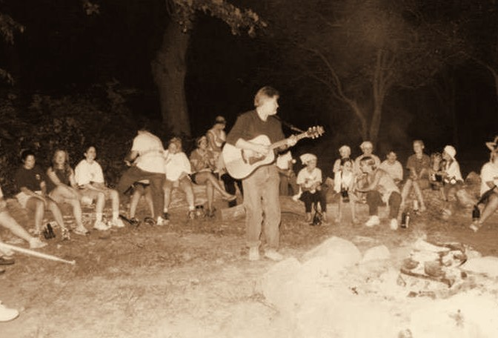
Throwback 17: 2003, ENVISION YOUTH SUMMER PROGRAMS
2003
ENVISION YOUTH SUMMER PROGRAMS
ENVISION THE FUTURE · HONOR THE LEGACY
Notes:
Year basis: spread across 2000 to 2005 at Laura’s direction; not from a dated record. Source photo: img-011.png. Photos already carry the sepia treatment; to swap one, right-click it > Change Picture.

Slide 25

Gold level sponsor INTRUST Bank
GOLD LEVEL SPONSOR
Notes:
Logos here are low-resolution cutouts from the sponsor thank-you graphic, placed so the loop runs complete. Replace each with the official logo file: right-click the logo > Change Picture (the white card fits it without cropping). Set the tier label to the sponsor level.

Slide 26
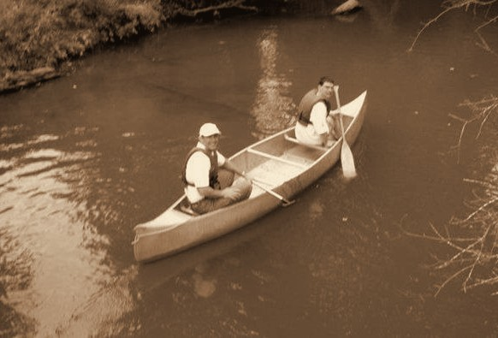
Throwback 19: 2004, HEATHER’S CAMP
2004
HEATHER’S CAMP
ENVISION THE FUTURE · HONOR THE LEGACY
Notes:
Year basis: spread across 2000 to 2005 at Laura’s direction; not from a dated record. Source photo: img-012.png. Photos already carry the sepia treatment; to swap one, right-click it > Change Picture.

Slide 27
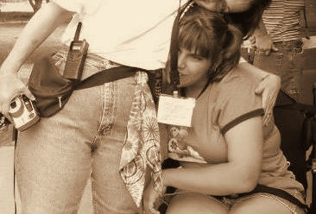
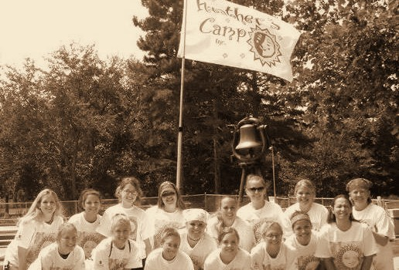
Throwback 23: 2004, DELTA GAMMA VOLUNTEERS WITH CAMPERS
2004
DELTA GAMMA VOLUNTEERS WITH CAMPERS
ENVISION THE FUTURE · HONOR THE LEGACY
Notes:
Year basis: Heather’s Camp photos from the PDF Laura sent; the PDF export carried no notes, year read from the print’s date stamp where one exists, otherwise a decade estimate; confirm (both stamped AUG 8 2004). Source photos: img-004.png, img-020.png. Photos already carry the sepia treatment; to swap one, right-click it > Change Picture.

Slide 28
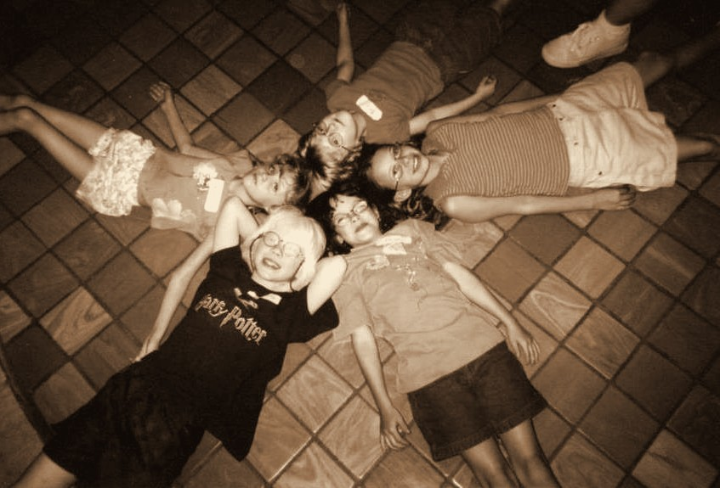
Throwback 20: 2005, ENVISION YOUTH PROGRAMS
2005
ENVISION YOUTH PROGRAMS
ENVISION THE FUTURE · HONOR THE LEGACY
Notes:
Year basis: spread across 2000 to 2005 at Laura’s direction; not from a dated record. Source photo: img-014.png. Photos already carry the sepia treatment; to swap one, right-click it > Change Picture.

Slide 29
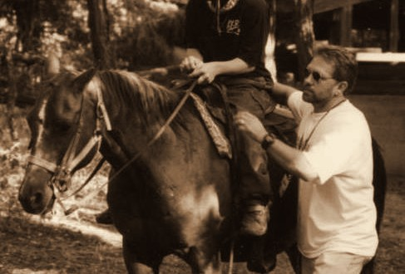
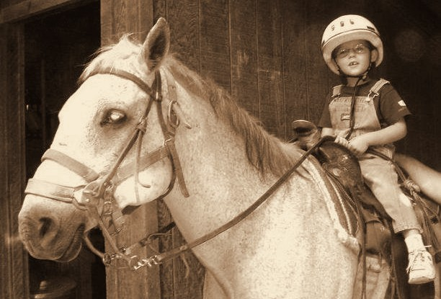
Throwback 21: 2005, HEATHER’S CAMP
2005
HEATHER’S CAMP
ENVISION THE FUTURE · HONOR THE LEGACY
Notes:
Year basis: spread across 2000 to 2005 at Laura’s direction; not from a dated record. Source photos: img-015.png, img-019.png. Photos already carry the sepia treatment; to swap one, right-click it > Change Picture.

Slide 30









Silver level sponsors
SILVER LEVEL SPONSORS
Notes:
Logos here are low-resolution cutouts from the sponsor thank-you graphic, placed so the loop runs complete. Replace each with the official logo file: right-click the logo > Change Picture (the white card fits it without cropping). Set the tier label to the sponsor level.

Slide 31
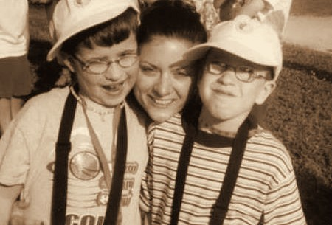
Throwback 22: 2005, DELTA GAMMA VOLUNTEERS WITH CAMPER
2005
DELTA GAMMA VOLUNTEERS WITH CAMPER
ENVISION THE FUTURE · HONOR THE LEGACY
Notes:
Year basis: spread across 2000 to 2005 at Laura’s direction; not from a dated record. Source photo: img-018.png. Photos already carry the sepia treatment; to swap one, right-click it > Change Picture.

Slide 32
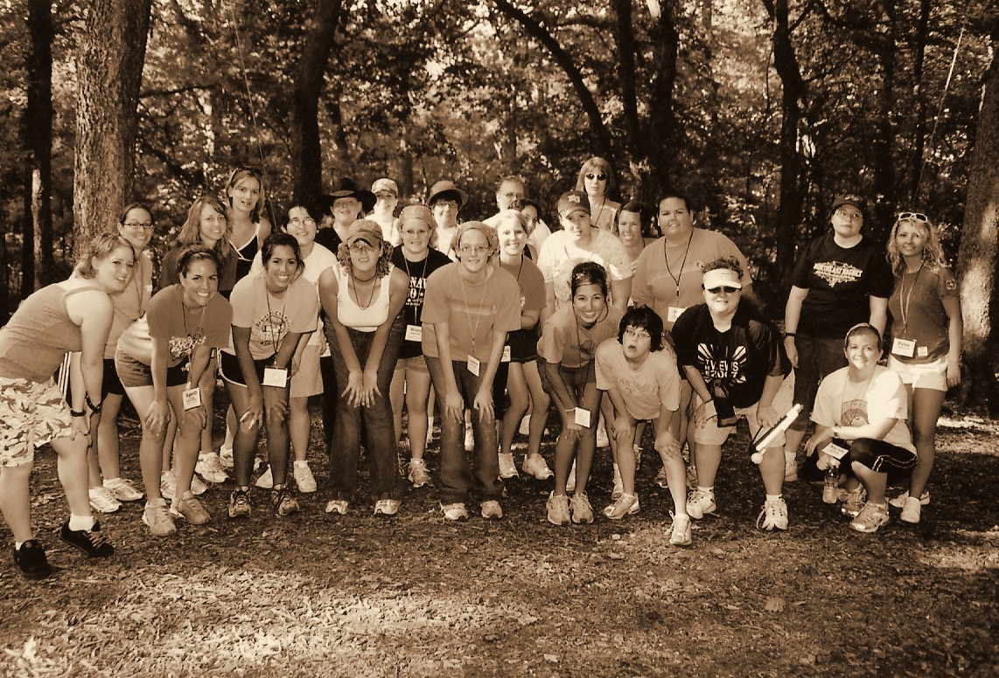
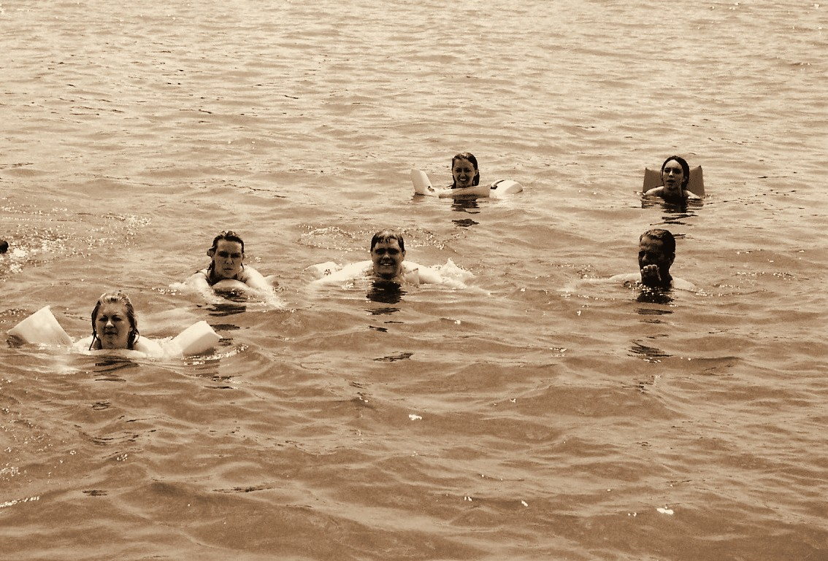
Throwback 24: 2007, ENVISION YOUTH SUMMER PROGRAMS
2007
ENVISION YOUTH SUMMER PROGRAMS
ENVISION THE FUTURE · HONOR THE LEGACY
Notes:
Year basis: Heather’s Camp 2007, confirmed by Laura. Source photos: scan0004_01a.jpg, scan0004_00b.jpg. Photos already carry the sepia treatment; to swap one, right-click it > Change Picture.

Slide 33
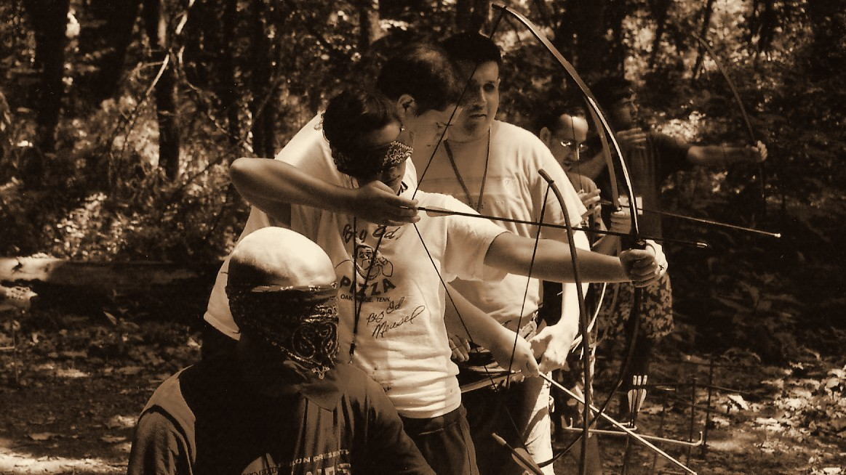
Throwback 25: 2007, ENVISION PROGRAMS
2007
ENVISION PROGRAMS
ENVISION THE FUTURE · HONOR THE LEGACY
Notes:
Year basis: Heather’s Camp 2007, confirmed by Laura. Source photo: scan0014_00b.jpg. Photos already carry the sepia treatment; to swap one, right-click it > Change Picture. The dark scrim over the bottom of the photo is a separate object on this slide; duplicate this slide rather than inserting a fresh one so it comes along.

Slide 34
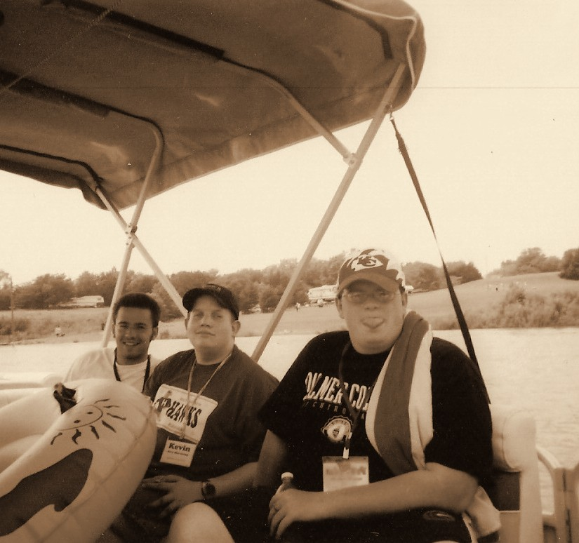
Throwback 26: 2007, HEATHER’S CAMP
2007
HEATHER’S CAMP
ENVISION THE FUTURE · HONOR THE LEGACY
Notes:
Year basis: Heather’s Camp 2007, confirmed by Laura. Source photo: scan0014_01a.jpg. Photos already carry the sepia treatment; to swap one, right-click it > Change Picture.

Slide 35
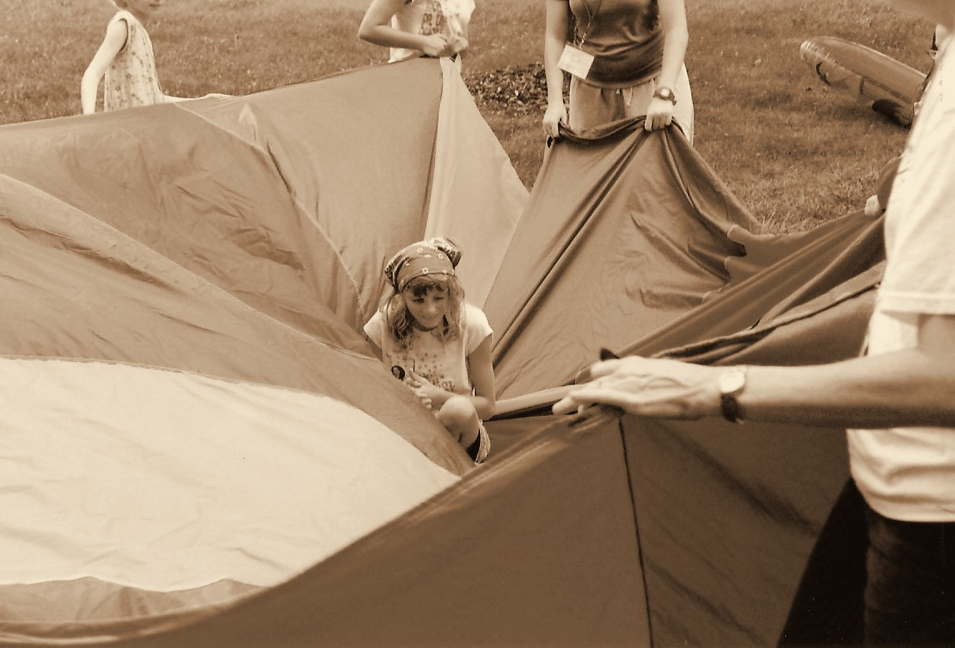
Throwback 27: 2007, ENVISION ANNUAL PROGRAMS
2007
ENVISION ANNUAL PROGRAMS
ENVISION THE FUTURE · HONOR THE LEGACY
Notes:
Year basis: Heather’s Camp 2007, confirmed by Laura. Source photo: scan0015_00b.jpg. Photos already carry the sepia treatment; to swap one, right-click it > Change Picture.

Slide 36
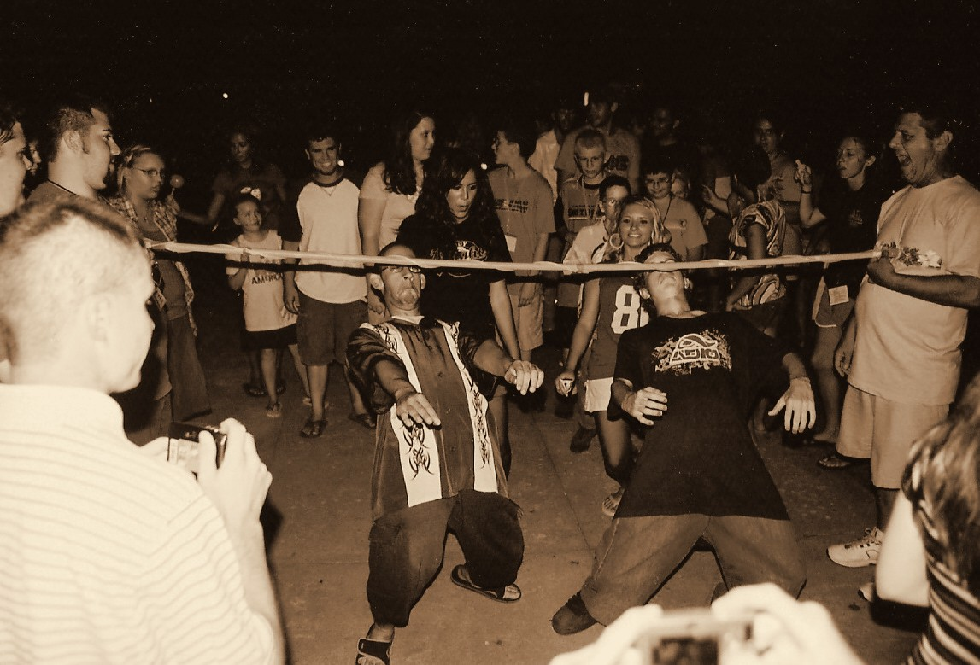
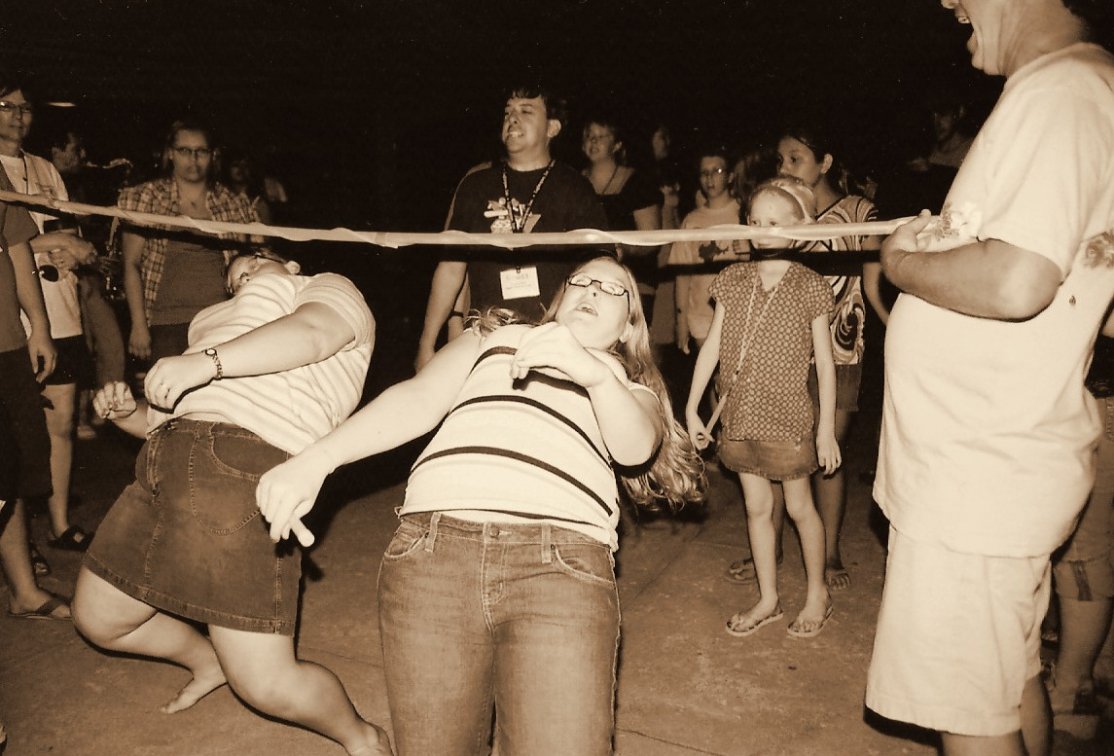
Throwback 28: 2007, ENVISION YOUTH PROGRAMS
2007
ENVISION YOUTH PROGRAMS
ENVISION THE FUTURE · HONOR THE LEGACY
Notes:
Year basis: Heather’s Camp 2007, confirmed by Laura. Source photos: scan0004_00a.jpg, scan0015_00a.jpg. Photos already carry the sepia treatment; to swap one, right-click it > Change Picture.

Slide 37
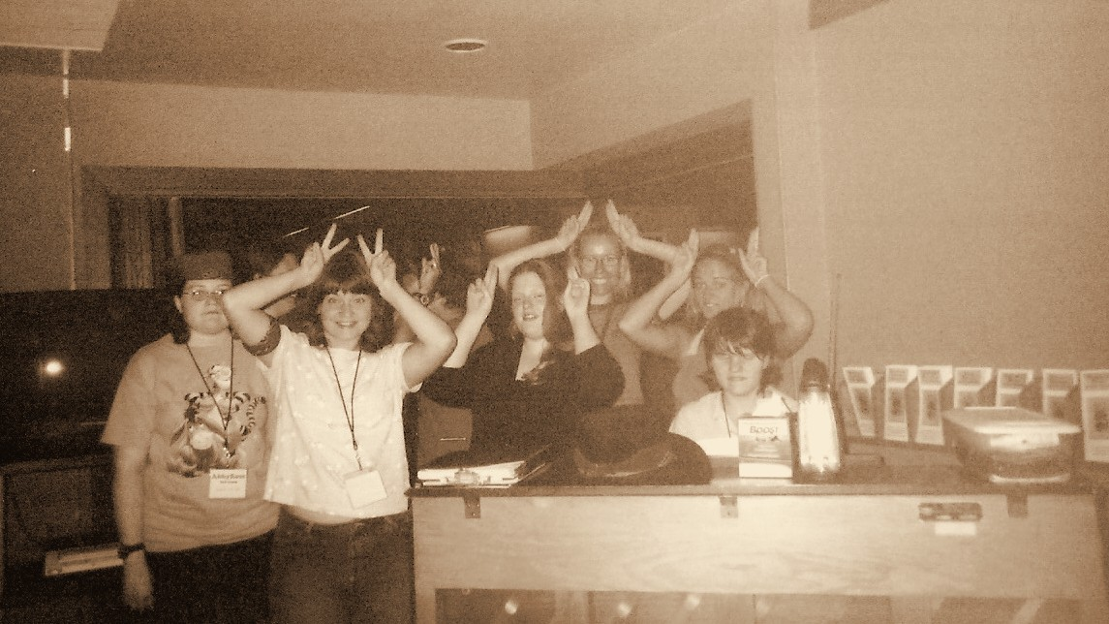
Throwback 29: 2007, ENVISION PROGRAMS
2007
ENVISION PROGRAMS
ENVISION THE FUTURE · HONOR THE LEGACY
Notes:
Year basis: Heather’s Camp 2007, confirmed by Laura. Source photo: scan0014_00a.jpg. Photos already carry the sepia treatment; to swap one, right-click it > Change Picture. The dark scrim over the bottom of the photo is a separate object on this slide; duplicate this slide rather than inserting a fresh one so it comes along.

Slide 38
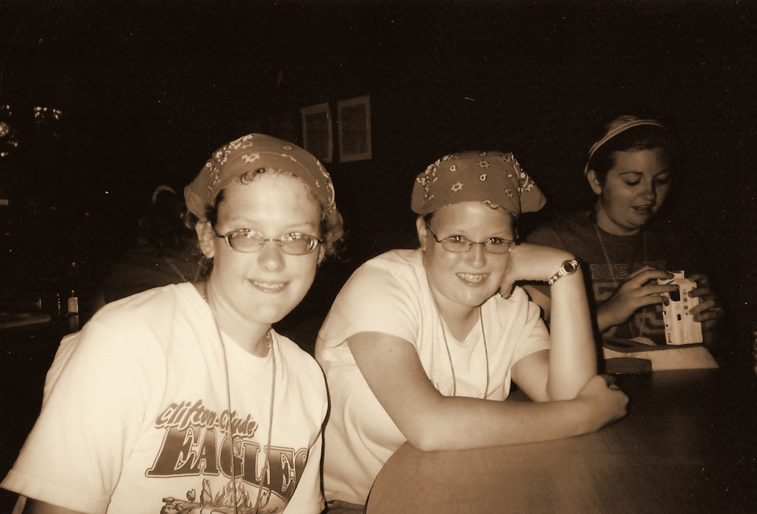
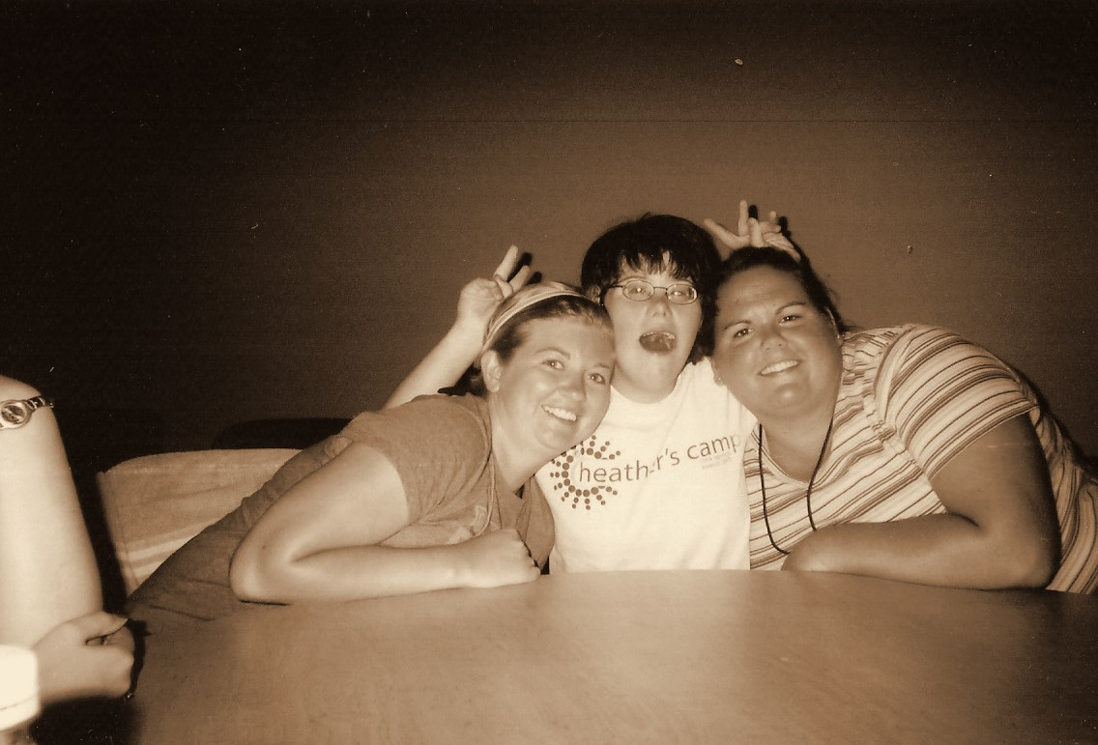
Throwback 30: 2007, HEATHER’S CAMP
2007
HEATHER’S CAMP
ENVISION THE FUTURE · HONOR THE LEGACY
Notes:
Year basis: Heather’s Camp 2007, confirmed by Laura. Source photos: scan0015_01a.jpg, scan0015_01b.jpg. Photos already carry the sepia treatment; to swap one, right-click it > Change Picture.

Slide 39
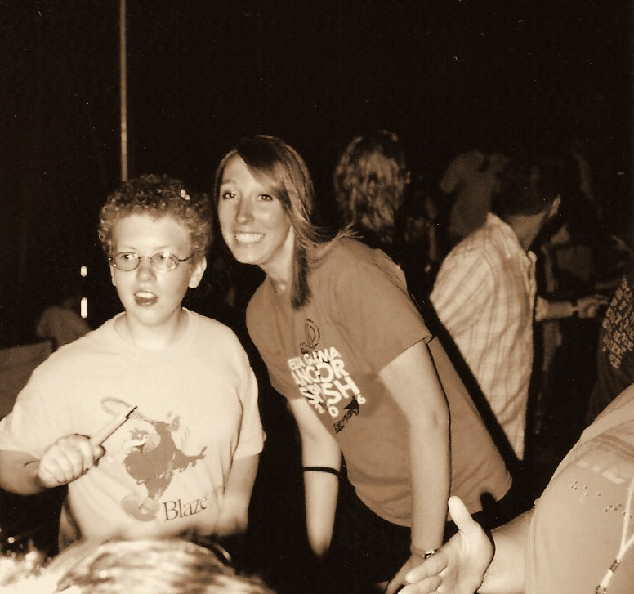
Throwback 31: 2007, ENVISION PROGRAMS
2007
ENVISION PROGRAMS
ENVISION THE FUTURE · HONOR THE LEGACY
Notes:
Year basis: Heather’s Camp 2007, confirmed by Laura. Source photo: scan0004_01b.jpg. Photos already carry the sepia treatment; to swap one, right-click it > Change Picture.

Slide 40
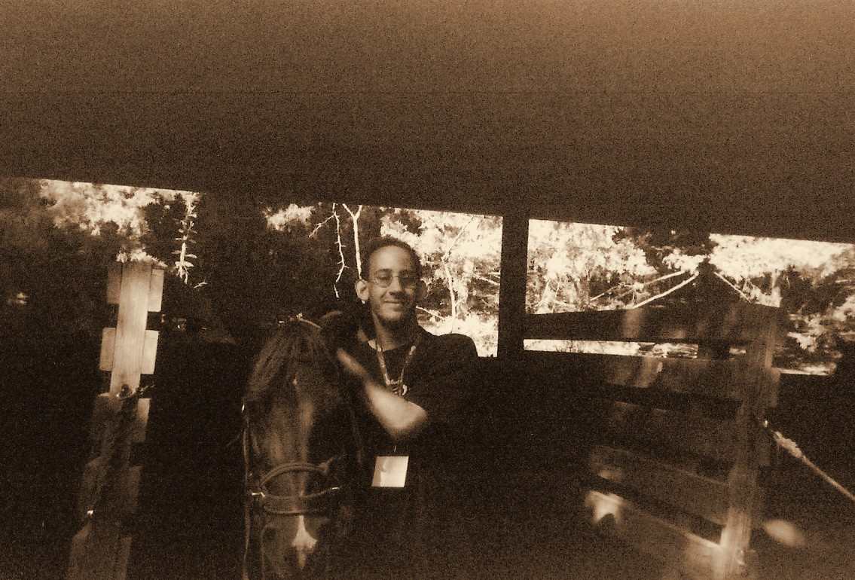
Throwback 32: 2007, ENVISION ANNUAL PROGRAMS
2007
ENVISION ANNUAL PROGRAMS
ENVISION THE FUTURE · HONOR THE LEGACY
Notes:
Year basis: Heather’s Camp 2007, confirmed by Laura. Source photo: scan0014_01b.jpg. Photos already carry the sepia treatment; to swap one, right-click it > Change Picture.

Slide 41
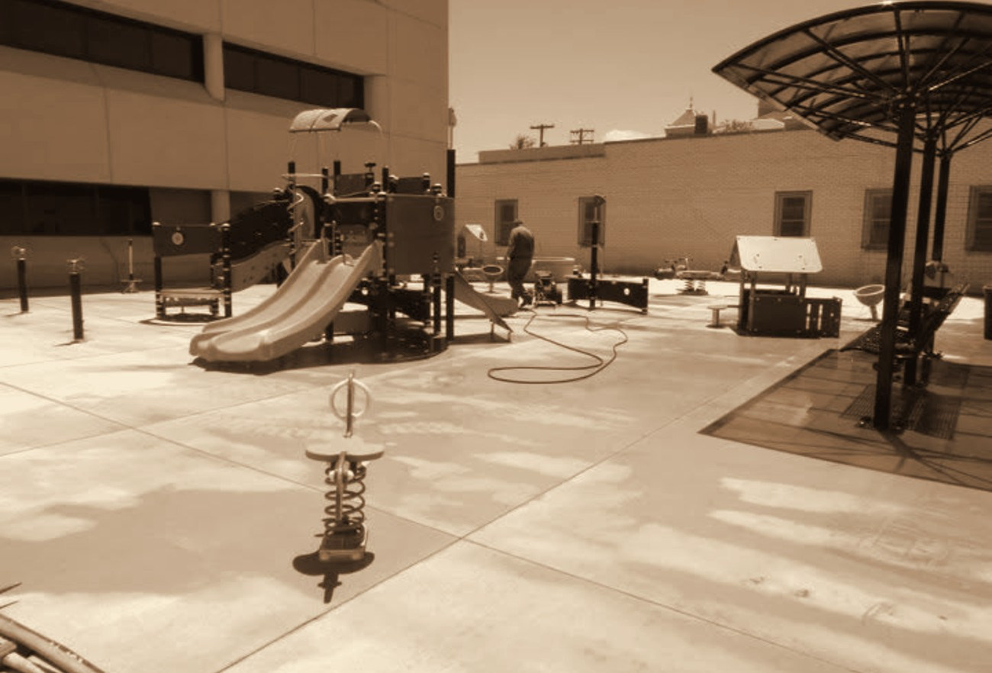
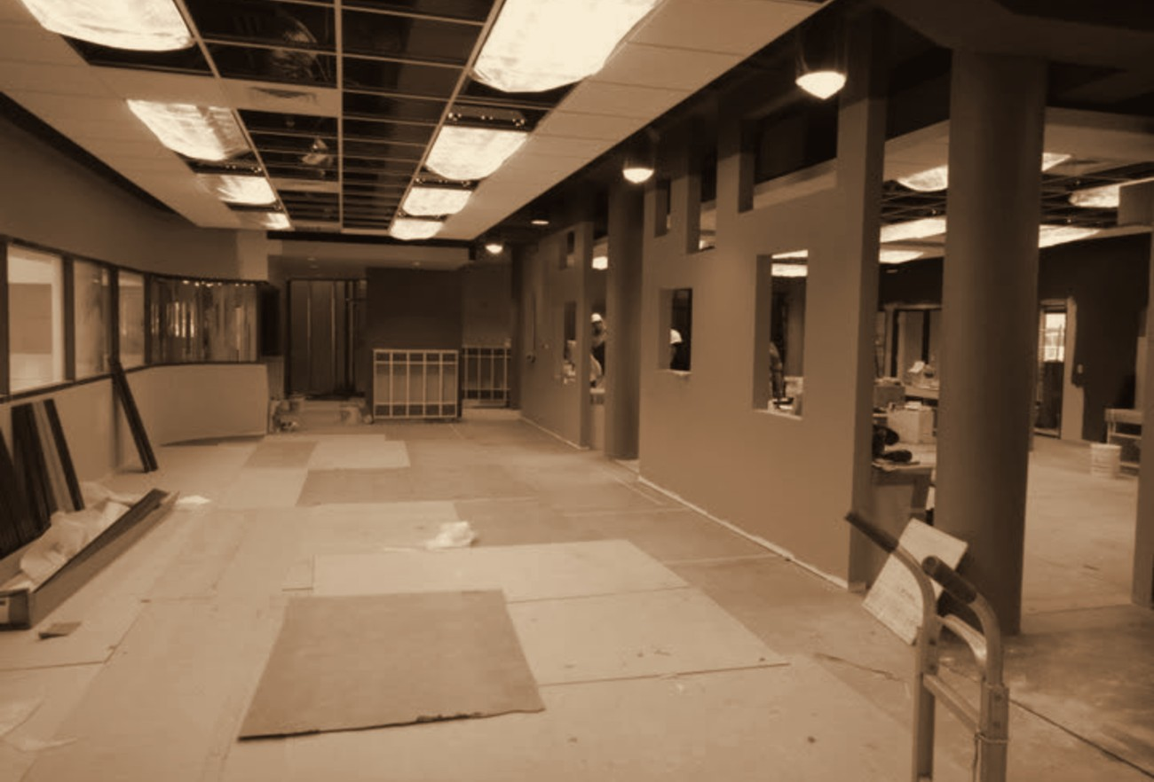
Throwback 33: 2010, BUILDING ENVISION CHILD DEVELOPMENT CENTER
2010
BUILDING ENVISION CHILD DEVELOPMENT CENTER
ENVISION THE FUTURE · HONOR THE LEGACY
Notes:
Year basis: Facebook posts dated July 9, 2010. Source photos: playground_2010.png, indoor_play_2010.png. Photos already carry the sepia treatment; to swap one, right-click it > Change Picture.

Slide 42
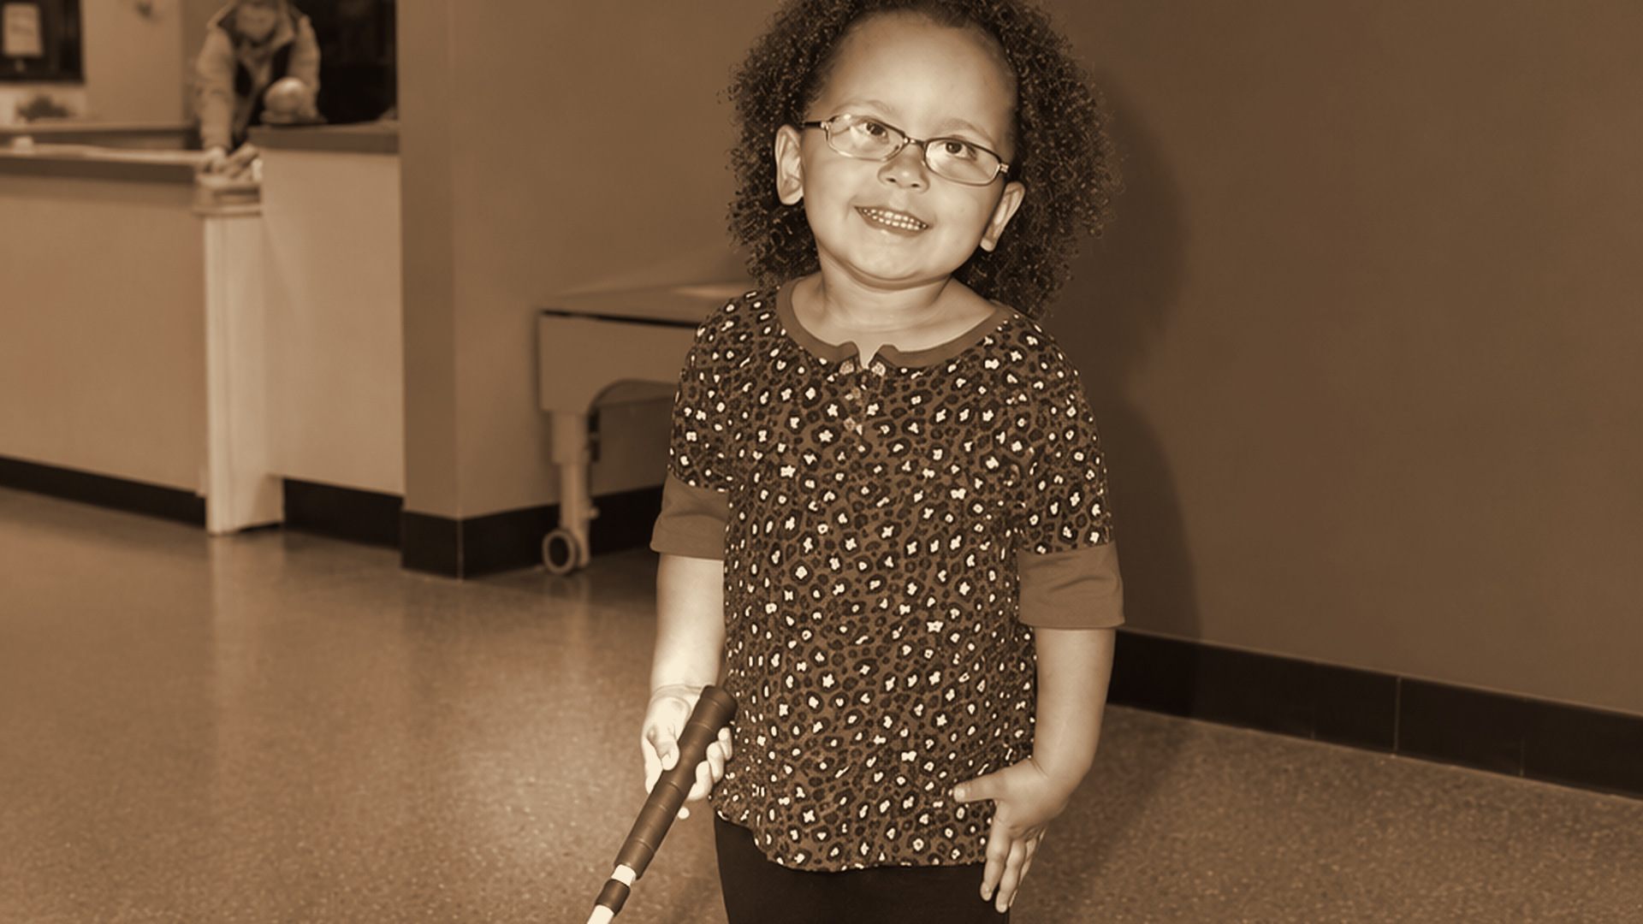
Throwback 34: 2014, ENVISION CHILD DEVELOPMENT CENTER WICHITA
2014
ENVISION CHILD DEVELOPMENT CENTER WICHITA
ENVISION THE FUTURE · HONOR THE LEGACY
Notes:
Year basis: Facebook post dated May 16, 2014. Source photo: ChatGPT_Image_Sep_18__2026_at_07_19_06_PM.png, the enlarged color version Laura supplied of girl_cane_2014.png; cropped to 16:9 and given the sepia treatment. Replaces the earlier two-portrait version of this slide.

Slide 43
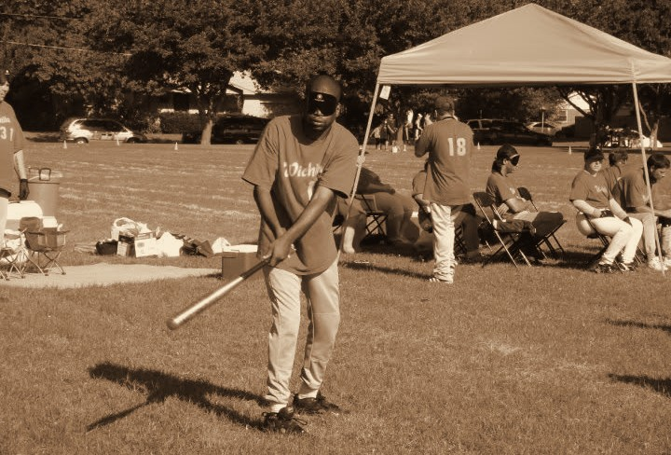
Throwback 35: 2010s, ENVISION BEEP BASEBALL
2010s
ENVISION BEEP BASEBALL
ENVISION THE FUTURE · HONOR THE LEGACY
Notes:
Year basis: decade is an estimate; confirm. Source photo: 505086650_24180749884856605_1969040299231642078_n.jpg. Photos already carry the sepia treatment; to swap one, right-click it > Change Picture.

Slide 44
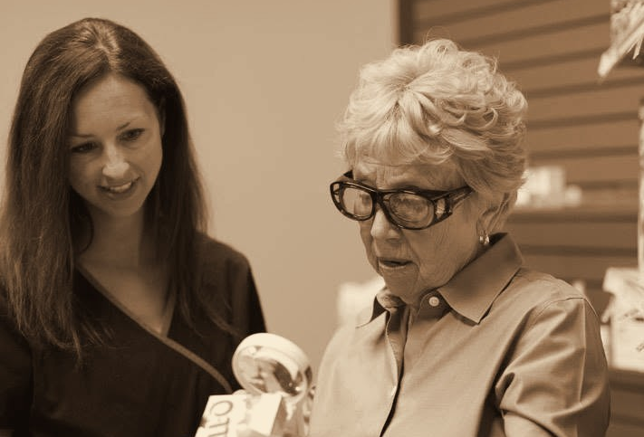
Throwback 36: 2010s, LOW VISION CLINIC REHABILITATION PROGRAMS
2010s
LOW VISION CLINIC REHABILITATION PROGRAMS
ENVISION THE FUTURE · HONOR THE LEGACY
Notes:
Year basis: decade is an estimate; program name not confirmed. Source photo: 514356143_24365277619737163_4572300578063408220_n.jpg. Photos already carry the sepia treatment; to swap one, right-click it > Change Picture.

Slide 45
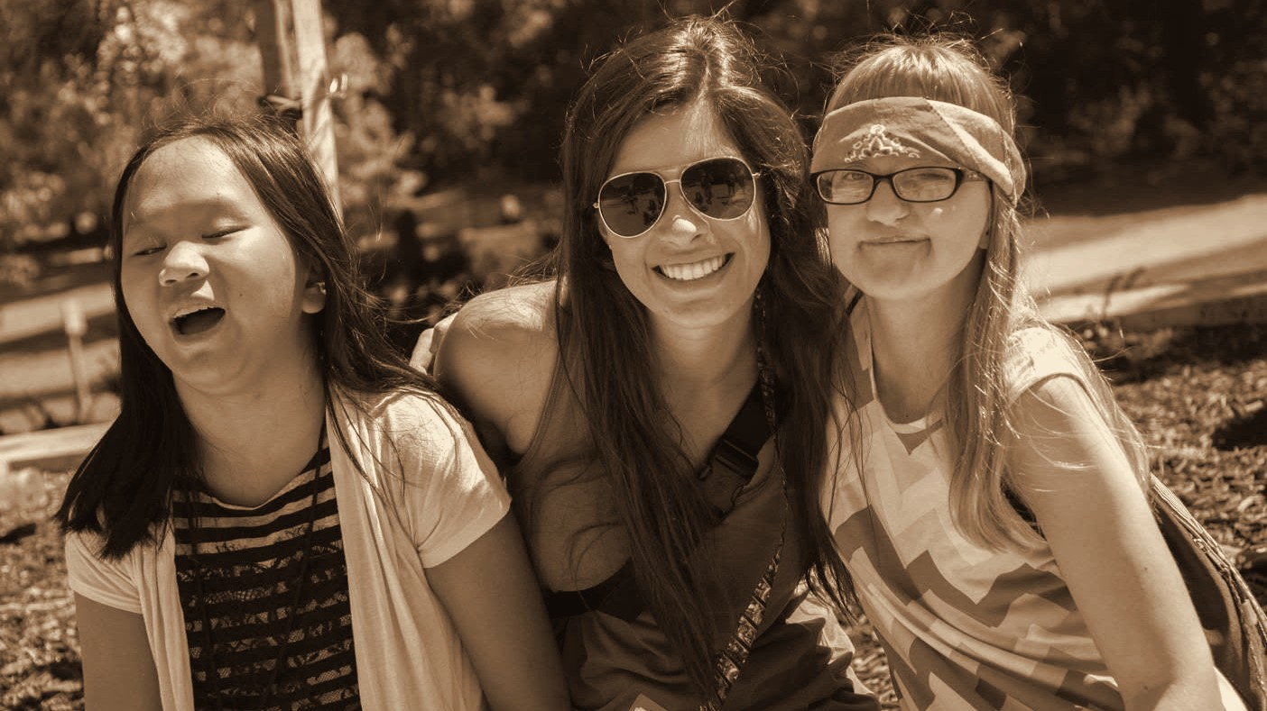
Throwback 37: 2015, DELTA GAMMA VOLUNTEER WITH CAMPERS
2015
DELTA GAMMA VOLUNTEER WITH CAMPERS
ENVISION THE FUTURE · HONOR THE LEGACY
Notes:
Year basis: Facebook post dated July 31, 2015; camp name not confirmed. Source photo: 515508522_24372597575671834_6507375247130789716_n.jpg. Photos already carry the sepia treatment; to swap one, right-click it > Change Picture. The dark scrim over the bottom of the photo is a separate object on this slide; duplicate this slide rather than inserting a fresh one so it comes along.

Slide 46
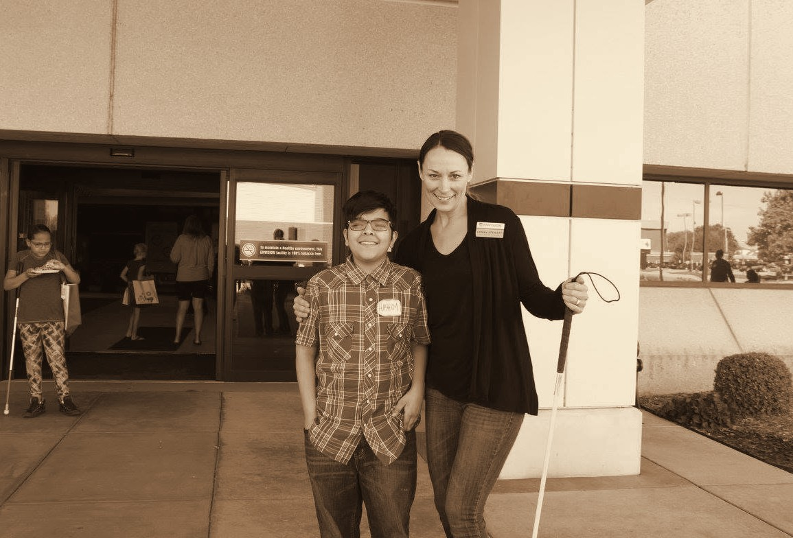
Throwback 38: 2015, ENVISION ARTS YOUTH PROGRAM PARTICIPANT
2015
ENVISION ARTS YOUTH PROGRAM PARTICIPANT
ENVISION THE FUTURE · HONOR THE LEGACY
Notes:
Year basis: Facebook post dated October 13, 2016; Laura confirms the photos are from 2015; program name not confirmed. Source photo: 515264128_24392120943719497_1144878044891021107_n.jpg. Photos already carry the sepia treatment; to swap one, right-click it > Change Picture.

Slide 47
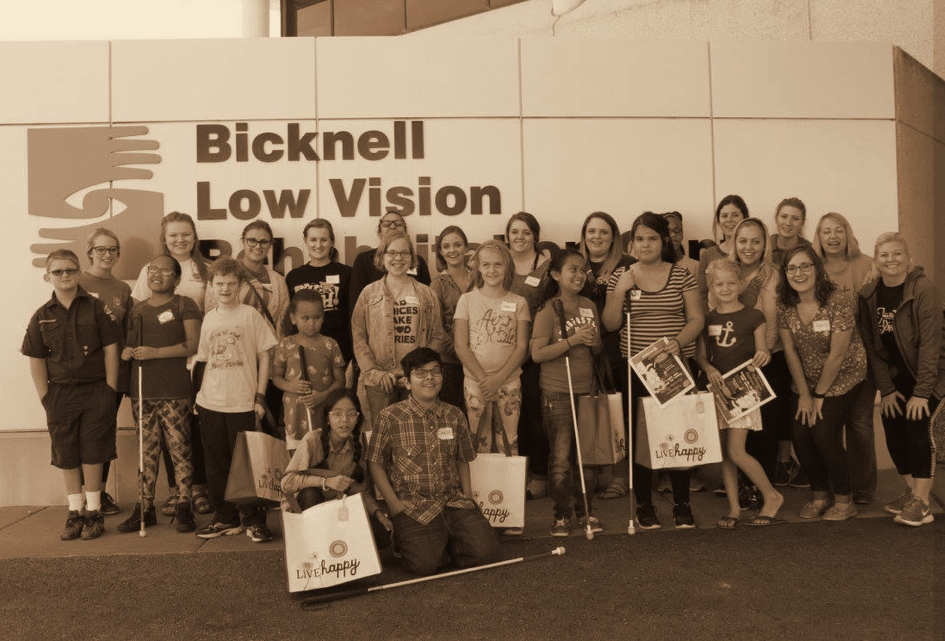
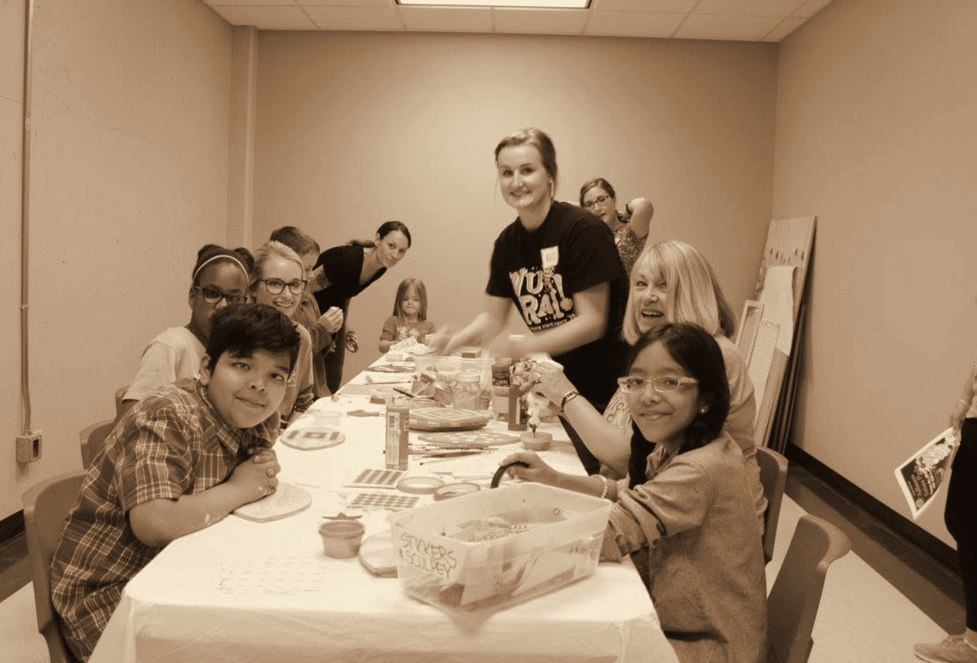
Throwback 39: 2015, ENVISION ARTS YOUTH PROGRAM PARTICIPANTS
2015
ENVISION ARTS YOUTH PROGRAM PARTICIPANTS
ENVISION THE FUTURE · HONOR THE LEGACY
Notes:
Year basis: Facebook post dated October 13, 2016; Laura confirms the photos are from 2015; program name not confirmed. Source photos: bicknell_group.png, art_table.png. Photos already carry the sepia treatment; to swap one, right-click it > Change Picture.

Slide 48
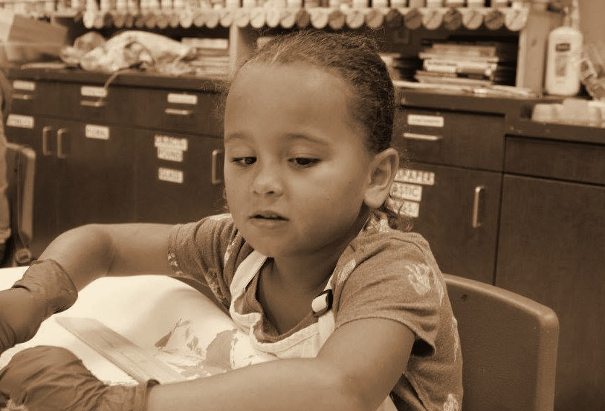
Throwback 40: 2015, ENVISION ARTS YOUTH PROGRAM
2015
ENVISION ARTS YOUTH PROGRAM
ENVISION THE FUTURE · HONOR THE LEGACY
Notes:
Year basis: Facebook post dated October 13, 2016; Laura confirms the photos are from 2015; Adah per Laura, program name not confirmed. Source photo: 515496848_24392121030386155_4959498615936162370_n.jpg. Photos already carry the sepia treatment; to swap one, right-click it > Change Picture.

Slide 49


Throwback 41: 2010s, ENVISION EDUCATION YOUTH PROGRAMS
2010s
ENVISION EDUCATION YOUTH PROGRAMS
ENVISION THE FUTURE · HONOR THE LEGACY
Notes:
Year basis: decade is an estimate; confirm. Source photos: 516307629_24404475582484033_4077145122123939934_n.jpg, 514398054_24407351508863107_4640940189281080079_n.jpg. Photos already carry the sepia treatment; to swap one, right-click it > Change Picture.

Slide 50

Throwback 42: 2017, ENVISION YOUTH EDUCATION PROGRAMS
2017
ENVISION YOUTH EDUCATION PROGRAMS
ENVISION THE FUTURE · HONOR THE LEGACY
Notes:
Year basis: Facebook post dated February 27, 2017. Source photo: 515666041_24396518596613065_9163789206916333567_n.jpg. Photos already carry the sepia treatment; to swap one, right-click it > Change Picture. The dark scrim over the bottom of the photo is a separate object on this slide; duplicate this slide rather than inserting a fresh one so it comes along.

Slide 51


Throwback 43: 2018, ENVISION’S LEVEL UP, PROGRAM PARTICIPANTS
2018
ENVISION’S LEVEL UP, PROGRAM PARTICIPANTS
ENVISION THE FUTURE · HONOR THE LEGACY
Notes:
Year basis: year from Facebook upload timing; program name not confirmed. Source photos: 36679840_1977772592247652_8857339367518109696_n.jpg, 36720032_1977770692247842_8607756704823640064_n.jpg. Photos already carry the sepia treatment; to swap one, right-click it > Change Picture.

Slide 52

Throwback 44: 2018, ENVISION ARTS YOUTH PROGRAM PARTICIPANTS
2018
ENVISION ARTS YOUTH PROGRAM PARTICIPANTS
ENVISION THE FUTURE · HONOR THE LEGACY
Notes:
Year basis: year from Facebook upload timing; program name not confirmed. Source photo: 39468117_2048172925207618_3198537865604628480_n.jpg. Photos already carry the sepia treatment; to swap one, right-click it > Change Picture.

Slide 53

Throwback 45: 2019, ENVISION GOLF CLINIC, PROGRAM PARTICIPANT
2019
ENVISION GOLF CLINIC, PROGRAM PARTICIPANT
ENVISION THE FUTURE · HONOR THE LEGACY
Notes:
Year basis: year from Facebook upload timing; event name not confirmed. Source photo: 56781124_2401507159874191_4435377701120901120_n.jpg. Photos already carry the sepia treatment; to swap one, right-click it > Change Picture.

Slide 54

Throwback 46: 2019, ENVISION PROGRAM PARTICIPANTS
2019
ENVISION PROGRAM PARTICIPANTS
ENVISION THE FUTURE · HONOR THE LEGACY
Notes:
Year basis: photo and names from Laura; event not named. Source photo: 583287134_122281118330027018_6014777694266862243_n.jpg. Photos already carry the sepia treatment; to swap one, right-click it > Change Picture.

Slide 55

Throwback 47: 2020, ENVISION’S LEVEL UP, PROGRAM PARTICIPANTS
2020
ENVISION’S LEVEL UP, PROGRAM PARTICIPANTS
ENVISION THE FUTURE · HONOR THE LEGACY
Notes:
Year basis: Facebook post dated December 4, 2020; names per Laura. Source photo: weseeclearly.png. Photos already carry the sepia treatment; to swap one, right-click it > Change Picture.

Slide 56


Throwback 48: 2020, ENVISION MONTHLY PROGRAMS
2020
ENVISION MONTHLY PROGRAMS
ENVISION THE FUTURE · HONOR THE LEGACY
Notes:
Year basis: group photo uploaded February 2020; the close-up was reposted March 30, 2021; confirm. Source photos: 87270349_3040969335927967_4814775488343965696_n.jpg, bowling_kid.png. Photos already carry the sepia treatment; to swap one, right-click it > Change Picture.

Slide 57

Throwback 49: 2021, ENVISION BEEP BASEBALL
2021
ENVISION BEEP BASEBALL
ENVISION THE FUTURE · HONOR THE LEGACY
Notes:
Year basis: Facebook post dated July 30, 2021. Source photo: falcons2021.png. Photos already carry the sepia treatment; to swap one, right-click it > Change Picture. The dark scrim over the bottom of the photo is a separate object on this slide; duplicate this slide rather than inserting a fresh one so it comes along.

Slide 58

Throwback 50: 2021, ENVISION PROGRAM PARTICIPANTS
2021
ENVISION PROGRAM PARTICIPANTS
ENVISION THE FUTURE · HONOR THE LEGACY
Notes:
Year basis: photo and names from Laura; event not named. Source photo: 467812732_122210648582027018_7527710767466559229_n.jpg. Photos already carry the sepia treatment; to swap one, right-click it > Change Picture.

Slide 59

Throwback 51: 2022, ENVISION’S LEVEL UP, PROGRAM PARTICIPANT
2022
ENVISION’S LEVEL UP, PROGRAM PARTICIPANT
ENVISION THE FUTURE · HONOR THE LEGACY
Notes:
Year basis: Facebook post dated July 21, 2022; Adah per Laura. Source photo: adah_2022.png. Photos already carry the sepia treatment; to swap one, right-click it > Change Picture.

Slide 60

Throwback 52: 2022, ENVISION’S LEVEL UP, PROGRAM PARTICIPANT
2022
ENVISION’S LEVEL UP, PROGRAM PARTICIPANT
ENVISION THE FUTURE · HONOR THE LEGACY
Notes:
Year basis: Facebook post dated July 19, 2022; Hashim per Laura. Source photo: hashim_2022.png. Photos already carry the sepia treatment; to swap one, right-click it > Change Picture. The dark scrim over the bottom of the photo is a separate object on this slide; duplicate this slide rather than inserting a fresh one so it comes along.

Slide 61

Throwback 53: 2022, ENVISION FOREVISION GOLF TOURNAMENT
2022
ENVISION FOREVISION GOLF TOURNAMENT
ENVISION THE FUTURE · HONOR THE LEGACY
Notes:
Year basis: phone camera timestamp; event name not confirmed. Source photo: 20220829_195341.jpg. Photos already carry the sepia treatment; to swap one, right-click it > Change Picture.

Slide 62

Throwback 59: 2023, ENVISION ADULT RECREATIONAL PROGRAMS
2023
ENVISION ADULT RECREATIONAL PROGRAMS
ENVISION THE FUTURE · HONOR THE LEGACY
Notes:
Year basis: 2023 per Laura, Sept 21, 2026; label from Laura. Source photo: steven_at_track.jpg, cropped to 16:9 and given the sepia treatment.

Slide 63

Throwback 54: 2024, ENVISION’S LEVEL UP, PROGRAM PARTICIPANT
2024
ENVISION’S LEVEL UP, PROGRAM PARTICIPANT
ENVISION THE FUTURE · HONOR THE LEGACY
Notes:
Year basis: Facebook post dated June 27, 2024; Kennick per Laura. Source photo: kennick_2024.png. Photos already carry the sepia treatment; to swap one, right-click it > Change Picture.

Slide 64


Throwback 55: 2024, HEATHER’S CAMP
AUBREE · FEATURED GUEST
2024
2026
HEATHER’S CAMP
LEVEL UP
ENVISION THE FUTURE · HONOR THE LEGACY
Notes:
Year basis: then: Facebook post dated August 1, 2024 (Heather’s Camp); now: Level Up 2026 photo from Laura. Source photos: 482091992_1036613011835564_1782698059698200373_n.jpg, Aubree_Calvert.jpg. Photos already carry the sepia treatment; to swap one, right-click it > Change Picture.

Slide 65


Throwback 56: 2011, ECDC WICHITA
ADAH · FEATURED GUEST
2011
2026
ECDC WICHITA
HIGH SCHOOL GRADUATE
ENVISION THE FUTURE · HONOR THE LEGACY
Notes:
Year basis: then: Facebook post dated December 29, 2011; now: high school graduation 2026 per Laura. Source photos: adah_2011.png, 705968911_122313865370027018_2361427042434269514_n.jpg. Photos already carry the sepia treatment; to swap one, right-click it > Change Picture.

Slide 66


Throwback 57: 2015, ENVISION ARTS YOUTH PROGRAM
HASHIM · FEATURED GUEST
2015
2026
ENVISION ARTS YOUTH PROGRAM
WICHITA STATE GRADUATE
ENVISION THE FUTURE · HONOR THE LEGACY
Notes:
Year basis: then: Facebook post dated October 13, 2016; Laura confirms the photos are from 2015; now: Wichita State graduation 2026. Source photos: boy_painting.png, hashim_grad_2026.jpg. Photos already carry the sepia treatment; to swap one, right-click it > Change Picture.

Slide 67

Throwback 58: 2000s, HEATHER’S CAMP
STEVEN · FEATURED GUEST
2000s
2026
HEATHER’S CAMP
ENVISION THE FUTURE · HONOR THE LEGACY
Notes:
Year basis: then: Laura, Sept 21, 2026: early 2000s at Heather’s Camp (an estimate, not a date from records). Source photo: 20240102_175857465_iOS.jpg, a phone photo of a print, cropped to the print and given the sepia treatment. NOW SIDE STILL TO COME: photo and label. This slide is hidden so the loop skips it; when the now photo is in, right-click the slide in the thumbnail pane > Unhide Slide.

Slide 68
Thank you to our sponsors
THANK YOU TO OUR SPONSORS
PRESENTING SPONSOR
CORPORATE SPONSORS
PLATINUM LEVEL
DIAMOND LEVEL
GOLD LEVEL
SILVER LEVEL

