Slide 1
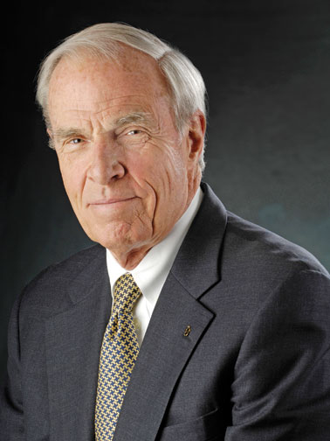
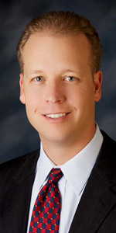
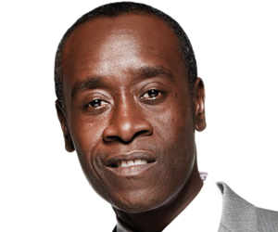
Don Cheadle
Actor
Alumnus of East High School
Bruce Benson
President of CU
Stranger

