Slide 1
Handeling FASTQ files
Laura Staal – p268859
https://github.com/LauraStaal/PBFB2018_Project

Slide 2
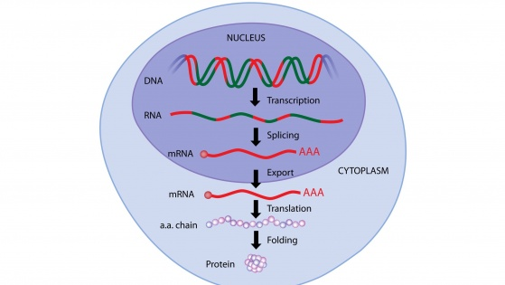
Introduction
RNA sequence data

Slide 3
FASTQfile
@HWI-ST0310R:359:C0TGDACXX:3:1101:2832:2200 1:N:0:GCCAAT
GGTGTGGAAGCGAAGGAAGTCGGCCAACTTGGCACGGTTGTTGCTGTCCTCGTGCACACCCAG+
CCBFFFFFHHGHHIJJJJJGHJJIIJJJJJJJJIIJJFHIJJJJI>J/JJJH@HFFFFEDDDDDDDDDDDACDDDDD

Slide 4
Basic info
Count the number of sequences
grep -c "@"
cat *.fastq | echo $((`wc -l`/4))
Create a file with only a few sequences
head -50 file.fastq > test.fastq
What kind of file am I working with?

Slide 5
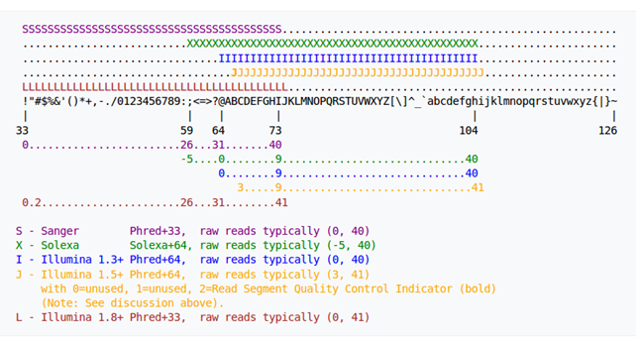
Type of base quality scores

Slide 6
Basic info
Count the number of sequences
cat *.fastq | echo $((`wc -l`/4))
Create a file with only a few sequences
head -50 file.fastq > test.fastq
What kind of file am I working with?
grep "J" file.fastq

Slide 7
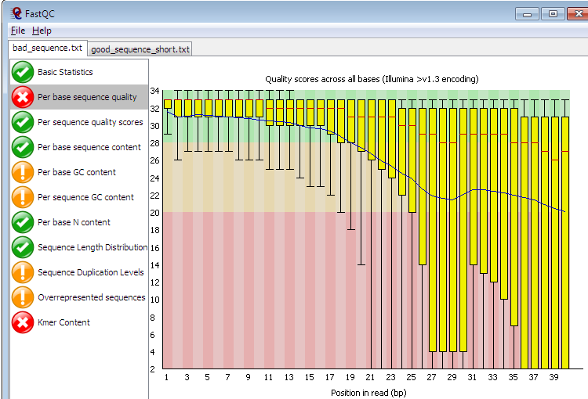
FastQC

Slide 8
Shell script
#!/bin/bash
fastqc *.fastq
unzip \*.zip #the output files of fastqc are unzipped
paste */sum*.txt > allsummaries.txt
cut -f 1,4,7,10,13,16,19,22,25,28,31,34,37,40,43,46,49,51,54 Allsummaries.txt> passandfail.txt
cut -f 2 allsummaries.txt >> Column1.txt
paste Column1.txt passandfail.txt > table.txt #this combines the criteria and pass and fail columns.
head -1 allsummaries.txt | cut -f 1,3,6,9,12,15,18,21,24,27,30,33,36,39,42,45,48,51,54,57 > header.txt
cat header.txt table.txt > newtable.txt

Slide 9
Shell script
#!/bin/bash
fastqc *.fastq
unzip \*.zip #the output files of fastqc are unzipped
paste */sum*.txt > allsummaries.txt
cut -f 1,4,7,10,13,16,19,22,25,28,31,34,37,40,43,46,49,51,54 Allsummaries.txt> passandfail.txt
cut -f 2 allsummaries.txt >> Column1.txt
paste Column1.txt passandfail.txt > table.txt #this combines the criteria and pass and fail columns.
head -1 allsummaries.txt | cut -f 1,3,6,9,12,15,18,21,24,27,30,33,36,39,42,45,48,51,54,57 > header.txt
cat header.txt table.txt > newtable.txt

Slide 10
Output summary
PASS Basic Statistics Dm_58_GCCAAT_L003_R1_001.fastq
PASS Per base sequence quality Dm_58_GCCAAT_L003_R1_001.fastq
WARN Per tile sequence quality Dm_58_GCCAAT_L003_R1_001.fastq
PASS Per sequence quality scores Dm_58_GCCAAT_L003_R1_001.fastq
FAIL Per base sequence content Dm_58_GCCAAT_L003_R1_001.fastq
FAIL Per sequence GC content Dm_58_GCCAAT_L003_R1_001.fastq
PASS Per base N content Dm_58_GCCAAT_L003_R1_001.fastq
PASS Sequence Length Distribution Dm_58_GCCAAT_L003_R1_001.fastq
FAIL Sequence Duplication Levels Dm_58_GCCAAT_L003_R1_001.fastq
WARN Overrepresented sequences Dm_58_GCCAAT_L003_R1_001.fastq
PASS Adapter Content Dm_58_GCCAAT_L003_R1_001.fastq
FAIL Kmer Content Dm_58_GCCAAT_L003_R1_001.fastq

Slide 11
Shell script
#!/bin/bash
fastqc *.fastq
unzip \*.zip #the output files of fastqc are unzipped
paste */sum*.txt > allsummaries.txt
cut -f 1,4,7,10,13,16,19,22,25,28,31,34,37,40,43,46,49,51,54 Allsummaries.txt> passandfail.txt
cut -f 2 allsummaries.txt >> Column1.txt
paste Column1.txt passandfail.txt > table.txt #this combines the criteria and pass and fail columns.
head -1 allsummaries.txt | cut -f 1,3,6,9,12,15,18,21,24,27,30,33,36,39,42,45,48,51,54,57 > header.txt
cat header.txt table.txt > newtable.txt

Slide 12
Table
Basic Statistics PASS PASS
Per base sequence quality PASS PASS
Per tile sequence quality WARN WARN
Per sequence quality scores PASS PASS
Per base sequence content FAIL FAIL
Per sequence GC content FAIL FAIL
Per base N content PASS PASS
Sequence Length Distribution PASS PASS
Sequence Duplication Levels FAIL FAIL
Overrepresented sequences WARN WARN
Adapter Content PASS PASS
Kmer Content FAIL FAIL

Slide 13
Shell script
#!/bin/bash
fastqc *.fastq
unzip \*.zip #the output files of fastqc are unzipped
paste */sum*.txt > allsummaries.txt
cut -f 1,4,7,10,13,16,19,22,25,28,31,34,37,40,43,46,49,51,54 Allsummaries.txt> passandfail.txt
cut -f 2 allsummaries.txt >> Column1.txt
paste Column1.txt passandfail.txt > table.txt #this combines the criteria and pass and fail columns.
head -1 allsummaries.txt | cut -f 1,3,6,9,12,15,18,21,24,27,30,33,36,39,42,45,48,51,54,57 > header.txt
cat header.txt table.txt > newtable.txt

Slide 14
Dm_58_GCCAAT_L003_R1_001.fastq Dm_58_GCCAAT_L003_R1_001.fastq
Basic Statistics PASS PASS
Per base sequence quality PASS PASS
Per tile sequence quality WARN WARN
Per sequence quality scores PASS PASS
Per base sequence content FAIL FAIL
Per sequence GC content FAIL FAIL
Per base N content PASS PASS
Sequence Length Distribution PASS PASS
Sequence Duplication Levels FAIL FAIL
Overrepresented sequences WARN WARN
Adapter Content PASS PASS
Kmer Content FAIL FAIL

Slide 15
Dm58_R1 Dm_58_R2
Basic statistics PASS PASS
Per base sequence quality PASS PASS
Per tile sequence quality WARN WARN
Per sequence quality scores PASS PASS
Per base sequence content FAIL FAIL
Per sequence GC content FAIL FAIL
Per base N content PASS FAIL
Sequence Length Distribution PASS PASS
Sequence Duplication Levels FAIL FAIL
Overrepresented sequences WARN WARN
Adapter Content PASS PASS
Kmer Content FAIL FAIL

Slide 16
Conclusion
It worked

Slide 17
Next?
Pipelines
Output table more easy to read
Visually attractive

