Slide 1
<AgencyName> SME Training: Phone Interview
<insert date>

Slide 2
<Delete THIS SLIDE BEFORE PRESENTING>
PREPARE THE FOLLOWING AHEAD OF TIME – 1 PRINTED COPY OF EACH PER ATTENDEE
Phone interview rating template customized with your questions and proficiency levels
Optional: copies of SME Background Info Sheet if they haven’t all submitted them already

Slide 3
Agenda for this session
Review interview questions
Write transcripts and determine proficiency
See a demo of a structured phone interview
Notes:
Most of the time in this training will be spent reviewing the phone interview rating template which contains the questions you created during Job Analysis.
SMEs will also learn how to write a transcript of the phone interviews and we will practice how to conduct the interviews.

Slide 4
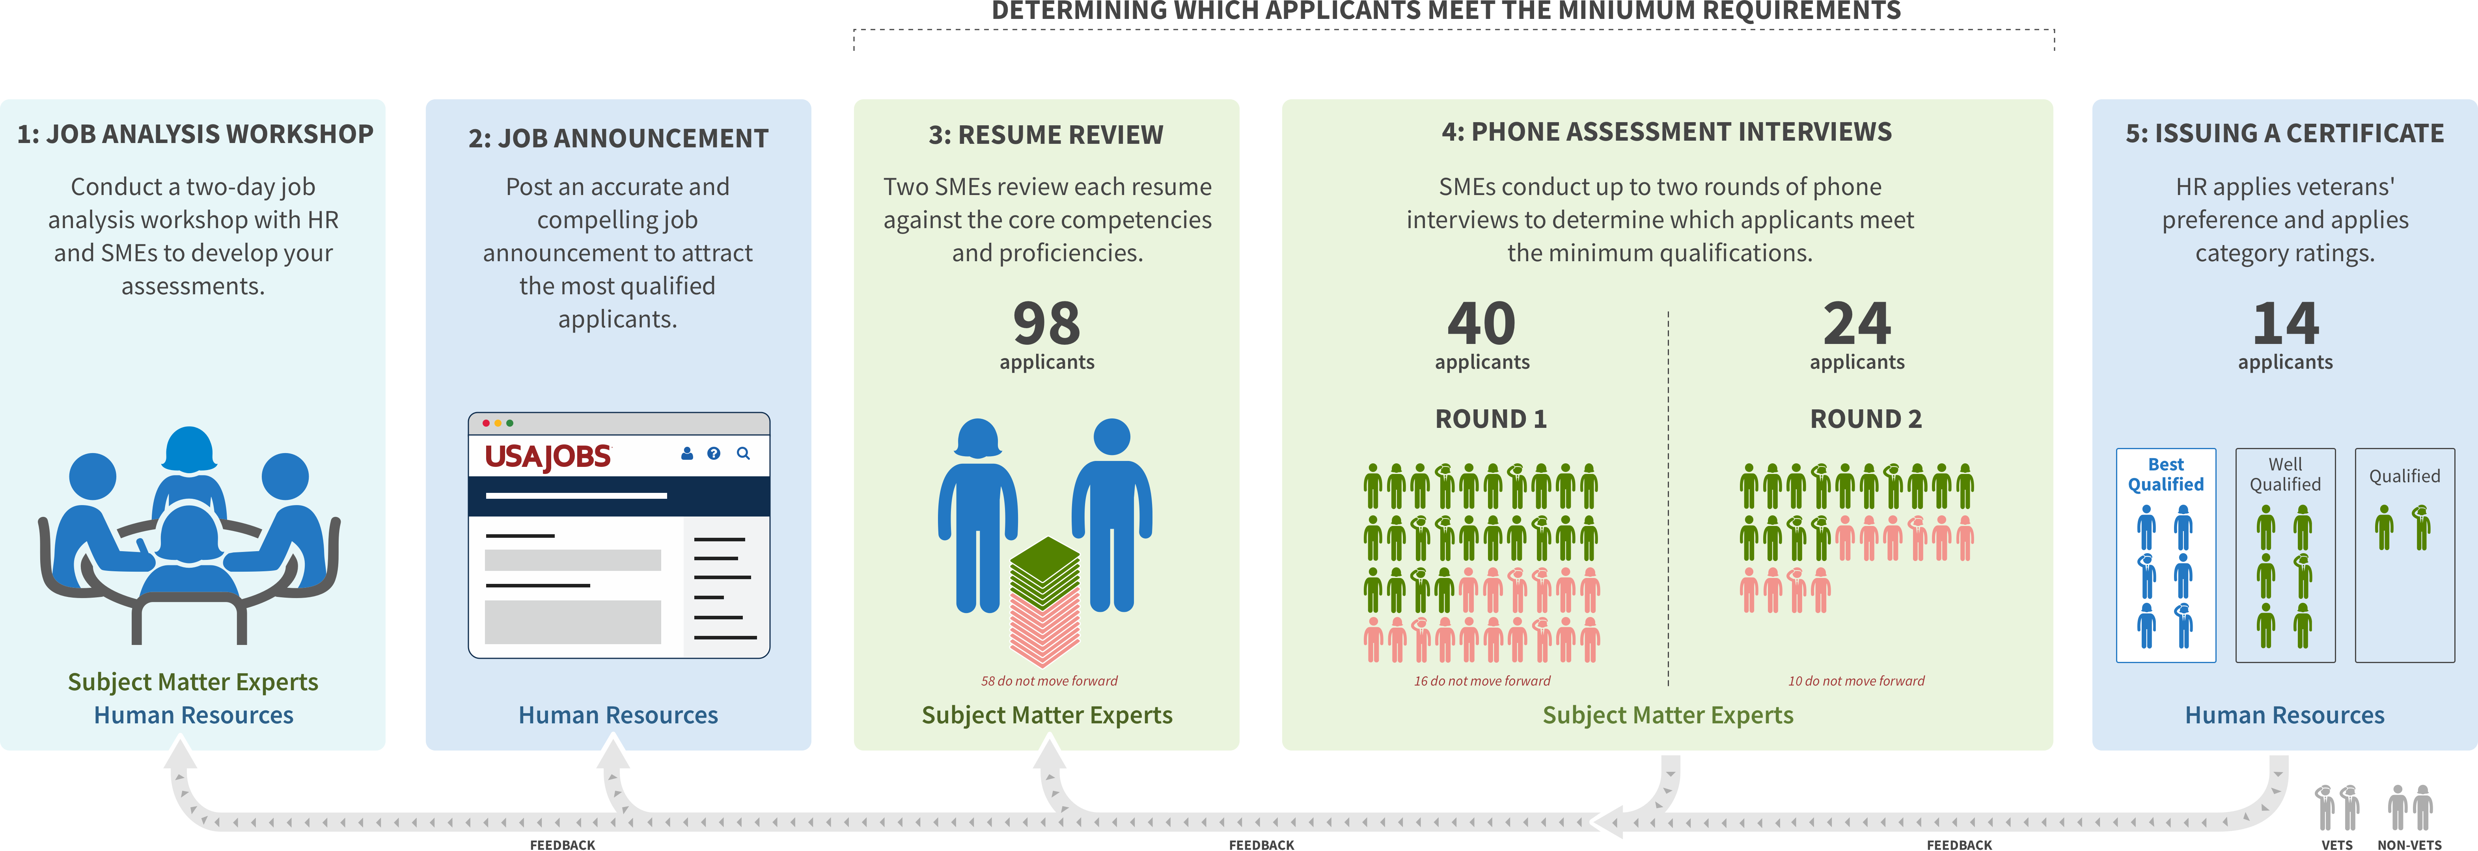
Multi-Hurdle SME Assessment Process
WE ARE HERE
Notes:
Reminder of the overall hiring process and where we are now
Job analysis workshop and Job Announcement already done. Resume Review stage is complete.
We are now preparing for Phone Interview (1 or 2) stage
One SME will conduct a phone interview for every applicant phase 1. Not every applicant will have a second phone interview.

Slide 5
Timeline and Hours Required – {NUMBER} interviews
{NUMBER} SMEs will be doing {NUMBER} interviews each between {DATES}
Interviews will be scheduled for up to 1 hour.
Email docs to HR by end of day of that interview.
Make sure you block off the 4 timeslots/day you provided to schedulers.
Schedule 30 minutes per interview for yourself to set up/fill out/submit feedback that same day.
Notes:
Replace variables on this slide with your details.
Details on this slide may change depending on request from HR.

Slide 6
This is an examination. You are testing their knowledge of the pre-defined competencies.

Slide 7
Prohibited Personnel Practices 5 U.S.C. 2302(b)
Giving an unauthorized preference or advantage to improve or injure the prospects of any particular person for employment (also, don’t promise anyone they’re going to get this job--you don’t know that!)
Engaging in nepotism
Discriminating (including discrimination based on marital status and political affiliation)
Considering employment based on factors other than personal knowledge or records of job-related abilities
Influencing any person to withdraw from job competition
Notes:
Reminder of relevant legal requirements around personnel practices

Slide 8
Walk through the phone interview ratings template
Notes:
This should take about an hour to review the template in-depth.

Slide 9
The questions you ask have been defined in advance, but you can repeat and clarify questions if needed.

Slide 10
Review interview questions
Read questions out loud as a team
Clarify questions if needed
Notes:
Reference the competency/target proficiency after reviewing *each* question.
Talking point: cannot deviate from probe questions to be fair to all applicants.

Slide 11
Transcribing responses

Slide 12
Writing a Transcript
Transcript should be detailed enough so that if one SME were to review another SME's assessment, they would arrive at the same proficiency level.
Transcript does not have to be a verbatim transcription, but do it to the best of your ability.
Your transcript and proficiency determination should be aligned.

Slide 13
Jot down your reaction (optional)
“Great example – shows expertise”
“Right terms but is not making sense”
“Response lacked sufficient detail to meet proficiency level”

Slide 14
Transcript Example 1
Question (Communication and Collaboration):
Tell me about a time you worked with a team to solve a technical issue? How was the problem identified and how did your group communicate your findings?
Transcript:
Able to give a detailed description of an issue and its resolution
Describes that they played an active role in finding and mitigating the risk (vs watching their team find and solve the problem)
Candidate identified size and scope of risk and how it would affect users
Candidate mentioned informing stakeholders
Notes:
This is not a good example. Reasons:
- Transcription with details? no -- the notes are high-level and overly summarized.
- Analysis at the end? yes
- Can another SME make a determination? no, not without details

Slide 15
Transcript Example 2
Question (Active Directory):
How does DNS resolution work?
Transcript:
User makes a request to a URL
DNS caches along the way
Local machine, network, and ISP have them
There are DNS lookup providers out there
Essentially what they are doing is mapping the domain name that you put in with the correct IP address that you're trying to go to.
Impression: Covers basics, but lacks details
Notes:
This is a good example. Reasons:
Transcription with details? Yes, this is a transcription
Analysis: yes. Short but separate
Can another SME make a determination? yes, because details are provided

Slide 16
Transcript Example 3
Question:
How is the cloud secure? How would you get data on the cloud securely?
Transcript:
Im speaking from amazon, because this is what I'm most familiar with. Security is a first class citizen. There are always VPCs or virtual subnets that are closed by default. You have to provision security groups and network ACLs to make them accessible from outside the VPC.
Storage systems can be encrypted via private key that you provide. You can encrypt at rest, or as you're writing to the storage systems.
Amazon load balancers designed to resist DDoS attacks, several ways to get things onto the cloud securely.
There are secure gateways that let you create T1 or T3 connections, a direct encrypted pipe, allows you to secure anything (machine on prem in government office, EBS storage). Encrypted E2E.
Amazon stuff can be certified -- I forget the organization that lets you certify as secure (health or PII).
Notes:
This is a good example. Reasons:
Transcription with details? Yes, this is a transcription
Analysis: yes. Short but separate
Can another SME make a determination? yes, because details are provided

Slide 17
Proficiency determination

Slide 18
Reminder: Reference the competency and proficiency definitions.
Notes:
Refer back to your interview transcript to determine proficiency level for each competency.

Slide 19
Writing your analysis

Slide 20
Example Interview Analysis
“The applicant has done full-stack work ranging from cloud to front-end. Their implementation of agile, both at previous orgs and in their own startup (albeit a single-person org), shows they knows how to prioritize user needs during development. Seems like well-rounded individual contributor and a strong communicator.
Minor concern: Knowledge on networking is on the weaker end.”

Slide 21
Email your docs to: <insert HR Specialist(s) email>
Notes:
Insert HR specialist(s) email addresses here

Slide 22
Problems with the interviews
If the applicant is a no-show, try calling again (give them 10 minutes).
If the interview doesn’t occur, in the Interview Analysis box, write “No-show” and submit the template to HR and the schedulers and make a note in the email body that it’s a no-show.
If the applicant is late or verbose, you must make the determination in the allotted time.
If you have a technical issue and you start late, and you can’t get to every question, go over the allotted time or work with the schedulers to make up the time difference.

Slide 23
QUESTION 1 – WHAT DO YOU DO?
The applicant was outstanding and it is now the end of the interview. What do you say to them?
You were one of the best – you will be qualified for sure.
Thank you for your time – you should hear back from HR soon.
Notes:
Correct answer: B
Talk through the consequences of A - first of all, they may not pass the second interview, there may be veterans on top of them and the agency can’t reach them, and you can create the impression of being unfair and bias when applicants talk to each other raising flags for the inspector general.
Do NOT tell them the results - you are just one part of the process and do not know what will happen.

Slide 24
QUESTION 2 – WHAT DO YOU DO?
The applicant has a lot of questions for you about the process and the position. How much time should you take to answer them?
Take as much time as needed – we need to recruit and this is a two way street.
Leave 5 minutes at the end for questions.
Do not answer questions about the process or job – refer them to HR so every applicant has the same information. Tell them they can ask more specific questions during a final fit interview with the hiring manger.
Notes:
Correct answer: C
This is a structured interview and though you can explain what you do for a few minutes at the beginning, ask them to hold questions for HR and/or the fit interview at the end.

Slide 25
QUESTION 3 – WHAT DO YOU DO?
It is now the end of the allotted time for the interview. The applicant took a lot of time answering the first several questions that you run out of time for the last one.
Give the applicant an extra 30 minutes at the end of the hour.
Schedule a follow up call to finish later.
Use the information you collected from the other questions to see if you feel they meet the missing competencies. Next time try to manage your time better and cut the applicant off if they’re taking too long with one question.
The applicant must be unqualified because you weren’t able to ask the last question.
Notes:
Correct answer: C
They can still qualify if you can assess the final competency with the information from the other questions - you still have an hour’s worth of information. You cannot give different amounts of time to each applicant. That would invalidate all the interview results.

Slide 26
See an interview demo
Notes:
TODO: give a script to SMEs, or get a volunteer.

Slide 27
The End

