Slide 1
SME-QA Hiring Pilot Kickoff Meeting

Slide 2
In the competitive hiring process, hiring managers often receive certificates of eligibles that may lack qualified applicants to select.
Notes:
^ Summary of the problem this assessment strategy is solving

Slide 3
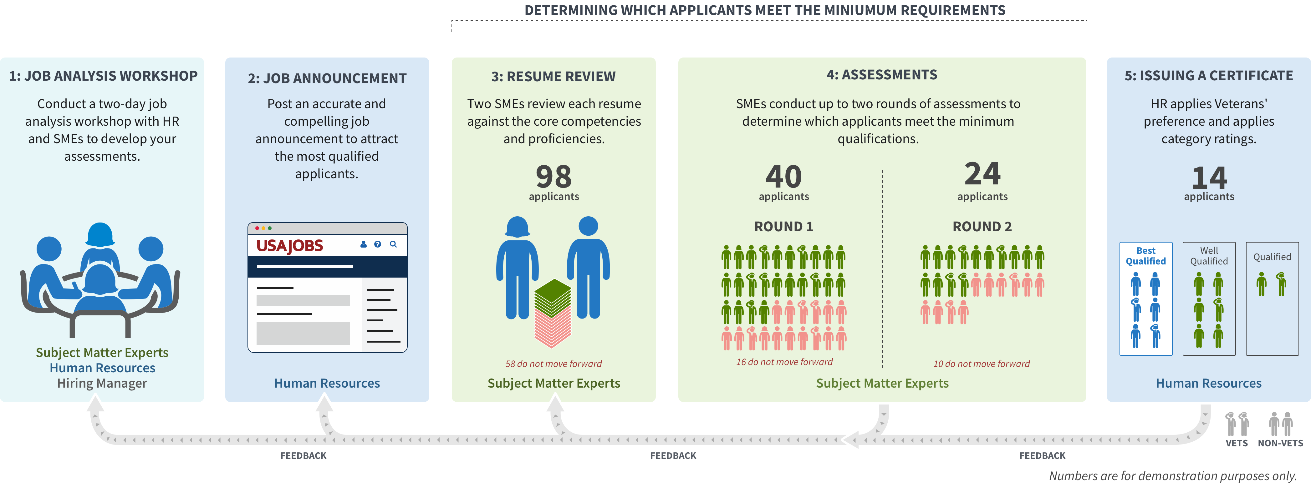
PILOT // WHAT WE TESTED

Slide 4
Proposed timeline
August –September: Find pooled vacancies, interested Hiring Managers, and SMEs
October: Hold 2.5 day job analysis workshop, recruit, and post announcement
November: SMEs conduct resume review and first assessment
December: SMEs conduct second assessment and HR issues certificates
Notes:
This is a draft- you can go from posting the job to issuing certs in just 5-6 weeks if you can get a project manager and HR specialist to commit to that timeframe.

Slide 5
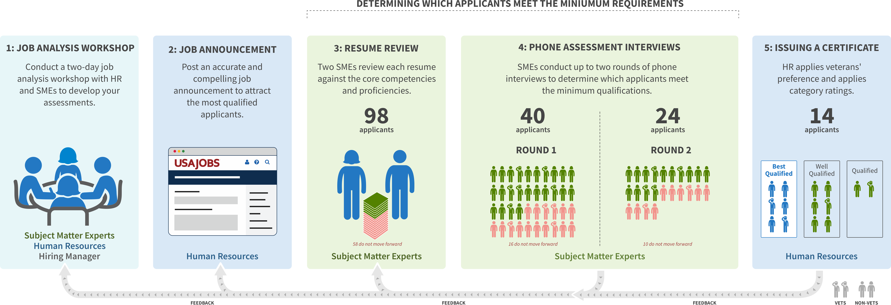
PILOT // Time Commitment
Subject Matter Experts
2 days: Job Analysis Workshop
2 hours: Resume review training and 2 hours for interview training
8 hours: Resume Review over 1 week
Up to 40 hours (over 3 weeks): Interviews with applicants*
*assumes 100-200 applicants/8 SMEs conducting 2 rounds of 1 on 1 interviews
Hiring Manager/Selecting Official
2 days: Job Analysis Workshop
10 hours: Once the Certificate is issued, commit to any additional interviews and selections within two weeks
Notes:
Here is breakdown of the time commitment required by SMEs in the process, and the time required by selecting officials.

Slide 6
Questions?

