Slide 1
<Agency Name> SME Training: Phone Interview
<insert date>

Slide 2
<Delete THIS SLIDE BEFORE PRESENTING>
PREPARE THE FOLLOWING AHEAD OF TIME – 1 PRINTED COPY OF EACH PER ATTENDEE
Phone interview rating template customized with your questions and proficiency levels
Optional: copies of SME Background Info Sheet if they haven’t all submitted them already

Slide 3
Agenda for this session
Review interview questions
Practice the interview transcripts
Tips
Wrap up discussion
Notes:
Most of the time in this training will be spent reviewing the phone interview rating template which contains the questions you created during Job Analysis.
SMEs will also learn how to write a transcript of the phone interviews and we will practice how to conduct the interviews.

Slide 4
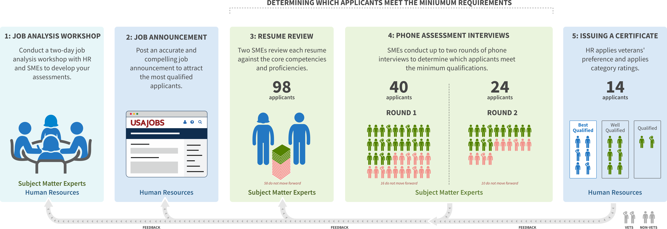
Multi-Hurdle SME Assessment Process
WE ARE HERE
291
~120
~ 75
?
Notes:
Reminder of the overall hiring process and where we are now
Job analysis workshop and Job Announcement already done
We are now preparing for Resume Review stage
Two SMEs will independently review each remaining applicant’s resume to determine whether they adequately reflect the core competencies and proficiencies to warrant the first of two phone assessment interviews.
If applicants move on from the resume review stage, they will each have up to 2 phone interviews

Slide 5
Timeline and Hours Required – {NUMBER} interviews
{NUMBER} SMEs will be doing ~{NUMBER} interviews each between {DATES}.
Commit to {NUMBER of hours}/{NUMBER} interviews each for round one.
First interviews will take {X} minutes, second interviews {X} minutes.
Email interview template to HR within 24 hours of the interview.
Plan 5 minutes each interview for set up and at least 30 minutes to submit your feedback.
Notes:
Replace variables on this slide with your details.
Details on this slide may change depending on request from HR.

Slide 6
Logistics of Interviews
One on one interviews
Make sure to confirms logistics of scheduling beforehand.
[Name of POC] will mark your calendar with the confirmed interview. Once all interviews been scheduled with ‘interview 1’ or ‘interview 2’, you can release the rest of your calendar holds.

Slide 7
This is an examination. You are testing their knowledge of the pre-defined competencies. Everyone must get the same script and the same time.

Slide 8
The questions you ask have been defined in advance, but you can repeat and clarify questions if needed.

Slide 9
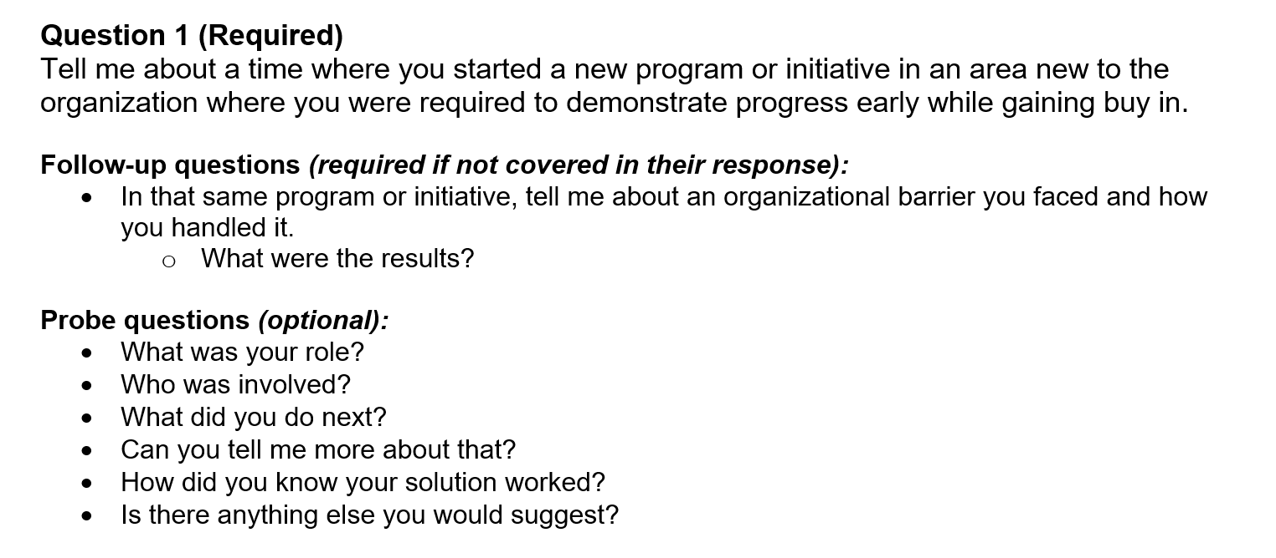
Follow-Up vs Probe Question
Notes:
You must ask required questions and follow up questions- if not already answered; probes are optional- you can keep repeating “can you tell me more about that” if you want.

Slide 10
Scoring and Ratings
First Interview
Did the applicant meet the required proficiency for the GS13 level for each competency?
Second Interview
Which proficiency level is met for each of the competencies? This will determine if they meet GS13, 14, or 15 and if they are minimally qualified or best qualified.
Make sure you are not the same reviewer for both interviews for the same applicant.

Slide 11
TIPS on Writing a Transcript
Transcript should be detailed enough so that if one SME were to review another SME's assessment, they would arrive at the same proficiency level.
Transcript does not have to be a verbatim transcription. As long as you capture the major details of what they are saying, that’s enough.
If you’re doing it by hand, you can include a picture of the notes and not type it up afterward.
Your transcript and proficiency determination should be aligned.

Slide 12
Jot down your reaction (optional)
“Great example – shows expertise”
“Right terms but is not making sense”
“Response lacked sufficient detail to meet proficiency level”

Slide 13
Prohibited Personnel Practices 5 U.S.C. 2302(b)
Giving an unauthorized preference or advantage to improve or injure the prospects of any particular person for employment (also, don’t promise anyone they’re going to get this job--you don’t know that!)
Engaging in nepotism
Discriminating (including discrimination based on marital status and political affiliation)
Considering employment based on factors other than personal knowledge or records of job-related abilities
Influencing any person to withdraw from job competition
Notes:
Reminder of relevant legal requirements around personnel practices

Slide 14
Guidance on Personal Relationships with Applicants
Recuse if:
You have a personal relationship with the applicant outside of work, whether or not the relationship is known to others.
There is any appearance of bias from you toward the applicant, such as when it’s well known that you and the applicant have regular disagreements, or that you and the applicant have a unique bond.
Attending happy hours together is fine.
Notes:
Guidance from SMEQA website:
It’s common for SMEs participating in a hiring action to know applicants. SMEs may review people they know, supervise, and work with, such as contract professionals or fellow public servants, except in these cases:
The SME has a personal relationship with the applicant outside of work, whether or not the relationship is known to others.
There is any appearance of bias from the SME toward the applicant, such as when it’s well known that the SME and applicant have regular disagreements, or that the SME and the applicant have a unique bond.
In general, if the SME and the applicant have occasionally attended the same office happy hour, there is no conflict. However, if the SME and applicant regularly socialize together outside of work, the SME should recuse themselves

Slide 15
Transcribing responses

Slide 16
Transcript Example 1: Good or bad?
Question: Tell me about a time you worked with a team to solve a technical issue. How was the problem identified and how did your group communicate your findings?
Transcript:
Able to give a detailed description of an issue and its resolution
Describes their role in finding and mitigating the risk
Talked about size and scope of risk and user impact
Candidate mentioned informing stakeholders
Notes:
This is not a good example. Reasons:
- Transcription with details? no -- the notes are high-level and overly summarized.
- Analysis at the end? yes
- Can another SME make a determination? no, not without details

Slide 17
Transcript Example 2: good or bad?
Question: What are a few techniques you use to identify and understand your customers?
Transcript:
Look at who uses the system
Segment the types of users into different categories using data
Do research by talking to those different types of users
Create/publish specific personas with results Impression: Covers basics, but lacks details
Notes:
Kyisha
This is a good example. Reasons:
(A) Transcription with details? Yes, this is a transcription; (B) Analysis: yes. Short but separate; (C) Can another SME make a determination? yes, because details are provided

Slide 18
Transcript Example 3: Good or Bad?
Question: Tell me about a time when you had to define and measure objectives or goals for a product you lead or helped to lead.
Transcript:
I’ll talk about my work at Kodak managing our website for customers to order film. We had a few objectives with the site; wanted to make it easy for consumers, versatile for enterprise buyers, and overall to grow revenue coming from online orders.
We measured how easy the site was by doing user research and specifically usability testing with the website as we developed it, and we asked our testers how easy they found the experience.
For enterprise buyers, we measured how often a user contacted a sales rep because the website didn’t support their need and talked to them every so often about their frustrations with the site
These all fed into an overall goal to grow the online business by increasing revenue according to the requirements of the company. We measured the business by looking at the total revenue of sales and the growth of new customers.
Notes:
This is a good example. Reasons:
(A) Transcription with details? Yes, this is a transcription; (B) Analysis: none; (C) Can another SME make a determination? yes, because details are provided

Slide 19
Writing your analysis

Slide 20
Example Interview Analysis
“The applicant has done full-stack work ranging from cloud to front-end. Their implementation of agile, both at previous orgs and in their own startup (albeit a single-person org), shows they knows how to prioritize user needs during development. Seems like well-rounded individual contributor and a strong communicator.
Minor concern: Knowledge on networking is on the weaker end.”

Slide 21
Proficiency determination

Slide 22
Interview Template: Demo + Practice (Send practice transcripts + rating to [name of POC) 1 hour
Notes:
Walk through both entire scripts, including the intros! Ask for a volunteer to read the ‘good answers’ in the back.

Slide 23
Stress Point: turn transcripts in within 24 hours
Do not create a backlog where you have done 8 interviews and have not finalized any of the transcripts/scores.
Do not be the last SME to submit any transcripts, holding up the entire process.
Submit them when the interview is fresh in your mind- within 24 hours of the interview- save time on your calendar to complete them.

Slide 24
Problems with the interviews
If the applicant is a no-show, call again (give them 10 minutes).
If the interview doesn’t occur, in the Interview Analysis box, write “No-show” and submit the template to HR and the schedulers and make a note in the email body that it’s a no-show.
If the applicant is late or verbose, you must make the determination in the allotted time. Do not give one applicant more time than another.
If you have a technical issue and you start late, and you can’t get to every question, go over the allotted time or work with the schedulers to make up the time difference.

Slide 25
QUESTION 1 – WHAT DO YOU DO?
The applicant was outstanding and it is now the end of the interview. What do you say to them?
You were one of the best – you will be qualified for sure.
Thank you for your time – you should hear back from HR soon.
This was a very string interview; thanks for your time!
Thank you for your time - please feel free to reach out to me in the future with questions about working in government!
Notes:
Correct answer: B
Talk through the consequences of A - first of all, they may not pass the second interview, there may be veterans on top of them and the agency can’t reach them, and you can create the impression of being unfair and bias when applicants talk to each other raising flags for the inspector general.
Do NOT tell them the results - you are just one part of the process and do not know what will happen.

Slide 26
QUESTION 2 – WHAT DO YOU DO?
The applicant has a lot of questions for you about the process and the position. How much time should you take to answer them?
Take as much time as needed – we need to recruit and this is a two way street.
Leave 5 minutes at the end for questions.
Do not answer questions about the process or job. Instead, refer process questions to HR so every applicant gets the same information. Tell them they can ask more specific questions about the positions during final fit interviews with hiring managers.
Notes:
Correct answer: C
This is a structured interview and though you can explain what you do for a few minutes at the beginning, ask them to hold questions for HR and/or the fit interview at the end.

Slide 27
QUESTION 3 – WHAT DO YOU DO?
It is now the end of the allotted time for the interview. The applicant took a lot of time answering the first several questions that you run out of time for the last one.
Give the applicant an extra 30 minutes at the end of the hour.
Schedule a follow up call to finish later.
Use the information you collected from the other questions to see if you feel they meet the missing competencies. Next time try to manage your time better and cut the applicant off if they’re taking too long with one question.
The applicant must be unqualified because you weren’t able to ask the last question.
Notes:
Correct answer: C
They can still qualify if you can assess the final competency with the information from the other questions - you still have an hour’s worth of information. You cannot give different amounts of time to each applicant. That would invalidate all the interview results.

Slide 28
QUESTION 3 – WHAT DO YOU DO?
It is now the end of the allotted time for the interview. The applicant took a lot of time answering the first several questions that you run out of time for the last one.
Give the applicant an extra 30 minutes at the end of the hour.
Emphasis: giving a single applicant extra time threatens the entire selection process. Do not do this.
Notes:
Correct answer: C
They can still qualify if you can assess the final competency with the information from the other questions - you still have an hour’s worth of information. You cannot give different amounts of time to each applicant. That would invalidate all the interview results.

Slide 29
Email your docs to: [Name of POC email]
Notes:
Insert HR specialist(s) email addresses here

Slide 30
What’s next
SMEs send [POC] times they’re available for interviews
Applicants will choose a timeslot they want
[POC] will create a calendar invite to the SMEs and applicant and will put in the invite on the SMEs calendar
[POC] will put either “interview 1” or “interview 2” in the invite so the SMEs know which slot to use
Round one interviews start [Date/Day] !
Notes:
Correct answer: C
They can still qualify if you can assess the final competency with the information from the other questions - you still have an hour’s worth of information. You cannot give different amounts of time to each applicant. That would invalidate all the interview results.

Slide 31
Questions?

