Slide 1
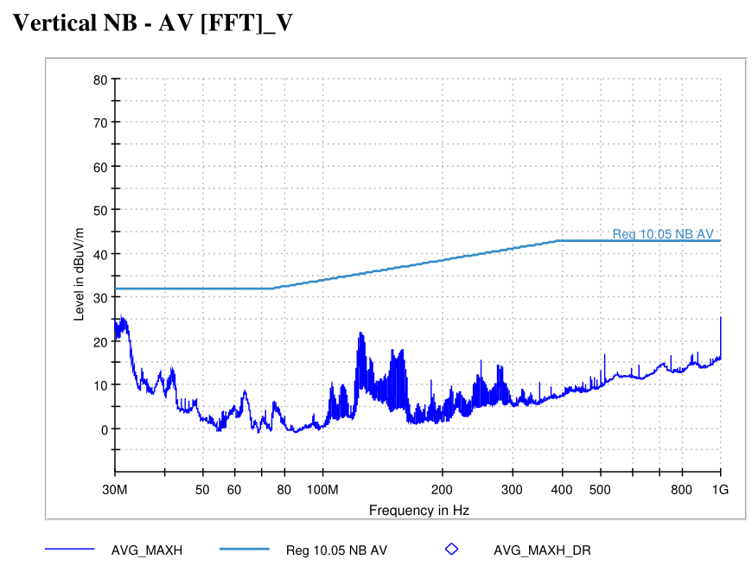
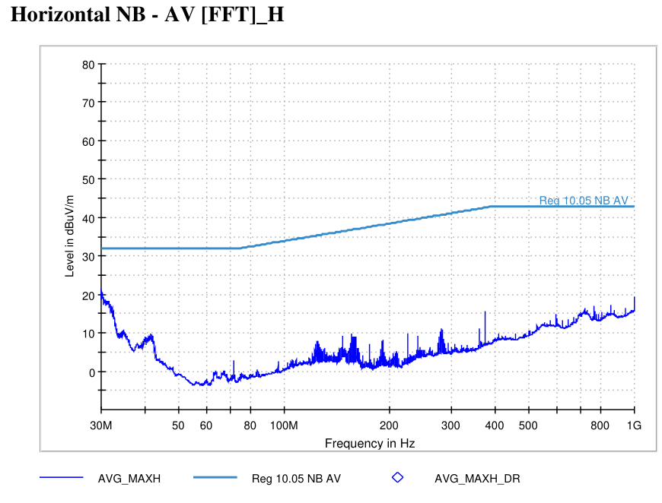
5582 - State 5 FLNB | VT-01 Off-Board Emissions (3m)
State Information

Slide 2
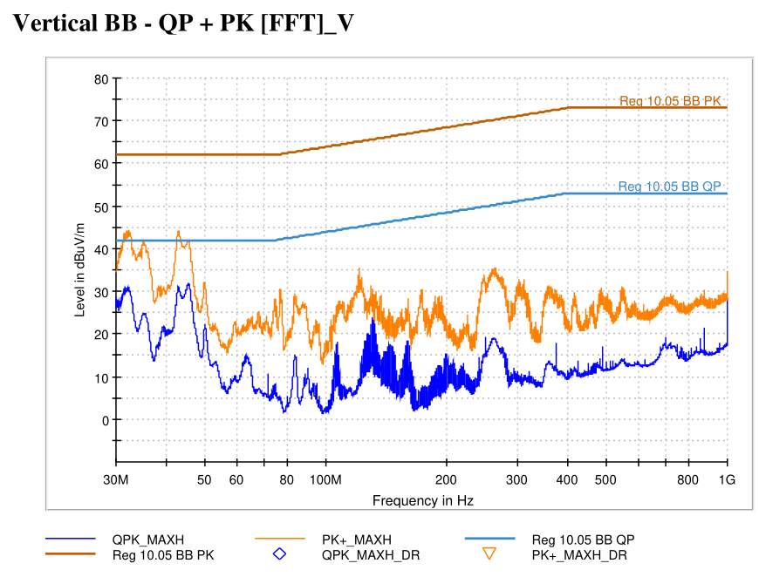
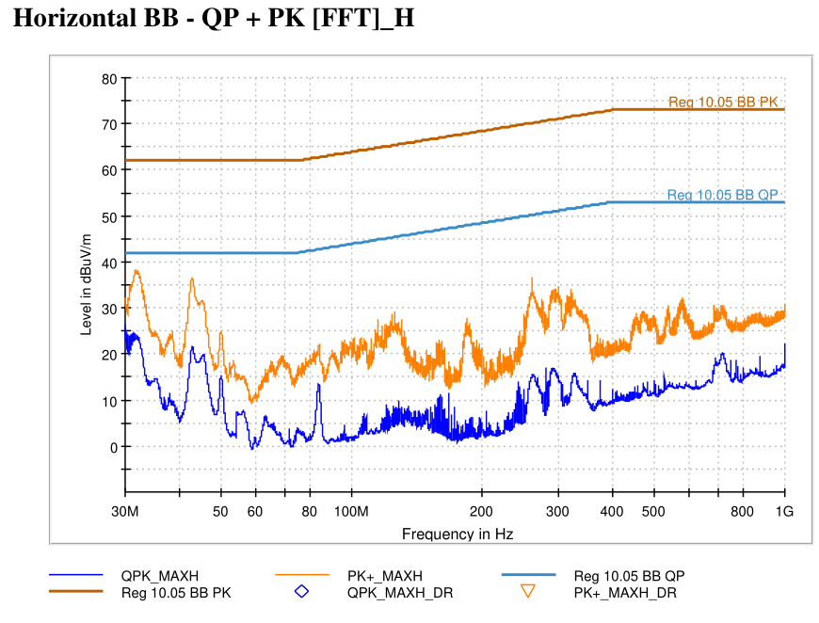
5582 - State 3 RRBB | VT-01 Off-Board Emissions (3m)
State Information

Slide 3
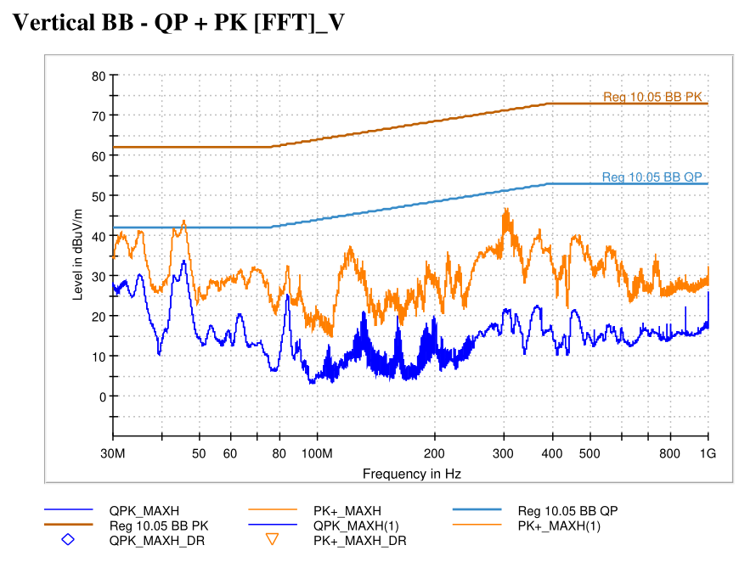
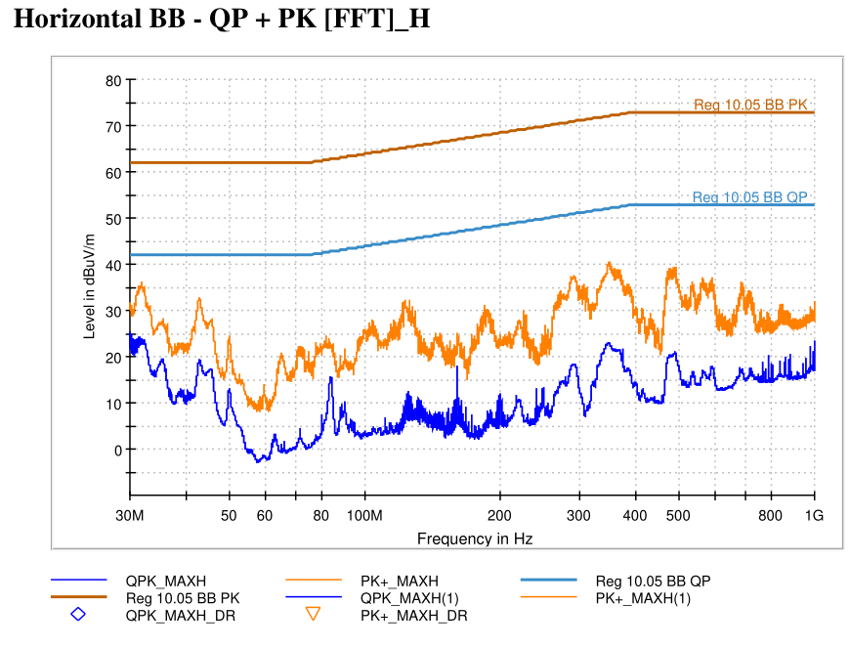
5582 - State 2 FRBB | VT-01 Off-Board Emissions (3m)
State Information

Slide 4
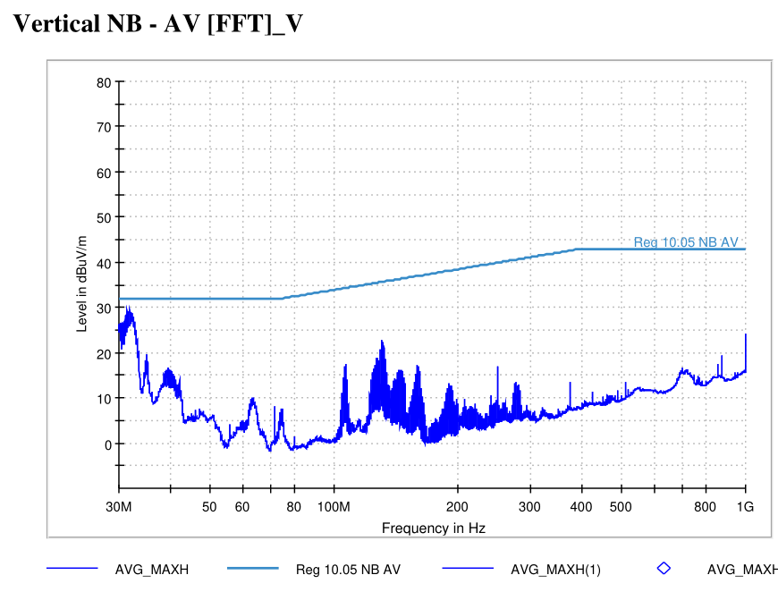
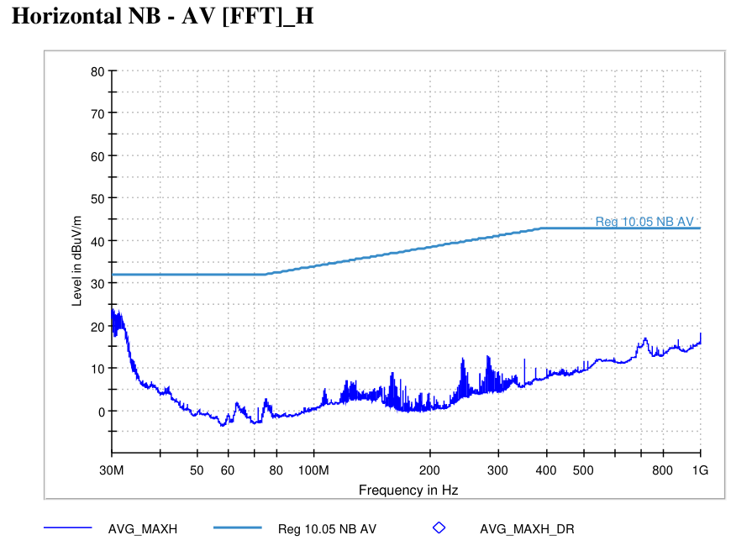
5582 - State 4 RRNB | VT-01 Off-Board Emissions (3m)
State Information

Slide 5
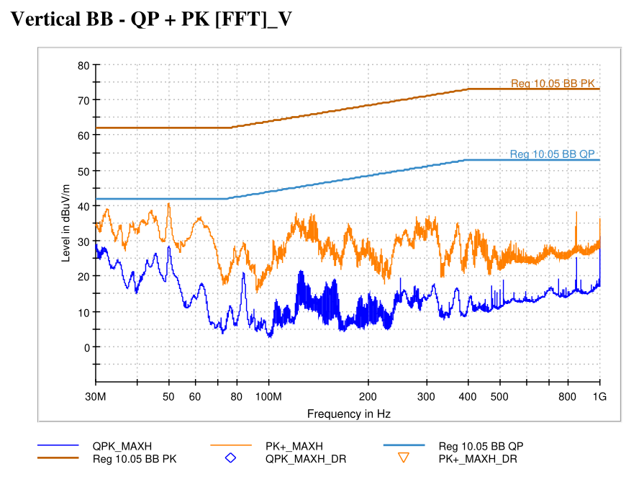
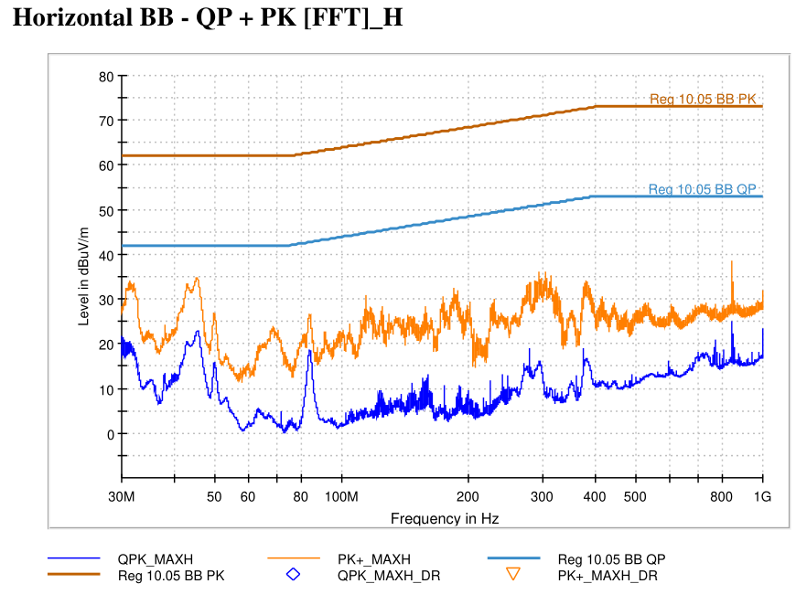
5582 - State 6 FLBB | VT-01 Off-Board Emissions (3m)
State Information

Slide 6
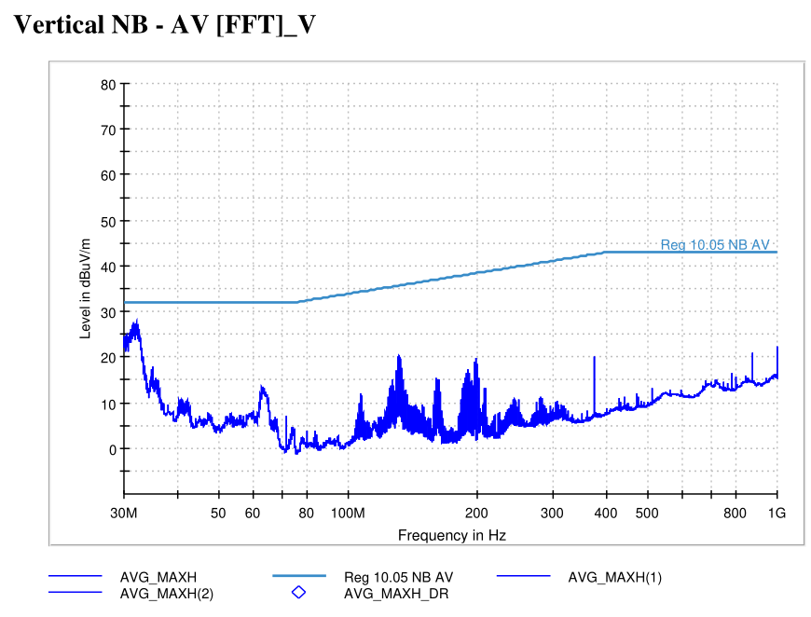
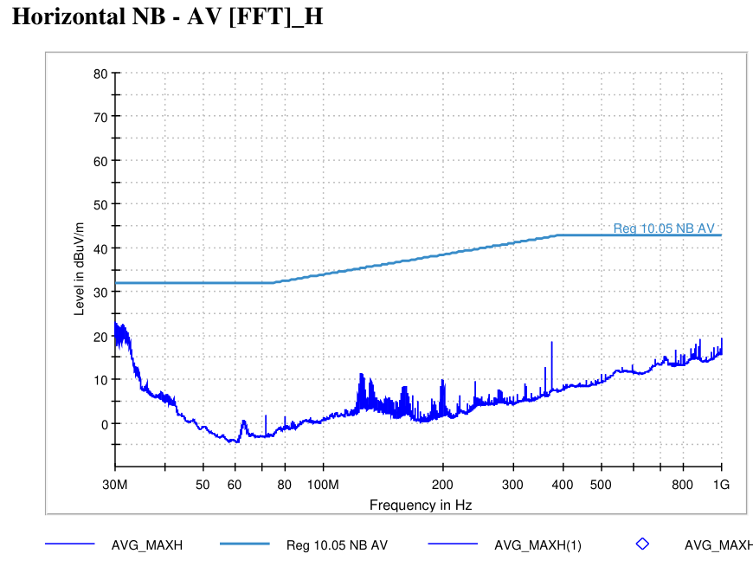
5582 - State 1 FRNB | VT-01 Off-Board Emissions (3m)
State Information

Slide 7
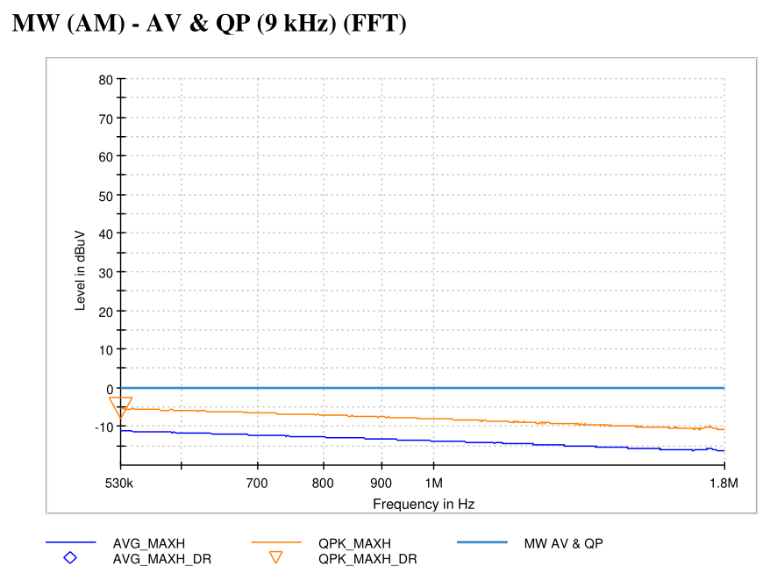
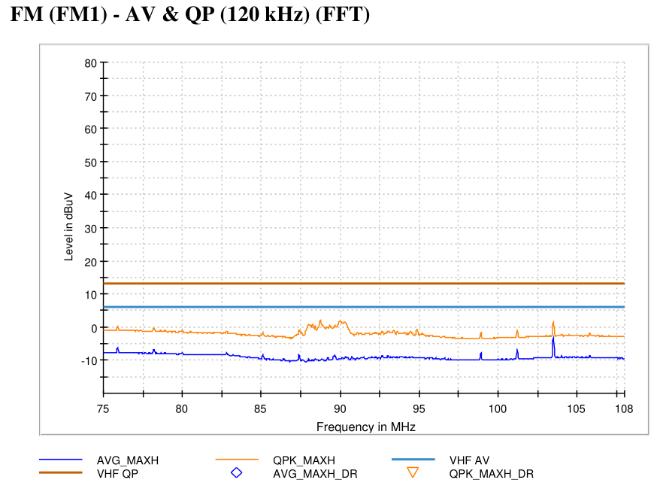
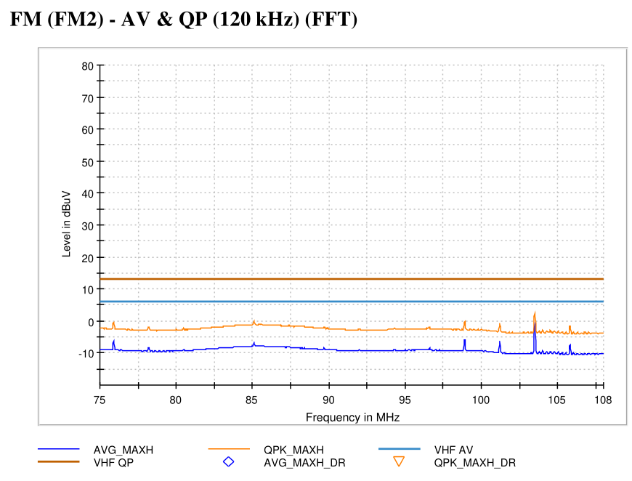
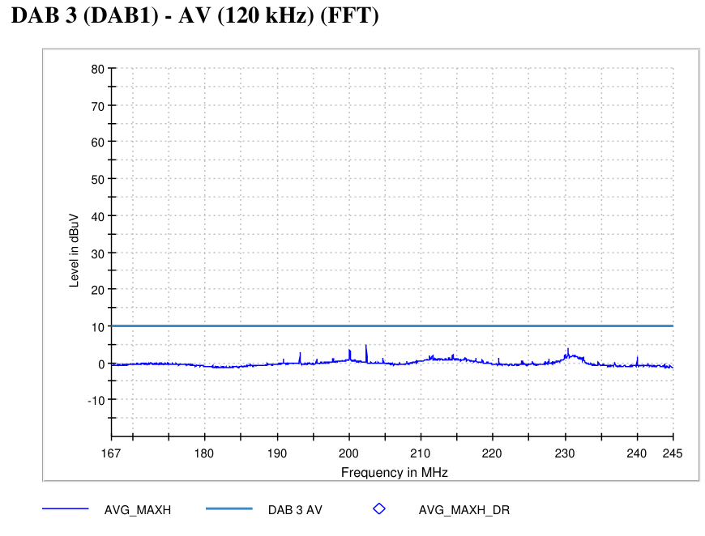
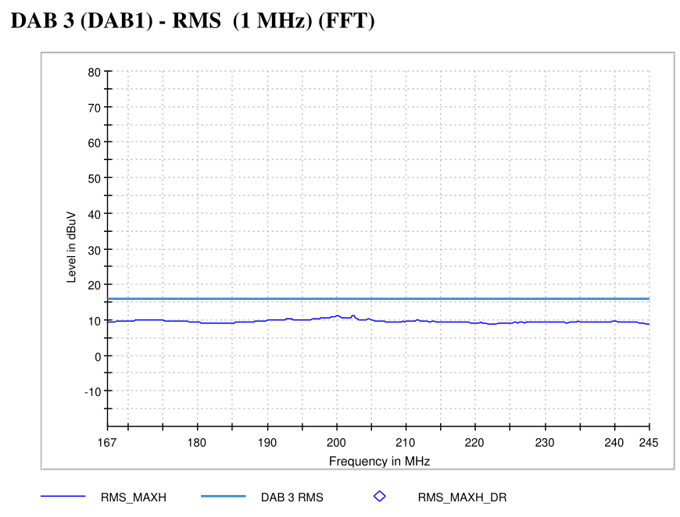
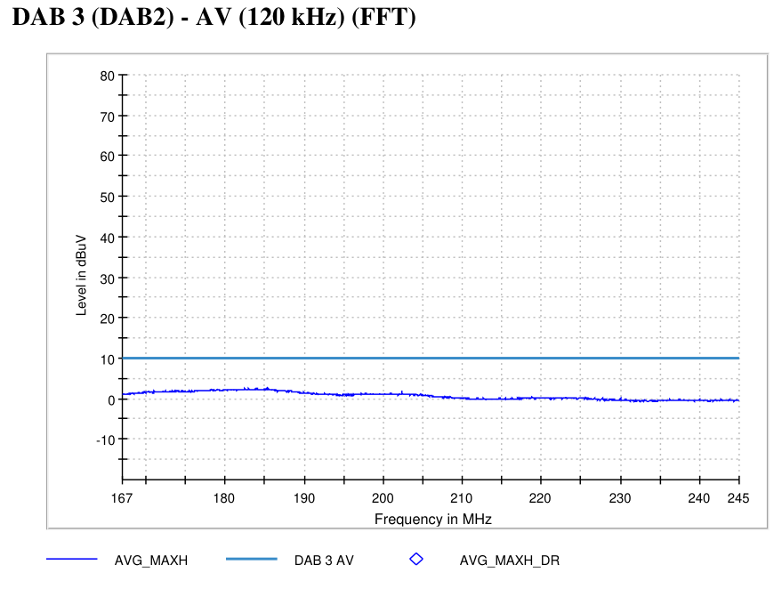
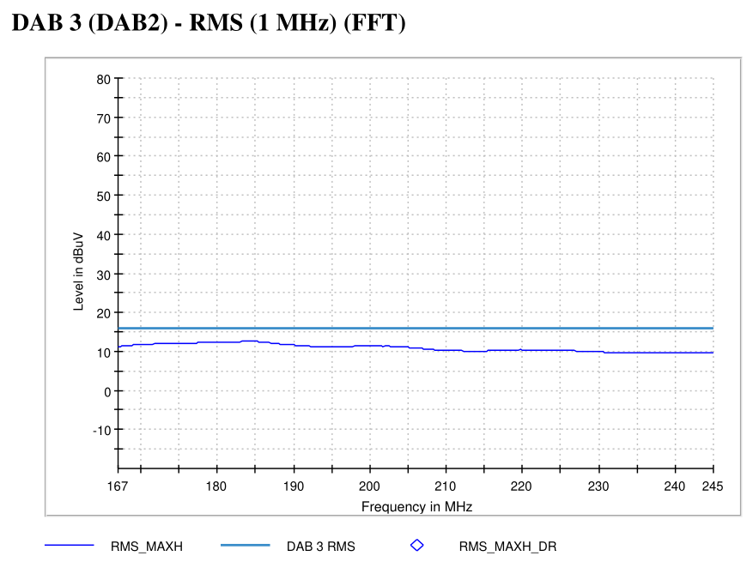
5582 - State 9 | VT-07 On-Board Emissions
State Information

Slide 8
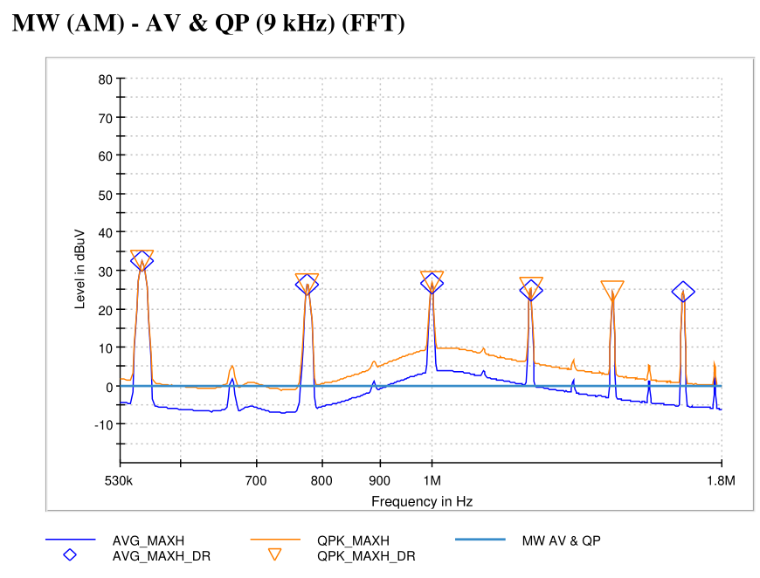
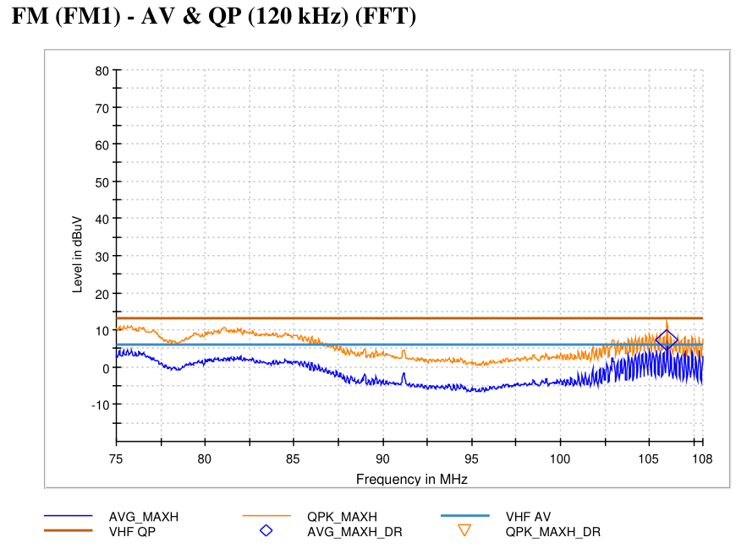
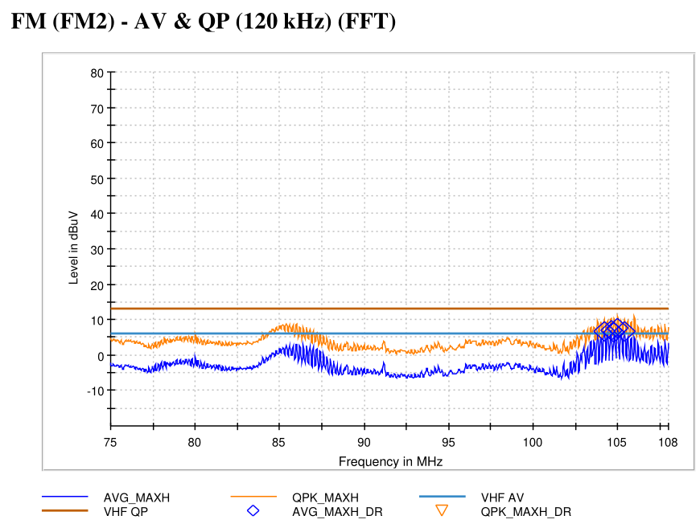
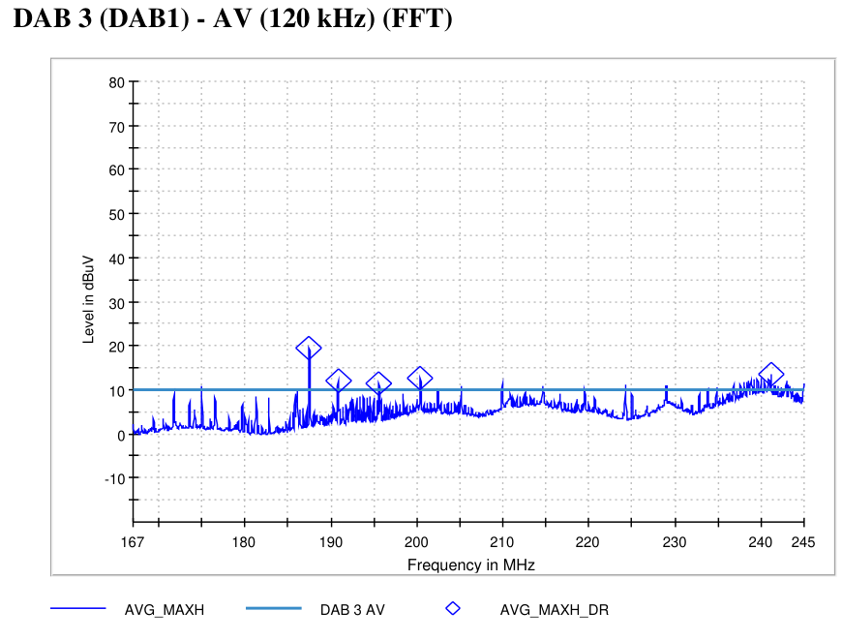
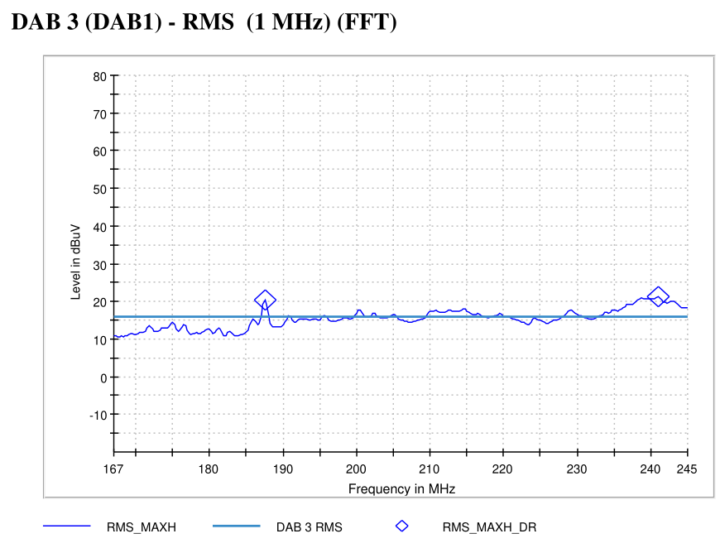
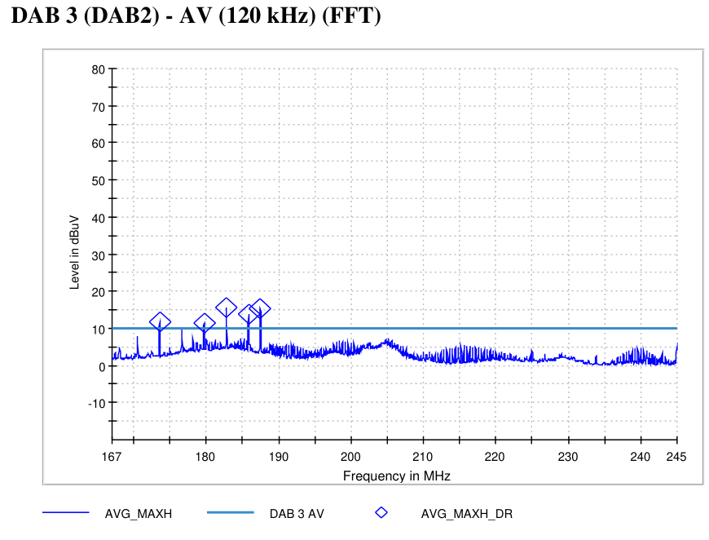

5582 - State 10 | VT-07 On-Board Emissions
State Information

Slide 9
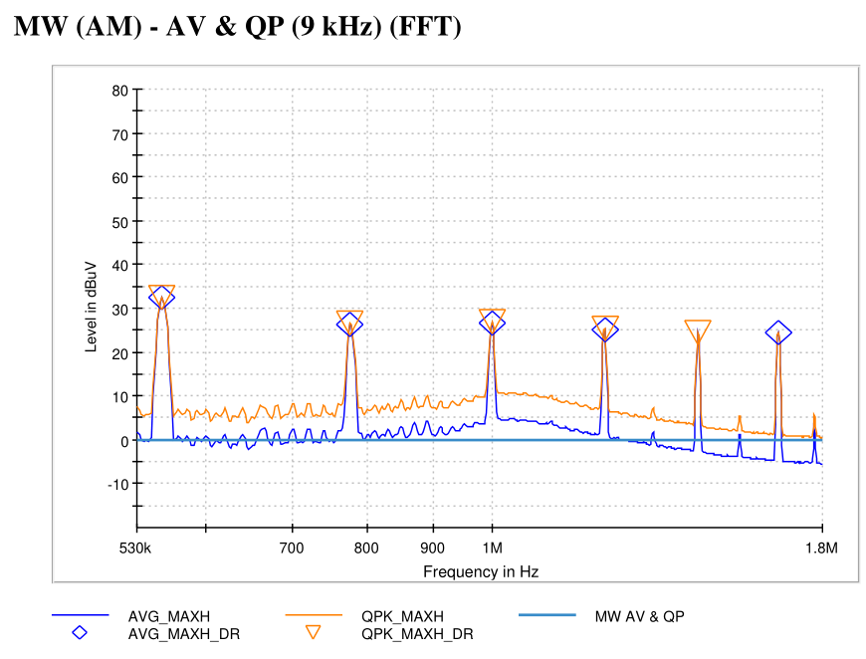
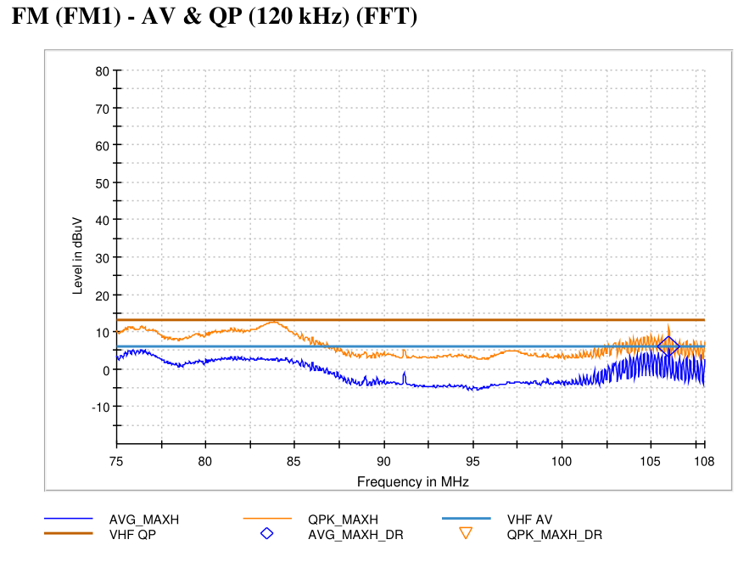
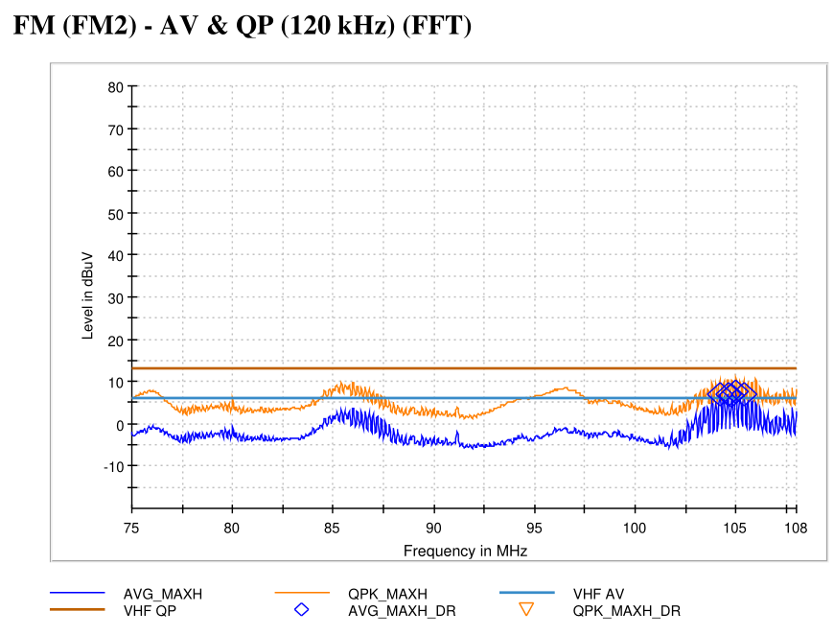


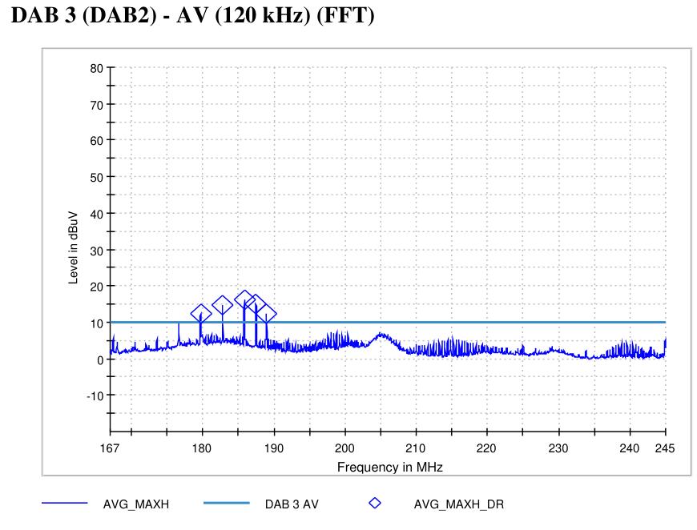

5582 - State 11 | VT-07 On-Board Emissions
State Information

Slide 10
*9*
State Information

Slide 11
*10*
State Information

Slide 12
*11*
State Information

Slide 13
*12*
State Information

Slide 14
*13*
State Information

Slide 15
*14*
State Information

Slide 16
*15*
State Information

Slide 17
*16*
State Information

Slide 18
*17*
State Information

Slide 19
*18*
State Information

Slide 20
*19*
State Information

Slide 21
*20*
State Information

Slide 22
*21*
State Information

Slide 23
*22*
State Information

Slide 24
*23*
State Information

Slide 25
*24*
State Information

Slide 26
*25*
State Information

Slide 27
*26*
State Information

Slide 28
*27*
State Information

Slide 29
*28*
State Information

Slide 30
*29*
State Information

Slide 31
*30*
State Information

Slide 32
*31*
State Information

Slide 33
*32*
State Information

Slide 34
*33*
State Information

Slide 35
*34*
State Information

Slide 36
*35*
State Information

Slide 37
*36*
State Information

Slide 38
*37*
State Information

Slide 39
*38*
State Information

Slide 40
*39*
State Information

Slide 41
*40*
State Information

Slide 42
*41*
State Information

Slide 43
*42*
State Information

Slide 44
*43*
State Information

Slide 45
*44*
State Information

Slide 46
*45*
State Information

Slide 47
*46*
State Information

Slide 48
*47*
State Information

Slide 49
*48*
State Information

Slide 50
*49*
State Information

