Slide 1
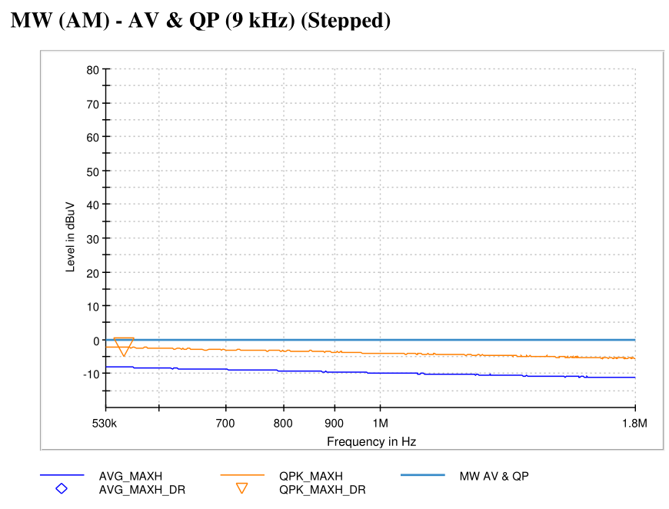
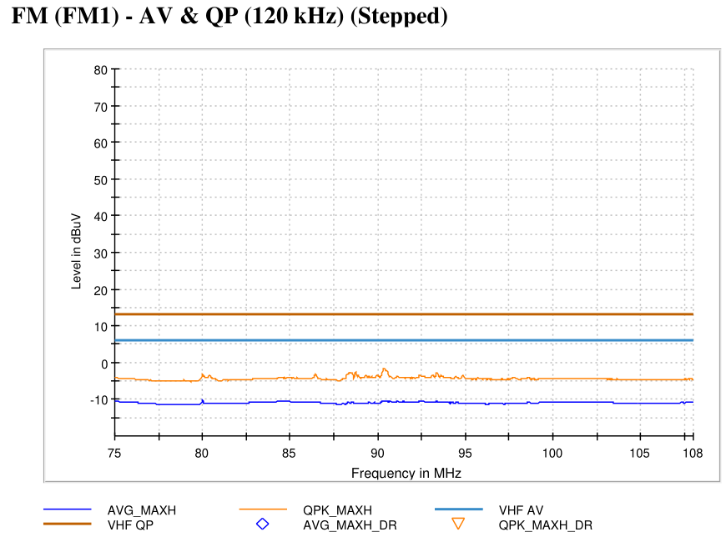
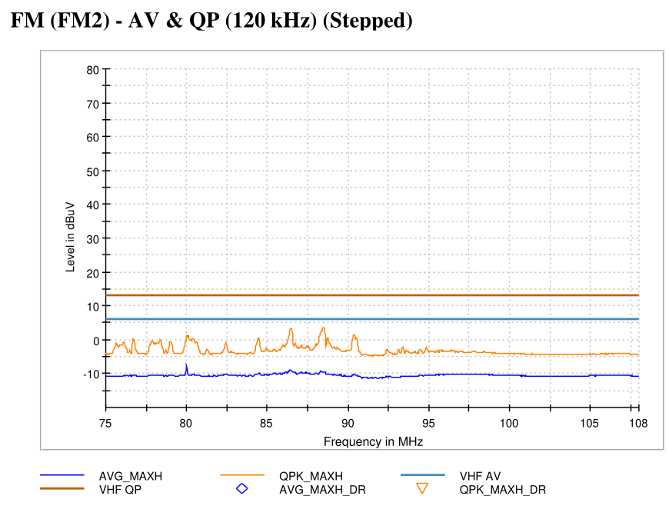
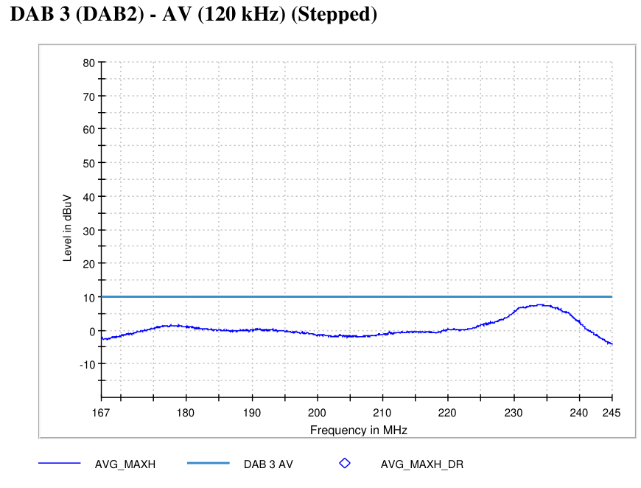
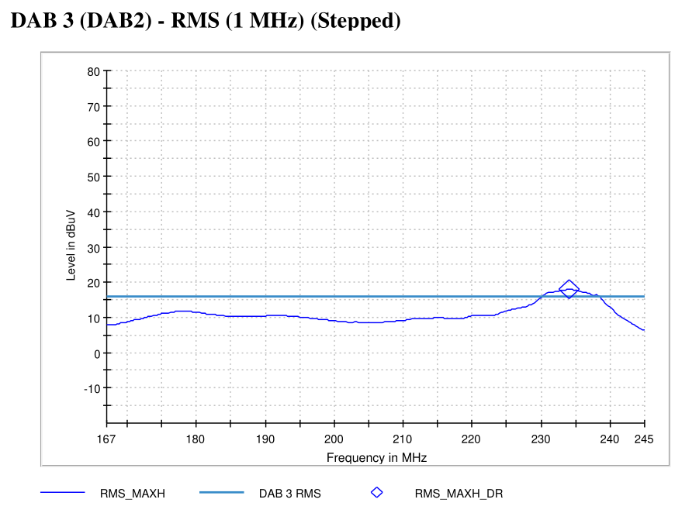

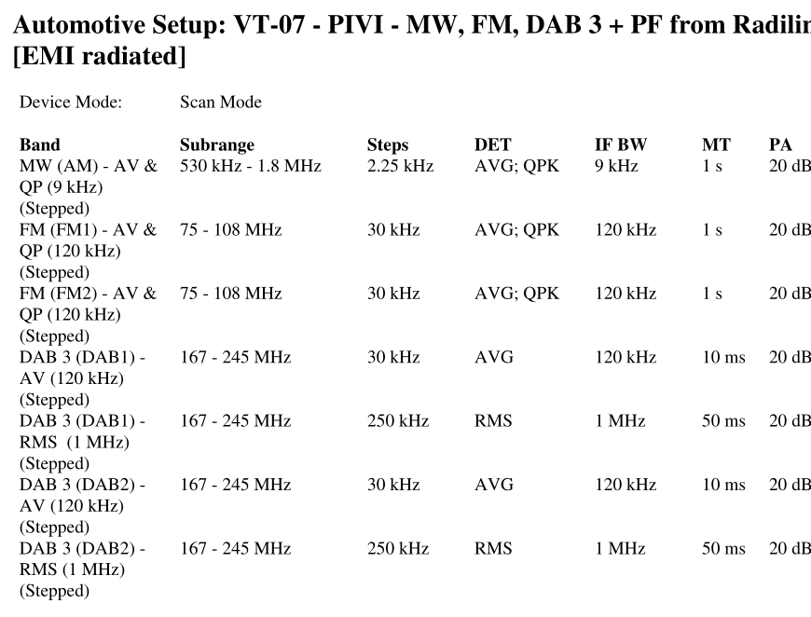
5580 - State 10 - VT-07 On-Board Emissions
State Information

Slide 2
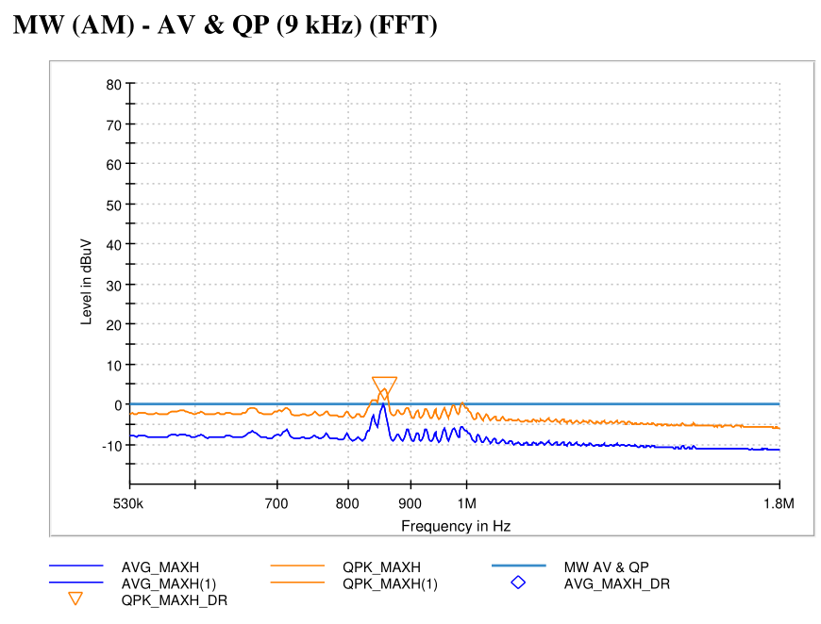
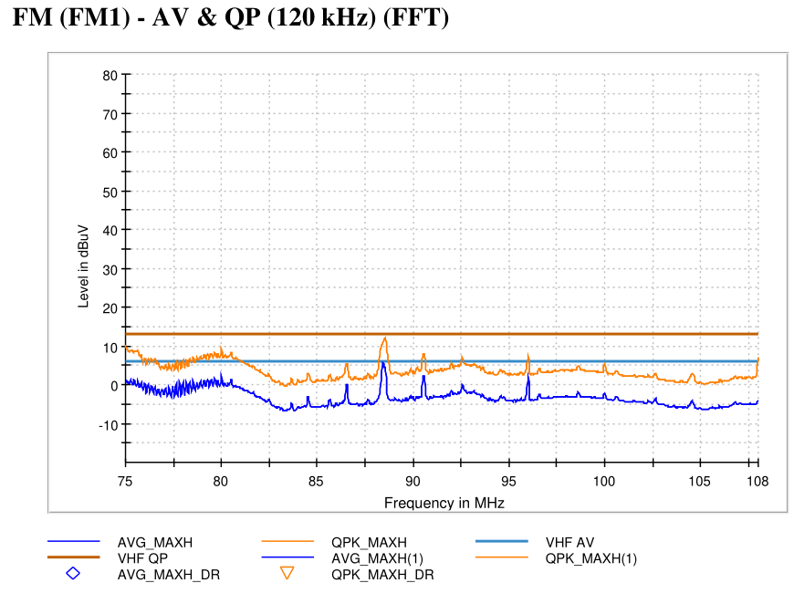
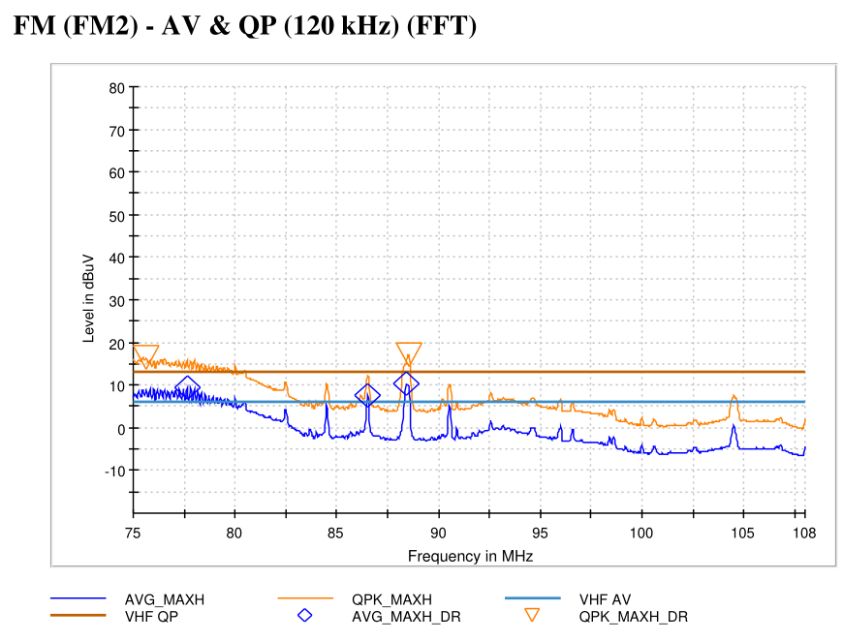
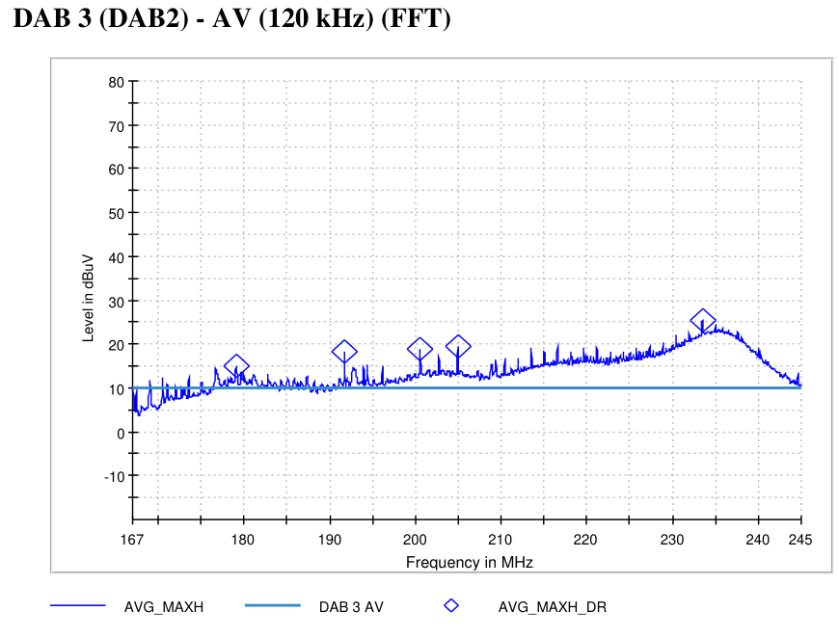
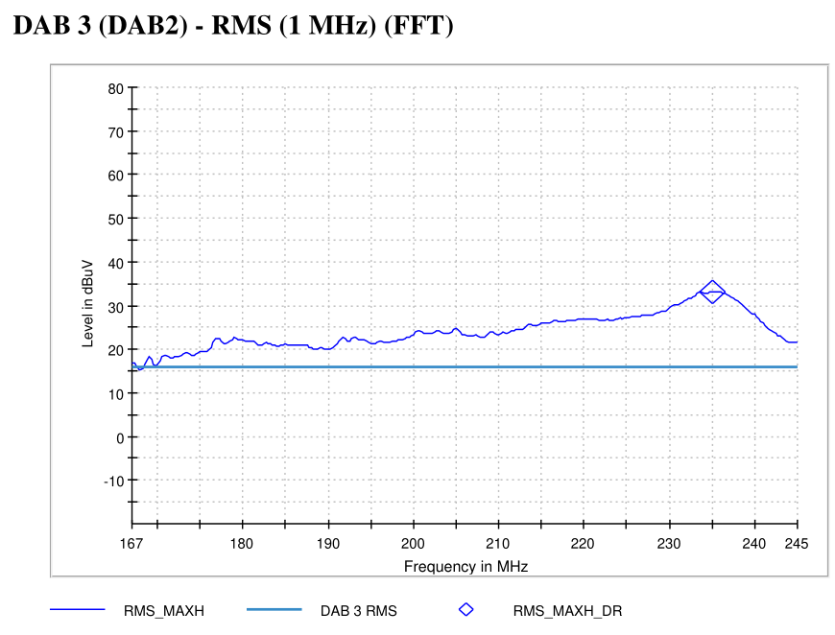
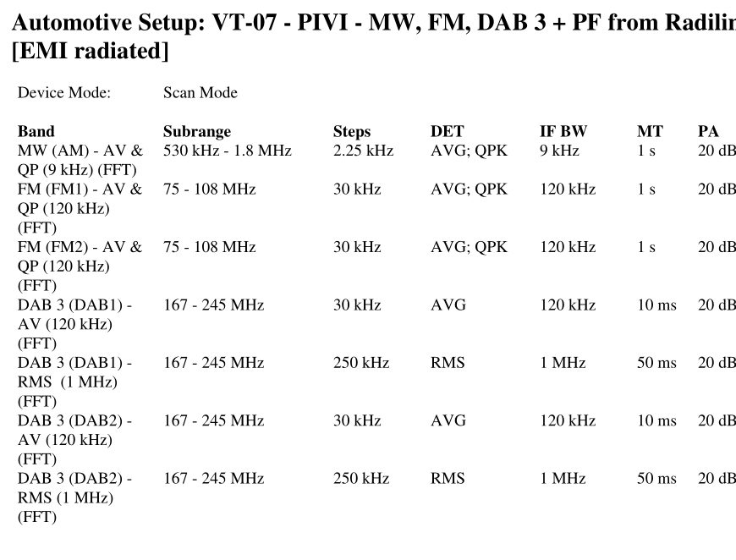
5580 - State 11 - VT-07 On-Board Emissions
State Information

Slide 3
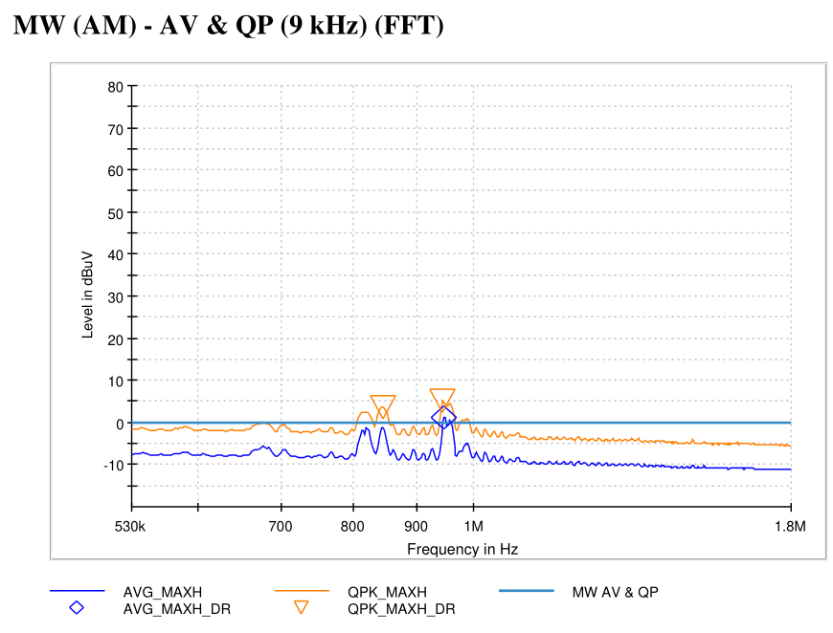
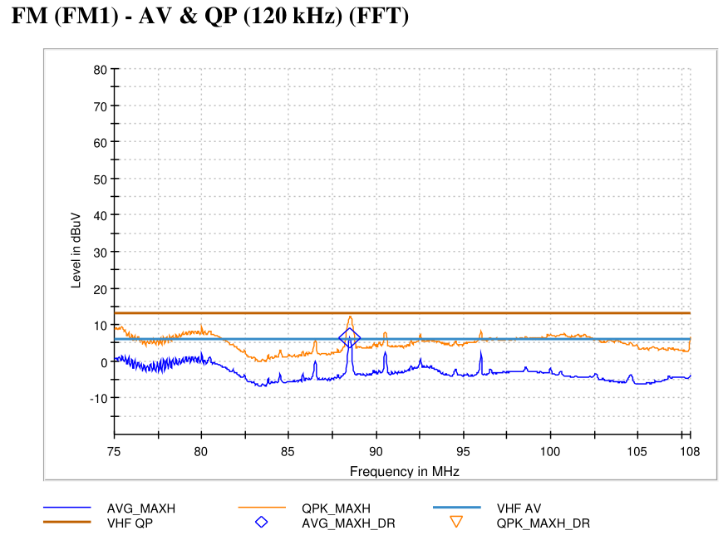
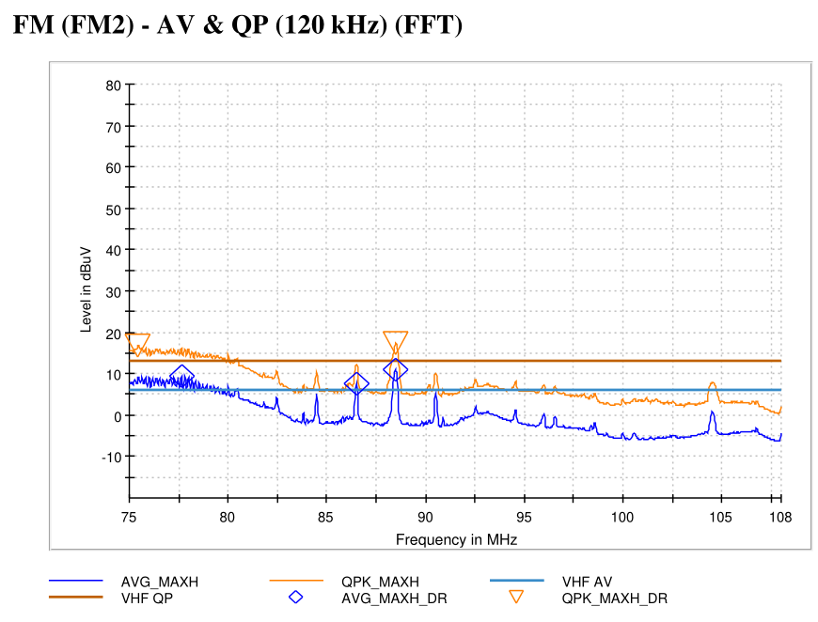
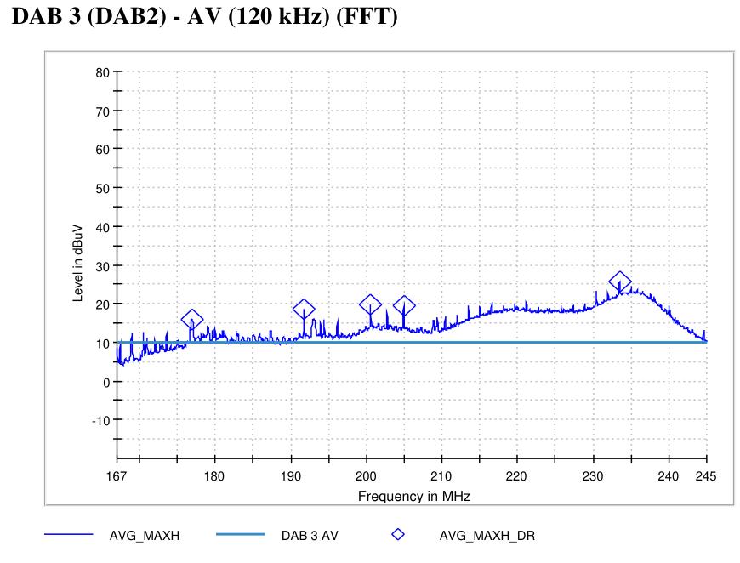

5580 - State 12 - VT-07 On-Board Emissions
State Information

Slide 4
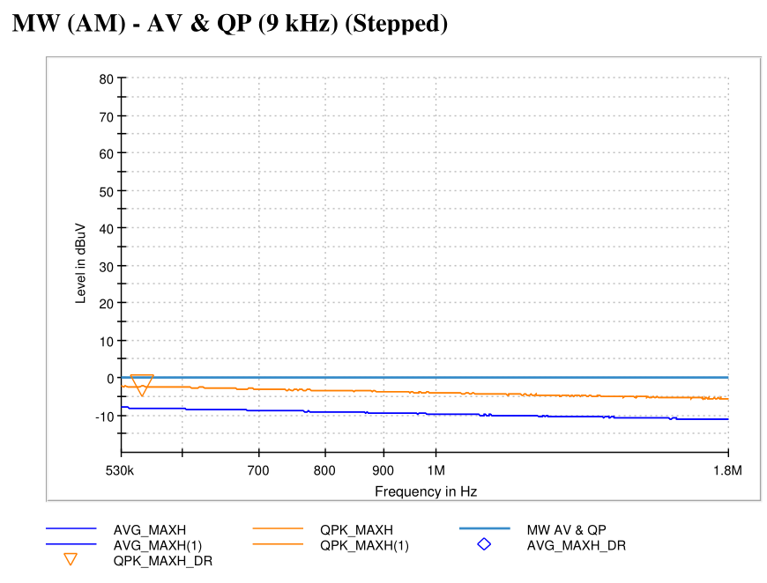
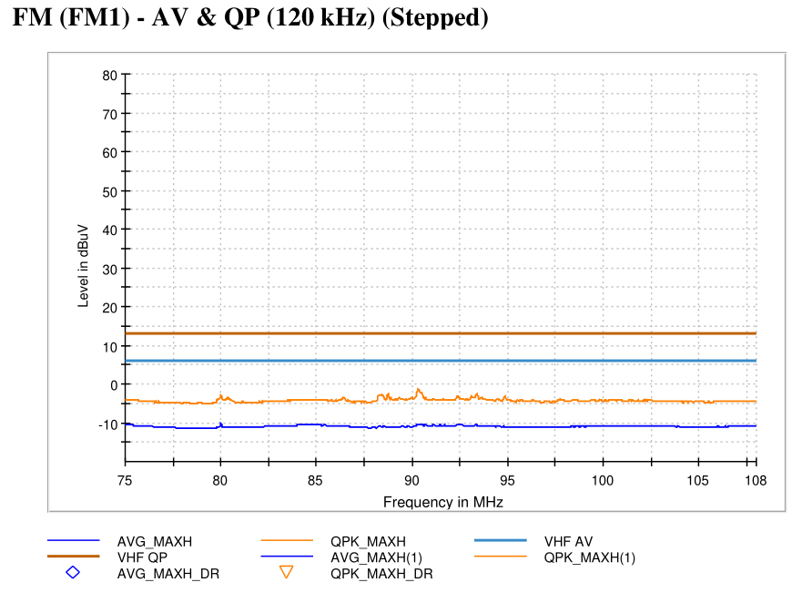
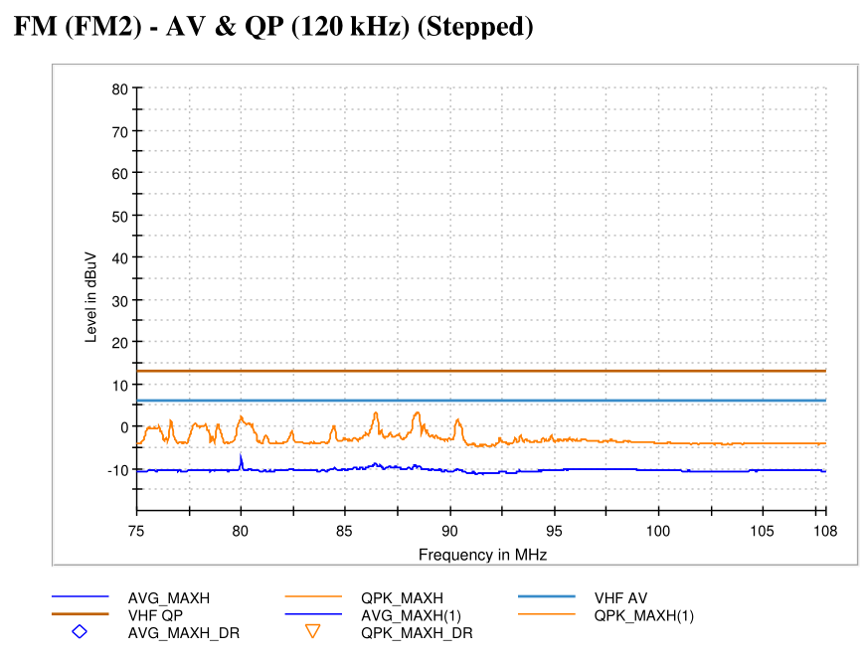
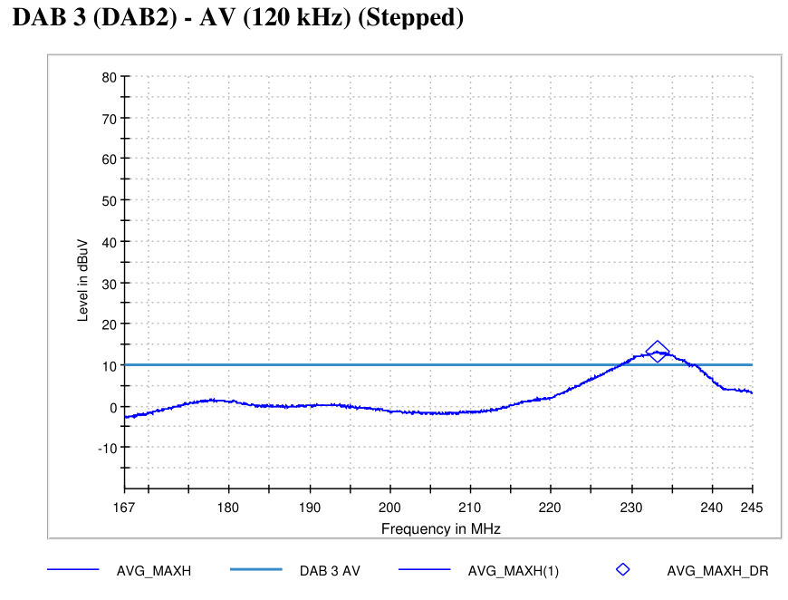
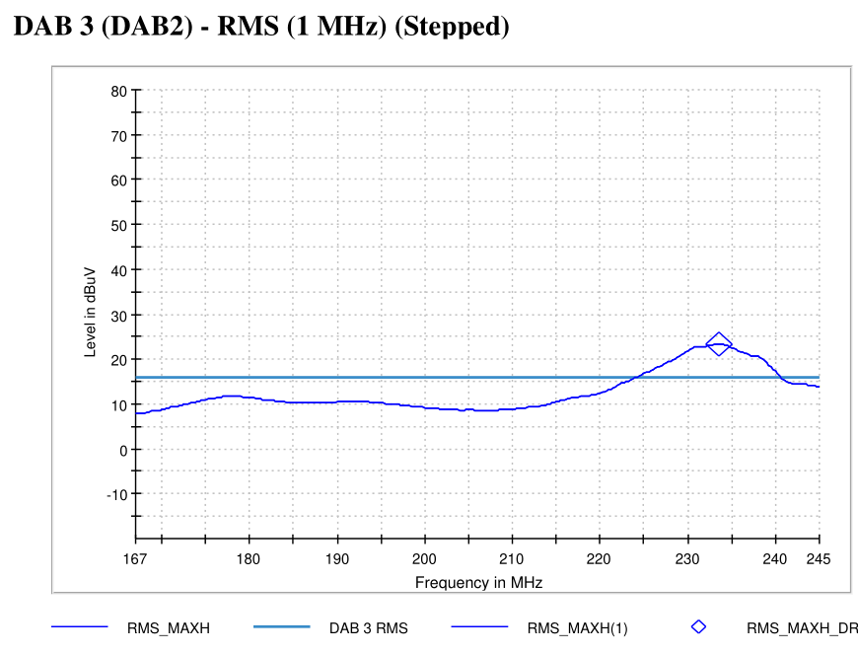
5580 - State 9 - VT-07 On-Board Emissions
State Information

Slide 5
*4*
State Information

Slide 6
*5*
State Information

Slide 7
*6*
State Information

Slide 8
*7*
State Information

Slide 9
*8*
State Information

Slide 10
*9*
State Information

Slide 11
*10*
State Information

Slide 12
*11*
State Information

Slide 13
*12*
State Information

Slide 14
*13*
State Information

Slide 15
*14*
State Information

Slide 16
*15*
State Information

Slide 17
*16*
State Information

Slide 18
*17*
State Information

Slide 19
*18*
State Information

Slide 20
*19*
State Information

Slide 21
*20*
State Information

Slide 22
*21*
State Information

Slide 23
*22*
State Information

