Slide 1
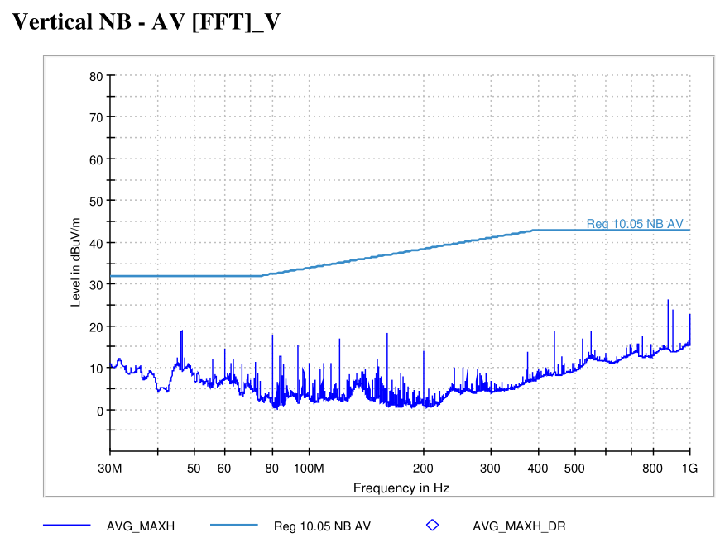
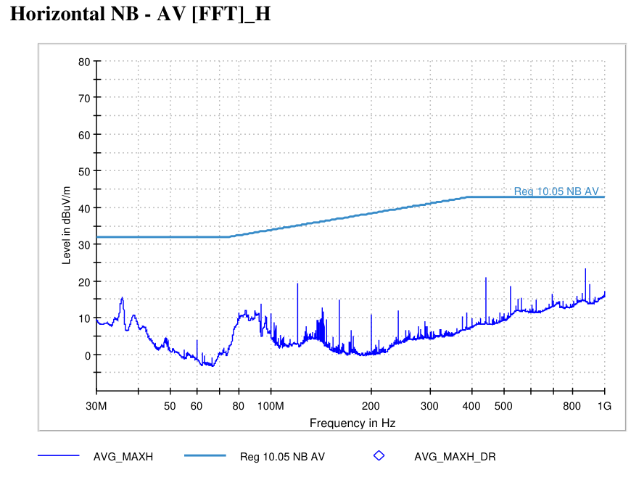
5537 - State 2 - RRNB | VT-01 Off-Board Emissions (3m)
State Information

Slide 2
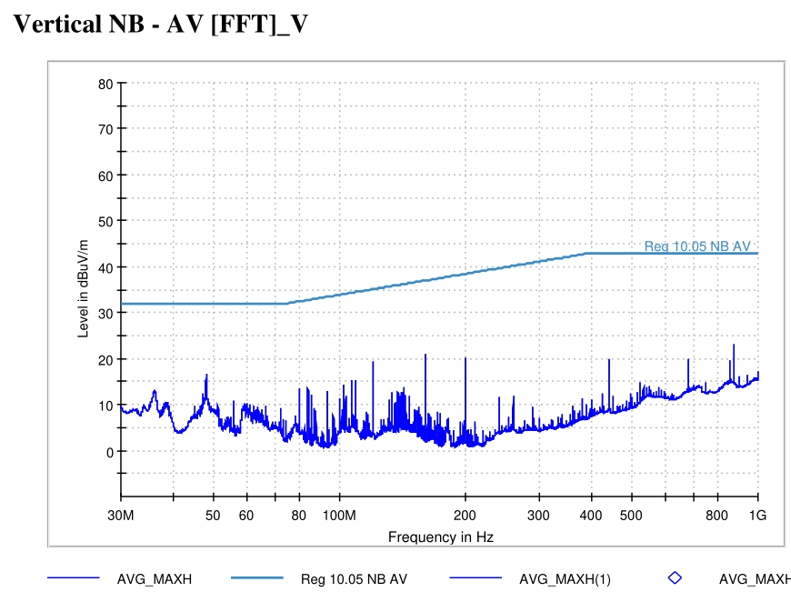
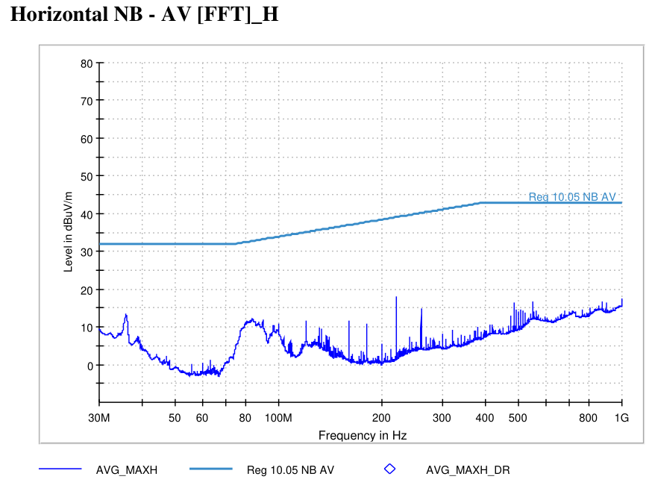
5537 - State 1 - FRNB | VT-01 Off-Board Emissions (3m)
State Information

Slide 3
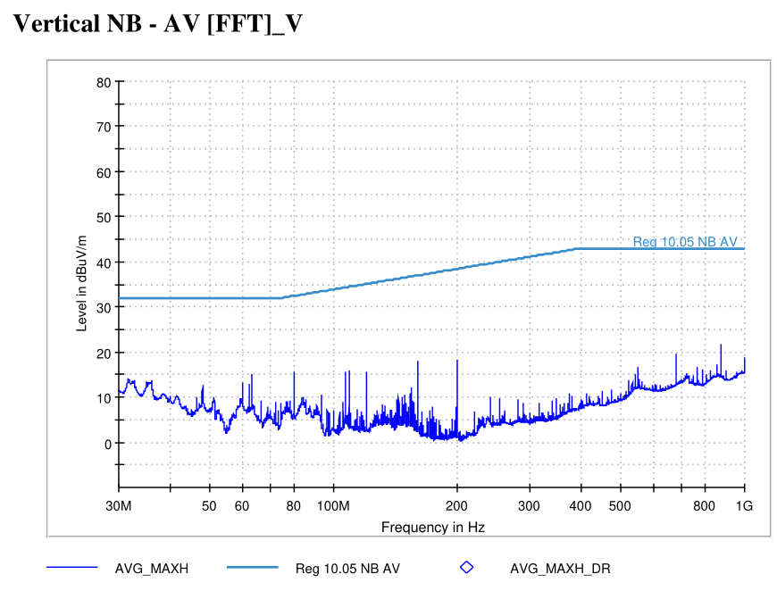
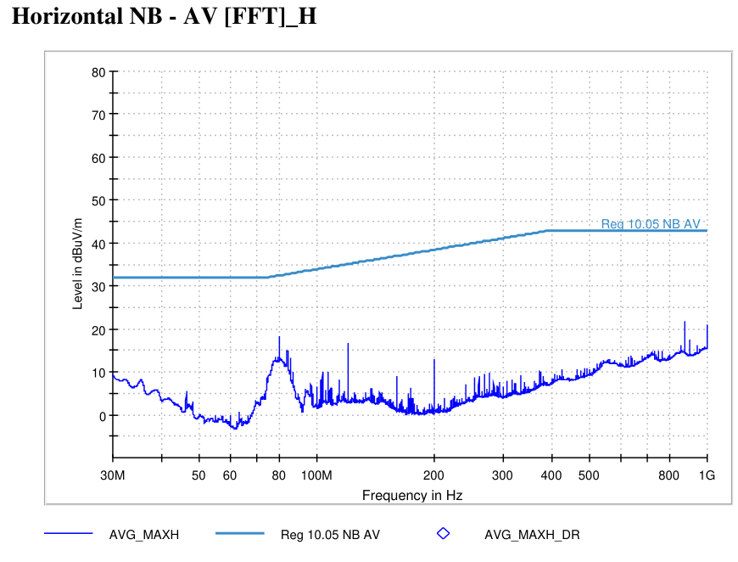
5537 - State 3 - FLNB | VT-01 Off-Board Emissions (3m)
State Information

Slide 4
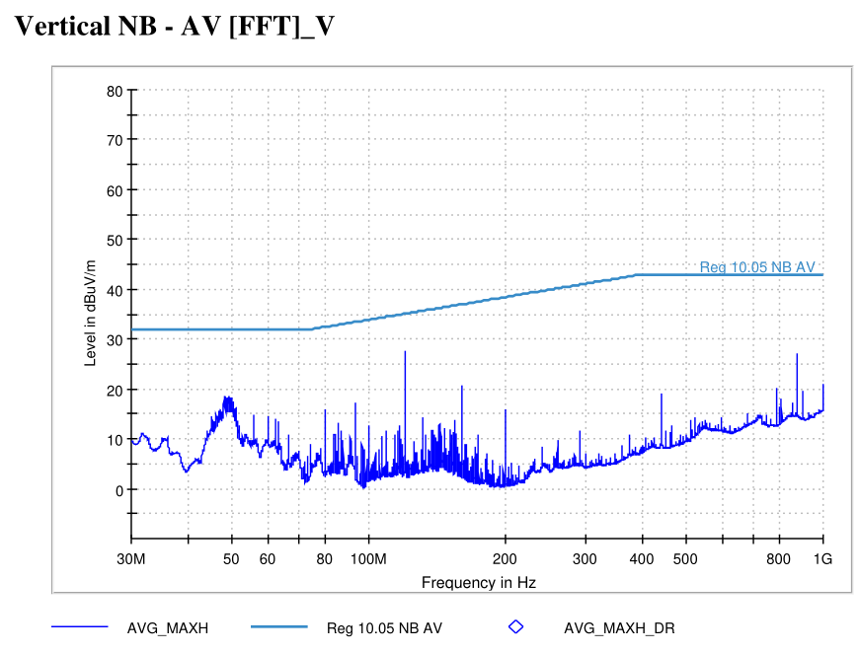
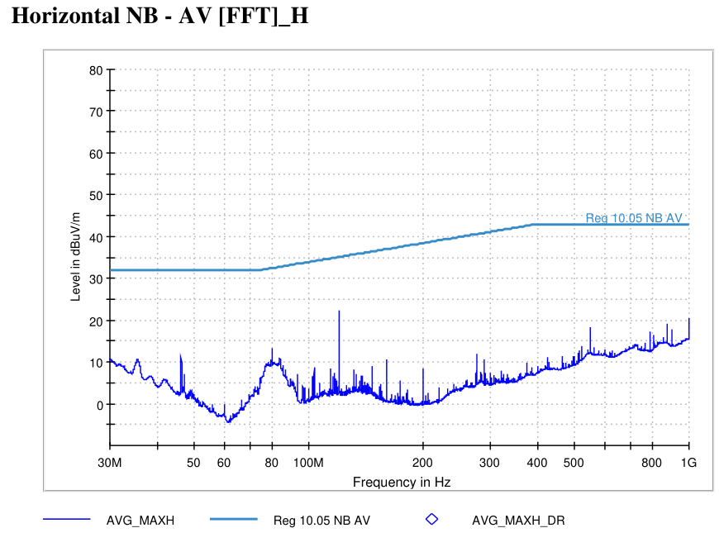
5537 - State 4 - RLNB | VT-01 Off-Board Emissions (3m)
State Information

Slide 5
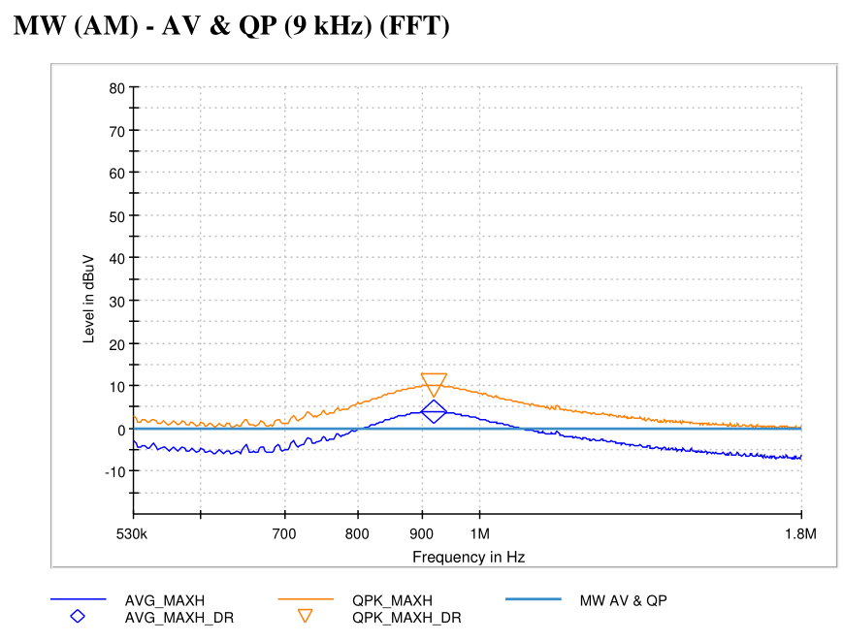
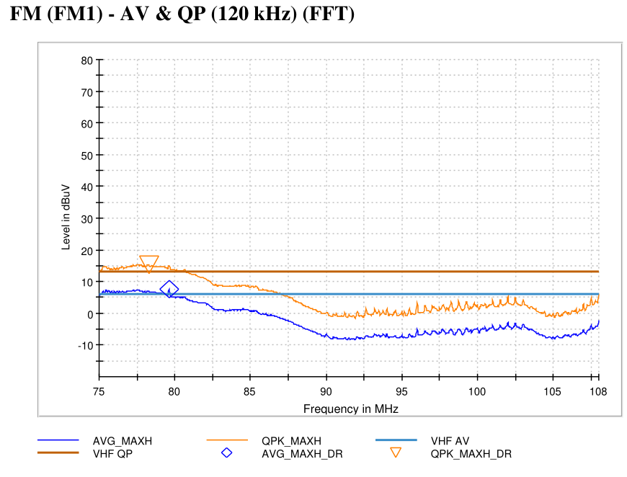
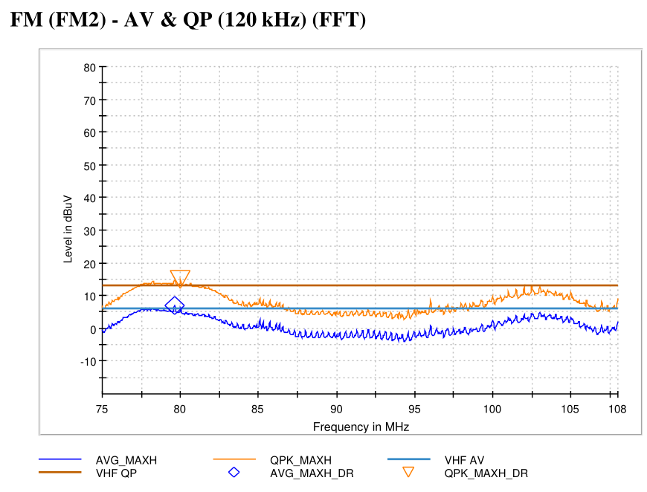
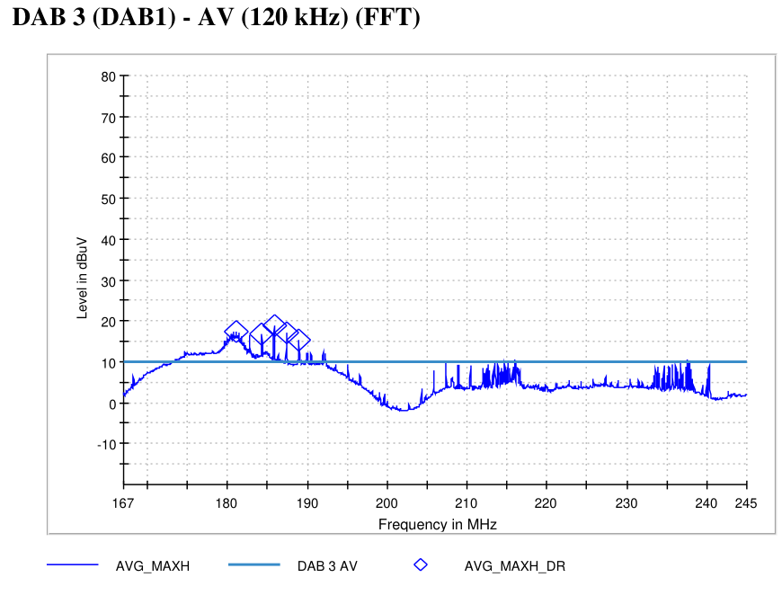
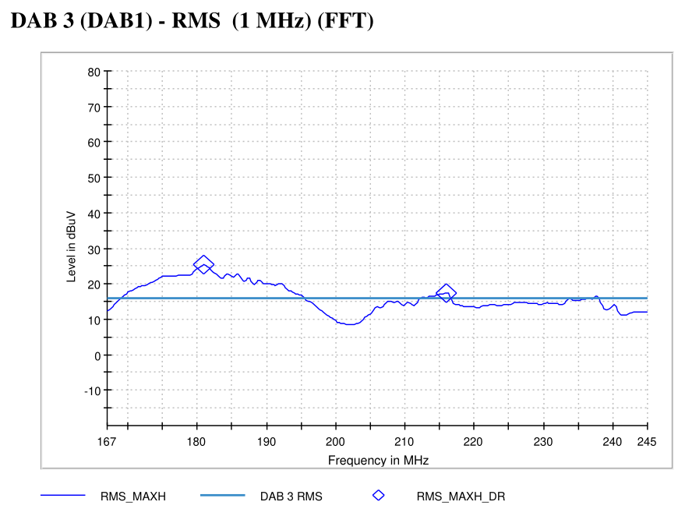
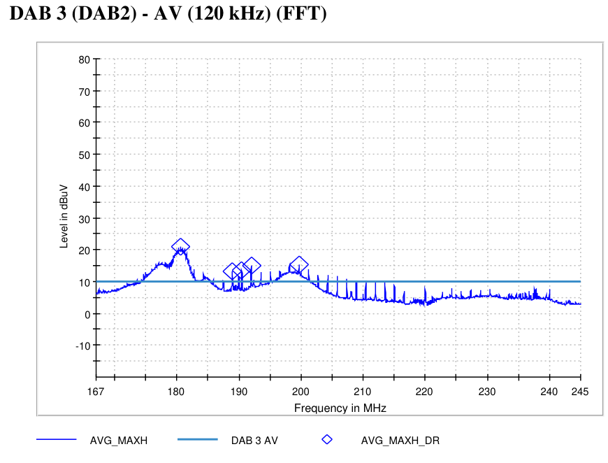
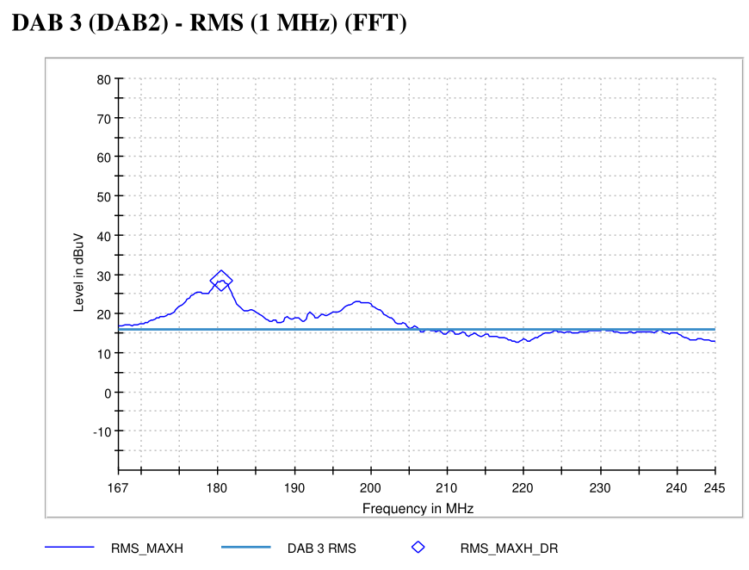
5537 - State 42 | VT-07 On-Board Emissions
State Information

Slide 6
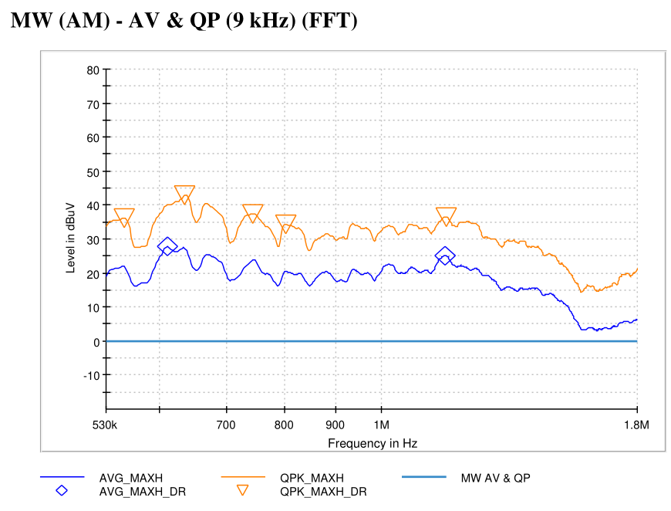
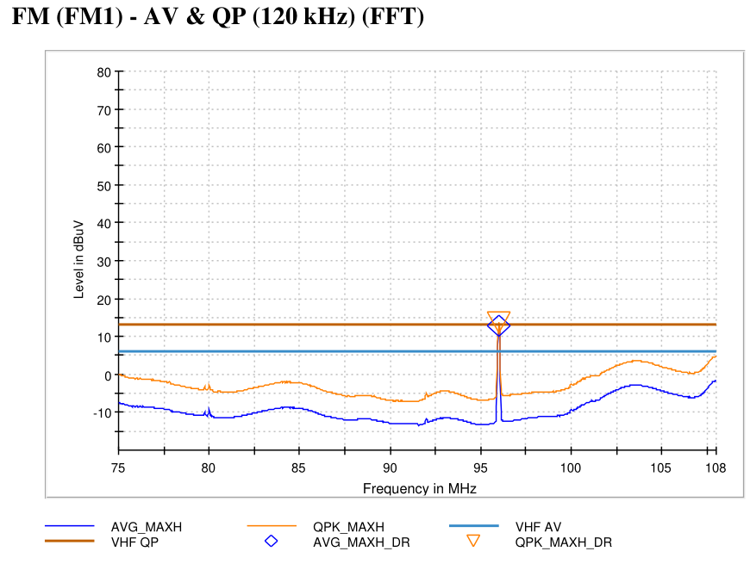
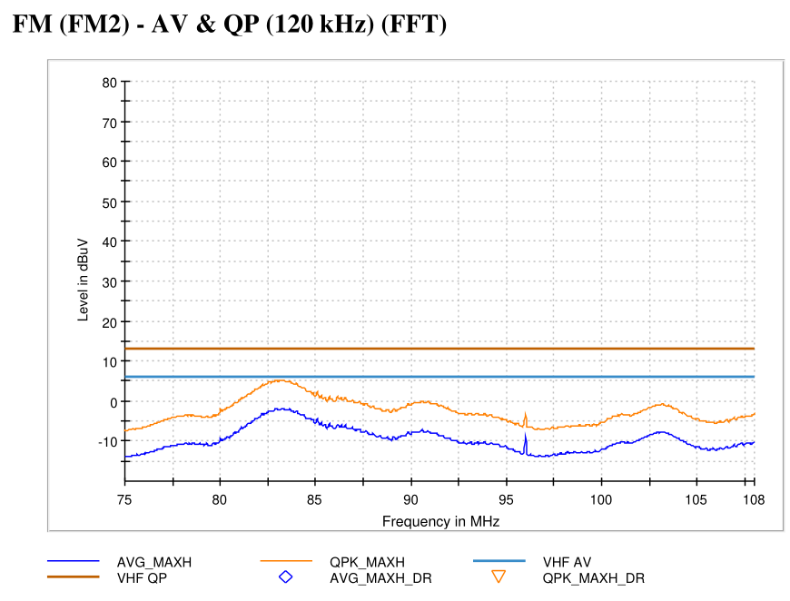
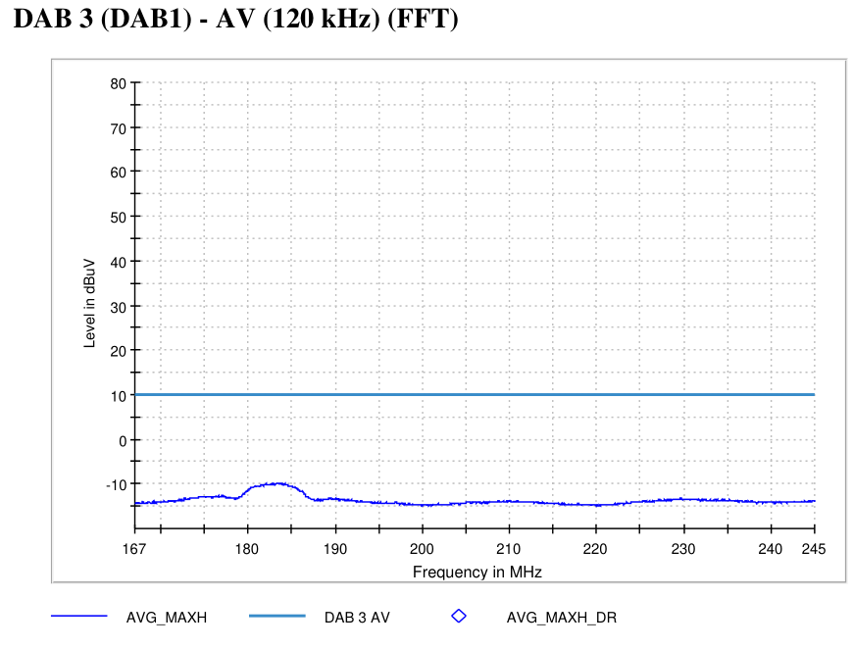
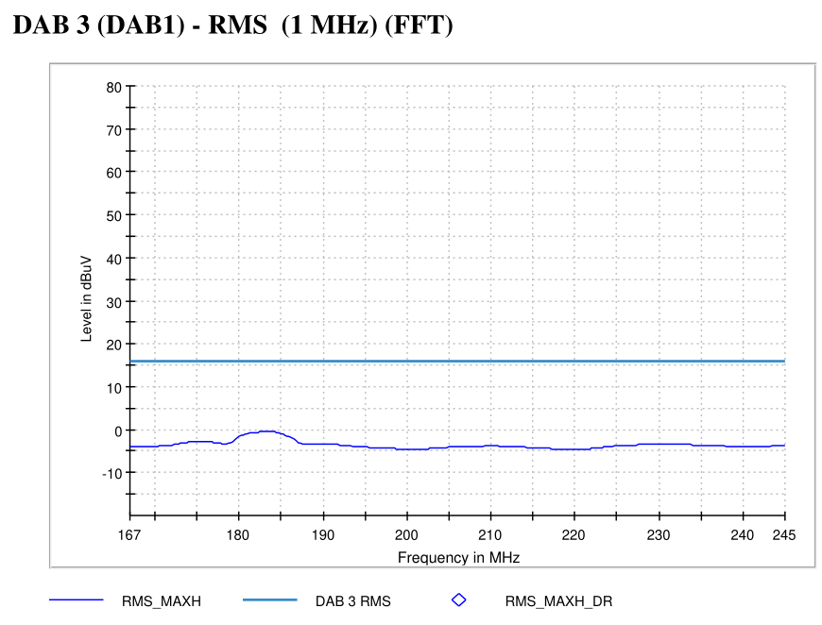
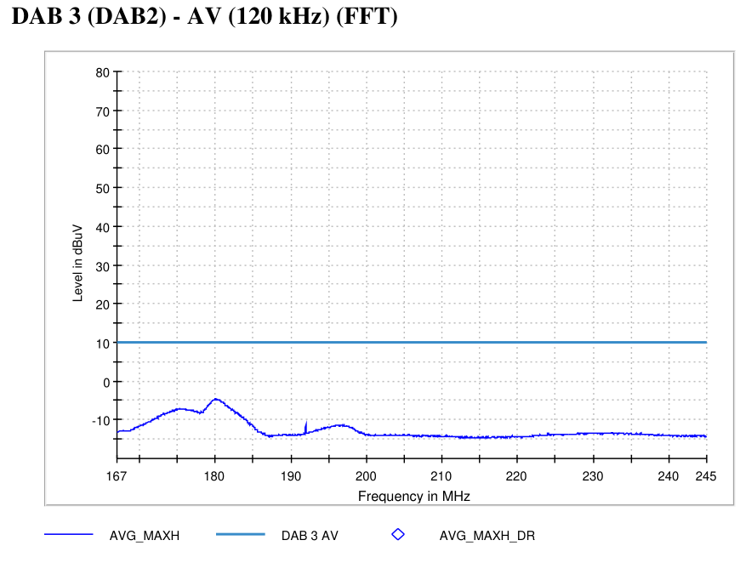
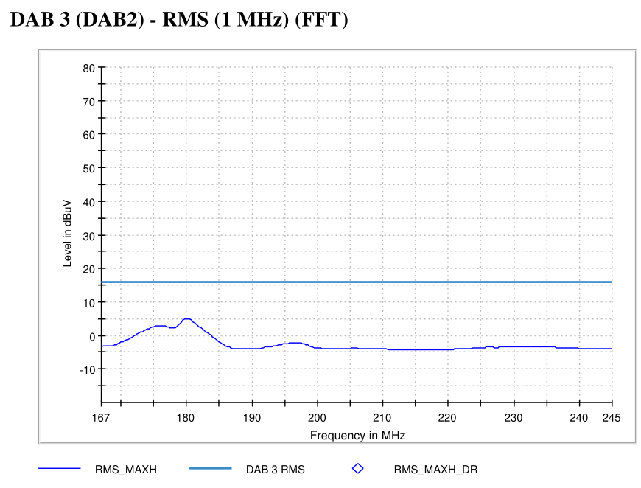
5537 - State 43 | VT-07 On-Board Emissions
State Information

Slide 7
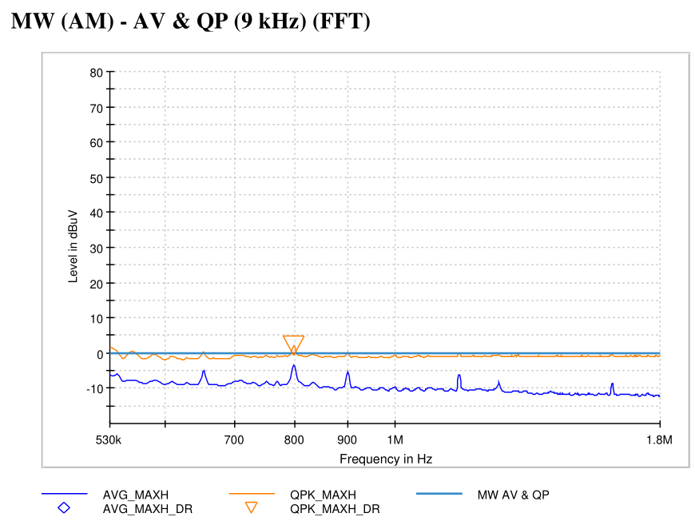
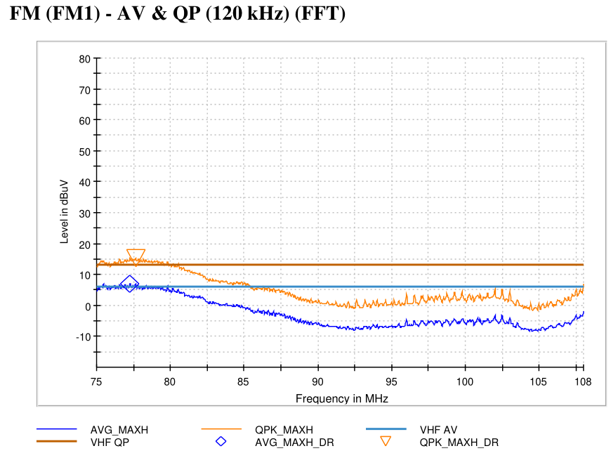
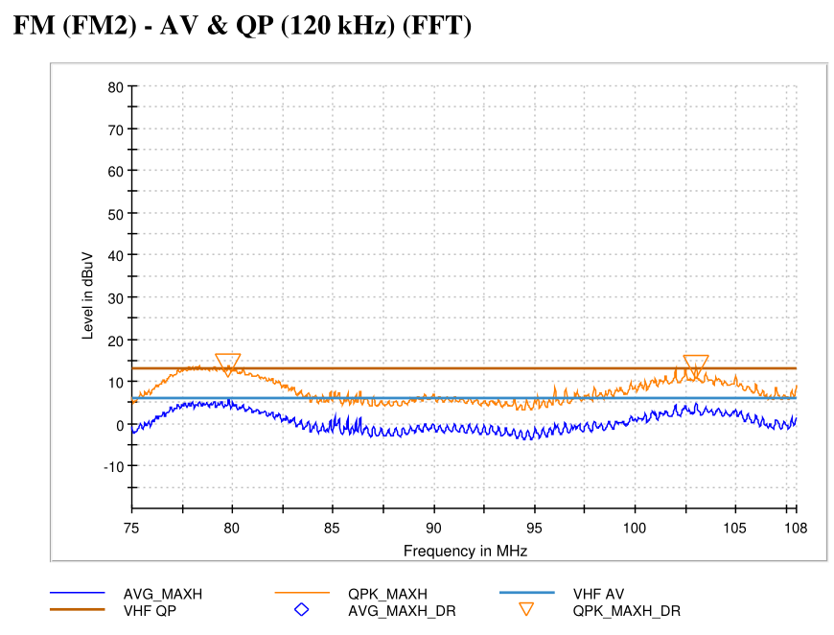
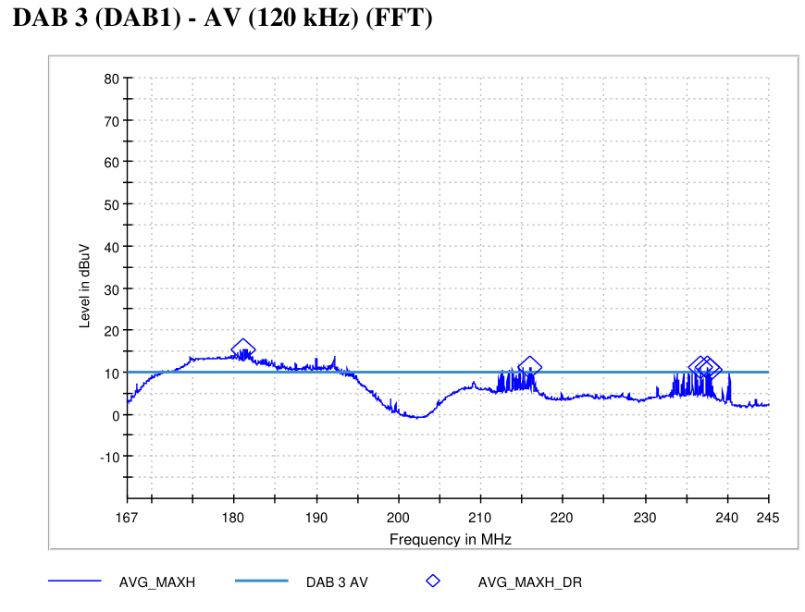
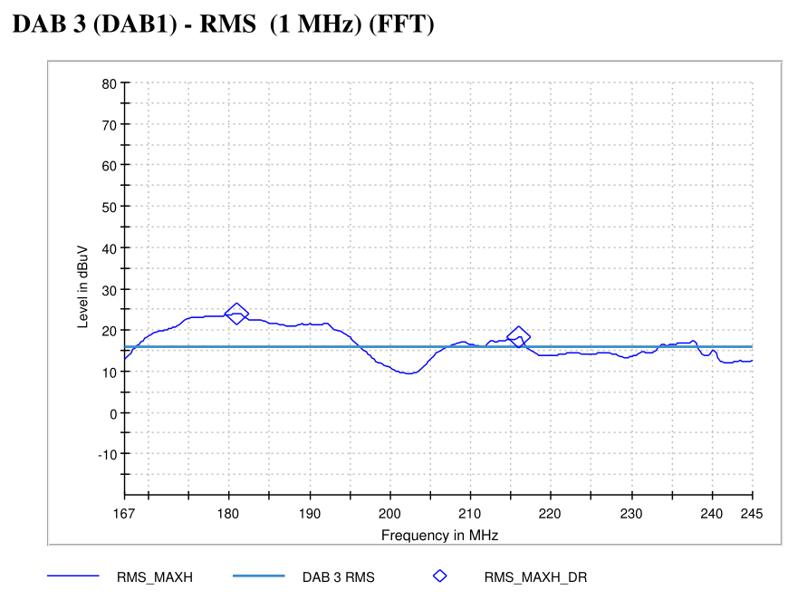
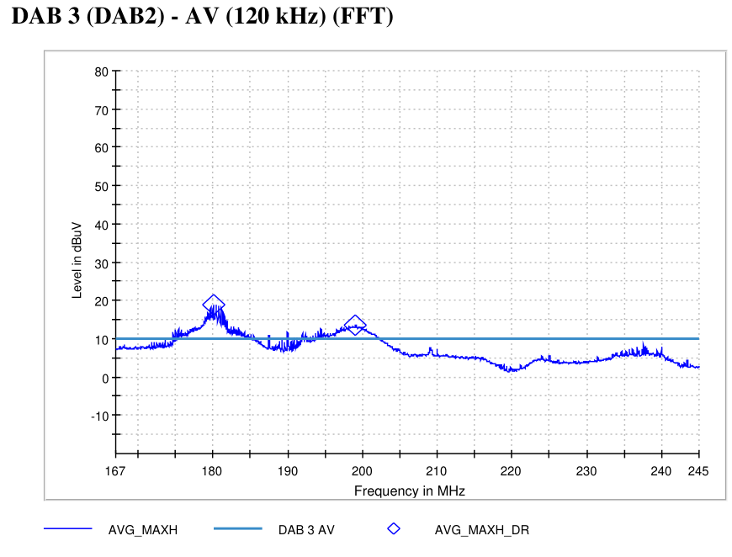
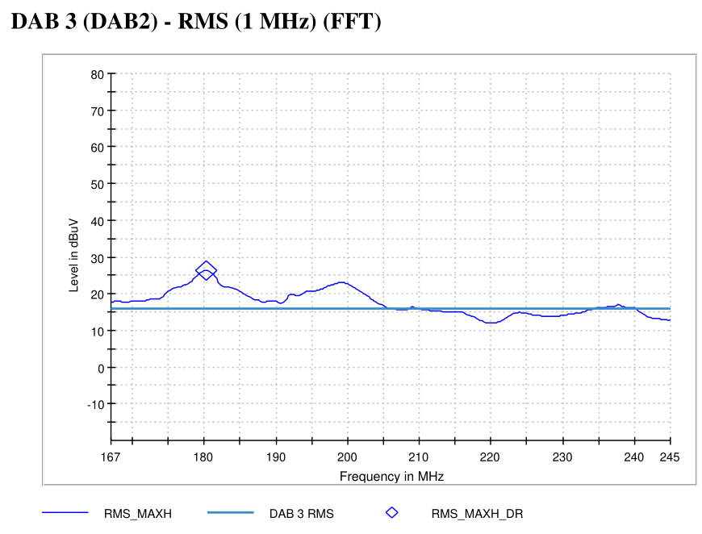
5537 - State 41 | VT-07 On-Board Emissions
State Information

Slide 8
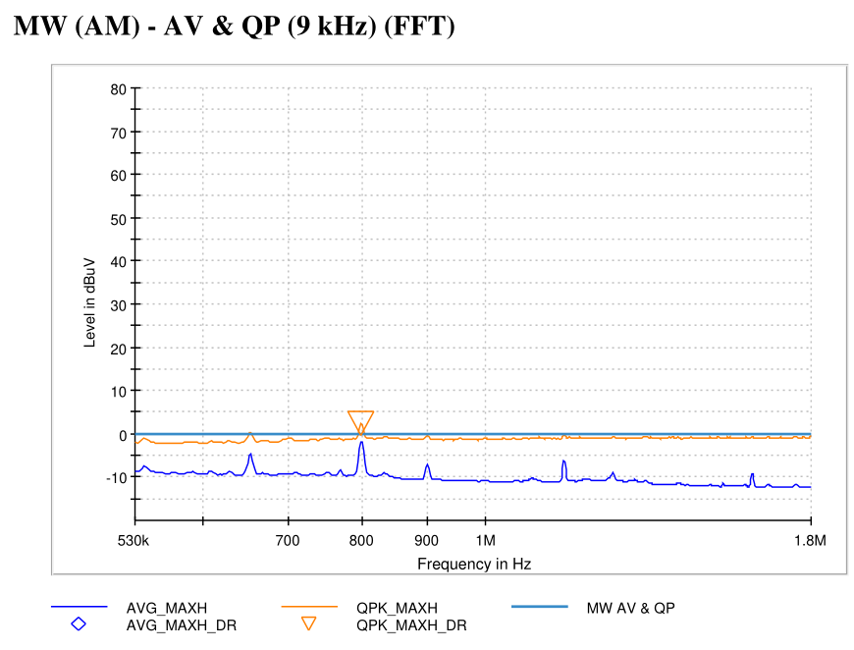
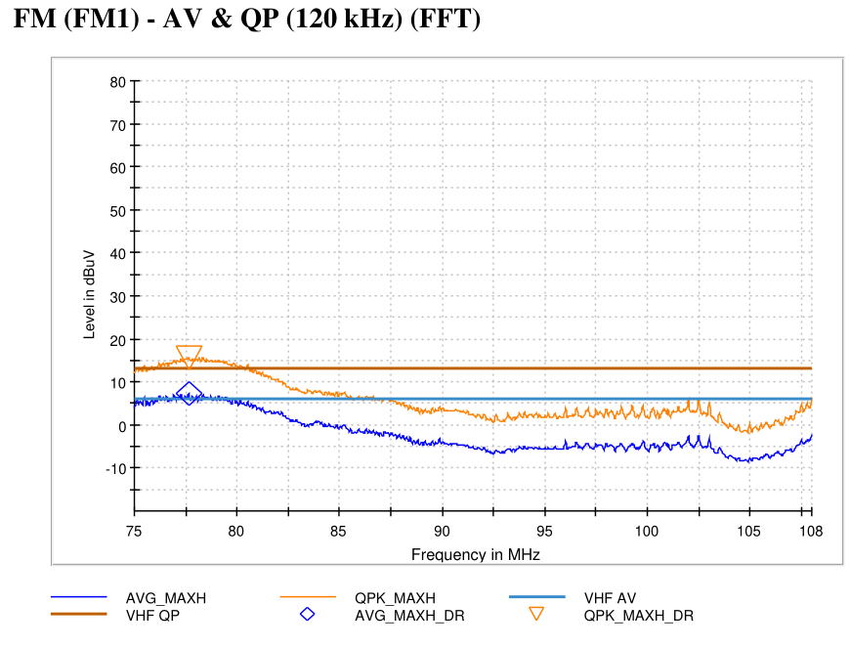
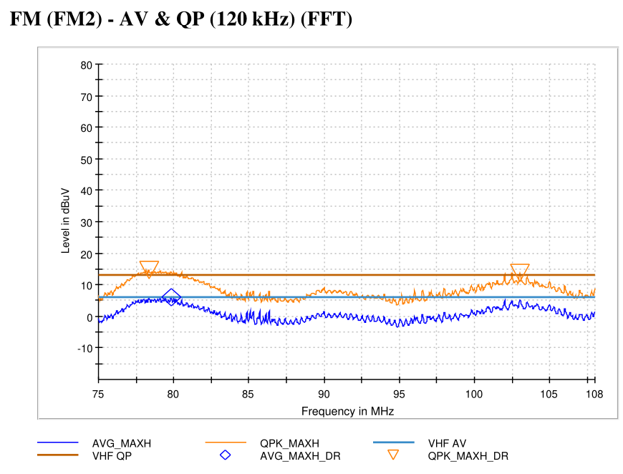


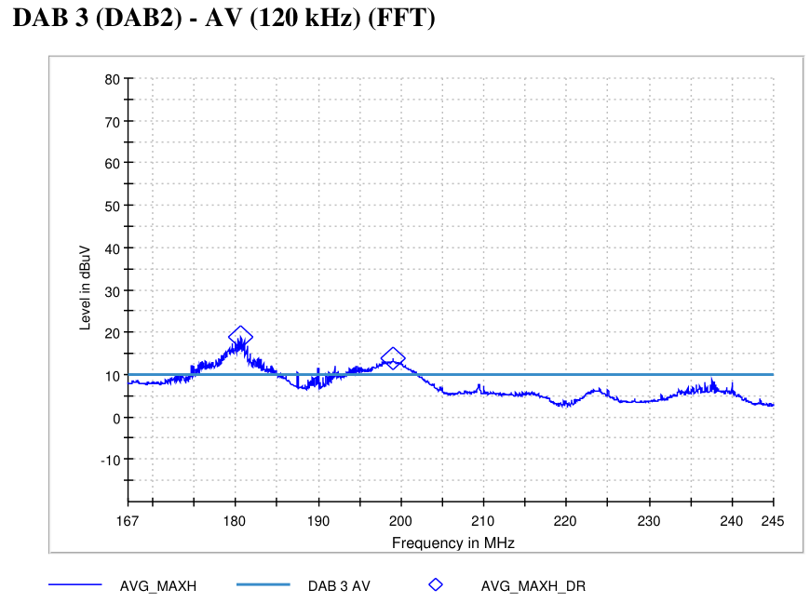
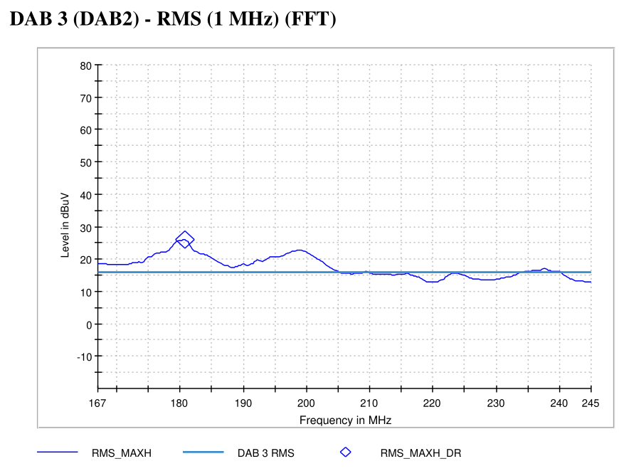
5537 - State 40 | VT-07 On-Board Emissions
State Information

Slide 9
*8*
State Information

Slide 10
*9*
State Information

Slide 11
*10*
State Information

Slide 12
*11*
State Information

Slide 13
*12*
State Information

Slide 14
*13*
State Information

Slide 15
*14*
State Information

Slide 16
*15*
State Information

Slide 17
*16*
State Information

Slide 18
*17*
State Information

Slide 19
*18*
State Information

Slide 20
*19*
State Information

Slide 21
*20*
State Information

Slide 22
*21*
State Information

Slide 23
*22*
State Information

