Slide 1


M05 : Mini-project
Source : https://investmentindustryintergroup.eu/
Source : https://machinelearninghd.com/
Laura Sidler – Jérôme Amos

Slide 2
Summary
Reproducibility – What is it ?
Workflow management
Version Control Git
Code sharing with github
Unit testing – CI
Documentation
Packaging
Licensing

Slide 3
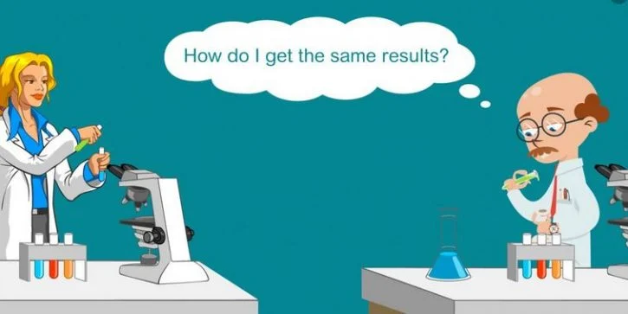
Reproducibility – What is it ?
0: Irreproducible
1 : Cannot semm to reproduce
2 : Reproducible, >1month
3 : Reproducible, >1week
4 : Reproducible, >15min, proprietary soft
5 : Reproducible, >15min, free soft
Source : M05 course
Source : https://www.scientific-editing.info

Slide 4





Workflow management
Pandas DataFrame
Train
Trainer
Pandas DataFrame
Pre-processing
Pandas DataFrame
Test
Machine
Analyser
Pandas DataFrame

Slide 5


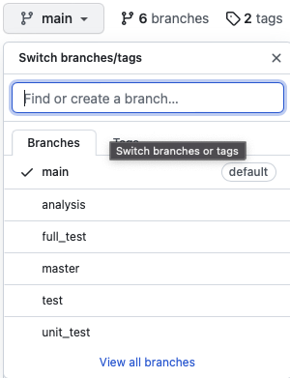
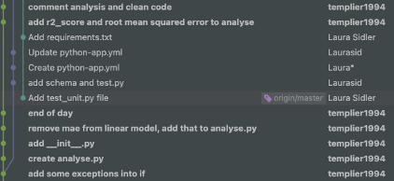
Version control : Git -> Github
Using git version control
Creation of branches on github
One commit per modification
https://github.com/Laurasid/M05_Project.git

Slide 6
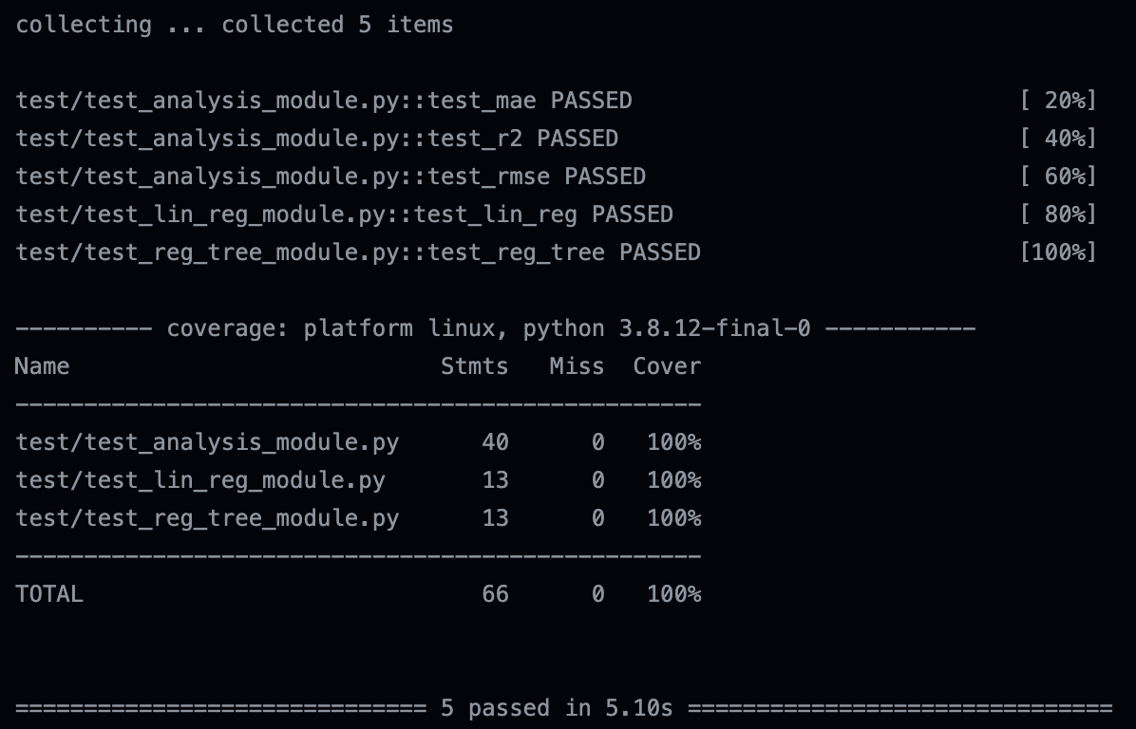

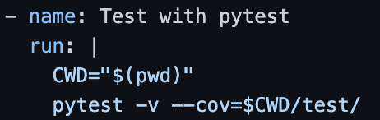
Unit Testing - CI
Unit tests with Pytest
Automation of tests with .yml script
test_analysis_module : tests mathematical formulae results and functions limits
test_lin_reg_module and test_reg_tree_module : test shape and instance of returned objects
Others module are not worth testing with unit test. But results was tested in the specific branch dedicated to.

Slide 7

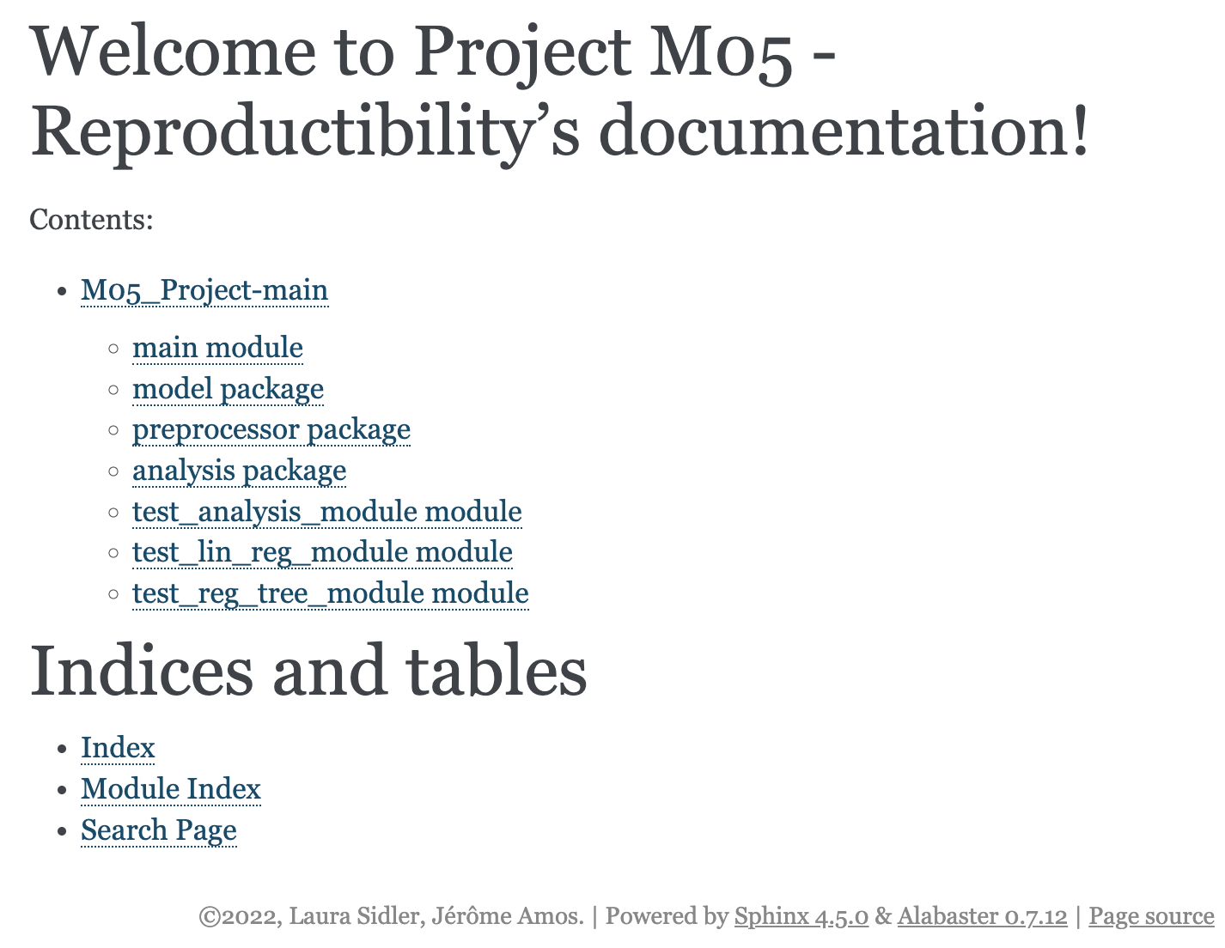
Documentation
Documentation is made with sphinx
.rst files are generated from .py files
Generation is made automatically in the CI

Slide 8
Packaging

Slide 9
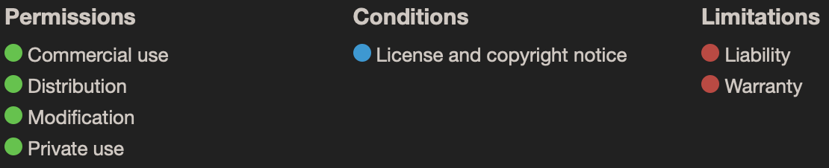

Licensing
Legal Instrument
Regulate the use and distribution of copyrighted software
MIT : can be modified or redistributed
Model : derivative work of dataset
=> Show license of dataset
MIT License Copyright (C) 2022, Laura Sidler - Jerome Amos Permission is hereby granted, free of charge, to any person obtaining a copy of this software and associated documentation files (the "Software"), to deal in the Software without restriction, including without limitation the rights to use, copy, modify, merge, publish, distribute, sublicense, and/or sell copies of the Software, and to permit persons to whom the Software is furnished to do so, subject to the following conditions: ….
Source : M05 course

