Slide 1


M05 : Mini-project
Source : https://investmentindustryintergroup.eu/
Source : https://machinelearninghd.com/
Laura Sidler – Jérôme Amos

Slide 2





Workflow management
Pandas DataFrame
Train
Trainer
Pandas DataFrame
Pre-processing
Versions:
Pandas 1.4.1
Sklearn 1.0.2
Pandas DataFrame
Test
Machine
Analyser
Pandas DataFrame

Slide 3


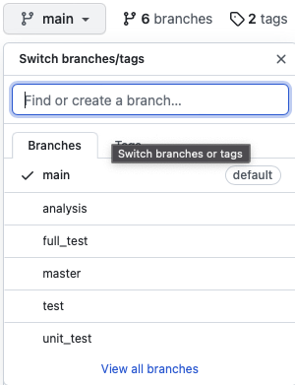
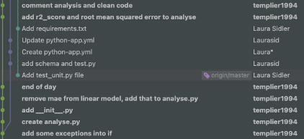
Version control : Git -> Github
Using git version control
Creation of branches on github
One commit per modification
https://github.com/Laurasid/M05_Project.git

Slide 4
Github - organization
~200 comits
6 branches

Slide 5
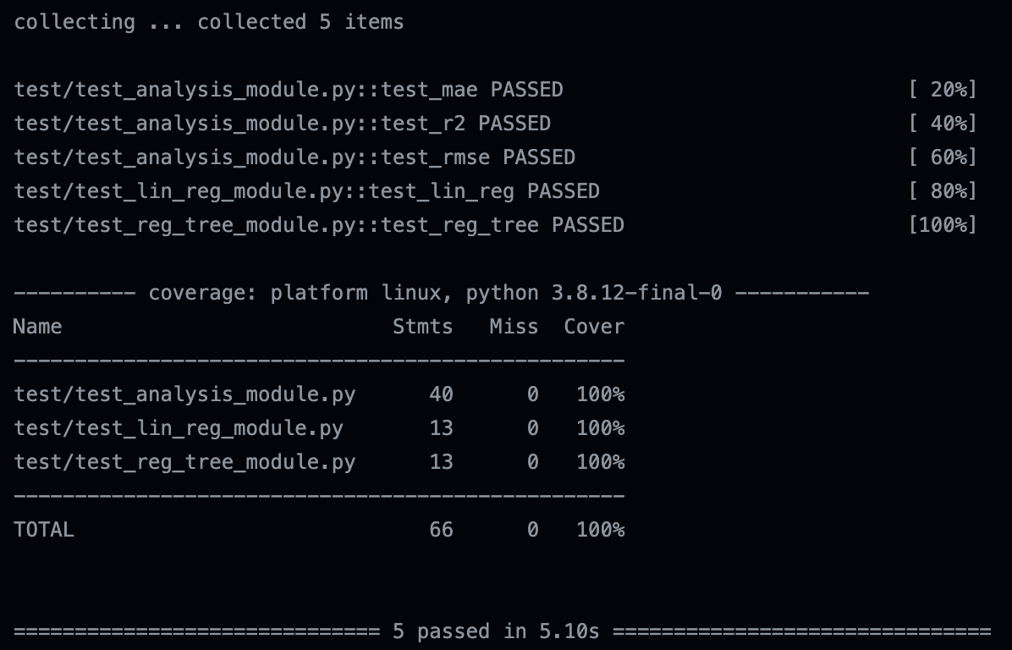

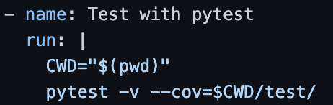
Unit Testing - CI
Unit tests with Pytest
Automation of tests with .yml script
test_analysis_module : tests mathematical formulae results and functions limits
test_lin_reg_module and test_reg_tree_module : test shape and instance of returned objects
Others module are not worth testing with unit test. But results was tested in the specific branch dedicated to.

Slide 6

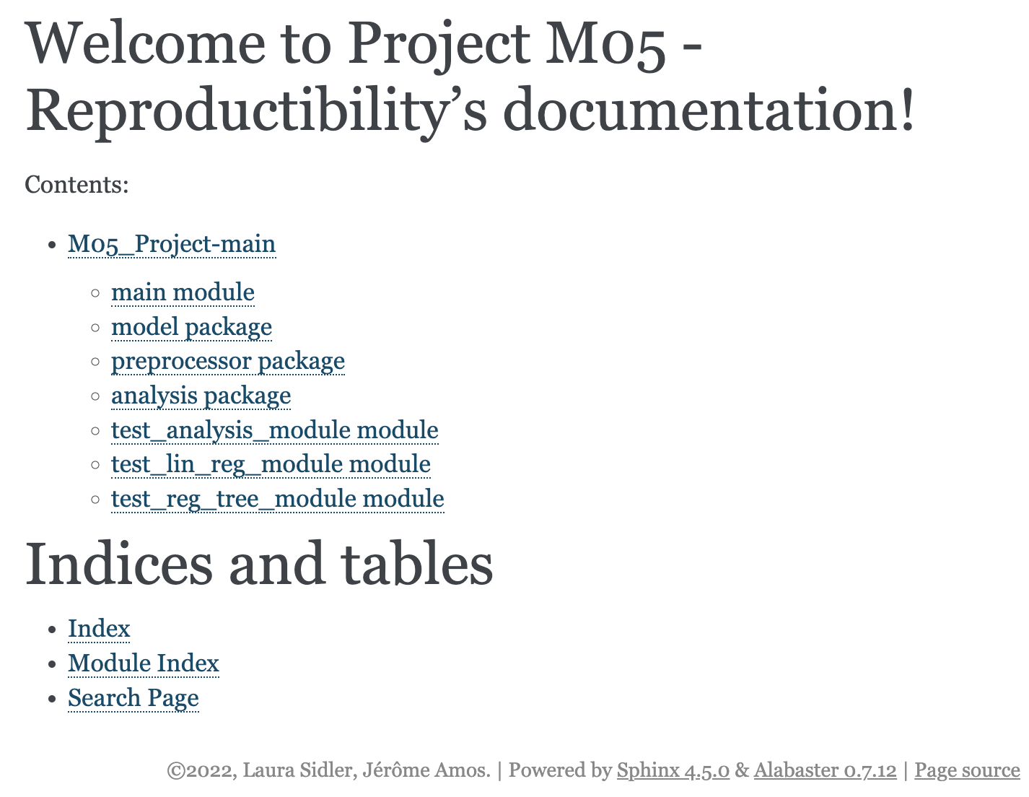
Documentation
Documentation is made with sphinx
.rst files are generated from .py files
Generation is made automatically in the CI

Slide 7


Licensing dependencies
Legal Instrument
Regulate the use and distribution of copyrighted software
Dependencies :
Pandas : BSD 3-Clause License
Numpy : BSD 3-Clause License
Sklearn : BSD 3-Clause License
Copyright application if redistributing source code
MIT License => compatible
Dataset :
Housing : no special license
Cite the authors
Source : M05 course

Slide 8
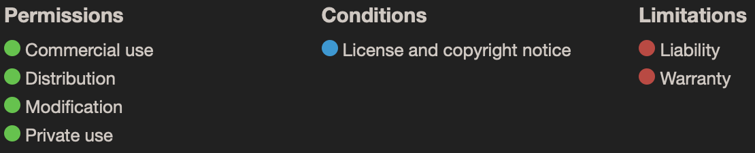
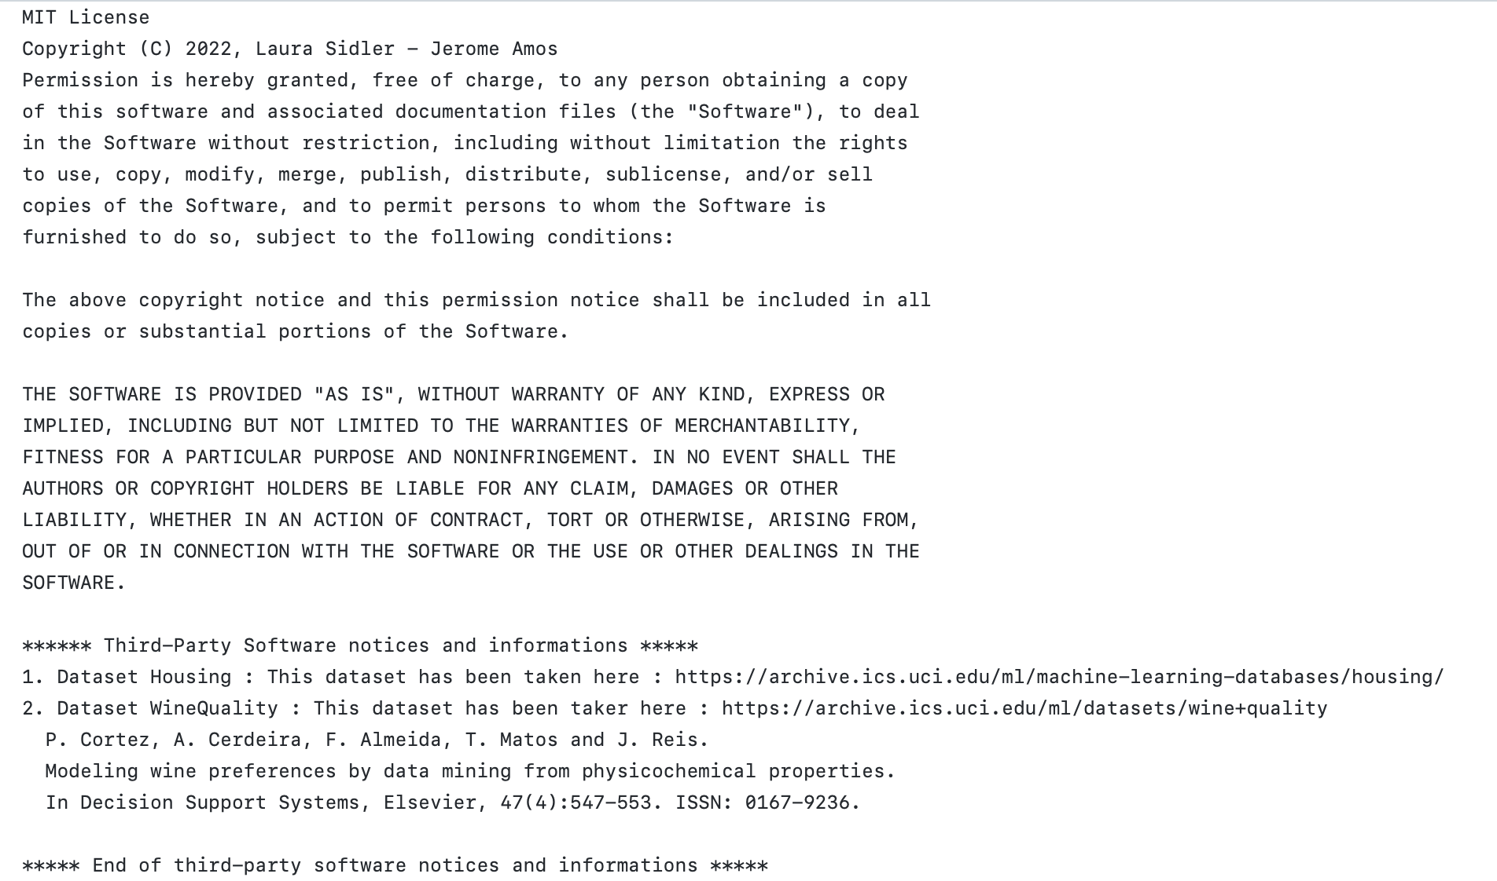

Licensing
MIT : can be modified or redistributed
Model : derivative work of dataset
=> Show license of dataset
Source : M05 course

