Slide 1


M05 : Mini-project
Source : https://investmentindustryintergroup.eu/
Source : https://machinelearninghd.com/
Laura Sidler – Jérôme Amos

Slide 2





Workflow management
Pandas DataFrame
Train
Trainer
Pandas DataFrame
Pre-processing
Versions:
Pandas 1.4.1
Sklearn 1.0.2
Pandas DataFrame
Test
Machine
Analyser
Pandas DataFrame

Slide 3


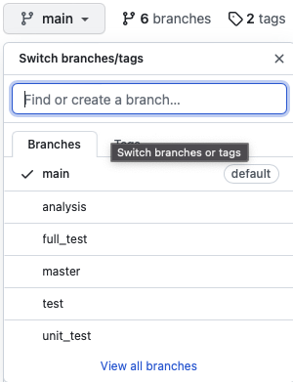
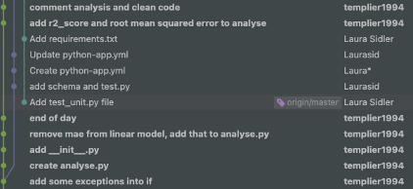
Version control : Git -> Github
Using git version control
Creation of branches on github
One commit per modification
https://github.com/Laurasid/M05_Project.git

Slide 4
Github - organization
~200 comits
6 branches

Slide 5

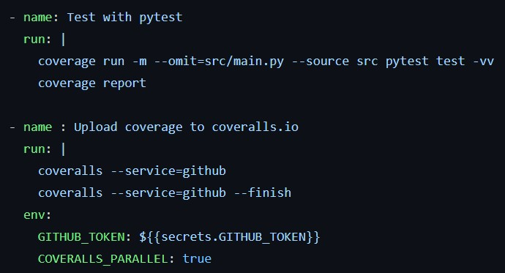
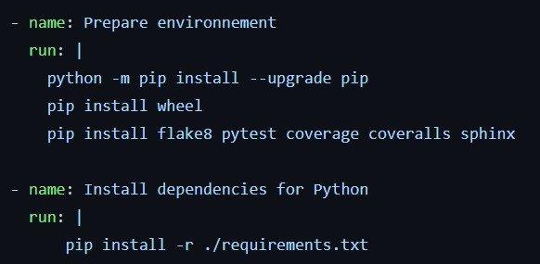
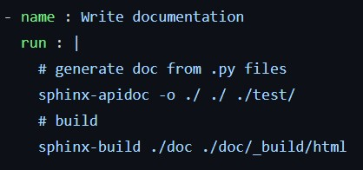
Unit Testing - CI
On push on all branches
2. Run test and upload coverage
1. Prepare environnement for CI
3. Generate and build documentation

Slide 6
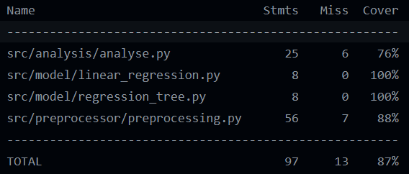
Unit Testing - CI
On push on all branches
Not covered : generation of plt figure
→ Test by visual confirmation
Not covered : all combinations of options
→ Already tested in analyse
Notes:
Tests for preprocessor are made to check the instance and shape of objects returned by the methods. The methods used for preprocessing are tested in tesT_analysis_module so, in fact, all methods are covered.

Slide 7

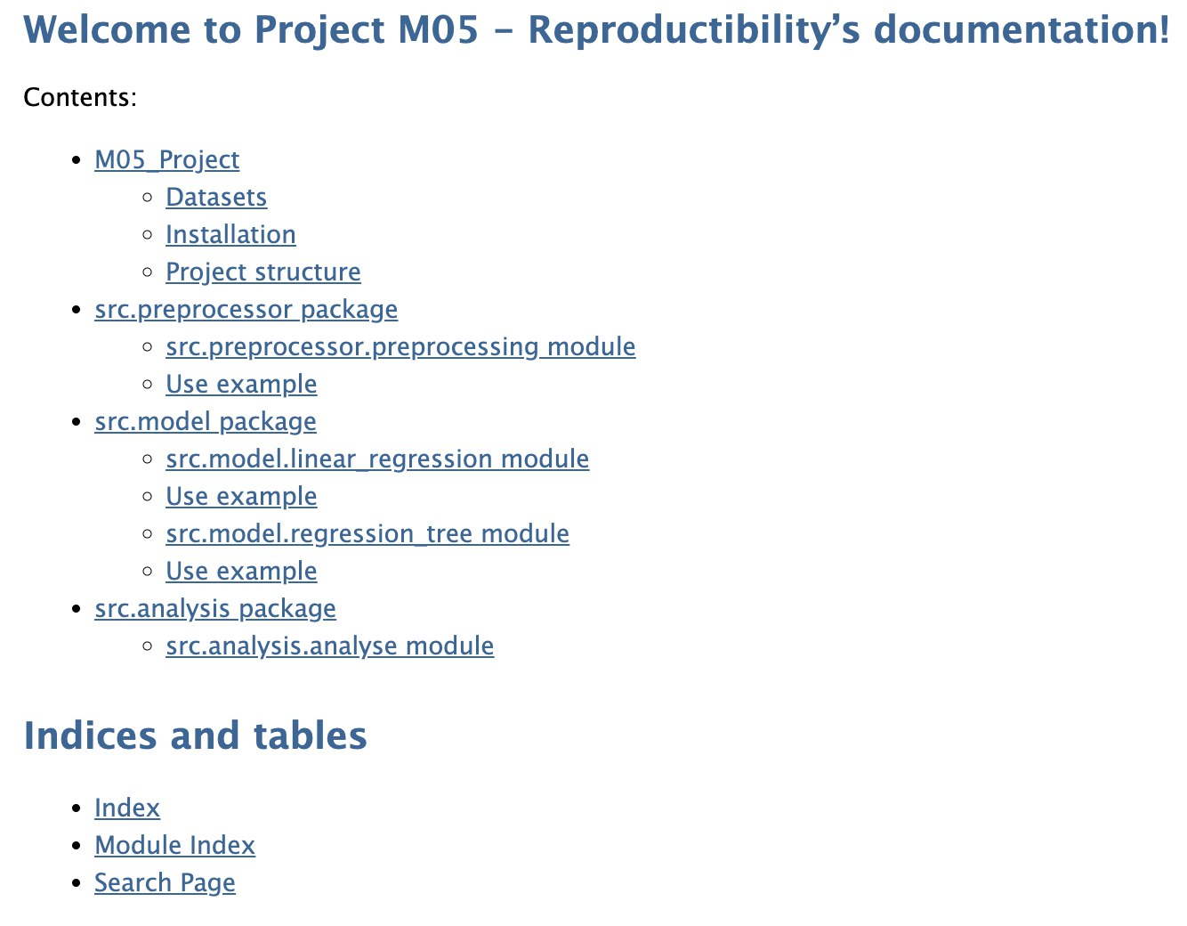
Documentation
Documentation is made with sphinx
.rst files are generated from .py files
Generation is made automatically in the CI
Documentation are generated in HTML
→ visible on browser

Slide 8
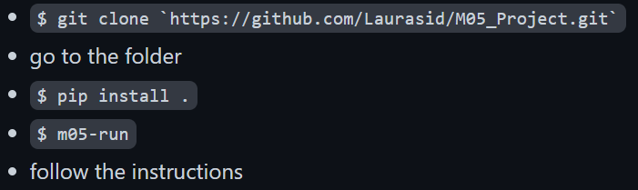
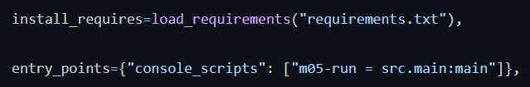
Distribution / Installation
Clone repository from github
Install program
Run program
Setup the distribution with setup file :
Install the dependencies
Launch the program

Slide 9


Licensing dependencies
Legal Instrument
Regulate the use and distribution of copyrighted software
Dependencies :
Pandas : BSD 3-Clause License
Numpy : BSD 3-Clause License
Sklearn : BSD 3-Clause License
Copyright application if redistributing source code
MIT License => compatible
Dataset :
Housing : no special license
Cite the authors
Source : M05 course

Slide 10
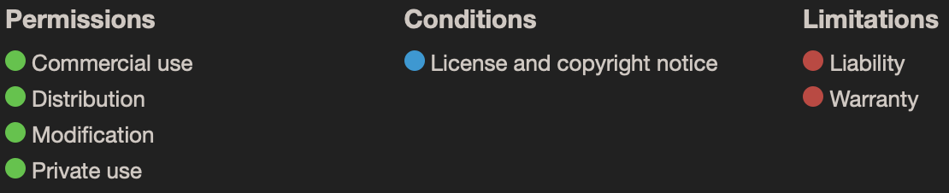
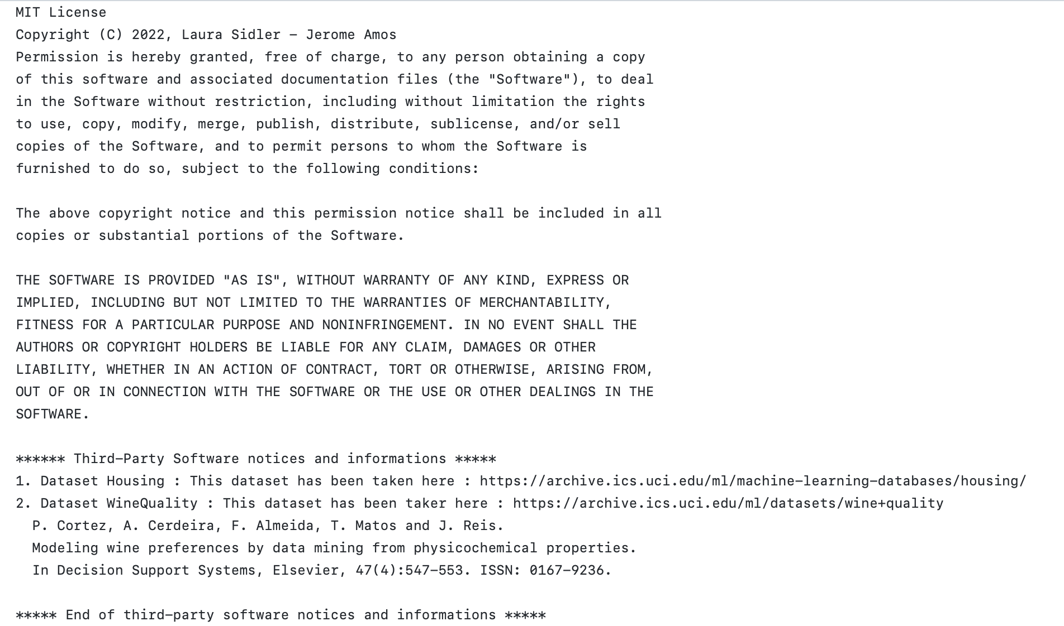

Licensing
MIT : can be modified or redistributed
Model : derivative work of dataset
=> Show license of dataset
Source : M05 course

