Slide 1

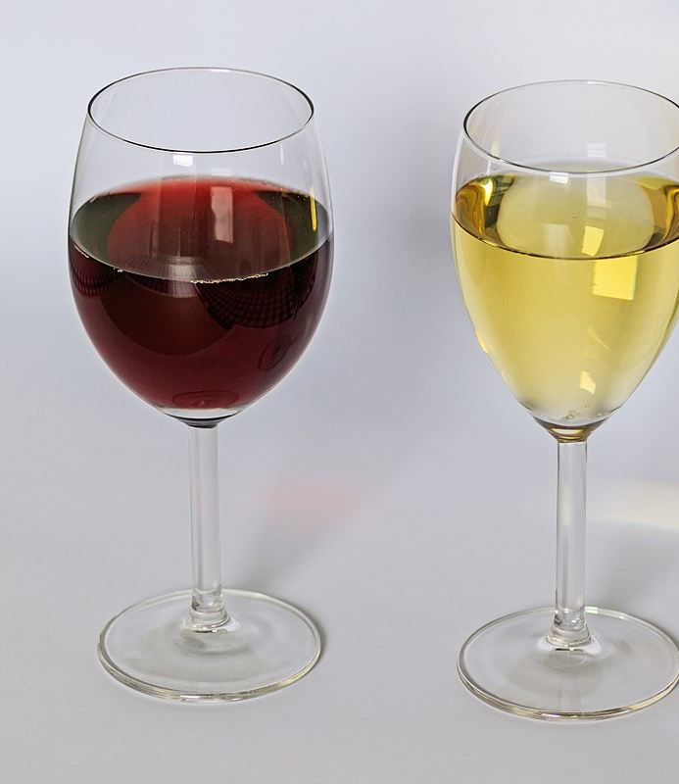
Mini-Project M05
Goal of the project :
- Master the concepts of reproductibility
Images © : - ceps.eu
- wikipedia.org
Sidler Laura, Amos Jérôme

Slide 2


Workflow
Train
Trainer
Pre-processing
Test
Machine
Score
Sidler Laura – Amos Jérôme
Source : M05 course content

Slide 3
Project Management
Version control : github project management

