Slide 1
Team ABN
Pricop Laurențiu
Stanciu Alin

Slide 2
Content
Application Context. Information Objective
Chosen techniques and motivatio
Findings
Issues found
Conclusions

Slide 3
Application Context. Information Objectives (1)
We are employees at a software agency, specializing in web software, in particular business-to-business solutions customized for each customer. The company lead has a middle-school child which came up with the idea of an application to manage snail mail they were constantly sending to their friends. Rather surprisingly, a specific market demand was identified for the application after development was complete. It seems the company’s business partners can apply the software as an internal solution to manage mail going in and out of their headquarters.
The company lead wants to capitulate on this newfound demand, but the application is currently in an unfit state. As such, our company decided to expand the development team on the so-called PMail project and bring in some new roles. In particular, we, Laurentiu and Alin, were hired as QA engineers, which now have the task of identifying an initial round of bugs and issues found with the product after its initial, internal, launch.

Slide 4
Application Context. Information Objectives (2)
Being an in-house and a training project, bugs are expected and the company lead insists on listing as many of them as possible. Additionally, the user interface and experience was an after-thought during development of PMail, so the company lead also wants to identify specific elements and flows of the application that might be a bit harder to grasp for a person unfamiliar with it, in the form of user experience hiccups.

Slide 5
Chosen techniques and motivation (1)
The strategy is fairly straightforward, and is broken up in two parts.
1. API Black-Box Testing
We are going to write integration tests for two functionalities of the application, that call APIs and test for proper responses and error messages. We limit ourselves to the API initially since we consider it to be the backbone of any web application, thus being of significant importance testing-wise. These tests try to uncover an assortment of types of bugs that relate to, but are not limited to, the following aspects: database connection, syntactically invalid data, semantically invalid data, incorrect references.

Slide 6
Chosen techniques and motivation (2)
2. User Experience: Exploratory Testing
We are going to fiddle with the application’s frontend, manually and in an exploratory manner, to try to uncover as many design anti-patterns as we can. We’re going to make a list of behaviors that we identify as potential issues and hand it over to the company lead, which will decide what, if any, corrective actions are going to be taken for each of them.

Slide 7
Findings (1)
Surprisingly, we found much fewer bugs on the technical side of the application. The backend API was implemented carefully, without any major issues. Although data validation was lacking, almost non-existent, we didn’t find any security risks, like SQL injection vulnerabilities, and the application is working without errors.
However, on the design side, we found more problems, including UI design consistency, confusing navigation or discarding data without warning

Slide 8
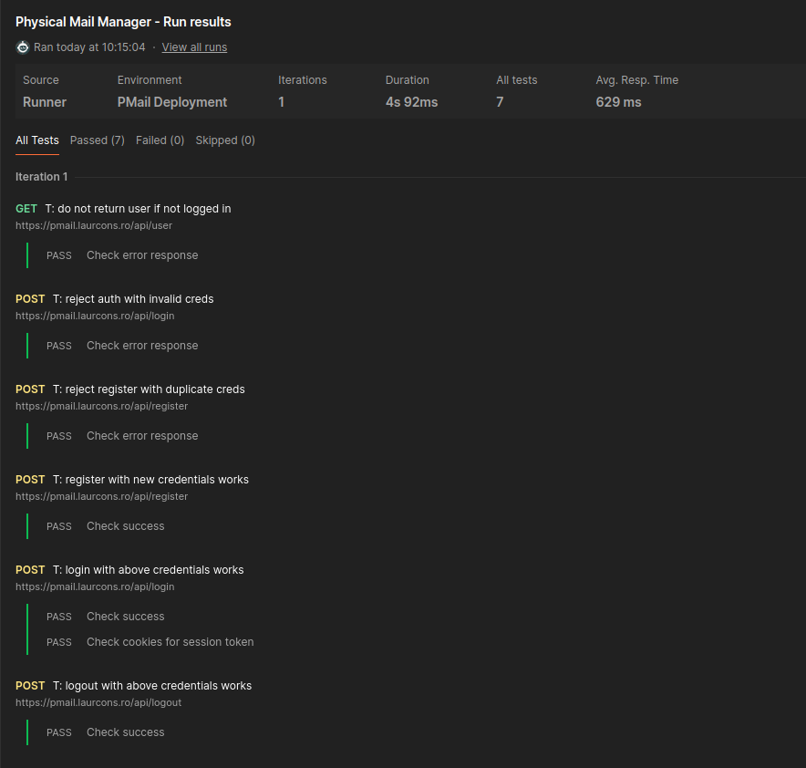
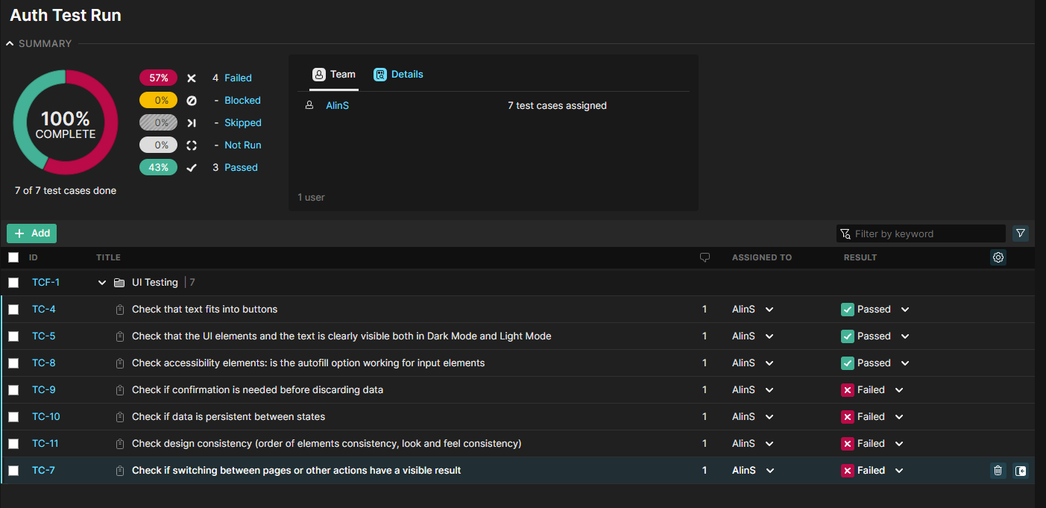
Findings (2)
Here is a side-by-side comparision between two test reports.
One for authentication on the backend side, with automated tests focused on the technical implementation. (7/7 passed)
Another report for the UI side, with manual tests focused on the design. (3/7 passed)

Slide 9
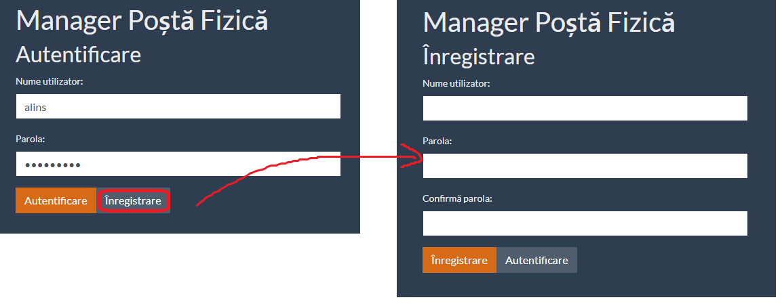
Issues found
One of the design issues we found during testing stems from the confusing design of the login page. The user is asked to enter a username and a password, then they must click on one of the two buttons below: the authentication button and the register button.
A first-time user might expect to be able to register by clicking the register button, but instead, the provided data is discarded and the user is redirected to a different page, the registration page.
Expected behavior: The data (username and password) should not be discarded when switching to the register page

Slide 10
Conclusions
Testing and the tehniques used while performing it are unique to every project and its requirements.
In this this project, manual UI testing proved to be the most valuable, being the best suited tool for finding UI design issues
Extensive automated tests were not needed, as the goal is to make sure the product is fit for release, not test reusability.
However, thorough API testing was valuable as well, by giving us the confidence that the technical side is well implemented.
As a tester, what I found the most challenging was the level of expertize required in many different areas of computer science, such as API implementation, UI design, cyber-security, accessibility

