Slide 1
组员：W Zhang, Z Yin, D Zhang.
指导老师：Z Jia.
Hefei University of Technology
November 30, 2019

Slide 2


目录/Content
研究选题
方案设计
调查实施
分析与结论

Slide 3
研究选题
研究背景
第一部分
课题来源
方案整体设计

Slide 4
研究背景
TEXT
TEXT
TEXT
TEXT

Slide 5
课题来源
1
TEXT
课题
来源
2
TEXT
3
TEXT

Slide 6
方案设计
调查目的
第二部分
问卷设计

Slide 7
调查目的
01
TEXT
02
TEXT
03
TEXT

Slide 8
问卷设计
第一部分
第二部分
第三部分
TEXT
TEXT
TEXT

Slide 9
调查实施
调查方案
第三部分
质量控制

Slide 10
调查方案
TEXT
TEXT

Slide 11
质量控制
TEXT
TEXT

Slide 12
分析与结论
主要影响因素研究——随机森林算法
使用者行为预测研究——GBDT算法
第四部分
用户画像与产品画像
结论与建议

Slide 13
TEXT？

Slide 14
描述统计
“TEXT”
“TEXT”
“TEXT”
TEXT
TEXT
TEXT
TEXT

Slide 15
THANKS!
恳请各位老师批评指正！
组员：W Zhang, Z Yin, D Zhang.
指导老师：Z Jia.
Hefei University of Technology
November 30, 2019

Slide 16
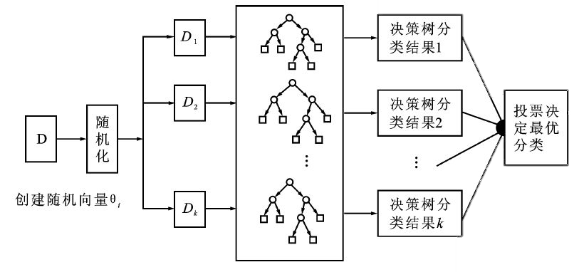
随机森林(Random Forest)
图1 随机森林算法流程图
随机：将变量（列）的使用和数据（行）随机化，生成很多分类树。以取得较好的泛化能力和抗过拟合能力。
森林：使用CART决策树作为弱学习器的Bagging方法。使它更精准。

Slide 17
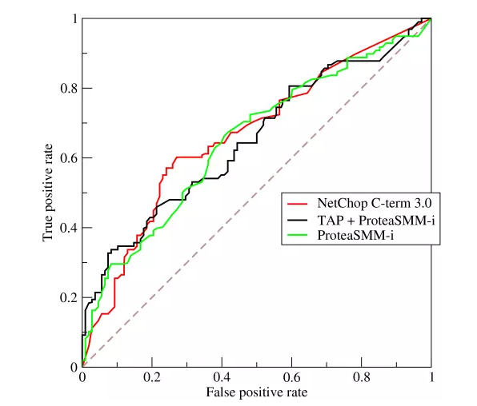
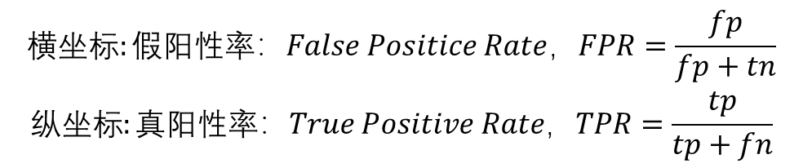
AUC分数
$$\begin{matrix}横坐标:假阳性率：False Positice Rate，FPR=\frac{fp}{fp+tn} \\ 纵坐标:真阳性率：True Positive Rate，TPR=\frac{tp}{tp+fn}\end{matrix}$$
AUC是衡量二分类模型优劣的一种评价指标，AUC越大，说明该分类器分类效果更好。
AUC Score (Train): 0.870019

Slide 18
OOB分数
袋外（OOB）误差，也称为袋外估计，是一种利用自助聚合（装袋）到子样本来测量随机森林，Boosting决策树和其他机器学习模型的预测误差的方法用于培训的数据样本。
它是用来计算正确分类的平均值。
即模型的分类正确分数较高，表明所选自变量对因变量的预测精度较高。
oob_sore：0.7783

Slide 19
梯度提升决策树(GBDT)算法的优点
预测精度高；
能处理非线性数据；
可以灵活处理各种类型的数据，包括连续值和离散值。
相对于支持向量机(SVM)在相对少的调参时间情况下，预测的准备率也可以比较高。
使用一些健壮的损失函数，对异常值的鲁棒性非常强。

Slide 20
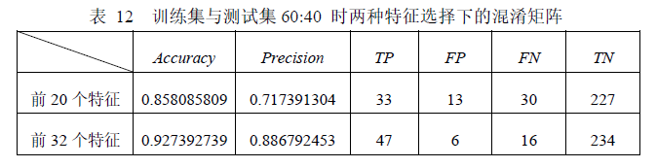
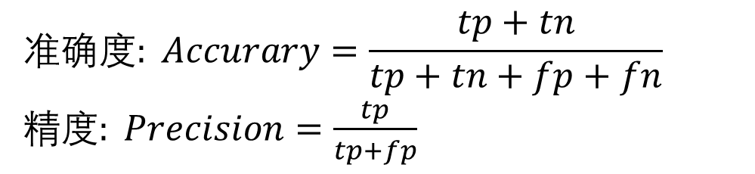
混淆矩阵
真阳性(True Positive，TP)：检测有且实际有
假阳性(False Positive，FP)：检测有但实际无
真阴性(True Negative，TN)：检测无且实际无
假阴性(False Negative，FN)：检测无但实际有
$$准确度: Accurary=\frac{tp+tn}{tp+tn+fp+fn}$$
精度$: Precision=\frac{tp}{tp+fp}$

Slide 21
RandomForst_GridSearchCV.py
#!/usr/bin/env python # -*- coding: utf-8 -*- # @File : RandomForst_GridSearchCV.py # @Software: PyCharm import pandas as pd import numpy as np from sklearn.model_selection import train_test_split from sklearn.ensemble import RandomForestClassifier from sklearn.model_selection import GridSearchCV from sklearn import metrics df = pd.read_csv("dodata_779.csv") x, y = df.iloc[:, 1:].values, df.iloc[:, 0].values x_train, x_test, y_train, y_test = train_test_split(x, y, test_size = 0.3, random_state = 0) feat_labels = df.columns[1:] print(feat_labels) forest = RandomForestClassifier(n_estimators=10000, oob_score=True,random_state=0, n_jobs=-1) forest.fit(x_train, y_train) importances = forest.feature_importances_ indices = np.argsort(importances)[::-1] for f in range(x_train.shape[1]): print("%2d) %-*s %f" % (f + 1, 30, feat_labels[indices[f]], importances[indices[f]])) print('\n') print (forest.oob_score_) y_predprob = forest.predict_proba(x_train)[:,1] print ("AUC Score (Train): %f" % metrics.roc_auc_score(y_train, y_predprob))

Slide 22
RandomForst_GridSearchCV.py
#调节参数 内部节点再划分所需最小样本数min_samples_split和叶子节点最少样本数min_samples_leaf param_test3 = {'min_samples_split':range(86,93,1), 'min_samples_leaf':range(1,14,1)} gsearch3 = GridSearchCV(estimator = RandomForestClassifier(n_estimators= 529, max_features='sqrt' ,oob_score=True, random_state=10), param_grid = param_test3, scoring='roc_auc',iid=False, cv=5) gsearch3.fit(x_train,y_train) print(gsearch3.best_params_, gsearch3.best_score_)

Slide 23
#!/usr/bin/env python # -*- coding: utf-8 -*- # @File : RF_result-to-CSV.py # @Software: PyCharm import pandas as pd import numpy as np import csv from sklearn.model_selection import train_test_split from sklearn.ensemble import RandomForestClassifier from sklearn import metrics df = pd.read_csv("dodata_779.csv") x, y = df.iloc[:, 1:].values, df.iloc[:, 0].values x_train, x_test, y_train, y_test = train_test_split(x, y, test_size = 0.3, random_state = 0) feat_labels = df.columns[1:] forest = RandomForestClassifier(n_estimators=529,min_samples_split=88,max_depth=5,oob_score=True,random_state=0, n_jobs=-1) forest.fit(x_train, y_train) importances = forest.feature_importances_ indices = np.argsort(importances)[::-1] with open("RFr.csv", "w", encoding='utf-8') as csvfile: writer = csv.writer(csvfile) for f in range(x_train.shape[1]): tup_d=(feat_labels[indices[f]],str(importances[indices[f]])) lis = list(tup_d) with open("RFr.csv", "a+",encoding='utf-8') as csvfile: csv_write = csv.writer(csvfile) csv_write.writerow(lis) print('\n') print (forest.oob_score_) y_predprob = forest.predict_proba(x_train)[:,1] print ("AUC Score (Train): %f" % metrics.roc_auc_score(y_train, y_predprob)) print("RF training set score: %f" % forest.score(x_train, y_train)) print("RF test set score: %f" % forest.score(x_test, y_test))
RF_result-to-CSV.py

Slide 24
GBDT参数调优.py
#!/usr/bin/env python # -*- coding: utf-8 -*- # @File : GBDT参数调优.py # @Software: PyCharm import pandas as pd import numpy as np from sklearn.model_selection import train_test_split from sklearn.ensemble import GradientBoostingClassifier from sklearn.model_selection import GridSearchCV from sklearn import metrics df = pd.read_csv("dodata_GBDT.csv") x, y = df.iloc[:, 1:].values, df.iloc[:, 0].values x_train, x_test, y_train, y_test = train_test_split(x, y, test_size = 0.3, random_state = 0) feat_labels = df.columns[1:] gbr= GradientBoostingClassifier(random_state=10) gbr.fit(x_train, y_train) y_pred= gbr.predict(x_train) y_predprob= gbr.predict_proba(x_train)[:,1] print("Accuracy : %.4g" % metrics.accuracy_score(y_train, y_pred)) print("AUC Score (Train): %f" % metrics.roc_auc_score(y_train, y_predprob)) param_test1= {'n_estimators':list(range(20,81,10))} gsearch1= GridSearchCV(estimator = GradientBoostingClassifier(learning_rate=0.1,
min_samples_split=300,min_samples_leaf=20,max_depth=8,max_features='sqrt’,
subsample=0.8,random_state=10), param_grid= param_test1, scoring='roc_auc',iid=False,cv=5) gsearch1.fit(x_train, y_train) print(gsearch1.best_params_, gsearch1.best_score_)

Slide 25
GBDT_result.py
#!/usr/bin/env python # -*- coding: utf-8 -*- # @File : GBDT_result.py # @Software: PyCharm import pandas as pd from sklearn.model_selection import train_test_split from sklearn.ensemble import GradientBoostingClassifier from sklearn import metrics from sklearn.externals import joblib df = pd.read_csv("dodata_GBDT.csv") x, y = df.iloc[:, 1:].values, df.iloc[:, 0].values x_train, x_test, y_train, y_test = train_test_split(x, y, test_size = 0.3, random_state = 0) feat_labels = df.columns[1:] # 模型训练，使用GBDT算法 gbr = GradientBoostingClassifier(n_estimators=100, max_depth=3, min_samples_split=2,learning_rate=0.1,subsample=1) gbr.fit(x_train, y_train.ravel()) joblib.dump(gbr, 'GBDT_train_model.m') # 保存模型 y_gbr = gbr.predict(x_train) y_gbr1 = gbr.predict(x_test) y_predprob= gbr.predict_proba(x_train)[:,1] acc_train = gbr.score(x_train, y_train) acc_test = gbr.score(x_test, y_test) print(acc_train) print(acc_test) print("Accuracy : %.4g" % metrics.accuracy_score(y_train, y_gbr)) print("AUC Score (Train): %f" % metrics.roc_auc_score(y_train, y_predprob))

Slide 26
GBDT_predict.py
#!/usr/bin/env python # -*- coding: utf-8 -*- # @File : GBDT_predict.py # @Software: PyCharm import numpy as np import pandas as pd from sklearn.externals import joblib import csv gbr = joblib.load('GBDT_train_model.m') # 加载模型 test_data = pd.read_csv("dodata_GBDT.csv") testx_columns = [] for xx in test_data.columns: if xx not in ['12.您的运动类 APP 使用经历是: *']: testx_columns.append(xx) test_x = test_data[testx_columns] test_y = gbr.predict(test_x) test_y = np.reshape(test_y, (779, 1)) with open("predict.csv", "w", encoding='utf-8') as csvfile: writer = csv.writer(csvfile) with open("predict.csv", "a+",encoding='utf-8') as csvfile: csv_write = csv.writer(csvfile) csv_write.writerow(list(test_y))

Slide 27
随机森林和GBDT的不同
Bagging + 决策树 = 随机森林
AdaBoost + 决策树 = 提升树
Gradient Boosting + 决策树 = GBDT

Slide 28
Bagging和Boosting的不同
样本选择上：Boosting训练集不变
样例权重上：Bagging，均值采样；Boosting，错误率越大权重越大
并行计算上：
Bagging：预测函数可以并行生成
Boosting：预测函数只能顺序生成
预测函数上：
Bagging：所有预测函数权重相等
Boosting：分类误差小的分类器会有更大的权重

