Slide 1
project_3
April 19 2018

Slide 2
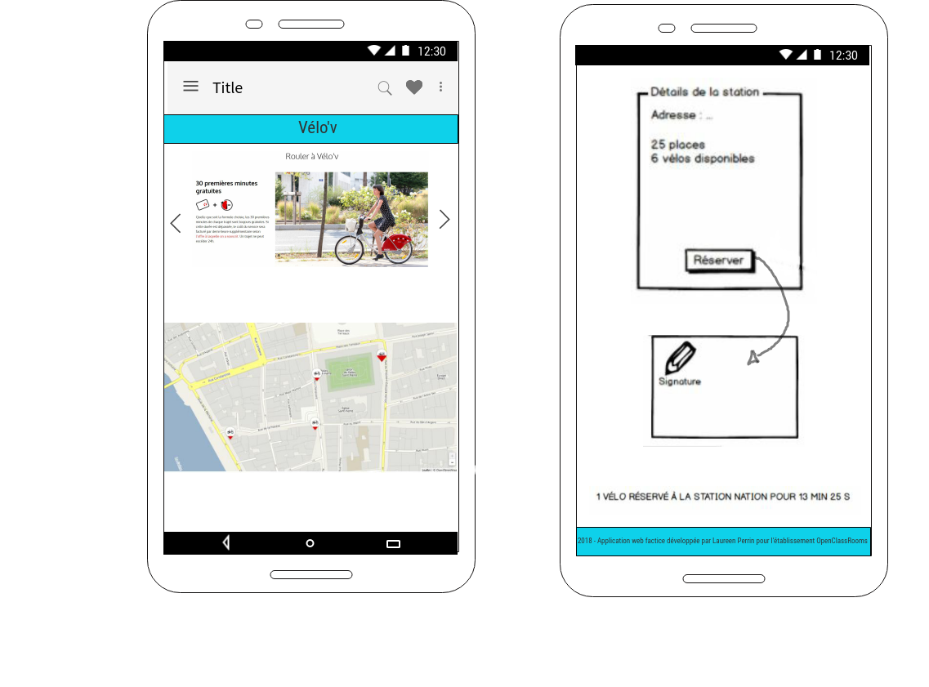

Slide 3
