Slide 1

SOFTWARE DEVELOPMENT PROJECT
PHASE 2
Partner 6 :
FOTSO LAUREL
MANGANO Alexandre
Under the coordination of Mr GRAVE

Slide 2
PLAN
I – Objectives
Objectives of the unit : phase 2
Subject n°2
II – UML study
Class diagram
Database diagram
Sequence diagram
III – Results

Slide 3
Objectives unit : phase 2
Realize the appropriate class diagram with the UML formalism (Application and Database)
Implement an Oracle database
Code a JAVA application which use an Oracle database

Slide 4
SUJBJECT N°2
The application should allow tracking of maintenance ticket :
Opening of a ticket
Processing of a ticket
Closing of a ticket
Reporting of the intervention
Customer validation of the report

Slide 5
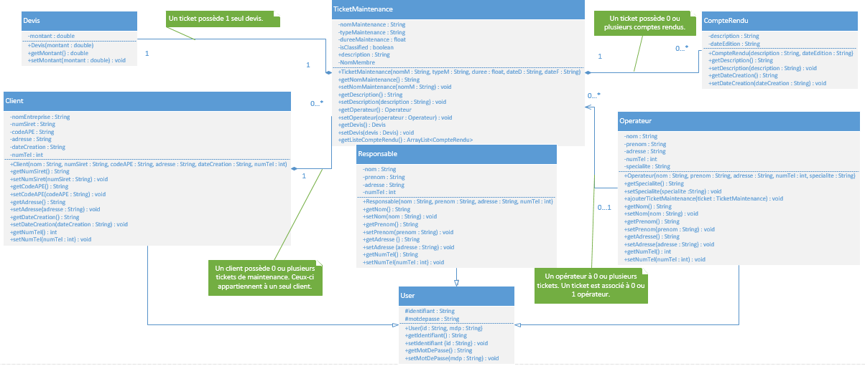
Class diagram

Slide 6
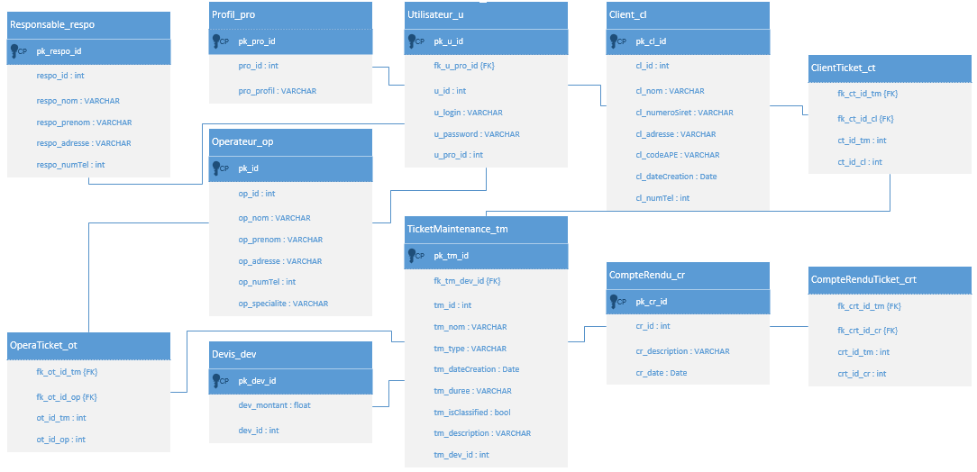
Database diagram

Slide 7
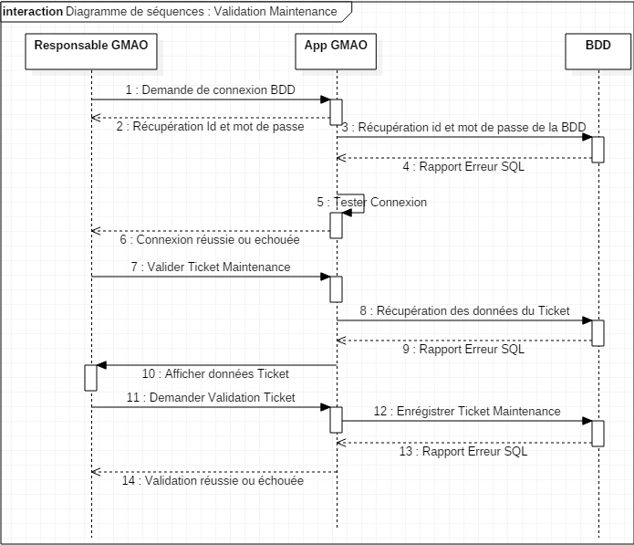
Sequence diagram

Slide 8
Results
Difficulties encountered :
Add Class while make the source code
Add table in the database in order to adapt the class with new data.
Some results:
Make the source code of all classes
Make the necessary tables in our database Oracle.
Create a customer, the maintenance ticket, the manager
List of maintenance ticket

Slide 9
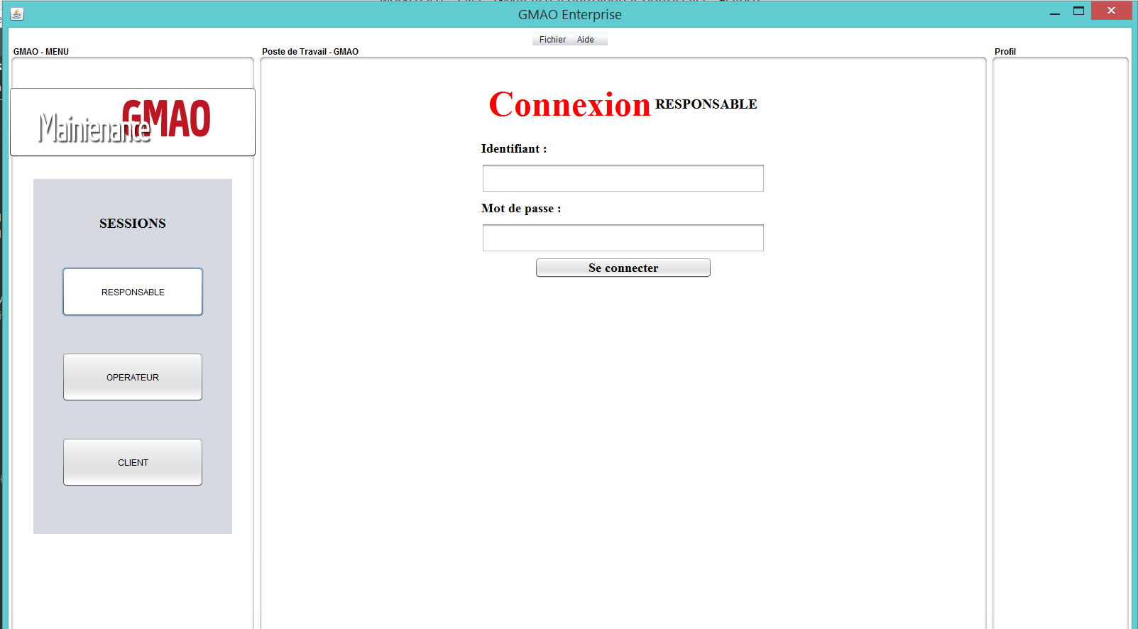
Results

Slide 10
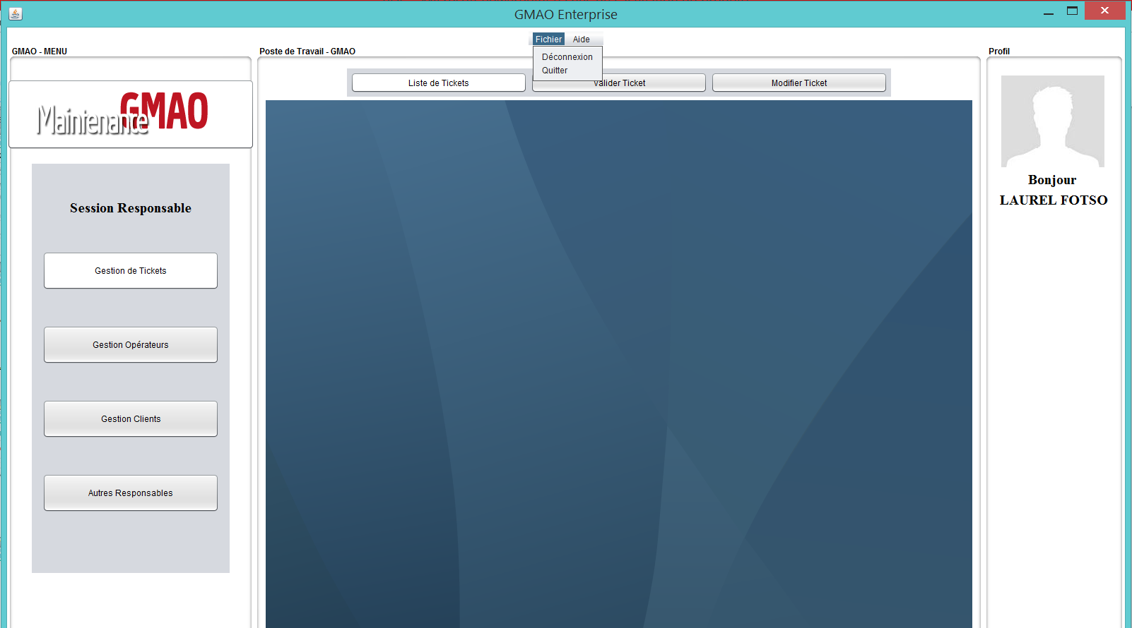
Results

