Slide 1
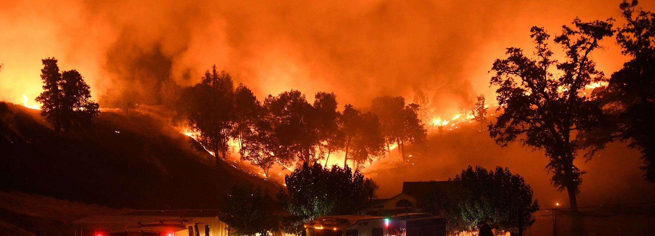
California Wildfire 2013-2022 Analysis
Laurel He
NYCDSA R Shiny App Project

Slide 2
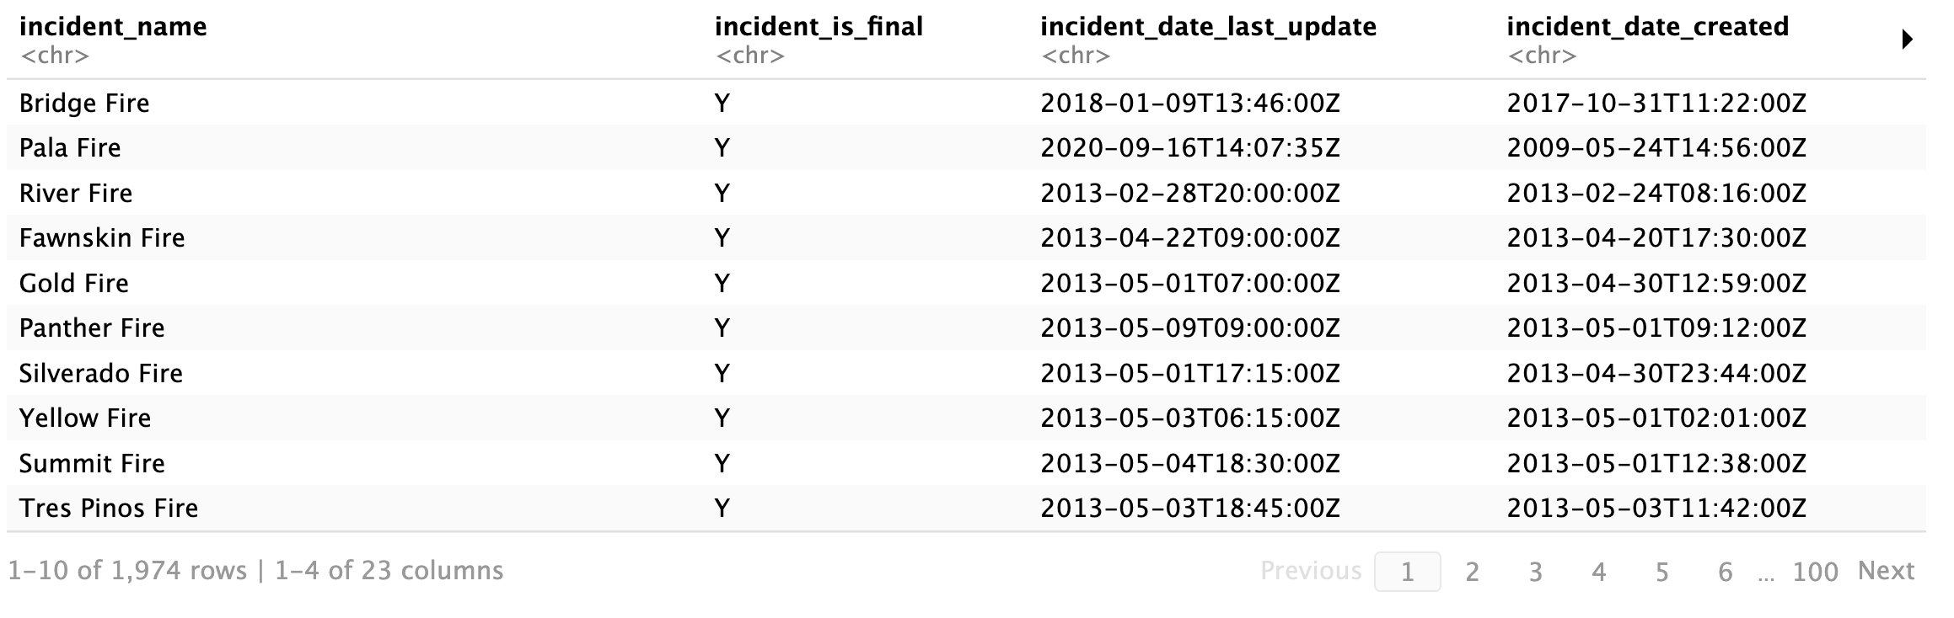
Overview
1. Dataset: The California Department of Forestry and Fire Protection (CAL FIRE) website (https://www.fire.ca.gov/incidents/) all recorded wildfire incidents from 2013 to 2022.
2. EDA and Data Visualization with R Shiny
3. Simple Linear Regression and Logistic Regression prediction in R

Slide 3
R Shiny Data Visualization
Most important features: fire start and end time, major incident or not, incident county, acres burned, fire latitude and longitude
Feature engineering: fire duration from fire extinguished time – fire start time
R Shiny to best visualize EDA results: https://laurelhe1.shinyapps.io/wildFire_dashboard/

Slide 4
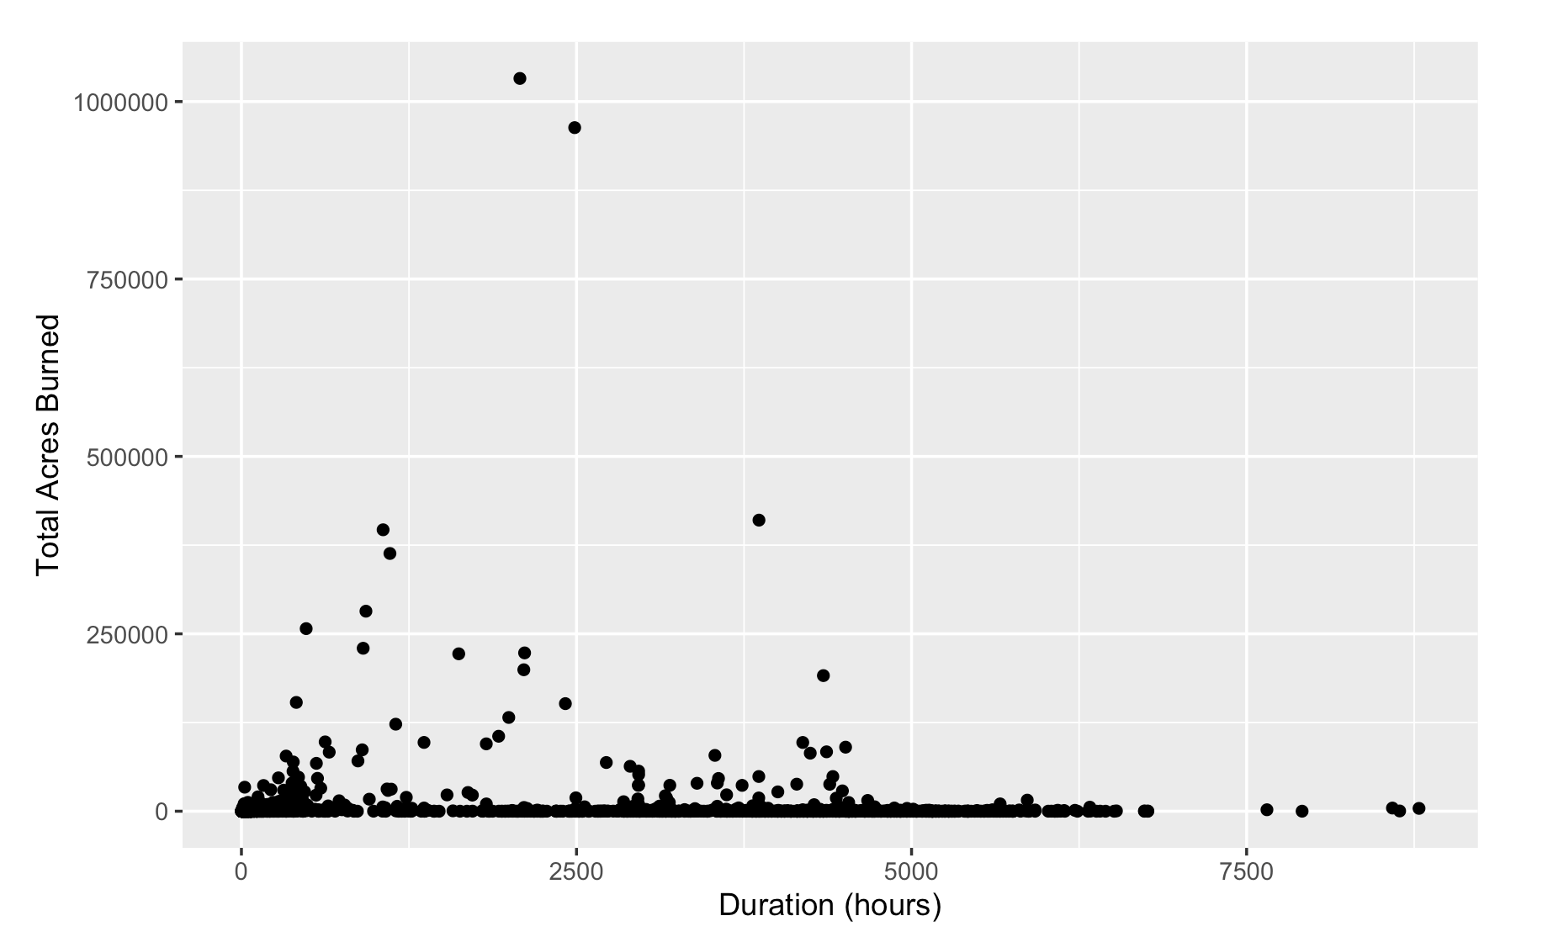
R Simple Linear Regression
Goal: What is the relationship between wildfire duration and acres burned?
Not as straightforward of a relationship as one would expect.
Some fires that are fast spreading will be extinguished first with more effort, thus shorter duration.
Other smaller scale fires are left unattended to die out on their own, thus longer duration.

Slide 5
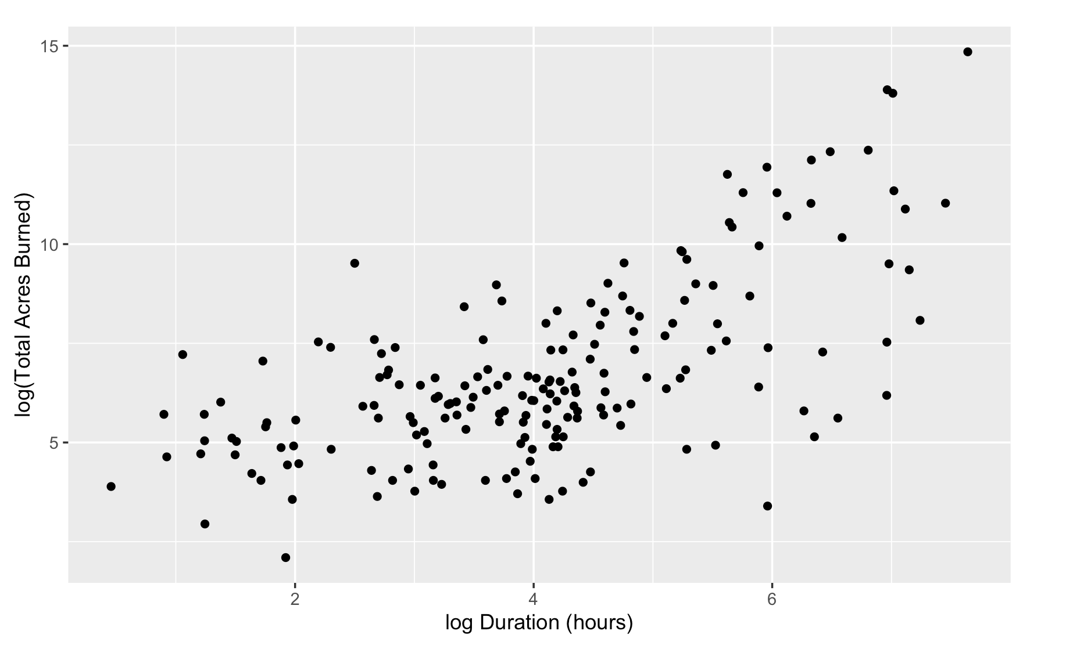
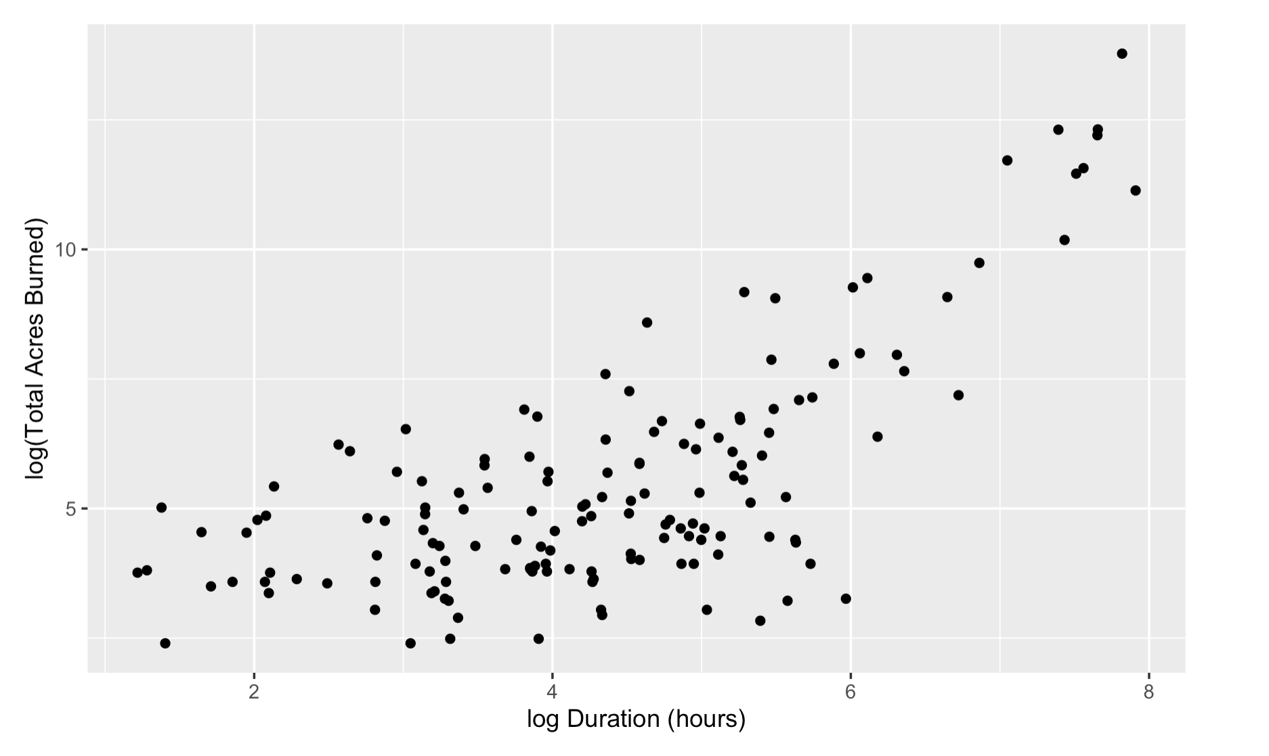
R Simple Linear Regression
After log-log transformation, and focusing on 2020 and 2021 only, do we see a somewhat linear relationship that we could model with SLR.
2020 log acres burned vs. log duration
2021 log acres burned vs. log duration

Slide 6
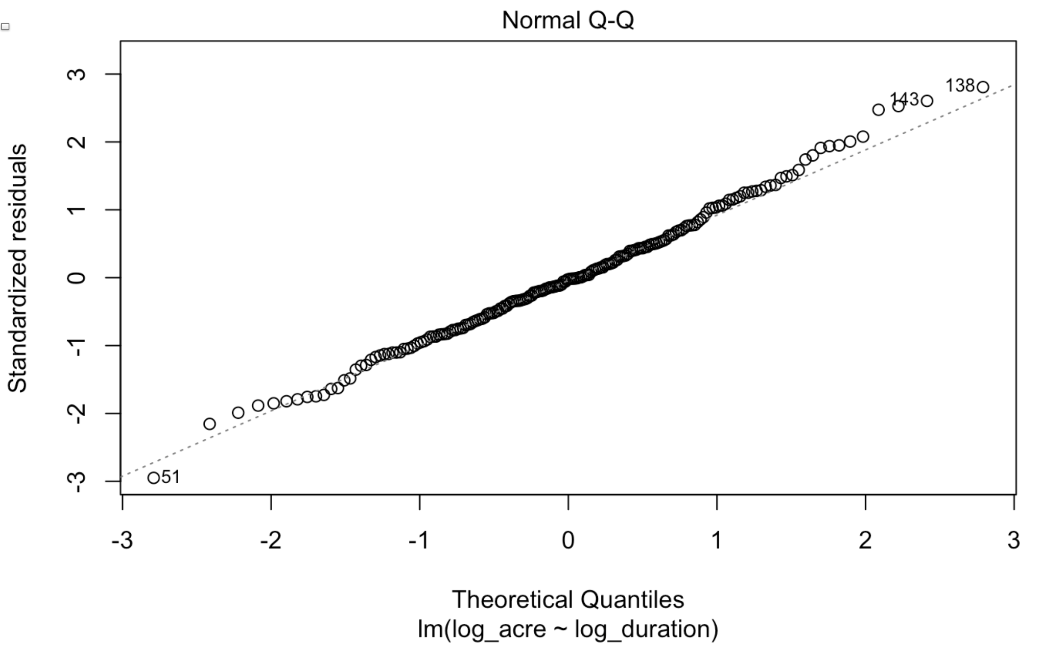
SLR Assumptions
1. Linearity: we have seen there exist a linear relationship between log(duration) and log(acres burned) after log transformation.
2. Normality of Errors: residuals are approximately normally distributed; points fall on Q-Q plot reference line.

Slide 7
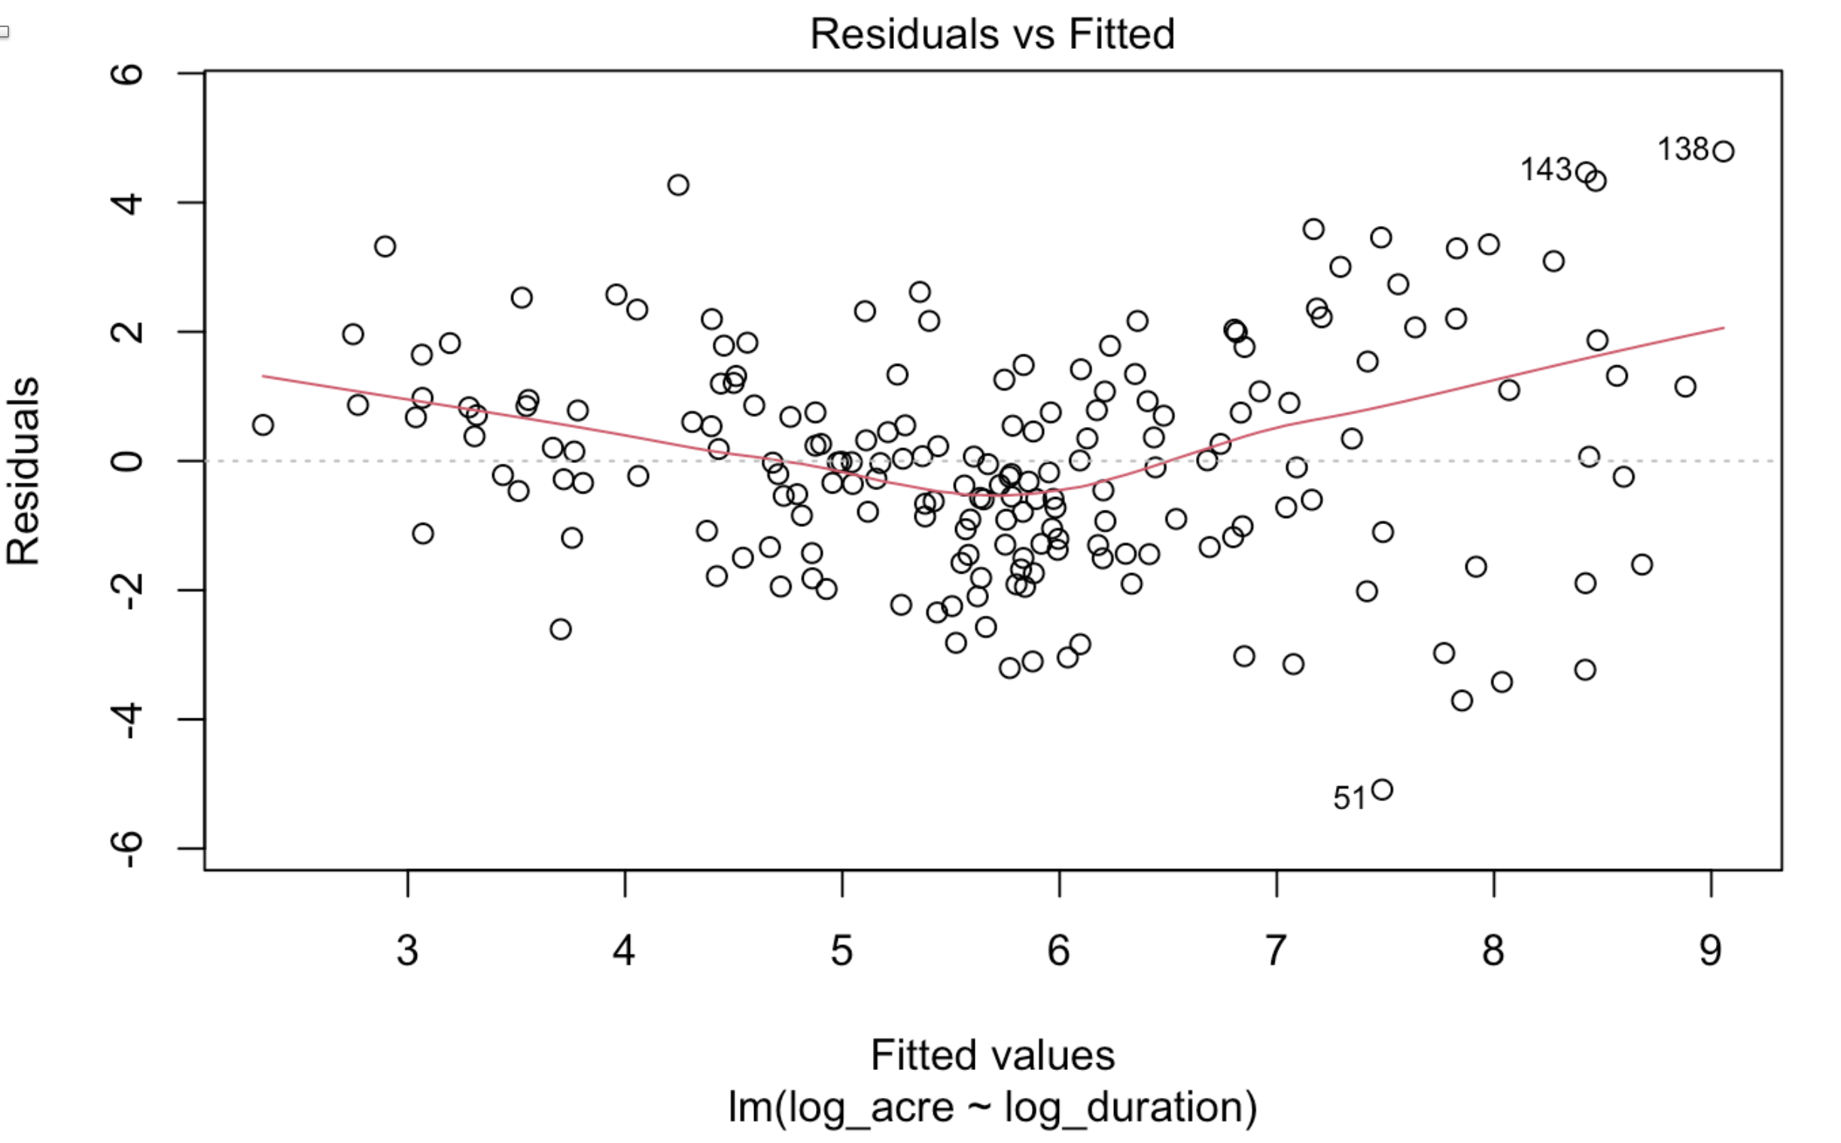
SLR Assumptions
3. Independent Errors: randomly distributed residuals around 0, red line showing a somewhat concerning v shape.

Slide 8
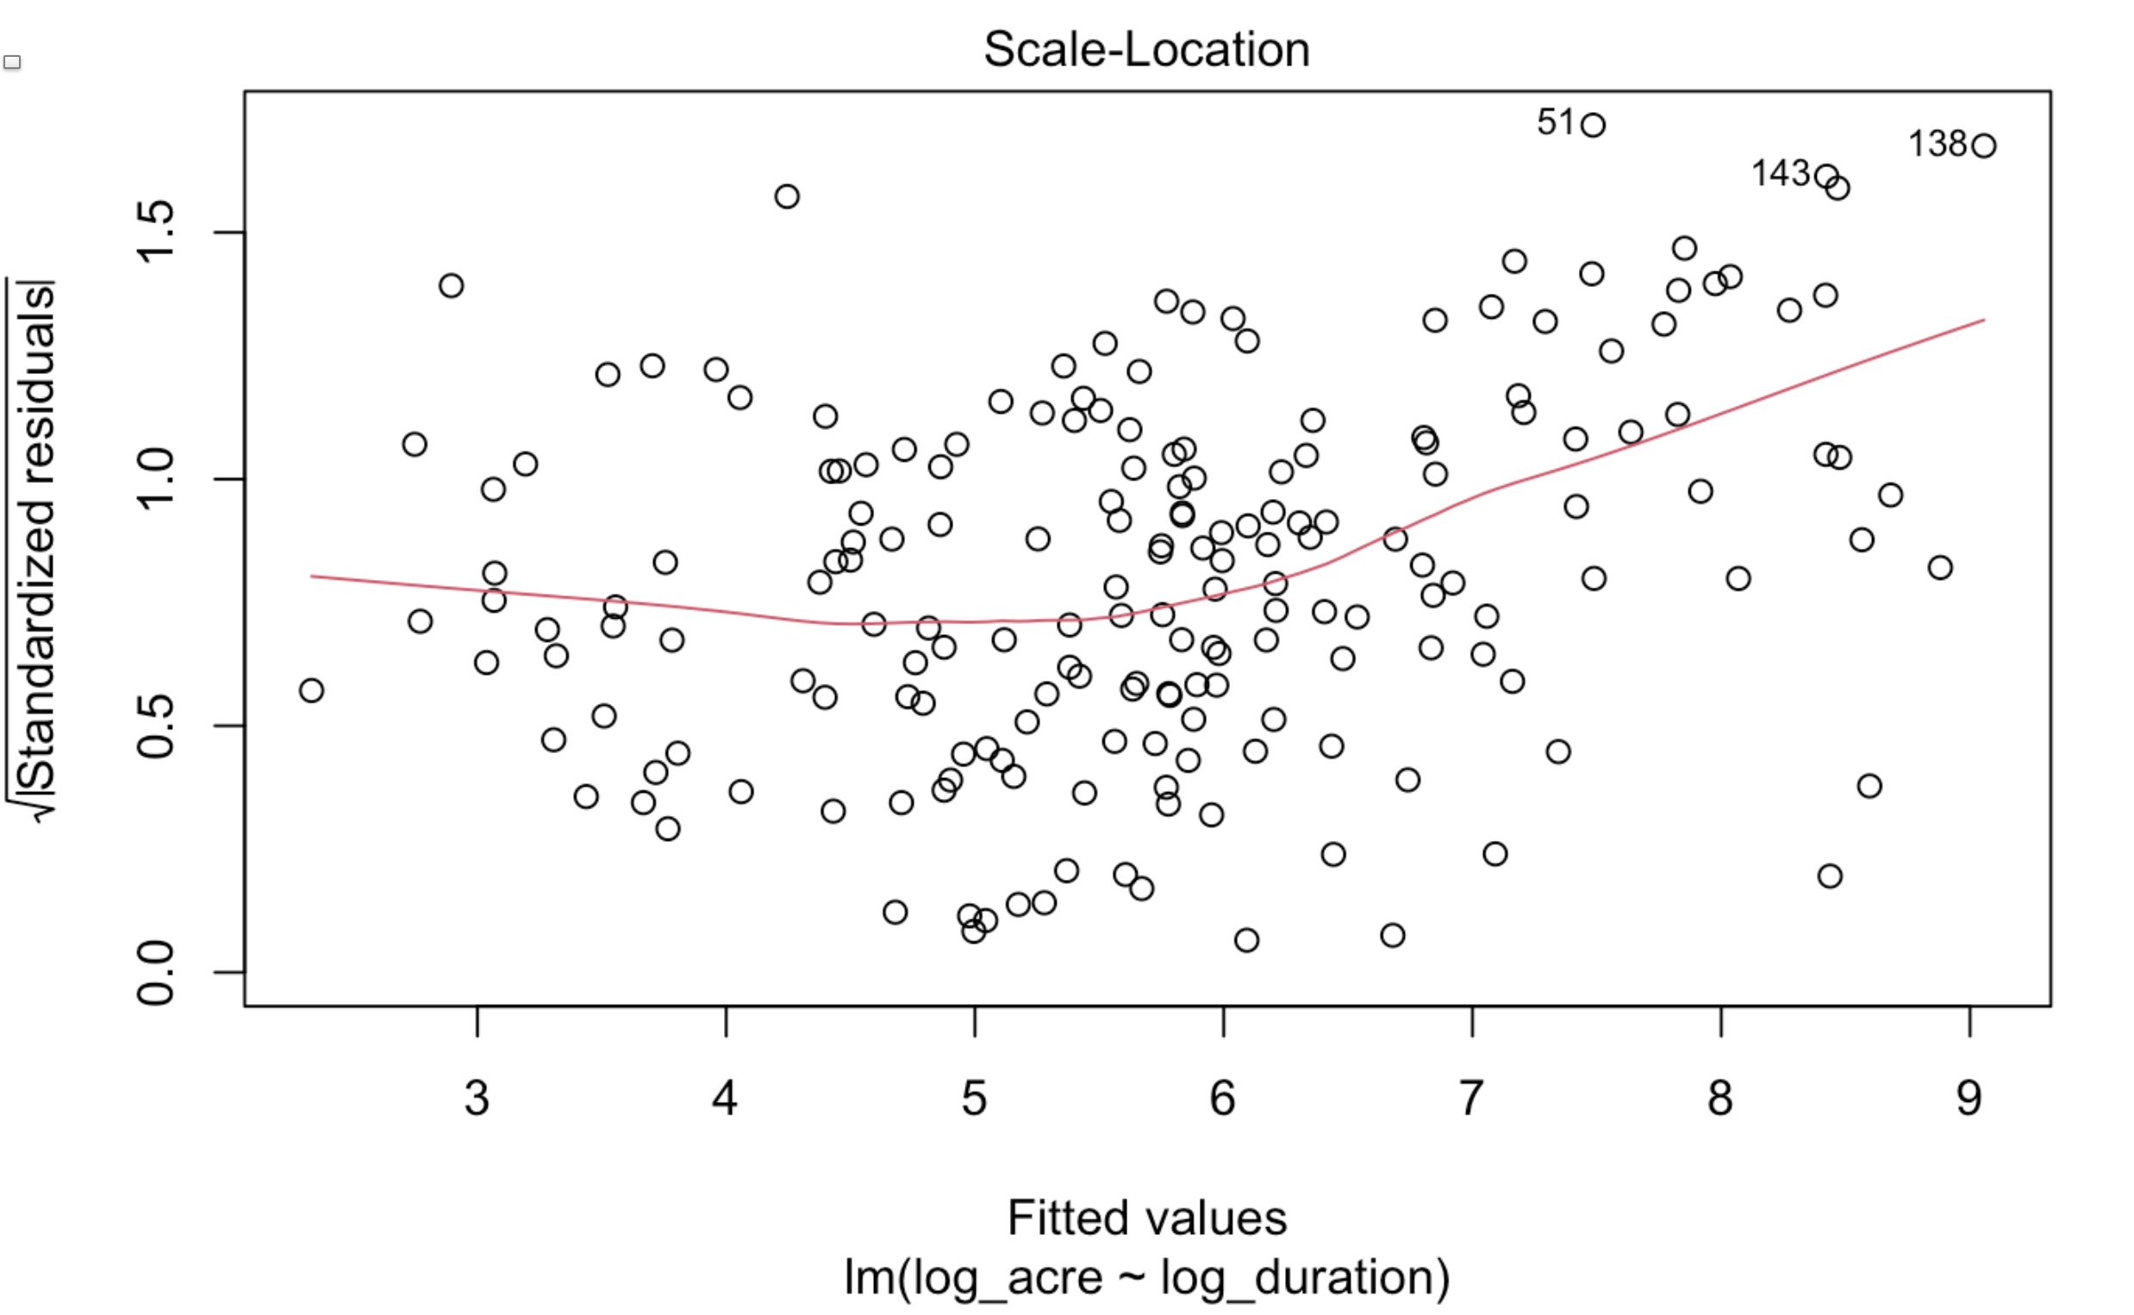
SLR Assumptions
4. Constant Variance: scale-location plot shows a somewhat equal spread of residuals along the ranges of predictors, but the
red line is somewhat curved upwards showing some non-constant variance.

Slide 9
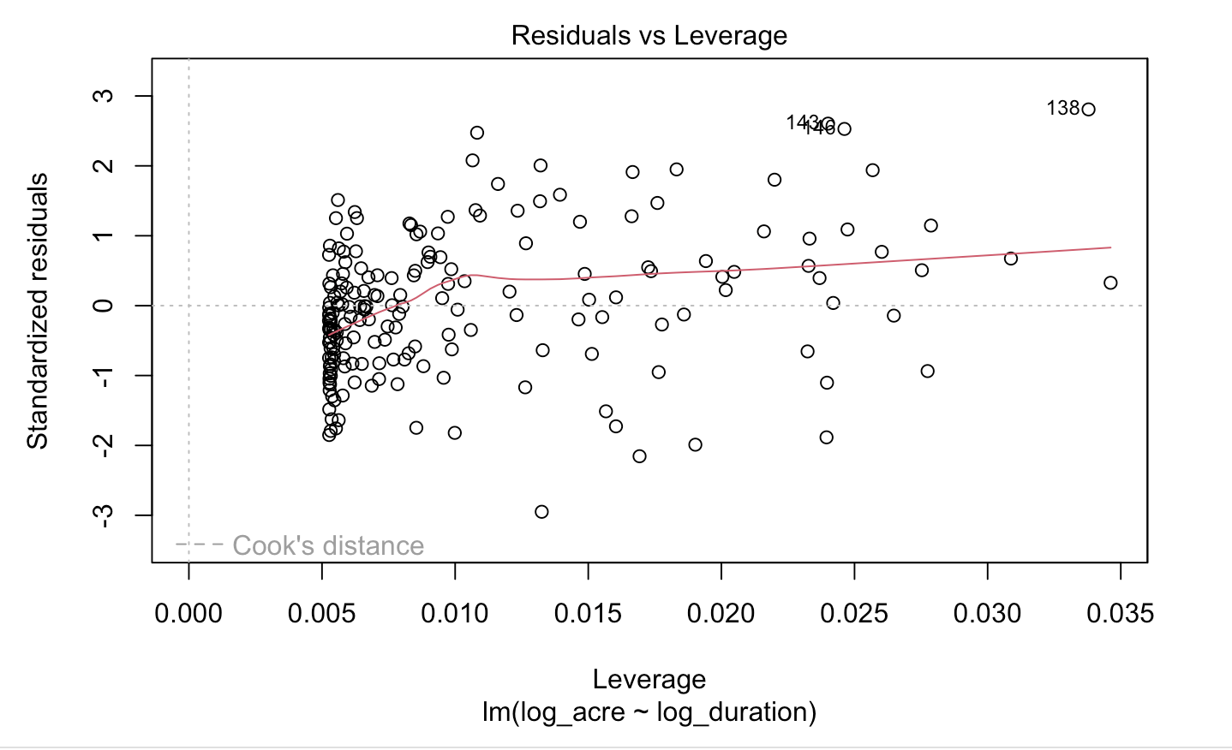
SLR Assumptions
3 potential outliers and high leverage points, However, there are no outliers that exceed 3 standard deviations or Cook’s distance, which is good.

Slide 10
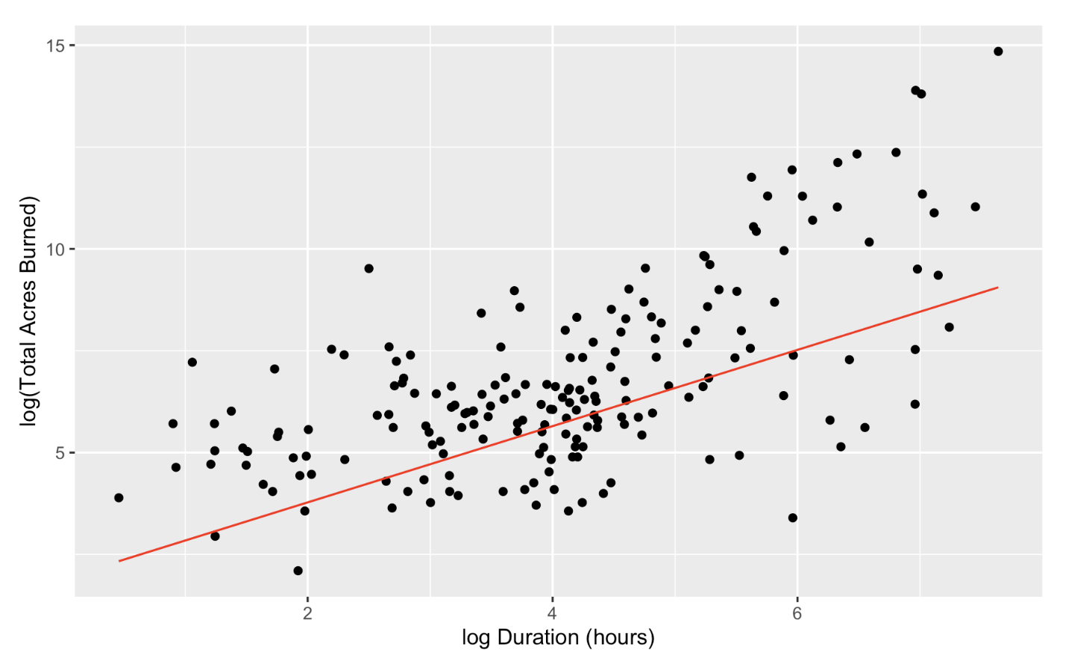
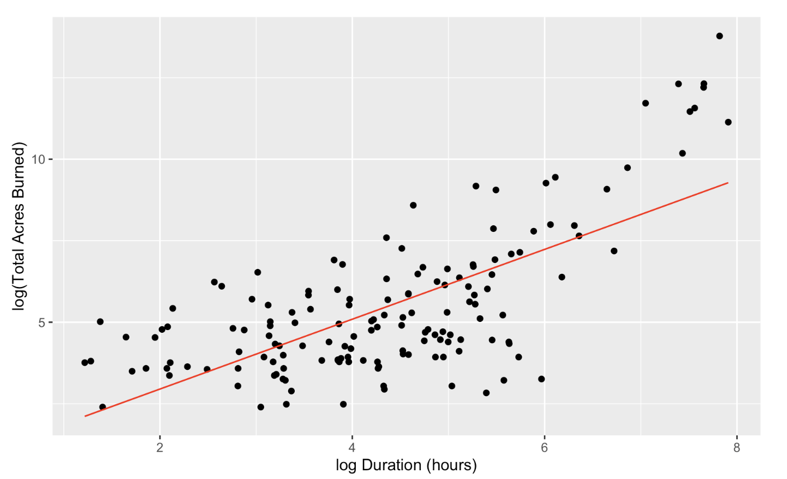
SLR Models and Predictions
Very small p-values in both cases indicating that log duration is a significant feature in predicting log acres burned.
2020 log acres burned vs. log duration & fitted SLR model
log(acres burned) = 0.93603 * log(duration) + 1.90509
R²: 0.40
2021 log acres burned vs. log duration
log(acres burned) = 1.07078 * log(duration) + 0.80965
R²: 0.48

Slide 11
R Logistic Regression
Goal: do acres burned and wildfire duration determine whether a fire is classified as major incident or not?
Logistic regression model with both features show that acres burned (p-value = 0.1794 > 0.05) isn't a significant feature like duration (p-value = 0.037 < 0.05), which is quite surprising.
Logistic regression model with only duration shows a very small p-value (2.47e-6) showing its feature significance.
Predicting with this model:
Compared to Truth:
False | True
68 | 84
 | Prediction
Truth | 0 | 1
False | 39 | 29
True | 12 | 72
True Negative is too low: 39 < 68
True Positive is also a bit low: 72 < 84
Error rate: (12+29)/152 = 27%
Accuracy: 73%
pchisq p-value: 0.41 > 0.05 overall good fit
McFadden's pseudo R²: 0.267, 26.7% variability explained

