Slide 1

Housing Market Analysis
Lauren Thompson
DSC530
Final Project

Slide 2
Variables
Primary variables used for analysis
Sale Date – date the sale of the home took place
Sale Price – the price the house was sold for
Square Feet of Living Space – the sq footage that is livable
Square Feet of Lot – the size of the lot the house is on
Year Built – the year the house was built
Other variables available
Address – House address
Zip Code – zip code of the house
City Name – city where the house is
Bedrooms – number of bedrooms
Bathroom Count – number and type of bathroom
Year Renovated – year the house was renovated
Some potential impact to these variables, are the economy, population size, natural disasters, crime in the area, and how desirable the area is

Slide 3
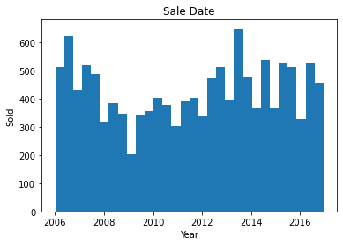
Histogram of Sale Date
SALE DATE
Mean: 2011-07-28
Mode: 2008-07-01
Spread: Bimodal
Tails: N/A
This could be classified as a bimodal histogram with the modes marked at the late 2006/early 2007 and 2013. There are no outliers present and a pattern of peaks and valleys. The valley that seems to separate the two sections is the year 2009. The pattern of having peaks and valleys does make sense as the housing market changes every year economically.

Slide 4
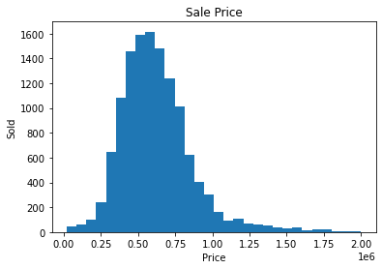
Histogram of Sale Price
SALE PRICE
Mean: $660737.75
Mode: $550,000
Spread: Unimodal, skew right
Tails: leading to upper end
This histogram is unimodal and skewed to the right as the tail is leading to the higher sale price values. There are no clear isolated outliers. The tail here is most likely caused by houses of greater value being sold but in low volume due to the price. It seems on average a house goes for approximately $625,000.

Slide 5
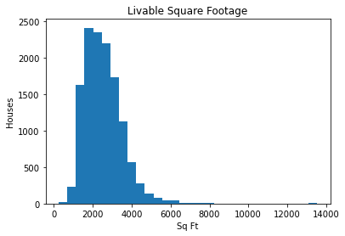
Histogram of Livable Square Footage
SQFT LIVING
Mean: 2539.51sqft
Mode: 1510sqft
Spread: Unimodal, skew right
Tails: leading toward upper end
This is a unimodal histogram with a strong skew right and outliers. There is a slight tail leading toward the higher end of livable square footage. There is an outlier around 13250sqft. This is most likely a mistyping in the dataset as there is only one isolated bin. If this outlier was removed the histogram would still resemble skew right as there is still a tail going toward the upper however that skew would full under a slight skew right.

Slide 6
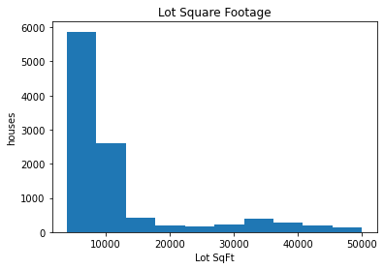
Histogram of Lot Square Footage
SQFT LOT
Mean: 22228.57sqft
Mode: 8400sqft
Spread: Unimodal, skew right
Tails: leading to upper end
This is a unimodal histogram with a strong skew right as the tail head to the upper end. Similar to the sale price the square footage of the lot varies. Most common as lots with less land, such as neighborhoods. There are farmlands and cabins to consider here which could be the cause of the tail. Seeing as there is no isolated outlier I do not believe any correction could be made while still representing the data accurately.

Slide 7
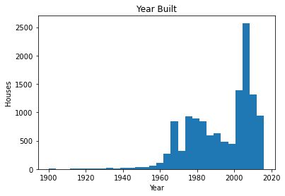
Histogram of Year Built
YEAR BUILT
Mean: 1993
Mode: 2007
Spread: unimodal, skew left
Tails: leading to lower end
At first glance this is a unimodal histogram however a case could be made that it is bimodal with the valley just before 2000. This histogram is skewed left with a tail heading towards the lower end. There does seem to be an outlier just after 1900. The overall pattern makes sense as older homes are not sold as easily of have not lasted over the years. Homes that are build more recently tend to be a buys first choice which could explain the skew of the histogram.

Slide 8
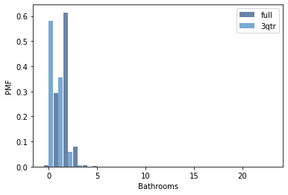
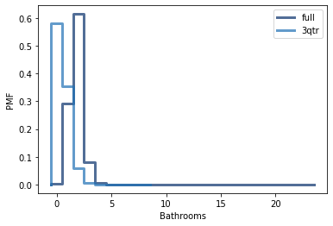
PMF
Bathrooms tend to come in the style of a full rather than a 3qtr. It does appear there is an outlier skewing the distributions

Slide 9
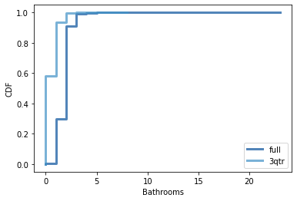
CDF
We can see that 3qtr bathrooms are consistently not as favorable/common as full bathrooms.

Slide 10
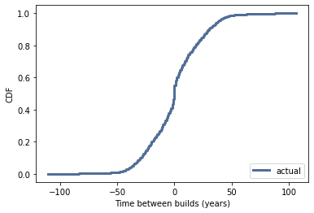
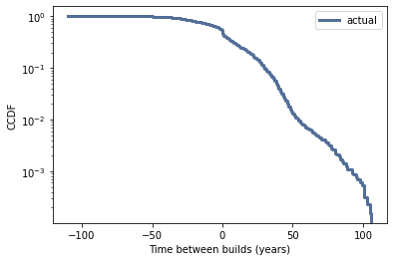
Analytical Distribution
Since I have data involving time, I have wanted to explore exponential distribution. At first, I had wanted to look at how spread apart house sales were but ran into an issue comparing the dates with the format provided by the dataset. I then explored the time between builds by year by both CDF of interarrival time and CCDF on a log-y scale. The results show that this model may not be the best even though it is dealing with time the line isn`t a straight shot. I think the normal distribution could be a better fit in this case.

Slide 11
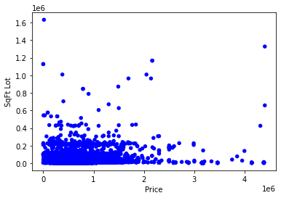
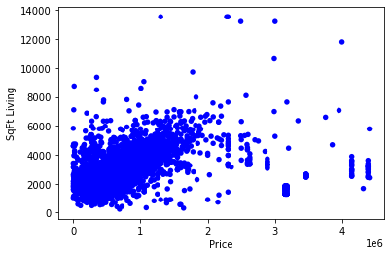
Scatter Plots
It is important to remember that correlation does not imply causation. Here we have two scatter plots the first looking at square footage of the lot and the sale price, and the second looking at livable square footage and the sale price.
The correlation value is 0.45 with a Spearman Correlation of 0.71. The difference between the two correlations could be an indicator of outliers or a non-linear relationship. The covariance is positive indicating both variables are high or low at the same time
The correlation here is 0.11 with a Spearman Correlation of 0.16, this indicates that the size of the lot does no influence the sale price. The covariance is positive indicating both are high or low at the same time.

Slide 12
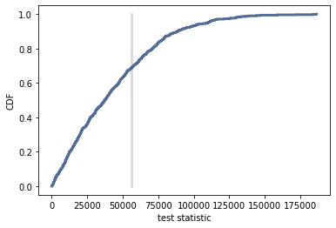
Chapter 9 Method
By creating two new data frames from the original we can preform the difference in means between houses that were built in 2008 vs houses built in 2012 and how much they were sold for. The p value is 0.314 and a one-sided p value of 0.855 these are not significant.
It is important to note that there are other variables to factor in such as newer homes are more expensive. Meaning the sale date could shed more light on the results. The sale date is in a format that has caused some complications further research in how to overcome this hurdle will need to be done.

Slide 13
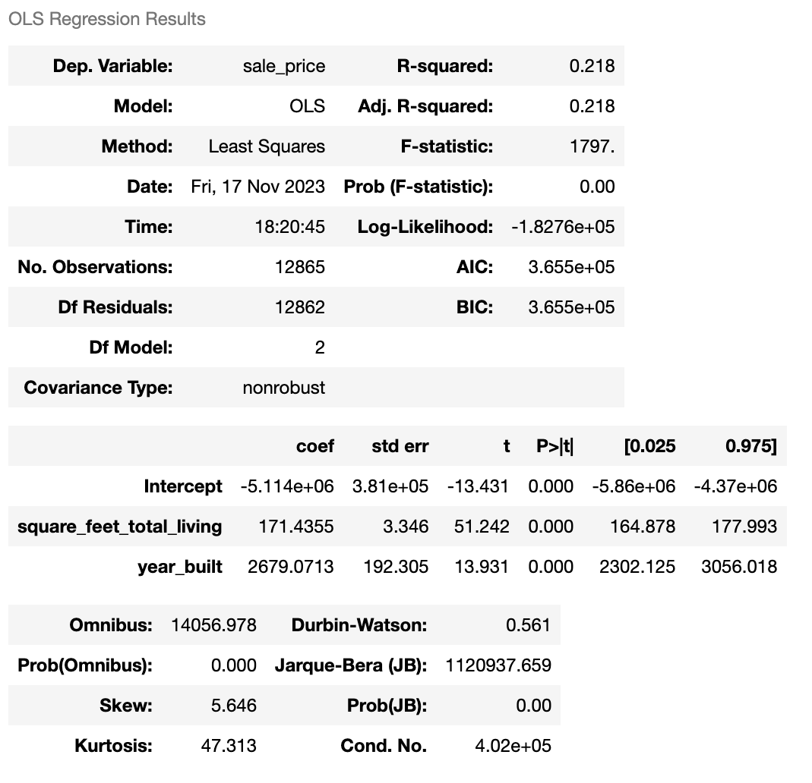
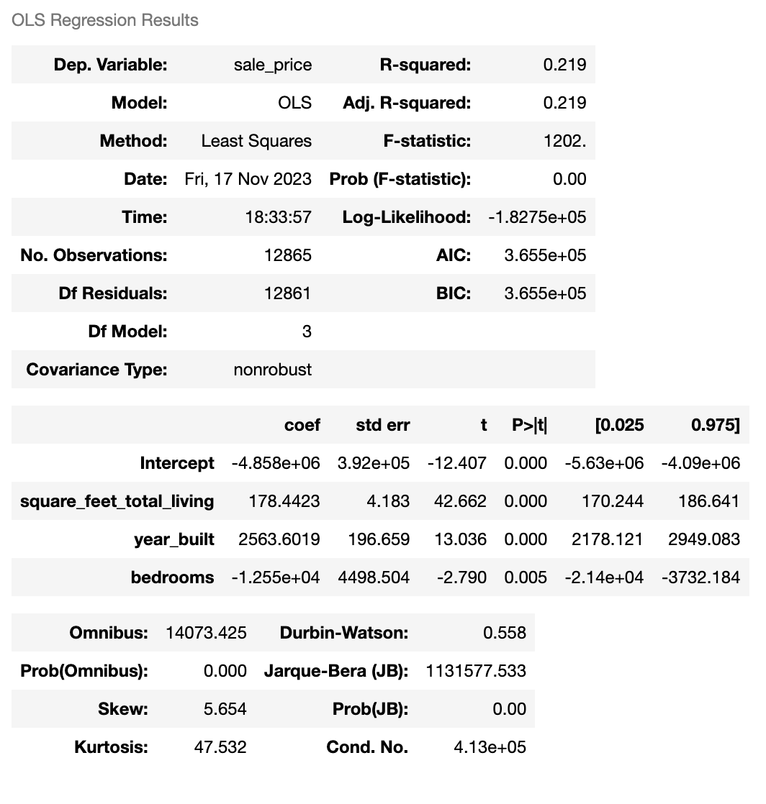
Regression Analysis
Two regressions have been preformed both having sale price as the dependent. The explanatory variables for the first regression are square feet of livable space and year built, however the results we not as significant with an r-squared value of 0.218, the standard error values, t, and p(t) values show a lack of significance as well. I added number of bedrooms to the regression analysis which didn`t yield significant changes to the p-value. Overall, I would say this is not a good fit of a model. I suspect location has a large impact on sale price which is why the other variables are not bearing significant results.

