Slide 1
Collaborating on GitHub
Stephens lab meeting
Joyce Hsiao
2015-12-03

Slide 2

We work as a team
Super awesome paper
Method beta
Teammate B
Method 1.0
Teammate A
Manuscript
Notes:
We’ve discovered many technical challenges that affect the interpretation of single cell RNA-seq results, especially batch effects across the single cell collections. This work was done by PoYuan, a postdoc in the lab, and John, a graduate student. Both unfortunately were unable to make it today.

Slide 3
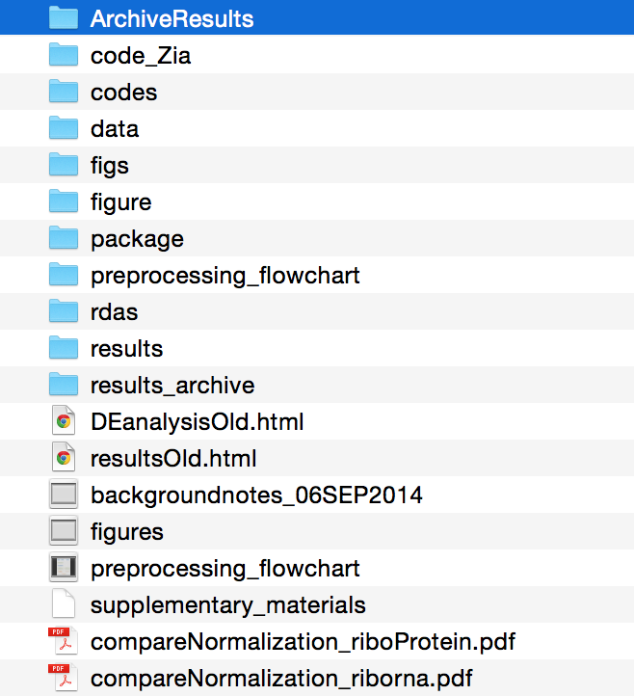
Before GitHub…
Results up-to-date
Results, beta version
R codes
R codes from collaborator
Input files
Interim R objects
Notes:
Many of us work on collaborative projects here in this lab. Sometimes I am astonished about how inefficient I was before I discovered github. I would always start with a results folder and a code folder, then both of these would eventually spiral out of control, and I would have to start a new folder entirely when writing the paper.

Slide 4


Recommended layout
Analysis (ALL Rmarkdown files and htmls)
Figure (exported directly by user or as a by-product of Rmarkdown files)
Output (R objects, work-in-progress analysis results)
Code (bash scripts, fresh R functions, or R functions that may not contribute to method development)
Data (data that do not change frequently over the course the analysis, such as read count or phenotype information)
Docs (method drafts, slides, etc.)

Slide 5
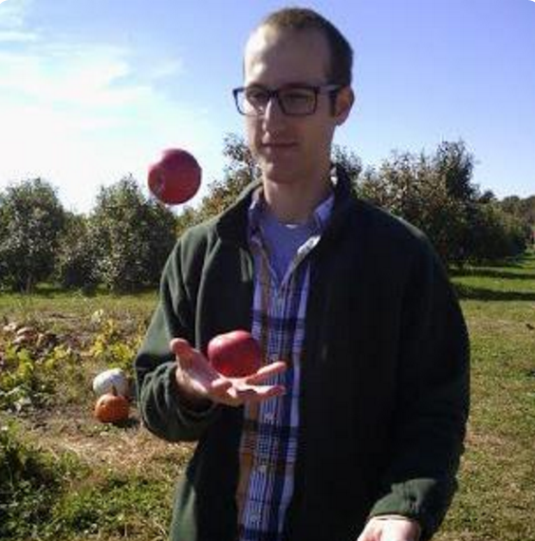
John Blischak says:
A workflow that works!
“Everything” goes into GitHub repo
Create a project website hosted on GitHub
https://github.com/jdblischak/singleCellSeq

Slide 6
Brief guide for first-timers
Making a project directory
Making htmls
Producing the website
Publishing the website
Add new analysis
Where I learned about this:
http://ialsa.github.io/tutorials/gh-pages-setup.html

Slide 7
A. Making a project directory
Clone ashlar and rename the repository
Open ashlar.Rproj (R project object) in the analysis directory. Once you do so, working directory of the current R session becomes ashlar-trial/analysis. No more specifying user-specific home directory. This is especially when working on collaborative projects.
Add your project information:
analysis/About.Rmd (project description)
analysis/Index.Rmd (homepage for the website)
analysis/License.Rmd (my default is Creative Common)
analysis/Template.Rmd (an example Rmarkdown template)
ashlar/README.md (github repo README)
ashlar/analysis/include/before_body.html (webpage header)
git clone https://github.com/jhsiao999/ashlar.git ashlar-trial

Slide 8
A. Making a project directory
Look at your .gitignore
By default, all image files (png, pdf, etc.) and htmls are
ignored in git add. We chose this to keep the master
branch consist of only analysis files. Under this setup, you must force add (git add –f ) in the first commit to the
master branch and “every commit” to the gh-pages
branch.

Slide 9
B. Making htmls
Run make command, which makes all changed Rmds.
To force make htmls for all of the Rmds,
Use knitr to compile Rmds into html files. If you work with RStudio, simply click on “knit html” in the tool bar.
cd ashlar-trial/anaysis
make
cd ashlar-trial/anaysis
make -B

Slide 10
B. Setting up GitHub repo
Reset git remote directory.
2. Go to to github.com. Create a repo called ashlar-trial. Then, commit all files
git remote rm origin
git remote add origin https:/github.com/jhsiao999/ashlar-trial.git
git add --all
git commit –m “first commit”
git push origin master

Slide 11
C. Producing the website (not publishing)
Approach 1:
Index.html is the table of content of your repository and contains hyperlinks to the listed content. You can use it as a TOC for your folder without ever publishing it. When published, index.html is the homepage of your webiste.
Approach 2: Use Jekyll
Setting up Jekyll pipeline. Here I assume you already have Ruby.
Producing the website
cd analysis
make
bundle exec jekyll serve
Localhost:4000
cd analysis
sudo gem install bundler
bundle install

Slide 12
D. Publishing website
Deploy to gh-pages.
Give it a minute, then wala!
git checkout gh-pages
git add –f .
git commit –m “build site”
git push origin gh-pages
https://jhsiao999.github.io/ashlar-trial

Slide 13
E. Add new analysis
If you’ve been working in the gh-pages branch,
git branch
cd analysis
git add –f *html figures/*
git commit –m “add new analysis”
git push origin gh-pages
Push the master branch to the gh-branches, run Make file and then push the updates to the gh-branches:
git checkout gh-pages
git merge master
cd analysis
make
git add --all
git commit –m “build site”
git push origin gh-pages

Slide 14
E. Add new analysis
If you’ve been working in the gh-pages branch,
git branch
cd analysis
git add –f *html figures/*
git commit –m “add new analysis”
git push origin gh-pages
Then to update the master branches with the changes, do
git checkout master
git merge gh-pages
git add *Rmd
git commit –m “add new analysis”
git push origin master
Likewise, if you work at the master branch, update the gh-pages branch when finished.

Slide 15
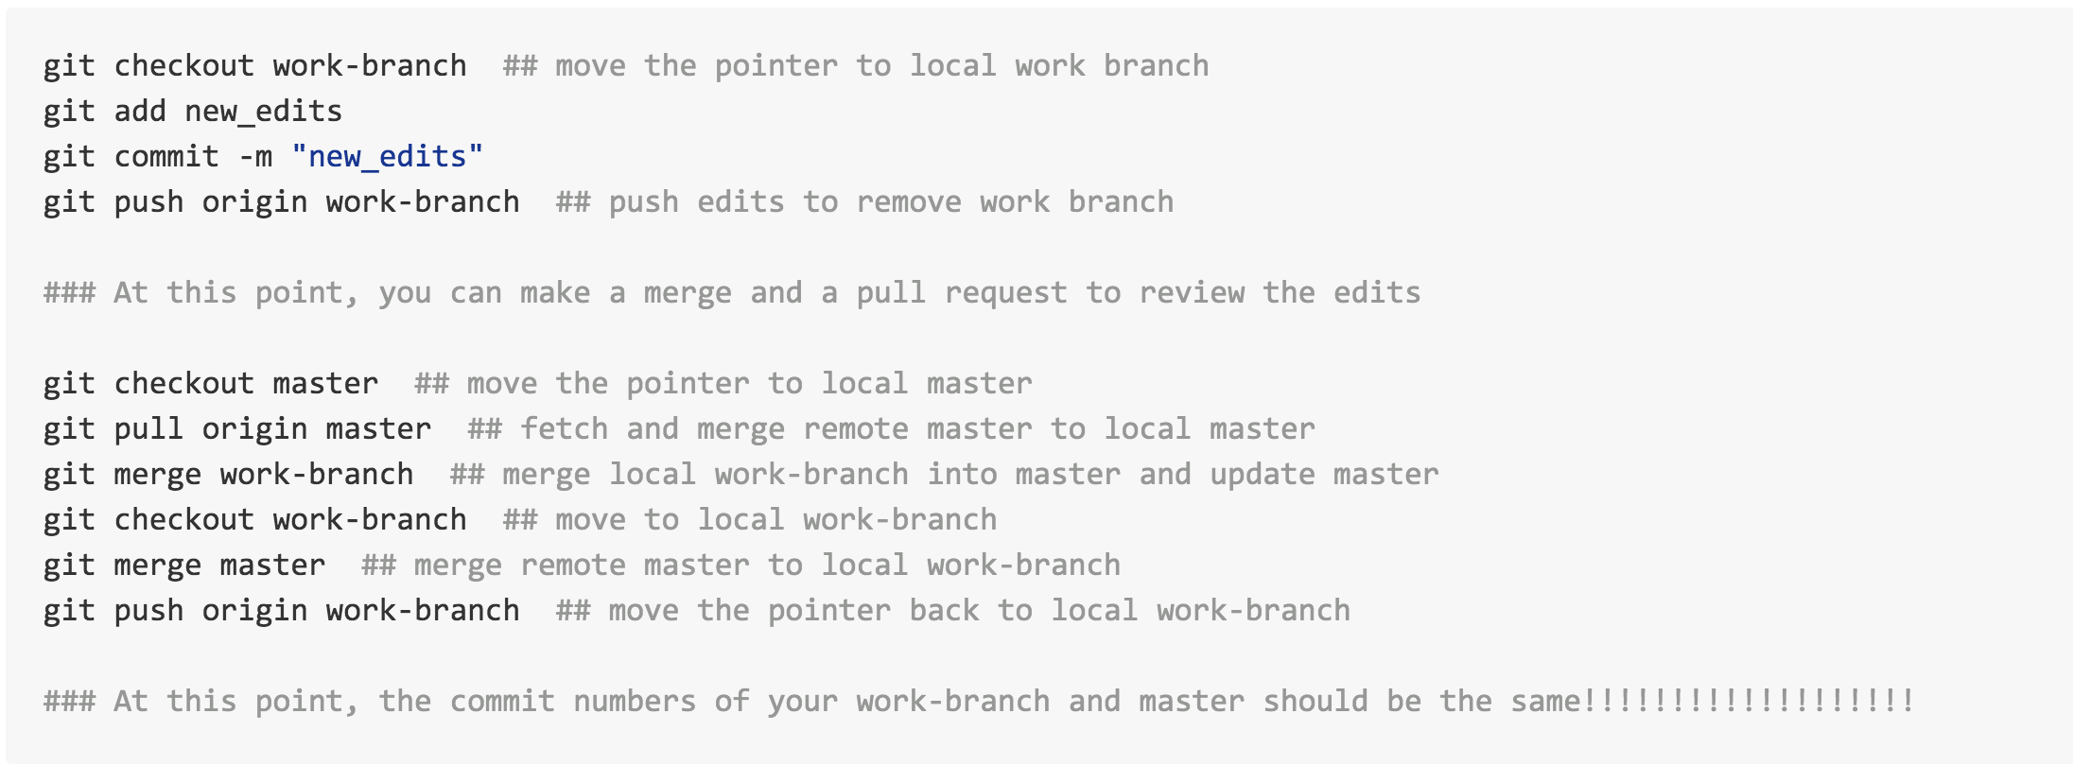
A useful Git tip
If > 1 person contributes to the repo on a regular basis,
do the following to avoid disasters!
https://github.com/jhsiao999/singleCell-method#collaborating-on-the-project
Notes:
Trial run on my Mac OSX following http://ialsa.github.io/tutorials/gh-pages-setup.html

Slide 16
Other tips
You don't have write permissions for the /Library/Ruby/Gems/2.0.0 directory.
sudo gem update --system
Notes:
Trial run on my Mac OSX following http://ialsa.github.io/tutorials/gh-pages-setup.html

