Slide 1
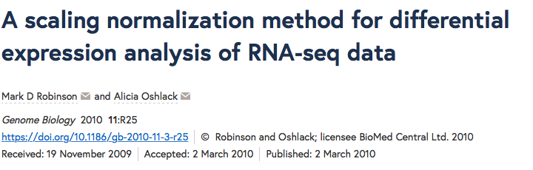
TMM: Trimmed Mean of M-values (TMM)
Samples/observations that have the closest average expressions to mean of all samples is considered as reference samples, and all others are test samples. For each test sample, the scaling factor is calculated based on weighted mean (weighted by estimated asymptotic variance) of log ratios between the test and reference, from a gene set removing most/lowest expressed genes and genes with highest/lowest log ratios.

Slide 2
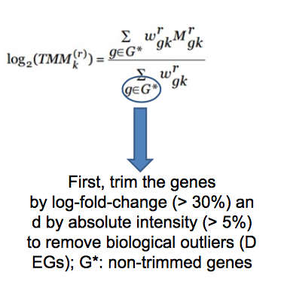

Slide 3
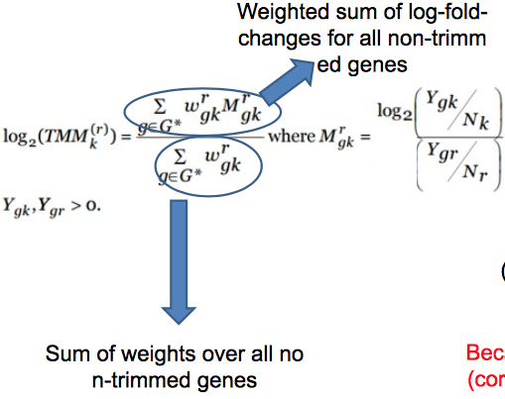
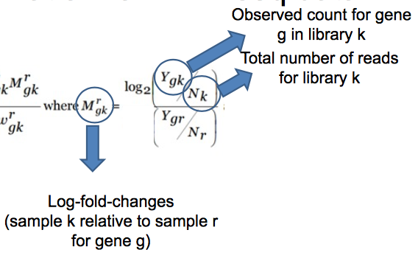

Slide 4
