Slide 1
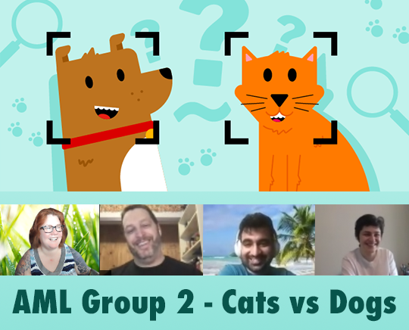
AML I526 Spring 2021 Group 2 Phase 2 Update Cats vs Dogs Classification and Prediction
Team Info: Left to right: Ben Perkins benperki@iu.edu Lauren Madar laurenmadar@gmail.com Mangesh Walimbe mwalimbe@iu.edu Samin Barghan s.barghan@gmail.com
Notes:
Video and in class presentationVideo and in class presentation * In-class explanation, and discussion of your results (as part of final exam period) * Your video should have a logical and scientific flow to it. All team members need to present a part of the video. In more detail, your video should have a logical and scientific flow to it with main sections for each of the following: -- a title slide (with the project name, Group Number, the team member names, and photos).

Slide 2
Abstract
One of the fundamental tasks in classifying images is object detection within images. Algorithms often employ a ‘bounding box’ tool. To study bounding boxes, our team first evaluated 3 models with GridSearchCV, to be trained on existing bounding box data for the purpose of predicting bounding boxes. The best model was used for bounding box prediction.
A feature engineering pipeline was created to generate additional numeric features from bbox inputs, and then transformed predictions from the bbox model for later use in training our classifier. Next, images were classified as ‘cat’ or ‘dog’ by two logistic regression models with SciKit Learn.
We created a PyTorch model with classification and bounding box predictions using Cross Entropy and Mean Squared Error loss functions. PyTorch allows for a much simpler modeling, training and prediction process, though the Nvidia GPU made a move to Google Colab necessary. The team will give brief updates on the following sections.
Notes:
THIS IS DONE – do not add to it, it is exactly 150 words!
-- Make sure it has an outline slide with good descriptive section headings -- Team names, photos (already done on Title slide) -- Project description -- Some summary visual EDA
This criterion is linked to a Learning OutcomeProject AbstractExpectations here are to get the following: Abstract (150 words approximately describing this phase of the project): that details the problem you are tackling, the main goal of this phase, what you did (main experiments), what were your results/findings (best pipeline and the corresponding public, private scores). Your abstract should be compelling and entice the reader to go through the work There should be 3 parts that should be clear in your abstract 1. Context of the project 2. Methods used 3. Results

Slide 3
Overview
During this update, we will only be talking through the following:
Changes to workflow for PyTorch - Lauren
PyTorch Models - Mangesh
Pytorch Metrics - Ben
Updates for Results, Discussion & Conclusion - Ben
Notes:
-- Make sure it has an outline slide with good descriptive section headings -- Team names, photos (already done on Title slide) -- Project description -- Some summary visual EDA
This criterion is linked to a Learning OutcomeProject AbstractExpectations here are to get the following: Abstract (150 words approximately describing this phase of the project): that details the problem you are tackling, the main goal of this phase, what you did (main experiments), what were your results/findings (best pipeline and the corresponding public, private scores). Your abstract should be compelling and entice the reader to go through the work There should be 3 parts that should be clear in your abstract 1. Context of the project 2. Methods used 3.(I asked what #3 is... was blank in the matrix)

Slide 4
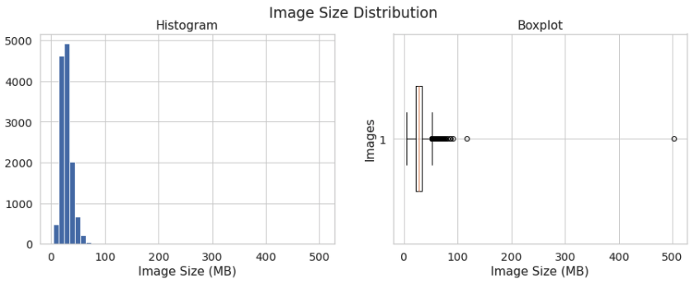
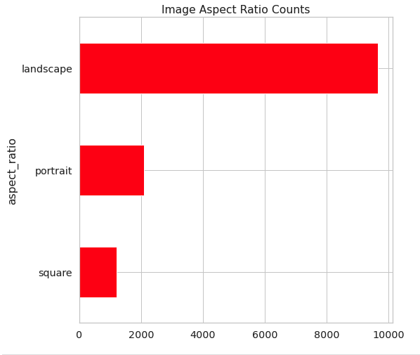
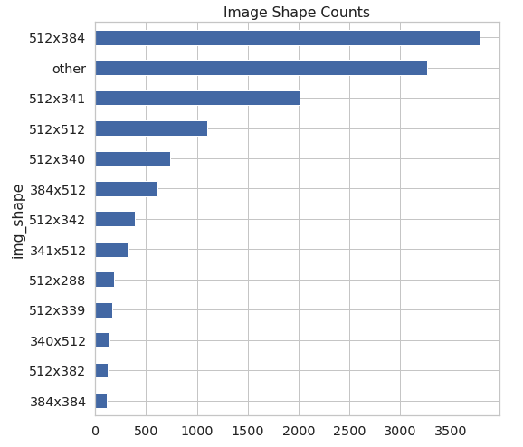
Data – Description and Statistics – no Phase 2 updates
12966 images varying in file size from ~ 4mb to ~502 mb
Variety of width and height in pixels (mix of portrait, landscape and square images and sizes) which creates normalization problems (comparing images of different sizes without adjusting for those differences will result in lower performance or inaccurate predictions)
Bounding box metadata to highlight the main object in each image for training and a class label for each image (detailed after the data dictionary)
2 total classes – “cat” and “dog”
Notes:
This criterion is linked to a Learning OutcomeProject Description (data and tasks)Expectations here are to provide the following in sections and subsections: Description of the data and task at hand --Data description --Task to be tackled -- Provide diagrams to aid understanding the workflow

Slide 5
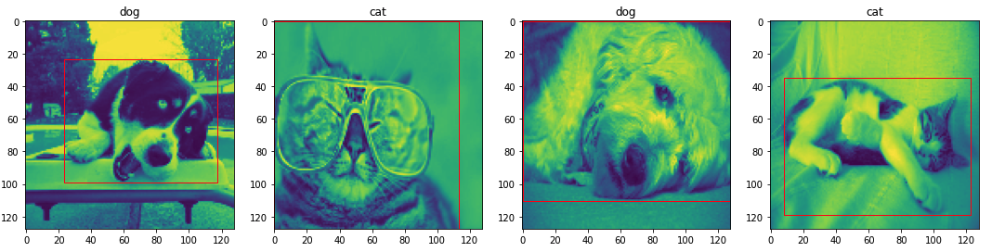
Data Tasks – Updated for Phase 2 - PyTorch
Import CSV and parse metadata, Train/Test split data indices using SubsetRandomSampler and DataLoader
Transform with CustomDataset:
Convert to Tensor
Transform to grayscale to reduce channels
Resize images to 128x128 as normalization
Train images after greyscale/resize with overlay ground truth bounding boxes and labels
Notes:
This criterion is linked to a Learning OutcomeProject Description (data and tasks)Expectations here are to provide the following in sections and subsections: Description of the data and task at hand --Data description --Task to be tackled -- Provide diagrams to aid understanding the workflow

Slide 6
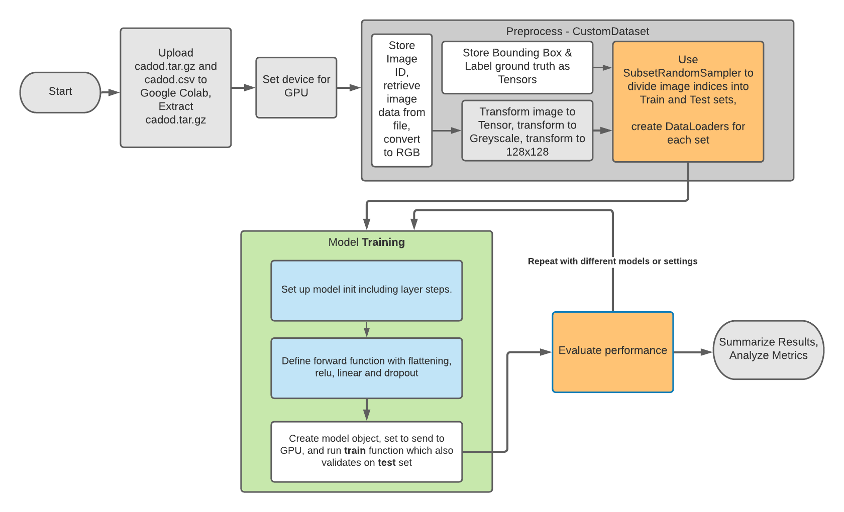
PyTorch Workflow – Phase 2
Notes:
Modeling Pipelines
Expectations here are to provide the following in sections and subsections:
[CaDoD] Modeling Pipelines -- Preprocessing images -- input Image size (w, h) -- Loss function used (data loss and regularization parts) in latex -- Number of experiments conducted -- Experiment table with the following details per experiment: ----- Baseline experiment ---- The families of input features used ----- For train/valid/test record the following in a Pandas DataFrame: ---- Accuracy

Slide 7
Models - PyTorch
Our PyTorch models are neural networks, and produce predictions for classification and bounding boxes in the same ‘pipeline’
Conv2d Model
LinNet/SimpleLinearNet Model
Intended to use 2d convolutions (2) and pooling before linear classification and regression. Issues: could not format parameters for Conv2d from our image, bbox and label tensors successfully.
Did not run due to bugs.
3 linear layers and 2 dropout layers (for regularization).
Issues: trains, but with max 53% accuracy. Run several times with train sizes on GPU: 4, 10, 30, 80, 500
Notes:
This criterion is linked to a Learning Outcome
Results and discussion of results
Expectations here are to provide the following in sections and subsections: Discussion’s aim is result interpretation, which means explain, analyse, and compare them. Often, this part is the most important, simply because it lets the researcher take a step back and give a broader look at the experiment. Do not discuss any outcomes not presented in the results part.

Slide 8
Metrics - PyTorch
Notes:
This criterion is linked to a Learning Outcome
Results and discussion of results
Expectations here are to provide the following in sections and subsections: Discussion’s aim is result interpretation, which means explain, analyse, and compare them. Often, this part is the most important, simply because it lets the researcher take a step back and give a broader look at the experiment. Do not discuss any outcomes not presented in the results part.

Slide 9
Results & Discussion
Project challenges/difficulties in Phase 2
Cuda GPU requirement for PyTorch required use of Google Colab (team working from Mac laptops that did not have applicable GPUs)
Issues with linking Google Drive (image set and data) reliably due to known issue/race condition (would freeze/hang on image open, fail to find image file)
Confusion on how to format parameters for Conv2d
Low performance on linear neural networks ~ 53% indicates a need for other transformation steps and different layer options in neural net setup
Notes:
This criterion is linked to a Learning Outcome
Results and discussion of results
Expectations here are to provide the following in sections and subsections: Discussion’s aim is result interpretation, which means explain, analyse, and compare them. Often, this part is the most important, simply because it lets the researcher take a step back and give a broader look at the experiment. Do not discuss any outcomes not presented in the results part.

Slide 10
Conclusion
We aimed to train a model to predict bounding boxes based on provided images and then predict whether each image was a dog or cat as a classification step, using PyTorch and neural networks. Image classification is a complex machine learning problem. Focusing on a subset of data allowed a short-term project to be approachable. Class prediction based on bounding-boxes alone doesn’t seem to indicate a high probability of success. We achieved about 53% accuracy and intended to explore additional convolutional layer options and image transformations to increase accuracy, and time limitations affected our outcome. One out of two of our model training processes functions properly. We hope to explore additional model setups and transformations to improve prediction accuracy.
Next Steps:
Tune PyTorch models and image transformations to improve prediction performance and accuracy.
Notes:
ConclusionExpectations here are to address the following following in your conclusion (in about 150 words) in a main section by itself: -- Restate your project focus explain why it’s important. Make sure that this part of the conclusion is concise and clear. -- Restate your hypothesis (e.g., ML pipelines with custom features can accurately forecast box office returns) -- Summarize main points of your project: Remind your readers your key points. -- Discuss the significance of your results -- Discuss the future of your project and closing thoughts.

