Slide 1
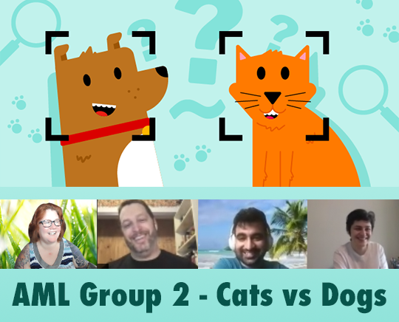
AML I526 Spring 2021 Group 2 Final Submission Cats vs Dogs Classification and Prediction (CaDoD)
Team Info: Left to right: Ben Perkins benperki@iu.edu Lauren Madar laurenmadar@gmail.com Mangesh Walimbe mwalimbe@iu.edu Samin Barghan s.barghan@gmail.com
Notes:
Video and in class presentationVideo and in class presentation * In-class explanation, and discussion of your results (as part of final exam period) * Your video should have a logical and scientific flow to it. All team members need to present a part of the video. In more detail, your video should have a logical and scientific flow to it with main sections for each of the following: -- a title slide (with the project name, Group Number, the team member names, and photos).

Slide 2
Abstract
One of the fundamental tasks in classifying images is object detection within images. Algorithms often employ a ‘bounding box’ tool. To study bounding boxes, our team first evaluated 3 models with GridSearchCV, to be trained on existing bounding box data for the purpose of predicting bounding boxes. The best model was used for bounding box prediction.
A feature engineering pipeline was created to generate additional numeric features from bbox inputs, and then transformed predictions from the bbox model for later use in training our classifier. Next, images were classified as ‘cat’ or ‘dog’ by two logistic regression models with SciKit Learn. We then created a PyTorch model with classification and bounding box predictions using Cross Entropy and Mean Squared Error loss functions. PyTorch allows for a much simpler modeling, training and prediction process, though the Nvidia GPU made a move to Google Colab necessary.
144 words...
Notes:
THIS IS DONE – do not add to it, it is exactly 150 words!
-- Make sure it has an outline slide with good descriptive section headings -- Team names, photos (already done on Title slide) -- Project description -- Some summary visual EDA
This criterion is linked to a Learning OutcomeProject AbstractExpectations here are to get the following: Abstract (150 words approximately describing this phase of the project): that details the problem you are tackling, the main goal of this phase, what you did (main experiments), what were your results/findings (best pipeline and the corresponding public, private scores). Your abstract should be compelling and entice the reader to go through the work There should be 3 parts that should be clear in your abstract 1. Context of the project 2. Methods used 3. Results

Slide 3
Overview
Purpose- Ben
Project activities- Lauren
Methodologies - Mangesh
Results & Conclusion - Samin
Notes:
-- Make sure it has an outline slide with good descriptive section headings -- Team names, photos (already done on Title slide) -- Project description -- Some summary visual EDA
This criterion is linked to a Learning OutcomeProject AbstractExpectations here are to get the following: Abstract (150 words approximately describing this phase of the project): that details the problem you are tackling, the main goal of this phase, what you did (main experiments), what were your results/findings (best pipeline and the corresponding public, private scores). Your abstract should be compelling and entice the reader to go through the work There should be 3 parts that should be clear in your abstract 1. Context of the project 2. Methods used 3.(I asked what #3 is... was blank in the matrix)

Slide 4
Purpose - Why?
The purpose of this project is to use various Python and machine learning tools to classify images from the Kaggle competition dataset, Cats and Dogs.
For this last phase, the goal was to create a PyTorch CNN to classify the images and predict the bounding box locations. We were to use Object-Oriented convolutional neural networks in PyTorch.
The main aim is to classify images and predict bounding boxes with the best accuracy possible. Also, documentation of work, with graphs and tabular data are included to display results and communicate methods.
Other aims include gaining experience with Deep Learning techniques and image classification tasks.
Notes:
This criterion is linked to a Learning Outcome
Results and discussion of results
Expectations here are to provide the following in sections and subsections: Discussion’s aim is result interpretation, which means explain, analyse, and compare them. Often, this part is the most important, simply because it lets the researcher take a step back and give a broader look at the experiment. Do not discuss any outcomes not presented in the results part.

Slide 5
Project activities – What?
During Phase 1, we imported data and performed exploratory data analysis using numpy, pandas, and by plotting image metadata, bounding boxes, and ground truth data.
We plotted XClick points to understand correlation and engineered new features based on bounding box points and normalized images by resizing to 128 by 128 and flattening to numpy arrays.
Several bounding box prediction models and hyperparameters were tested with GridSearch crossfold validation, and we tested an SKLearn Logistic Regression model as well as a homegrown Logistic Regression model trained with gradient descent.
In Phase 2, we explored several neural network models built with PyTorch and transformed image numpy arrays to greyscale resized Tensors, and trained a simple linear neural net model with an accuracy of 53%. A classification-only model (FrankenNet)was trained with 95% accuracy and tested at 72% accuracy.
In Phase 3, we intended on adding bounding box prediction to FrankenNet, but did not have time to finish configuring it with Google Colab’s GPU runtime. We trained a different Conv2d model based on Group 4’s Phase 2 model with an accuracy of 54% before exhausting our project time. Given the time, we would have added a pretrained neural network model like ResNet18 and tuned our model’s accuracy.
Notes:
Our project had three phases, in which we imported, examined data, resized and transformed it, performed feature engineering and compared models using crossfold validation. We trained linear and logistic regression prediction models with gradient descent and then used Pytorch and tensors to build linear and convolutional neural network models running on Google Colab’s GPU. With additional time we would have added a pretrained model and adjusted for accuracy.

Slide 6
Methodologies – How?
Notes:
This criterion is linked to a Learning Outcome
Results and discussion of results
Expectations here are to provide the following in sections and subsections: Discussion’s aim is result interpretation, which means explain, analyse, and compare them. Often, this part is the most important, simply because it lets the researcher take a step back and give a broader look at the experiment. Do not discuss any outcomes not presented in the results part.

Slide 7
Results, Findings, Challenges
Notes:
This criterion is linked to a Learning Outcome
Results and discussion of results
Expectations here are to provide the following in sections and subsections: Discussion’s aim is result interpretation, which means explain, analyse, and compare them. Often, this part is the most important, simply because it lets the researcher take a step back and give a broader look at the experiment. Do not discuss any outcomes not presented in the results part.

Slide 8
Conclusion
We aimed to train a model to predict bounding boxes based on provided images and then predict whether each image was a dog or cat as a classification step, using PyTorch and neural networks. Image classification is a complex machine learning problem. Focusing on a subset of data allowed a short-term project to be approachable. Class prediction based on bounding-boxes alone doesn’t seem to indicate a high probability of success. We achieved about 53% accuracy for classification and box prediction, and 80% accuracy on classification-only convolutional neural net models. Time and hardware (GPU) limitations affected our progress. Though PyTorch makes certain aspects of dataset splitting and neural net model training simpler, tensor datasets and correctly matching layer input and output can be complex to work with, especially with network/remote GPU tools. Next steps would involve transfer learning with a pretrained model, which we did not have sufficient time to perform.
150 words exactly....
Notes:
ConclusionExpectations here are to address the following following in your conclusion (in about 150 words) in a main section by itself: -- Restate your project focus explain why it’s important. Make sure that this part of the conclusion is concise and clear. -- Restate your hypothesis (e.g., ML pipelines with custom features can accurately forecast box office returns) -- Summarize main points of your project: Remind your readers your key points. -- Discuss the significance of your results -- Discuss the future of your project and closing thoughts.

