Slide 1
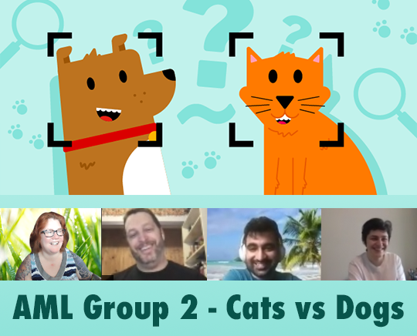
AML I526 Spring 2021 Group 2 Phase 2 Update Cats vs Dogs Classification and Prediction
Team Info: Left to right: Ben Perkins benperki@iu.edu Lauren Madar laurenmadar@gmail.com Mangesh Walimbe mwalimbe@iu.edu Samin Barghan s.barghan@gmail.com
Notes:
Video and in class presentationVideo and in class presentation * In-class explanation, and discussion of your results (as part of final exam period) * Your video should have a logical and scientific flow to it. All team members need to present a part of the video. In more detail, your video should have a logical and scientific flow to it with main sections for each of the following: -- a title slide (with the project name, Group Number, the team member names, and photos).

Slide 2
Abstract
One of the fundamental tasks in classifying images is object detection within images. Algorithms often employ a ‘bounding box’ tool. To study bounding boxes, our team first evaluated 3 models with GridSearchCV, to be trained on existing bounding box data for the purpose of predicting bounding boxes. The best model was used for bounding box prediction.
A feature engineering pipeline was created to generate additional numeric features from bbox inputs, and then transformed predictions from the bbox model for later use in training our classifier. Next, images were classified as ‘cat’ or ‘dog’ by two logistic regression models with SciKit Learn.
We created a PyTorch model with classification and bounding box predictions using Cross Entropy and Mean Squared Error loss functions. PyTorch allows for a much simpler modeling, training and prediction process, though the Nvidia GPU made a move to Google Colab necessary. The team will give brief updates on the following sections.
Notes:
THIS IS DONE – do not add to it, it is exactly 150 words!
-- Make sure it has an outline slide with good descriptive section headings -- Team names, photos (already done on Title slide) -- Project description -- Some summary visual EDA
This criterion is linked to a Learning OutcomeProject AbstractExpectations here are to get the following: Abstract (150 words approximately describing this phase of the project): that details the problem you are tackling, the main goal of this phase, what you did (main experiments), what were your results/findings (best pipeline and the corresponding public, private scores). Your abstract should be compelling and entice the reader to go through the work There should be 3 parts that should be clear in your abstract 1. Context of the project 2. Methods used 3. Results

Slide 3
Overview
During this update, we will only be talking through the following:
Changes to workflow for PyTorch - Lauren
PyTorch Models - Mangesh
Pytorch Metrics - Ben
Updates for Results, Discussion & Conclusion - Ben
Notes:
-- Make sure it has an outline slide with good descriptive section headings -- Team names, photos (already done on Title slide) -- Project description -- Some summary visual EDA
This criterion is linked to a Learning OutcomeProject AbstractExpectations here are to get the following: Abstract (150 words approximately describing this phase of the project): that details the problem you are tackling, the main goal of this phase, what you did (main experiments), what were your results/findings (best pipeline and the corresponding public, private scores). Your abstract should be compelling and entice the reader to go through the work There should be 3 parts that should be clear in your abstract 1. Context of the project 2. Methods used 3.(I asked what #3 is... was blank in the matrix)

Slide 4
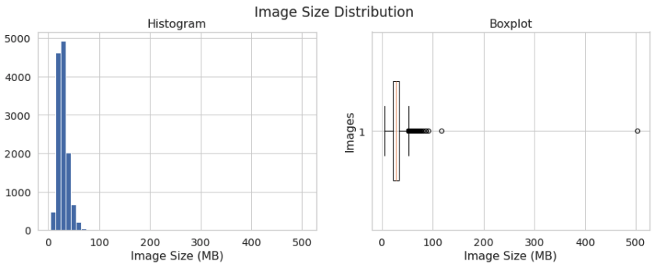
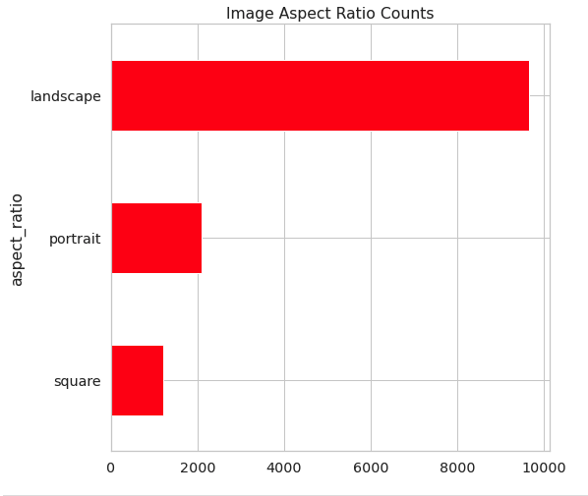
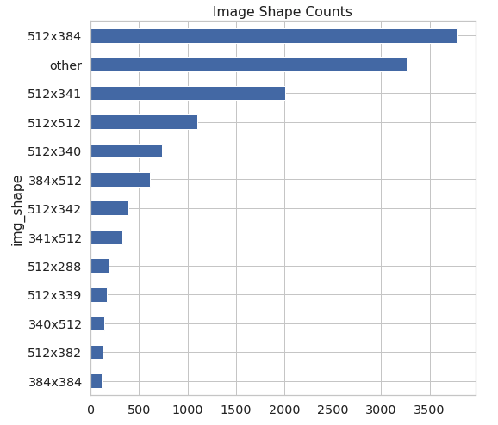
Data – Description and Statistics
12966 images varying in file size from ~ 4mb to ~502 mb
Variety of width and height in pixels (mix of portrait, landscape and square images and sizes) which creates normalization problems (comparing images of different sizes without adjusting for those differences will result in lower performance or inaccurate predictions)
Bounding box metadata to highlight the main object in each image for training and a class label for each image (detailed after the data dictionary)
2 total classes – “cat” and “dog”
Notes:
This criterion is linked to a Learning OutcomeProject Description (data and tasks)Expectations here are to provide the following in sections and subsections: Description of the data and task at hand --Data description --Task to be tackled -- Provide diagrams to aid understanding the workflow

Slide 5
Data Tasks – Updated for PyTorch
Import CSV and parse metadata
Extract and import images & examine width, height, ratios, filesize, etc.
Resize images to 128x128 as normalization
Convert resized image data to a numpy array
Exploratory Data Analysis
Save resized images, bounding box points and image labels to numpy files as a checkpoint
Feature engineering, create additional columns from bounding box XMin, YMin, XMax, YMax
Train/Test split data, and run feature engineering steps after training models
Notes:
This criterion is linked to a Learning OutcomeProject Description (data and tasks)Expectations here are to provide the following in sections and subsections: Description of the data and task at hand --Data description --Task to be tackled -- Provide diagrams to aid understanding the workflow

Slide 6
Data Dictionary – result of Exploratory Data Analysis
Item | Description | Source | Type | Required?
image | The original, unresized image data of a cat or dog. Various widths, heights and file sizes. | cadod.tar.gz | bitmap image | yes
bb_coords (aka y_bbox) | XMin, YMin, XMax, YMax The (x,y) points of the upper left and lower right boundaries of an object to be classified as a cat or dog in the resized image. Represents a percentage of the width, not actual pixels. Acts as ground truth for the localization model and as training data for the classification model. | cadod.csv or localization prediction | float, % between 0 and 1 | yes
resized_image | A 128x128 pixel resized version of the original image data, for normalization purposes. | preprocessing | bitmap image | yes
img_npy | A numpy array of image data (int) based on the resized image. | preprocessing | int array | yes
label (aka y_label) | A classification label, ‘cat’ or ‘dog’ (also encoded to 0 or 1), used as ground truth for training the classification model. Also, the output prediction from the classification model. | cadod.csv | str or int (0, 1) | yes
bb_meta | bbox_w_percent, bbox_h_percent, bbox_centerX, bbox_centerY, bbox_area (float between 0 and 1 as percentages) bb_touch_left, bb_touch_right, bb_touch_top, bb_touch_bottom (int 0 or 1) num_touch_edges (int from 0 to 4) Metadata generated using bb_coords. Float values are dimensional percentages or locations, and ‘bb_touch’ items are 0 if false and 1 if true. num_touch_edges is total number of ‘touching edges’ min 0 and max 4 | feature engineering pipeline | float, % between 0 and 1, or int 0/1 or int 0..4 | yes
XClick | XClick1X, XClick1Y, XClick2X, XClick2Y, XClick3X, XClick3Y The (x,y) points that a human reviewer marked as ‘outer features’ when using a bounding box tool. These points can be any order and any shape, and are used to determine a rectangular bounding box. These points are contained by the bounding box in bb_coords above. Not present for all provided images. | cadod.csv | float, % between 0 and 1 or -1 if not present | no
other metadata | Source (string “xclick” or “activemil”) IsOccluded, IsTruncated, IsGroup, IsDepiction (int 0 or 1) Confidence (set to 1 for every row) | cadod.csv | string or int 0 or 1 | no
Notes:
This criterion is linked to a Learning OutcomeProject Description (data and tasks)Expectations here are to provide the following in sections and subsections: Description of the data and task at hand --Data description --Task to be tackled -- Provide diagrams to aid understanding the workflow

Slide 7
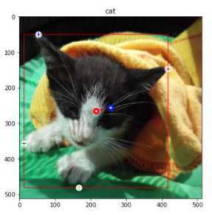
Data: Bounding Box Detail
Example Image, annotated
Bounding Box Attributes
XClick attributes are coordinates that a human reviewer clicked on an image to choose 4 ‘outer’ feature points, any order, eg tips of ears and paws (shown here as 4 circles with plusses )
XMin, YMin, XMax and YMax points are the bounding box upper left and lower right points that contain all of the XClick points (shown here plotted as a red box )
Each of these bounding boxes and the class information is only as good as the human’s interpretation (examples: raccoon labeled as dog, inaccurate bounding boxes)
We decided to perform feature engineering to determine the width, center point, and height of the bounding boxes. Center point of bounding box shown here as a blue dot with white center, center of images as a red dot/white center.
(XMin, YMin)
+
+
+
(bbox_center_x, bbox_center_y)
+
(XMax, YMax)
+

Slide 8
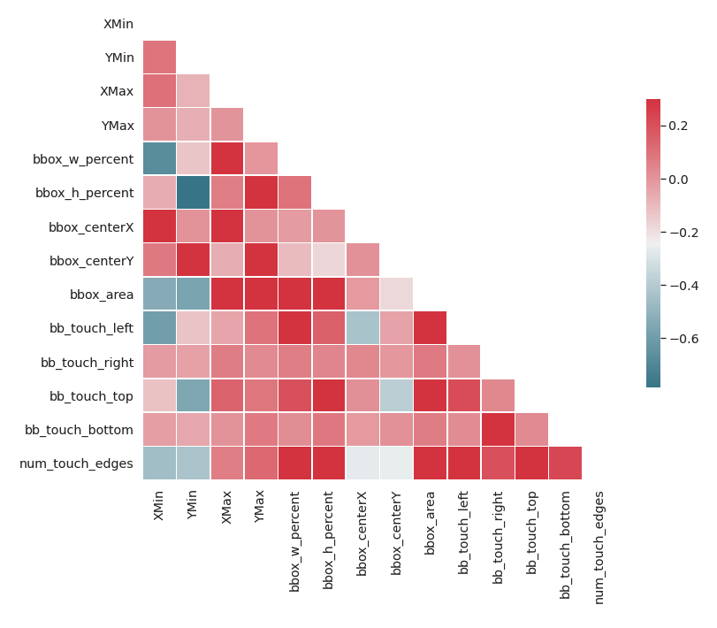
Feature Engineering
From
New Features
bbox_w_percent (width of bbox as a % of the whole image)
bbox_h_percent (height of bbox as % of the image)
bbox_centerX (X coordinate of bbox centerpoint as %)
bbox_centerY (Y coordinate of bbox centerpoint as %)
bbox_area (bbox_w_percent * bbox_h_percent)
bb_touch_left, _right, _top, _bottom (4 features) (1 if bounding box touches image edge, 0 otherwise)
num_touch_edges (sum of bb_touch edges)
XMin
YMin
XMax
YMax
Correlation Matrix
Notes:
This criterion is linked to a Learning Outcome
EDA
Expectations here are to provide the following in sections and subsections:
[CaDoD] -- Overview of images (i.e. count of cat images, dog images, total images, memory size of images, etc..) -- Other useful text-based analysis (as opposed to graphic-based)
This criterion is linked to a Learning Outcome
Visual EDA
Expectations here are to provide the following in sections and subsections:
[CaDoD] -- preview and a small sample of images before and after transformations

Slide 9
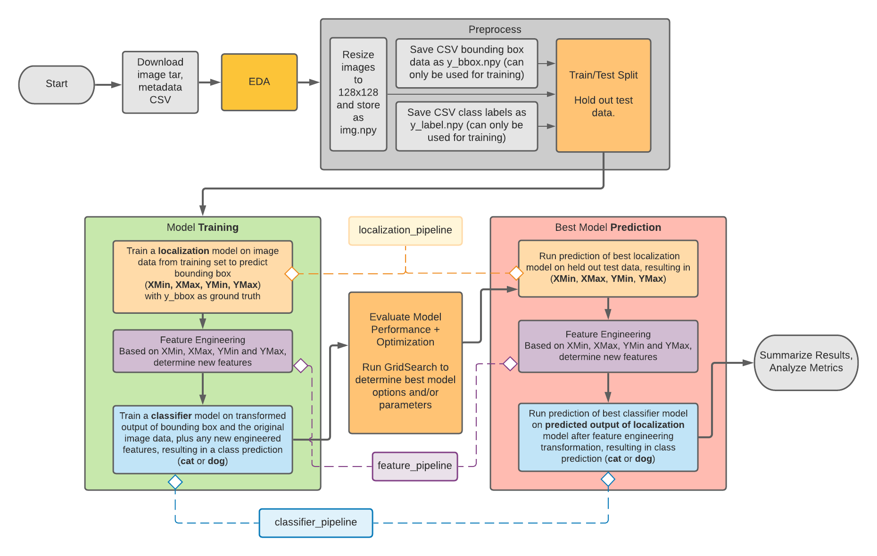
SciKit Learn Pipelines & Workflow
Notes:
Modeling Pipelines
Expectations here are to provide the following in sections and subsections:
[CaDoD] Modeling Pipelines -- Preprocessing images -- input Image size (w, h) -- Loss function used (data loss and regularization parts) in latex -- Number of experiments conducted -- Experiment table with the following details per experiment: ----- Baseline experiment ---- The families of input features used ----- For train/valid/test record the following in a Pandas DataFrame: ---- Accuracy

Slide 10
PyTorch Workflow
Notes:
Modeling Pipelines
Expectations here are to provide the following in sections and subsections:
[CaDoD] Modeling Pipelines -- Preprocessing images -- input Image size (w, h) -- Loss function used (data loss and regularization parts) in latex -- Number of experiments conducted -- Experiment table with the following details per experiment: ----- Baseline experiment ---- The families of input features used ----- For train/valid/test record the following in a Pandas DataFrame: ---- Accuracy

Slide 11
Models - SKLearn
Bounding Box Prediction Models
Classification Models
3 models evaluated with GridSearchCV and different alpha parameters and KNN parameters (in order of performance)
Lasso Linear Regression *
K Nearest Neighbor
Ridge Linear Regression
* winner with alpha = 1 during subset training Winning model (along with its params) placed into the localization pipeline.
SKLearn Logistic Regression model
Homegrown Logistic Regression model using gradient descent
We did not have sufficient time to perform CV on these two models, but ran them both through training and test sets to compare predictions and performance.
Notes:
This criterion is linked to a Learning Outcome
Results and discussion of results
Expectations here are to provide the following in sections and subsections: Discussion’s aim is result interpretation, which means explain, analyse, and compare them. Often, this part is the most important, simply because it lets the researcher take a step back and give a broader look at the experiment. Do not discuss any outcomes not presented in the results part.

Slide 12
Models - PyTorch
Notes:
This criterion is linked to a Learning Outcome
Results and discussion of results
Expectations here are to provide the following in sections and subsections: Discussion’s aim is result interpretation, which means explain, analyse, and compare them. Often, this part is the most important, simply because it lets the researcher take a step back and give a broader look at the experiment. Do not discuss any outcomes not presented in the results part.

Slide 13
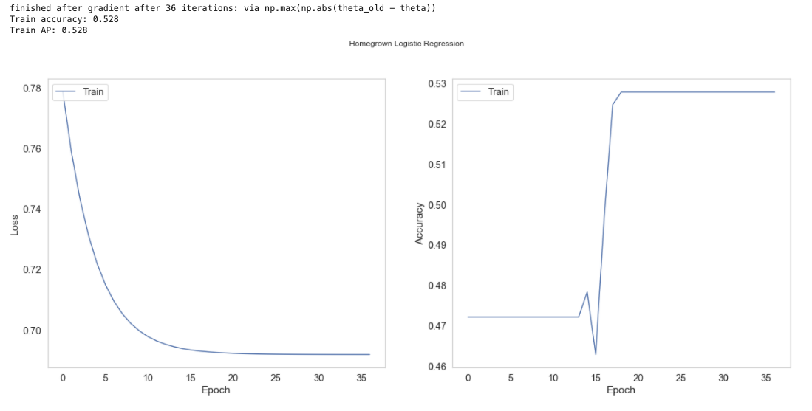
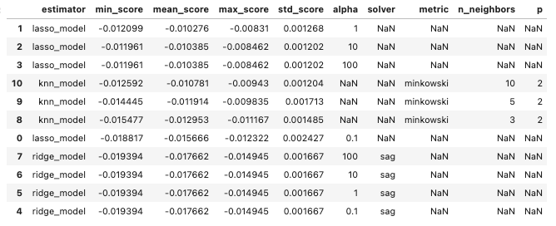
Metrics - SKLearn
Loss and Cost over Epochs with Logistic Regression
Linear Model Comparison with MSE
Notes:
This criterion is linked to a Learning Outcome
Results and discussion of results
Expectations here are to provide the following in sections and subsections: Discussion’s aim is result interpretation, which means explain, analyse, and compare them. Often, this part is the most important, simply because it lets the researcher take a step back and give a broader look at the experiment. Do not discuss any outcomes not presented in the results part.

Slide 14
Metrics - PyTorch
Notes:
This criterion is linked to a Learning Outcome
Results and discussion of results
Expectations here are to provide the following in sections and subsections: Discussion’s aim is result interpretation, which means explain, analyse, and compare them. Often, this part is the most important, simply because it lets the researcher take a step back and give a broader look at the experiment. Do not discuss any outcomes not presented in the results part.

Slide 15
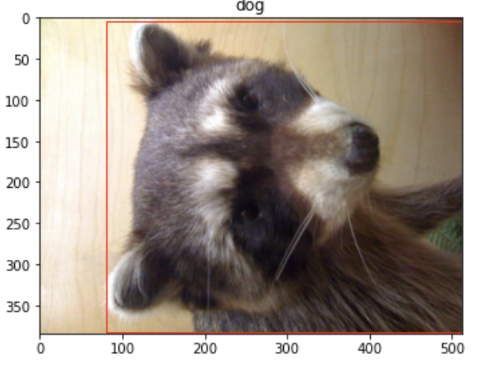
Results & Discussion
dog?
Project challenges/difficulties
Confusion over which models to use and Phase 1 expectations took time away from coding efforts, took a while to understand which data to use for which step
Not able to perform ideal optimization or cross validation of Homegrown vs LogReg model for classification
Pipelines not optimized, unable to debug Feature Union in time for ideal flow from bbox predict > feature engineering > class predict
Irregular image ground truth (raccoon image classified as dog, inaccurate bounding boxes, “depictions” which could be paintings, statues, filtered images, etc.)
Cuda GPU requirement for PyTorch required use of Google Colab (team working from Mac laptops that did not have applicable GPUs)
Notes:
This criterion is linked to a Learning Outcome
Results and discussion of results
Expectations here are to provide the following in sections and subsections: Discussion’s aim is result interpretation, which means explain, analyse, and compare them. Often, this part is the most important, simply because it lets the researcher take a step back and give a broader look at the experiment. Do not discuss any outcomes not presented in the results part.

Slide 16
Conclusion
We aimed to train a model to predict bounding boxes based on provided images and then predict whether each image was a dog or cat as a classification step, using pipelines, SKLearn, and a homegrown model. Image classification’s a complex ML problem. Focusing on a subset of data allowed a short-term project to be approachable. Class prediction based on bounding-boxes alone doesn’t seem to indicate a high probability of success. We’d hoped to achieve above 50% accuracy and planned to use confusion matrices and a combination of F1/accuracy scoring to compare our classification models. Time limitations affected our outcome and though the bbox prediction models and pipelines function properly, the predictions from our classification models were not usable. They predicted the same values for all images. We hope that implementing unsupervised machine learning with PyTorch and additional tools available therein will allow us to examine metrics on the classification task.
Future Steps:
Develop unsupervised machine learning models in PyTorch to better predict bounding boxes and image classes.
Notes:
ConclusionExpectations here are to address the following following in your conclusion (in about 150 words) in a main section by itself: -- Restate your project focus explain why it’s important. Make sure that this part of the conclusion is concise and clear. -- Restate your hypothesis (e.g., ML pipelines with custom features can accurately forecast box office returns) -- Summarize main points of your project: Remind your readers your key points. -- Discuss the significance of your results -- Discuss the future of your project and closing thoughts.

