Slide 1
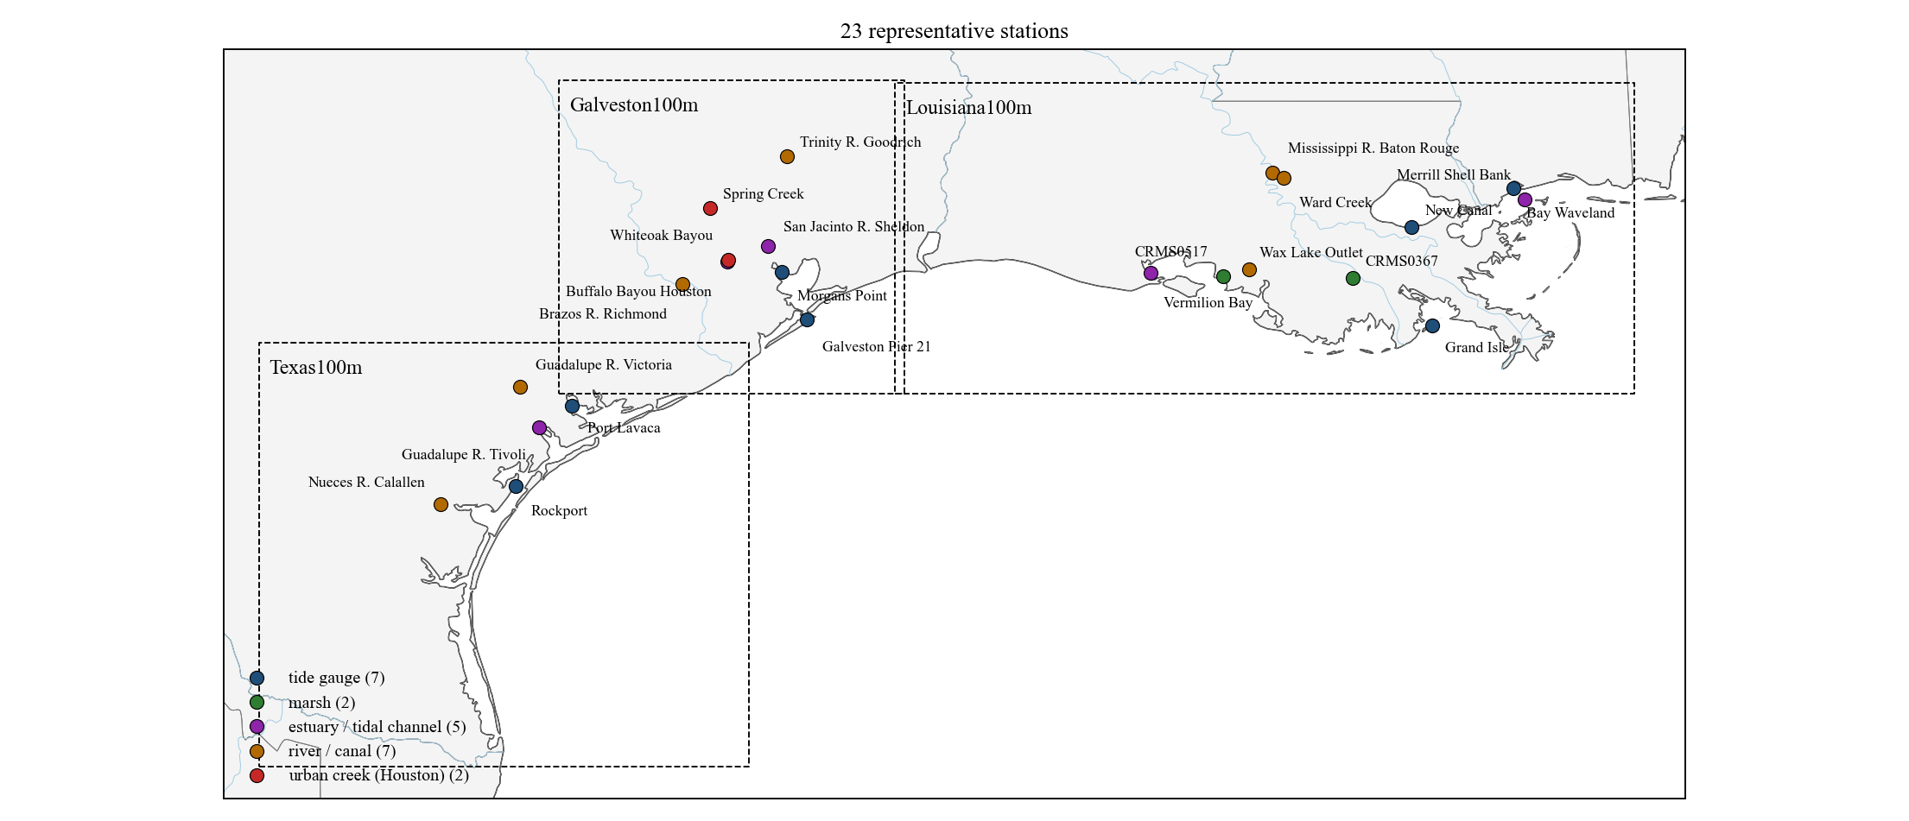
Representative stations: 1–6 h water-level forecasts of the LSTM (inputs: water level, wind, upstream discharge)
Test period 2024-01 to 2025-12. Forecasts issued every hour; the plots show the 1–6 h trajectory issued every 6 h.
Louisiana100m: 3 tide gauge, 2 marsh (CRMS), 2 estuary / tidal channel, 3 river.
Galveston100m: 2 tide gauge, 2 estuary / tidal channel, 2 river, 2 urban creek (Houston).
Texas100m: 2 tide gauge, 1 estuary / tidal channel, 2 river.
1

Slide 2
How to read the station slides
Each station slide has three 4-day windows from the test period:
hurricane — Francine (10–14 Sep 2024) for Louisiana100m, Beryl (7–11 Jul 2024) for Galveston100m and Texas100m;
high water — the 4 days around the highest observed level outside the hurricane;
normal — 4 days whose 6 h error equals the station's whole-year error.
Black: observation. Red: the LSTM with water level + wind + upstream discharge, 1–6 h forecast issued every 6 h, drawn from the observation at the issue time.
Blue dashed: the same LSTM trained on water level alone (no wind, no discharge), same issue times.
The RMSE in each window title uses every hourly issue time in the window, not only the drawn ones.
Whole-year RMSE is the test-period RMSE of all hourly forecasts (2024-01 to 2025-12). All errors in cm.
Where no red line is drawn, the past 72 h of observations or wind were too incomplete to issue a forecast.
2

Slide 3
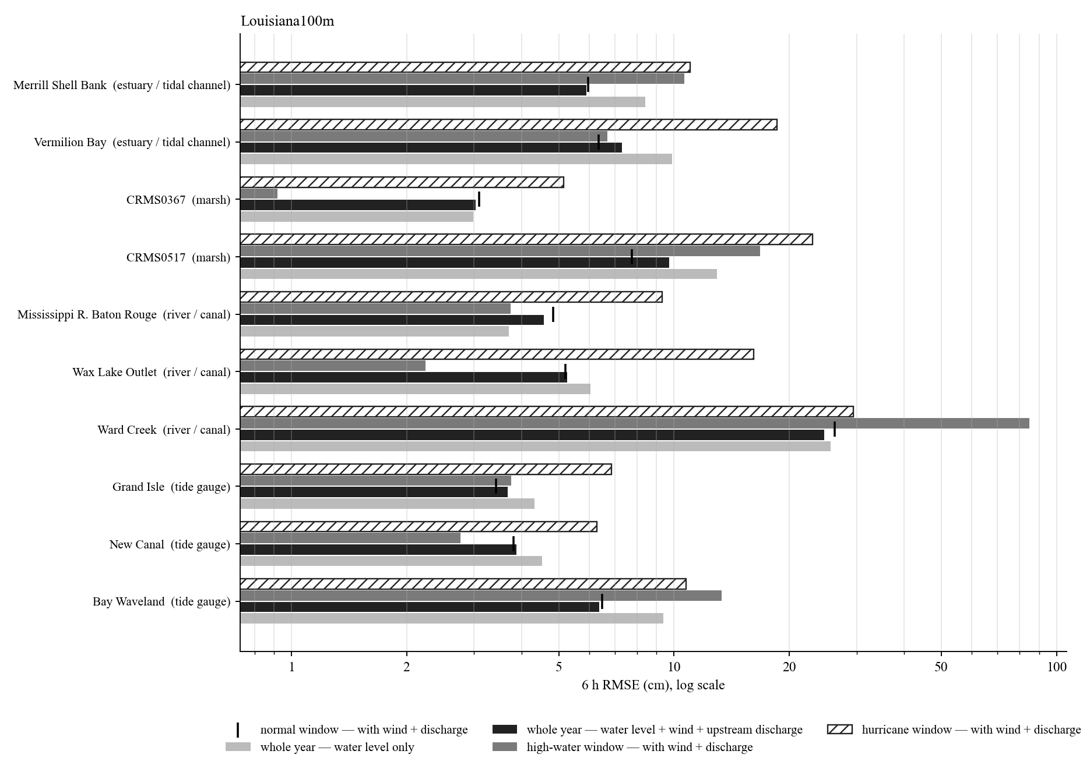
Louisiana100m: 6 h RMSE of the representative stations
Hurricane window: Francine (Sep 2024).
Whole-year 6 h RMSE from 3.0 cm (CRMS0367) to 24.7 cm (Ward Creek).
Tide gauges, marsh and estuaries: hurricane windows 2 to 3 times the whole-year error; the wind input reduces them most.
Rivers and creeks: the high-water or hurricane window is 5 to 10 times the whole-year error; errors sit in the first hours of each rise.
Log scale.
3

Slide 4
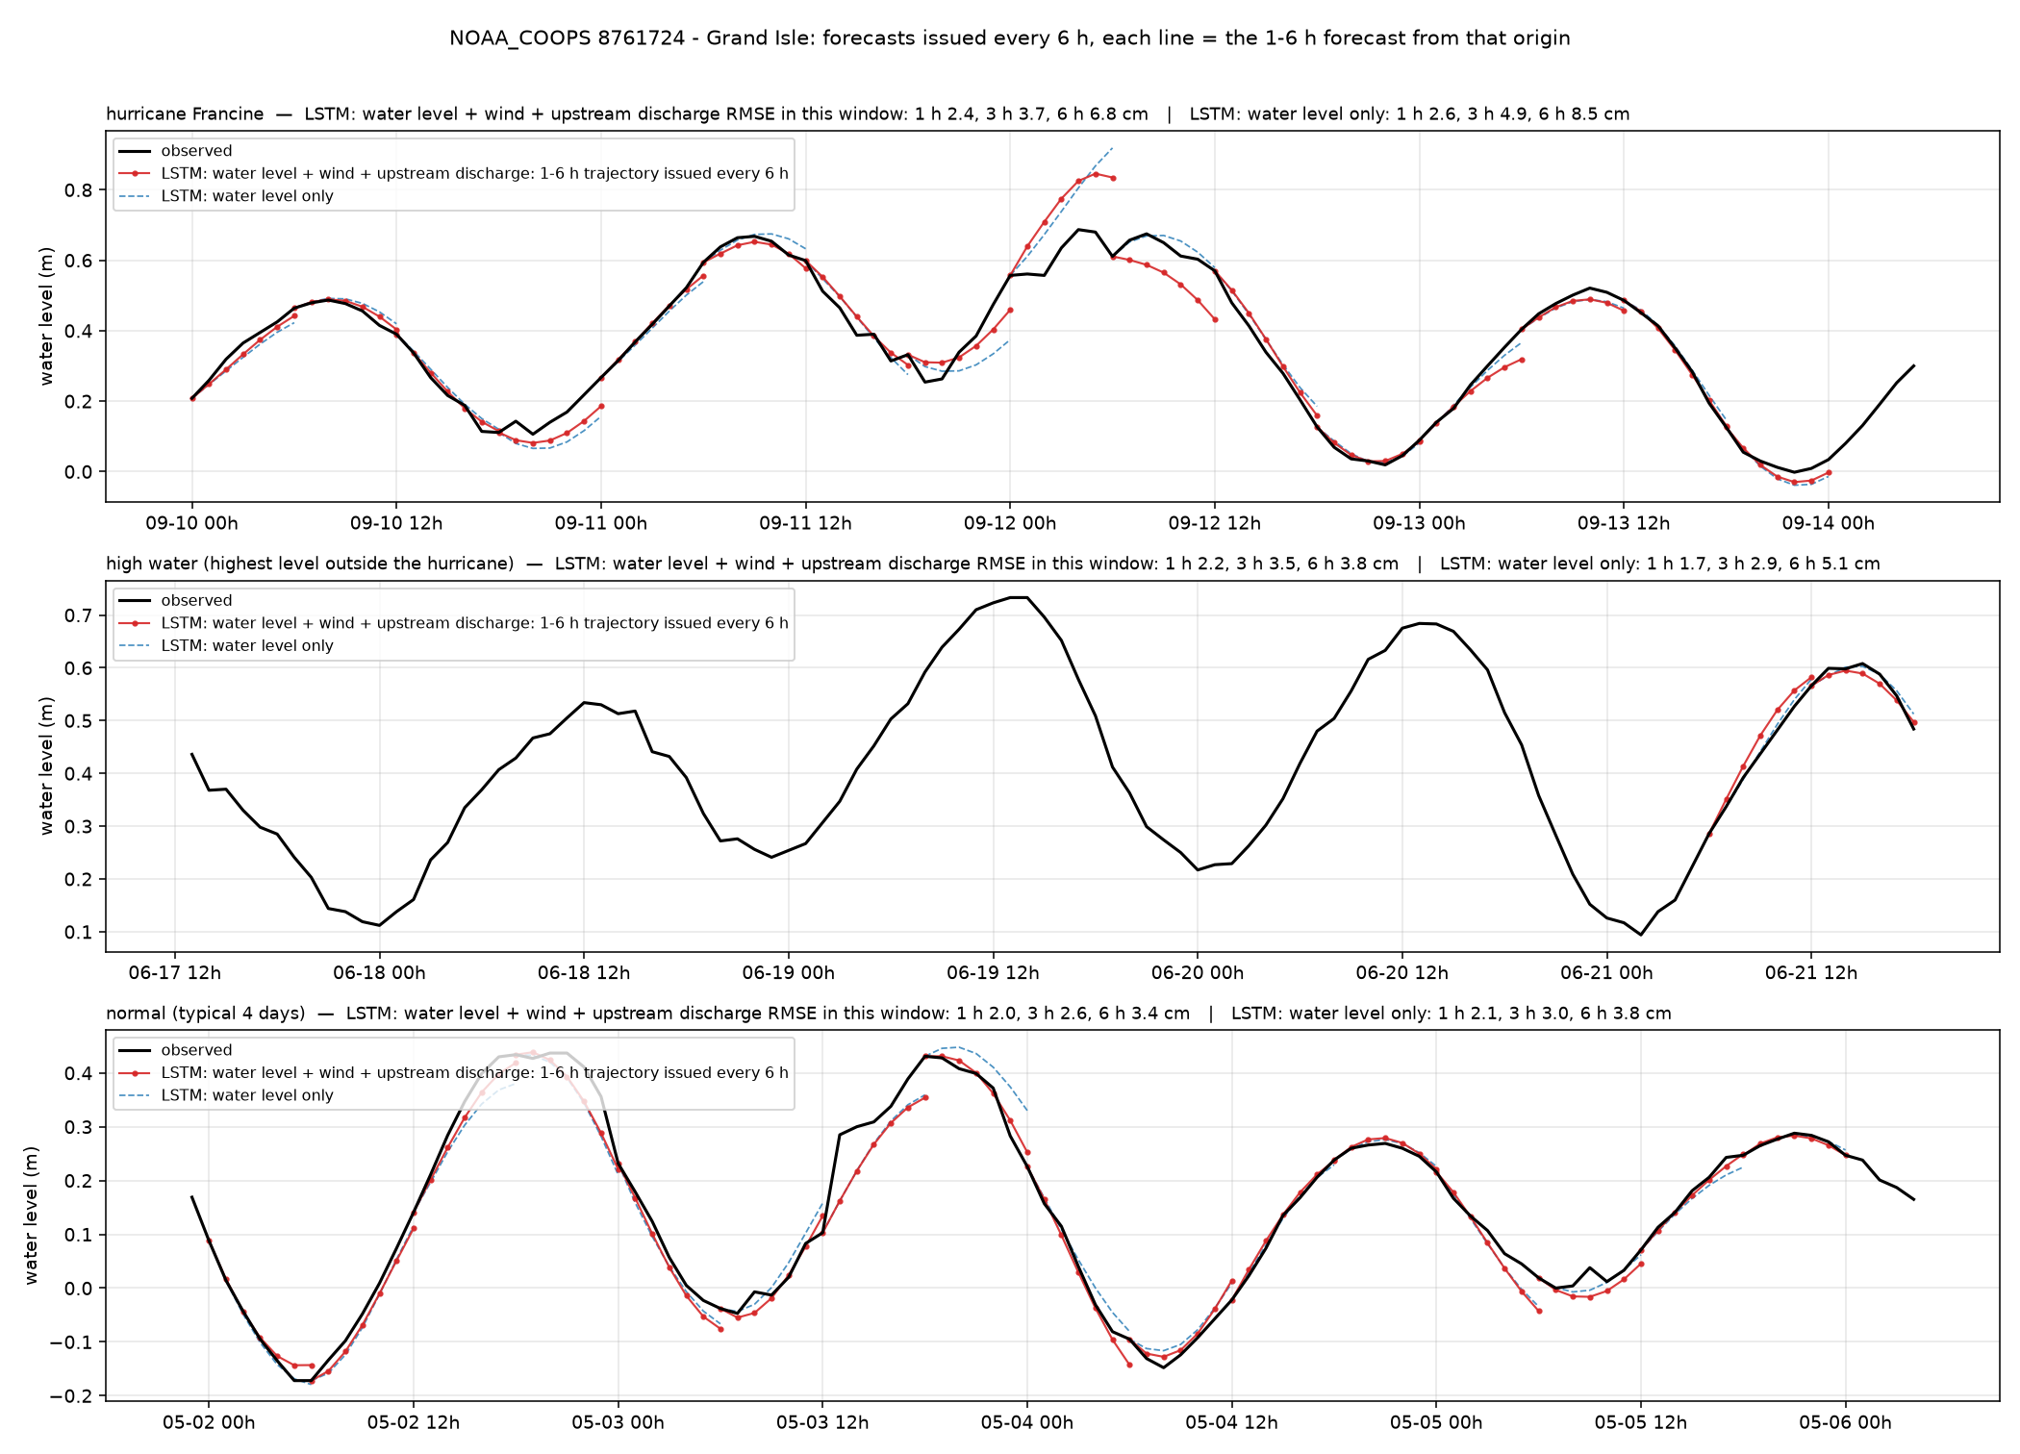
Grand Isle — Grand Isle (NOAA_COOPS 8761724)
Louisiana100m · tide gauge · 29.263°N 89.957°W
6 h RMSE, cm
whole year, with wind + discharge
3.7
whole year, water level only
4.3
hurricane window (2024-09-10)
6.8
high-water window (2024-06-17)
3.8
normal window (2025-05-01)
3.4
1 / 3 / 6 h, whole year, with wind + discharge
1.8 / 2.6 / 3.7 cm
Open coast. Tide dominates; both models within 4 cm except the Francine surge hours.
4

Slide 5
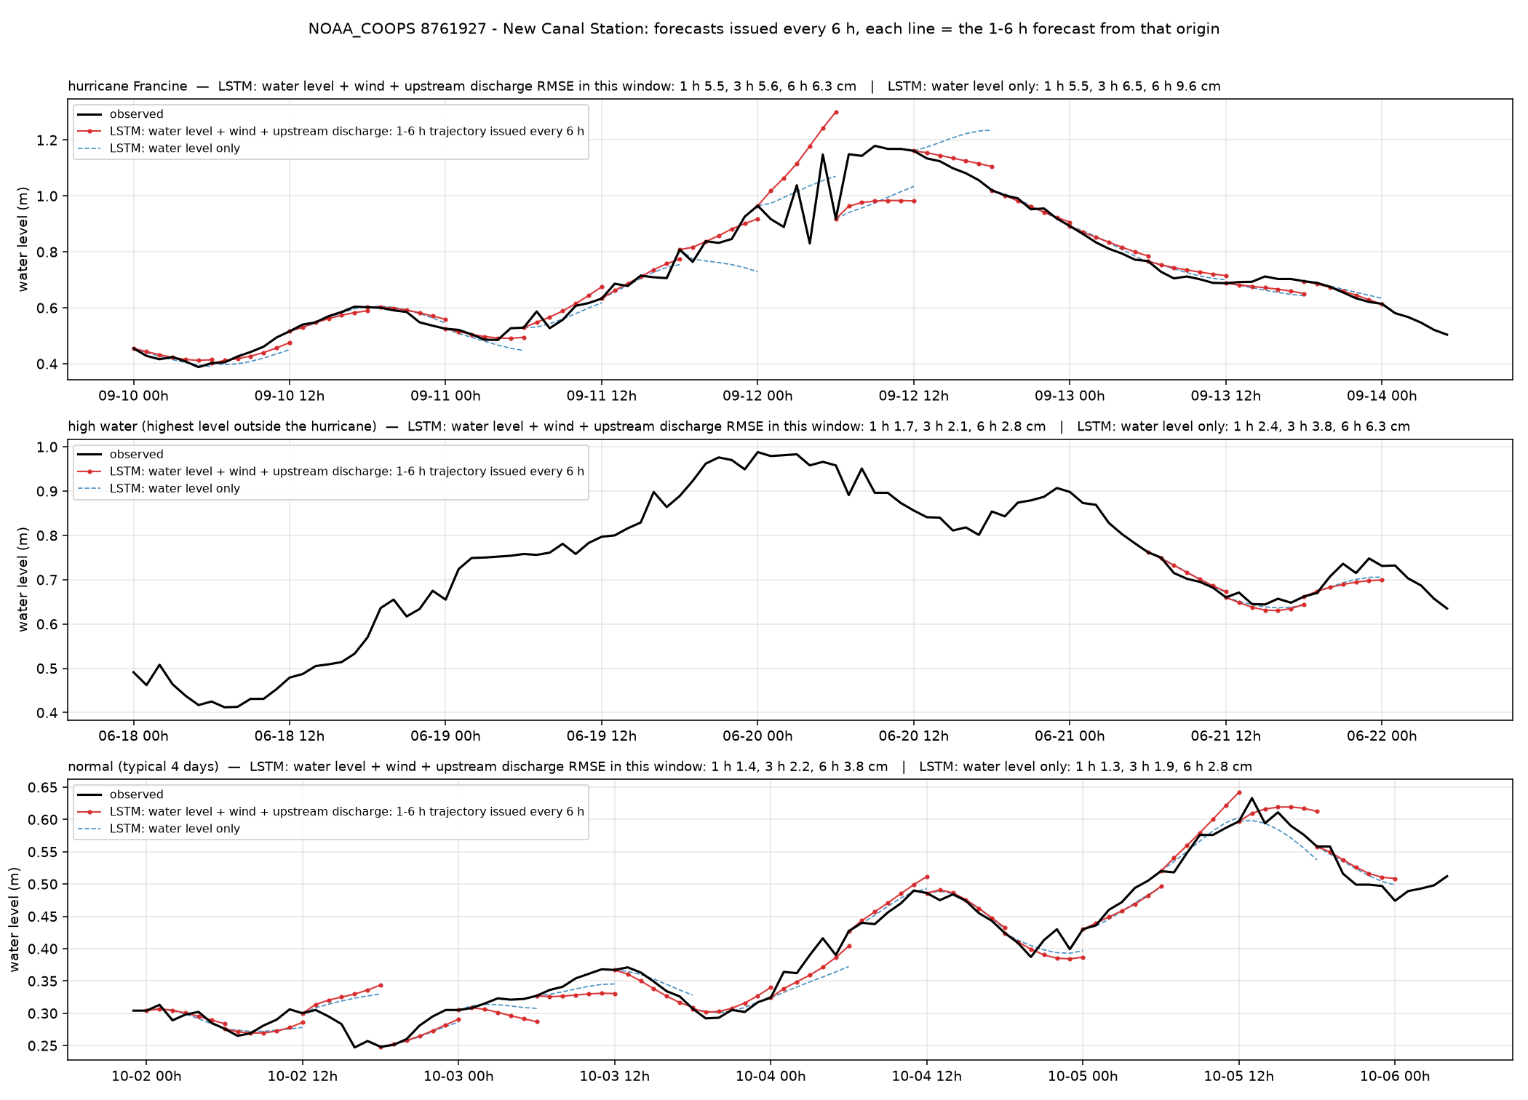
New Canal — New Canal Station (NOAA_COOPS 8761927)
Louisiana100m · tide gauge · 30.027°N 90.113°W
6 h RMSE, cm
whole year, with wind + discharge
3.9
whole year, water level only
4.5
hurricane window (2024-09-10)
6.3
high-water window (2024-06-18)
2.8
normal window (2024-10-01)
3.8
1 / 3 / 6 h, whole year, with wind + discharge
2.5 / 2.8 / 3.9 cm
Lake Pontchartrain. Wind set-up is the main signal; wind input halves the error on windy days.
5

Slide 6
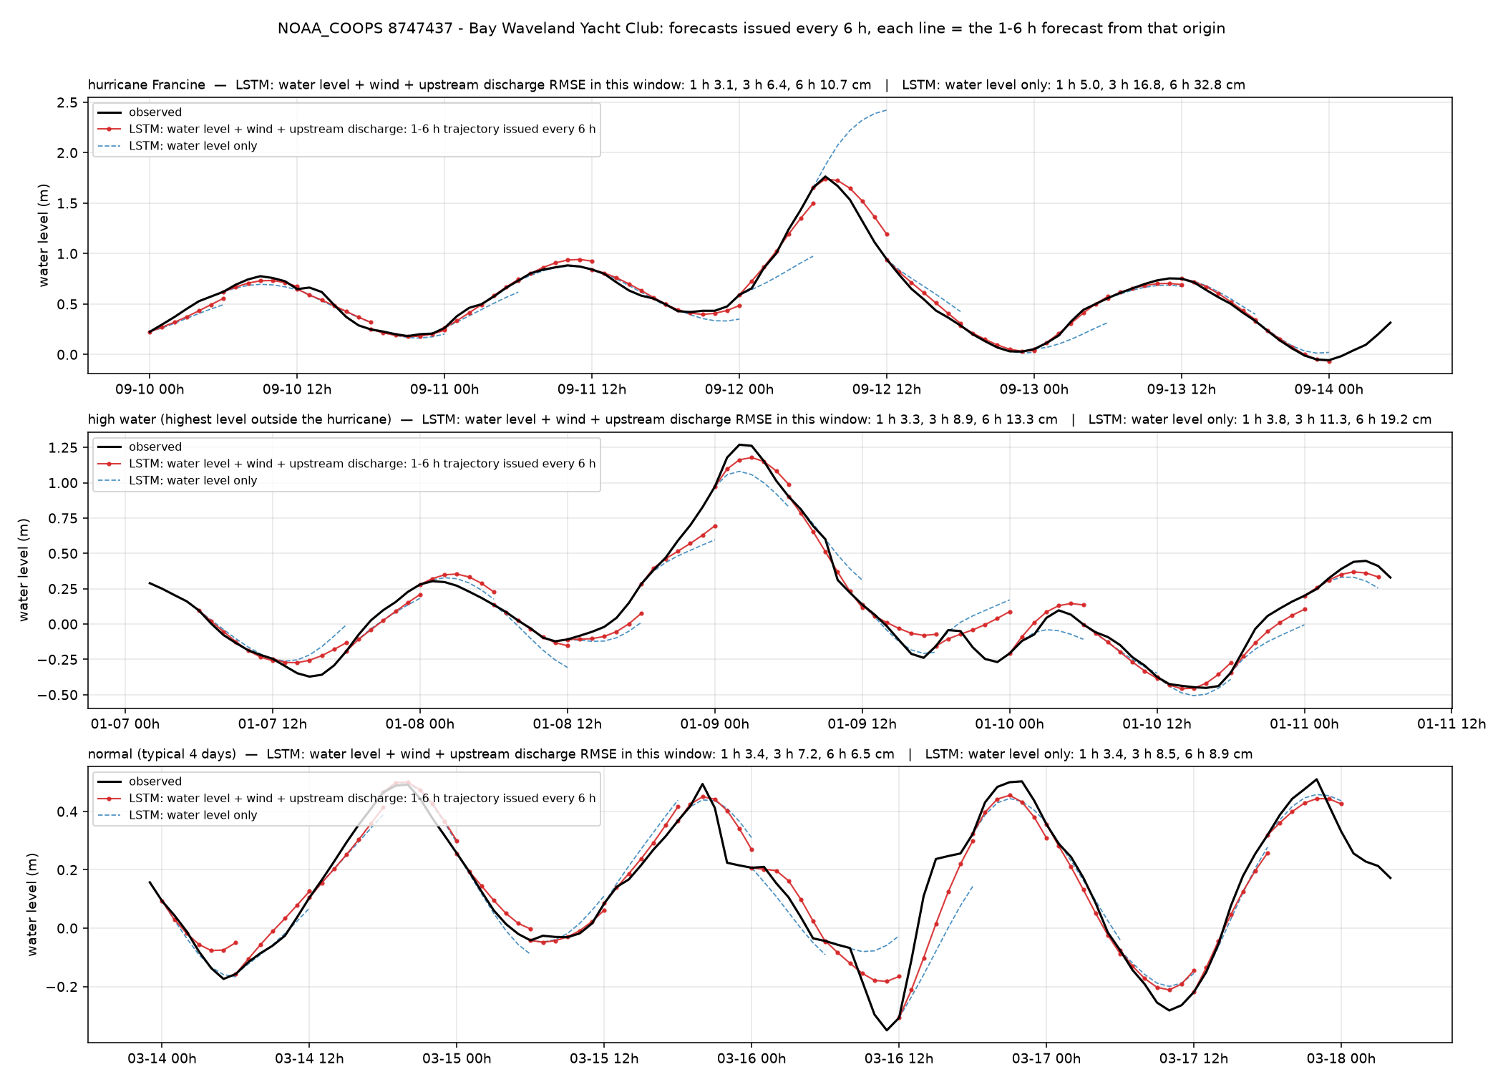
Bay Waveland — Bay Waveland Yacht Club (NOAA_COOPS 8747437)
Louisiana100m · tide gauge · 30.326°N 89.326°W
6 h RMSE, cm
whole year, with wind + discharge
6.4
whole year, water level only
9.4
hurricane window (2024-09-10)
10.8
high-water window (2024-01-07)
13.3
normal window (2024-03-13)
6.5
1 / 3 / 6 h, whole year, with wind + discharge
2.2 / 5.1 / 6.4 cm
Mississippi Sound. Francine surge of 1.75 m followed by the wind model; the water-level-only model overshoots to 2.4 m.
6

Slide 7
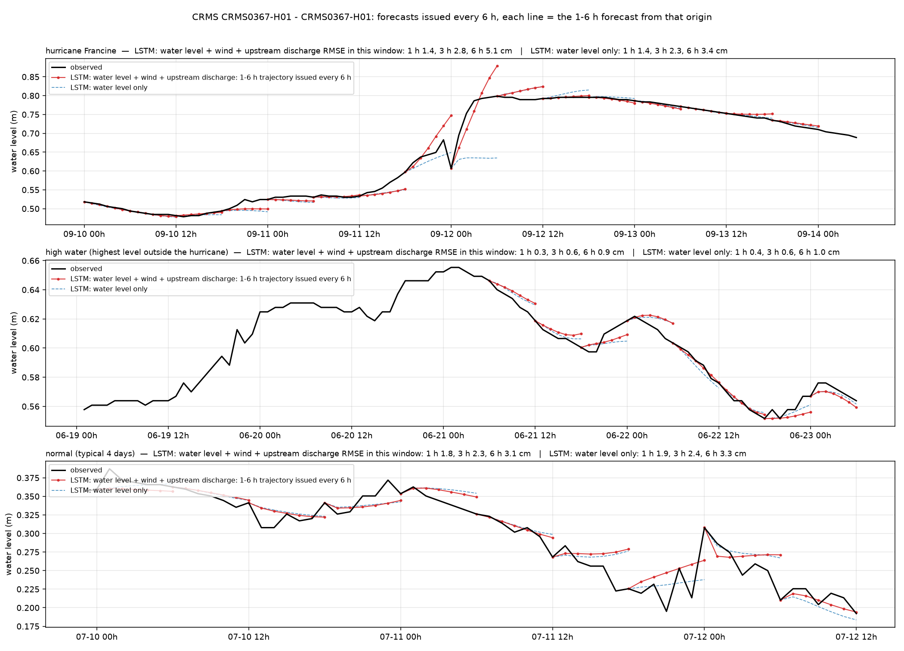
CRMS0367 — CRMS0367-H01 (Terrebonne) (CRMS CRMS0367-H01)
Louisiana100m · marsh (CRMS) · 29.631°N 90.572°W
6 h RMSE, cm
whole year, with wind + discharge
3.0
whole year, water level only
3.0
hurricane window (2024-09-10)
5.2
high-water window (2024-06-19)
0.9
normal window (2024-07-09)
3.1
1 / 3 / 6 h, whole year, with wind + discharge
1.3 / 2.3 / 3.0 cm
Terrebonne marsh, slow water. Errors under 1 cm in quiet weeks; Francine window 5 cm.
7

Slide 8
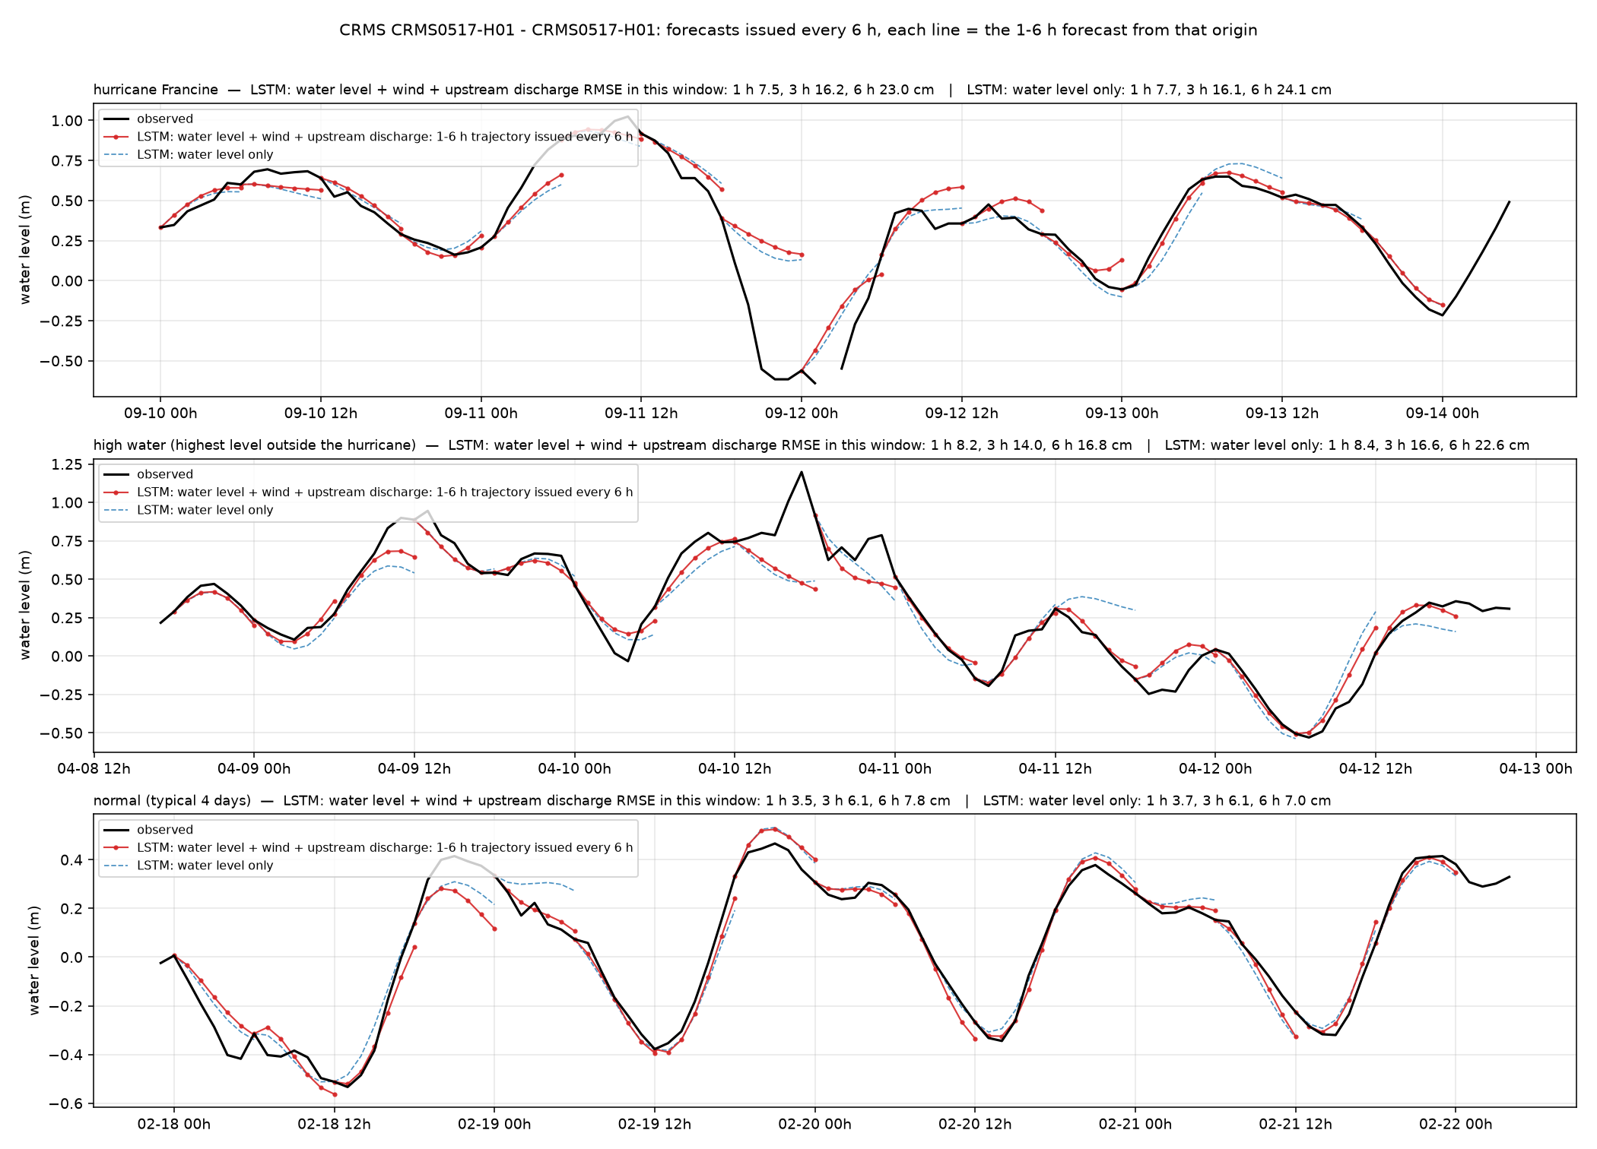
CRMS0517 — CRMS0517-H01 (Teche/Vermilion) (CRMS CRMS0517-H01)
Louisiana100m · marsh (CRMS) · 29.643°N 91.572°W
6 h RMSE, cm
whole year, with wind + discharge
9.7
whole year, water level only
12.9
hurricane window (2024-09-10)
23.0
high-water window (2024-04-08)
16.8
normal window (2024-02-17)
7.8
1 / 3 / 6 h, whole year, with wind + discharge
4.9 / 7.8 / 9.7 cm
Teche/Vermilion marsh. One of the largest wind gains among marsh stations (12.9 to 9.7 cm over the year).
8

Slide 9
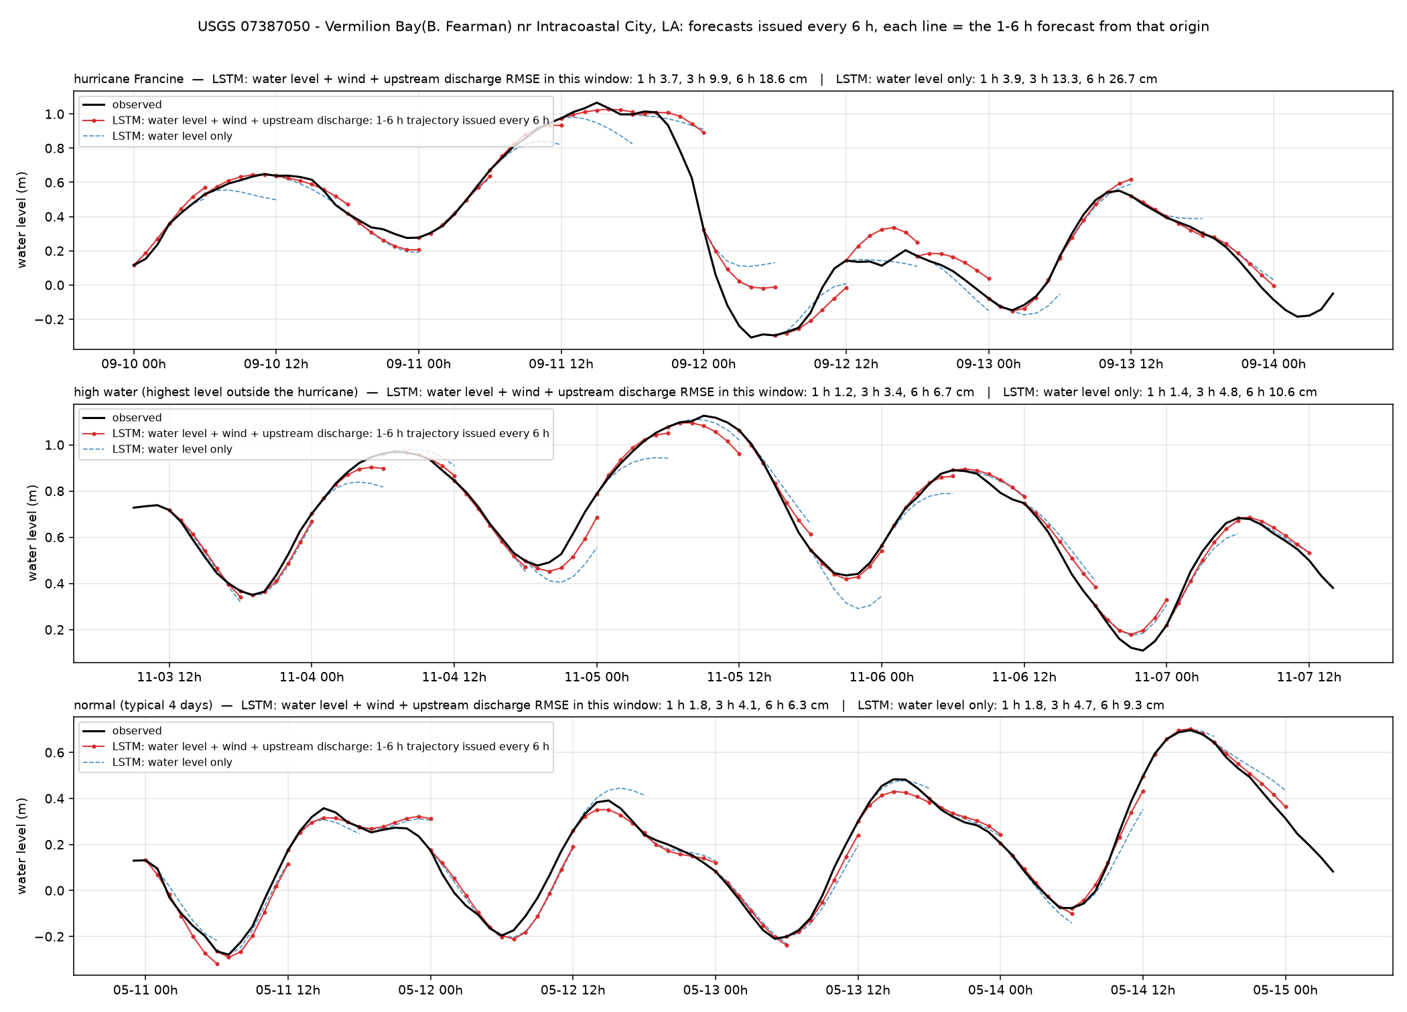
Vermilion Bay — Vermilion Bay(B. Fearman) nr Intracoastal City, LA (USGS 07387050)
Louisiana100m · estuary / tidal channel · 29.674°N 92.136°W
6 h RMSE, cm
whole year, with wind + discharge
7.3
whole year, water level only
9.9
hurricane window (2024-09-10)
18.6
high-water window (2024-11-03)
6.7
normal window (2025-05-10)
6.3
1 / 3 / 6 h, whole year, with wind + discharge
2.1 / 4.9 / 7.3 cm
Vermilion Bay. Shallow bay pushed by wind; hurricane window 18.6 cm, normal 6.4 cm.
9

Slide 10
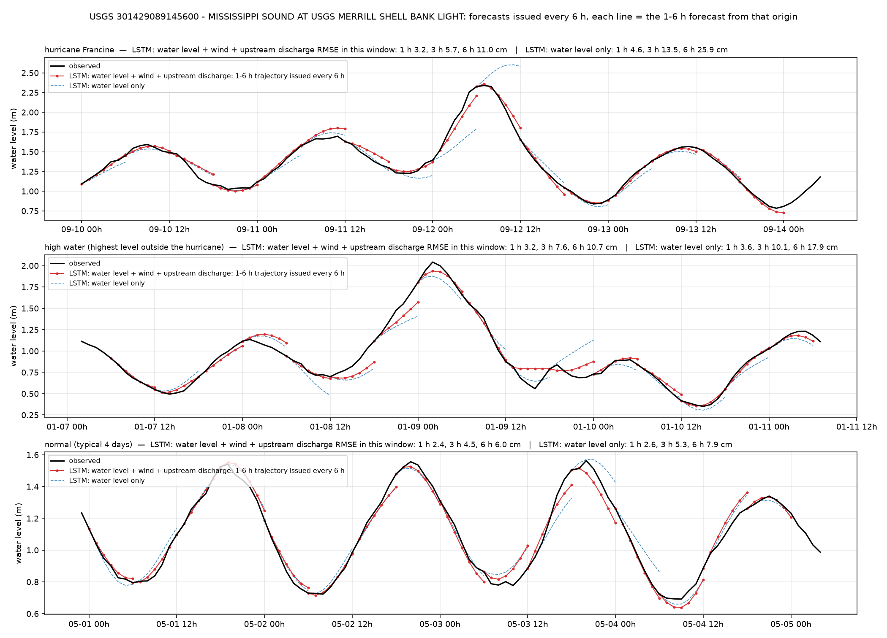
Merrill Shell Bank — MISSISSIPPI SOUND AT USGS MERRILL SHELL BANK LIGHT (USGS 301429089145600)
Louisiana100m · estuary / tidal channel · 30.238°N 89.243°W
6 h RMSE, cm
whole year, with wind + discharge
5.9
whole year, water level only
8.4
hurricane window (2024-09-10)
11.0
high-water window (2024-01-07)
10.7
normal window (2025-04-30)
6.0
1 / 3 / 6 h, whole year, with wind + discharge
2.1 / 4.3 / 5.9 cm
Mississippi Sound light. Storm set-up resolved by the wind model.
10

Slide 11
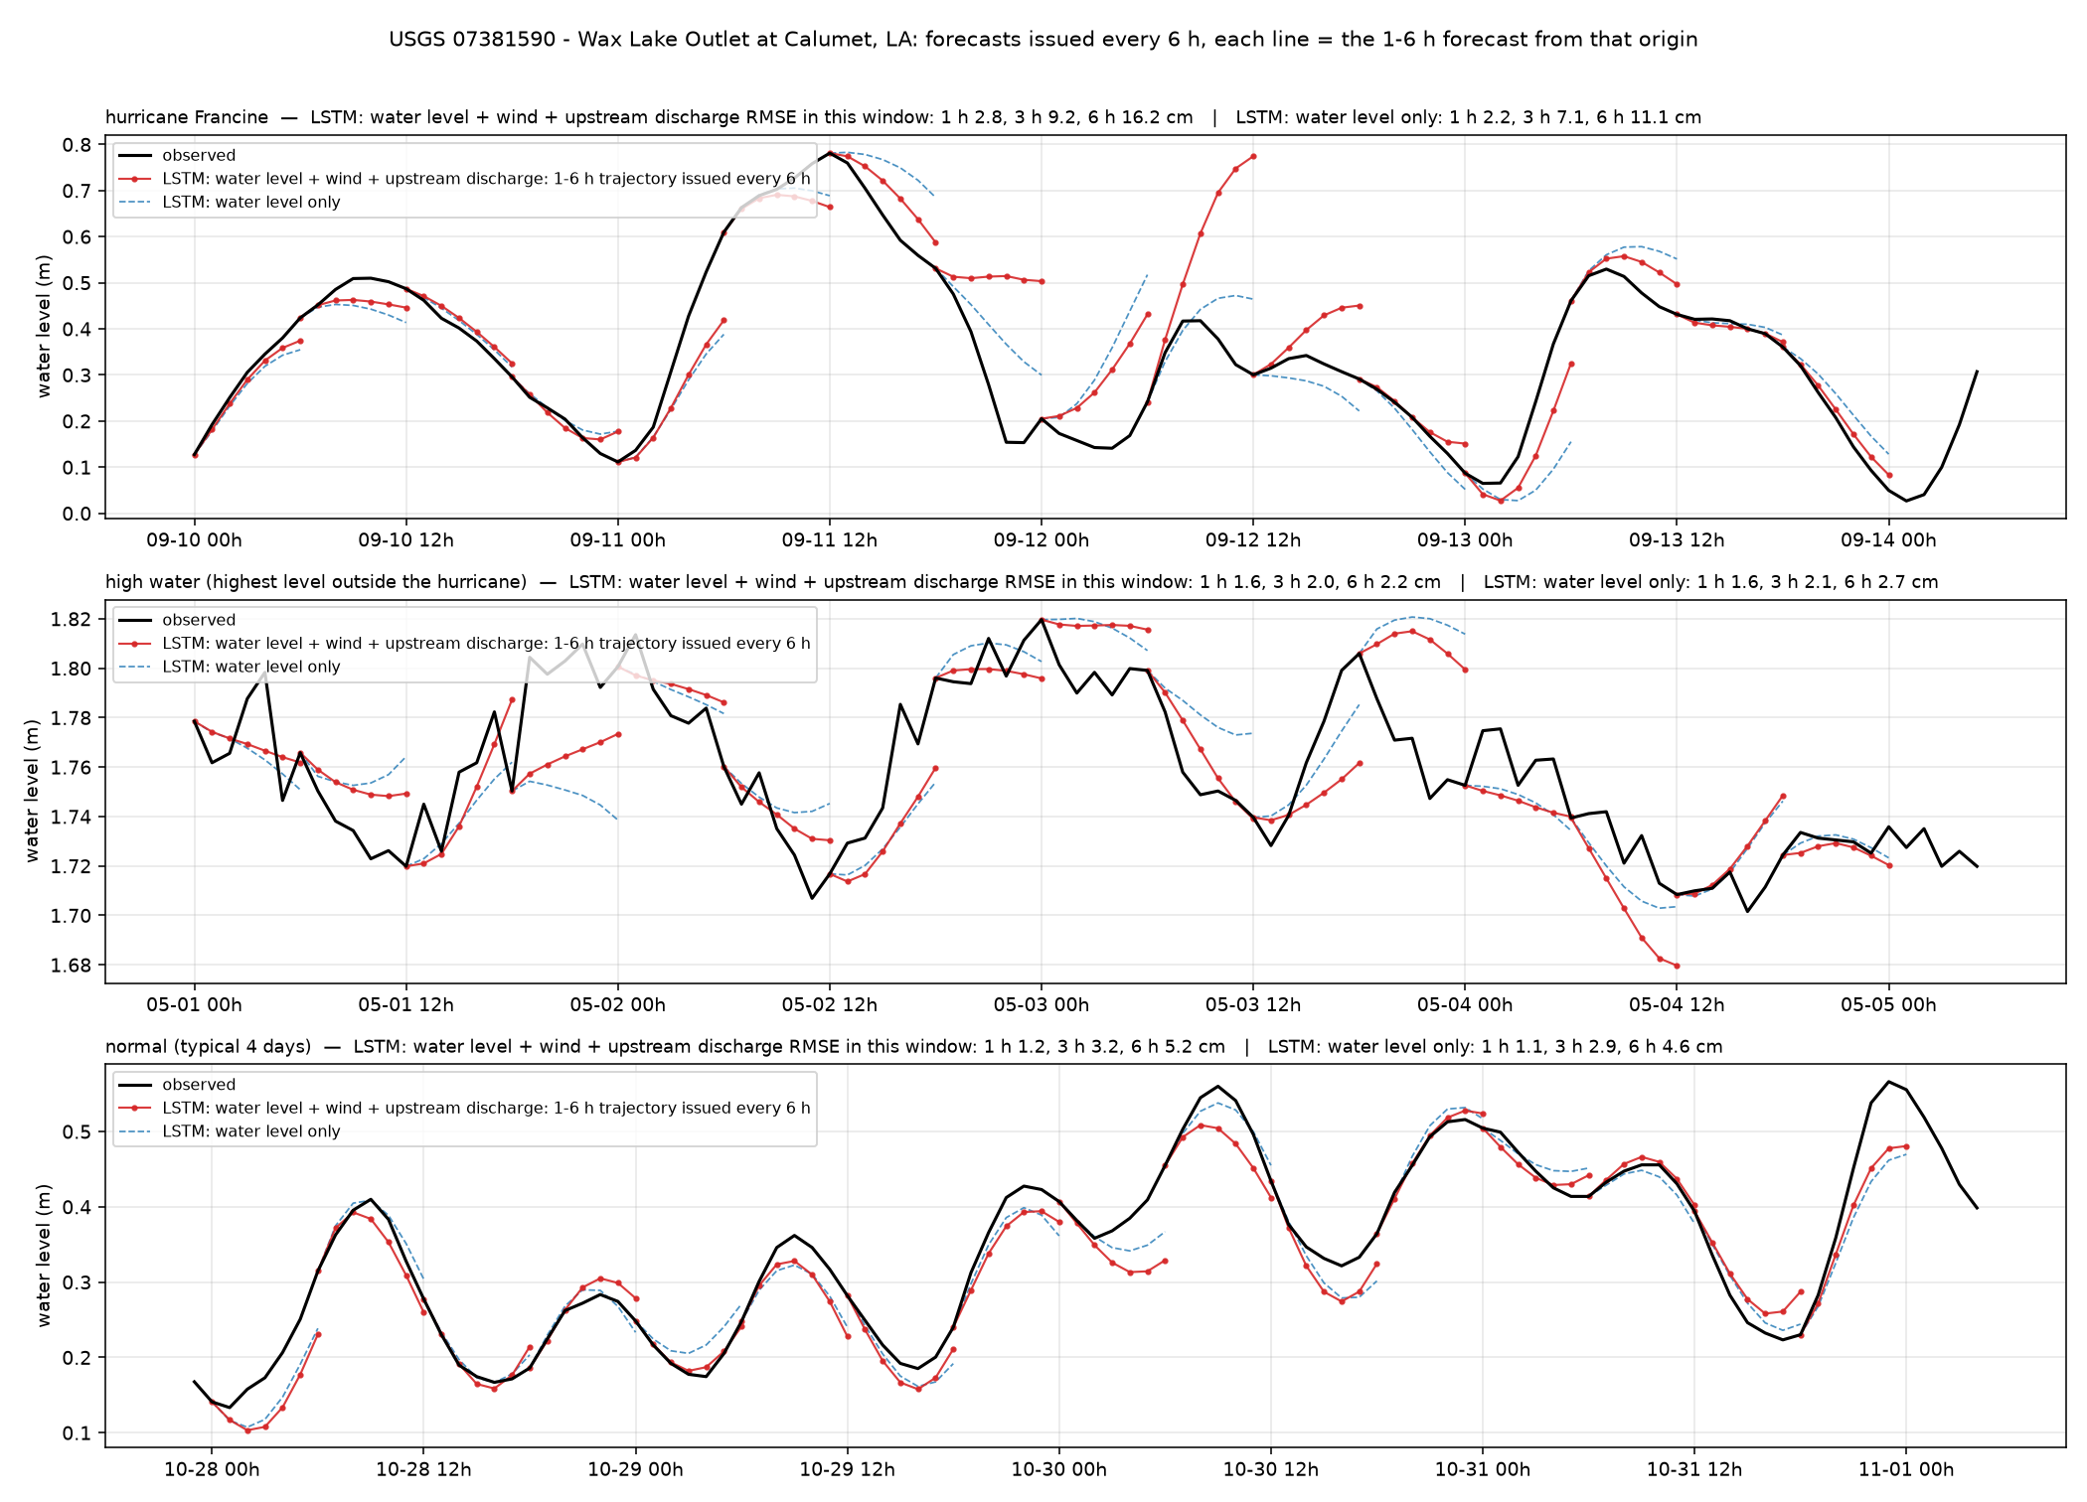
Wax Lake Outlet — Wax Lake Outlet at Calumet, LA (USGS 07381590)
Louisiana100m · river · 29.698°N 91.373°W
6 h RMSE, cm
whole year, with wind + discharge
5.3
whole year, water level only
6.0
hurricane window (2024-09-10)
16.2
high-water window (2025-05-01)
2.2
normal window (2024-10-27)
5.2
1 / 3 / 6 h, whole year, with wind + discharge
1.5 / 3.5 / 5.3 cm
Wax Lake Outlet, Atchafalaya distributary. River plus tide; Francine window 16 cm, otherwise 2 to 5 cm.
11

Slide 12
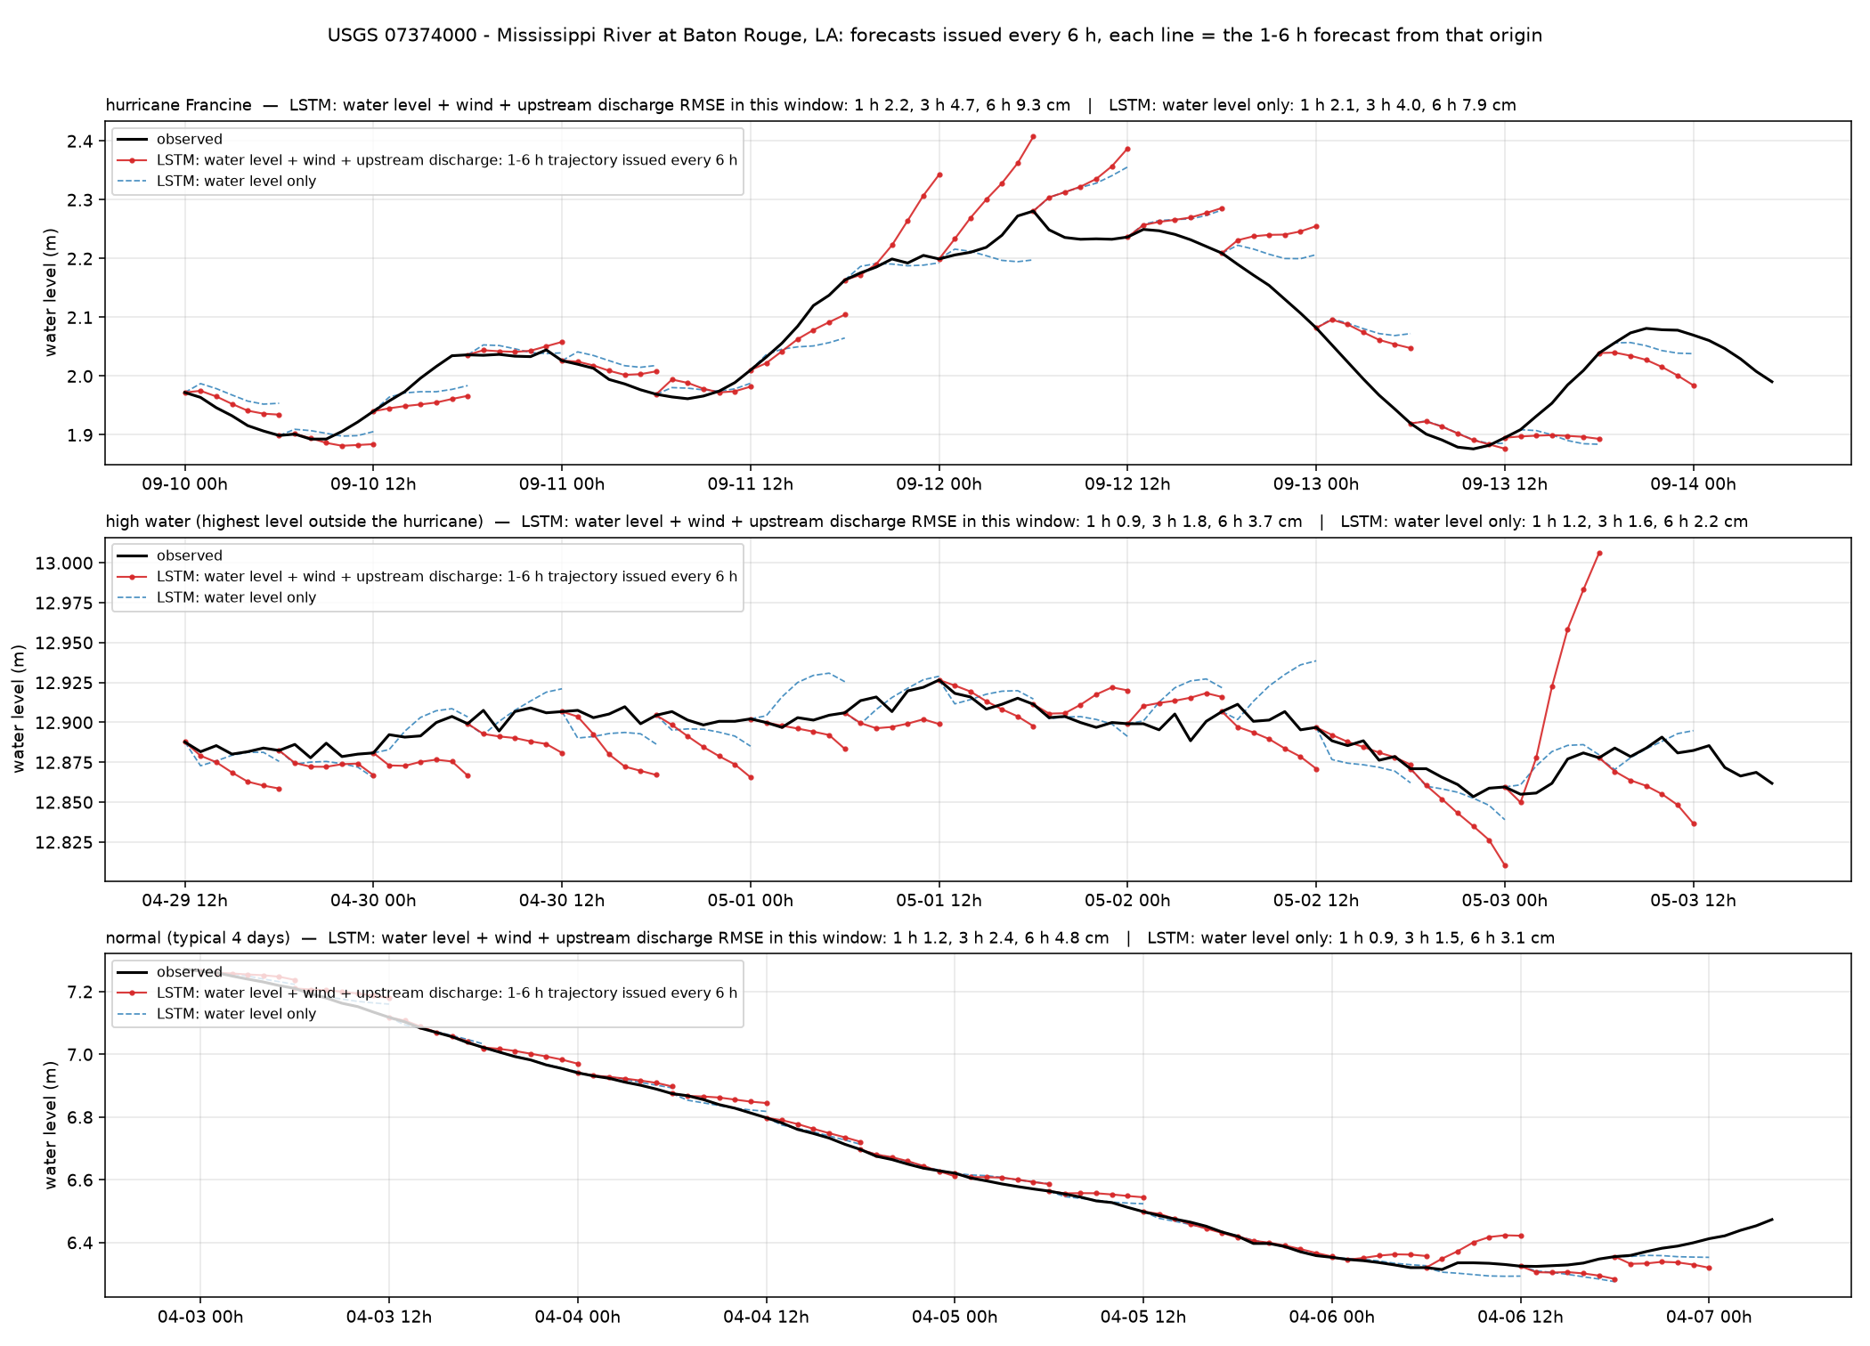
Mississippi R. Baton Rouge — Mississippi River at Baton Rouge, LA (USGS 07374000)
Louisiana100m · river · 30.446°N 91.192°W
6 h RMSE, cm
whole year, with wind + discharge
4.6
whole year, water level only
3.7
hurricane window (2024-09-10)
9.3
high-water window (2025-04-29)
3.7
normal window (2025-04-02)
4.8
1 / 3 / 6 h, whole year, with wind + discharge
1.6 / 2.2 / 4.6 cm
Lower Mississippi. Water-level-only model is better here (3.7 vs 4.6 cm): wind is noise for a far-inland river station.
12

Slide 13
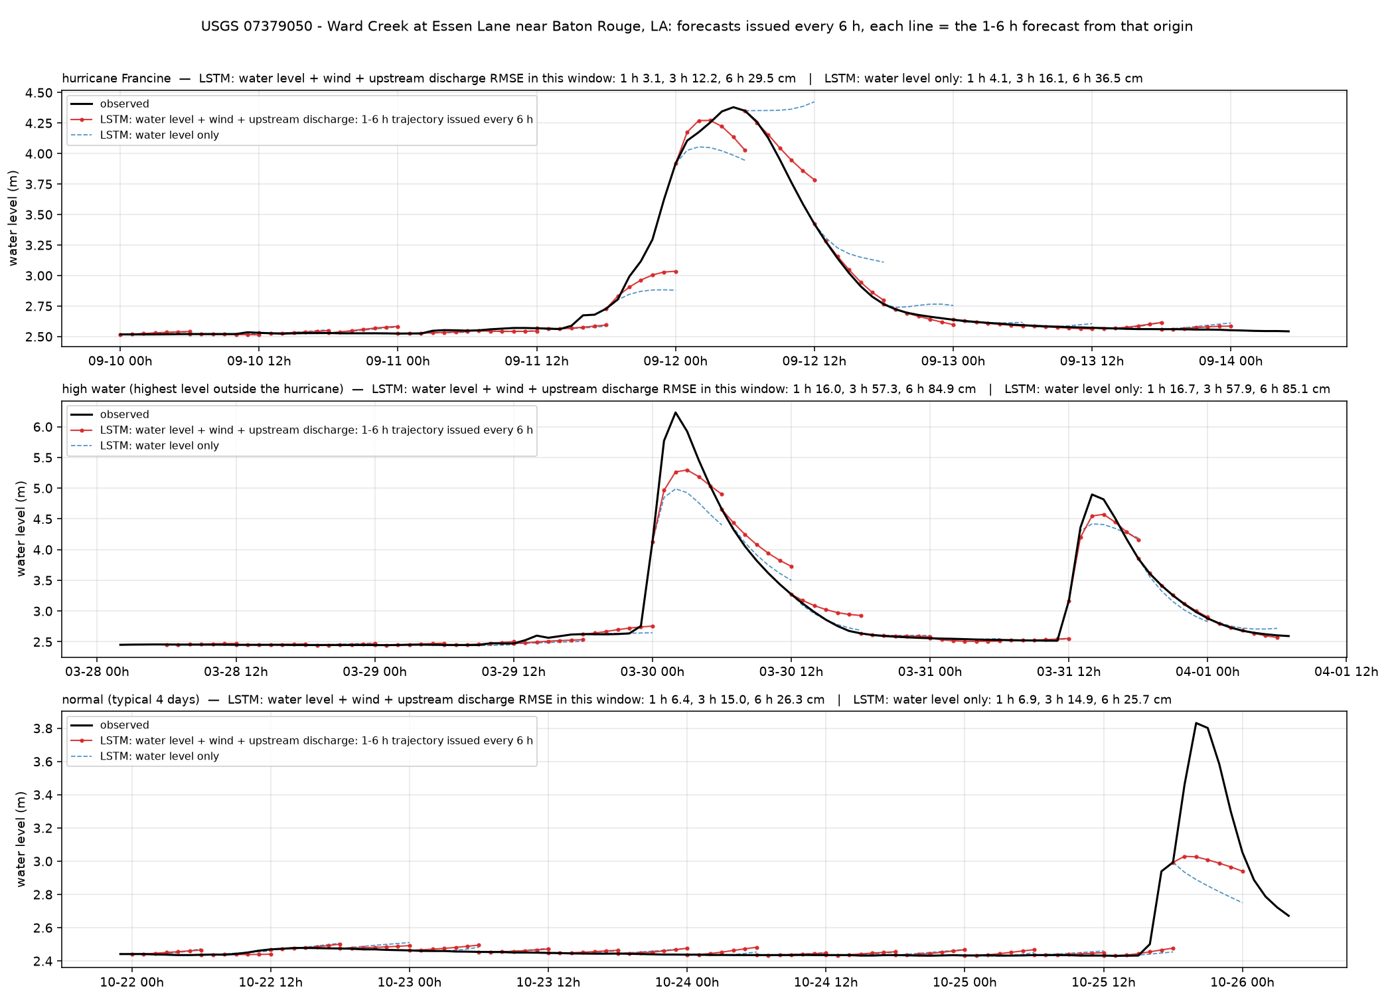
Ward Creek — Ward Creek at Essen Lane near Baton Rouge, LA (USGS 07379050)
Louisiana100m · river · 30.405°N 91.103°W
6 h RMSE, cm
whole year, with wind + discharge
24.7
whole year, water level only
25.7
hurricane window (2024-09-10)
29.5
high-water window (2025-03-28)
84.9
normal window (2025-10-21)
26.3
1 / 3 / 6 h, whole year, with wind + discharge
6.2 / 17.3 / 24.7 cm
Baton Rouge urban creek. Flash rises of 3 m in two hours are not forecastable from level, wind or discharge; rain is missing.
13

Slide 14
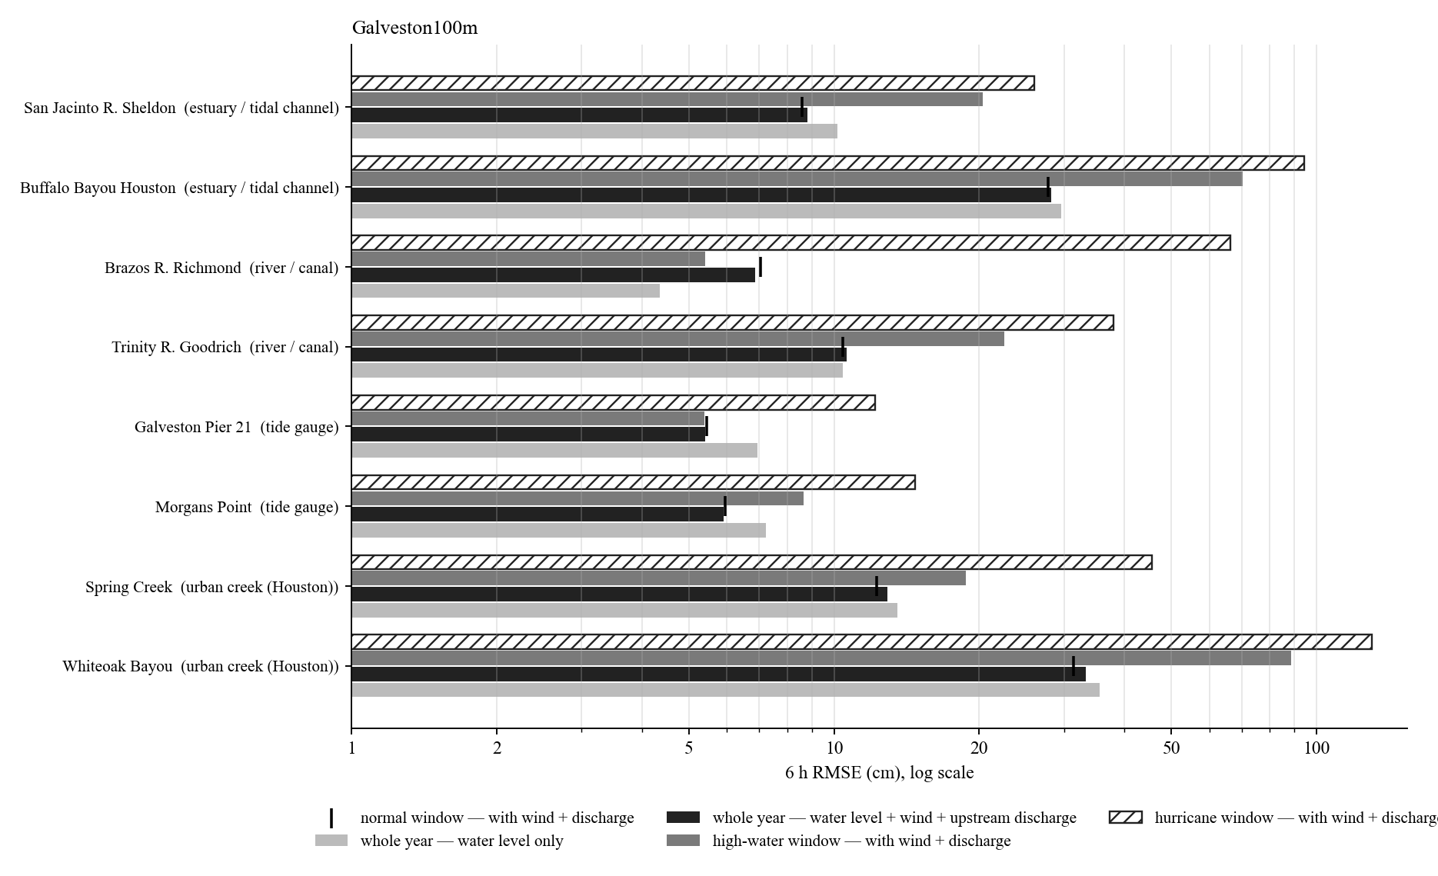
Galveston100m: 6 h RMSE of the representative stations
Hurricane window: Beryl (Jul 2024).
Whole-year 6 h RMSE from 5.4 cm (Galveston Pier 21) to 33.2 cm (Whiteoak Bayou).
Tide gauges, marsh and estuaries: hurricane windows 2 to 3 times the whole-year error; the wind input reduces them most.
Rivers and creeks: the high-water or hurricane window is 5 to 10 times the whole-year error; errors sit in the first hours of each rise.
Log scale.
14

Slide 15
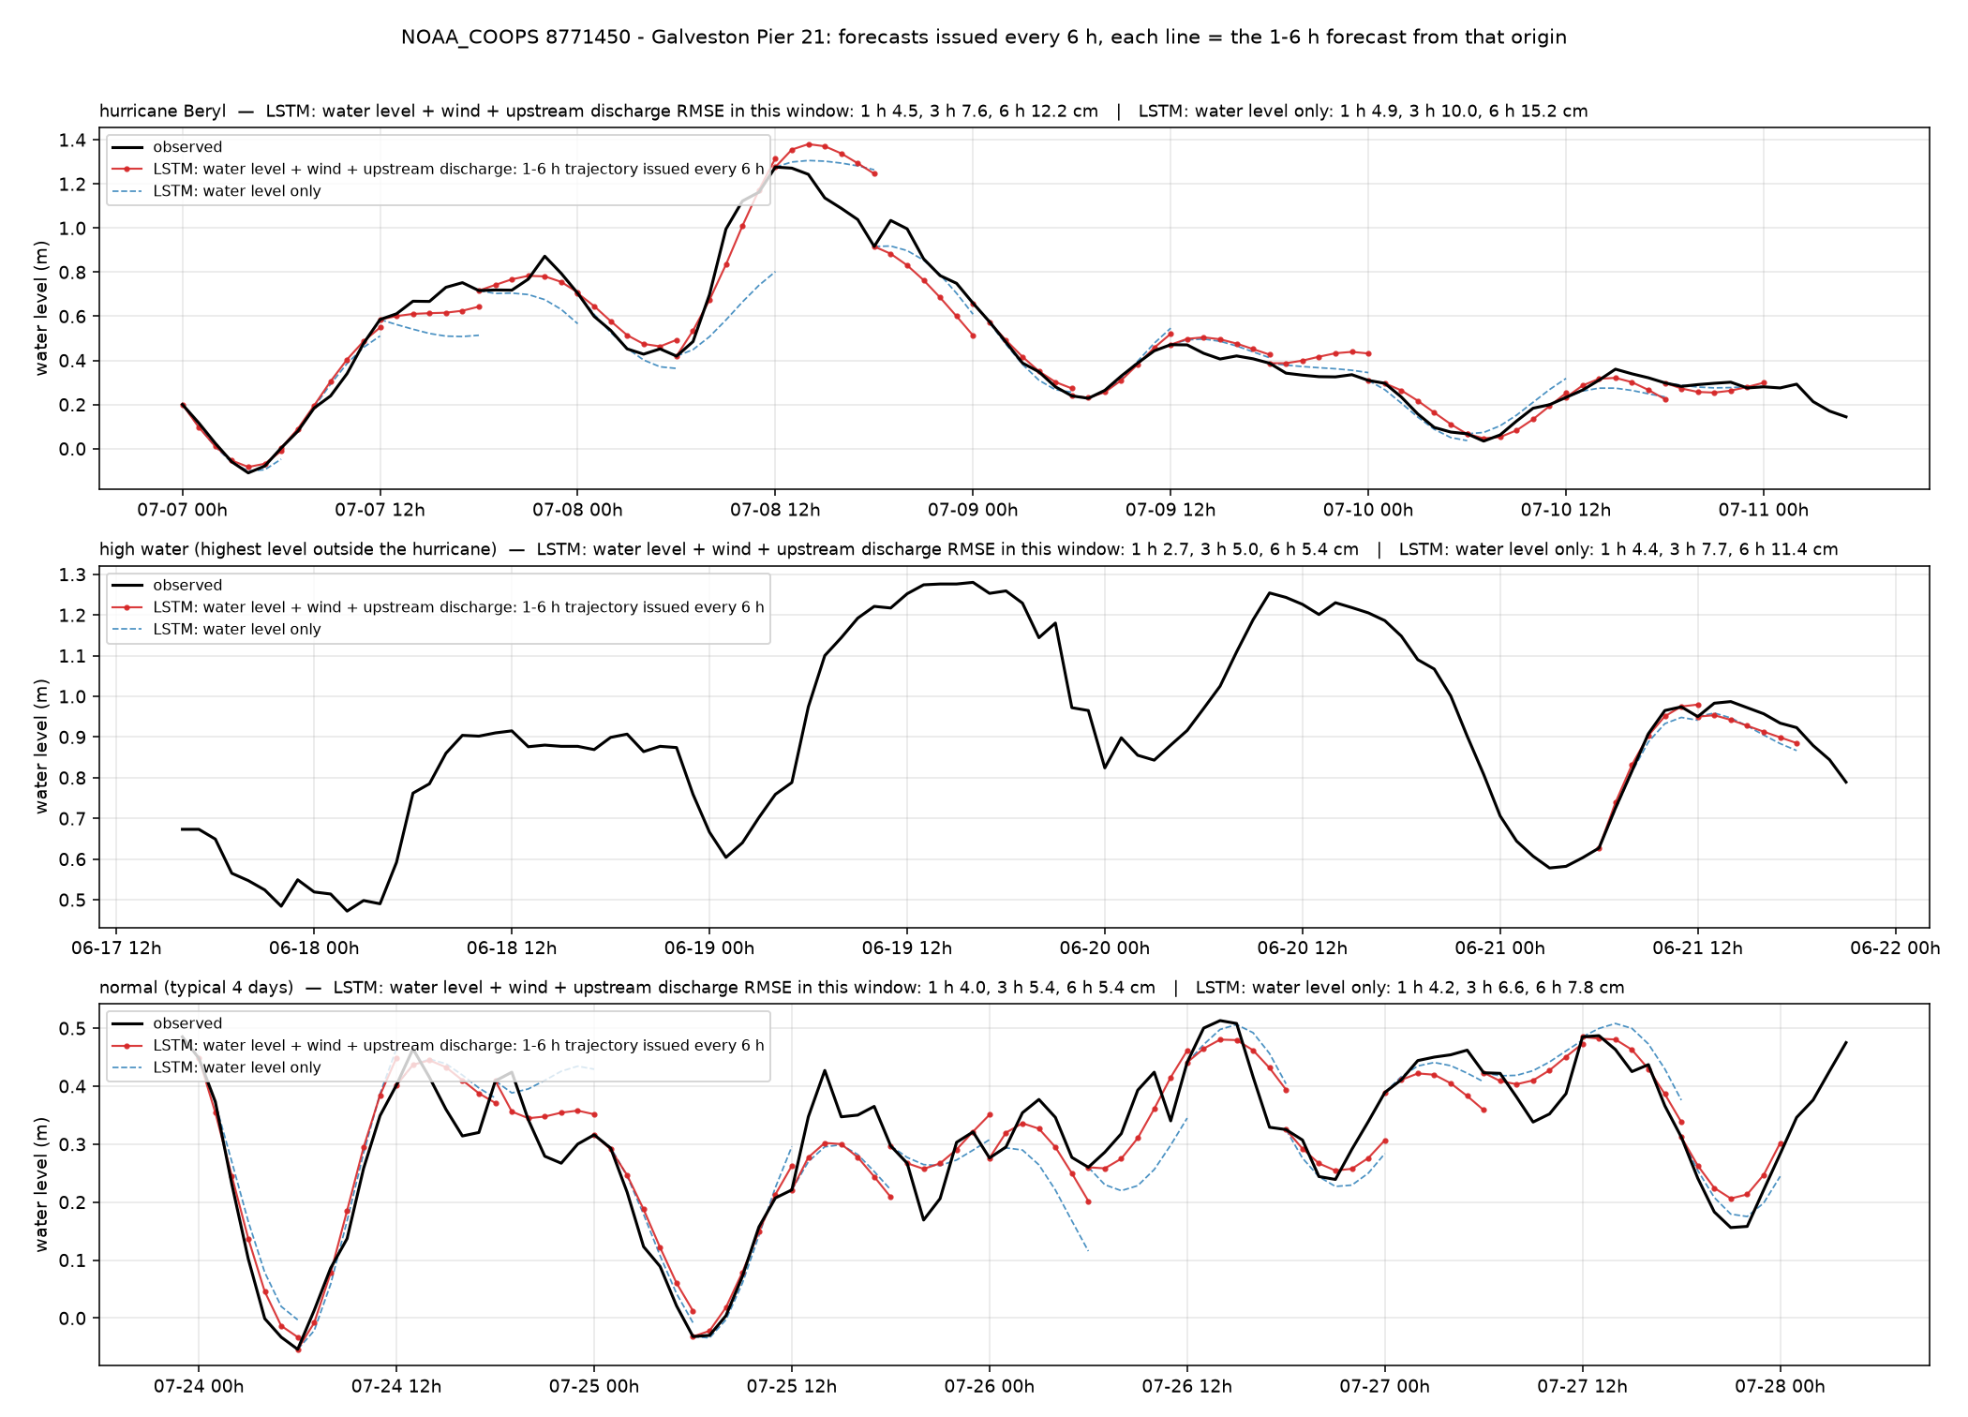
Galveston Pier 21 — Galveston Pier 21 (NOAA_COOPS 8771450)
Galveston100m · tide gauge · 29.310°N 94.793°W
6 h RMSE, cm
whole year, with wind + discharge
5.4
whole year, water level only
6.9
hurricane window (2024-07-07)
12.2
high-water window (2024-06-17)
5.4
normal window (2024-07-23)
5.4
1 / 3 / 6 h, whole year, with wind + discharge
2.6 / 4.3 / 5.4 cm
Galveston Pier 21. Beryl window 12 cm (water-level-only 15 cm); normal weeks 5 cm.
15

Slide 16
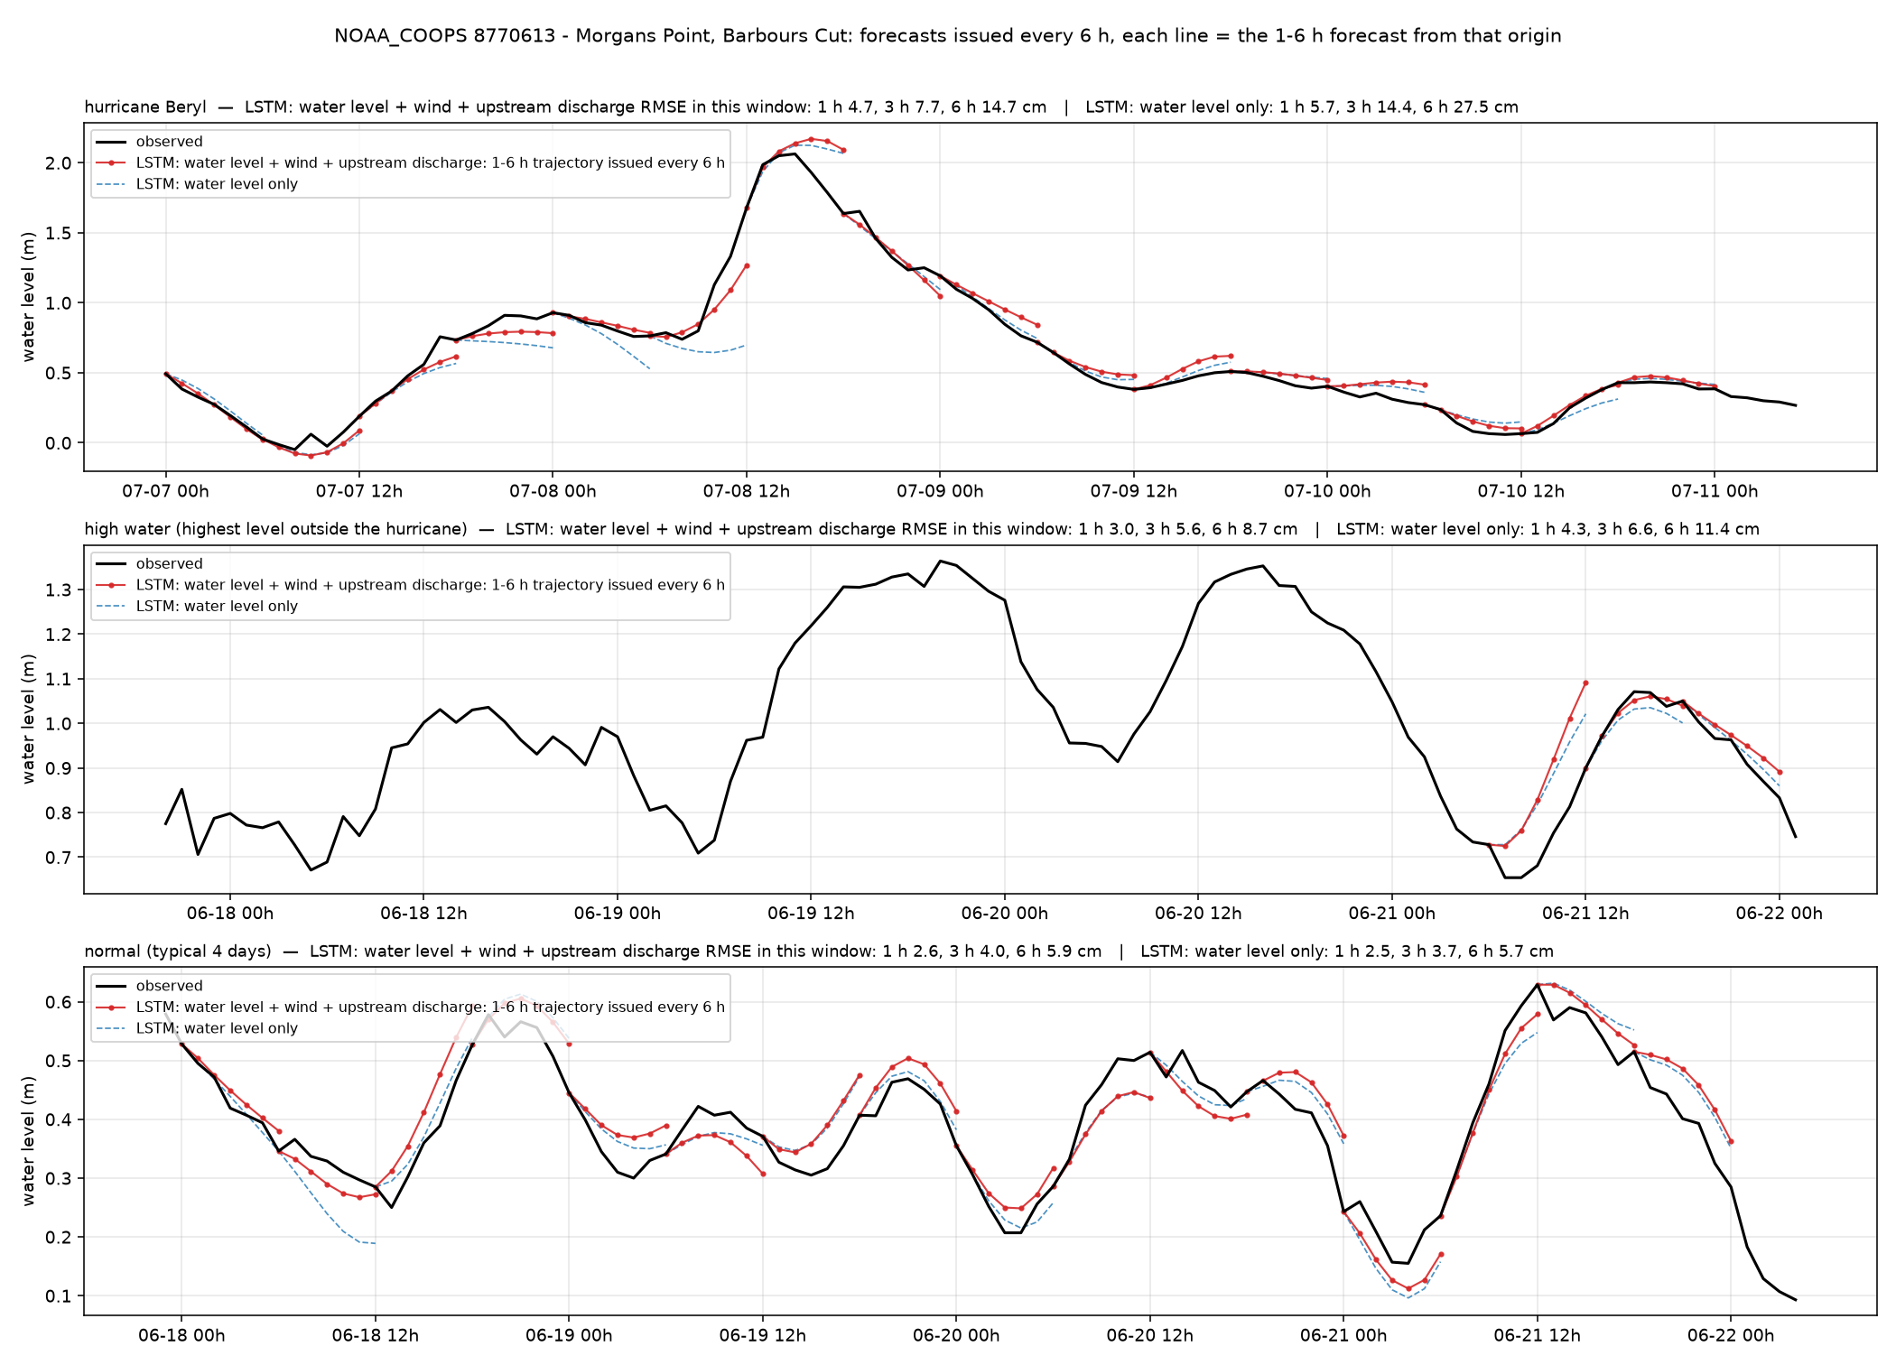
Morgans Point — Morgans Point, Barbours Cut (NOAA_COOPS 8770613)
Galveston100m · tide gauge · 29.682°N 94.985°W
6 h RMSE, cm
whole year, with wind + discharge
5.9
whole year, water level only
7.2
hurricane window (2024-07-07)
14.7
high-water window (2024-06-17)
8.7
normal window (2025-06-17)
5.9
1 / 3 / 6 h, whole year, with wind + discharge
2.7 / 3.8 / 5.9 cm
Upper Galveston Bay. Beryl surge of 2.1 m followed by the wind model (14.7 cm vs 27.6 cm water-level-only).
16

Slide 17
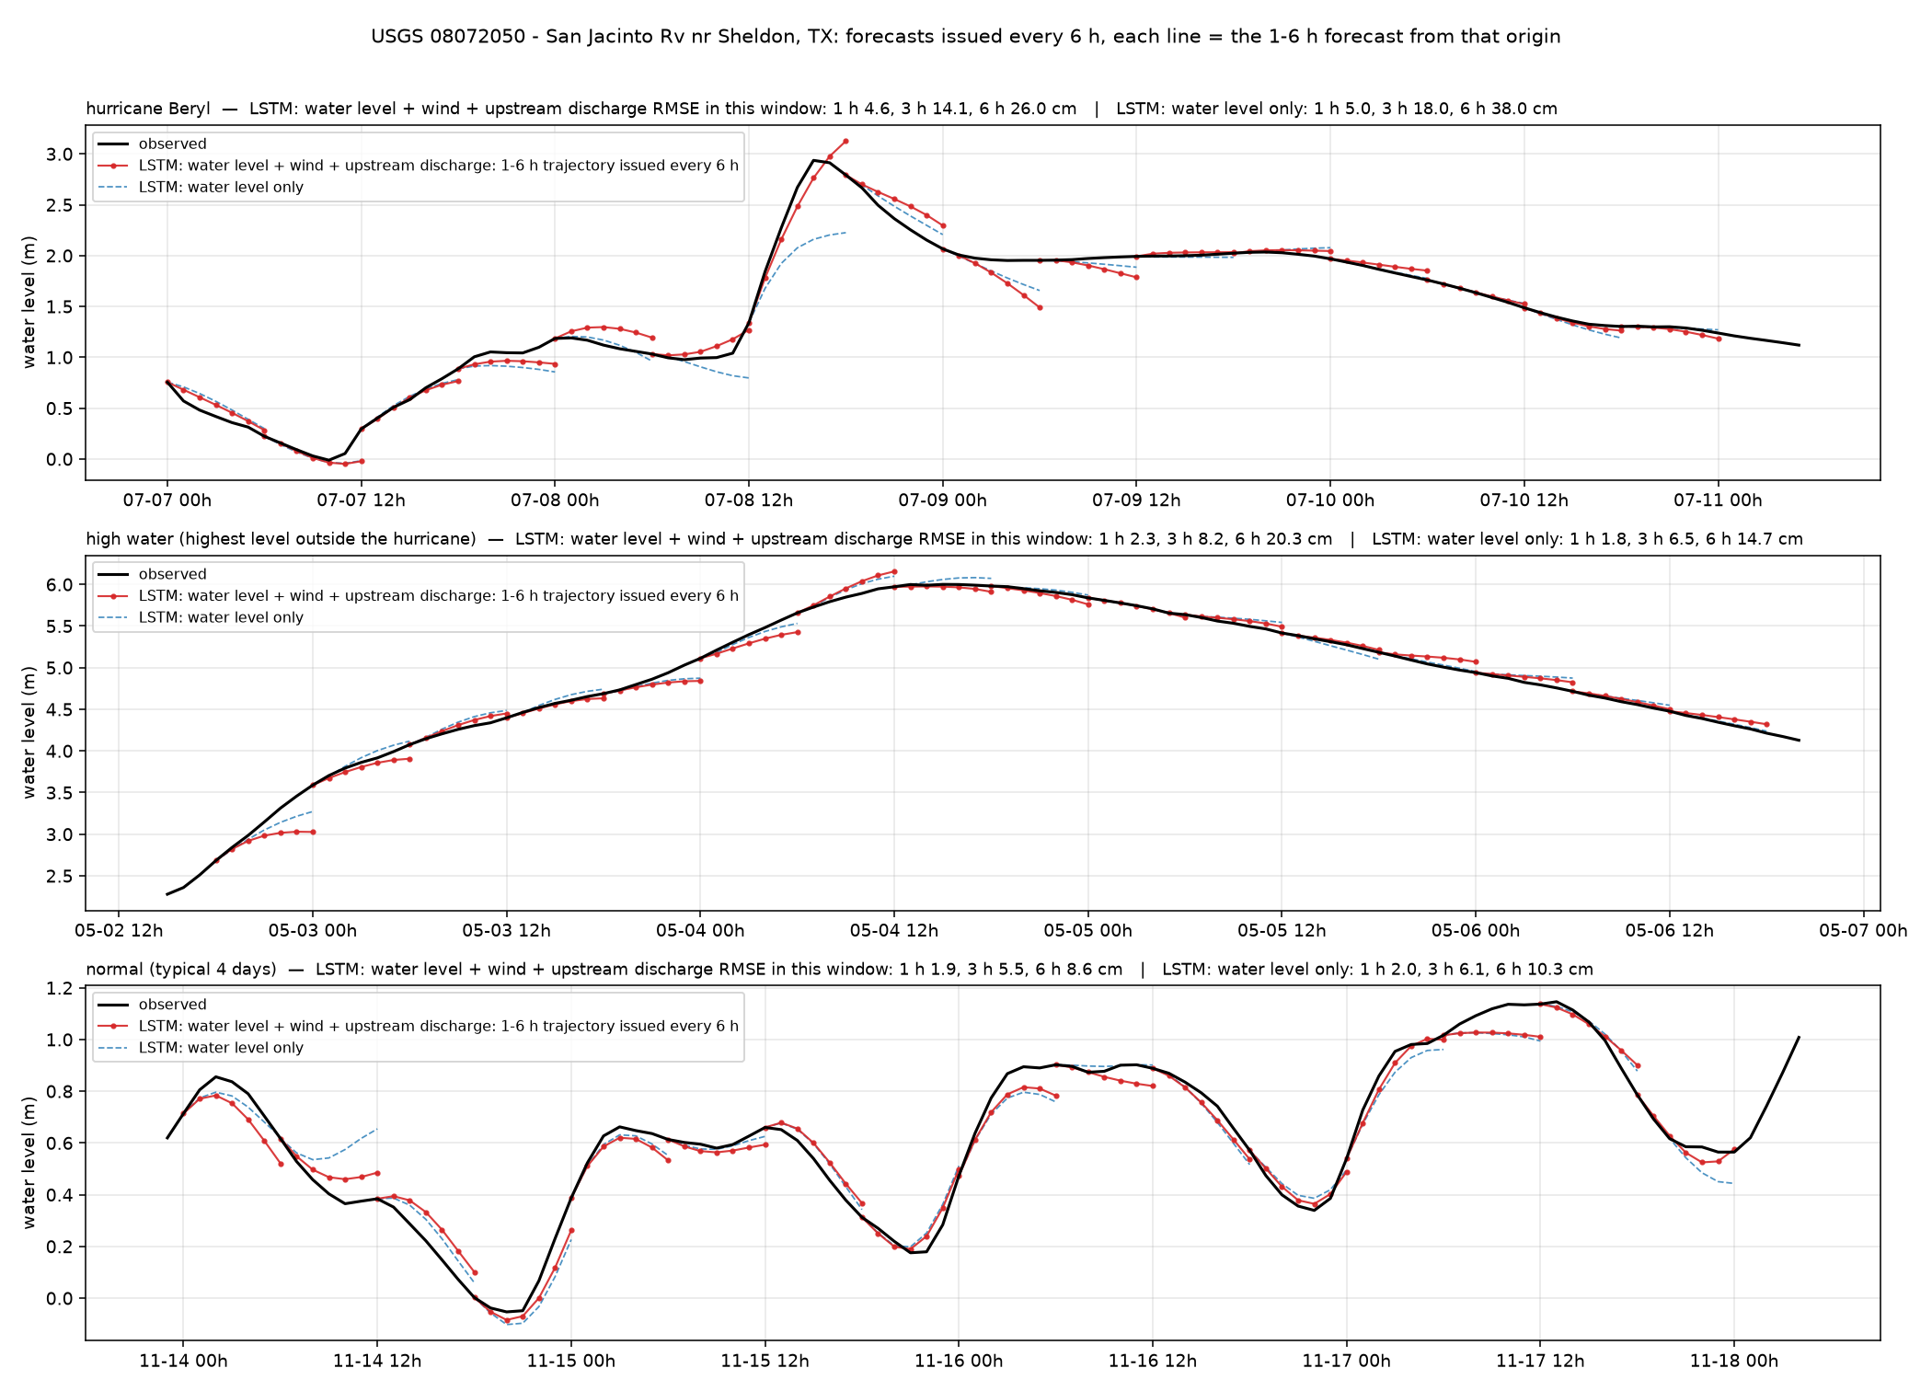
San Jacinto R. Sheldon — San Jacinto Rv nr Sheldon, TX (USGS 08072050)
Galveston100m · estuary / tidal channel · 29.876°N 95.094°W
6 h RMSE, cm
whole year, with wind + discharge
8.8
whole year, water level only
10.2
hurricane window (2024-07-07)
26.0
high-water window (2024-05-02)
20.4
normal window (2024-11-13)
8.6
1 / 3 / 6 h, whole year, with wind + discharge
2.2 / 5.8 / 8.8 cm
San Jacinto River above the bay. Tide plus Lake Houston releases; Beryl window 26 cm.
17

Slide 18
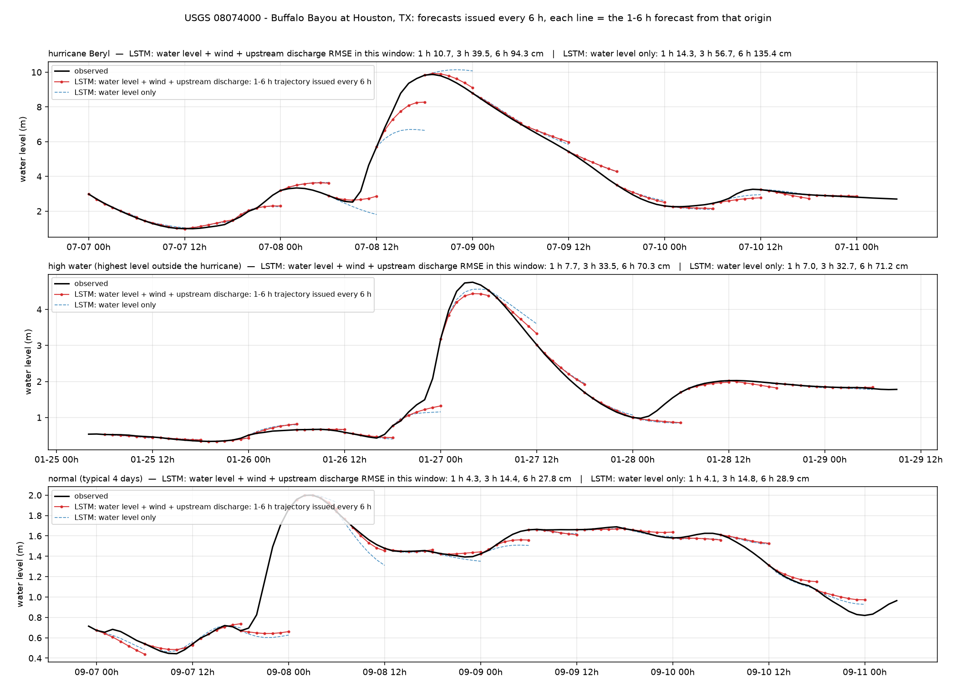
Buffalo Bayou Houston — Buffalo Bayou at Houston, TX (USGS 08074000)
Galveston100m · estuary / tidal channel · 29.760°N 95.409°W
6 h RMSE, cm
whole year, with wind + discharge
28.2
whole year, water level only
29.6
hurricane window (2024-07-07)
94.3
high-water window (2025-01-25)
70.3
normal window (2025-09-06)
27.8
1 / 3 / 6 h, whole year, with wind + discharge
4.5 / 15.1 / 28.2 cm
Buffalo Bayou downtown. Beryl rise of 7 m: the 6 h forecast reaches 8.3 m of 9.9 m; recession well captured.
18

Slide 19
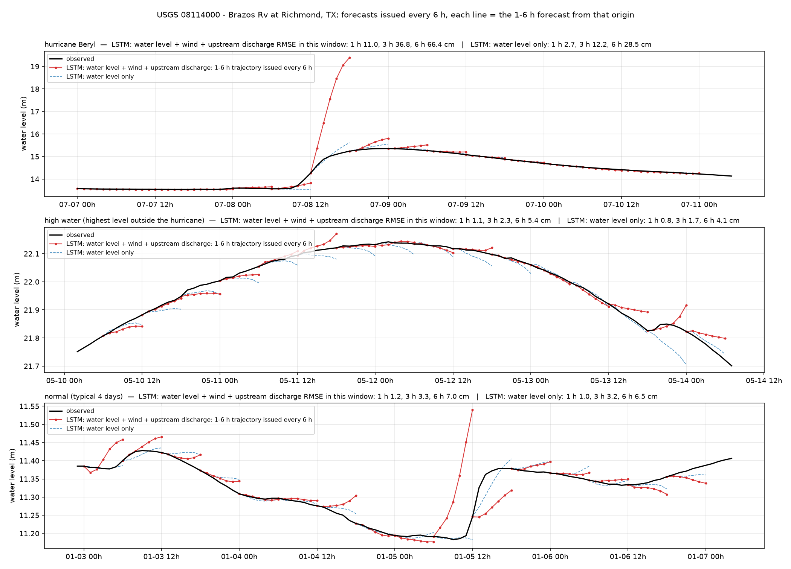
Brazos R. Richmond — Brazos Rv at Richmond, TX (USGS 08114000)
Galveston100m · river · 29.582°N 95.758°W
6 h RMSE, cm
whole year, with wind + discharge
6.9
whole year, water level only
4.4
hurricane window (2024-07-07)
66.4
high-water window (2024-05-10)
5.4
normal window (2024-01-02)
7.0
1 / 3 / 6 h, whole year, with wind + discharge
1.2 / 3.4 / 6.9 cm
Brazos River at Richmond. Same-river upstream discharge helps every month; a false 5 m spike during Beryl remains (wind).
19

Slide 20
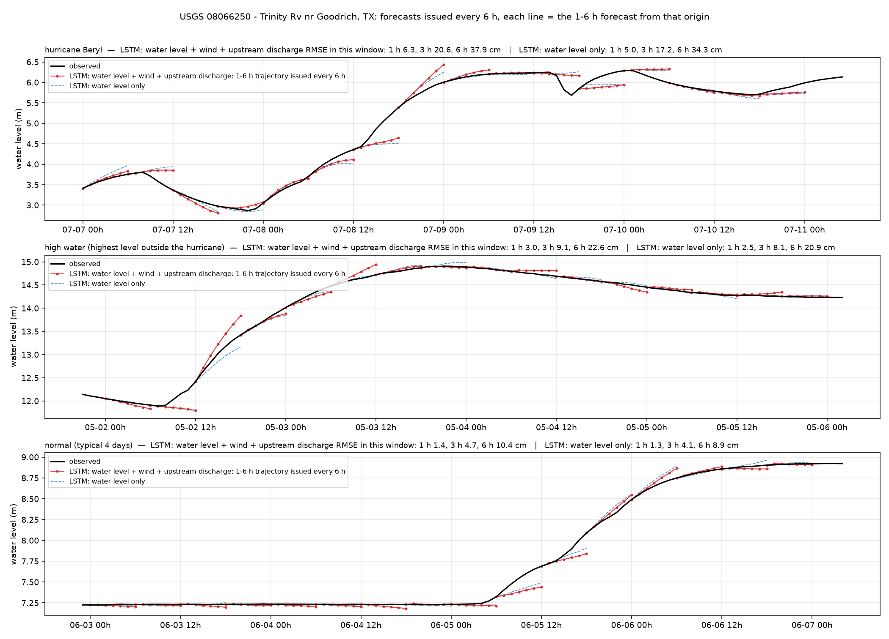
Trinity R. Goodrich — Trinity Rv nr Goodrich, TX (USGS 08066250)
Galveston100m · river · 30.572°N 94.949°W
6 h RMSE, cm
whole year, with wind + discharge
10.6
whole year, water level only
10.4
hurricane window (2024-07-07)
37.9
high-water window (2024-05-01)
22.6
normal window (2025-06-02)
10.4
1 / 3 / 6 h, whole year, with wind + discharge
1.5 / 4.9 / 10.6 cm
Trinity River below Lake Livingston dam. Releases are scheduled; no input anticipates them.
20

Slide 21
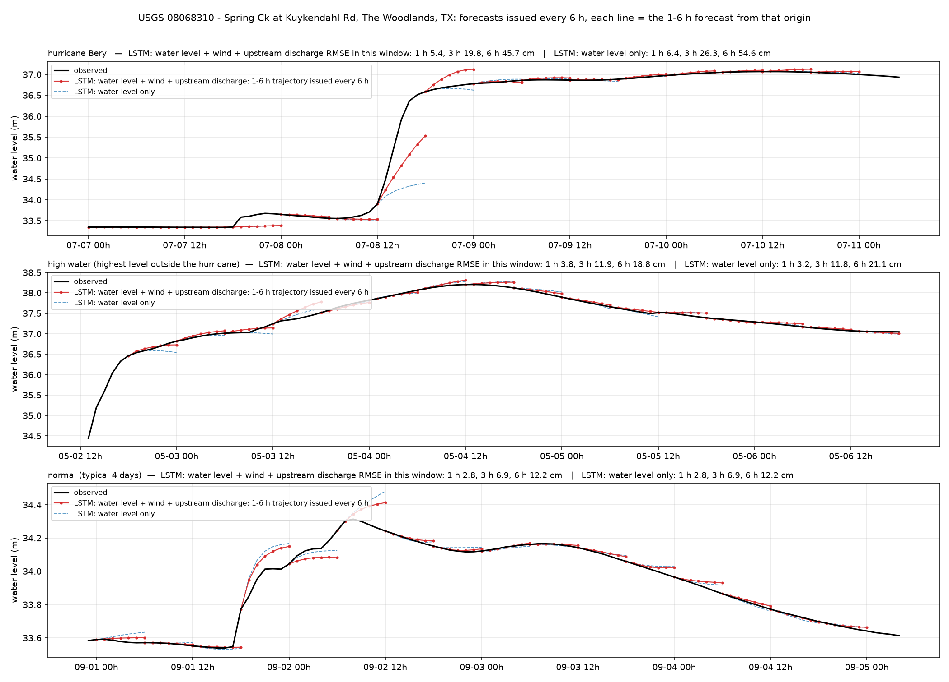
Spring Creek — Spring Ck at Kuykendahl Rd, The Woodlands, TX (USGS 08068310)
Galveston100m · urban creek (Houston) · 30.170°N 95.542°W
6 h RMSE, cm
whole year, with wind + discharge
12.9
whole year, water level only
13.5
hurricane window (2024-07-07)
45.7
high-water window (2024-05-02)
18.8
normal window (2024-08-31)
12.2
1 / 3 / 6 h, whole year, with wind + discharge
2.8 / 7.7 / 12.9 cm
Spring Creek, The Woodlands. Typical Houston creek: quiet weeks 12 cm, Beryl 46 cm.
21

Slide 22
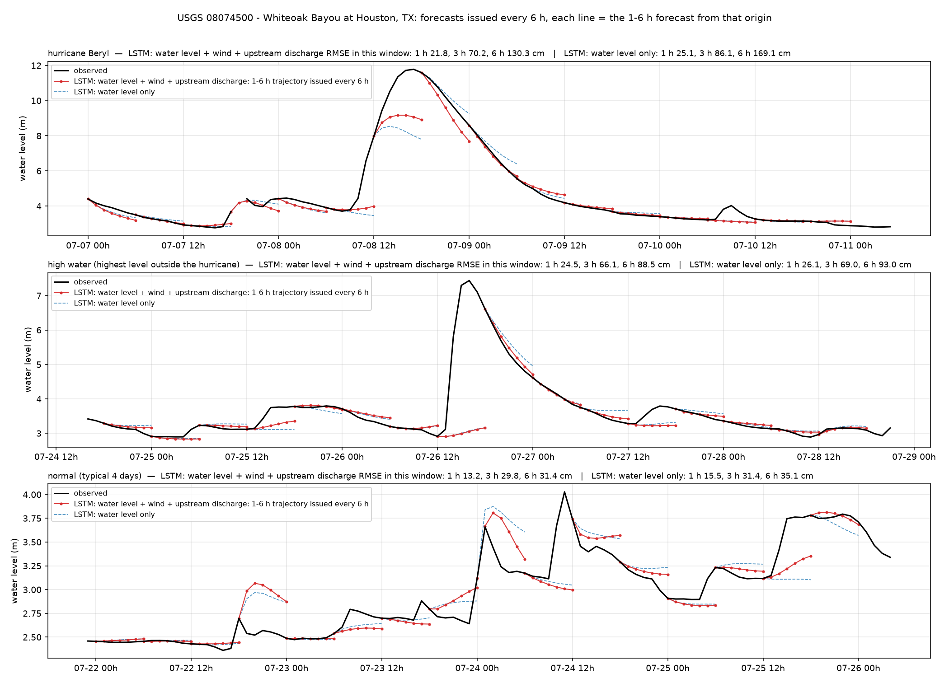
Whiteoak Bayou — Whiteoak Bayou at Houston, TX (USGS 08074500)
Galveston100m · urban creek (Houston) · 29.775°N 95.397°W
6 h RMSE, cm
whole year, with wind + discharge
33.2
whole year, water level only
35.5
hurricane window (2024-07-07)
130.3
high-water window (2024-07-24)
88.5
normal window (2024-07-21)
31.4
1 / 3 / 6 h, whole year, with wind + discharge
8.0 / 22.4 / 33.2 cm
Whiteoak Bayou, Houston. Largest errors in the set: 33 cm over the year, 130 cm in the Beryl window.
22

Slide 23
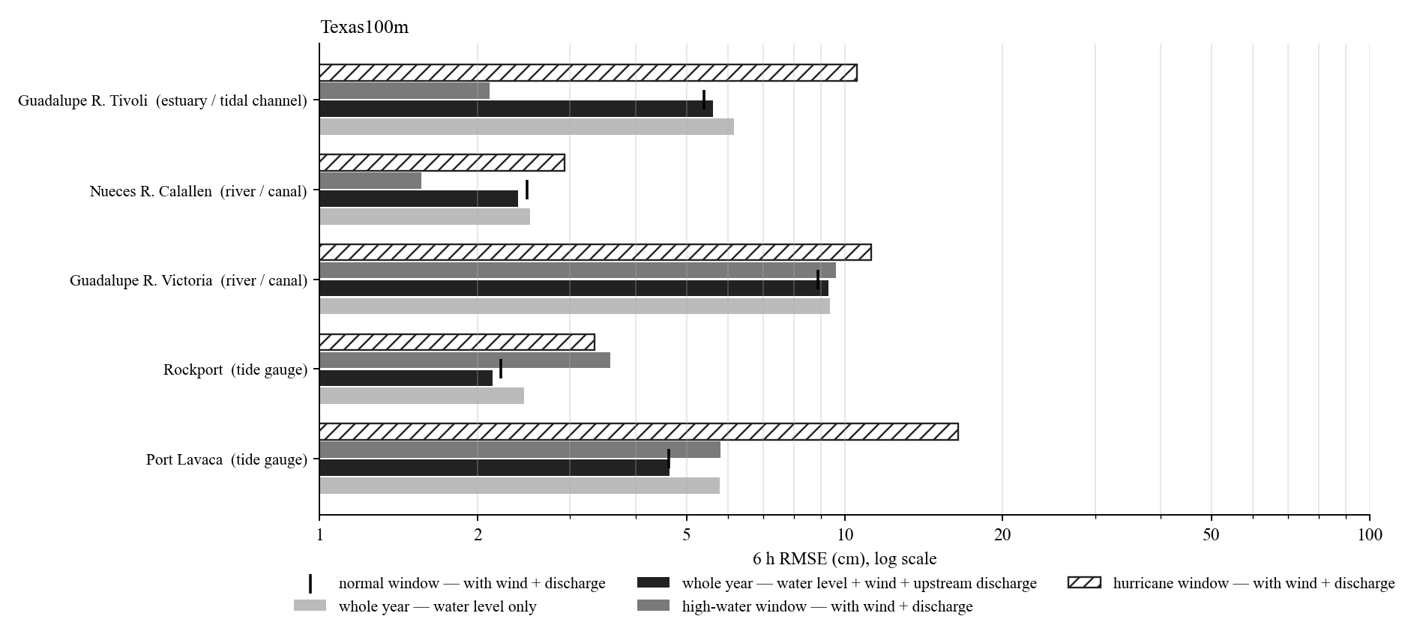
Texas100m: 6 h RMSE of the representative stations
Hurricane window: Beryl (Jul 2024).
Whole-year 6 h RMSE from 2.1 cm (Rockport) to 9.3 cm (Guadalupe R. Victoria).
Tide gauges, marsh and estuaries: hurricane windows 2 to 3 times the whole-year error; the wind input reduces them most.
Rivers and creeks: the high-water or hurricane window is 5 to 10 times the whole-year error; errors sit in the first hours of each rise.
Log scale.
23

Slide 24
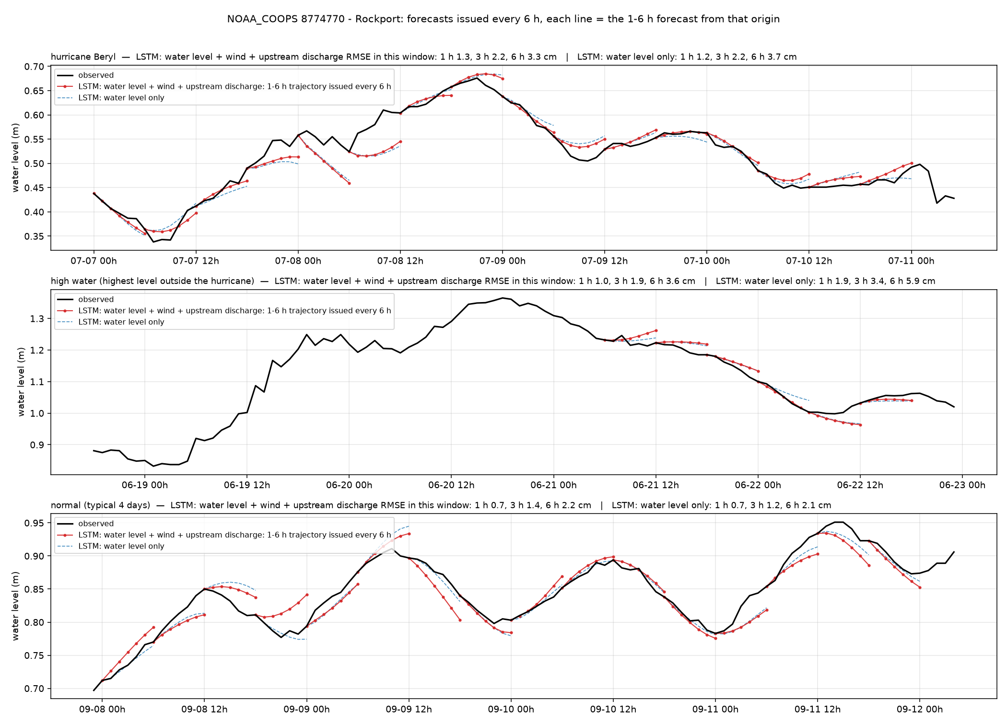
Rockport — Rockport (NOAA_COOPS 8774770)
Texas100m · tide gauge · 28.022°N 97.047°W
6 h RMSE, cm
whole year, with wind + discharge
2.1
whole year, water level only
2.4
hurricane window (2024-07-07)
3.3
high-water window (2024-06-18)
3.6
normal window (2024-09-07)
2.2
1 / 3 / 6 h, whole year, with wind + discharge
1.0 / 1.6 / 2.1 cm
Rockport, Aransas Bay. Best station class: 2 cm over the year, 3 cm during Beryl.
24

Slide 25
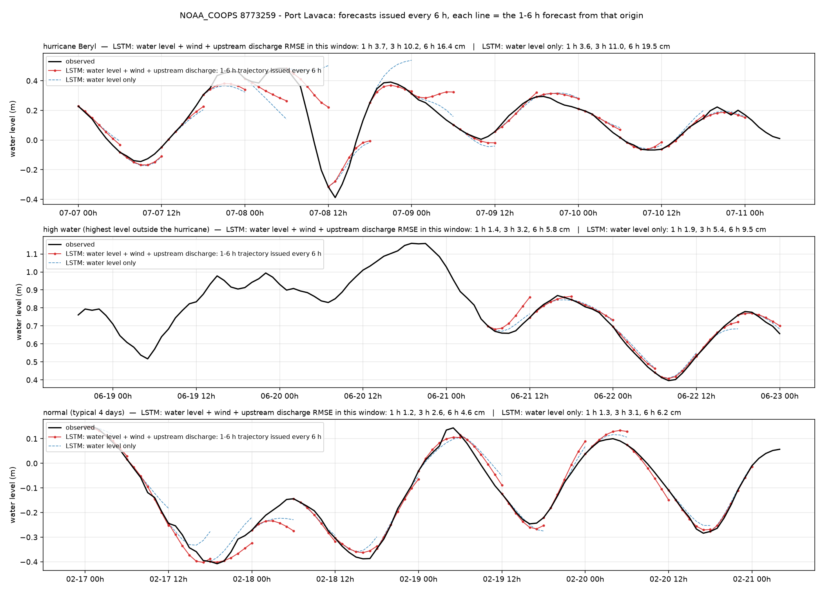
Port Lavaca — Port Lavaca (NOAA_COOPS 8773259)
Texas100m · tide gauge · 28.641°N 96.610°W
6 h RMSE, cm
whole year, with wind + discharge
4.6
whole year, water level only
5.8
hurricane window (2024-07-07)
16.4
high-water window (2024-06-18)
5.8
normal window (2024-02-16)
4.6
1 / 3 / 6 h, whole year, with wind + discharge
1.2 / 2.8 / 4.6 cm
Port Lavaca, Matagorda Bay. Beryl window 16 cm, otherwise 5 cm.
25

Slide 26
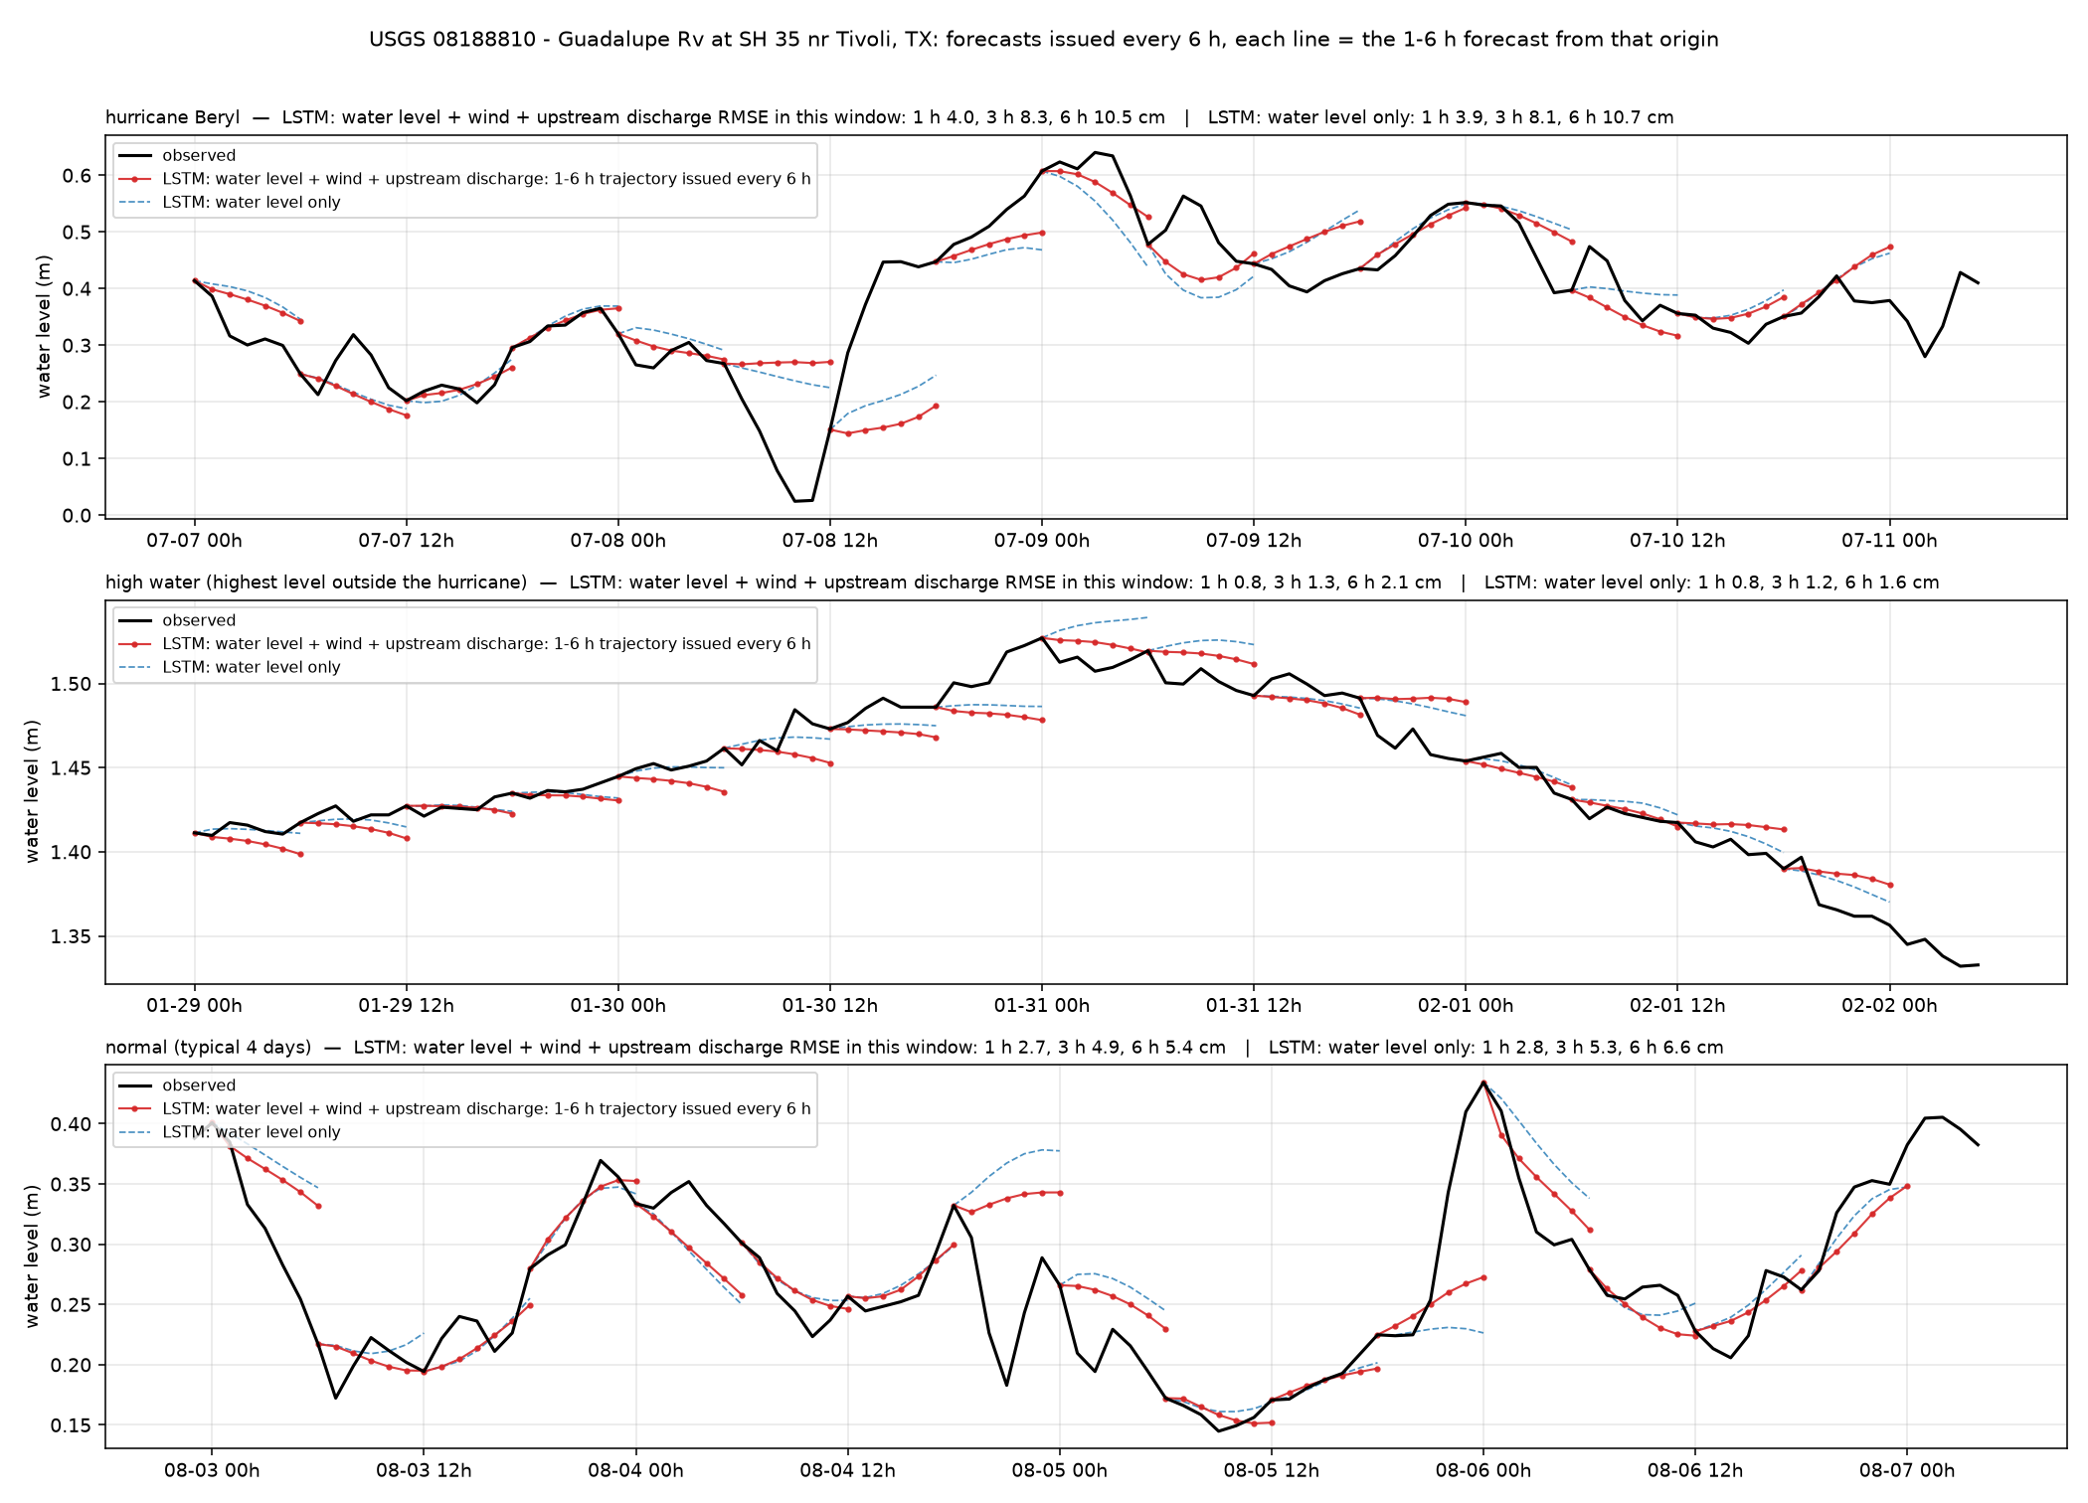
Guadalupe R. Tivoli — Guadalupe Rv at SH 35 nr Tivoli, TX (USGS 08188810)
Texas100m · estuary / tidal channel · 28.478°N 96.863°W
6 h RMSE, cm
whole year, with wind + discharge
5.6
whole year, water level only
6.2
hurricane window (2024-07-07)
10.5
high-water window (2024-01-29)
2.1
normal window (2025-08-02)
5.4
1 / 3 / 6 h, whole year, with wind + discharge
2.4 / 4.5 / 5.6 cm
Lower Guadalupe, tidal. Hurricane window 10.5 cm; river rises 2 cm.
26

Slide 27
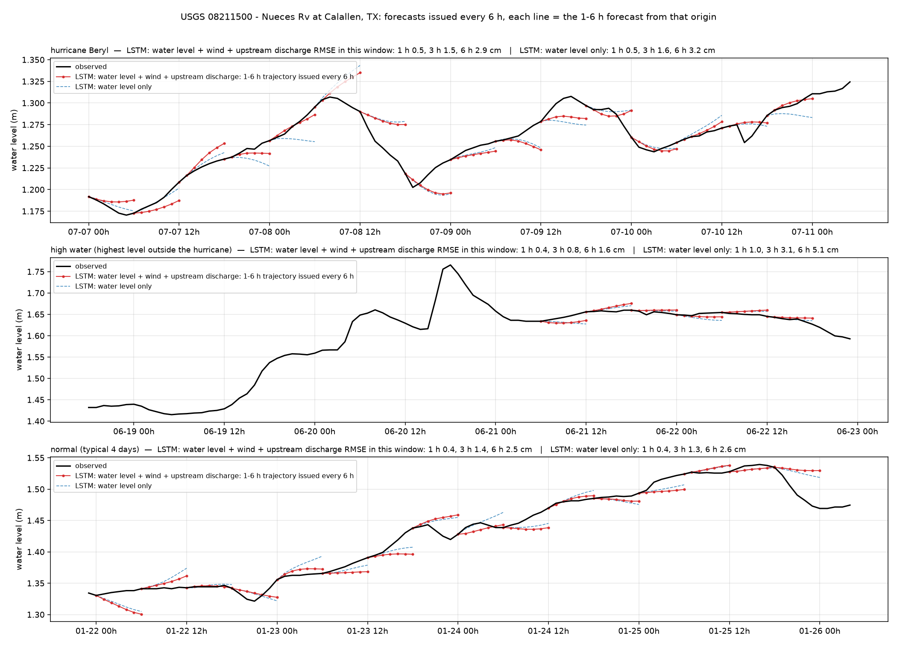
Nueces R. Calallen — Nueces Rv at Calallen, TX (USGS 08211500)
Texas100m · river · 27.883°N 97.625°W
6 h RMSE, cm
whole year, with wind + discharge
2.4
whole year, water level only
2.5
hurricane window (2024-07-07)
2.9
high-water window (2024-06-18)
1.6
normal window (2025-01-21)
2.5
1 / 3 / 6 h, whole year, with wind + discharge
0.5 / 1.3 / 2.4 cm
Nueces River at Calallen, below the saltwater dam. Nearly flat; 2.4 cm over the year.
27

Slide 28
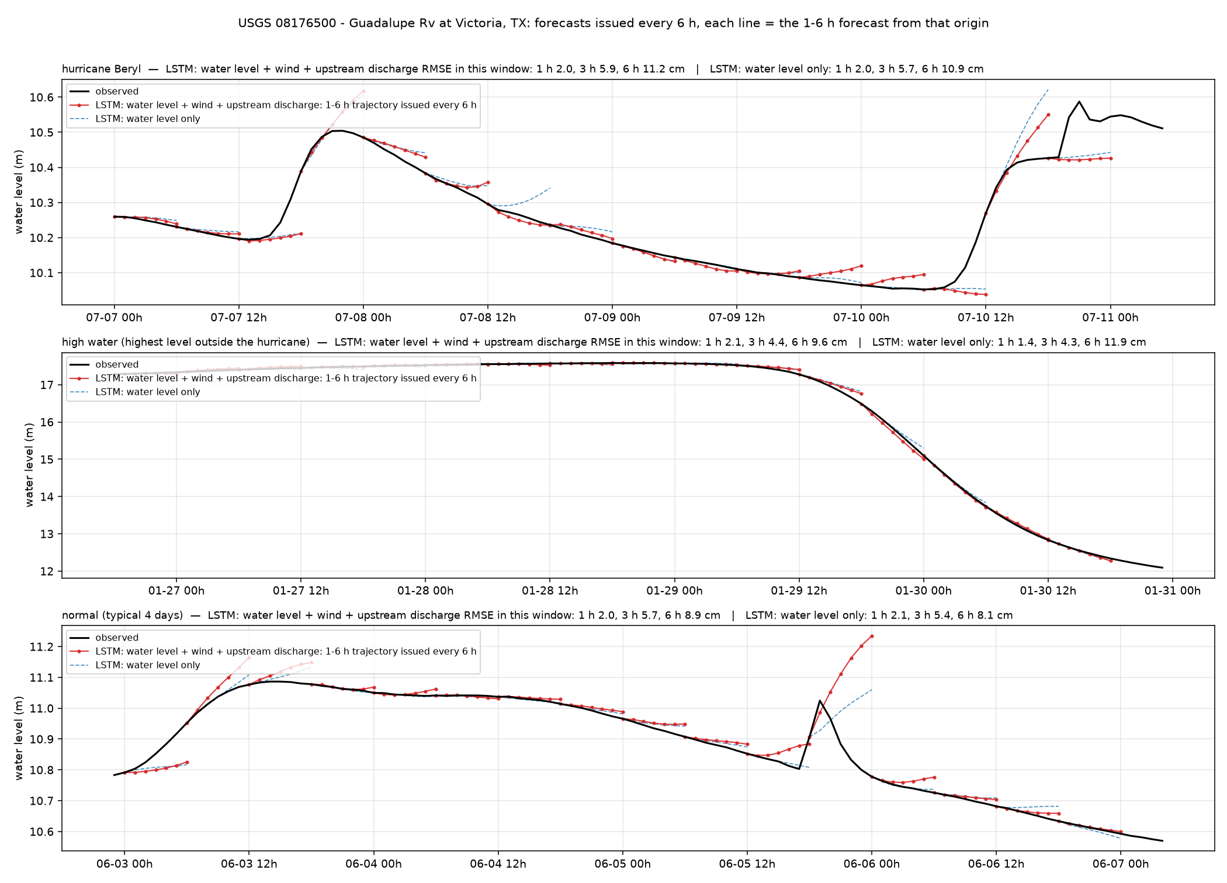
Guadalupe R. Victoria — Guadalupe Rv at Victoria, TX (USGS 08176500)
Texas100m · river · 28.793°N 97.013°W
6 h RMSE, cm
whole year, with wind + discharge
9.3
whole year, water level only
9.4
hurricane window (2024-07-07)
11.2
high-water window (2024-01-26)
9.6
normal window (2024-06-02)
8.9
1 / 3 / 6 h, whole year, with wind + discharge
1.2 / 4.5 / 9.3 cm
Guadalupe River at Victoria. Inland river; errors concentrate in the first hours of each rise (June 2025 flood).
28

Slide 29
Louisiana100m: summary (6 h RMSE, cm)
station | type | year, wind + discharge | year, level only | hurricane | high water | normal | 1 h | 3 h
Grand Isle | tide gauge | 3.7 | 4.3 | 6.8 | 3.8 | 3.4 | 1.8 | 2.6
New Canal | tide gauge | 3.9 | 4.5 | 6.3 | 2.8 | 3.8 | 2.5 | 2.8
Bay Waveland | tide gauge | 6.4 | 9.4 | 10.8 | 13.3 | 6.5 | 2.2 | 5.1
CRMS0367 | marsh (CRMS) | 3.0 | 3.0 | 5.2 | 0.9 | 3.1 | 1.3 | 2.3
CRMS0517 | marsh (CRMS) | 9.7 | 12.9 | 23.0 | 16.8 | 7.8 | 4.9 | 7.8
Vermilion Bay | estuary / tidal channel | 7.3 | 9.9 | 18.6 | 6.7 | 6.3 | 2.1 | 4.9
Merrill Shell Bank | estuary / tidal channel | 5.9 | 8.4 | 11.0 | 10.7 | 6.0 | 2.1 | 4.3
Wax Lake Outlet | river | 5.3 | 6.0 | 16.2 | 2.2 | 5.2 | 1.5 | 3.5
Mississippi R. Baton Rouge | river | 4.6 | 3.7 | 9.3 | 3.7 | 4.8 | 1.6 | 2.2
Ward Creek | river | 24.7 | 25.7 | 29.5 | 84.9 | 26.3 | 6.2 | 17.3
Hurricane window: Francine (Sep 2024). year = whole test period 2024-01 to 2025-12; windows = 4 days; all values are 6 h RMSE of the LSTM with wind + discharge except the level-only column.
29

Slide 30
Galveston100m: summary (6 h RMSE, cm)
station | type | year, wind + discharge | year, level only | hurricane | high water | normal | 1 h | 3 h
Galveston Pier 21 | tide gauge | 5.4 | 6.9 | 12.2 | 5.4 | 5.4 | 2.6 | 4.3
Morgans Point | tide gauge | 5.9 | 7.2 | 14.7 | 8.7 | 5.9 | 2.7 | 3.8
San Jacinto R. Sheldon | estuary / tidal channel | 8.8 | 10.2 | 26.0 | 20.4 | 8.6 | 2.2 | 5.8
Buffalo Bayou Houston | estuary / tidal channel | 28.2 | 29.6 | 94.3 | 70.3 | 27.8 | 4.5 | 15.1
Brazos R. Richmond | river | 6.9 | 4.4 | 66.4 | 5.4 | 7.0 | 1.2 | 3.4
Trinity R. Goodrich | river | 10.6 | 10.4 | 37.9 | 22.6 | 10.4 | 1.5 | 4.9
Spring Creek | urban creek (Houston) | 12.9 | 13.5 | 45.7 | 18.8 | 12.2 | 2.8 | 7.7
Whiteoak Bayou | urban creek (Houston) | 33.2 | 35.5 | 130.3 | 88.5 | 31.4 | 8.0 | 22.4
Hurricane window: Beryl (Jul 2024). year = whole test period 2024-01 to 2025-12; windows = 4 days; all values are 6 h RMSE of the LSTM with wind + discharge except the level-only column.
30

Slide 31
Texas100m: summary (6 h RMSE, cm)
station | type | year, wind + discharge | year, level only | hurricane | high water | normal | 1 h | 3 h
Rockport | tide gauge | 2.1 | 2.4 | 3.3 | 3.6 | 2.2 | 1.0 | 1.6
Port Lavaca | tide gauge | 4.6 | 5.8 | 16.4 | 5.8 | 4.6 | 1.2 | 2.8
Guadalupe R. Tivoli | estuary / tidal channel | 5.6 | 6.2 | 10.5 | 2.1 | 5.4 | 2.4 | 4.5
Nueces R. Calallen | river | 2.4 | 2.5 | 2.9 | 1.6 | 2.5 | 0.5 | 1.3
Guadalupe R. Victoria | river | 9.3 | 9.4 | 11.2 | 9.6 | 8.9 | 1.2 | 4.5
Hurricane window: Beryl (Jul 2024). year = whole test period 2024-01 to 2025-12; windows = 4 days; all values are 6 h RMSE of the LSTM with wind + discharge except the level-only column.
31

Slide 32
What the 23 stations show
Tide gauges, marsh, estuaries (14 stations): whole-year 6 h RMSE 2.1–28.2 cm; hurricane windows 3.3–94.3 cm. The wind input gives most of the improvement over the water-level-only model, and it shows in the surge hours (Bay Waveland, Morgans Point).
Rivers (7 stations): whole-year 2–11 cm. Large rivers are quiet most of the year; the first hours of a rise carry the error. Upstream discharge helps mid-river stations (Brazos Richmond); it cannot anticipate dam releases (Trinity Goodrich). For the far-inland Mississippi the wind input only adds noise.
Urban creeks and small creeks (3 stations incl. Ward Creek): whole-year 13–33 cm, hurricane windows 30–130 cm. Flash rises from local rainfall are not visible in any current input.
Normal 4-day windows equal the whole-year RMSE at every station: the whole-year number describes ordinary days; event skill has to be read from the event windows.
32

