Slide 1
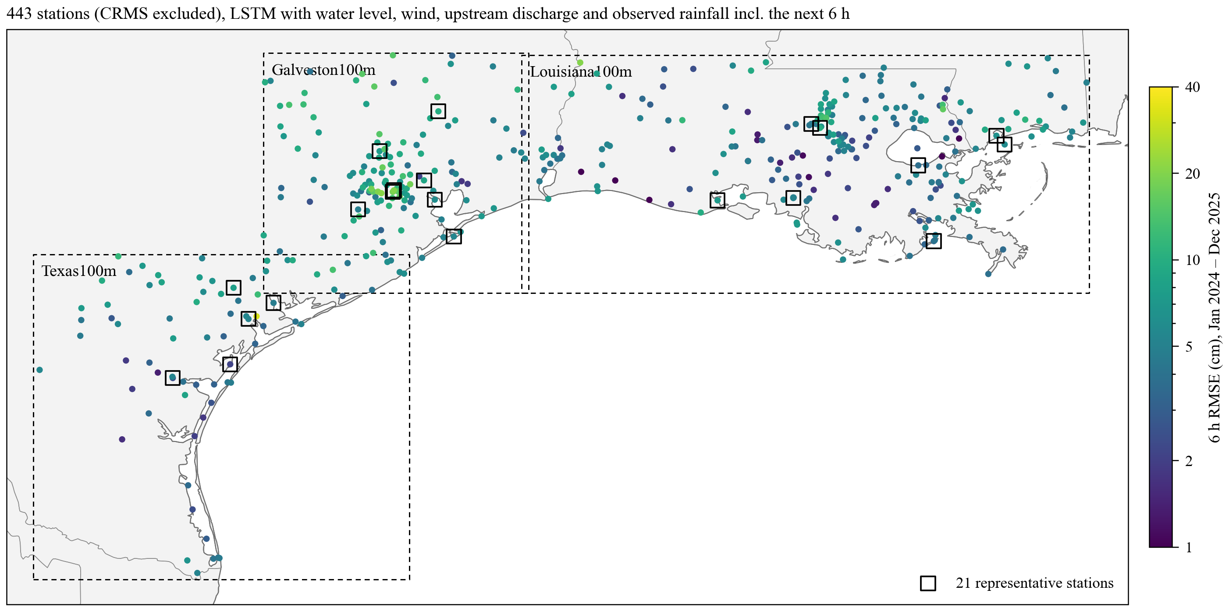
6 h forecast error with rainfall as an input: 443 stations, January 2024 to December 2025
LSTM inputs: water level, wind, upstream discharge and rainfall (15 km mean around the station), each for the past 72 h; wind and rainfall also for the next 6 h. Colour: RMSE of the 6 h forecast over the test period. Squares: the 21 stations on the following slides.
The rainfall is observed (AORC analysis), including the next 6 h. A real-time system only has a rainfall forecast for those hours, so every number in this deck is the best case with a perfect rainfall forecast. The last slide gives the result with HRRR forecast rainfall.
1

Slide 2
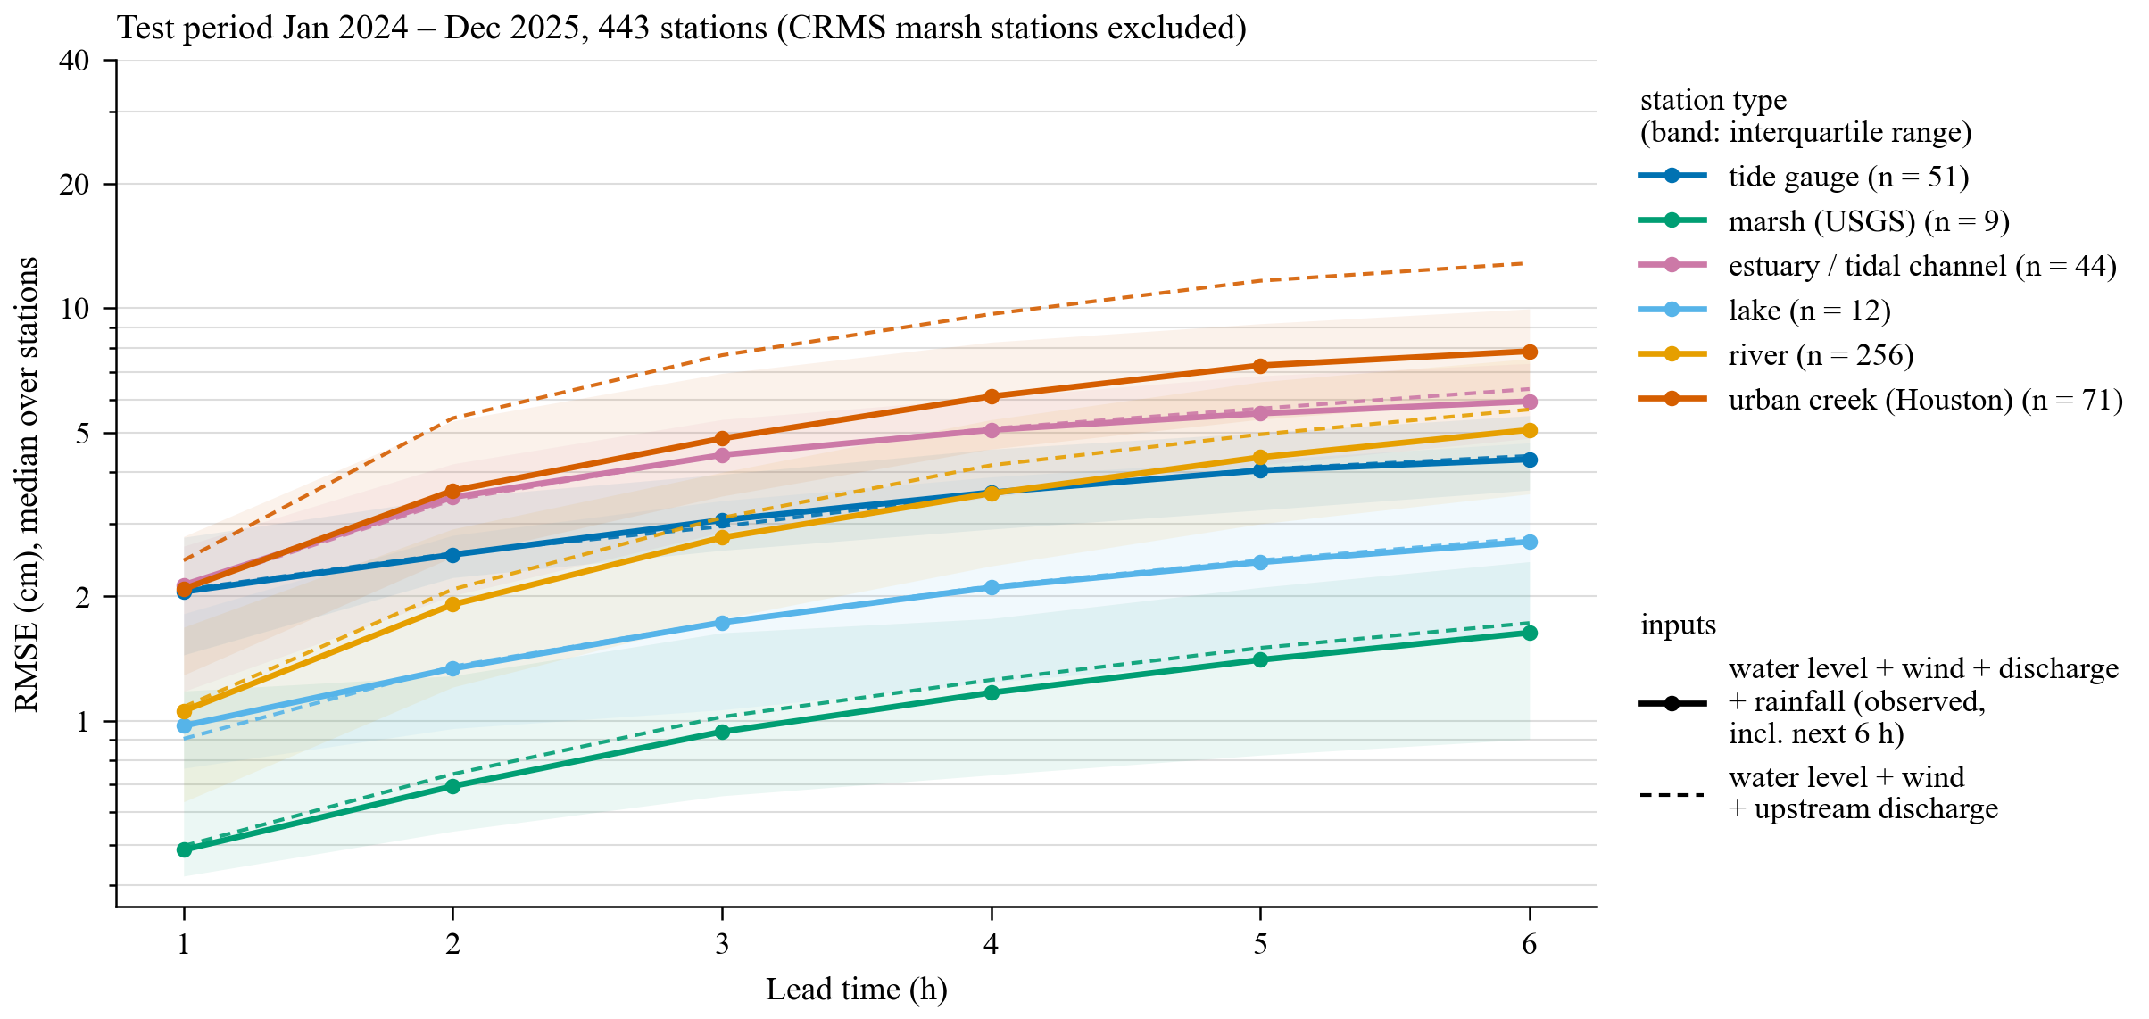
Rainfall removes much of the urban-creek and river error; tidal station types do not change
Median RMSE over the stations of each type, 1 to 6 h lead. Solid: with rainfall (observed, incl. next 6 h). Dashed: without rainfall. Shading: interquartile range.
Urban creeks (Houston): 6 h median 12.9 to 7.9 cm. The gain grows with lead time because the rain of the next hours decides the rise.
Rivers: 5.7 to 5.1 cm; small creeks gain most, large rivers little.
Tide gauges, lakes, marsh, estuaries: within 0.1 cm. No station type gets worse.
2

Slide 3
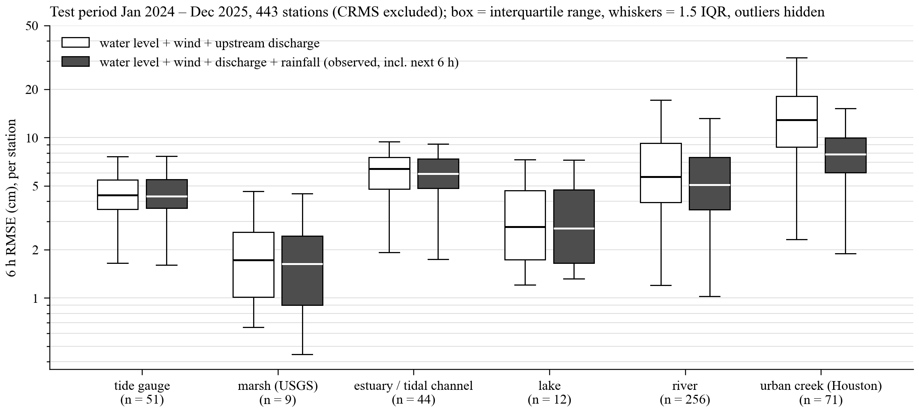
Spread across stations within each type
Per-station 6 h RMSE, whole test period, CRMS marsh stations excluded. White: without rainfall. Grey: with rainfall (observed, incl. next 6 h).
For urban creeks the whole distribution moves down; for rivers the upper half moves down; the tidal types overlap.
3

Slide 4
How to read the station slides
Each station: three 4-day windows from the test period, side by side.
(a) hurricane — Francine, 10 to 13 September 2024, for Louisiana100m; Beryl, 7 to 10 July 2024, for Galveston100m and Texas100m;
(b) high water — the 4 days around the highest observed level outside the hurricane;
(c) normal — 4 days whose 6 h error equals the station's whole-year error.
Black: observation. Blue lines, light to dark: the forecast valid at each hour that was issued 1, 3 and 6 hours earlier (model with rainfall).
Grey band: 24 hours around the window peak. RMSE in each panel title: all hourly forecasts in that window.
Below each figure: whole-year 6 h RMSE with and without the rainfall input, and the three window values.
All errors in cm. Water levels in metres above each station's own datum.
Rainfall of the next 6 h is taken from observations in all of these figures: best case, not what a real-time forecast would give.
4

Slide 5
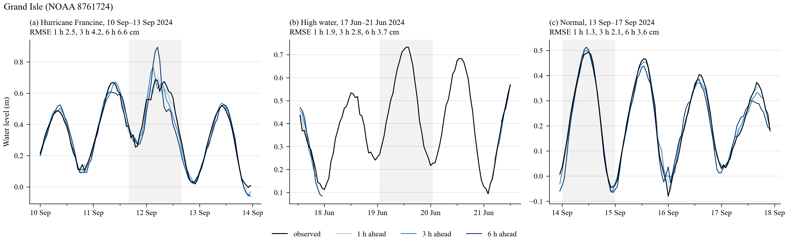
Grand Isle (NOAA_COOPS 8761724) — Louisiana100m, tide gauge
6 h RMSE, cm
Open coast. Tide dominates; rainfall adds nothing here (3.7 cm with and without). Francine window 6.6 cm.
with rainfall
without rainfall
whole year 2024–2025
3.7
3.7
hurricane window
6.6
8.2
high-water window
3.7
2.9
normal window
3.6
3.4
5

Slide 6
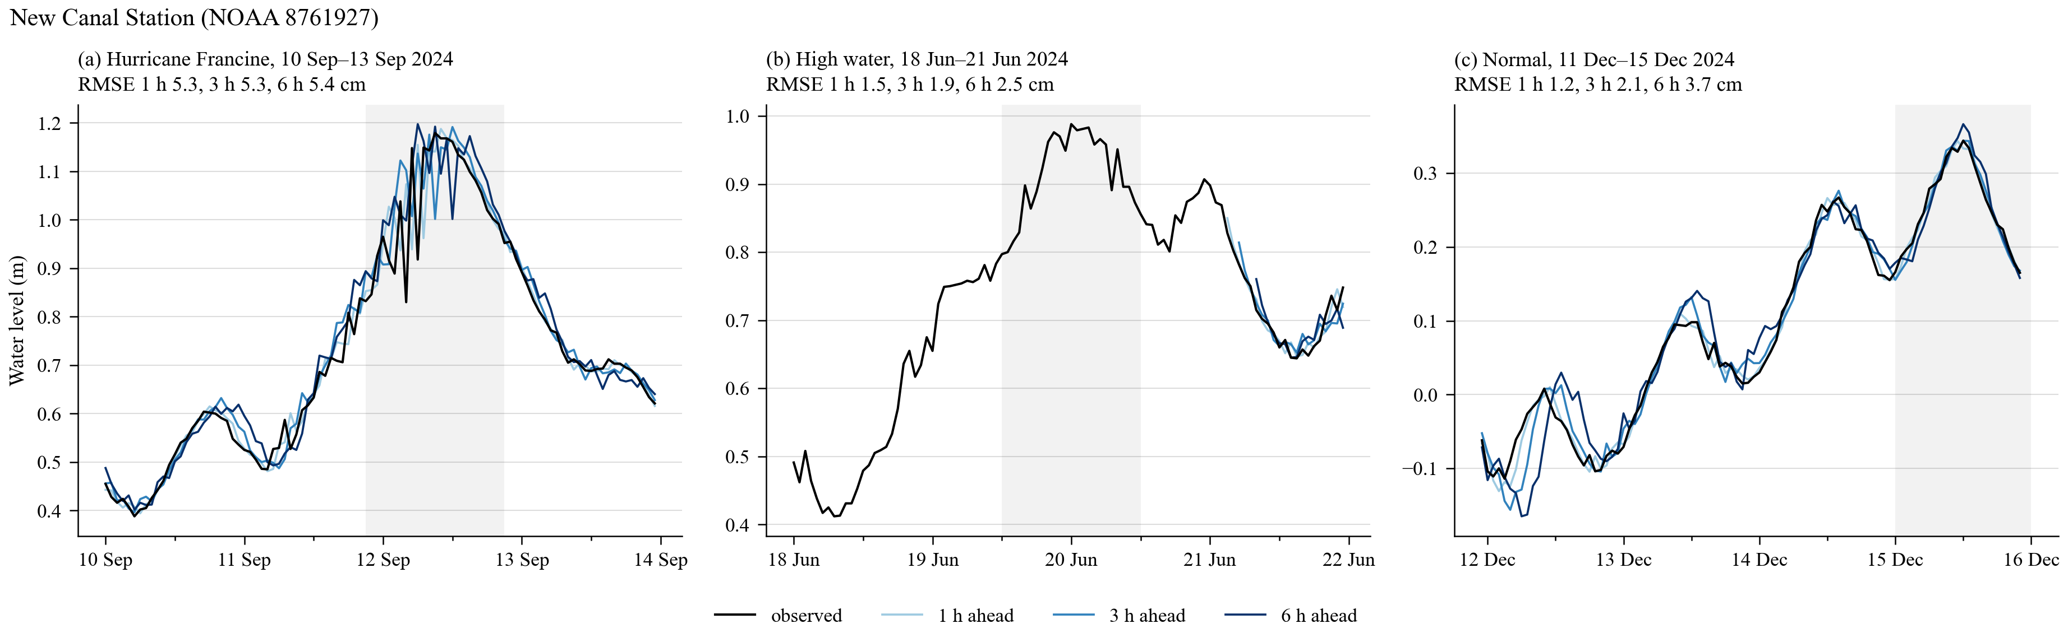
New Canal Station (NOAA_COOPS 8761927) — Louisiana100m, tide gauge
6 h RMSE, cm
Lake Pontchartrain. Wind set-up is the main signal; 3.8 cm over the year, 5.4 cm in the Francine window.
with rainfall
without rainfall
whole year 2024–2025
3.8
3.9
hurricane window
5.4
6.8
high-water window
2.5
3.2
normal window
3.7
4.1
6

Slide 7
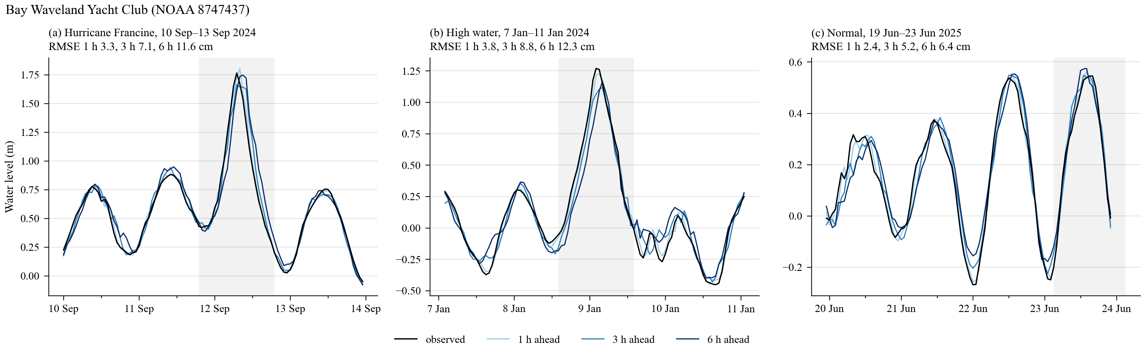
Bay Waveland Yacht Club (NOAA_COOPS 8747437) — Louisiana100m, tide gauge
6 h RMSE, cm
Mississippi Sound. The 1.8 m Francine surge is followed at all leads (12 cm). Rainfall makes no difference at open-water gauges.
with rainfall
without rainfall
whole year 2024–2025
6.3
6.5
hurricane window
11.6
10.4
high-water window
12.3
14.0
normal window
6.4
6.8
7

Slide 8
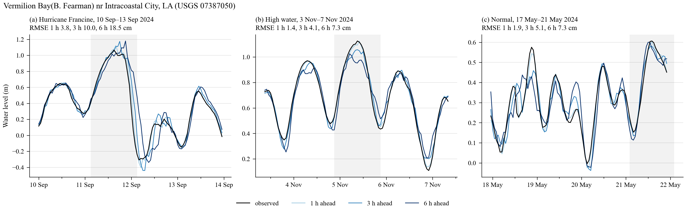
Vermilion Bay(B. Fearman) nr Intracoastal City, LA (USGS 07387050) — Louisiana100m, estuary / tidal channel
6 h RMSE, cm
Vermilion Bay. Shallow bay pushed by wind; Francine window 18.5 cm, two to three times the normal error.
with rainfall
without rainfall
whole year 2024–2025
7.3
7.5
hurricane window
18.5
23.2
high-water window
7.3
6.4
normal window
7.3
6.7
8

Slide 9
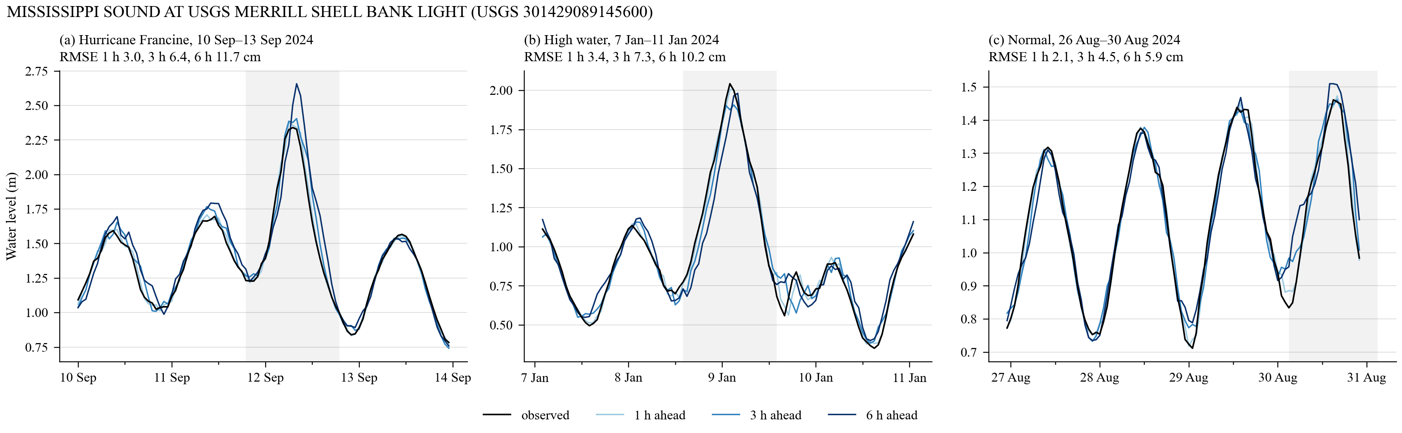
MISSISSIPPI SOUND AT USGS MERRILL SHELL BANK LIGHT (USGS 301429089145600) — Louisiana100m, estuary / tidal channel
6 h RMSE, cm
Mississippi Sound light. Storm set-up is carried by the wind input; rainfall changes nothing (5.8 vs 5.9 cm).
with rainfall
without rainfall
whole year 2024–2025
5.8
5.9
hurricane window
11.7
10.8
high-water window
10.2
11.2
normal window
5.9
5.6
9

Slide 10
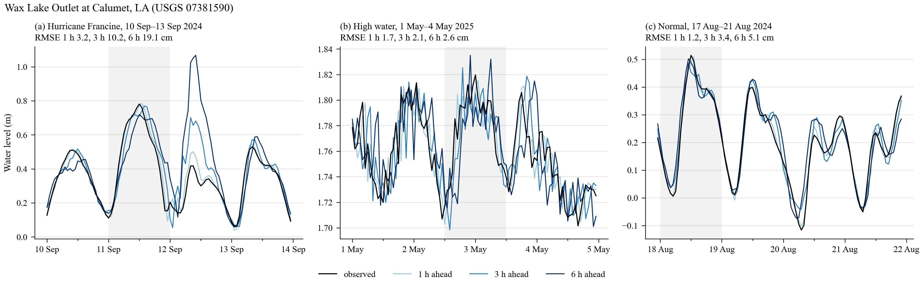
Wax Lake Outlet at Calumet, LA (USGS 07381590) — Louisiana100m, river
6 h RMSE, cm
Wax Lake Outlet, Atchafalaya distributary. River plus tide; Francine window 19 cm, otherwise 3 to 5 cm.
with rainfall
without rainfall
whole year 2024–2025
5.1
5.2
hurricane window
19.1
13.7
high-water window
2.6
2.1
normal window
5.1
6.0
10

Slide 11
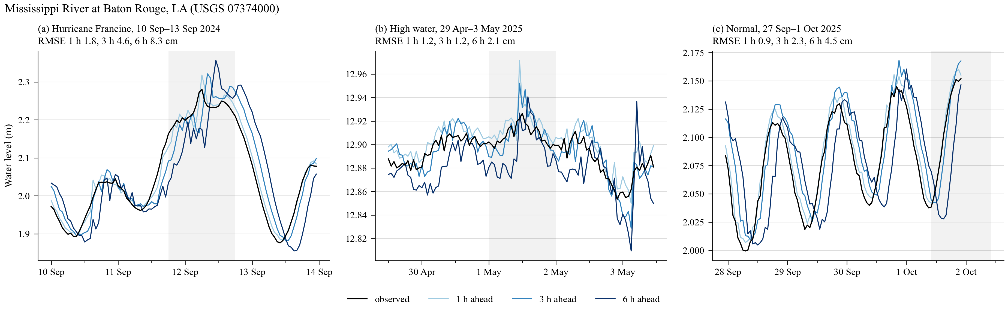
Mississippi River at Baton Rouge, LA (USGS 07374000) — Louisiana100m, river
6 h RMSE, cm
Lower Mississippi, far inland; wind input switched off. 4.5 cm over the year: a slow river that needs little beyond its own level.
with rainfall
without rainfall
whole year 2024–2025
4.5
4.8
hurricane window
8.3
8.8
high-water window
2.1
3.3
normal window
4.5
3.7
11

Slide 12
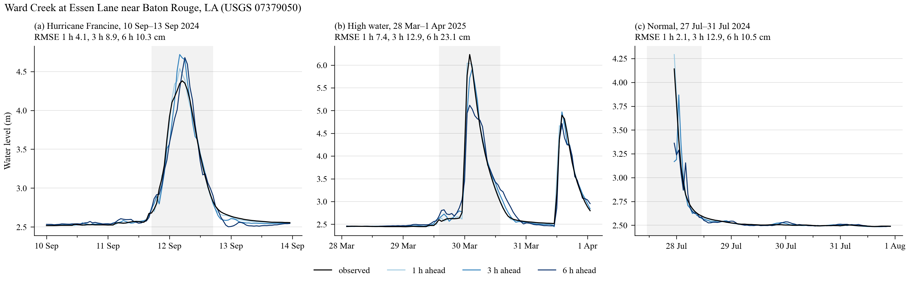
Ward Creek at Essen Lane near Baton Rouge, LA (USGS 07379050) — Louisiana100m, river
6 h RMSE, cm
Baton Rouge urban creek. With observed rainfall the 6 h error falls from 24.8 to 10.2 cm over the year and from 84 to 23 cm in the high-water window: the rise is forecast before it starts.
with rainfall
without rainfall
whole year 2024–2025
10.2
24.8
hurricane window
10.3
29.6
high-water window
23.1
84.3
normal window
10.5
22.3
12

Slide 13
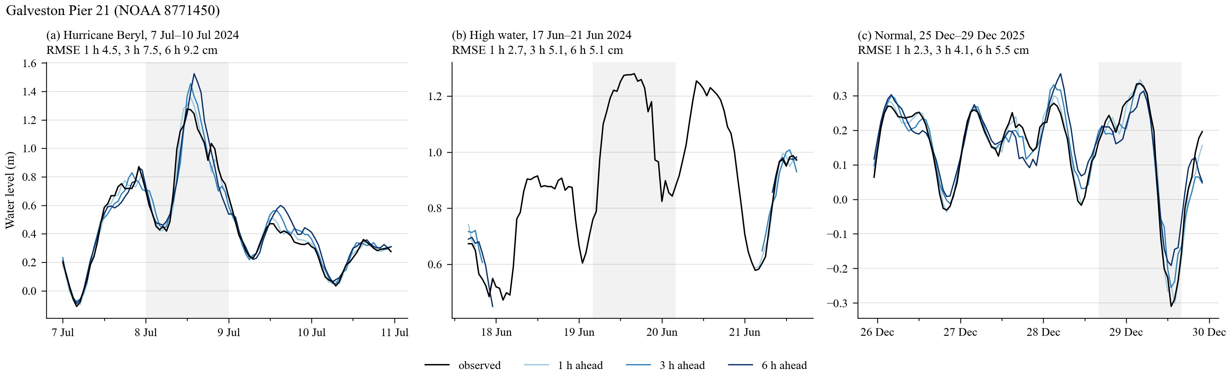
Galveston Pier 21 (NOAA_COOPS 8771450) — Galveston100m, tide gauge
6 h RMSE, cm
Galveston Pier 21. Beryl window 9 cm; normal weeks 5 cm. No effect of rainfall.
with rainfall
without rainfall
whole year 2024–2025
5.4
5.4
hurricane window
9.2
11.8
high-water window
5.1
6.0
normal window
5.5
5.4
13

Slide 14
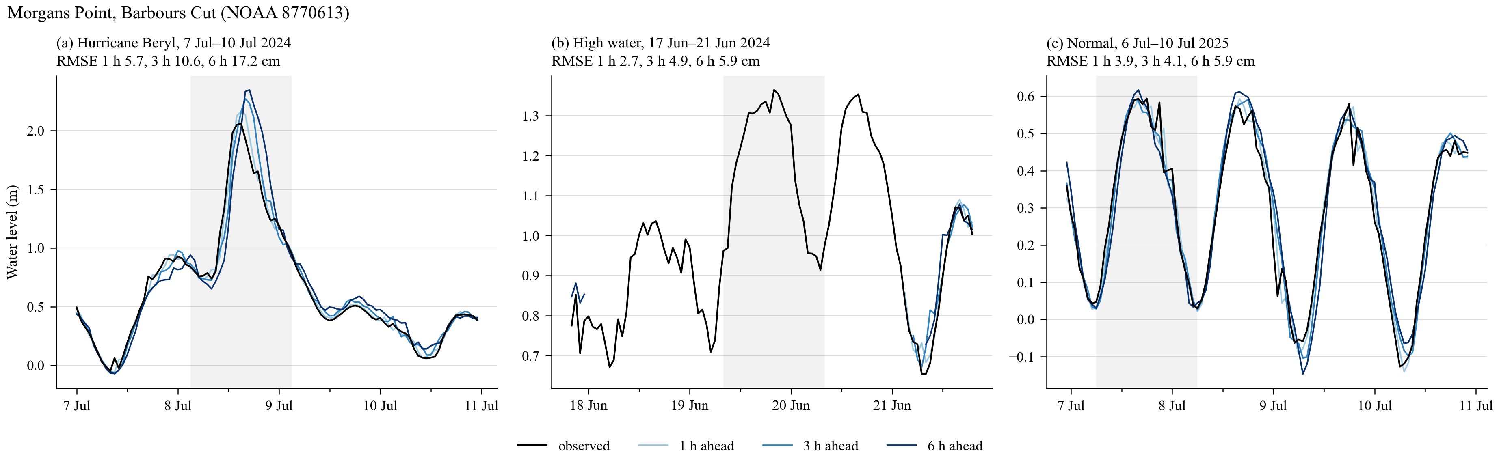
Morgans Point, Barbours Cut (NOAA_COOPS 8770613) — Galveston100m, tide gauge
6 h RMSE, cm
Upper Galveston Bay. The 2.1 m Beryl surge is followed at all leads (17 cm); 5.9 cm over the year.
with rainfall
without rainfall
whole year 2024–2025
5.9
6.0
hurricane window
17.2
15.0
high-water window
5.9
6.2
normal window
5.9
5.4
14

Slide 15
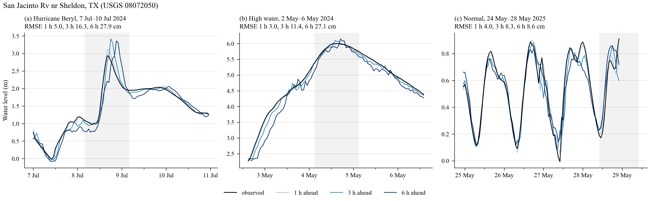
San Jacinto Rv nr Sheldon, TX (USGS 08072050) — Galveston100m, estuary / tidal channel
6 h RMSE, cm
San Jacinto River above the bay. Tide plus Lake Houston releases; the releases are in no input and rainfall does not help (8.7 vs 8.3 cm).
with rainfall
without rainfall
whole year 2024–2025
8.7
8.3
hurricane window
27.9
19.5
high-water window
27.1
19.4
normal window
8.6
9.5
15

Slide 16
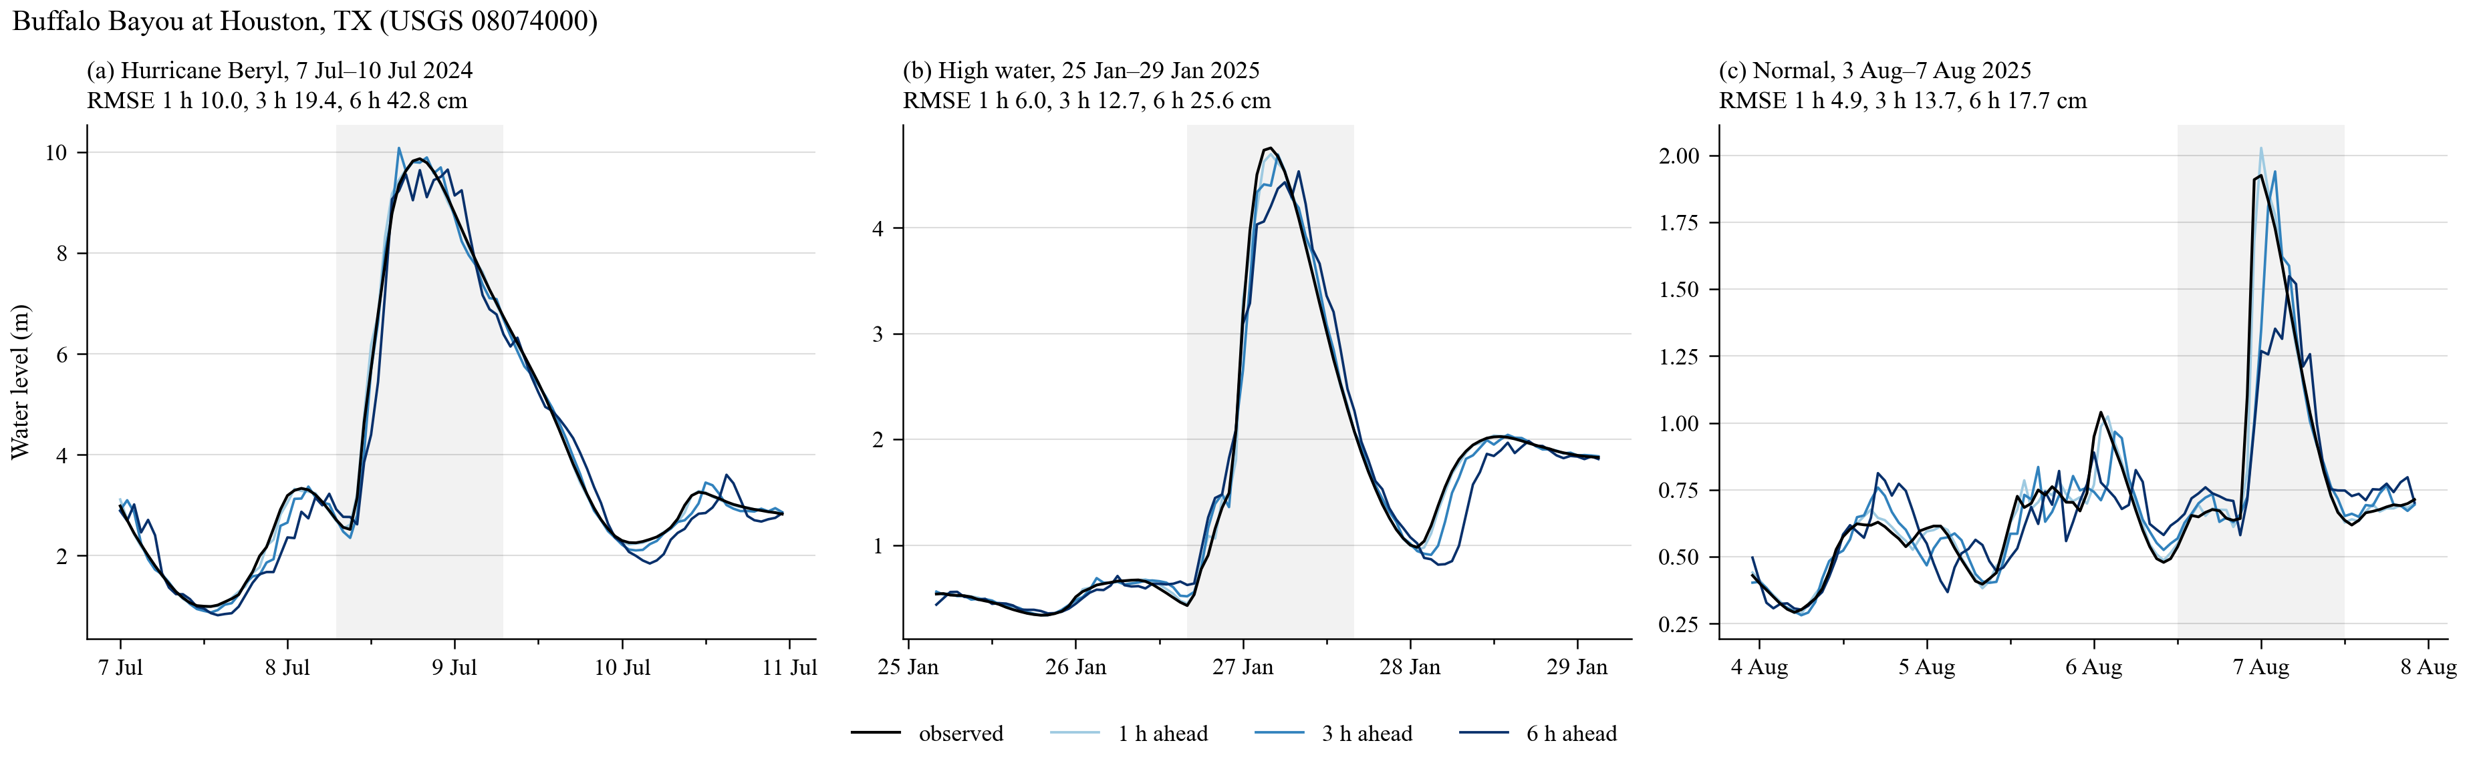
Buffalo Bayou at Houston, TX (USGS 08074000) — Galveston100m, estuary / tidal channel
6 h RMSE, cm
Buffalo Bayou downtown. Beryl rise of 9 m: 6 h error 43 cm with observed rainfall, 103 cm without. Whole year 18.2 vs 27.9 cm.
with rainfall
without rainfall
whole year 2024–2025
18.2
27.9
hurricane window
42.8
103.3
high-water window
25.6
68.6
normal window
17.7
27.8
16

Slide 17
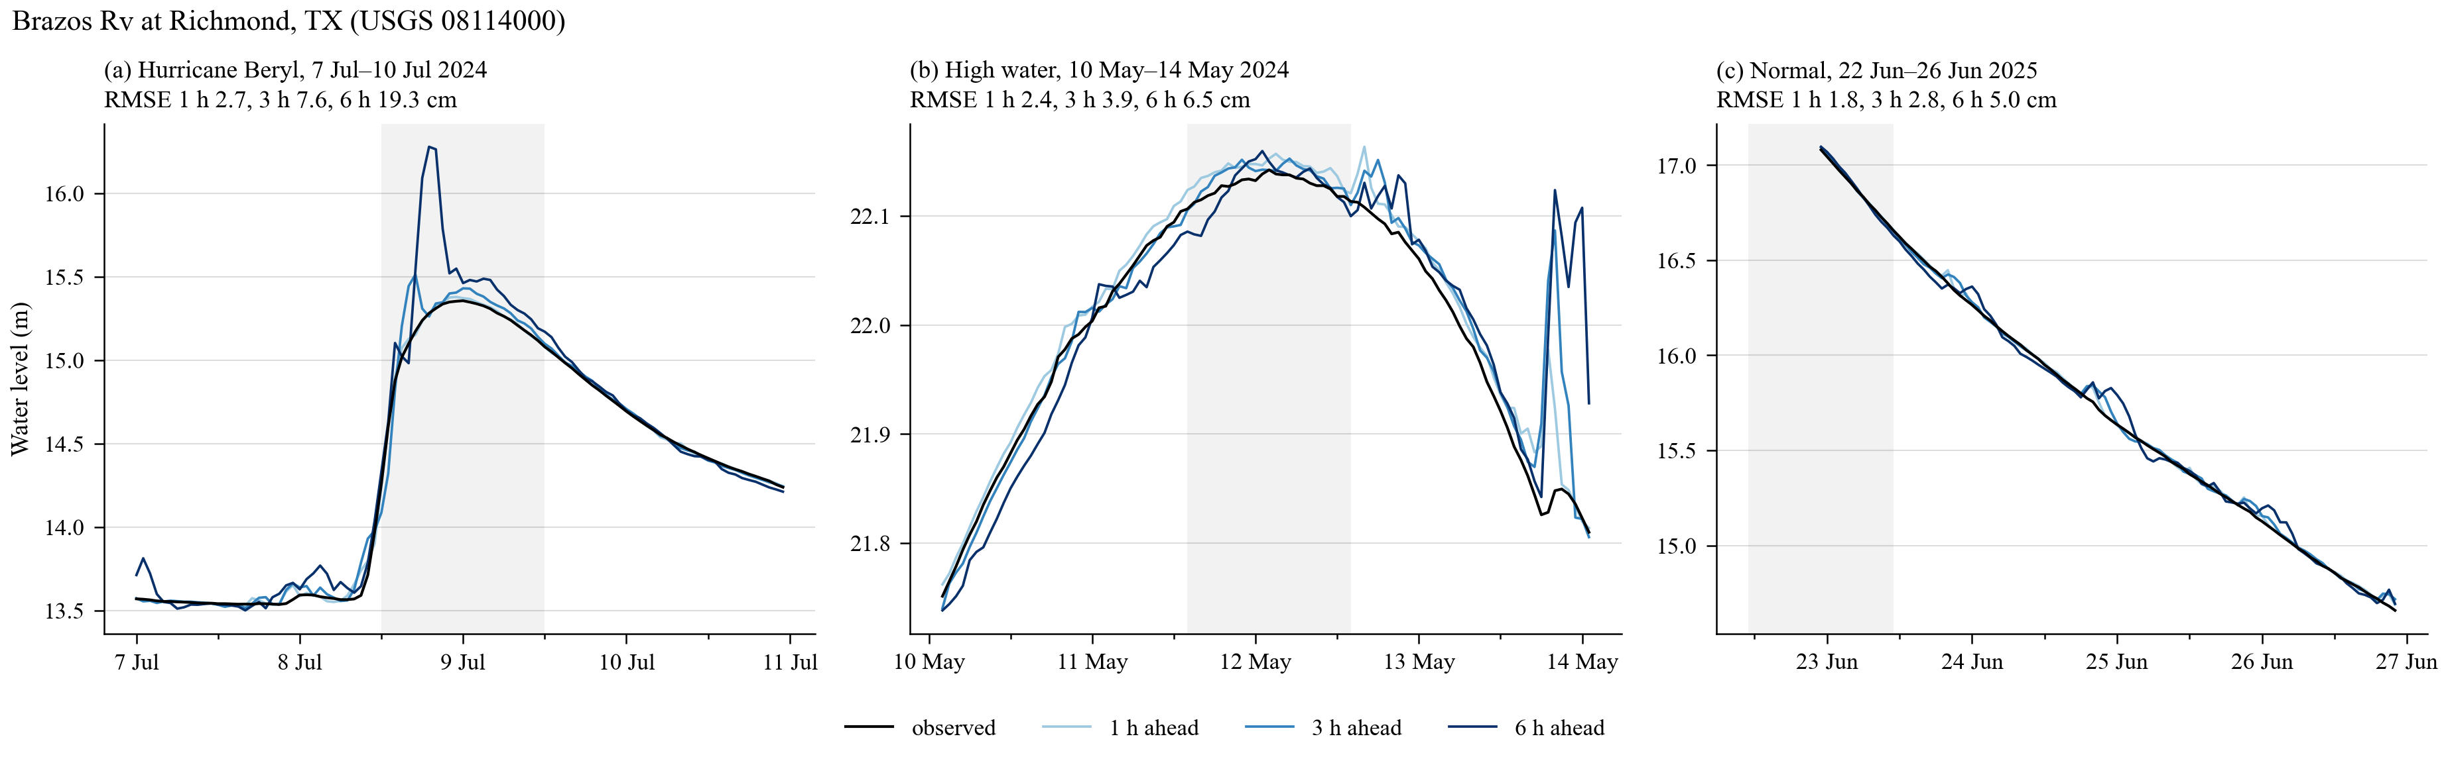
Brazos Rv at Richmond, TX (USGS 08114000) — Galveston100m, river
6 h RMSE, cm
Brazos River at Richmond. Large river, wind switched off. 4.8 cm over the year, rainfall makes no difference; Beryl window 19 cm.
with rainfall
without rainfall
whole year 2024–2025
4.8
4.6
hurricane window
19.3
30.7
high-water window
6.5
4.6
normal window
5.0
4.7
17

Slide 18
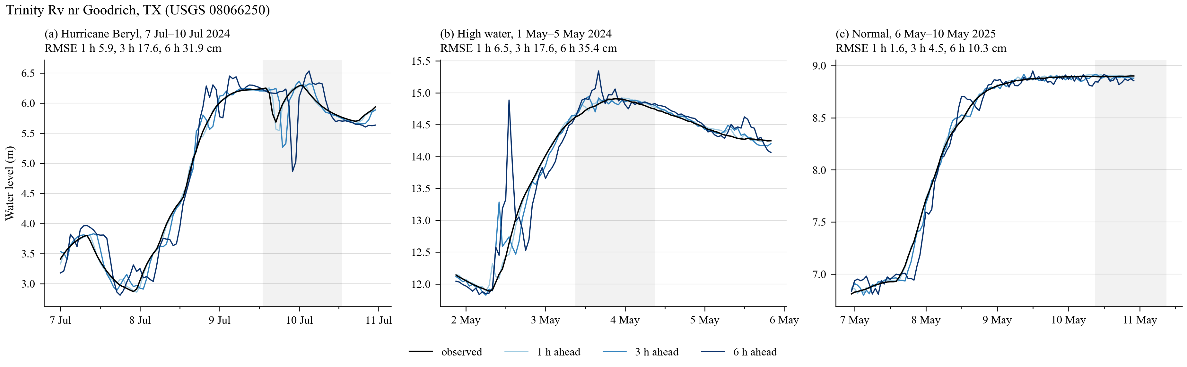
Trinity Rv nr Goodrich, TX (USGS 08066250) — Galveston100m, river
6 h RMSE, cm
Trinity River below Lake Livingston dam. Releases are scheduled by the operator; rainfall does not anticipate them (9.7 vs 10.5 cm).
with rainfall
without rainfall
whole year 2024–2025
9.7
10.5
hurricane window
31.9
38.2
high-water window
35.4
22.6
normal window
10.3
10.1
18

Slide 19
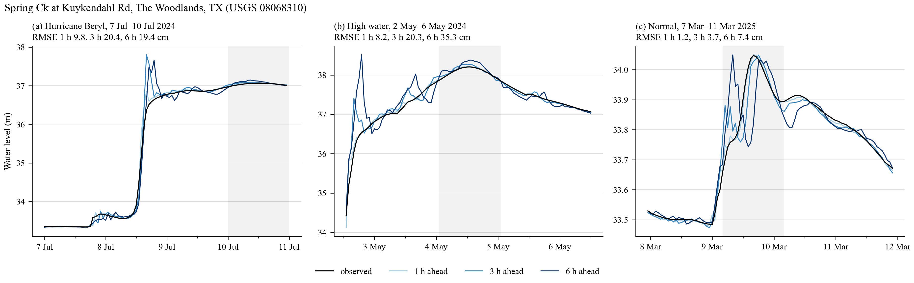
Spring Ck at Kuykendahl Rd, The Woodlands, TX (USGS 08068310) — Galveston100m, urban creek (Houston)
6 h RMSE, cm
Spring Creek, The Woodlands. Typical Houston creek: 7.5 cm with observed rainfall, 12.9 cm without; Beryl window 19 vs 42 cm.
with rainfall
without rainfall
whole year 2024–2025
7.5
12.9
hurricane window
19.4
42.1
high-water window
35.3
48.3
normal window
7.4
6.3
19

Slide 20
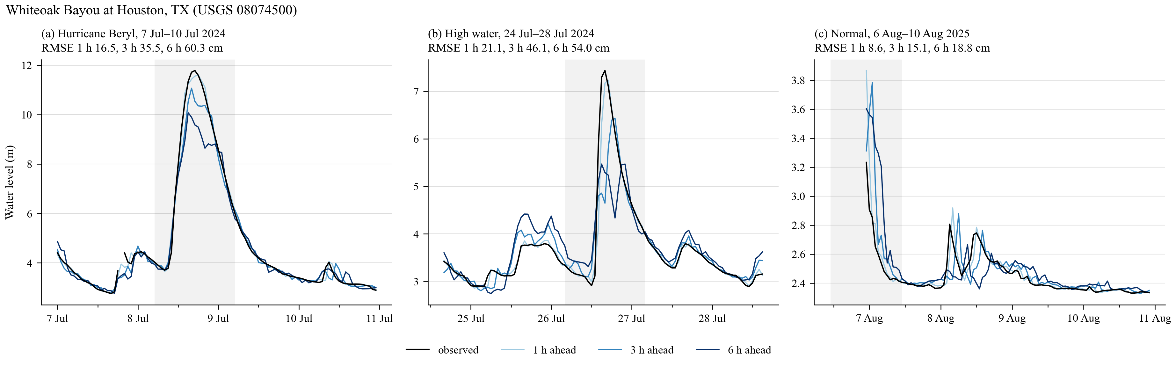
Whiteoak Bayou at Houston, TX (USGS 08074500) — Galveston100m, urban creek (Houston)
6 h RMSE, cm
Whiteoak Bayou, Houston. Largest errors in the set: 20 cm over the year with rainfall (33 without), Beryl window 60 cm (144 without).
with rainfall
without rainfall
whole year 2024–2025
20.0
33.2
hurricane window
60.3
143.7
high-water window
54.0
89.9
normal window
18.8
16.9
20

Slide 21
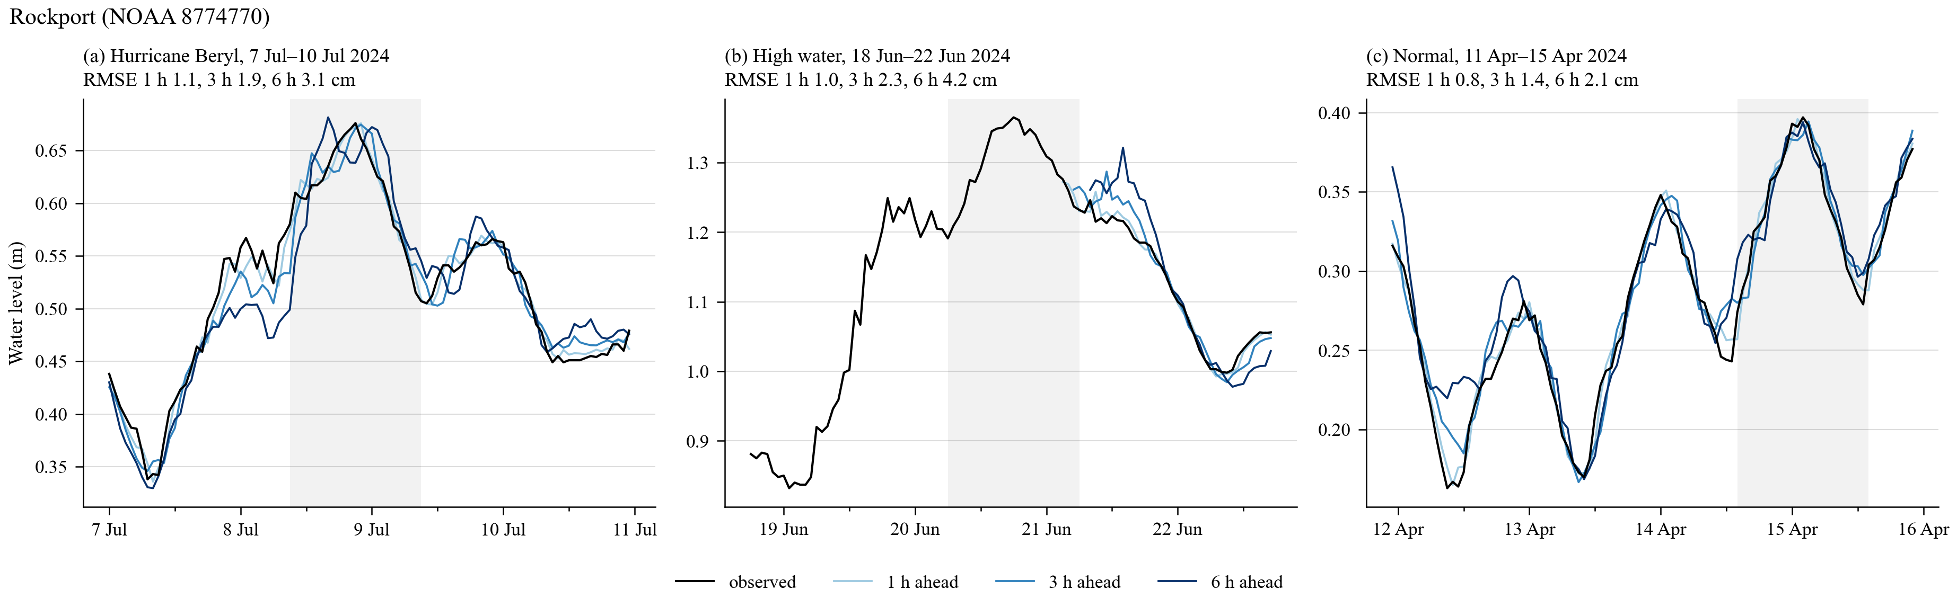
Rockport (NOAA_COOPS 8774770) — Texas100m, tide gauge
6 h RMSE, cm
Rockport, Aransas Bay. Best station class: 2 cm over the year, 3 cm during Beryl.
with rainfall
without rainfall
whole year 2024–2025
2.1
2.2
hurricane window
3.1
3.5
high-water window
4.2
4.7
normal window
2.1
2.1
21

Slide 22
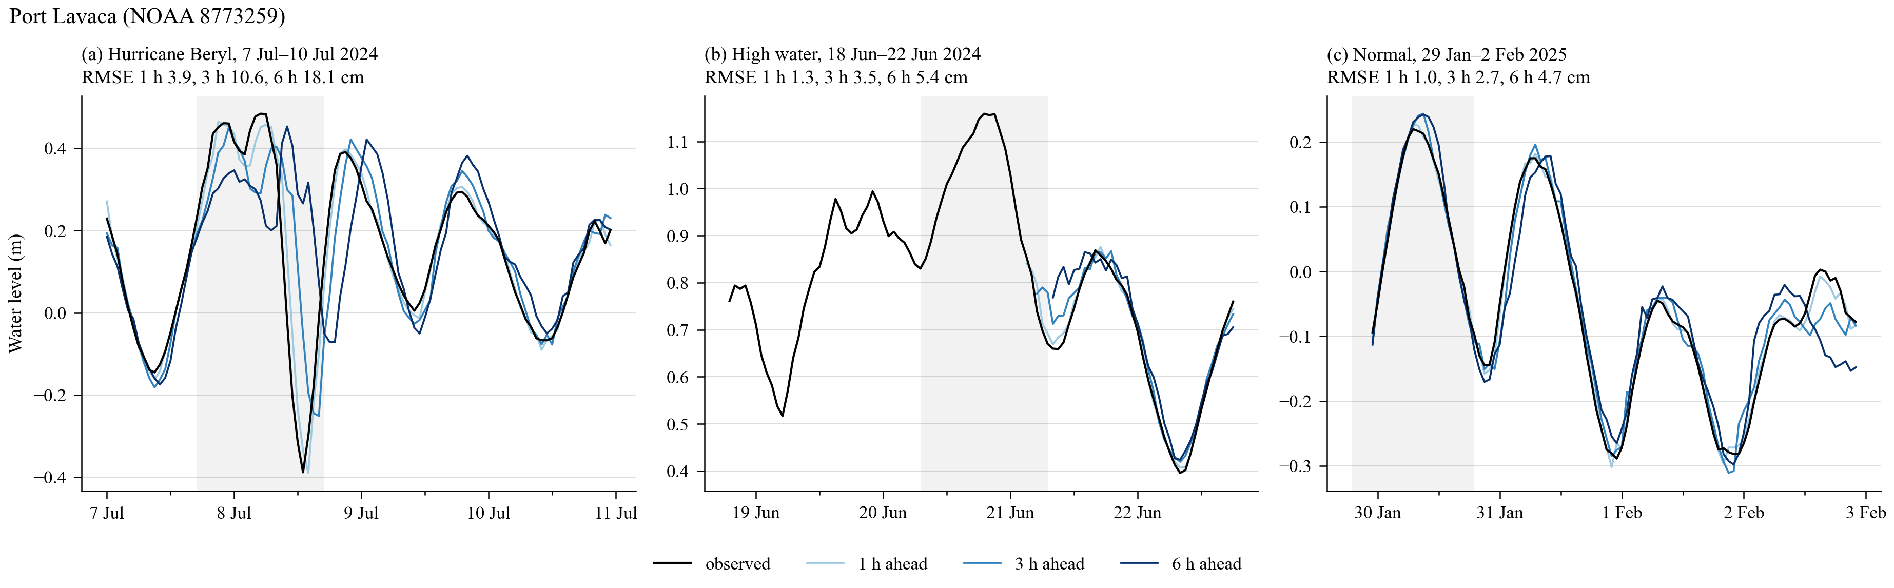
Port Lavaca (NOAA_COOPS 8773259) — Texas100m, tide gauge
6 h RMSE, cm
Port Lavaca, Matagorda Bay. Beryl window 18 cm, otherwise 5 cm.
with rainfall
without rainfall
whole year 2024–2025
4.7
4.6
hurricane window
18.1
15.7
high-water window
5.4
4.8
normal window
4.7
5.0
22

Slide 23
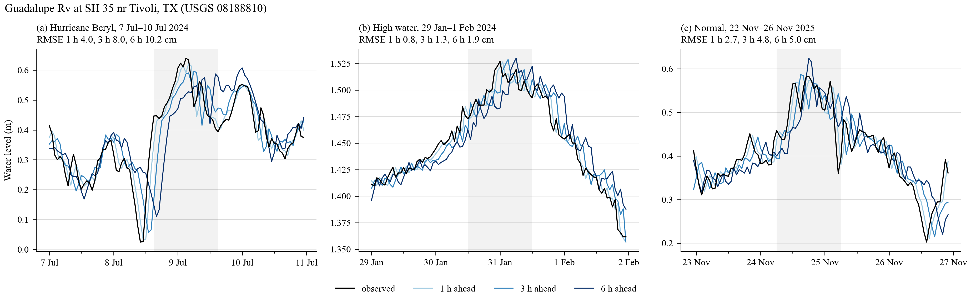
Guadalupe Rv at SH 35 nr Tivoli, TX (USGS 08188810) — Texas100m, estuary / tidal channel
6 h RMSE, cm
Lower Guadalupe, tidal. Hurricane window 10 cm; river rises 2 cm.
with rainfall
without rainfall
whole year 2024–2025
5.1
5.4
hurricane window
10.2
10.2
high-water window
1.9
2.0
normal window
5.0
5.3
23

Slide 24
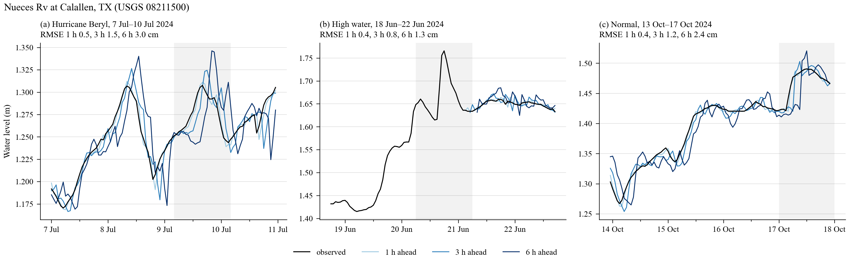
Nueces Rv at Calallen, TX (USGS 08211500) — Texas100m, river
6 h RMSE, cm
Nueces River at Calallen, below the saltwater dam. Nearly flat; 2.4 cm over the year.
with rainfall
without rainfall
whole year 2024–2025
2.4
2.4
hurricane window
3.0
2.9
high-water window
1.3
1.1
normal window
2.4
2.3
24

Slide 25
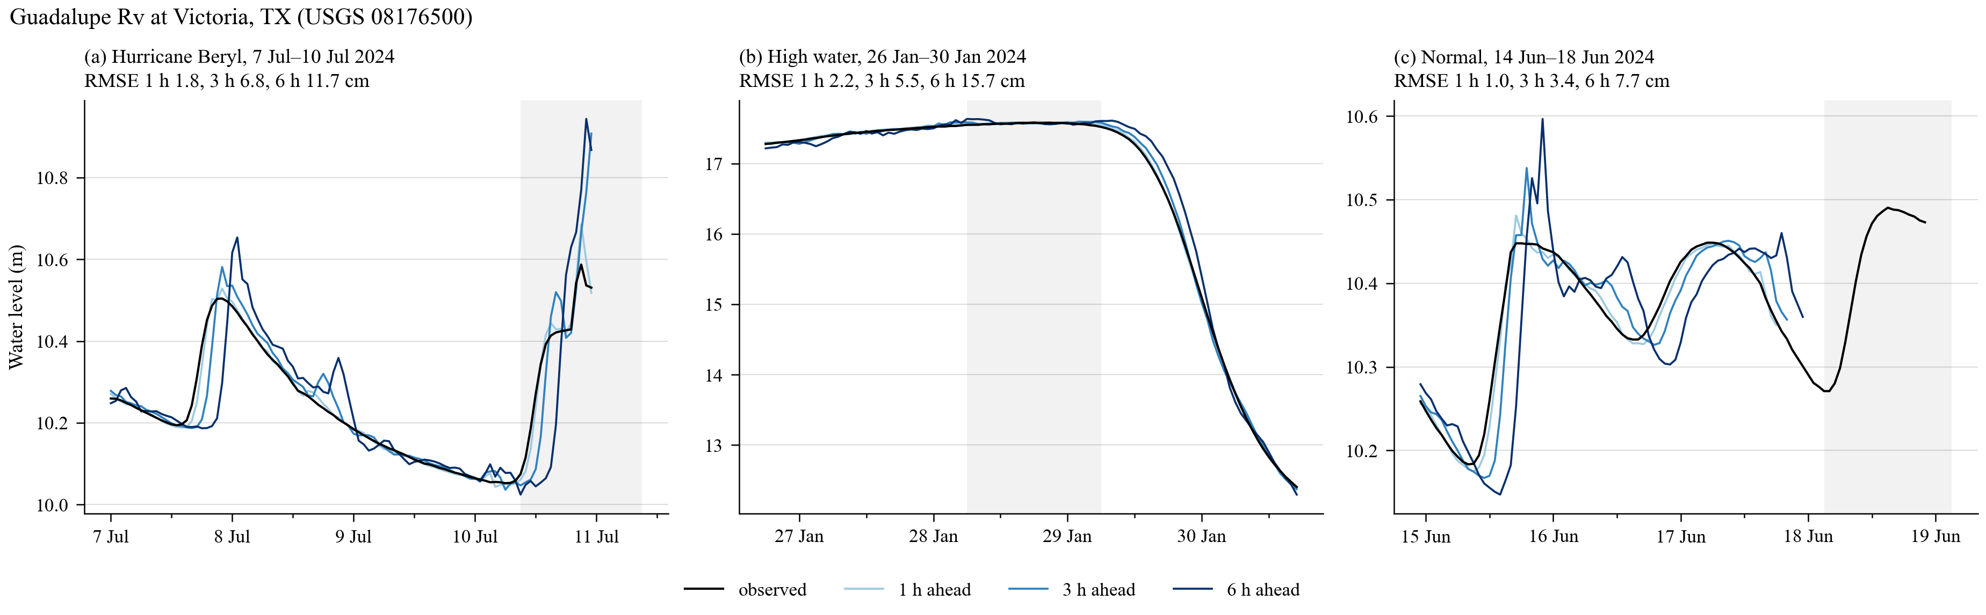
Guadalupe Rv at Victoria, TX (USGS 08176500) — Texas100m, river
6 h RMSE, cm
Guadalupe River at Victoria. Inland river; rainfall lowers the whole-year error from 9.3 to 7.9 cm.
with rainfall
without rainfall
whole year 2024–2025
7.9
9.3
hurricane window
11.7
11.1
high-water window
15.7
10.1
normal window
7.7
8.1
25

Slide 26
What the 21 stations show
Tide gauges and estuaries (12 stations): rainfall changes nothing, 2 to 9 cm over the year with and without. The exception is Buffalo Bayou downtown, a tidal urban bayou: 27.9 to 18.2 cm.
Rivers (7 stations): large rivers do not change (Mississippi, Brazos, Trinity below the dam). Small rain-fed rivers and creeks gain: Ward Creek 24.8 to 10.2 cm, Guadalupe at Victoria 9.3 to 7.9 cm.
Urban creeks (2 stations in this set, 71 in the test set): Spring Creek 12.9 to 7.5 cm, Whiteoak Bayou 33 to 20 cm. In the Beryl window the 6 h error is cut by more than half. With the rainfall of the next hours known, the forecast rises with the observation instead of six hours after it.
What rainfall does not fix: releases from reservoirs (San Jacinto below Lake Houston, Trinity below Lake Livingston) and the largest flash rises, where 20 to 60 cm of error remain.
26

Slide 27
With a real rainfall forecast the gain is not there yet
All previous slides use observed rainfall for the next 6 h. The same model was re-tested with HRRR forecast rainfall in that slot (test period 2024 to 2025, all 847 stations, 6 h RMSE over all samples):
without rainfall (current operational inputs) 7.65 cm
with rainfall, next 6 h observed (perfect forecast) 5.95 cm
with rainfall, next 6 h from the HRRR cycle issued at forecast time 7.39 cm
with rainfall, next 6 h from the HRRR cycle issued 1 h earlier 7.66 cm
HRRR has the right amount of rain over 6 h (correlation 0.67 with observations in a 15 km box) but not the right hour and place (0.3 to 0.4 hour by hour). A model trained on observed rainfall trusts the forecast too much and follows its errors.
Next step, in progress: train the model with HRRR forecast rainfall for the next 6 h, hourly or as a 6 h total, over a 15 km or 45 km box, so that it learns how far to trust the forecast.
Operational model for now: water level + wind + upstream discharge, without rainfall.
27

